Slide 1

RaahiBima
Parametric Income Protection for Q-Commerce Delivery Partners.
Problem Statement: AI-Powered Insurance for India’s Gig Economy
Guidewire DEVTrails | 2026
Presented by:
Team MARVELS

Slide 2

Team: Marvels
Aasha Kumari
Aritra Maji
Vaibhav Shrivastava
Team Lead
Team Member - 2
Team Member - 3
Trupti Jain
Shreshth
Sinha
Team Member - 4
Team Member - 5

Slide 3
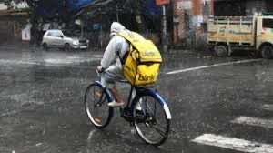
PROBLEM STATEMENT: What’s Missing Today
India’s Q-commerce ecosystem depends on millions of delivery partners working on a daily earning model.
Their income is directly tied to physical ability to work.
THE GAP:
External disruptions like:
Heavy rainfall
Extreme heat
Hazardous air quality
Civic restrictions
All this external disruptions can instantly stop work!
There is no system today that compensates income loss from these events
Why this matters:
⁠Even a “2–3 hour disruption can cut 30–40% of daily earnings”
Most workers have no savings or fallback
What’s missing in the world:
A system that protects “earning continuity”, not just life or assets.

Slide 4
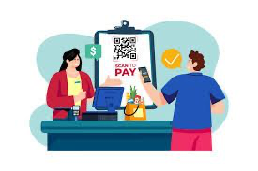
Our Solution: RaahiBima
RaahiBima is an “AI-powered parametric income protection system”.
What we do:
Detect real-world disruptions automatically
Calculate income loss based on time and earnings
Trigger “instant payouts via UPI”.
What we don’t do:
No health insurance
No accident coverage
No vehicle insurance
We focus on “one thing only: lost income”.
Key principle:
If a rider cannot work due to verified external conditions,
they are compensated automatically.

Slide 5
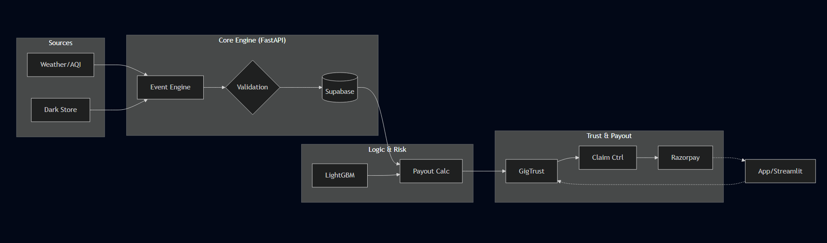
Project Architecture and Workflow
⁠System continuously monitors:
-Weather
-Air quality
-Government alerts
A disruption is confirmed using “multiple data sources”.
System calculates:
Duration of disruption
Expected earnings loss
Trust and fraud checks are applied.
Payout is sent instantly:
No claims.
No paperwork.
No delays.

Slide 6
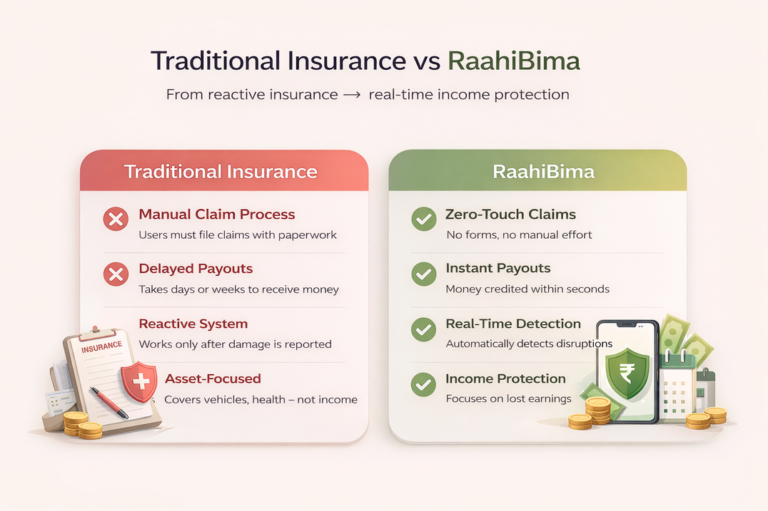
Novelty — Why This Is Different
Traditional insurance = reactive + manual claims.
•⁠ ⁠RaahiBima = automatic + real-time payouts
Key innovations:
•⁠ ⁠Parametric triggers (data-driven, not claim-driven)
•⁠ ⁠Income-focused coverage (not asset-focused)
•⁠ ⁠GigTrust scoring system for reliability
•⁠ ⁠Weekly dynamic pricing based on risk
•⁠ ⁠Fully automated claim lifecycle
This creates a “new category of insurance: income continuity insurance”.

Slide 7

Application & Impact
Direct impact:
•⁠ Protects daily earnings of gig workers
•⁠ ⁠Reduces financial stress and uncertainty
Indirect impact:
•⁠ ⁠Improves worker retention for platforms
•⁠ ⁠Builds trust in gig economy systems
•⁠ ⁠Encourages more people to participate in flexible work
Quality of life improvement:
•⁠ ⁠Stable income → better financial planning
•⁠ ⁠Reduced risk → improved mental well-being
•⁠ ⁠Faster payouts → immediate support when needed
We are not just solving a financial problem — we are improving daily life stability.

Slide 8
Feasibility and tech stack
Uses “existing, reliable data sources”.
•⁠ ⁠No new infrastructure required
•⁠ ⁠Works on standard cloud architecture
This is implementation-ready, not theoretical.
Tech stack:
•⁠ ⁠FastAPI backend
•⁠ ⁠React-based frontend
•⁠ ⁠PostgreSQL database
•⁠ ⁠Existing UPI payment systems

Slide 9

Scalability — How It Grows
Horizontal scalability:
Expand from one zone → multiple cities
Same logic works across all urban areas
System scalability:
Event processing is asynchronous
Database supports real-time updates
ML models are lightweight and efficient
Future expansion:
⁠Other gig sectors (ride-hailing, logistics)
More environmental triggers
Designed to scale with the gig economy.

Slide 10
Conclusion
⁠Gig workers face unavoidable income disruptions.
⁠Current systems do not address this problem.
RaahiBima introduces:
⁠Automatic disruption detection
⁠Fair income loss calculation
Instant compensation
Final takeaway:
We are shifting insurance from “after damage” to “during disruption”.
From protecting assets to protecting livelihoods.

