Slide 1
Frontend
Development
Introduction
- By TRUPTI MOHANE

Slide 2
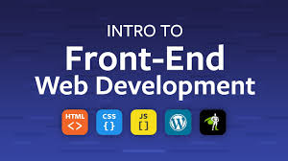
What is Frontend Development?
Everything you see on a website, like buttons, overall layout , links, animations, and how the user interacts with the page was created by a front end web developer.

Slide 3
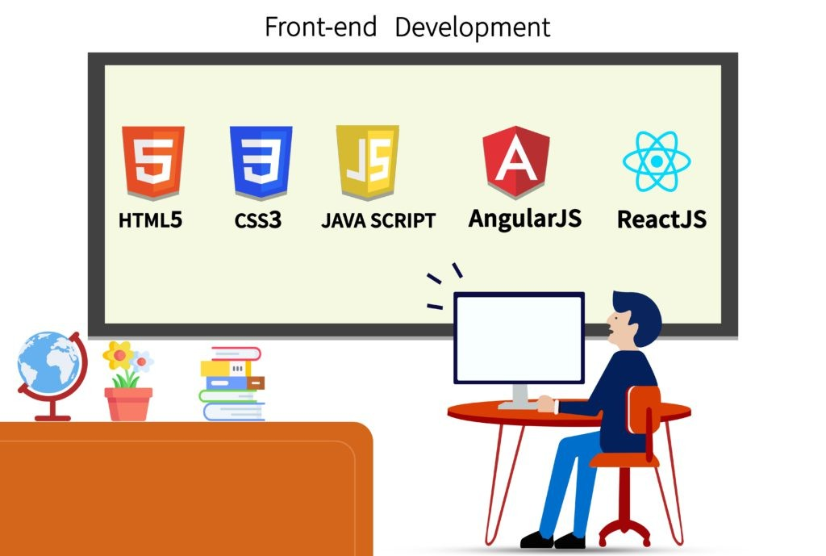
Skill Requirement to Become Frontend Developer
The three main languages you need to know well are HTML, CSS, and JavaScript. From there you can focus on frameworks, libraries, and other useful tools.
CSS's frameworks like bootstrap and Tailwind CSS and JavaScript's libraries and framework like as React , Angular etc.

Slide 4
Why Did I choose IT field
Interest in Technology
High Demand for Skills
Career Growth Opportunities
Freelancing

Slide 5
Technologies Up gradation in Current field
Responsive Web Designing :
With an increasing variety of devices and screen sizes, responsive web design practices remain crucial.
JavaScript Frameworks and Libraries:
React.js

Slide 6
Career Aspirations
My career aspiration is centered around learning Node JS.

Slide 7
Learning & Growth
Continuous learning new technologies, tools, and techniques in frontend development.

Slide 8
Why Did I choose this course
Because , Frontend Development course is creative, always challenging and never boring.

Slide 9
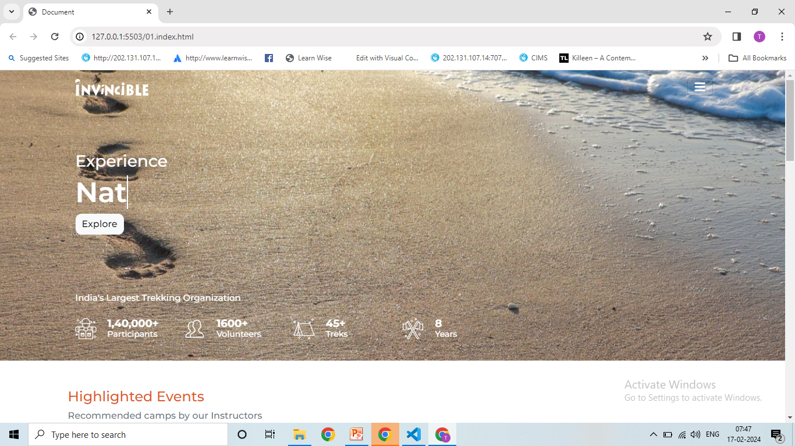
My web Designing Project
1.Responsive clone :
Title : Invincible
link : https://github.com/truptimohane/Project/tree/main/invincible

Slide 10
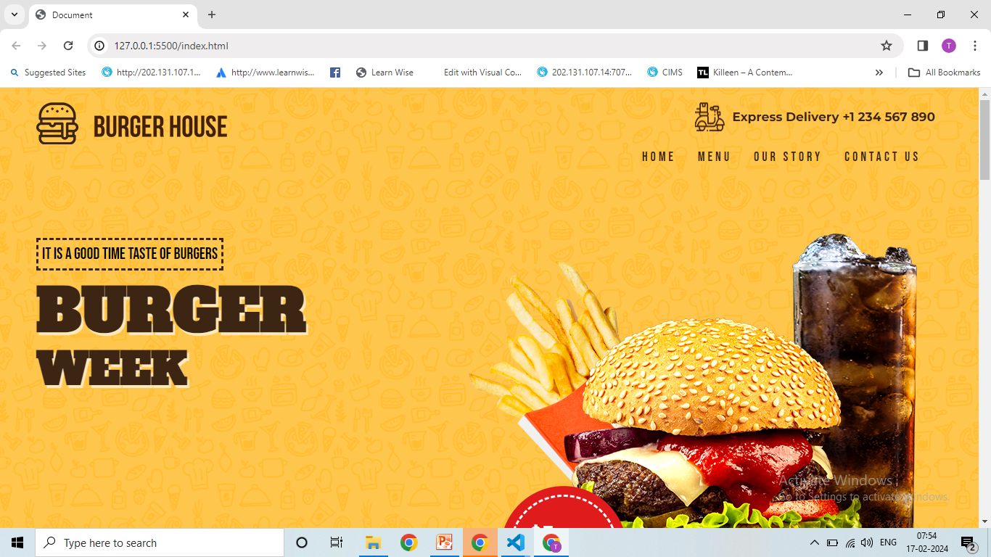
2.PSD to HTML :
Title : Burger House
link : https://github.com/truptimohane/Project/tree/main/psd%20to%20html

Slide 11
Thank
You

