Slide 1
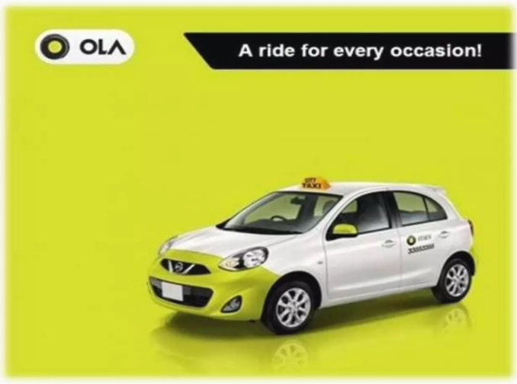
OLA RIDE PROJECT
Presented by Tanvi Sable

Slide 2

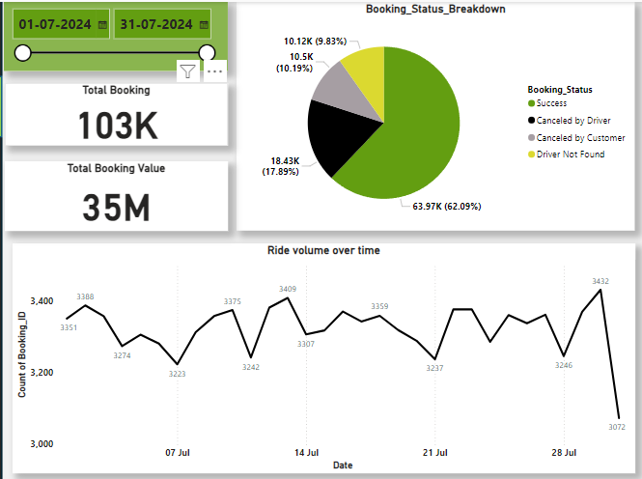






Overall
Vehicle Type
Revenue
Cancellation
Ratings

Slide 3
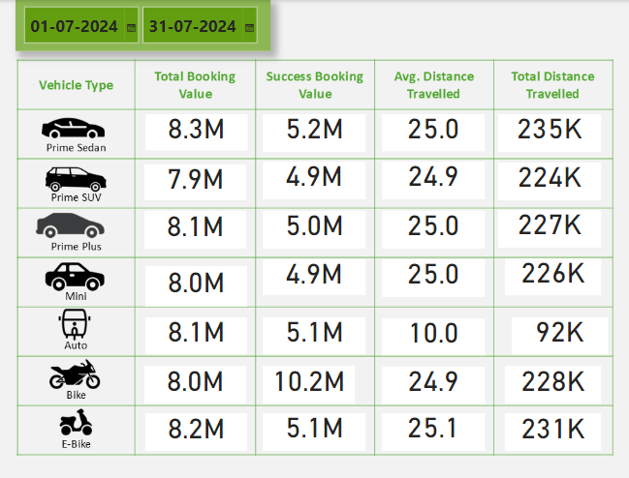









Vehicle Type | Total Booking Value | Success Booking Value | Avg. Distance Travelled | Total Distance Travelled
Prime Sedan
Prime SUV
Prime Plus
Mini
Auto
Bike
E-Bike
Overall
Vehicle Type
Revenue
Cancellation
Ratings

Slide 4
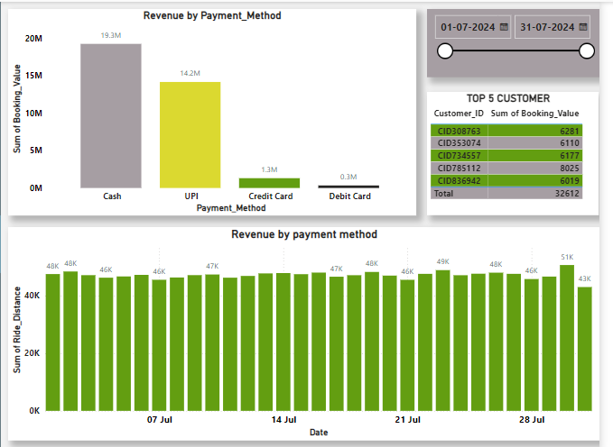

Overall
Vehicle Type
Revenue
Cancellation
Ratings

Slide 5
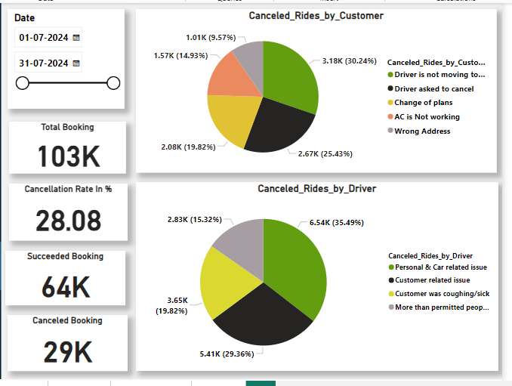

Overall
Vehicle Type
Revenue
Cancellation
Ratings

Slide 6
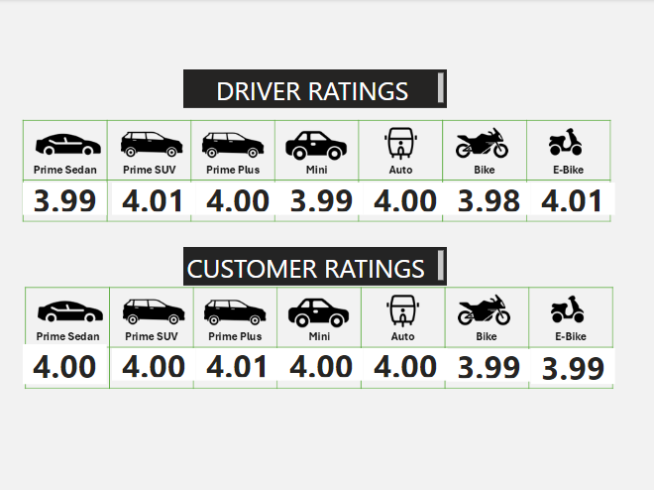

Overall
Prime Sedan | Prime SUV | Prime Plus | Mini | Auto | Bike | E-Bike
Vehicle Type
Revenue
Prime Sedan | Prime SUV | Prime Plus | Mini | Auto | Bike | E-Bike
Cancellation
Ratings

Slide 7


