Slide 1
Selection of a locality in the city of Toronto based on an individual’s preference

Slide 2
Target Audience
For this problem statement, the prospective target audience are individuals who when relocating to a new city, a city where they are unaware of which location would be best suited according to their choices and current lifestyle. Though this case study deals with the city of Toronto, it can be used for any city based on the postcodes and foursquare data.

Slide 3
Problem Statement
For an individual, who wishes to relocate to a different country, he hasn’t been in before, this case study is about analyzing different localities in a city and find out an optimum location meeting the business requirement.
These requirements can be very specific like food habits, preferred venues for recreation , commute and other parameters which my seem trivial but are very important in day today choices.

Slide 4
Data Selection, data cleaning and methodology used
Data related to zip codes are extracted from Wikipedia. It has information of all Boroughs and Neighbourhoods in Toronto.
The latitude and longitude information is clubbed with the zip codes
Data is cleaned and incomplete information is removed and if necessary data is removed from the data set.
By defining categories for all venues in all Neighbourhoods, the most relevant categories are identified and from the venue data , only those which belong to these categories are selected for further processing.
In order to use k means clustering, the elbow method is used to find out the optimum value of k . K means ( unstructured ) clustering is used to cluster the information and display it in a map.

Slide 5
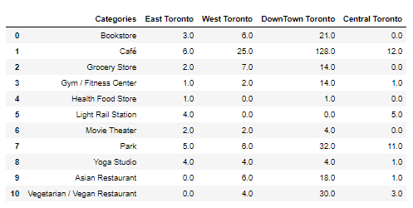
Results
Following table shows the count of various categories of venues in all four areas of Toronto

Slide 6
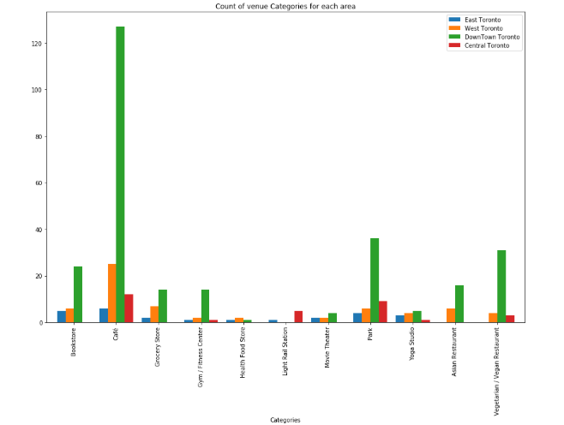
Results ( cont’d )
Following graph shows that Down Town Toronto is best suited for the kind of venue categories our problem statement is about. Hence we can continue our analysis of venues in Down Town Toronto

Slide 7
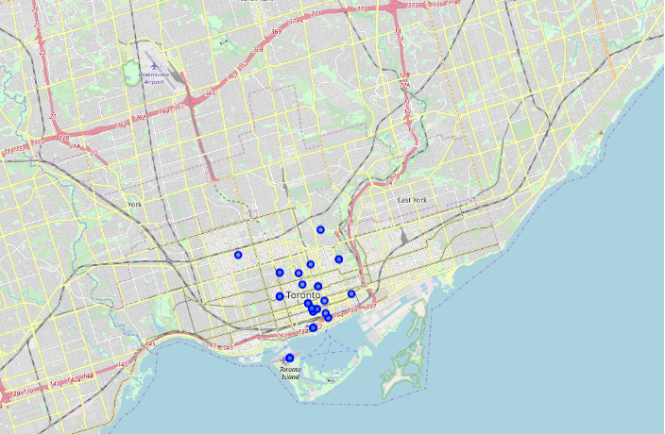
Plots
The following chloropleth map of DownTown Toronto shows the various Neighbourhoods in the area.

Slide 8
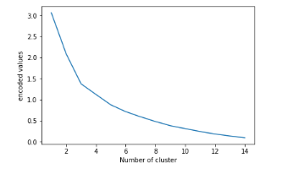
Plots ( cont’d )
For k means clustering, we need to find the optimum value of k. For this we use the elbow method. The following graph shows 3 as the optimum value for clustering

Slide 9
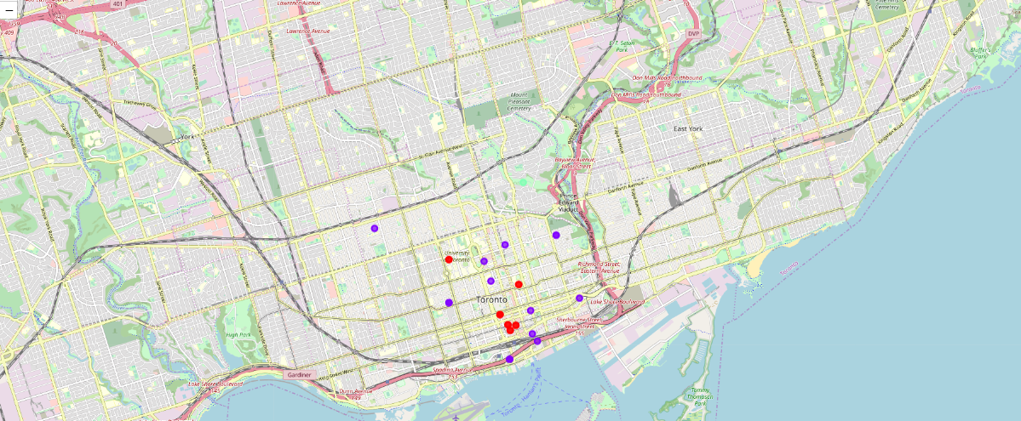
Plots ( cont’d )
Using 3 clusters , we plot the chloropleth graph of DownTown Toronto with three clusters

Slide 10
Conclusions
By using the methodology used here to find out which locality best suits a person based on his or her needs, it can in future help people decide on a locality even before they relocate. It becomes easier for a person to gather such information and decide on a locality to relocate rather than move to a place first and then relocate later.

