Slide 1




ReturnGuard
AI Return Processing Assistant
Governed AI for Trustworthy E-Commerce Returns
Detect return abuse. Explain the evidence. Keep humans in control.
Input
E-Commerce Return
Analysis
Policy & Evidence RAG
Reasoning Governed Decision
Authority Human Oversight
Team Members
Aditya Kamath
Trupti Reddy
Avni Wadhwani
Sharayu Jadhav

Slide 2







Problem & Motivation
TOO PERMISSIVE
TOO AGGRESSIVE
FRAUD LOSS
CUSTOMER TRUST DAMAGE
THE RETURN DILEMMA
Every Return Is a Judgment Call
$849.9B
9%
71%
U.S. retail returns projected in 2025 across e-commerce and store channels
Estimated fraudulent returns, inflicting immense losses across merchant operations
Say a poor return experience makes them less likely to shop with that retailer again
The challenge isn't simply stopping fraud. It's stopping fraud without punishing legitimate customers.

Slide 3











Human-AI Interaction Design
Persona 01
Persona 02 (Oversight)
Persona 03
CUSTOMER
TRUST & SAFETY REVIEWER
RISK / PLATFORM TEAM
Primary Task Submit & track returns
Primary Task Review flagged returns
Primary Task Audit decisions
Essential Need Fast, fair and explainable outcomes
Essential Need Evidence, not an opaque fraud score
Essential Need Policy compliance and traceability
Three Users. One Accountable Decision.
CUSTOMER
AI REVIEW
TRUST & SAFETY REVIEWER
AUDIT
Submits return
Analyzes evidence
Confirms adverse decisions
Decision remains traceable
Accurate Review
+
Explainable Reasoning
+
Human Accountability
=
System Success

Slide 4





Gap Analysis & Opportunity
Manual Review
Human judgment
Slow · Inconsistent · Hard to scale
Missing Capabilities
Existing approaches often leave gaps across:
Multi-Evidence Reasoning
Rule-Based Engines
Explainability
Fast & predictable
Rigid thresholds · Weak on nuance
Governance
Human Oversight
Black-Box Risk Models
Scale patterns
Opaque scores · No reasoning visibility
Core Opportunity: Explores this interaction rather than simply producing another fraud score

Slide 5






Academic Foundations
THEME 01
THEME 02
Return Fraud
Evidence & Grounding
Key idea: Fraud takes multiple forms Supporting: Behavior and context matter
Key idea: Decisions need evidence Supporting: Policies + case info constrain reasoning
Behavior Analysis
ReturnGuard
Policy RAG
LITERATURE → DESIGN
THEME 03
Synthesizing four distinct research streams into one coherent governed system.
THEME 04
Explainable AI
Human–AI Governance
Key idea: A score isn't enough Supporting: People need understandable reasoning
Key idea: High-impact AI needs oversight Supporting: Humans retain authority over adverse decisions
Explanation + Critic
Governance Gate

Slide 6
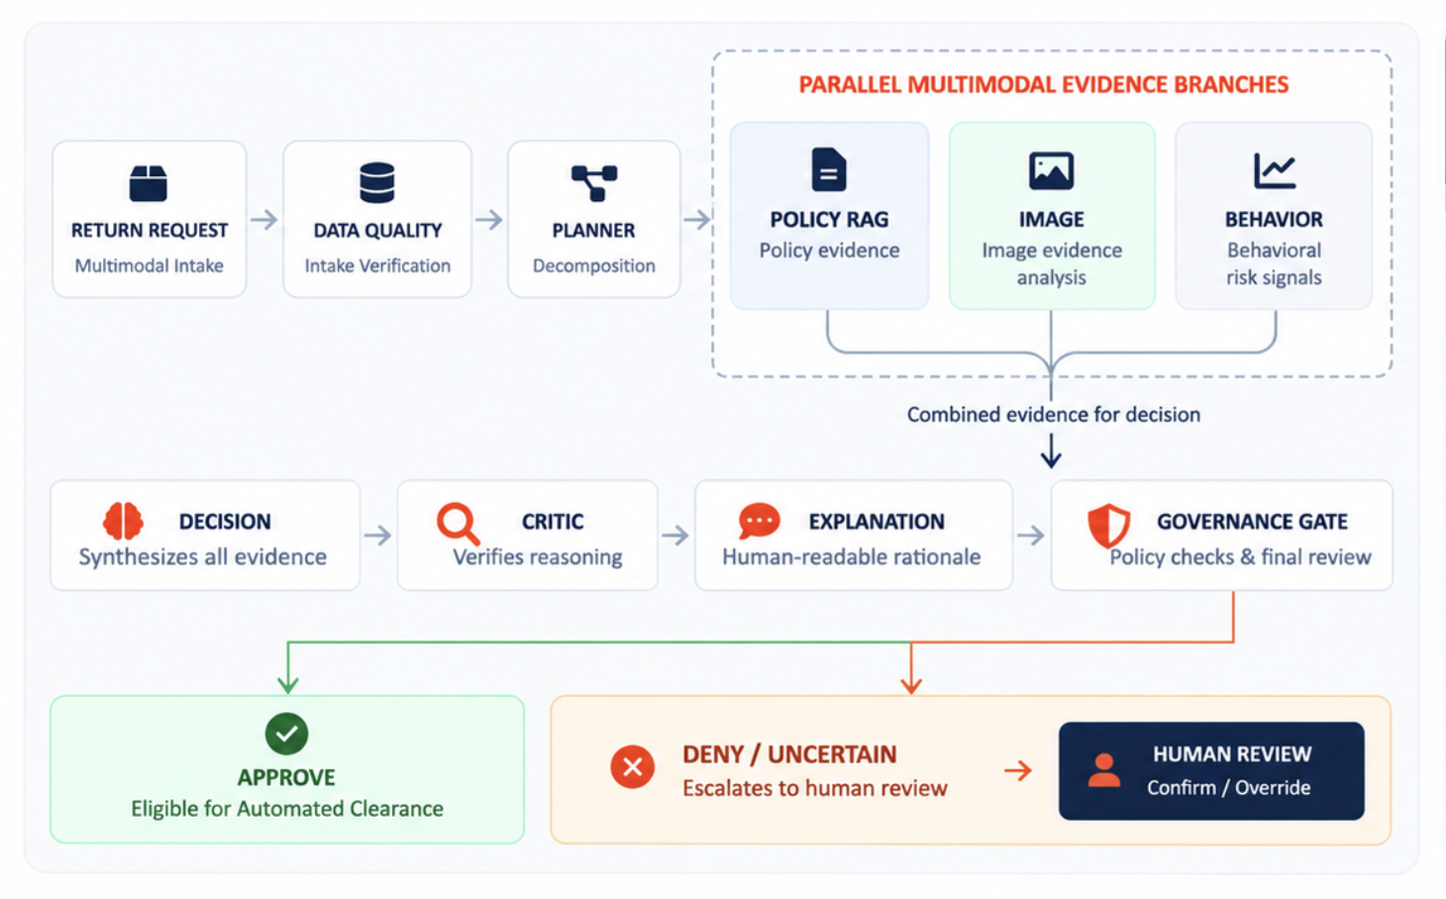












System Architecture & Capabilities
CAPABILITY RATIONALE
PARALLEL EVIDENCE BRANCHES MULTI-MODAL
WHY GenAI?
POLICY RAG / policy evidence
RETURN REQUEST
DATA QUALITY
PLANNER
Multimodal Intake
Intake Verification
Decomposition
IMAGE Image evidence analysis
UNDERSTAND
BEHAVIOR Behavioral risk signals
Unstructured return reasons & policies
SYNTHESIZE
Conflicting multimodal evidence
EXPLAIN
DECISION
CRITIC
EXPLANATION
GOVERNANCE GATE
Why the system reached its recommendation
APPROVE
DENY / UNCERTAIN Escalates automatically with structured reasoning
HUMAN REVIEW
Core Governance Rule
Confirm / Override
Automated Clearance

Slide 7







Milestones & Next Steps
Experimental Protocol: Identical Realistic Return Scenarios Standardized Benchmark Input
BASELINE MODEL
PROPOSED ARCHITECTURE
SINGLE LLM BASELINE
RETURNGUARD MULTI-AGENT
Direct prompt execution without decomposed critic agents
Specialized agents with planner, RAG, critic and governance
EVALUATION AXES:
CP1 Completed
CP2 · Immediate Focus In Progress
CP3 Upcoming
CP4 Final
Research & Proposal
Core Pipeline + Validation
Governance + Human Review
End-to-End Evaluation
Watch for: false positives · bias · hallucination · privacy · automation bias
The goal is not more automation. It is more accountable automation.

