Slide 1
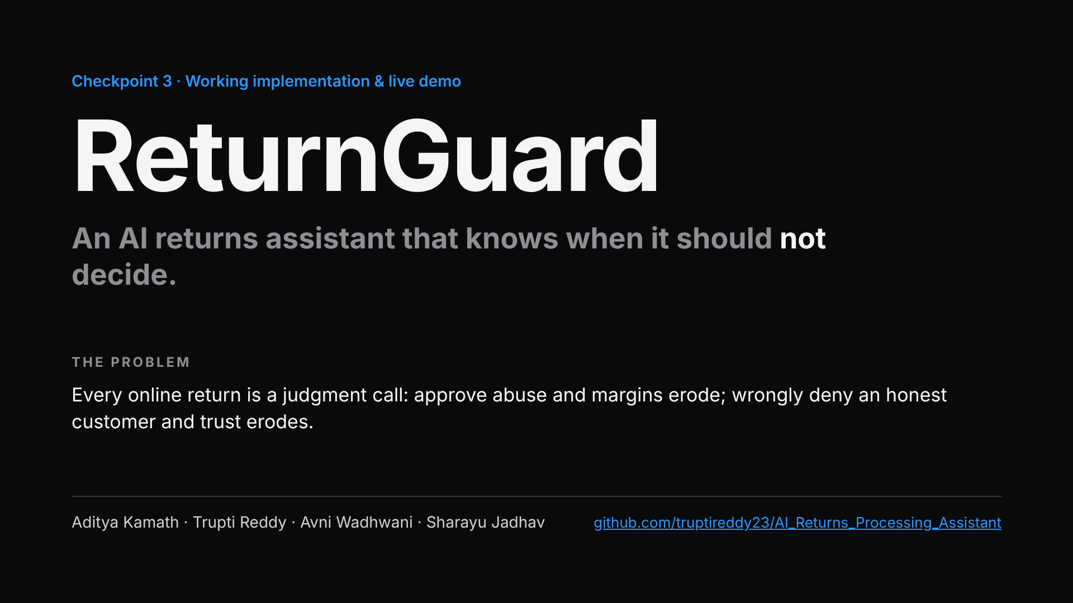
Notes:
About 30 seconds. Every online return is a judgment call: fraud and policy abuse on one side, wrongly denied honest customers on the other. About 9% of returns are fraudulent (NRF 2025), but 57% of shoppers leave a retailer after being charged for a return. ReturnGuard lets AI approve the easy cases, and always puts a person on denials and ambiguous cases, with a full audit trail.

Slide 2
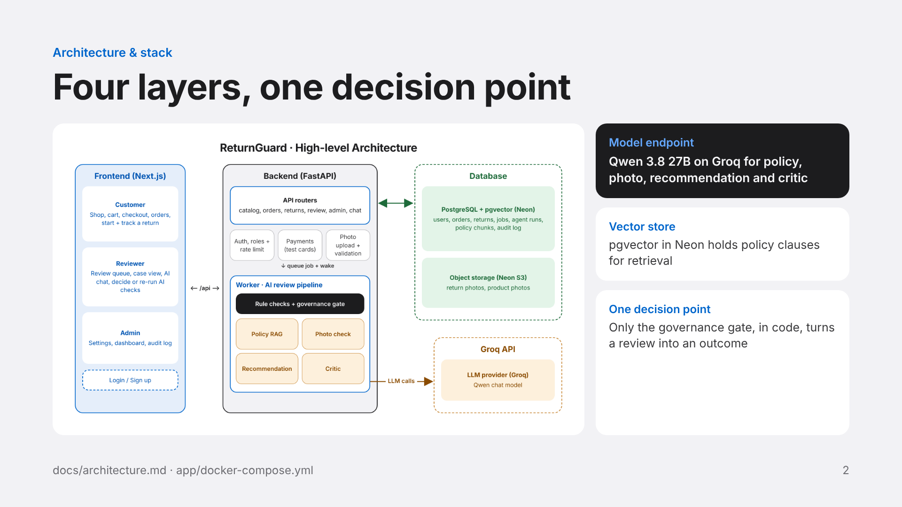
Notes:
About 1 minute. Walk left to right. The Next.js frontend serves three roles: customers shop and start returns, reviewers work the queue and chat, admins change settings and read the audit log. It proxies /api to the FastAPI backend, which handles auth and rate limits, test-card payments and photo validation. Submitting a return queues a job and wakes the worker over HTTP (no polling, so Neon can sleep). The worker runs rule checks in code, then real LLM calls to Qwen 3.8 27B on Groq for policy eligibility with retrieved clauses, the photo check against the real catalog photo, the recommendation and an independent critic. The governance gate, a pure function, is the only step that decides. Data lives in Neon Postgres with pgvector, photos in Neon object storage. With no model key, the same pipeline runs on conservative rule-based steps.

Slide 3
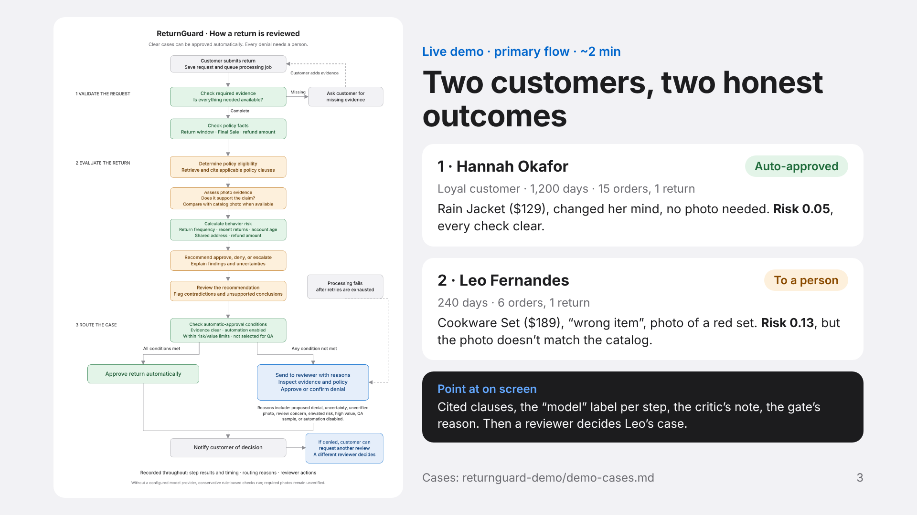
Notes:
Use the flowchart to frame the demo in 15 seconds: validate, evaluate, route. Then switch to the live app. Before the demo, sign in as admin (priya.shah@example.com) and turn automatic approvals on, or every case goes to a person as “automation off”. Case 1: sign in as hannah.okafor@example.com, return the Lightweight Rain Jacket as “changed my mind”. Every gate condition is clear, so it approves without a person. If it lands with a person as a “QA sample”, say so: 10% of would-be auto-approvals are checked by a person on purpose. Case 2: sign in as leo.fernandes@example.com, return the Stainless Steel Cookware Set as “wrong item” with the red non-stick set photo, note “I ordered the stainless steel set but a red non-stick set arrived.” The photo check compares it with the catalog photo, so the risk score is low but it goes to a person as “unverified photo”. Then sign in as reviewer riley.chen@example.com and open the case. Photo verdicts come from the model, so do a dry run first. Customer passwords are in app/seed/users.json.

Slide 4
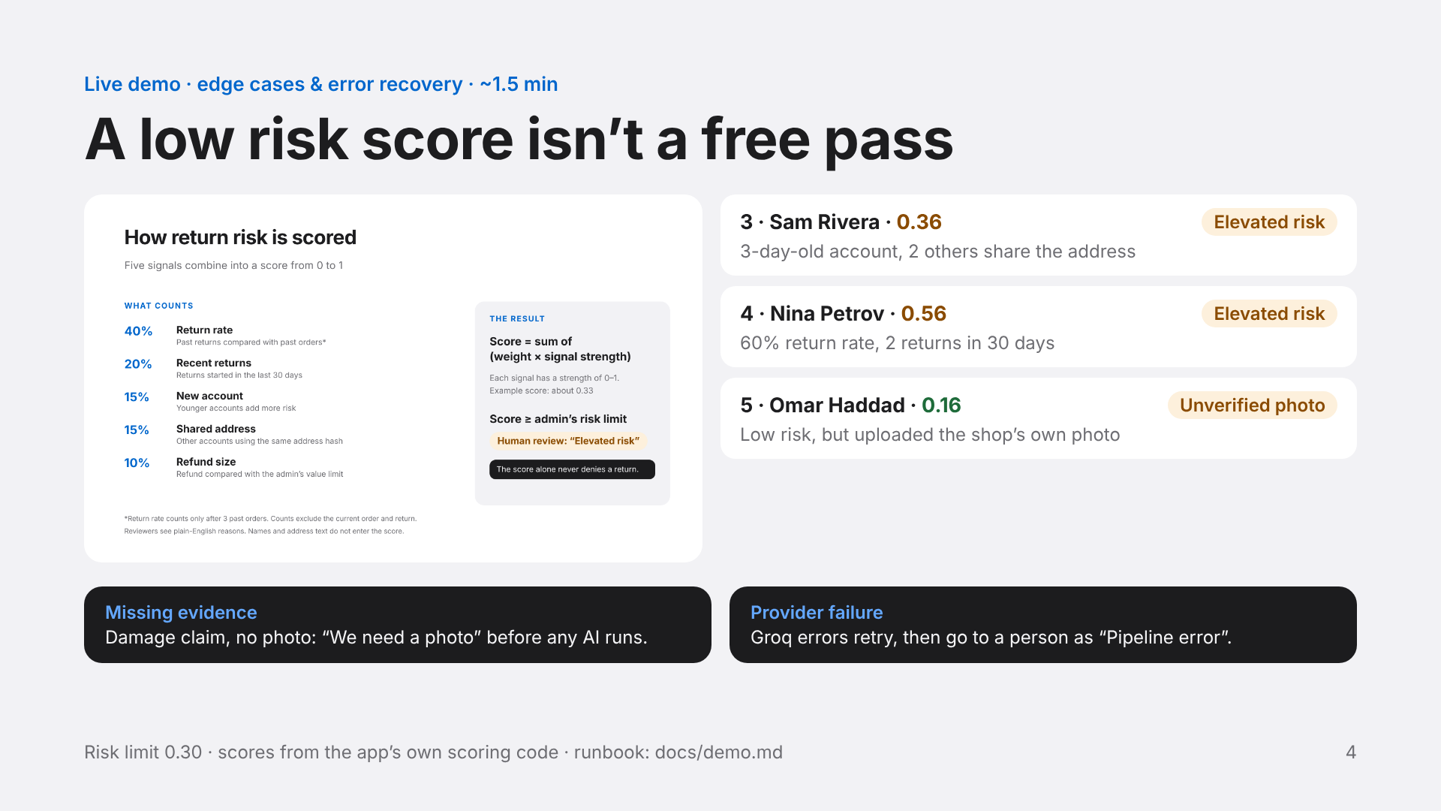
Notes:
Use the scoring panel for 10 seconds: five weighted signals, a score from 0 to 1, and at or above the admin’s limit (0.30) the case goes to a person as “elevated risk”. The score alone never denies. The point for the audience: Omar (and Leo on the last slide) have low risk scores but still go to a person, because the photo check caught them. Sam and Nina have clean evidence but go to a person because of account history. Only Hannah was clean on both. Omar: open the Trailrunner Mesh Sneaker in the shop, save its main photo, and upload that same file as the “damage” photo with the note “The sole came apart after two days.” The catalog photo comparison only works on the team’s Neon database. Missing evidence: Dana Whitfield, EL-003, reason damaged, no photo; status becomes needs_info, and adding a photo re-runs the review. Provider failure: prepare it before going on stage on a private local database (invalid CHAT_API_KEY, see docs/demo.md); job retries at 30 s and 2 min, then the case lands in the queue as Pipeline error, and a reviewer can re-run the AI once the key is fixed. Don’t claim tool calling or a second provider fallback.

Slide 5
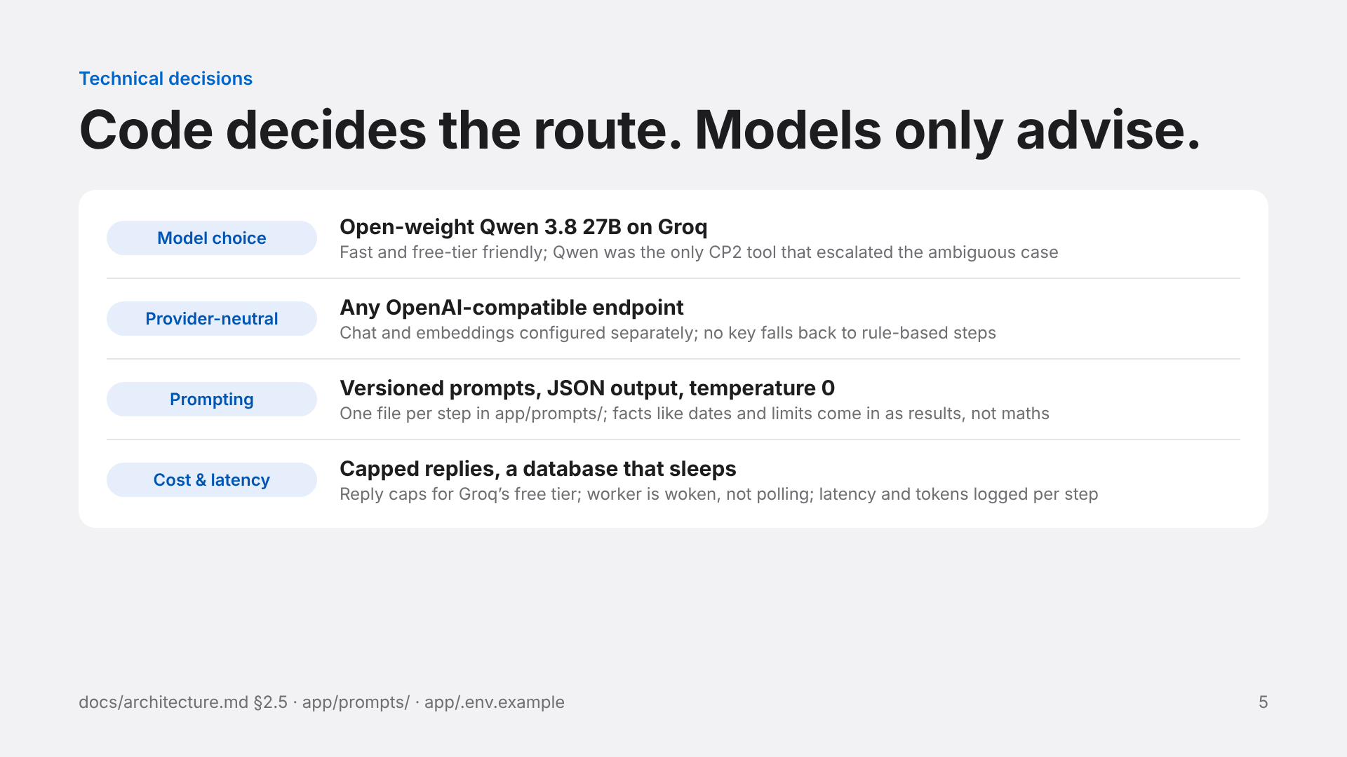
Notes:
About 1 to 1.5 minutes. Model selection tradeoff: open-weight Qwen on Groq instead of a proprietary model. It is fast and runs on a free tier, and in our Checkpoint 2 prompting study open-weight Qwen was the only tool that escalated the ambiguous wear-vs-defect case instead of confidently denying it. The client is provider-neutral (pipeline/llm.py), so OpenAI or any OpenAI-compatible endpoint works; embeddings for policy retrieval are optional and separate, and without them the whole short policy is sent. Prompt engineering: one versioned Markdown prompt per step (policy, image, recommendation, critic, chat), JSON mode with step-specific parsers, temperature 0, and customer notes quoted as data. Cost: reply caps keep us inside Groq’s free tier; per-step latency and token counts are recorded in agent_runs. Be honest: dollar cost isn’t calculated yet.

Slide 6
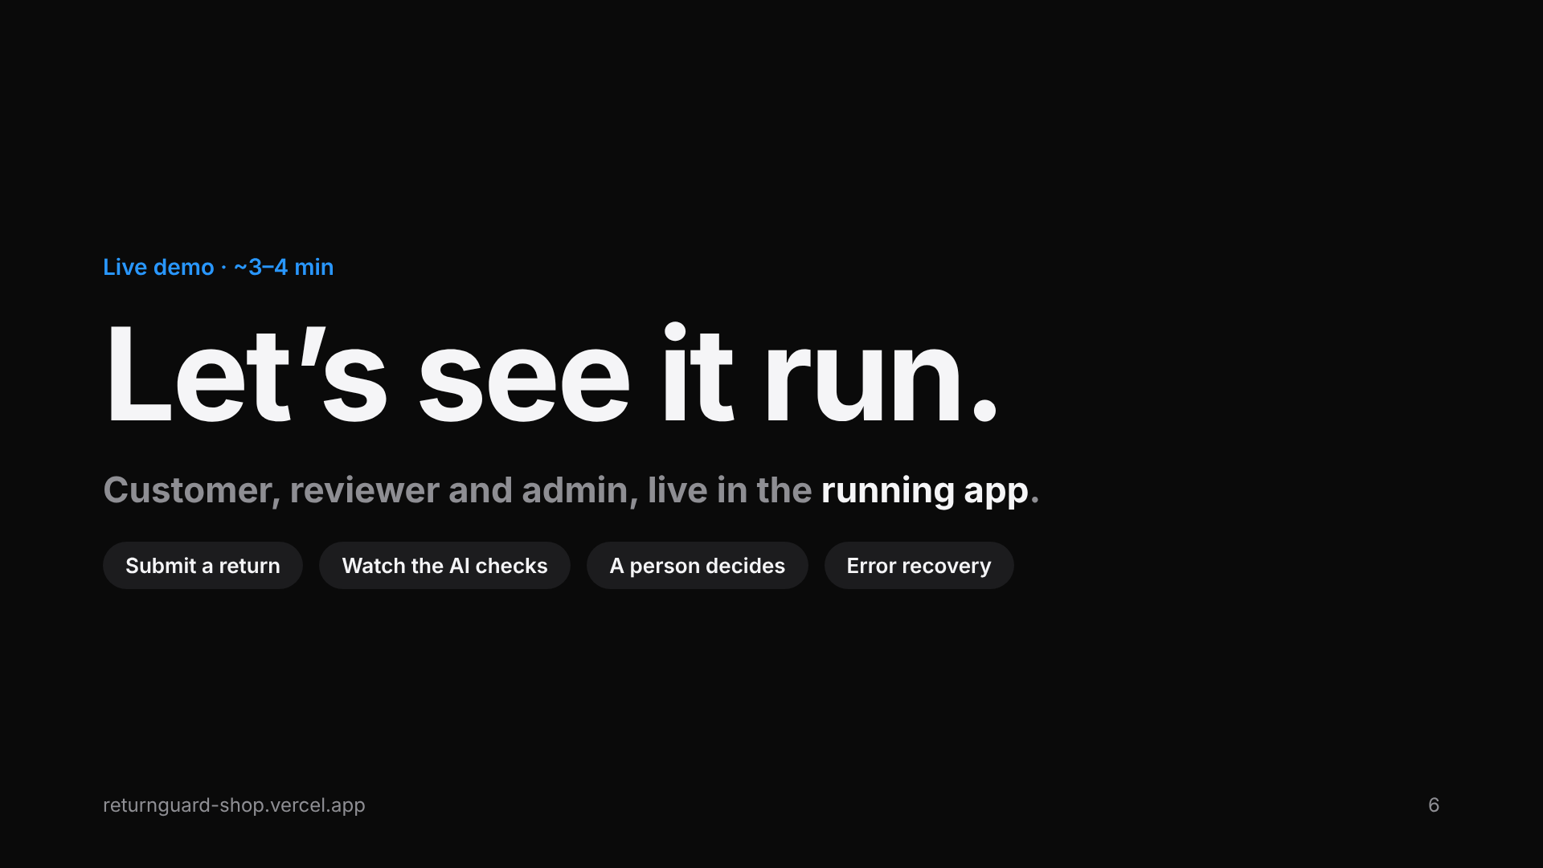
Notes:
Switch to the running app here. Before presenting: sign in as admin and turn automatic approvals on, have the customer, reviewer and admin logins ready (app/seed/users.json and demo-cases.md), and keep the provider-failure case prepared ahead of time. The rubric needs at least half the talk (3–4 minutes) spent live in the app.

Slide 7
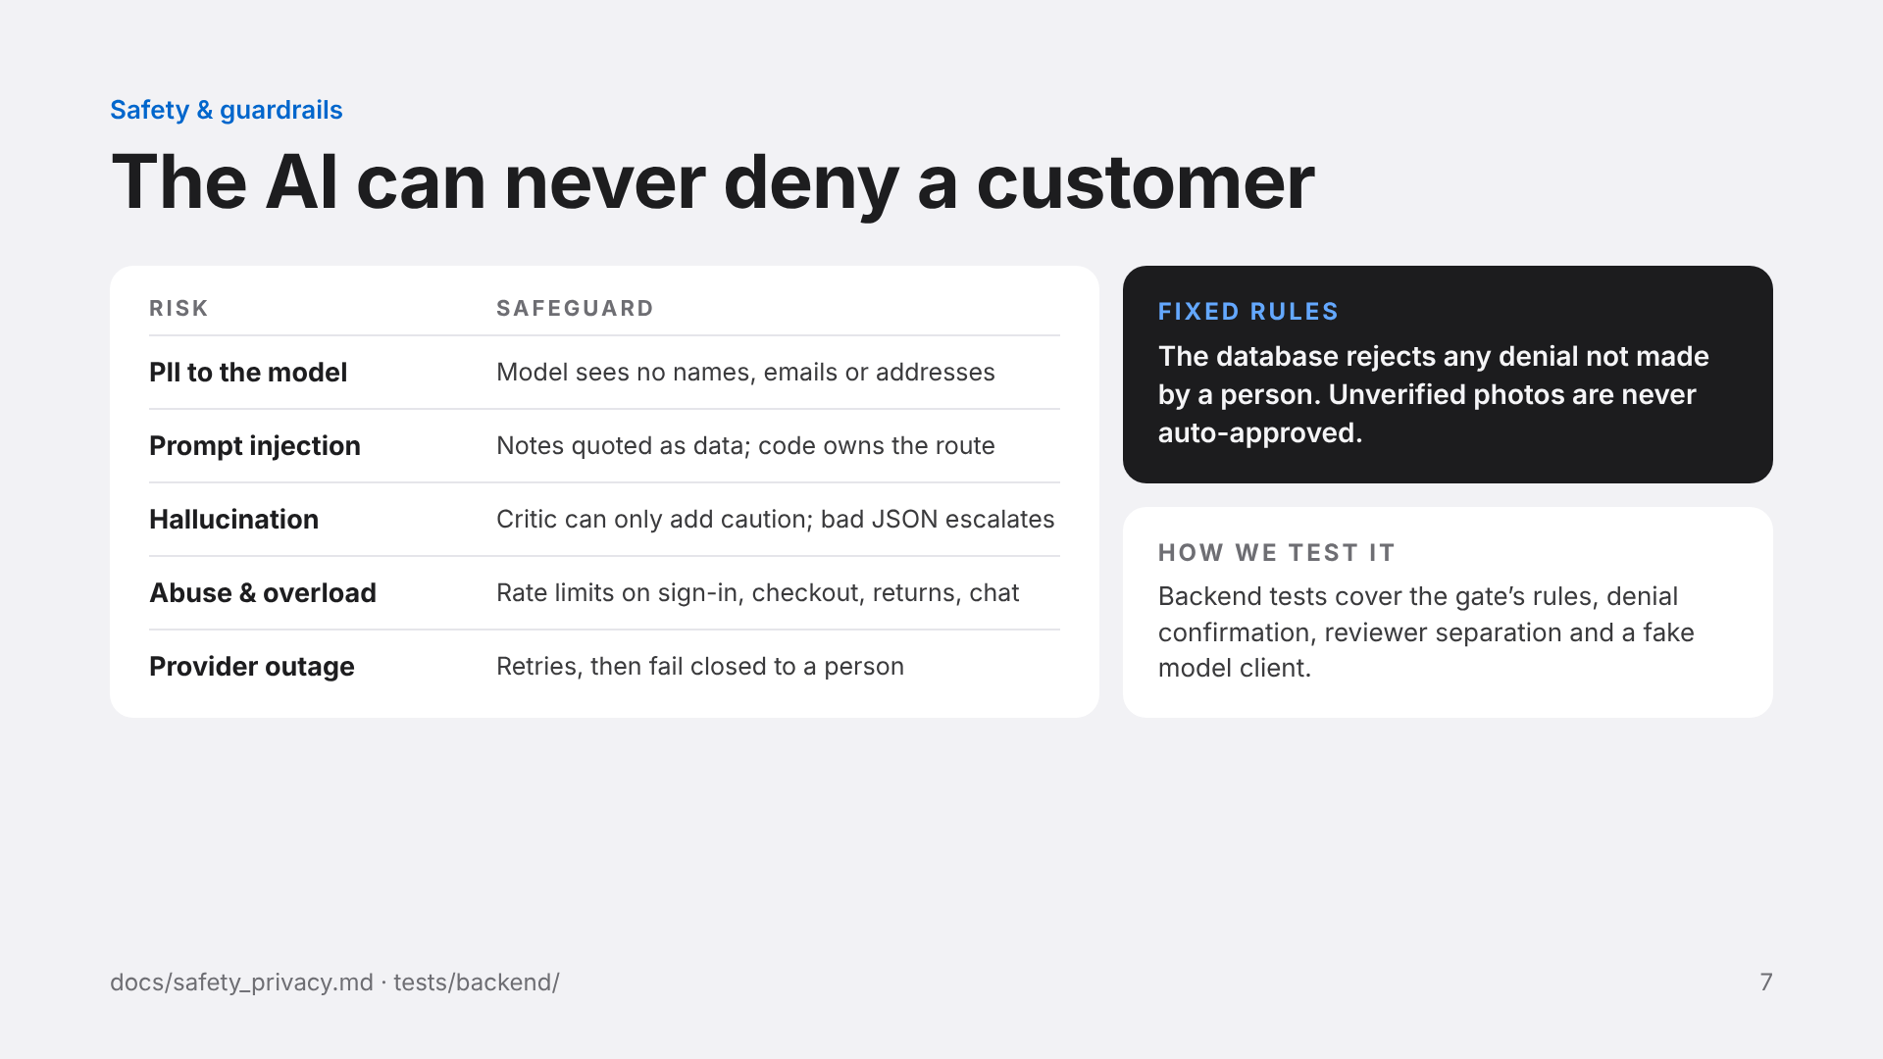
Notes:
About 45 seconds. Be precise about PII: the judgment steps get a restricted case without names, emails or raw addresses, which is data minimisation, not text masking. A customer’s free-text note can still contain PII, so we use synthetic data. Prompt injection: policy prompts quote customer notes as data and tell the model to ignore instructions inside them, and the governance gate is code, so text can’t change a route. Hallucination: invalid model output routes conservatively (unclear policy, unverified photo, escalation or critic veto). A denial needs a confirmation and a cited policy clause, and a customer’s review request goes to a different reviewer. Uploads are checked by their real bytes, re-encoded, and stripped of GPS. Provider failure: SDK and job retries, then “Pipeline error” to a person. All of this is tested with fake model clients so tests never call the network.

Slide 8
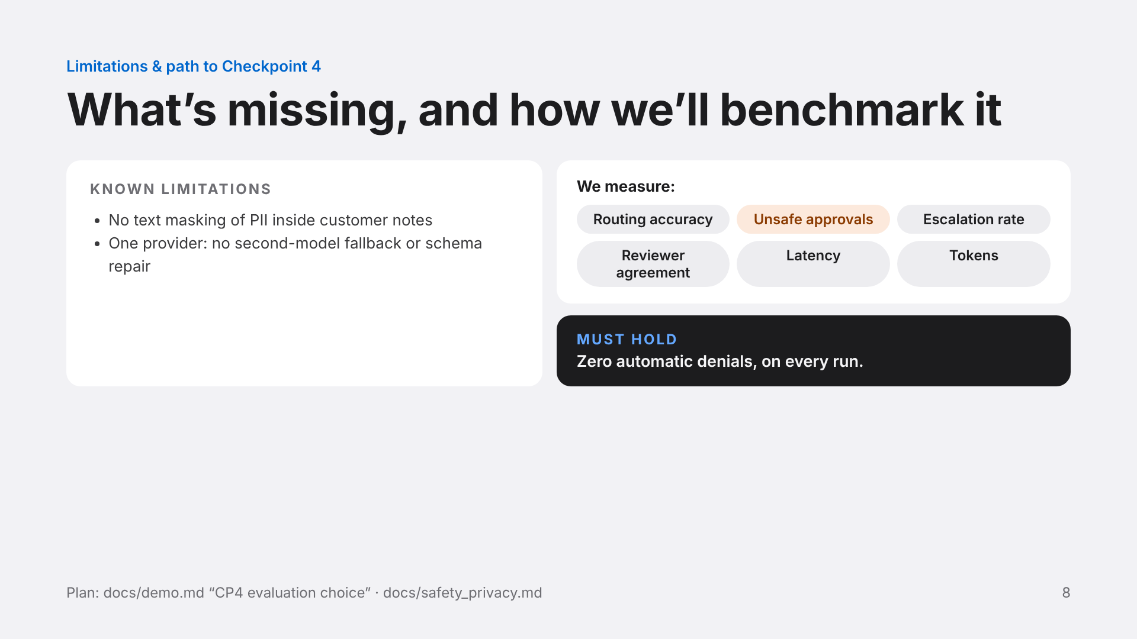
Notes:
About 45 seconds. Limitations are from the team’s own docs: no text masking of PII inside notes, and no second provider or schema-repair call. CP4 plan (docs/demo.md): Track B, an algorithmic benchmark. Freeze the policy, prompts, model settings and gate settings. Build a held-out set of eligible, late or Final Sale, ambiguous, missing-evidence, injection and provider-failure cases; two team members label the expected route and resolve disagreements. Compare rule-based steps with model steps on the same cases, with repeated runs for model variability. Report routing accuracy, unsafe auto-approvals, automatic denials (must be zero), escalation rate, reviewer agreement, latency and token counts.

