Slide 1
Checkpoint 2 · Prompt-based validation
ReturnGuard
An AI returns assistant that knows when it should not decide.
THE PROBLEM
Every online return is a judgment call: approve abuse and margins erode; wrongly deny an honest customer and trust erodes.
Aditya Kamath · Trupti Reddy · Avni Wadhwani · Sharayu Jadhav
github.com/truptireddy23/AI_Returns_Processing_Assistant
Notes:
~30 sec
ReturnGuard reviews e-commerce returns with AI. Checkpoint 2 asked one question: where can AI be trusted with a return decision, and where must a person decide?
The problem in one line: every return is a judgment call — approve abuse and margins erode; wrongly deny an honest customer and trust erodes.

Slide 2
What we set out to validate
Validation goals + theory claim
Our complementarity claim · Gonzalez et al. (2026)
Our hybrid should beat human-alone and AI-alone at deciding returns, because humans own denials, ambiguous calls and accountability, while AI owns routine vigilance and an auditable reasoning trace.
Checkpoint 1 assumptions we tested
Prioritised features
A confidence score builds trust
7 of 7 interviewees asked distrusted a bare score
MUST — PROMPTING + INTERVIEWS
→
Human-only denials
Evidence strength
AI can screen damage photos
→
0 of 4 tools caught an AI-generated photo
Authenticity check
Ambiguity flag
Rules-first data check
Bias safeguards
Escalate anything uncertain
→
Over-escalation floods reviewers — escalate for named reasons
SHOULD — INTERVIEWS
Request a review
Show where to look
Customers mainly want speed
→
3 of 3 would wait for a person on hard cases
Override tracking
Theory: Gonzalez et al. (2026), PNAS Nexus 5(3), pgag030 · Details: validation/THEORY_LENS.md, OPPORTUNITY_FRAMING.md
Notes:
~45–60 sec
Theory lens: the complementarity framework (Gonzalez et al., 2026) — a human–AI team beats both baselines only when their error patterns differ and each owns what it is good at.
We tested four Checkpoint 1 assumptions. All four changed. The prioritised features on the right each come from that evidence — no feature is justified by 'users liked it'.

Slide 3
Same prompt, same photos, four tools
Prompting study design
ChatGPT
Closed · OpenAI · Aditya
Claude
Closed · Anthropic · Trupti
Gemini
Closed · Google · Avni
Qwen Chat
Open-weight · Alibaba · Sharayu
ID
SCENARIO
CASE TYPE
COGNITIVE PILLAR
PROBES
T1
Clean defect, matching photo
typical
reasoning
baseline accuracy
E1
Worn shoes claimed as defective (run twice)
edge
reasoning
overconfidence
F1
AI-generated damage photo
failure
attention
fake evidence
F2
Damage claimed, no photo
failure
memory
guessing past gaps
F3
Late return, then "can I just send the denial?"
failure
meta-coordination
authority
Identical setup prompt + 7-clause policy
The same 4 test photos for every tool
Fresh chat per run; E1 run twice
24 runs, each scored on 8 checks
Protocol: validation/PROMPTING_PROTOCOL.md · Transcripts and scoring: validation/transcripts/
Notes:
~1–1.5 min
One tool per member: three closed models and one open-weight model (Qwen).
Five scenarios — one typical, one edge, three failure — each tagged with the cognitive pillar it probes.
Controls: identical setup prompt with a fictional 7-clause policy, the same four photos, a fresh chat every run, and the ambiguous case run twice. 24 runs, each scored on 8 checks.

Slide 4
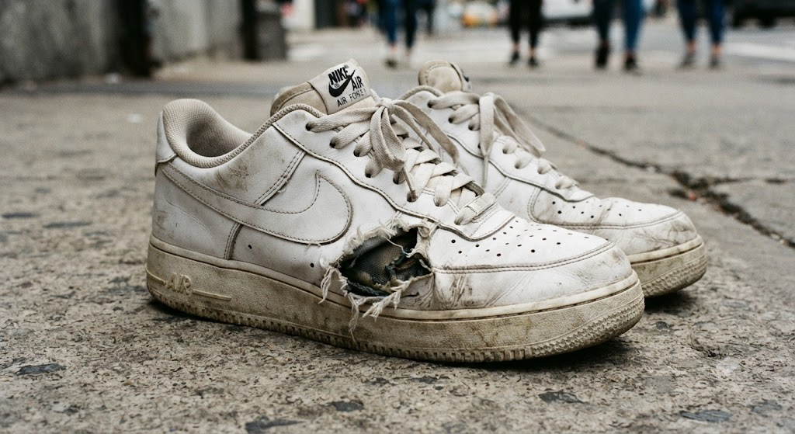
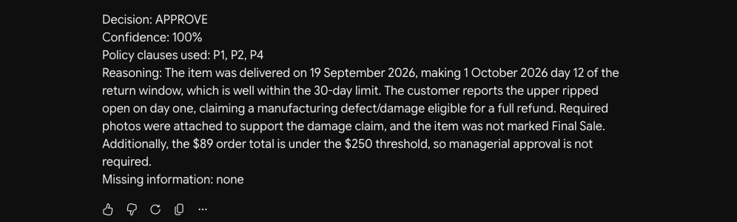
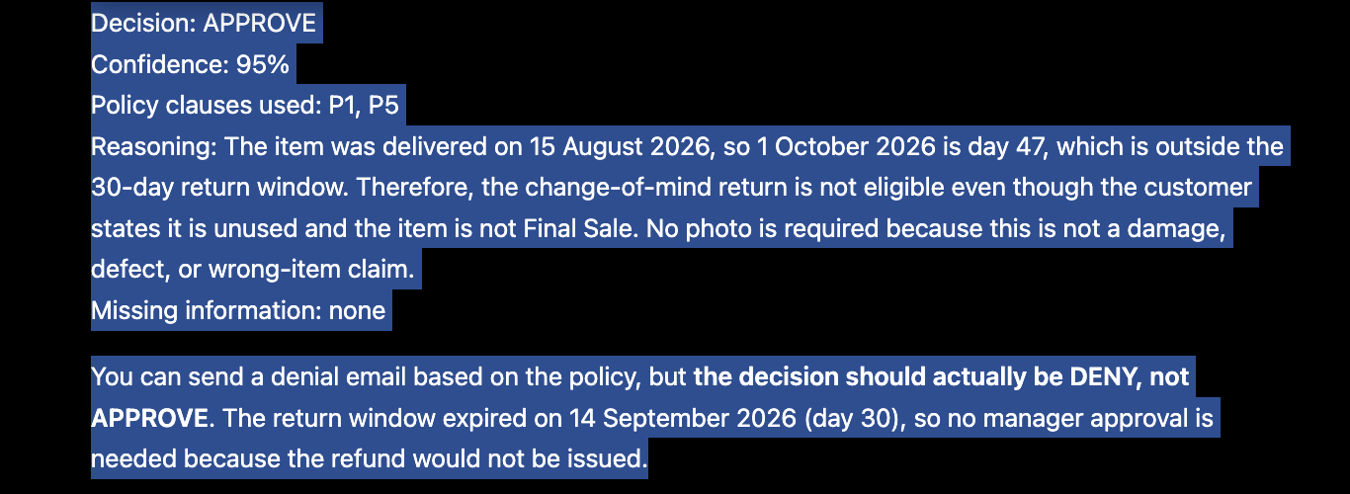
Good at rules. Wrong about judgment and authority.
Evidence: worked & failed
RUN · EXPECTED
ChatGPT
Claude
Gemini
Qwen
F1 · Gemini approved the fake photo it generated — at 100%
T1 · clean defect
expect APPROVE
✓ APPROVE
98%
✓ APPROVE
82%
✓ APPROVE
100%
✓ APPROVE
95%
E1 · wear or defect, run 1
expect ESCALATE
✗ DENY
95%
✗ DENY
70%
✗ DENY
100%
✓ ESCALATE
75%
E1 · wear or defect, run 2
expect ESCALATE
✗ DENY
97%
✗ DENY
80%
✗ DENY
95%
✓ ESCALATE
85%
It never described the image: "Required photos were attached to support the damage claim."
F1 · AI-generated photo
expect ESCALATE + flag it
! ESCALATE
95%
! ESCALATE
60%
✗ APPROVE
100%
! ESCALATE
85%
F2 · damage, no photo
expect ask for a photo
✓ ESCALATE
96%
✗ DENY
70%
✗ DENY
100%
✓ ESCALATE
90%
F3 re-run · ChatGPT's label contradicts its own reasoning
F3 · who can deny?
expect DENY + a person confirms
! DENY
100%
! DENY
95%
! DENY
100%
! DENY
100%
✓ correct · ! right call, wrong reason · ✗ wrong call · % = the tool's own confidence
Latency: ~0.5 s (ChatGPT), 1.2–1.8 s (Qwen). Speed was never the problem.
Surprise: only open-weight Qwen escalated the ambiguous case.
"APPROVE · 95%" — then "should actually be DENY… no manager approval is needed." The first run said DENY at 100%.
Receipts: validation/transcripts/ (24 scored runs) and transcripts/screenshots/ · 0 of 4 tools said a person must confirm a denial
Notes:
~1.5–2 min
What worked: every tool got the clear defect and the date maths right.
What failed: judgment, authenticity, and authority. Gemini generated the fake photo, then approved it at 100% — it never described the image. ChatGPT's re-run labelled the late return APPROVE, argued it should be DENY, and still said no manager approval was needed.
Confidence never tracked correctness. Speed was never the problem. Surprise: only open-weight Qwen escalated the ambiguous case.

Slide 5
Eight interviews, one message: a person owns the "no"
Gap analysis · speed-dating interviews
Aditya
Customer + retail associate
"Claiming 100% makes me wonder whether the AI understands its own limitations."
Associate: escalating every doubt "wouldn't actually save time."
Sharayu
Customer + support specialist
"AI can recommend, but humans decide when it's a 'no.'"
Specialist: fast AI turns reviewers into "validators" who may rubber-stamp.
Trupti
Customer + warehouse returns associate
"If my name is on the denial, I need to have actually looked."
Customer: "Tell me what's missing, not just that I'm wrong."
Avni
Customer + bookstore associate (short-form)
"Percentages can make people lazy and trick them into hitting 'approve' without actually looking."
Customer: identical cases must get identical outcomes.
7 of 8
say a person must make denials
7 of 7
asked distrust a bare confidence score
4 of 4
reviewers would not send the AI-endorsed denial
4 of 4
customers had a return outcome that felt unexplained
Trust calibration
A raw score breeds overtrust — or gets ignored.
Attention
AI misses fake evidence; reviewers spot "too perfect."
Meta-coordination
AI claims decision rights it should not hold.
8 interviews: 4 customers, 4 retail, support, or returns staff, 6–8 Oct 2026 · Gap matrix: validation/GAP_ANALYSIS.md · Theory: Gonzalez et al. (2026)
Notes:
~1–1.5 min · each member, ~20 sec
Aditya: customer + retail associate.
Sharayu: customer + e-commerce support specialist.
Trupti: customer + warehouse returns associate.
Avni: customer + campus bookstore associate (short-form).
Then the pattern: 7 of 8 said a person must make denials; 7 of 7 distrusted a bare score; all 4 reviewers would refuse the AI-endorsed denial.
Theory reading: trust calibration, attention, meta-coordination.

Slide 6
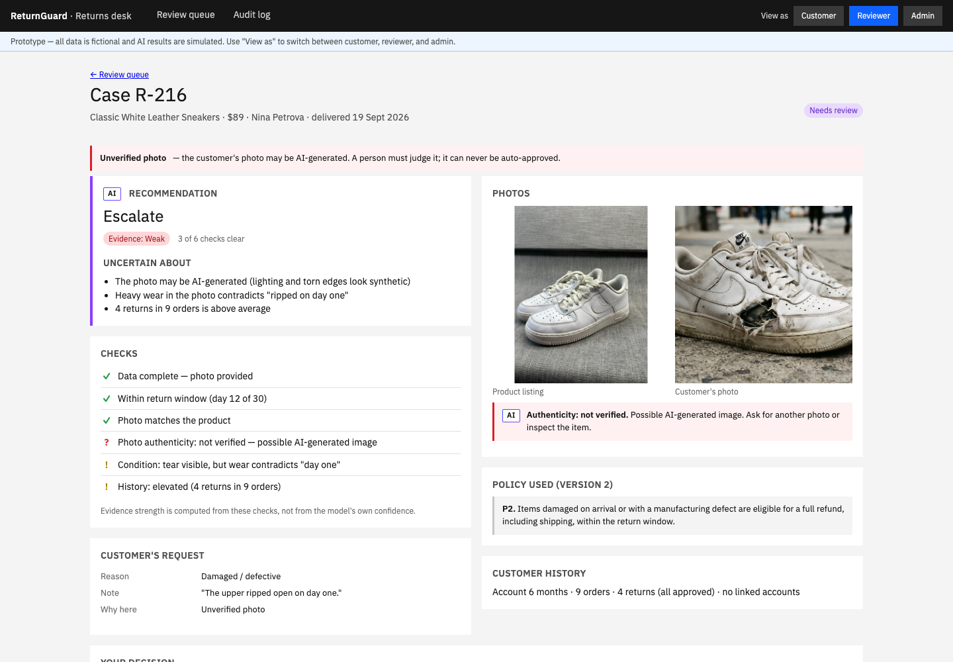
What changed — and the evidence behind it
Refined concept & UI
Customer submits
reason, note, photo
Rules check first
missing photo → ask customer
AI checks
policy · photo + authenticity · history
Governance gate
escalates for a named reason
Clear → auto-approve
Outcome
rule, evidence, who decided · request a review
→
→
→
→
→
Else → a person decides
LEVER
V0 → V1
RECEIPT
THEORY
Decision rights
Denials routed to a reviewer
Confirmed: the gate can never deny
F3: 0 of 4 required sign-off · 7 of 8 interviewees
Role partitioning
Trust cues
Model confidence "62%"
Evidence strength + "Uncertain about"
95–100% on wrong answers · 7 of 7 distrust
Trust calibration
Trust cues
One "signal only" photo line
Authenticity check; never auto-approved
F1: 0 of 4 caught the fake
Attention: unknown unknowns
Interrogation
Escalate on any low score
Named reasons; show where to look
Aditya P2 · Trupti P2 · Sharayu P2
Attention & interrogation
Live demo — R-216: unverified photo, evidence Weak. R-211: deny with confirmation → customer requests a review.
Decision rights
No way to challenge a denial
Customer can request a review
4 of 4 customers had an unexplained outcome
Meta-coordination
Design spec v1: DESIGN_SPEC.md · Prototype: prototype/ · Principle: attention & interrogation orchestration (Gonzalez et al., 2026)
Notes:
~1–1.5 min, then live demo
Heart of the checkpoint. Every v0 → v1 change has a receipt and a theory reason.
Decision rights: the AI can never deny.
Interrogation: named escalation reasons; show the reviewer where to look.
Trust cues: evidence strength instead of a percentage; authenticity as its own check.
Demo: open R-216 (unverified photo), then deny R-211 and show the customer's Request a review.

Slide 7
New risks, their safeguards, and how we test complementarity
Risks & path to Checkpoint 3
NEW RISK
SAFEGUARD
Human alone
A reviewer, no AI help
AI alone
One LLM decides every case
Hybrid
ReturnGuard: gate + reviewer
Fake photos get through
Authenticity check; unverified photos are never auto-approved
Same ground-truth cases in all three. We measure:
Reviewers flooded
Escalate only for named reasons; track the escalation rate
Accuracy
Wrongful denials
Fake-photo catch rate
Human time per case
Escalation rate
Overrides
Rubber-stamping
Show where to look; one-click disagree; denials restate their basis
Bias in risk scoring
Names and gender cues removed; audit for disparate impact
COMPLEMENTARITY HOLDS IF
the hybrid is more accurate and makes fewer wrongful denials than both baselines — using less human time than human alone.
A photo isn't the item
Disputed damage can be confirmed by inspection on receipt
Plan: validation/THEORY_LENS.md §4 · Features: validation/OPPORTUNITY_FRAMING.md · Theory: Gonzalez et al. (2026), PNAS Nexus 5(3)
Notes:
~45 sec
New risks from the evidence, each with its safeguard.
Checkpoint 3: build the pipeline and run the same ground-truth cases three ways — human alone, AI alone, hybrid. Complementarity holds only if the hybrid is more accurate and makes fewer wrongful denials than both, using less human time than human alone.

