Slide 1
Data Mining: Preprocessing Techniques
Organization
Data Quality
Follow Discussions of Ch. 2 of the Textbook
    Aggregation
    Sampling
    Dimensionality Reduction
    Feature subset selection
    Feature creation
    Discretization and Binarization
    Attribute Transformation
Similarity Assessment (part of the clustering transparencies)

Slide 2
Data Quality
What kinds of data quality problems?
How can we detect problems with the data?
What can we do about these problems?
Examples of data quality problems:
  Noise and outliers
  missing values
  duplicate data

Slide 3


Noise
Noise refers to modification of original values
  Examples: distortion of a person’s voice when talking on a poor phone and “snow” on television screen
Two Sine Waves
Two Sine Waves + Noise

Slide 4

Outliers
Outliers are data objects with characteristics that are considerably different than most of the other data objects in the data set

Slide 5
Missing Values
Reasons for missing values
  Information is not collected
  (e.g., people decline to give their age and weight)
  Attributes may not be applicable to all cases
  (e.g., annual income is not applicable to children)
Handling missing values
  Eliminate Data Objects
  Estimate Missing Values
  Ignore the Missing Value During Analysis
  Replace with all possible values (weighted by their probabilities)

Slide 6
Duplicate Data
Data set may include data objects that are duplicates, or almost duplicates of one another
  Major issue when merging data from heterogeous sources
Examples:
  Same person with multiple email addresses
Data cleaning
  Process of dealing with duplicate data issues

Slide 7
Data Preprocessing
Aggregation
Sampling
Dimensionality Reduction
Feature subset selection
Feature creation
Discretization and Binarization
Attribute Transformation

Slide 8
Aggregation
Combining two or more attributes (or objects) into a single attribute (or object)
Purpose
  Data reduction
    Reduce the number of attributes or objects
  Change of scale
    Cities aggregated into regions, states, countries, etc
  More “stable” data
    Aggregated data tends to have less variability

Slide 9
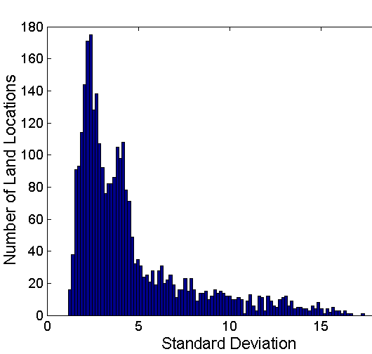
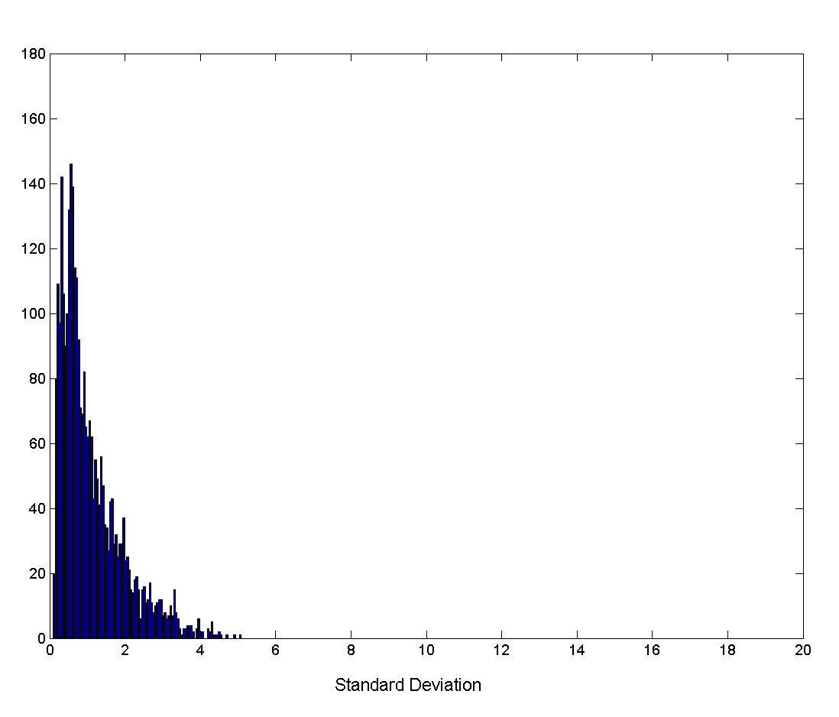
Aggregation
Variation of Precipitation in Australia
Standard Deviation of Average Monthly Precipitation
Standard Deviation of Average Yearly Precipitation

Slide 10
Sampling
Sampling is the main technique employed for data selection.
  It is often used for both the preliminary investigation of the data and the final data analysis.
Statisticians sample because obtaining the entire set of data of interest is too expensive or time consuming.
Sampling is used in data mining because processing the entire set of data of interest is too expensive or time consuming.

Slide 11
Sampling …
The key principle for effective sampling is the following:
  using a sample will work almost as well as using the entire data sets, if the sample is representative
  A sample is representative if it has approximately the same property (of interest) as the original set of data

Slide 12
Types of Sampling
Sampling without replacement
  As each item is selected, it is removed from the population
Sampling with replacement
  Objects are not removed from the population as they are selected for the sample.
    In sampling with replacement, the same object can be picked up more than once
Stratified sampling
  Split the data into several partitions; then draw random samples from each partition

Slide 13

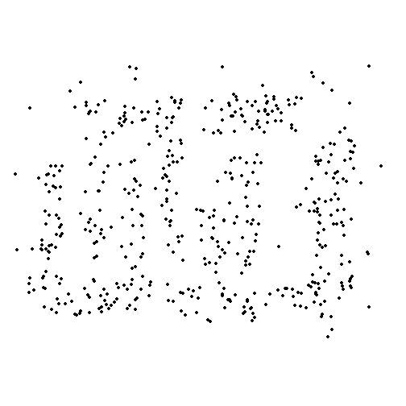
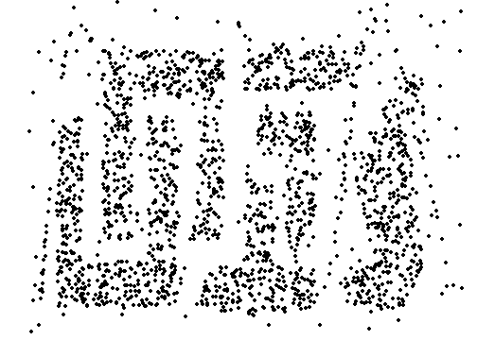
Sample Size
8000 points 2000 Points 500 Points

Slide 14
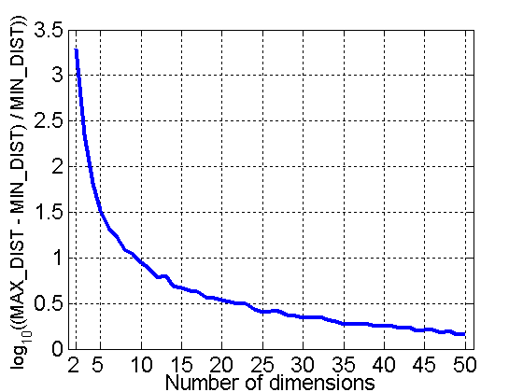
Curse of Dimensionality
When dimensionality increases, data becomes increasingly sparse in the space that it occupies
Definitions of density and distance between points, which is critical for clustering and outlier detection, become less meaningful
Randomly generate 500 points
Compute difference between max and min distance between any pair of points

Slide 15
Dimensionality Reduction
Purpose:
  Avoid curse of dimensionality
  Reduce amount of time and memory required by data mining algorithms
  Allow data to be more easily visualized
  May help to eliminate irrelevant features or reduce noise
Techniques
  Principle Component Analysis
  Singular Value Decomposition
  Others: supervised and non-linear techniques

Slide 16
Dimensionality Reduction: PCA
Goal is to find a projection that captures the largest amount of variation in data
x₂
e
x₁

Slide 17
Dimensionality Reduction: PCA
Find the m eigenvectors of the covariance matrix
The eigenvectors define the new space
Select only those m eigenvectors that contribute the most to the variation in the dataset (m<n)
x₂
e
x₁

Slide 18
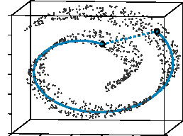
Dimensionality Reduction: ISOMAP
By: Tenenbaum, de Silva, Langford (2000)
Construct a neighbourhood graph
For each pair of points in the graph, compute the shortest path distances – geodesic distances

Slide 19
Feature Subset Selection
Another way to reduce dimensionality of data
Redundant features
  duplicate much or all of the information contained in one or more other attributes
  Example: purchase price of a product and the amount of sales tax paid
Irrelevant features
  contain no information that is useful for the data mining task at hand
  Example: students' ID is often irrelevant to the task of predicting students' GPA

Slide 20
Feature Subset Selection
Techniques:
  Brute-force approch:
    Try all possible feature subsets as input to data mining algorithm
  Embedded approaches:
    Feature selection occurs naturally as part of the data mining algorithm
  Filter approaches:
    Features are selected before data mining algorithm is run
  Wrapper approaches:
    Use the data mining algorithm as a black box to find best subset of attributes

Slide 21
Feature Creation
Create new attributes that can capture the important information in a data set much more efficiently than the original attributes
Three general methodologies:
  Feature Extraction
    domain-specific
  Mapping Data to New Space
  Feature Construction
    combining features

Slide 22

Mapping Data to a New Space
Fourier transform
Wavelet transform
Two Sine Waves
Two Sine Waves + Noise
Frequency

Slide 23
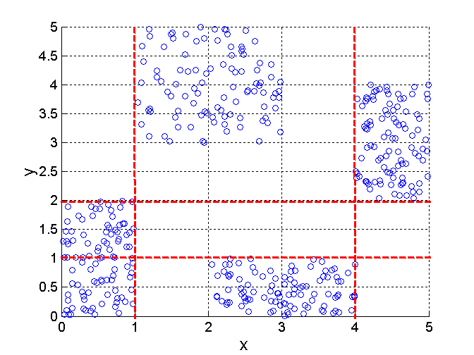
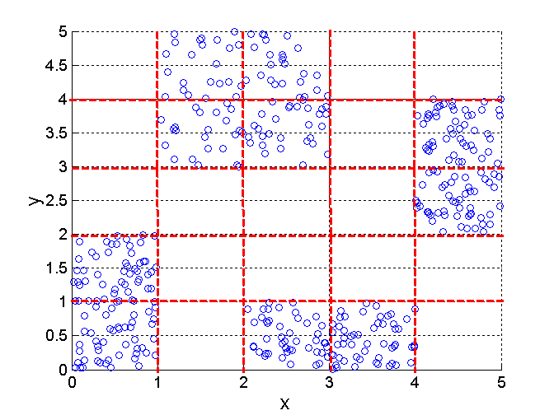
Discretization Using Class Labels
Entropy based approach
3 categories for both x and y
5 categories for both x and y

Slide 24




Discretization Without Using Class Labels
Data
Equal interval width
Equal frequency
K-means

Slide 25
Similarity and Dissimilarity
Already covered!
Similarity
  Numerical measure of how alike two data objects are.
  Is higher when objects are more alike.
  Often falls in the range [0,1]
Dissimilarity
  Numerical measure of how different are two data objects
  Lower when objects are more alike
  Minimum dissimilarity is often 0
  Upper limit varies
Proximity refers to a similarity or dissimilarity

Slide 26
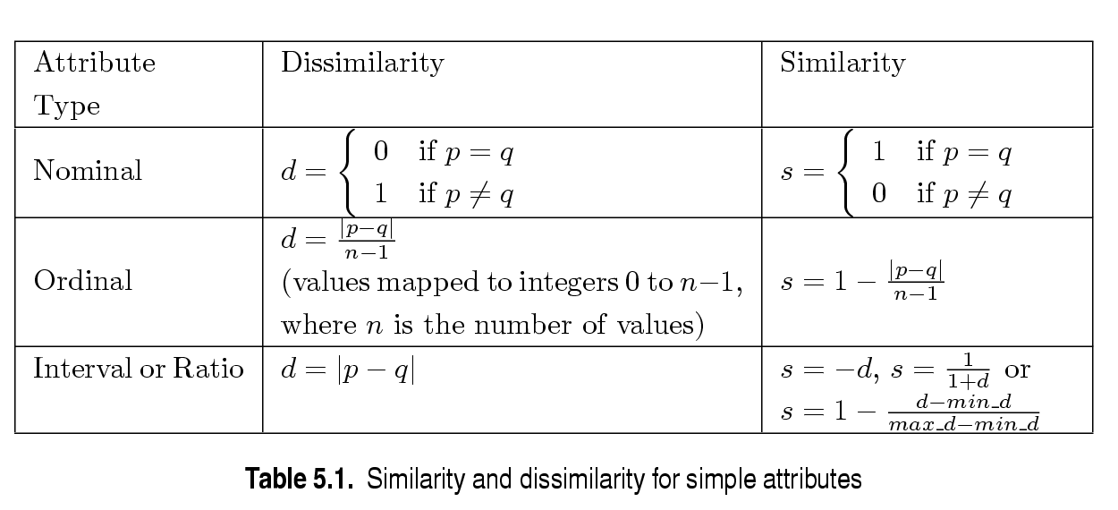
Similarity/Dissimilarity for Simple Attributes
p and q are the attribute values for two data objects.

Slide 27
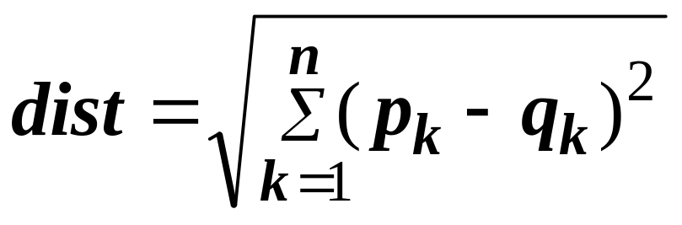
Euclidean Distance
Euclidean Distance
  Where n is the number of dimensions (attributes) and p_{k} and q_{k} are, respectively, the k^{th} attributes (components) or data objects p and q.
Standardization is necessary, if scales differ.

Slide 28
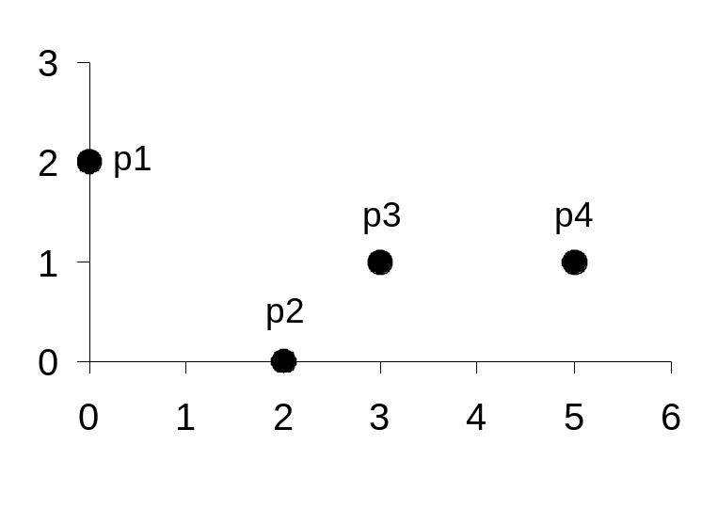
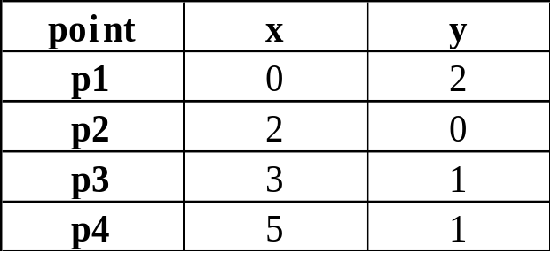
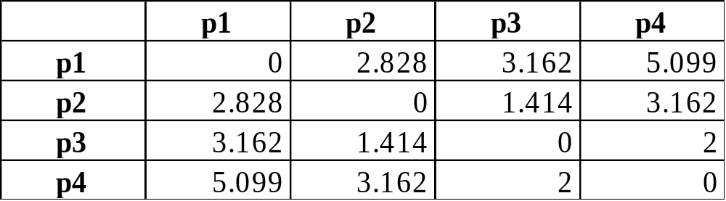
Euclidean Distance
Distance Matrix

Slide 29
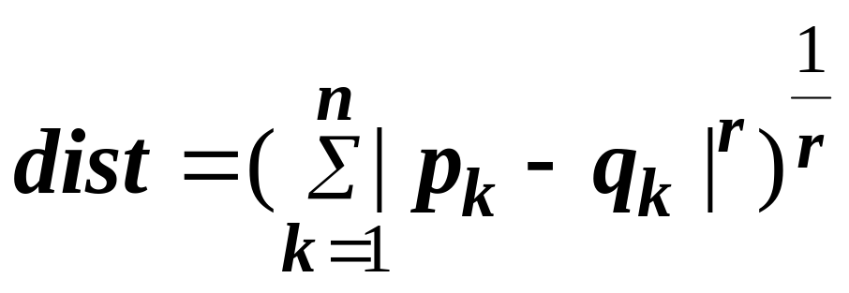
Minkowski Distance
Minkowski Distance is a generalization of Euclidean Distance
  Where r is a parameter, n is the number of dimensions (attributes) and p_{k} and q_{k} are, respectively, the kth attributes (components) or data objects p and q.

Slide 30
Minkowski Distance: Examples
r = 1. City block (Manhattan, taxicab, L₁ norm) distance.
  A common example of this is the Hamming distance, which is just the number of bits that are different between two binary vectors
r = 2. Euclidean distance
r → ∞. “supremum” (L_{max} norm, L∞ norm) distance.
  This is the maximum difference between any component of the vectors
Do not confuse r with n, i.e., all these distances are defined for all numbers of dimensions.

Slide 31
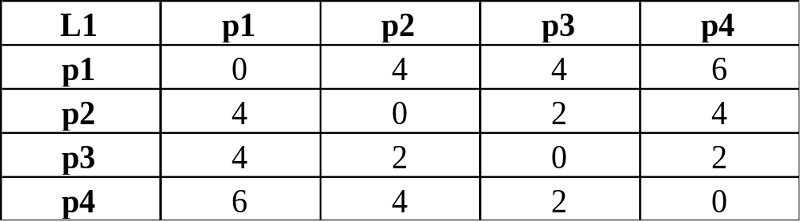
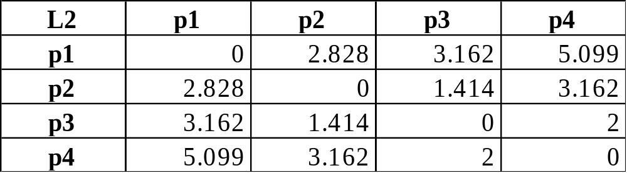
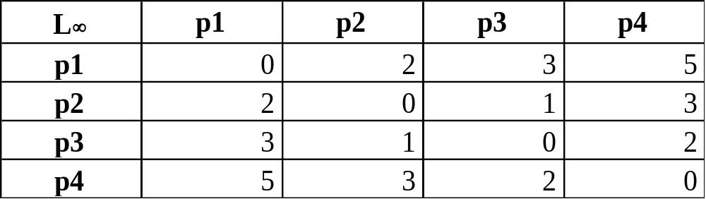
Minkowski Distance
Distance Matrix

Slide 32
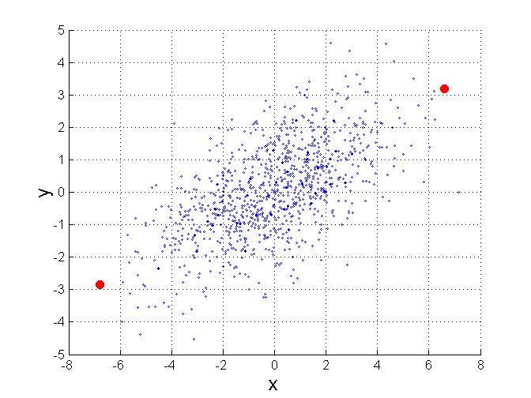
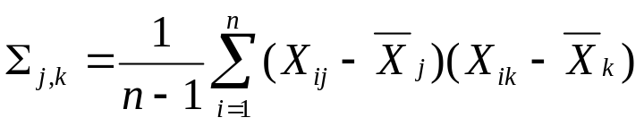
Mahalanobis Distance
Cover!
Σ is the covariance matrix of the input data X
Advantage: Eliminates differences
in scale and down-plays importance
f correlated attributes in distance
Computations.
Alternative to attribute normalization!
For red points, the Euclidean distance is 14.7, Mahalanobis distance is 6.

Slide 33
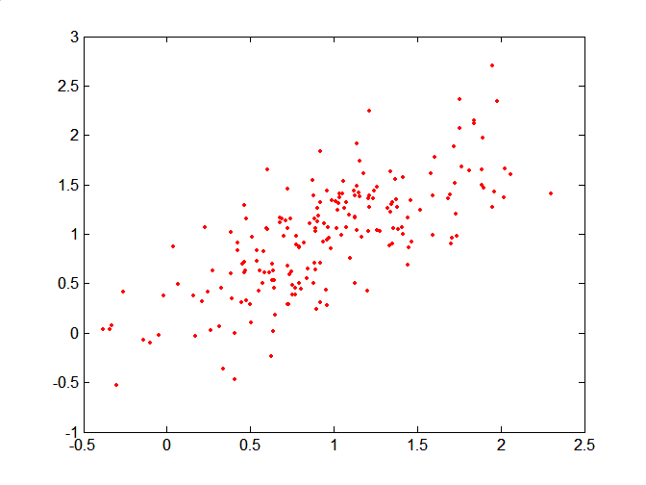
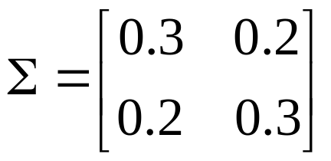
Mahalanobis Distance
Covariance Matrix:
C
B
A: (0.5, 0.5)
B: (0, 1)
C: (1.5, 1.5)
Mahal(A,B) = 5
Mahal(A,C) = 4
A

Slide 34
Common Properties of a Distance
Distances, such as the Euclidean distance, have some well known properties.
  d(p, q) ≥ 0 for all p and q and d(p, q) = 0 only if
  p = q. (Positive definiteness)
  d(p, q) = d(q, p) for all p and q. (Symmetry)
  d(p, r) ≤ d(p, q) + d(q, r) for all points p, q, and r.
  (Triangle Inequality)
where d(p, q) is the distance (dissimilarity) between points (data objects), p and q.
A distance that satisfies these properties is a metric

Slide 35
Common Properties of a Similarity
Similarities, also have some well known properties.
  s(p, q) = 1 (or maximum similarity) only if p = q.
  s(p, q) = s(q, p) for all p and q. (Symmetry)
where s(p, q) is the similarity between points (data objects), p and q.

Slide 36
Similarity Between Binary Vectors
Common situation is that objects, p and q, have only binary attributes
Compute similarities using the following quantities
M₀₁ = the number of attributes where p was 0 and q was 1
M₁₀ = the number of attributes where p was 1 and q was 0
M₀₀ = the number of attributes where p was 0 and q was 0
M₁₁ = the number of attributes where p was 1 and q was 1
Simple Matching and Jaccard Coefficients
SMC = number of matches / number of attributes
= (M₁₁ + M₀₀) / (M₀₁ + M₁₀ + M₁₁ + M₀₀)
J = number of 11 matches / number of not-both-zero attributes values
= (M₁₁) / (M₀₁ + M₁₀ + M₁₁)

Slide 37
SMC versus Jaccard: Example
p = 1 0 0 0 0 0 0 0 0 0
q = 0 0 0 0 0 0 1 0 0 1
M₀₁ = 2 (the number of attributes where p was 0 and q was 1)
M₁₀ = 1 (the number of attributes where p was 1 and q was 0)
M₀₀ = 7 (the number of attributes where p was 0 and q was 0)
M₁₁ = 0 (the number of attributes where p was 1 and q was 1)
SMC = (M₁₁ + M₀₀)/(M₀₁ + M₁₀ + M₁₁ + M₀₀) = (0+7) / (2+1+0+7) = 0.7
J = (M₁₁) / (M₀₁ + M₁₀ + M₁₁) = 0 / (2 + 1 + 0) = 0

Slide 38
Cosine Similarity
If d₁ and d₂ are two document vectors, then
cos( d₁, d₂ ) = (d₁ • d₂) / ||d₁|| ||d₂|| ,
where • indicates vector dot product and || d || is the length of vector d.
Example:
d₁ = 3 2 0 5 0 0 0 2 0 0
d₂ = 1 0 0 0 0 0 0 1 0 2
d₁ • d₂= 3*1 + 2*0 + 0*0 + 5*0 + 0*0 + 0*0 + 0*0 + 2*1 + 0*0 + 0*2 = 5
||d₁|| = (3*3+2*2+0*0+5*5+0*0+0*0+0*0+2*2+0*0+0*0)^{0.5} = (42) ^{0.5} = 6.481
||d₂|| = (1*1+0*0+0*0+0*0+0*0+0*0+0*0+1*1+0*0+2*2) ^{0.5} = (6) ^{0.5} = 2.245
cos( d₁, d₂ ) = .3150

Slide 39
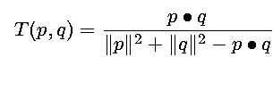
Extended Jaccard Coefficient (Tanimoto)
Variation of Jaccard for continuous or count attributes
  Reduces to Jaccard for binary attributes

Slide 40
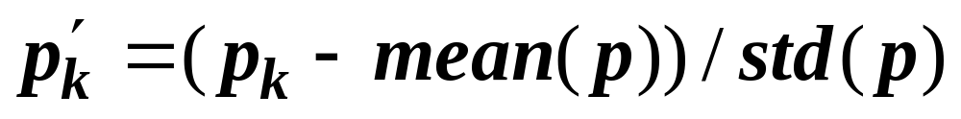
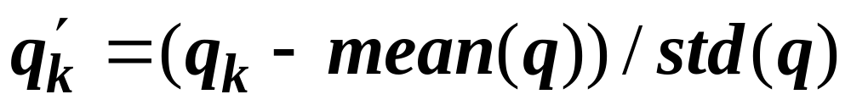
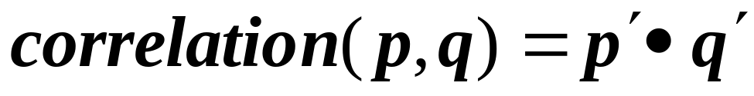
Correlation
Correlation measures the linear relationship between objects
To compute correlation, we standardize data objects, p and q, and then take their dot product

Slide 41

Visually Evaluating Correlation
Scatter plots showing the similarity from –1 to 1.

