Slide 1

VeriForge: Image Forgery Detection
PRESENTED BY: RISHIKESH RAVI, HAMZA RANGWALA, AYAZ AFZAL, TRUSHIT PATEL
WILFRID LAURIER UNIVERSITY
SUPERVISOR: DR. ANK ZAMAN

Slide 2
Introduction

Slide 3
Introduction
Overall Goal: Develop an efficient deep learning model for accurate image forgery detection
Key Points:
Combining CNN with Error Level Analysis (ELA)
Using CASIA V2.0 dataset for training and testing
Aiming for real-time analysis capabilities
Presentation Overview:
Problem Statement
Project Objective & Scope
Methodology: Deep learning with traditional forensic techniques
Key findings and performance metrics
Conclusion
Notes:
rishi

Slide 4
Problem Statement
Recap: Image Forgery Detection Challenge
Context: Rapid Evolution of Digital Manipulation Techniques
Significance: Critical Need for Automated Forensic Tools
Impact: Addressing Limitations in Current Detection Methods
Notes:
rishi

Slide 5
Project Objective & Scope
Objectives:
Develop a deep learning model to accurately detect original vs. tampered images
Integrate traditional techniques with modern neural network architecture
Create a user-friendly tool accessible to the general public
Scope:
Development of CNN-based deep learning model
Implementation and Integration of Error Level Analysis (ELA) and other preprocessing techniques
Use of CASIA v2.0 dataset for training, validation and testing
Notes:
ayaz

Slide 6
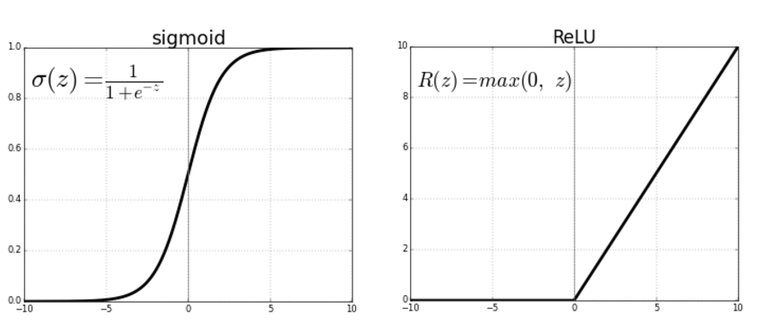
Methodology
To identify the images we developed a CNN architecture using VGG16
as base model; with 5 convolutional layers and a max pooling layer.
Classification Type: Binary
Preprocessing: Resize, ELA, RGB Conversion and Normalization
Loss Function: Binary Cross Entropy
Activation Functions: ReLU & Sigmoid activation function
Source: towardsdatascience.com
Notes:
ayaz

Slide 7
Key Findings
Significant Improvement: Model Accuracy Boosted by 12.6% Over
the previous custom model
Improved ELA Function
Identified underlying issues & bottlenecks by data examination
Increased trainable parameters
Modified custom layer architecture
Notes:
hamza I’ll share the significant improvements achieved in our model, which resulted in a remarkable 12.6% boost in accuracy compared to the previous custom model. Let’s dive into the key factors behind this improvement.”
Key Points:
Improved ELA Function:
"Firstly, we enhanced the Error Level Analysis (ELA) function. By optimizing the preprocessing pipeline, we improved how discrepancies in compression levels are detected and represented. This refinement enabled the model to capture more subtle forgery cues, which were missed previously."
Identifying Issues and Bottlenecks:
"Through meticulous data examination, we uncovered several bottlenecks. These included mislabeled samples, underrepresented cases of specific tampering techniques, and noise in the dataset. Addressing these issues not only cleaned the data but also allowed the model to learn more effectively from a balanced and relevant dataset."
Increased Trainable Parameters:
"We strategically increased the trainable parameters by fine-tuning the base model and expanding the architecture. This allowed the model to learn more complex features and relationships in the data without overfitting, thanks to improved regularization techniques."
Modified Custom Layer Architecture:
"Lastly, we redesigned the custom classification layers, adding additional dropout layers for better generalization and increasing neurons in the dense layer. These changes made the model more robust to unseen data and helped close the performance gap we observed in prior iterations."

Slide 8
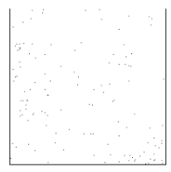
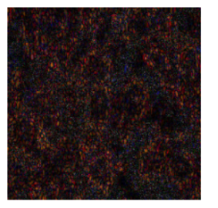
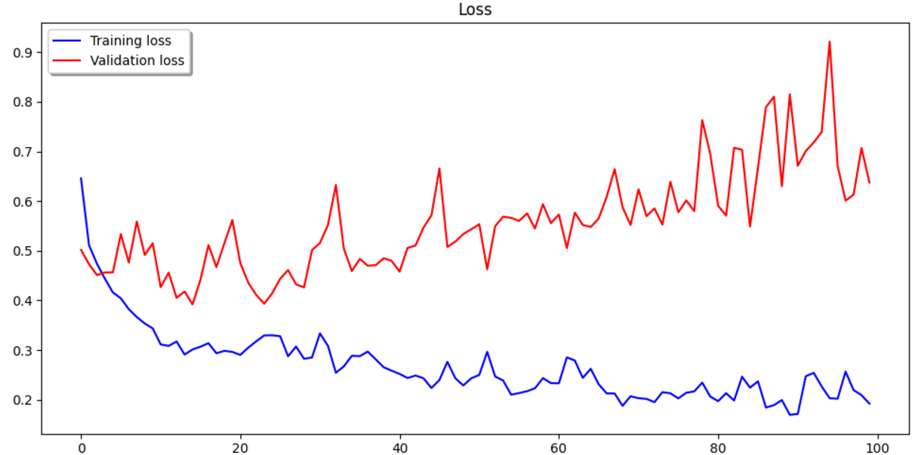
Results
Loss Analysis of Improved Model
(Primitive Image) (Improved Image)
ELA Batch Images
* All images and graphs are sourced from our codebase
Notes:
hamza The Initial ELA Method:
based on edge detection.
grayscale conversion
had limited accuracy due to its focus on intensity variations.
The Revised Method:
incorporating JPEG compression analysis.
RGB processing.
resulted in significant accuracy improvements.
identifying compression artifacts and color discrepancies.
Using dynamic brightness scaling.

Slide 9
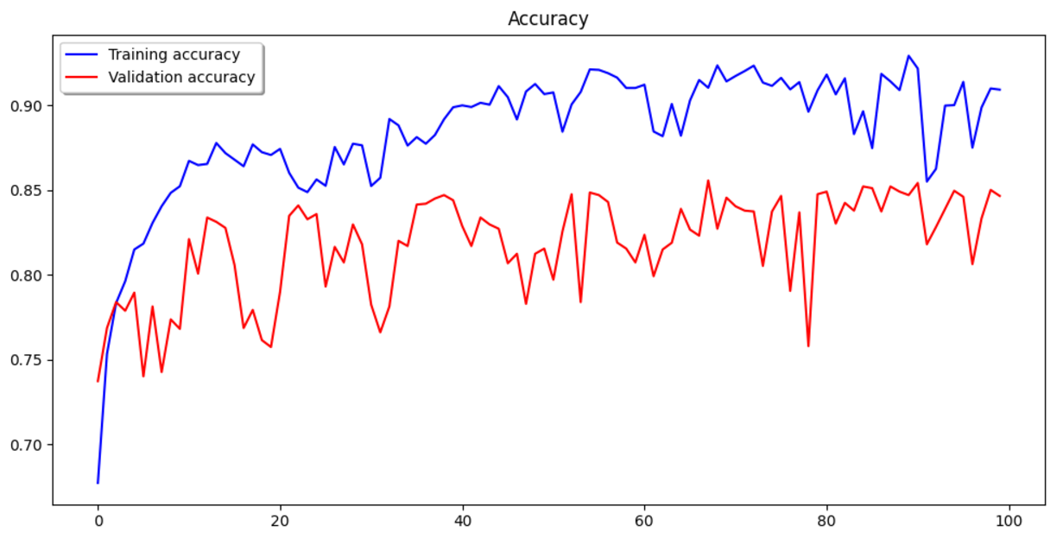
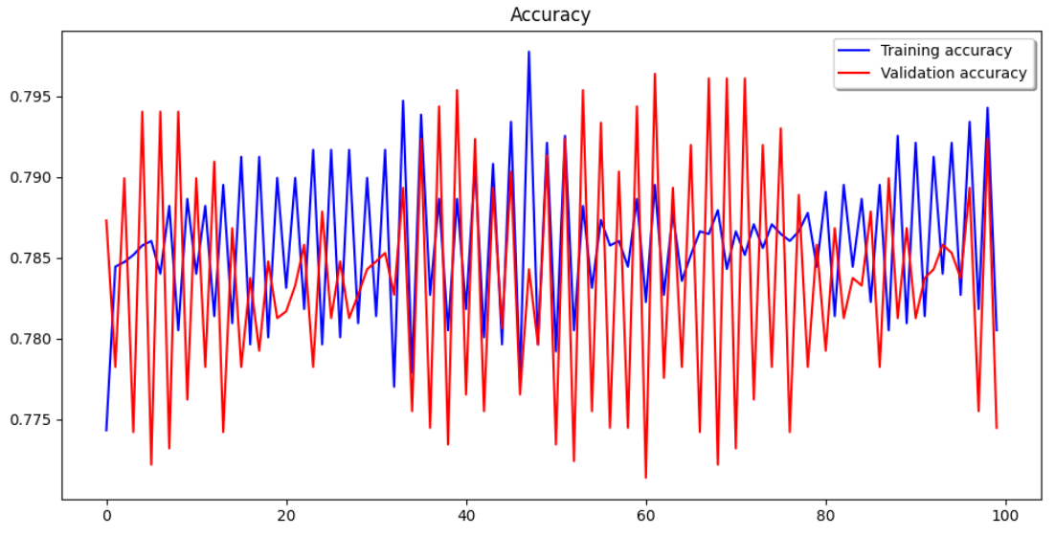
Analysis
Approach (VGG16) | Initial Model | Improved Model
Accuracy | 80.7% | 92.3%
AUC | 85% | 97%
* All images and graphs are sourced from our codebase
Notes:
trushit

Slide 10
Conclusion

Slide 11
Conclusion
Layer Architecture:
The Initial Model:
2 Dense layers: A 256-neuron layer and a final output layer.
1 Dropout layer.
The Revised Model:
3 Dense layers: Two layers with 4096 neurons each and a final output layer.
2 Dropout layers.
Model Complexity:
The Initial Model:
Total params: 21 Millions (80.63 MB)
Trainable params: 6 Millions (24.50 MB)
The Revised Model:
Total params: 134 Millions (512.18 MB)
Trainable params: 119 Millions (456.05 MB)
Notes:
Trushit

Slide 12
Next Step
Aim to keep Improving the Model Performance.
Bring F1 Score to Optimum Range.
Host the Trained Model.
Create a Backend Application.
Design a User Friendly Interface that allows users to:
To Upload Images they might think are suspicious
Give a prediction on the probability of it being tampered
Notes:
Trushit

Slide 13
Q&A

Slide 14
THANK YOU

