Slide 1

Data Speaks: Exploring Developer Tech Stack
Trushit Rana
September 09/2025

Slide 2



OUTLINE
Executive Summary
Introduction
Methodology
Results
Visualization – Charts
Dashboard
Discussion
Findings & Implications
Conclusion
Appendix

Slide 3

EXECUTIVE SUMMARY
Staying Competitive in IT Industry
Study Overview
Utilizes data analytics and spotlights present and projected trends in coding languages, databases, and tech areas
Analyzes the demographic characteristics of technology professionals
Data Sources
Stack Overflow survey, IBM website
Data Analysis Process
Collection -> Cleaning -> Exploratory analysis -> Visualization through dashboards
Key Findings
Top programming languages in demand:
JavaScript, HTML/CSS, SQL, Typescript, Bash/Shell/PowerShell, Python
Top database skills in demand:
My SQL, Microsoft SQL Server, PostgreSQL, SQLite, MongoDB

Slide 4

INTRODUCTION
This presentation analyzes current and future skill demands in programming languages, databases, platforms, and web frameworks using data analytics.
Key questions explored:
Which programming languages are most in demand?
What are the top database skills sought?
Which IDEs and web frameworks are most popular?
Audience: IT professionals, HR managers, and tech sector stakeholders.
Goal: Highlight essential, future-proof IT skills in each domain.
Let’s explore the key findings.

Slide 5

METHODOLOGY
Data Collection 🛠️
Collected survey and web data via web scraping and public APIs using Python’s requests library.
Data Wrangling 🧹
Cleaned and structured the data by removing unnecessary separators and handling missing values (e.g., deletion or imputation based on defined criteria).
Exploratory Data Analysis (EDA) 📊
Analyzed data distributions, addressed outliers, and identified key correlations between variables.
Data Visualization 📈
Employed various visualization techniques to represent distributions, relationships, compositions, and comparisons within the dataset.
Dashboard Development 📋
Built interactive dashboards to present insights in a clear, accessible, and user-friendly format.

Slide 6
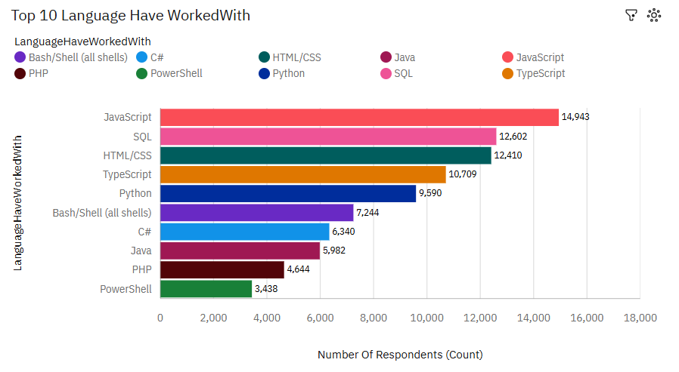
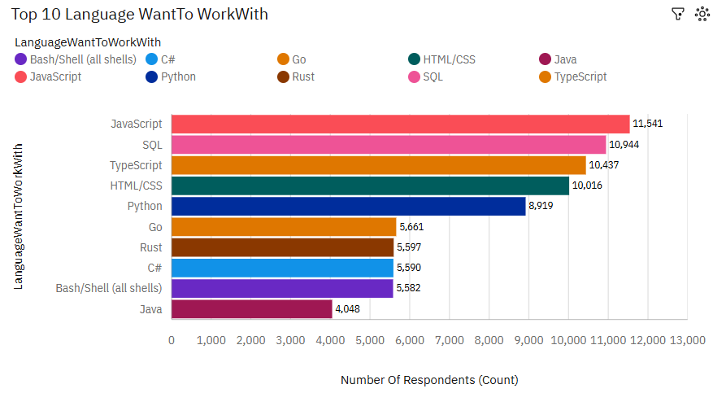
PROGRAMMING LANGUAGE TRENDS
Current Year
Next Year

Slide 7
PROGRAMMING LANGUAGE TRENDS - FINDINGS & IMPLICATIONS
Findings
Current Year - Languages Worked With:
JavaScript, SQL, HTML/CSS, and TypeScript dominate usage.
Python and Bash/Shell remain popular.
Next Year - Languages Wanted to Work With:
JavaScript stays most desired.
TypeScript gains popularity, moving up in interest.
Go and Rust emerge as new languages of interest.
Java sees decreased interest.
Implications
The dominance of JavaScript and HTML/CSS underscores their essential role in modern web development; mastering them is crucial for developers.
The widespread use of SQL highlights the vital importance of data management and querying across various software applications.
The growing popularity of Python reflects its versatility and ease of use, attracting developers from fields like data science and software development.
The rising interest in Go and Rust signals a trend towards modern, performance-oriented programming languages.
A decline in interest for Java may indicate a gradual shift away from some traditional enterprise languages.
Developers, recruiters, and educators should align skills development and hiring strategies with these evolving trends to stay competitive and future-ready.

Slide 8
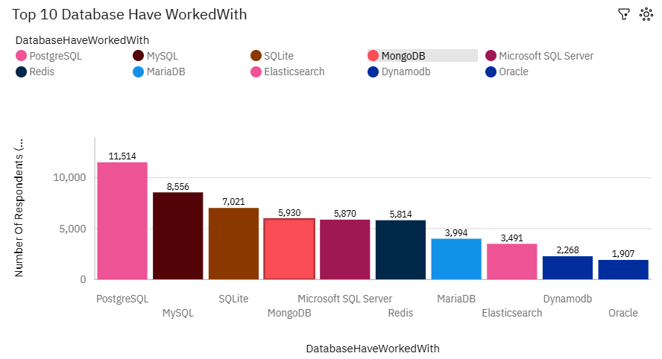
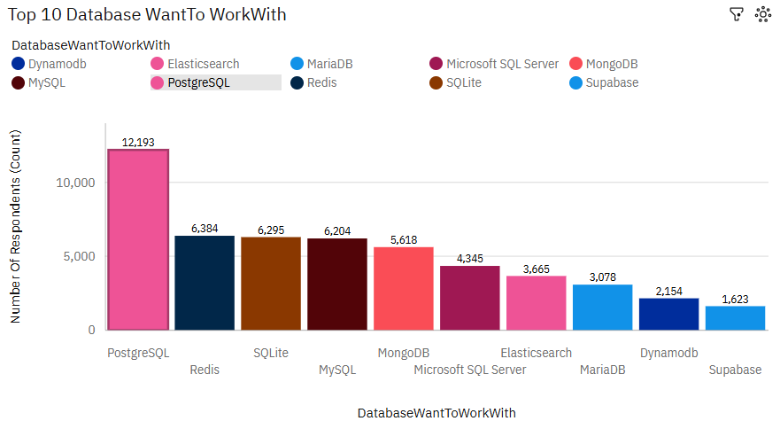
DATABASE TRENDS
Current Year
Next Year

Slide 9
DATABASE TRENDS - FINDINGS & IMPLICATIONS
Findings
Current Year - Database Worked With:
PostgreSQL is the most used database, followed by MySQL and SQLite.
MongoDB, Microsoft SQL Server, and Redis also have significant usage.
Emerging databases like Elasticsearch, DynamoDB, and Oracle have moderate adoption.
Next Year - Database Wanted to Work With:
PostgreSQL is expected to remain the top choice, with even higher interest.
SQLite and Redis show increased demand compared to current usage.
MongoDB, MySQL, and Microsoft SQL Server continue to be popular choices.
Cloud-native and NoSQL databases like DynamoDB maintain steady demand.
Implications
The strong preference for PostgreSQL indicates a trend towards robust, open-source relational databases favored for their versatility and advanced features.
Continued demand for SQLite and MySQL suggests their importance for lightweight and web-based applications.
The growing interest in MongoDB and Redis reflects a shift towards NoSQL and in-memory databases that support scalability and performance.
Adoption of Elasticsearch and DynamoDB highlights the importance of specialized databases in modern applications, including search and cloud-native environments.
Database professionals and organizations should consider diversifying skills to include both traditional SQL and emerging NoSQL technologies to stay competitive.
Businesses planning infrastructure upgrades should evaluate hybrid approaches to leverage the strengths of both relational and NoSQL databases.

Slide 10

DASHBOARD
You can find the dashboard link below:
https://github.com/trushitr/CapstoneProject/blob/main/DashBoard/IBM_Capstone.pdf

Slide 11
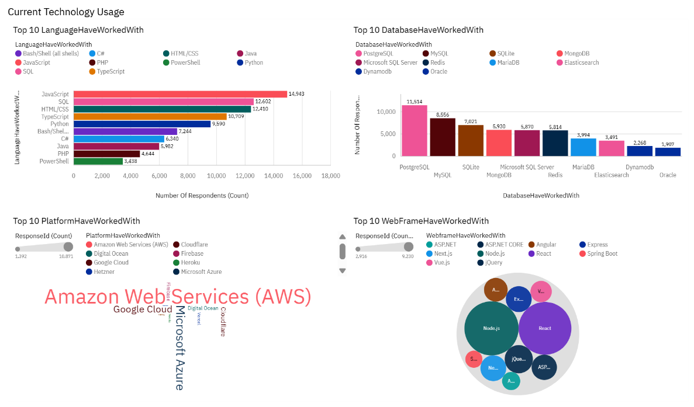
DASHBOARD TAB 1

Slide 12
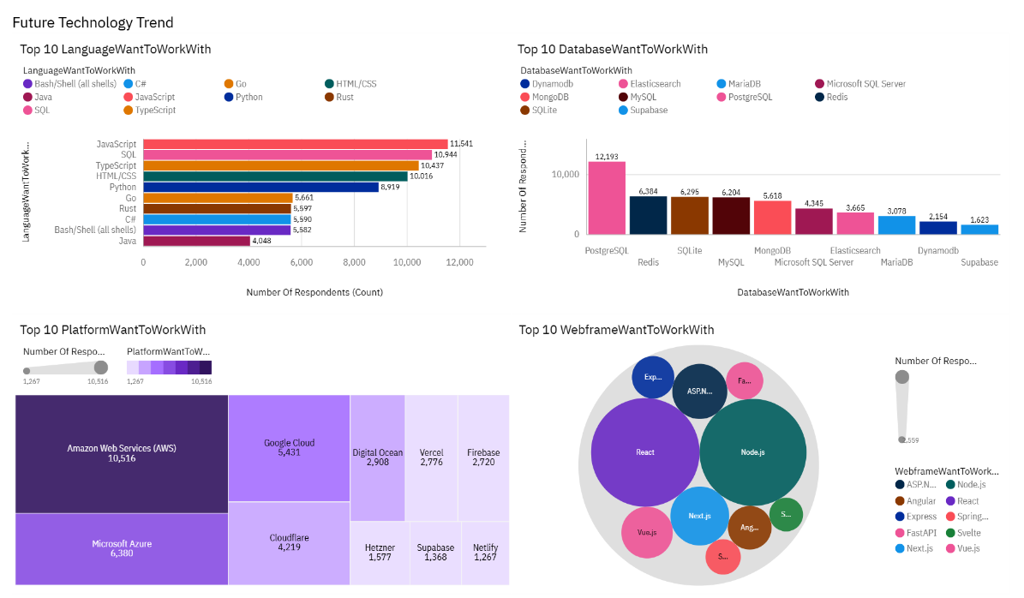
DASHBOARD TAB 2

Slide 13
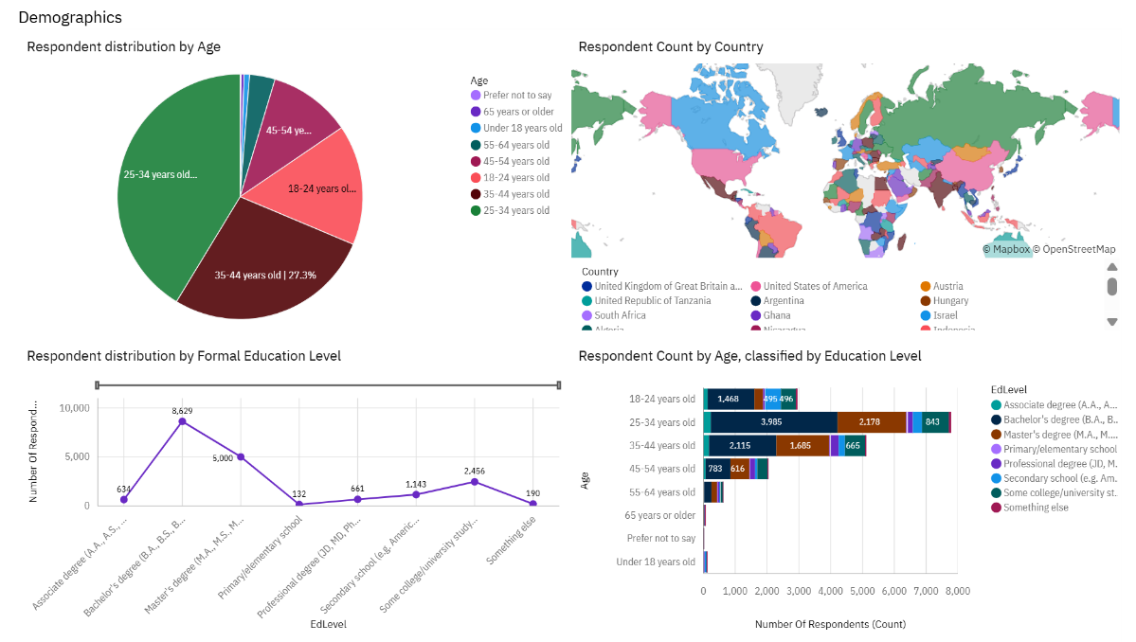
DASHBOARD TAB 3

Slide 14
DISCUSSION
The continued dominance of JavaScript and HTML/CSS, along with MySQL as a top database choice, underscores the pivotal role of web development in today’s tech ecosystem.
This highlights the importance of mastering client-side scripting and styling for building dynamic, responsive web applications.
These trends invite deeper exploration into evolving web development frameworks and the ongoing transformation of web technologies.

Slide 15
OVERALL FINDINGS & IMPLICATIONS
Findings
Dominance of Web Technologies: JavaScript and HTML/CSS continue to lead as the most used programming languages, emphasizing their critical role in modern web development.
Strong Data Management Focus: MySQL, PostgreSQL, and Microsoft SQL Server remain the top databases, reflecting the ongoing importance of robust data handling in applications.
Platform Preference: Amazon Web Services (AWS) is the most popular cloud platform, highlighting the industry's shift towards cloud-based solutions.
Web Framework Popularity: Node.js and React dominate as the primary web frameworks, showing the preference for JavaScript-based full-stack development.
Future Demand Growth: Emerging interest in languages like Go and Rust, and increasing demand for newer platforms and frameworks suggest evolving technology stacks and developer preferences.
Developer Demographics: Majority of respondents are aged 25-34, mostly holding bachelor’s degrees, indicating the profile of active technology professionals.
Implications
Focus on Web Skills: Mastery of JavaScript, HTML/CSS, and associated frameworks like React and Node.js is essential for developers aiming to stay relevant.
Database Flexibility: Organizations should be adaptable with database technologies, choosing solutions based on scalability, performance, and specific use cases.
Cloud Adoption: Proficiency in AWS and other cloud platforms is becoming a standard expectation, driving demand for cloud computing expertise.
Evolving Skillsets: Developers and organizations should anticipate shifts toward newer languages and frameworks, investing in continuous learning and technology evaluation.
Workforce Planning: Understanding the age and education demographics helps in tailoring recruitment, training, and retention strategies to the current tech workforce profile.

Slide 16

CONCLUSION
Web technologies like JavaScript and HTML/CSS lead current and future trends.
Databases such as MySQL and PostgreSQL remain essential for data management.
Cloud platforms, especially AWS, dominate infrastructure choices.
Emerging languages and frameworks highlight the need for continuous learning.
Adapting to evolving tech is key to staying relevant in the industry.

Slide 17

APPENDIX

Slide 18
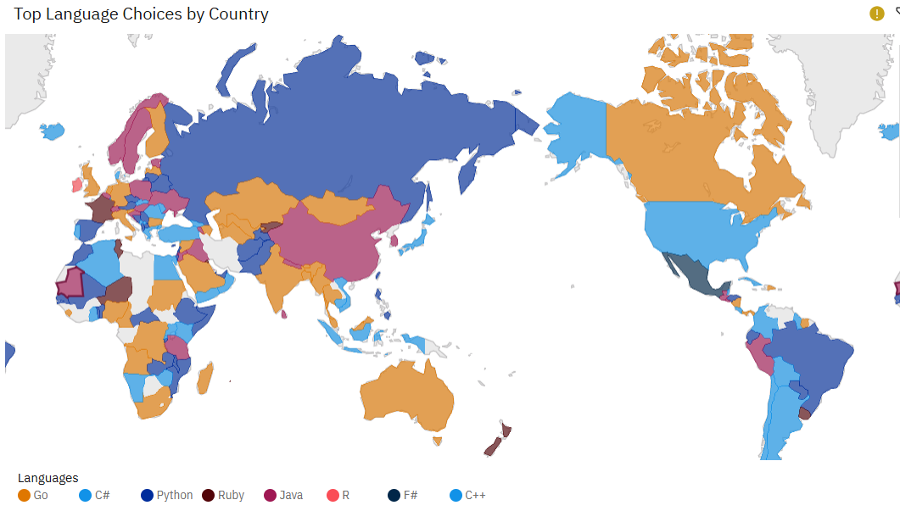
Top Language Choices by Country

Slide 19
JOB POSTINGS

