Slide 1

Behavioural Similarities Analysis and Detection of Bot Accounts in Twitter
IT752 WSC - Mini-project End Sem Evaluation
[Feb-May 2021]
Submitted by:
Divyanshi Bhojak(202IT007)
Tarushi Jat(202IT029)
Under the Supervision of:
Dr. Sowmya Kamath S

Slide 2
Agenda
Problem Statement & Objectives
Methodology
Dataset Details & System Setup
Extracting the Digital DNA
Analyzing Behaviour of Twitter Bot Detection
Twitter Bot Detection using Machine Learning
Conclusion & Future work
IT752 WSC - Mini-project Endsem Evaluation [Feb-May 2021]
03-June-21

Slide 3
Introduction
Social media channels like Twitter and Facebook keeps the power to change or manipulate anything that is going on in the world.
And these channels are regularly target by automated bots and it was estimated in the research by Carnegie Mellon University that bots are involved in upto 20% of the conversations on social media, especially pertaining to elections and other political issues.
In 2016, 20,258 Russian linked automated account tweeted “election-related content”.
Modeling and analyzing online user behaviors deserves attention for a variety of reasons.
Therefore, in this project we will be exploiting digital DNA for the analysis of behavioral similarities in Twitter users.
IT752 WSC - Mini-project Endsem Evaluation [Feb-May 2021]
03-June-21

Slide 4
Research Objectives
Investigating the occurrence of behavioral similarities among Twitter users and classifying whether it is from a spambot and legitimate accounts.
Characterizing the behavior of bot accounts and genuine accounts based on different activities like number of tweets, tweeting behavior, tweet content, number of followers and users following account etc.
Classify the likelihood of being bot or human by using the combination of features extracted from user’s accounts.
IT752 WSC - Mini-project Endsem Evaluation [Feb-May 2021]
03-June-21

Slide 5
Problem Statement
DNA-inspired online behavioral modeling and analysis techniques have been proposed and successfully applied to a broad range of tasks. In this project, we employ a DNA-inspired technique to investigate the fundamental laws that drive the occurrence of similarities among Twitter users. First, we will demonstrate that, despite apparently showing little to no similarities, the online behaviors of Twitter users are far from being uniformly random. Then, we demonstrate that the extent of behavioral similarities within a group of Twitter users. Finally, discriminate between genuine and spambot accounts on Twitter by applying various classification models.
IT752 WSC - Mini-project Endsem Evaluation [Feb-May 2021]
03-June-21

Slide 6
Methodology
The proposed methodology of our project is to extract and analyze digital DNA sequences from user online actions and used Twitter as a benchmark to test the proposal.
Extracting behavioral similarities among group of users modeling the randomness of human online behaviors by Digital DNA sequence & LCS generation then leverage results to derive a fundamental law for the emergence of similarities in human online behaviors.
Lastly, discriminating accounts into legitimate and automated using machine learning models.

Slide 7
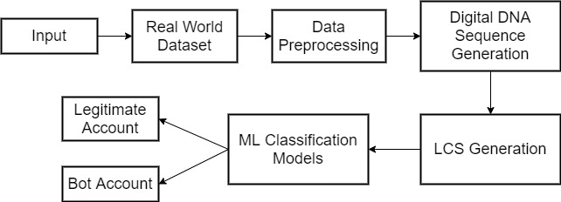
Workflow Architecture
03-June-21

Slide 8
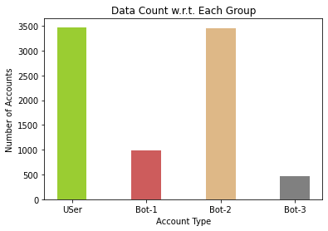
Dataset Details & System Setup
Dataset Details:
Types of accounts:
i) Legitimate user
ii) Bot user 1 (political)
iii) Bot User 2 (product promotion)
iv) Bot User 3 (ecommerce ads)
System Setup:
Collected from : fakeproject@iit.cnr.it
Google colab environment
Language : Python
IT752 WSC - Mini-project Endsem Evaluation [Feb-May 2021]
03-June-21

Slide 9
Analyzing Behaviour of Twitter Bot Accounts

Slide 10
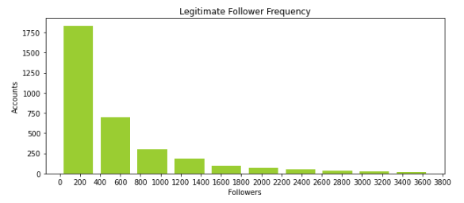
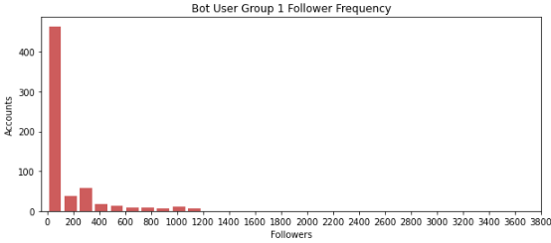
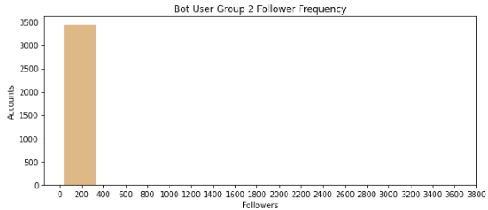
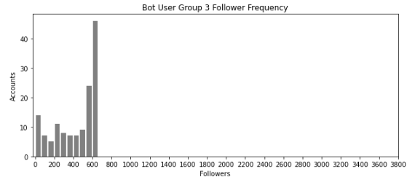
Follower Frequency
IT752 WSC - Mini-project Endsem Evaluation [Feb-May 2021]
03-June-21

Slide 11
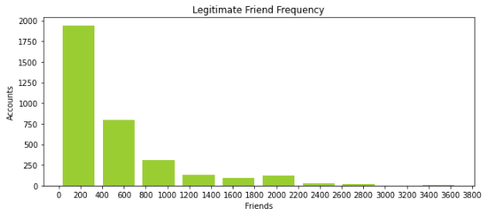

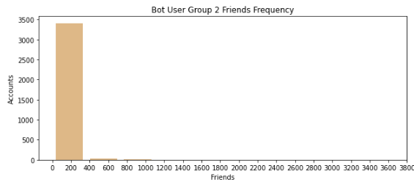
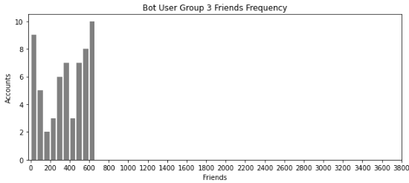
Friend Frequency
IT752 WSC - Mini-project Endsem Evaluation [Feb-May 2021]
03-June-21

Slide 12
Analysis of Follower vs. Friend Ratio
Follower vs Friend Ratio is defined as the number of people you are following & the number of people following you. Also called as “Follower ratio”.
If the number of follower is relatively small compared to the amount of people you are following, the follower ratio is relatively small & account being spam is high.
Account Type | Follower Ratio
Legitimate Account | 0.5027722347999382
Bot Account Group - 1 | 0.5237114689719357
Bot Account Group - 2 | 0.11543068901989084
Bot Account Group - 3 | 0.3778966696976445
IT752 WSC - Mini-project Endsem Evaluation [Feb-May 2021]
03-June-21

Slide 13
Extracting the Digital DNA Sequence
Label | Information | Number [Base] | Description
B³_{𝑡𝑦𝑝𝑒} | Type | 3 | encodes user behaviors according to the type of tweets produced, either tweets, retweets, or replies.
B³_{content} | Content | 3 | provide a way to model Twitter actions, with different granularities, by looking at the content of tweets rather than the type.
B⁶_{content} | Content | 6
B³_{interaction} | Interaction | 3 | Using bases with respect to the popularity level of the peers with whom a given user interacts and used to capture the interaction patterns of Twitter users.
B⁶_{interaction} | Interaction | 6
B³_{account-type} | Account-age | 3 | represents the age of the accounts (i.e., time since the account’s creation)

Slide 14
Preprocessing Tweets
To extract information from different type of tweets, three techniques are utilized.
B³_{type} : Tweets are processed based on the type of tweet. 3 alphabets are utilized :
A : Tweet
C : Reply
T : Retweet
B³_{content} : Tweets are processed based on the content of tweet. Three alphabets are b
utilized :
N : tweets contains no entities (plain text)
E : tweets contain one or more entities of one type.
X : tweets contains entities of mixed type.
IT752 WSC - Mini-project Endsem Evaluation [Feb-May 2021]
03-June-21

Slide 15
Preprocessing Tweets
B⁶_{content} : Tweets are processed based on the content of tweet. Six alphabets are sfggfgdfbutilized :
N : tweets contains no entities (plain text)
U : tweets contain one or more URLs
H : tweets contain one or more hashtags
M : tweets contain one or more mentions
D : tweets contain one or more medias
X : tweets contain entities of mixed type.
IT752 WSC - Mini-project Endsem Evaluation [Feb-May 2021]
03-June-21

Slide 16
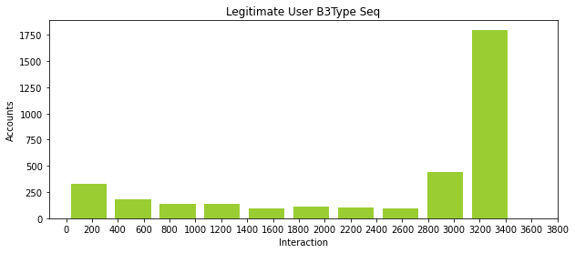
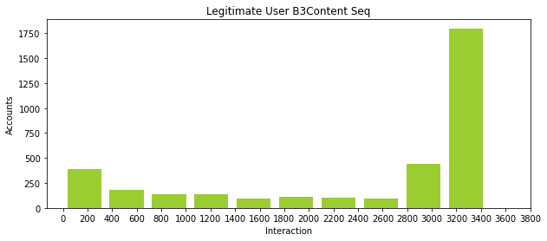

Interaction Level - Legitimate User
IT752 WSC - Mini-project Endsem Evaluation [Feb-May 2021]
03-June-21

Slide 17
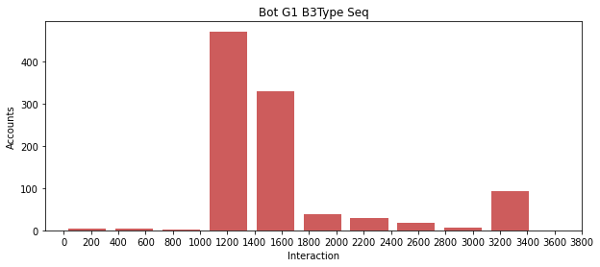


Interaction Level - Bot User Group 1
IT752 WSC - Mini-project Endsem Evaluation [Feb-May 2021]
03-June-21

Slide 18
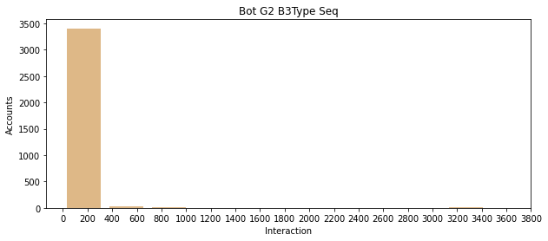


Interaction Level - Bot User Group 2
IT752 WSC - Mini-project Endsem Evaluation [Feb-May 2021]
03-June-21

Slide 19
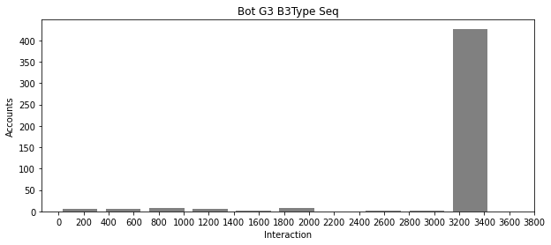


Interaction Level - Bot User Group 3
IT752 WSC - Mini-project Endsem Evaluation [Feb-May 2021]
03-June-21

Slide 20
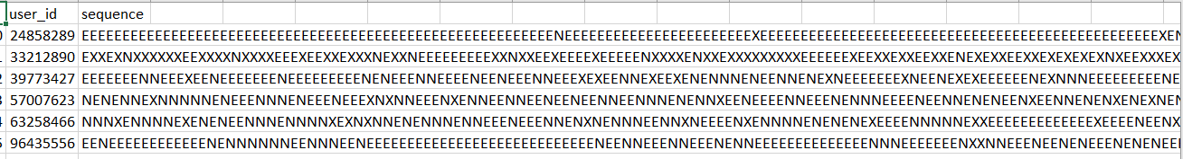
Generating Longest Common Subsequence (LCS)
To evaluate the extent of content similarity in the four groups, LCS of Digital DNA sequence is being calculated.
We have calculated LCS starting from the two sequences to the number of sequences exist in the group.
Observation: Length of matching substring decreases as the number of strings increases.
IT752 WSC - Mini-project Endsem Evaluation [Feb-May 2021]
03-June-21

Slide 21
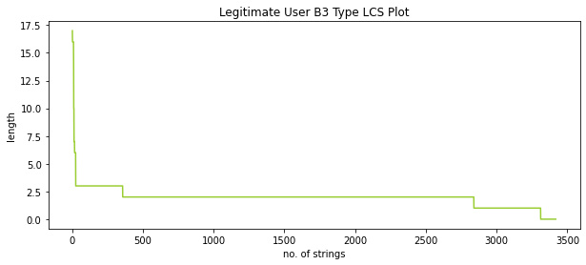
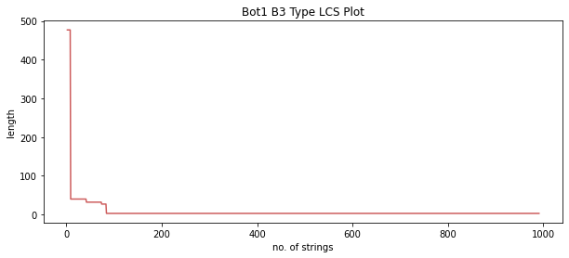
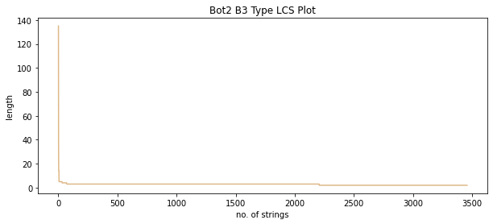
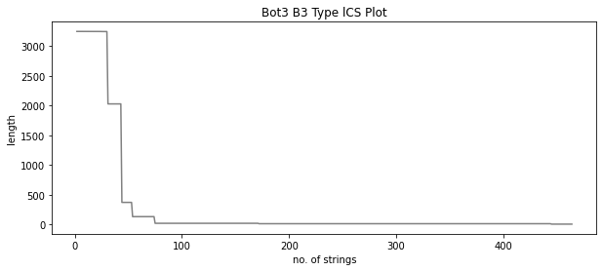
LCS Curve (B3 Type)
Legitimate User
Bot User Group 1
Bot User Group 2
Bot User Group 3
IT752 WSC - Mini-project Endsem Evaluation [Feb-May 2021]
03-June-21

Slide 22
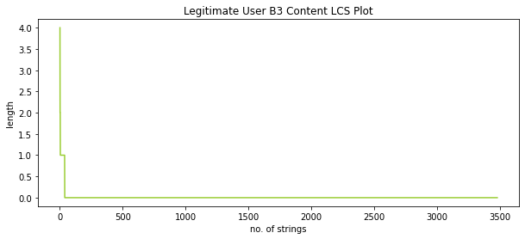
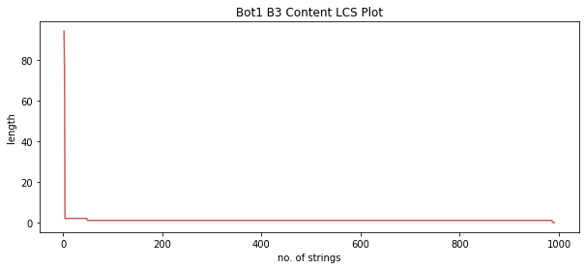
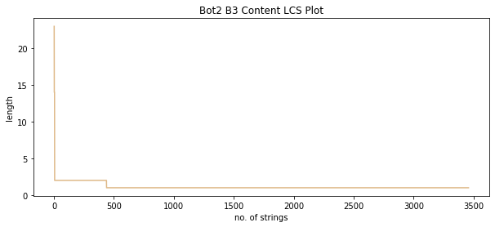

LCS Curve (B3 Content)
Legitimate User
Bot User Group 1
Bot User Group 2
Bot User Group 3
IT752 WSC - Mini-project Endsem Evaluation [Feb-May 2021]
03-June-21

Slide 23

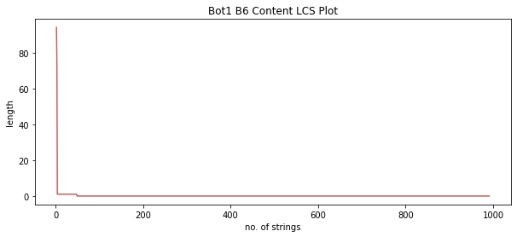


LCS Curve (B6 Content)
Legitimate User
Bot User Group 1
Bot User Group 2
Bot User Group 3
IT752 WSC - Mini-project Endsem Evaluation [Feb-May 2021]
03-June-21

Slide 24
Area under the LCS Curves
To find the single measure for similarity analysis between groups and to interpret LCS, Area Under Curve is being calculated.
A bigger value of AUC describes that there exists high similarity between the group of users.
A smaller value of AUC describes that there is low similarity between the group of users.
Account Type | Average AUC
Legitimate Account | 2252.29
Bot User Group 1 | 4453.76
Bot user Group 2 | 43739.99
Bot user Group 3 | 3222.18
IT752 WSC - Mini-project Endsem Evaluation [Feb-May 2021]
03-June-21

Slide 25
Twitter Bots Detection using Machine Learning

Slide 26
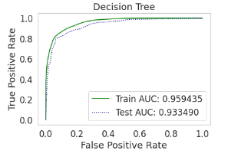
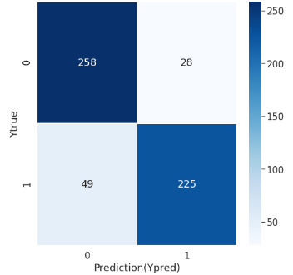
Decision Tree Model
Accuracy : 86.25%
IT752 WSC - Mini-project Endsem Evaluation [Feb-May 2021]
03-June-21

Slide 27
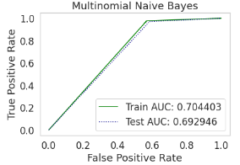
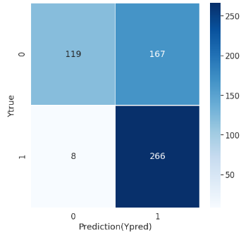
Multinomial Naive Bayes Model
Accuracy : 68.75%
IT752 WSC - Mini-project Endsem Evaluation [Feb-May 2021]
03-June-21

Slide 28
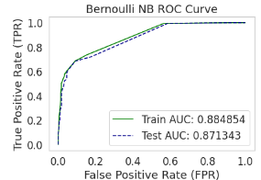
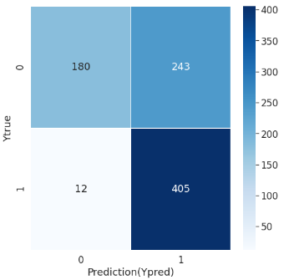
Bernoulli Naive Bayes Model
Accuracy : 69.06%
IT752 WSC - Mini-project Endsem Evaluation [Feb-May 2021]
03-June-21

Slide 29
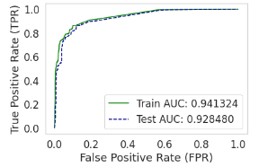
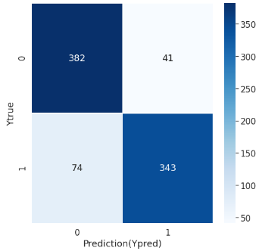
XGBoost Model
Accuracy : 86.30%
IT752 WSC - Mini-project Endsem Evaluation [Feb-May 2021]
03-June-21

Slide 30
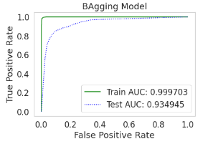
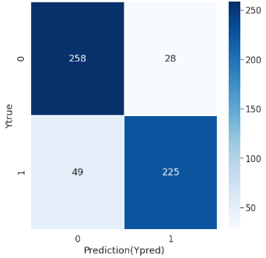
Bagging Model
Accuracy : 86.25%
IT752 WSC - Mini-project Endsem Evaluation [Feb-May 2021]
03-June-21

Slide 31
Result & Analysis
Models | Accuracy | ROC score | Precision | Recall
Decision Tree | 0.8625 | 0.86 | 0.86 | 0.86
Multinomial NB | 0.6875 | 0.6934 | 0.78 | 0.69
Bernoulli NB | 0.6964 | 0.6983 | 0.78 | 0.70
XGBoost | 0.8630 | 0.862 | 0.87 | 0.86
Bagging | 0.8625 | 0.8616 | 0.86 | 0.86
IT752 WSC - Mini-project Endsem Evaluation [Feb-May 2021]
03-June-21

Slide 32
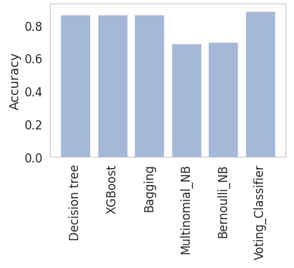
Voting Classifier
Train Accuracy : 93.47%
Test Accuracy : 88.57%
IT752 WSC - Mini-project Endsem Evaluation [Feb-May 2021]
03-June-21

Slide 33
Conclusion & Future Work
One of the foremost problems in social media platforms like Twitter is the large number of automated generally used for malicious activities, political benefits, and commercial advertisements.
In this project, we seek deep insights in the behavioral properties and similarities on the real world Twitter dataset we used for the experiments generated a digital DNA sequence and then computed the similarities using the LCS.
Consequently, addressed the problem by classifying this using various machine learning algorithms and lastly applied ensemble techniques where majority voting classifier gave the highest accuracy of 88.57%.
IT752 WSC - Mini-project Endsem Evaluation [Feb-May 2021]
03-June-21

Slide 34
Individual Contribution
Literature Survey, Data Collection - [Deepu]
Behavioural Similarities Analysis among Bot Accounts and Legit Accounts in Twitter - [Divyanshi, Tarushi]
Detection of Bot Accounts in Twitter - [Divyanshi, Tarushi]
IT752 WSC - Mini-project Endsem Evaluation [Feb-May 2021]
03-June-21

Slide 35
References
Emergent properties, models, and laws of behavioral similarities within groups of twitter users
https://www.sciencedirect.com/science/article/abs/pii/S014036641930283X
2. Exploiting Digital DNA for the Analysis of Similarities in Twitter Behaviours
https://ieeexplore.ieee.org/document/8259831/
IT752 WSC - Mini-project Endsem Evaluation [Feb-May 2021]
03-June-21

Slide 36
Thank you!
IT752 WSC - Mini-project Endsem Evaluation [Feb-May 2021]
03-June-21

