Slide 1

Recent Improvements in Training Neural
Network Models
IT-834 PECSS Project Final Evaluation
[Feb-May 2021]
Submitted by:
Divyanshi Bhojak(202IT007) Tarushi Jat(202IT029)
Under the Supervision of:
Dr. Biju R Mohan
Mentor:
Mr. Pragnesh Thaker

Slide 2

Introduction
Neural Networks are no longer rare phrases in the Computer Science community.
Neural networks are machine learning algorithms that provide state of the accuracy on many use cases.
The learning rates and the optimizers are two important concepts in training neural networks.
Aiming at this, we have worked on techniques to enhance the performance of training neural networks.
In this project, we have implemented Cyclical Learning Rate (CLR) that will remove the efforts of tuning learning rate, followed by optimization algorithms which plays important role in training neural network.
IT834 PECSS Project Evaluation [Feb-May 2021]
MAY-2021

Slide 3
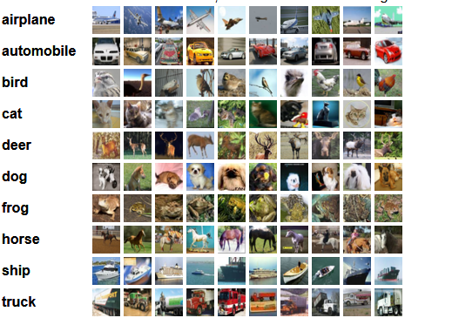
Dataset (CIFAR-10)
No. of images = 60,000
Image size = 32 x 32
Total Size = 163MB
No. of classes = 10
Image per class = 6,000
IT834 PECSS Project Evaluation [Feb-May 2021]
MAY-2021

Slide 4
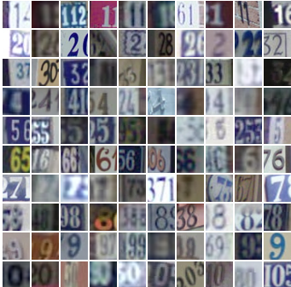
Dataset (SVHN)
The Street View House Numbers dataset.
No. of classes = 10
Image size = 32 x 32
Digits for training: 73257
Digits for testing: 26032
IT834 PECSS Project Evaluation [Feb-May 2021]
MAY-2021

Slide 5
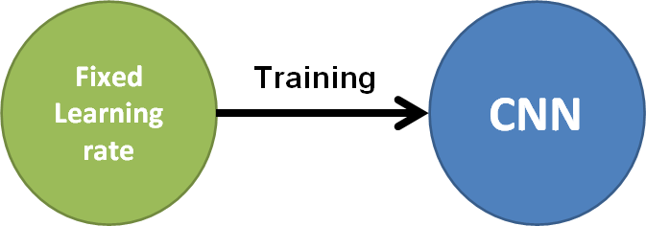
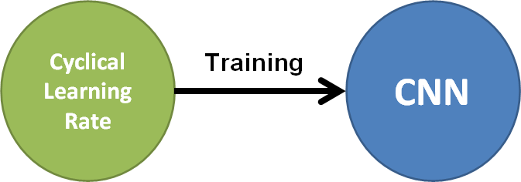
Objective
Cyclical learning rate to train CNN with three variants of optimizers using CIFAR-10 & SVHN datasets.
Fixed learning rate to train CNN with three variants of optimizers using CIFAR-10 & SVHN datasets.
Performance comparison with the help of different performance metrics.
IT834 PECSS Project Evaluation [Feb-May 2021]
MAY-2021

Slide 6
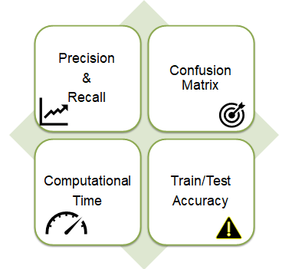
Performance Metrics

Slide 7
Methodology - Overview
The main focus of our project is to improve the training of neural network using recent performance evaluation techniques.
Instead of monotonically decreasing the learning rate, this project lets the learning rate cyclically vary between reasonable boundary values.
In CLR, instead of monotonically decreasing the learning rate, it allows the learning rate to vary cyclically between reasonable boundary values.
After implementation of CLR with three optimizers, its performance is compared with fixed learning rate implemented with three different optimization algorithms.
IT834 PECSS Project Evaluation [Feb-May 2021]
MAY-2021

Slide 8
Optimization Algorithms
Adam optimizer in recent studies shown that fails to give a generalized neural network model as opposed to SGD.
Stochastic Gradient Descent with momentum is method which helps to accelerate gradients vectors in the right directions.
In deep neural networks, the most practical optimization methods are based on stochastic gradient descent (SGD) algorithms, but its convergence time is larger than other optimization algorithms like Adam.
Adam with weight decay keeps the weights of the network small prevent overfitting and avoid exploding gradient.
AdamW aims to fill in the differences of Adam and SGD with momentum in terms of performance generalization.

Slide 9
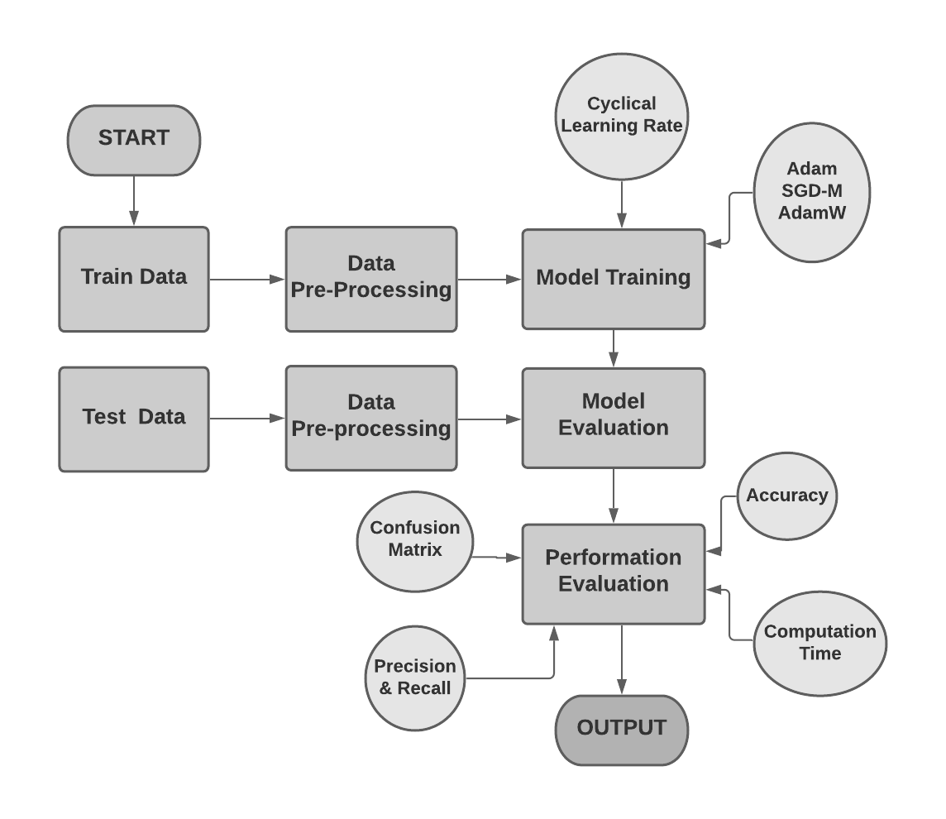
Workflow Architecture

Slide 10
Cyclical Learning Rates (CLRs)
The values of learning rate keep on updating rather than adopting a fixed value, during the entire process of training.
The boundaries between which leaning rate keeps oscillating is given explicitly as lower bound (minimum boundary value) & upper bound (maximum boundary value).
Cyclical learning rate can be implemented with Triangular Cyclical Learning Rate policy.
These policy helps in implementing CLR within fixed boundary values.
Lower bound represented by “base_lr” Upper bound represented by “max_lr”
IT834 PECSS Project Evaluation [Feb-May 2021]
MAY-2021

Slide 11
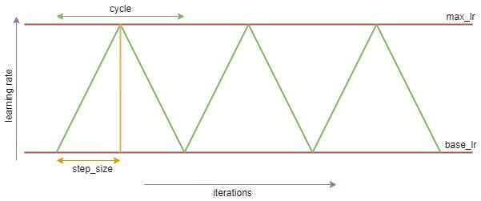
Cyclical Learning Rates - Triangular Policy
For our project, we have implemented triangular policy for CLR, because it has proved to be most effective.
Initially, the learning rate is very small value,
represented by base_lr.
During training, the learning rate continues
to increase till step_size.
After reaching max_lr, the learning rate will
start decreasing till it reaches to the base_lr
back.
step_size = ½ * cycle_length
IT834 PECSS Project Evaluation [Feb-May 2021]
MAY-2021

Slide 12
Cyclical Learning Rates - Triangular Policy (Pseudocode)
Where,
lr = learning rate
base_lr = lower bound of learning rate
max_lr = upper bound of learning rate
iterations = the number of completed mini batches
step_size = one half of cycle length
1 - x = always a positive value.
lr = base_lr+(max_lr-base_lr)× max(0, 1-x) x = abs(iterations/(2×step_size)) cycle=floor(1+iterations/(2×step_size))

Slide 13
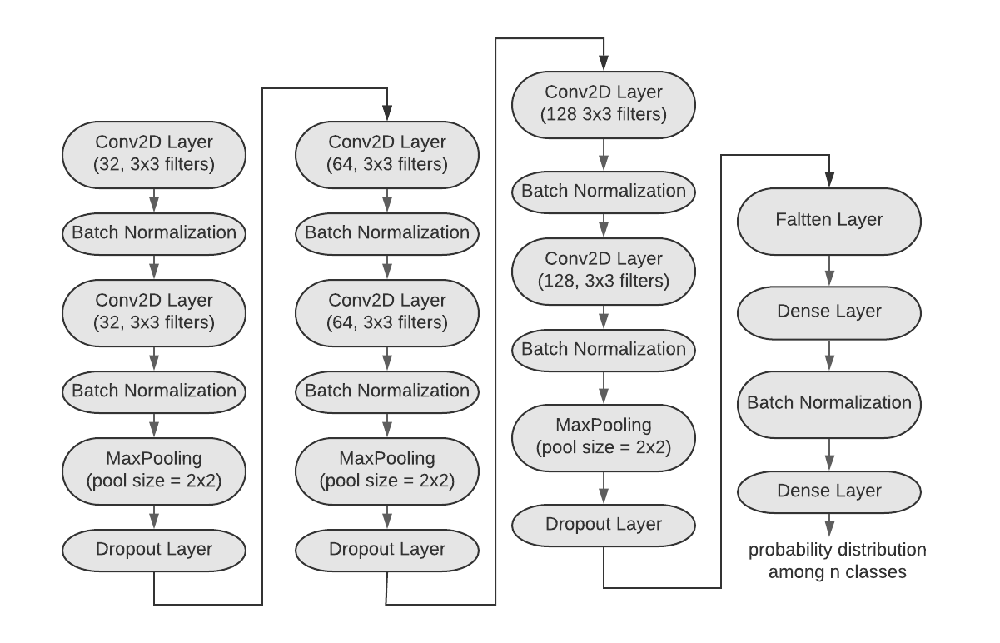
CNN Architecture for CLR
IT834 PECSS Project Evaluation [Feb-May 2021]
MAY-2021

Slide 14
Hyperparameter Details - CIFAR-10
Hyperparameters | Value
base_lr | 0.001
max_lr | 0.005
batch size | 128
epochs - Adam | 50
epochs - SGDM | 100
epochs - AdamW | 50
IT834 PECSS Project Evaluation [Feb-May 2021]
MAY-2021

Slide 15
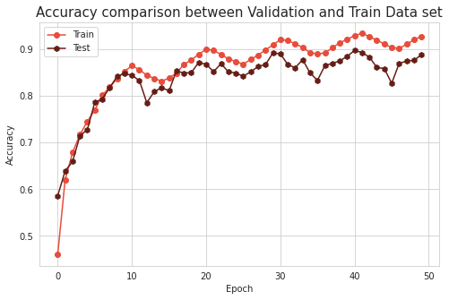
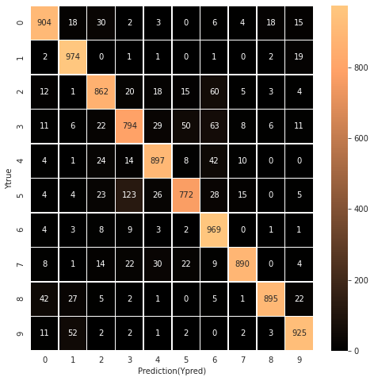
Analysis & Results with Adam Optimization Algorithm
CIFAR-10 Dataset
cyclical learning rate
Training Accuracy = 92.72%
Test Accuracy = 88.82%
Training Time = 57 minutes 45 seconds
Epochs = 50

Slide 16
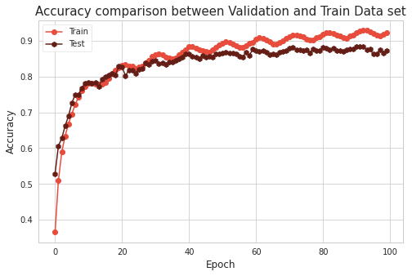
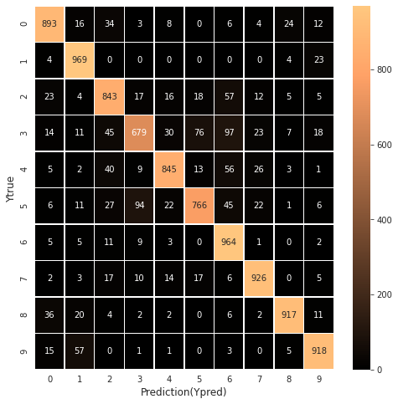
Analysis & Results with SGDM Optimization Algorithm
CIFAR-10 Dataset
cyclical learning rate
Training Accuracy = 92.34%
Test Accuracy = 87.20%
Training Time = 1 hour 14 minutes
Epochs = 100

Slide 17
Analysis & Results with AdamW Optimization Algorithm
CIFAR-10 Dataset
cyclical learning rate
Training Accuracy = 92.15%
Test Accuracy = 88.95%
Training Time = 49 minutes
Epochs = 50
Converges faster than the other two.

Slide 18
Hyperparameter Details - SVHN
Hyperparameters | Value
base_lr | 0.001
max_lr | 0.005
batch size | 128
epochs - Adam | 50
epochs - SGDM | 100
epochs - AdamW | 50
IT834 PECSS Project Evaluation [Feb-May 2021]
MAY-2021

Slide 19
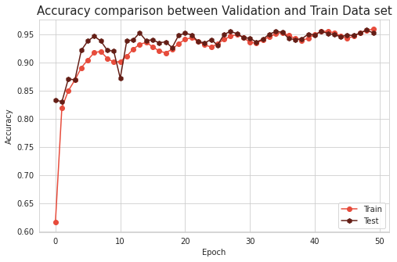
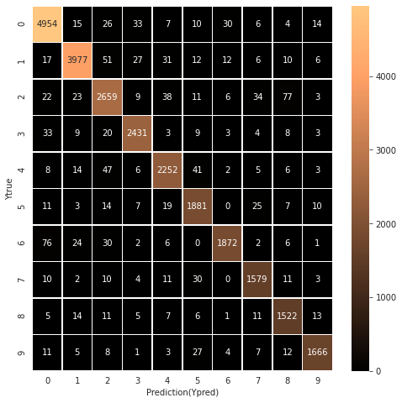
Analysis & Results with Adam Optimization Algorithm
SVHN Dataset
cyclical learning rate
Training Accuracy = 95.97%
Test Accuracy = 95.24%
Training Time = 33 minutes
Epochs = 50

Slide 20
Analysis & Results with SGDM Optimization Algorithm
SVHN Dataset
cyclical learning rate
Training Accuracy = 95.44%
Test Accuracy = 95.41%
Training Time = 1 hour 7 minutes
Epochs = 100

Slide 21
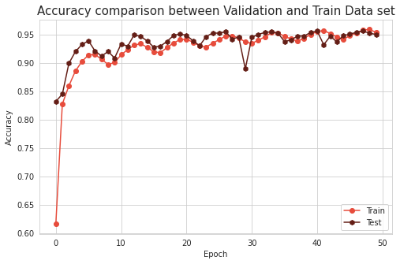

Analysis & Results with AdamW Optimization Algorithm
SVHN Dataset
cyclical learning rate
Training Accuracy = 95.55%
Test Accuracy = 95.01%
Training Time = 32 minutes 15 seconds
Epochs = 50

Slide 22
Comparison of Cyclical & Fixed Learning Rate
Learning Rate | Dataset | Optimizer | Test Accuracy | Precision | Recall
Fixed Learning Rate | CIFAR-10 | Adam | 76.75% | 0.78 | 0.77
 |  | SGD | 71.64% | 0.72 | 0.72
 |  | AdamW | 78.63% | 0.79 | 0.79
 | SVHN | Adam | 92.14% | 0.91 | 0.92
 |  | SGD | 91.28% | 0.91 | 0.90
 |  | AdamW | 92.64% | 0.92 | 0.92
Cyclical Learning Rate | CIFAR-10 | Adam | 89.05% | 0.89 | 0.89
 |  | SGD | 87.50% | 0.88 | 0.88
 |  | AdamW | 89.52% | 0.89 | 0.90
 | SVHN | Adam | 94.75% | 0.95 | 0.95
 |  | SGD | 95.13% | 0.95 | 0.94
 |  | AdamW | 95.37% | 0.95 | 0.95

Slide 23
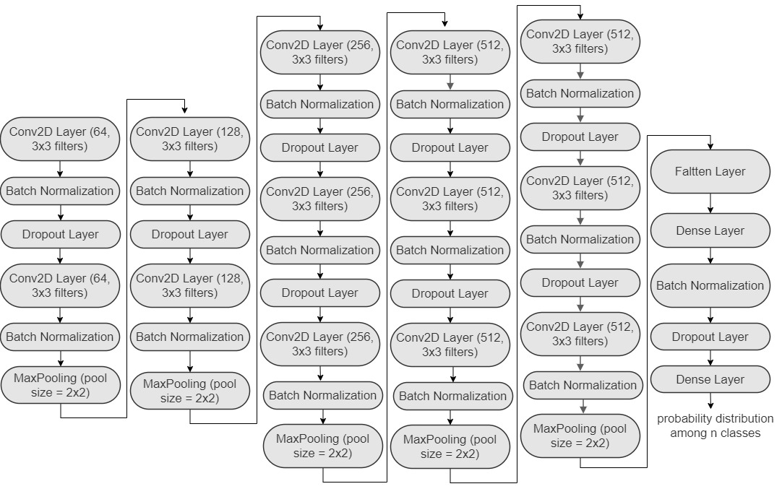
VGG-16 Architecture

Slide 24
Hyperparameters Details - CIFAR-10
Hyperparameters | Value
learning rate | 0.001
batch size | 128
steps per epoch | 100
epochs - Adam | 50
epochs - SGDM | 100
epochs - AdamW | 50
IT834 PECSS Project Evaluation [Feb-May 2021]
MAY-2021

Slide 25
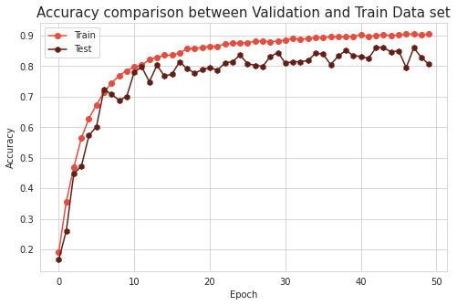
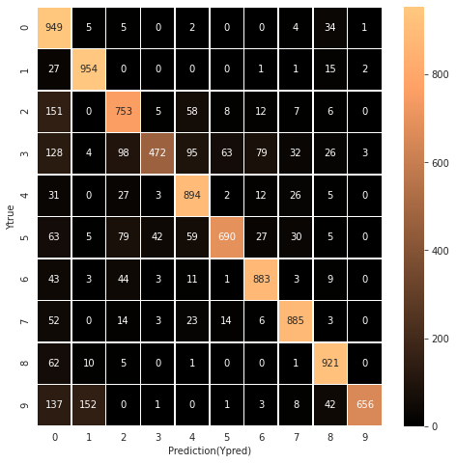
Analysis & Results with Adam Optimization Algorithm
CIFAR-10 Dataset
fixed learning rate
Training Accuracy = 90.93%
Test Accuracy = 80.57%
Training Time = 33 minutes 14 seconds
Epochs = 50

Slide 26
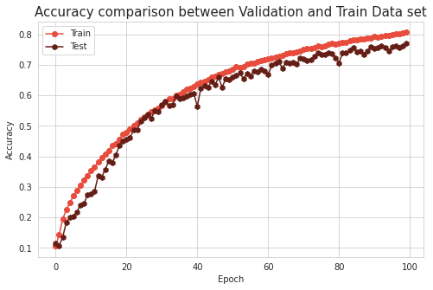
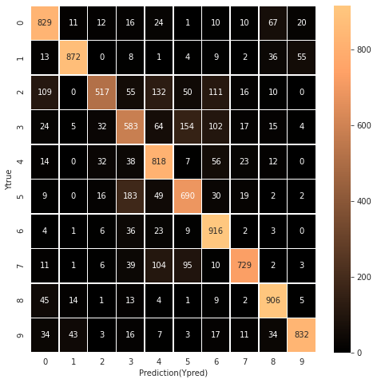
Analysis & Results with SGDM Optimization Algorithm
CIFAR-10 Dataset
Training Accuracy = 80.68%
Test Accuracy = 76.92%
Training Time = 1 hour 14 minutes
Epochs = 100

Slide 27
Analysis & Results with AdamW Optimization Algorithm
CIFAR-10 Dataset
Training Accuracy = 94.05%
Test Accuracy = 85.64%
Training Time = 32 minutes 16 seconds
Epochs = 50
Converges faster than the other two.

Slide 28
Hyperparameters Details - SVHN
Hyperparameters | Value
learning rate | 0.001
batch size | 128
steps per epoch | 147
epochs - Adam | 50
epochs - SGDM | 100
epochs - AdamW | 50
IT834 PECSS Project Evaluation [Feb-May 2021]
MAY-2021

Slide 29
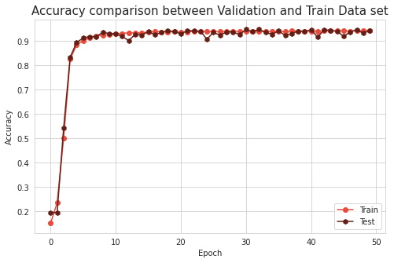

Analysis & Results with Adam Optimization Algorithm
SVHN Dataset
fixed learning rate
Training Accuracy = 94.33%
Test Accuracy = 94.37%
Training Time = 35 minutes 25 seconds
Epochs = 50

Slide 30
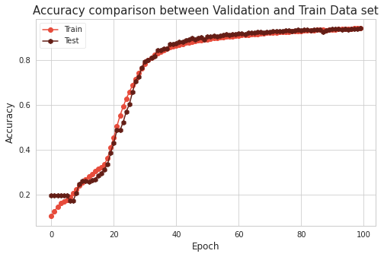

Analysis & Results with SGDM Optimization Algorithm
SVHN Dataset
Training Accuracy = 93.96%
Test Accuracy = 92.98%
Training Time = 1 hour 14 minutes
Epochs = 100

Slide 31
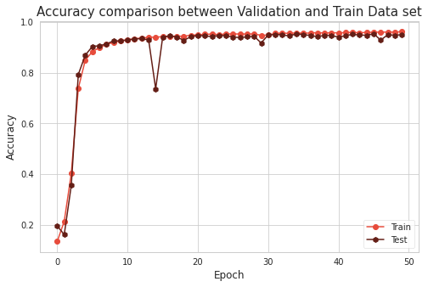

Analysis & Results with AdamW Optimization Algorithm
SVHN Dataset
Training Accuracy = 95.65%
Test Accuracy = 95.03%
Training Time = 34 minutes 9 seconds
Epochs = 50
Converges faster than the other two.

Slide 32
Conclusion
Among the three optimization algorithms, AdamW converged faster than the other two algorithms.
Accuracy achieved by CLR w.r.t. the three optimizer is higher than accuracy achieved by training model with fixed learning rate.
Model took more time to get converged with SGDM optimization algorithm than the other two.
For SVHN dataset:- Highest accuracy of 95.41% with cyclical learning rate algorithm.
For CIFAR-10 dataset:- Highest accuracy of 88.95% with cyclical learning rate and AdamW optimization algorithm.
IT834 PECSS Project Evaluation [Feb-May 2021]
MAY-2021

Slide 33
References
1. Cyclical Learning Rates for Training Neural Networks [IEEE, 2017]
https://arxiv.org/pdf/1506.01186.pdf
2. COMPARISON OF VARIOUS LEARNING RATE SCHEDULING TECHNIQUES ON CONVOLUTIONAL NEURAL NETWORK [IEEE, 2020]
https://sci-hub.mksa.top/10.1109/SCEECS48394.2020.94
3. ADAM: A METHOD FOR STOCHASTIC OPTIMIZATION
https://arxiv.org/pdf/1412.6980.pdf

Slide 34
THANK YOU!

