Slide 1

A Comparison between MPI and OpenMP using 0/1 Knapsack Problem
IT-751 Project Implementation
[Feb-May 2021]
Submitted by:
Divyanshi Bhojak(202IT007) Tarushi Jat(202IT029)
Under the Supervision of:
Prof. Ananthanarayana V.S.
Mentor:
Dr. B. Neelima

Slide 2
Overview
Introduction
OpenMP
MPI
Problem Statement - 0/1 Knapsack Problem
Sequential Algorithm
Technologies Used
Results & Comparison
Conclusion
Execution
References

Slide 3
Introduction
The objective of our project is to familiarize ourselves with OpenMP and MPI and to analyze the consistency of the results .
Our project consists on designing and implementing a parallel algorithm to solve knapsack problem.
To solve the knapsack problem, three programs have been implemented using sequential, MPI and OpenMP.
Finally to test the performance of the programs we have used some set of data to compare the results of the three programs.

Slide 4
OpenMP
Open specifications for Multi Processing via collaborative work between interested parties from the hardware and software industry, government and academia.
OpenMP is an Application Program Interface (API) that may be used to explicitly direct multi-threaded, shared memory parallelism.
OpenMP is a directive-based method to invoke parallel computations on share-memory multiprocessors.
OpenMp uses the Fork-Join model for parallel implementation.

Slide 5
MPI (Message Passing Interface)
De Facto standard framework for distributed computing.
MPI is message passing library specification for parallel computers, clusters and heterogeneous network.
The goal of the Message Passing Interface is to establish a portable, efficient and flexible used standard for writing message passing programs.
Message passing model allows multiple processes to read and write data to the message queue without being connected to each other.
In MPI two primarily types of communication used are Point-to-Point and Collective communication.

Slide 6
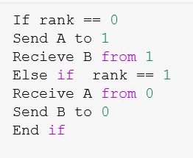
MPI Pseudocode

Slide 7
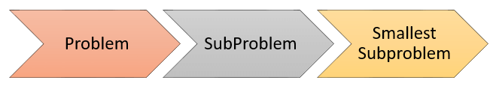
Knapsack Approach
Idea: Knapsack dynamic programming uses a table to store the solutions of solved subproblems.
Input:
Maximum Knapsack Capacity C and the number of n items.
Array of weight W[i] and corresponding value V[i].
Output:
Maximize value and corresponding weight in capacity.
Maximum optimal profit value that can be obtained from ‘n’ items

Slide 8
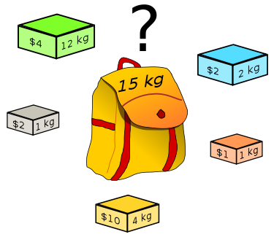
0/1 Knapsack Problem
Problem of combinatorial optimization
A set of items with a weight and a values and a knapsack with a maximum weight it can carry.
Find which items to take to get the best value but not exceed the knapsack capacity

Slide 9
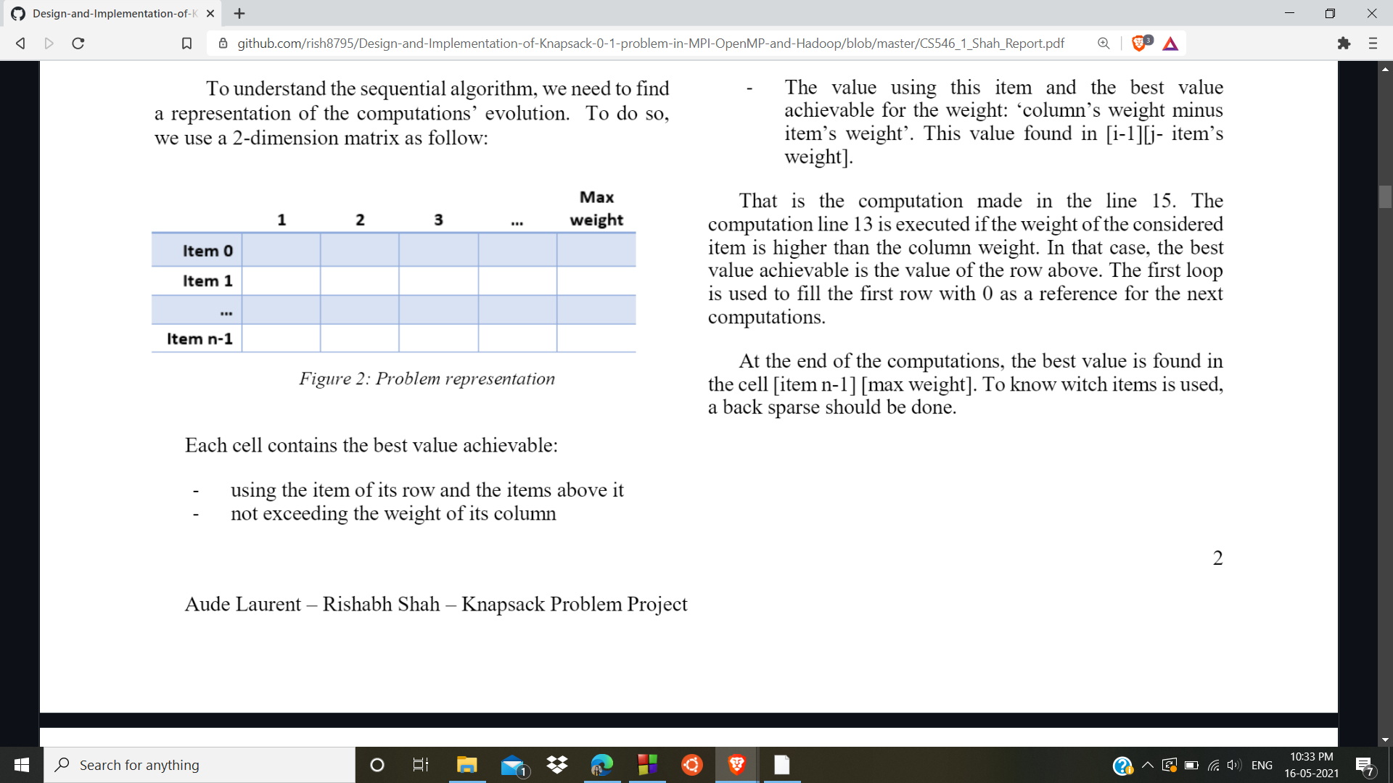
Sequential Algorithm - Understanding
We have used a 2-dimensional
matrix as represented in figure.
Each cell contains the best value
achievable:
using item of its row and items above it.
not exceeding the weight of its columns.
At the end of the computation, we get the best value achievable for the input data in the cell [item n-1] [max weight].

Slide 10
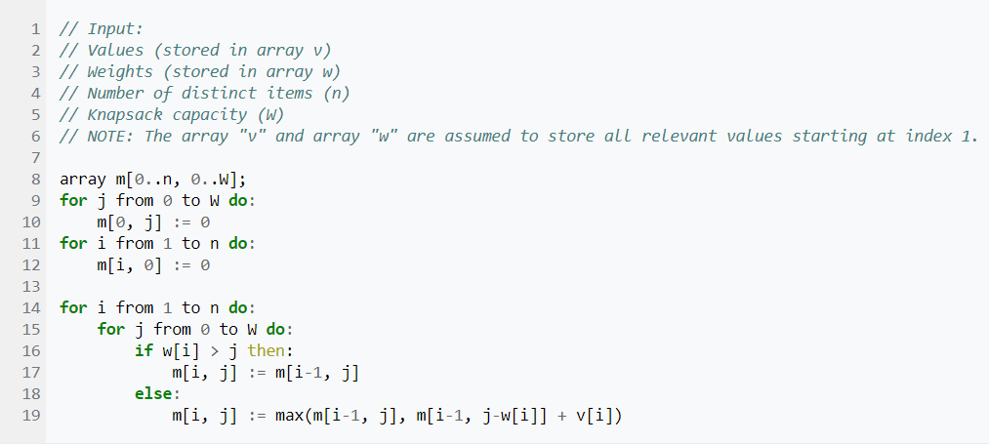
Pseudo code for knapsack Problem

Slide 11
Technology
OpenMP:
To implement parallel processing with openMP, column parallelization is used.
Firstly, a new instance is generated for the knapsack problem, where a user is suppose to enter the following:
N: total number of items.
max_: knapsack capacity.
w: array of weights.
v: arrays of values.
We tried to parallelize the calculation of every column. So, once all the weights are calculated column wise then we compare all the weights to find out the best profit.

Slide 12
Technology
MPI:
For MPI implementation also we used column parallelization in which each column matrix will map to a processor.
Dataset Description:
Number of items: 50, 100, 250.
Maximum Knapsack Capacity: 100, 500, 900.
Values: generated with using srandom() function.
Weights: generated with using srandom() function.

Slide 13
Best Optimal Value Analysis
Knapsack Capacity | Item | Optimal Values
100 | 50 | 450
 | 100 | 755
 | 250 | 1387
500 | 50 | 732
 | 100 | 929
 | 250 | 1402
900 | 50 | 617
 | 100 | 866
 | 250 | 1217

Slide 14
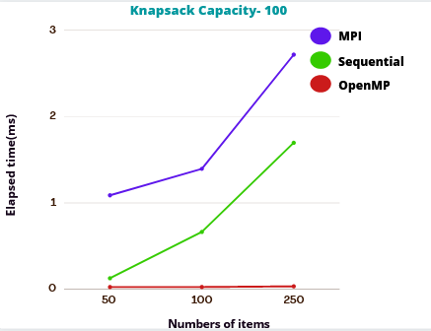
Result Analysis (Knapsack Capacity- 100)
 | Elapsed Time(ms)
Items | MPI | OpenMP | Sequential
50 | 1.088 | 0.024 | 0.126
100 | 1.395 | 0.024 | 0.663
250 | 2.718 | 0.032 | 1.697

Slide 15
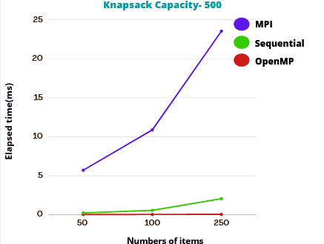
Result Analysis (Knapsack Capacity- 500)
 | Elapsed Time(ms)
Items | MPI | OpenMP | Sequential
50 | 5.708 | 0.023 | 0.225
100 | 10.889 | 0.030 | 0.588
250 | 23.552 | 0.038 | 2.057

Slide 16
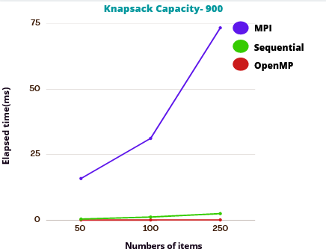
Result Analysis (Knapsack Capacity- 900)
 | Elapsed Time(ms)
Items | MPI | OpenMP | Sequential
50 | 15.847 | 0.023 | 0.372
100 | 31.204 | 0.032 | 1.146
250 | 73.606 | 0.045 | 2.454

Slide 17
Conclusion
To conclude this project we design and implemented programs using sequential, MPI and OpenMP.
OpenMP performed better in less time than MPI and Sequential program.
We could observe that:
For Sequential program, compute a high number of items takes more time.
For the openMP and MPI program, compute a high capacity takes more time.

Slide 18
Reference
Comparing MPI and OpenMP implementations of the 0-1 Knapsack Problem
A comparison between MPI and OpenMP Branch-and-Bound Skeletons
[https://ieeexplore.ieee.org/document/1213254
A parallel solution for the 0–1 knapsack problem using firefly algorithm https://www.researchgate.net/publication/303772834_A_parallel_solution_for_the_0-1_knapsack_problem_using_firefly_algorithm

Slide 19
Execution
Sequential program execution:
Compile: gcc seq_knapsack.c -o seq_knapsack
Run: ./seq_knapsack <capacity> <no_of_items> <seed>
MPI Program Execution:
Compile: mpicc mpi_knapsack.c -o mpi_knapsack
Run: mpirun -np <no_of_threads> mpi_knapsack <capacity> <no_of_items> <seed>
openMP Program Execution:
Compile: gcc -fopenmp omp_knapsack.c
Run: ./a.out <capacity> <no_of_items> <seed>

Slide 20
THANK YOU!

