Slide 1


TRUSTIFY:
Your Trust, Our Priority
Team Name: HighOnPot
Empowering users with AI-driven security for safer browsing.

Slide 2

INTRODUCTION
About Our Team
Vibhavasu Bhardwaj: AI-driven solutions lead. Designs robust ML models for fraud detection.
Swadhin Maharana: Full-stack developer ensuring secure and scalable UIs.
Dhruv Pratap Singh: Back-end developer focusing on databases and secure server architectures.
Abhinav Gupta: Cybersecurity expert specializing in threat analysis and risk mitigation.
Contact Information:
Email: trustifysecure@gmail.com
GitHub: TrustifySecure
Submission Date: January 25th, 2025

Slide 3
Problem Statement
The Issue:
Online Fraud Escalation: Rapid growth in phishing, piracy, and fraudulent websites threatens user safety.
User Impact: Loss of trust, financial fraud, and identity theft are increasingly prevalent.
Current Solutions: Existing tools either focus on narrow aspects (e.g., phishing emails) or are limited in effectiveness due to static detection methods.
Our Challenge:
Build a comprehensive, AI-powered browser extension to proactively identify, analyze, and mitigate threats while empowering users with real-time security.

Slide 4
Brief About the Idea
What is TRUSTIFY?
TRUSTIFY is an advanced browser extension designed to protect users from harmful websites by leveraging artificial intelligence, community feedback, and real-time threat analysis.
Core Objectives:
Enhance user trust and safety while browsing.
Deliver actionable insights to detect and prevent online fraud.
Foster a community-driven database for shared intelligence on threats.

Slide 5
SOLUTION
An AI-backed, all-in-one security tool that works seamlessly in the background while providing a user-friendly interface for actionable alerts and analysis.

Slide 6
Opportunities and USP
Opportunities in Cybersecurity:
The browser security market is projected to grow exponentially, driven by increasing online transactions and remote work environments.
No current solution combines AI-powered threat detection, trust verification, and real-time feedback integration.
How It's Different:
Uses dynamic, multi-layered AI models for precise fraud detection.
Offers unique features like sentiment analysis for reviews, advanced URL pattern detection, and user-driven feedback mechanisms.
USP:
Real-Time Analysis: Immediate identification and mitigation of threats.
AI-Driven Insights: Accurate and evolving detection models.
Community Contributions: A growing database of reported fraudulent websites.

Slide 7
Features
1. Design Analysis:
Checks: Detects visual anomalies like broken links, excessive ads, and poorly designed payment gateways.
AI Integration: Identifies whether site is malicious or not by html and css code .
2. Trust Seal Verification:
Validates certificates like SSL/TLS and payment system authenticity.
Cross-references seals with official repositories to confirm legitimacy.
3. Customer Reviews Analysis:
Sentiment Analysis: Detects fake or bot-generated reviews using NLP techniques.
Patterns: Identifies trends in fraudulent reviews or unusually low numbers of genuine reviews.
4. URL Pattern Analysis:
Scans for typosquatting, misspelled domains, and unusual registration details.
Uses WHOIS data to analyze domain age and authenticity.
5. Real-Time Alerts:
User Experience: Clear and concise pop-ups explaining detected threats.
Detailed Reports: Provides actionable insights into why a website is flagged.
6. User Feedback Integration:
Enables users to report suspicious sites directly.
Enhances the collective intelligence of the community database.

Slide 8
Process Flow Diagram
User accesses a website.
TRUSTIFY automatically scans the website for:
Design inconsistencies.
Trust seal verification failures.
Customer reviews and sentiment analysis.
URL anomalies.
AI model evaluates risk factors and generates a score.
If risk score exceeds a threshold, the user receives an alert with mitigation steps.

Slide 9
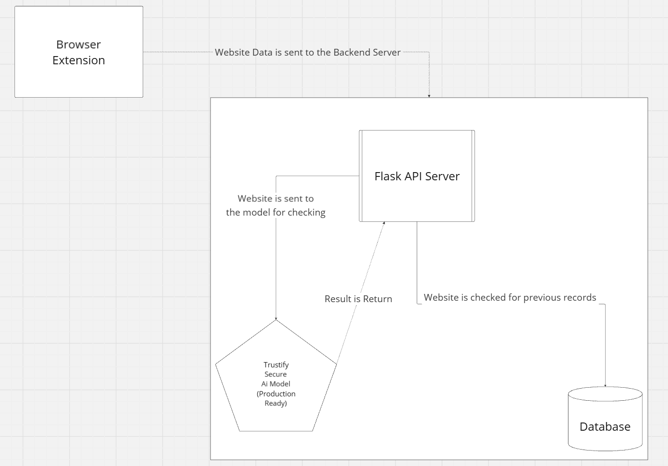
Architecture Diagram
Front-End:
Browser extension interface built using React and modern web technologies
.
Back-End:
Flask server for API calls and database interactions.
AI Models:
TensorFlow,Scikit-Learn and Spacy for fraud detection and sentiment analysis using transfer learning
Databases:
Firebase for real-time data storage.
Integration with third-party APIs for trust seals and review analysis.
Cloud Infrastructure:
Deployed on Google Cloud for scalability and resilience.
Utilizes Google IDX Platform for seamless development.

Slide 10
Technologies and Design
Wireframes/Mockups
Technologies
Homepage: Highlighting alerts and status of browsing safety.
Detailed Report: A page summarizing risk factors for flagged websites.
Feedback Form: Simple and intuitive interface for users to report sites.
Development Tools:
Front-End: React, HTML5, CSS3
Back-End: Flask/Django, Firebase
AI: TensorFlow, Scikit-Learn
APIs: Gemini APIs for AI integration, IDX Platform for scalability
Estimated Cost: *** for prototype development (hosting, data access, and API calls).

Slide 11
Future Development
Short-Term:
Long-Term:
Expand threat detection models to mobile applications.
Add detailed phishing training for users.
Collaborate with enterprises for large-scale deployments.
Integrate blockchain for secure reporting and feedback.

Slide 12
THANK YOU

