Slide 1
Natural Language Processing in Cybersecurity: Phishing Email Detection

Slide 2
CONTENTS OF THIS PRESENTATION
Introduction
Importance
Challenges
Methodology
Limitations
Future directions
Conclusion
References

Slide 3
INTRODUCTION
What is phishing?
Phishing is a cybercrime where individuals are targeted via email, text messages or phone calls in order to retrieve private information. It is trying to trick a person into:
Clicking an unsafe link
Downloading/opening an unsafe file
Type your credentials on websites
Transfer funds
Methods of operation
Sense of urgency
Offer of money/rewards
IT support
Giving confirmations to certain actions

Slide 4
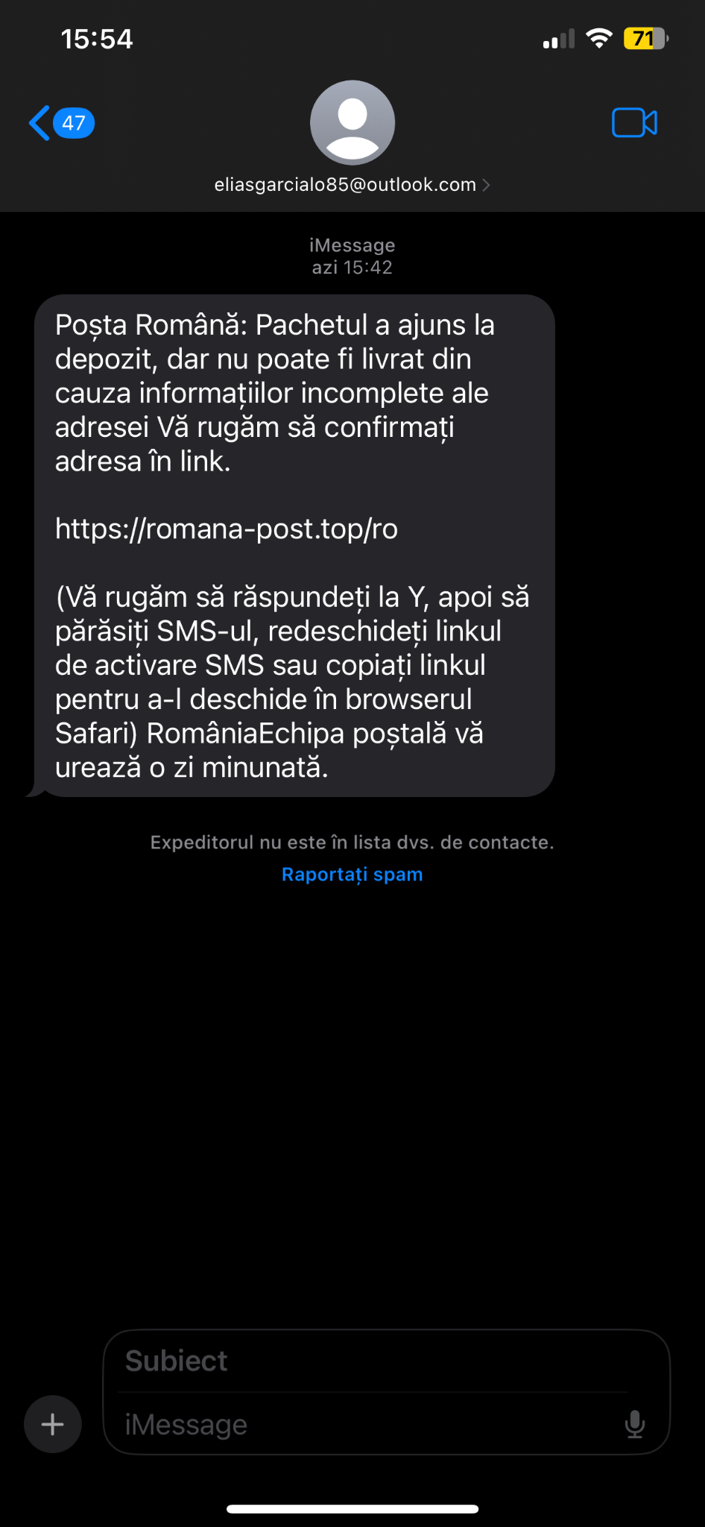
Personal example
Sender: eliasgarcialo85@outlook.com
Subject: Packet delivery
Unsafe link: https://romana-post.top/ro
Issues:
I was not expecting any packet delivery especially from outside the country.
Text is in romanian, but poorly written
Emphasize on clicking on the provided link

Slide 5



IMPORTANCE OF DETECTION
Prevent financial loss
Protect personal information
Mitigate the spread of malware

Slide 6
CHALLENGES
Phishers continue to refine their strategies constantly
Phishing exploits human psychology, so even the most sophisticated detection can fail if individuals are not trained to recognize and react to these attempts
Incorporating phishing detection systems into existing IT infrastructures without compromising user experience

Slide 7
METHODOLOGY
Heuristic Analysis
Blacklisting
Natural Language Processing
1
3
ex: set of rules/algorithms
2
ex: PhishTank, OpenPhish
enhanced by machine learning/deep learning methods

Slide 8
NATURAL LANGUAGE PROCESSING METHODOLOGY
Feature extraction
Feature selection
Classification
Dataset
Results

Slide 9
Feature extraction
= identifying key characteristics from the email content that may indicate phishing attempts
Types of features to be extracted:
Email body-based features: These are features derived straight from the content of the email body. These may include binary characteristics of shapes used or HTML, specific phrases, and links to be included.
Subject-based features: These are features derived from email subjects.
URL-based features: Analyze the contained URLs. Other notable items included using the IP address instead of the domain name, ”@” in URLs, and other noticeable items in the count of images, the number, and types of links(external and internal) of the email. It also considers the complexity of the links, including the number of redirections or loops.
Script-based features: This refers to features that detect the existence of scripts, like JavaScript, or code that causes on-click events and pop-up windows.
Sender-based features: These are hints on the credibility of the sender.

Slide 10
Feature selection
= focuses on selecting the most relevant features for phishing email detection
Techniques such as text parsing, word tokenization are employed to preprocess the email content
Different papers may employ variations in feature selection methods, some of them might do a removal of common words and an inclusion of email-specific information, while others prioritized essential components such as word counts, punctuation, or emphasized on the existence of unique stems

Slide 11
Classification, datasets and results
For classification, there were employed Machine learning algorithms such as Decision Tree, Logistic Regression, Neural Network, SVM, and Naive Bayes are commonly used for classification. There were also employed hybrid approaches, combining multiple classifiers such as SVM and Bayes, are explored to improve detection accuracy and resilience to varying email characteristics.
The datasets are various. For example, in paper [2], out of the 1705 emails in the dataset, 1291 area units were ham and 404 area units were phished. The phished emails were a compilation of emails from multiple sources, whereas the ham emails were gathered from a publicly available dataset. They discovered that their suggested hybrid method with 98% accuracy, 97% sensitivity, and 97.5% specificity outperformed the simple approaches such as Support Vector Machine or Neural Network
On the other hand, the paper [1] had 3865 ham emails and 735 phishing emails in the training dataset, and 3824 ham emails and 475 phishing emails in the testing dataset. The origins of the ham emails were multiple Wikileaks sources, but the sources of the phishing emails were the Nazario phishing corpus, the IT websites of different colleges, and some created with the Dada engine. 95% of ham emails and over 80% of phishing emails could be correctly identified by the detector.

Slide 12
Classification, datasets and results
Paper [3] also talks about notable work has proposed a model based on R-CNN (Region convolutional neural network) model with attention mechanisms for multi-level analysis. It achieved a very high detection accuracy, totaling 99.848%. This represents a good indication that Deep Learning approaches may improve phishing detection capabilities by looking comprehensively into the analysis of email content and context, at multi-levels.
In some other research, document embedding techniques like Doc2Vec were employed together with traditional classifiers (SVM, LR, RF, and Naive Bayes), which facilitated a nuanced analysis of the textual data, yielding a classification accuracy and F1 score of approximately 81.6% and 76.6% respectively.
Additionally, the paper gives insights regarding some novel techniques like Binary Search Feature Selection (BSFS) that bring out the basic set of features most efficiently with consideration of accuracy and load on computation. The approach produced an improved accuracy of 97.41%.

Slide 13
LIMITATIONS
NLP struggles with understanding the deeper context and nuances of language
Phishing techniques text always evolve
NLP's effectiveness is highly dependent on the diversity and size of the training datasets
NLP models can underperform in languages or dialects for which they were not originally trained

Slide 14
FUTURE DIRECTIONS
Developing more sophisticated NLP models that better understand the context and subtleties of communication
Enhancing NLP systems to handle multiple languages and dialects effectively to broaden their applicability
Promote open-source collaborations for sharing of advancements and datasets across the global research community

Slide 15
CONCLUSION
While Natural Language Processing and machine-learning techniques have improved this detection, their human-like complexity presents an evolving situation. To combat these effectively, ongoing research needs to focus on the development of adaptable systems using wide datasets and sophisticated analytics.

Slide 16

QUESTIONS

Slide 17

References
1. Egozi, G., Verma, R.: Phishing email detection using robust nlp techniques. In: 2018 IEEE International Conference on Data Mining Workshops (ICDMW). pp. 7–12 (2018). https://doi.org/10.1109/ICDMW.2018.00009
2. Kumar, A., Chatterjee, J.M., D´ıaz, V.G.: A novel hybrid approach of svm combined with nlp and probabilistic neural network for email phishing. International Journal of Electrical and Computer Engineering (IJECE) 10(1), 486 (Feb 2020). https://doi.org/10.11591/ijece.v10i1.pp486-493, http://dx.doi.org/ 10.11591/ijece.v10i1.pp486-493
3. Salloum, S., Gaber, T., Vadera, S., Shaalan, K.: Phishing email detection using natural language processing techniques: A literature survey. Procedia Computer Science 189, 19–28 (2021). https://doi.org/https://doi.org/10.1016/j.procs.2021.05.077, https://www.sciencedirect.com/science/article/pii/S1877050921011741, aI in Computational Linguistics

