Slide 1
Multi-input, Multi-output Neural Operator Learning for Acoustic Metamaterials
Han Zhang
Ph.D. Candidate
Duke University, Department of Mechanical Engineering & Materials Science

Slide 2
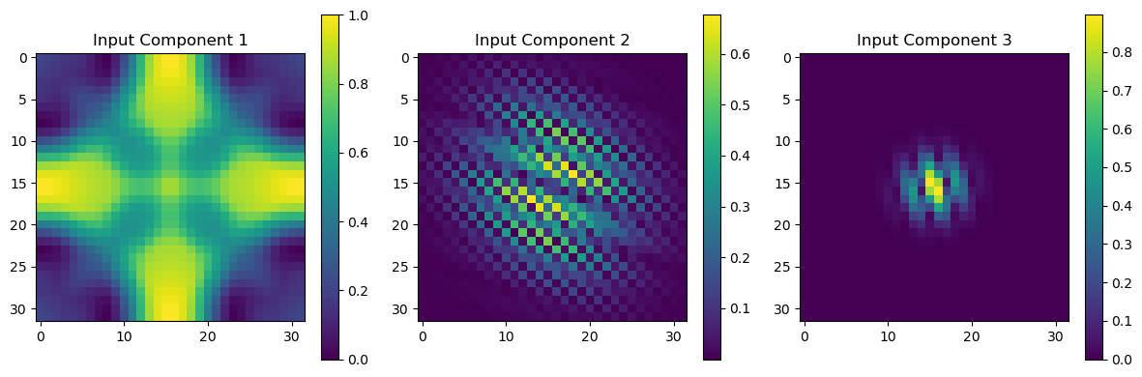
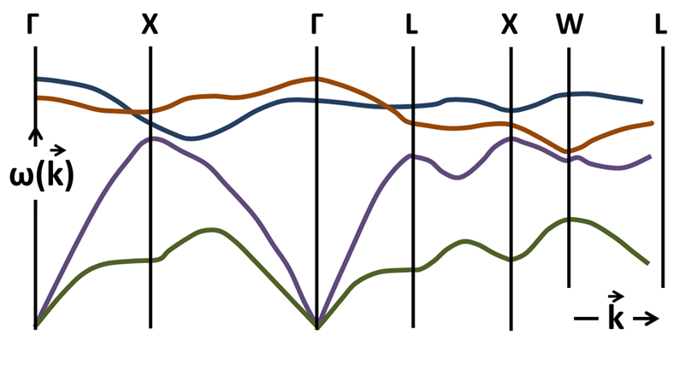
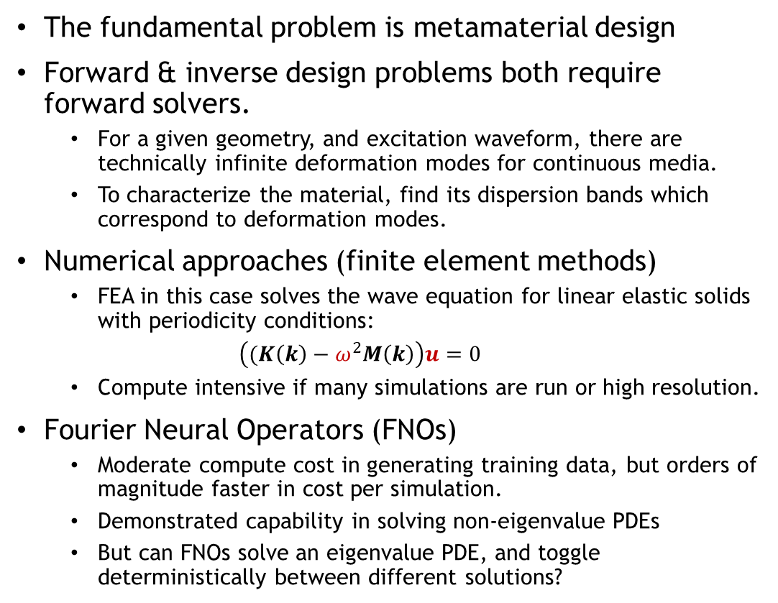
Introduction
The fundamental problem is metamaterial design
Forward & inverse design problems both require forward solvers.
For a given geometry, and excitation waveform, there are technically infinite deformation modes for continuous media.
To characterize the material, find its dispersion bands which correspond to deformation modes.
Numerical approaches (finite element methods)
FEA in this case solves the wave equation for linear elastic solids with periodicity conditions:
$\left((K\left(k\right)−ω^{2}M\left(k\right)\right)u=0$
Compute intensive if many simulations are run or high resolution.
Fourier Neural Operators (FNOs)
Moderate compute cost in generating training data, but orders of magnitude faster in cost per simulation.
Demonstrated capability in solving non-eigenvalue PDEs
But can FNOs solve an eigenvalue PDE, and toggle deterministically between different solutions?
Waveform (k)
Geometry
Dispersion Relation w(k)

Slide 3
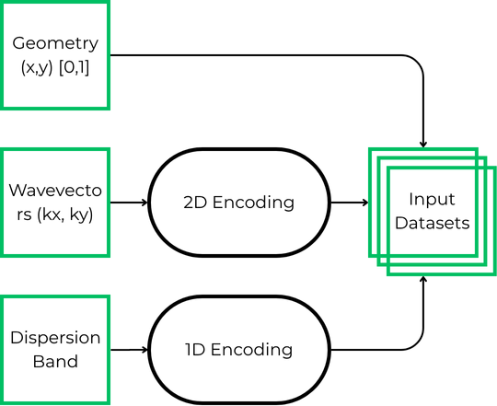
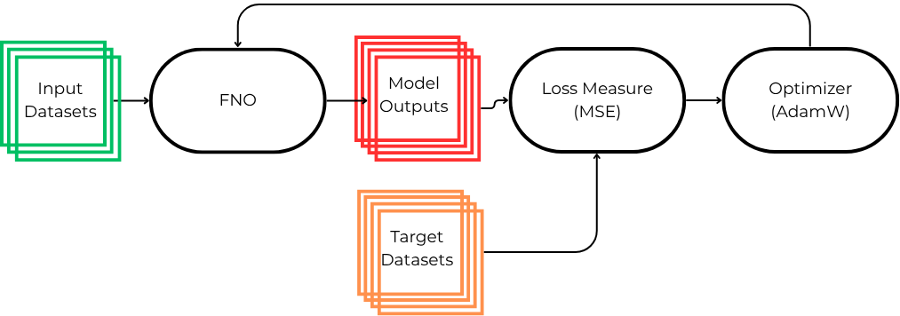
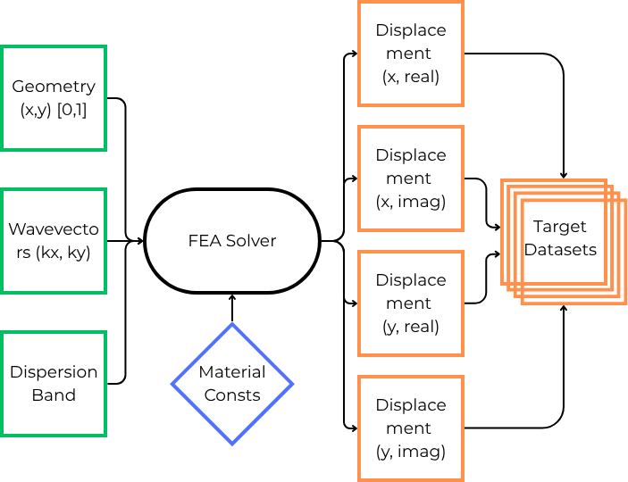
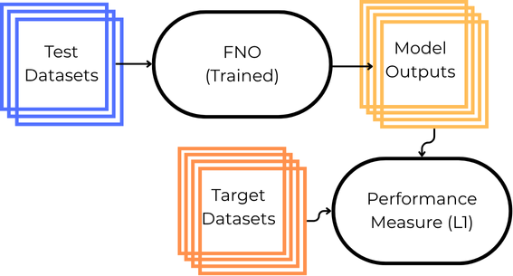
Methodology
Generate Input Data
Train Model
Generate
Output Data
Evaluate Model

Slide 4
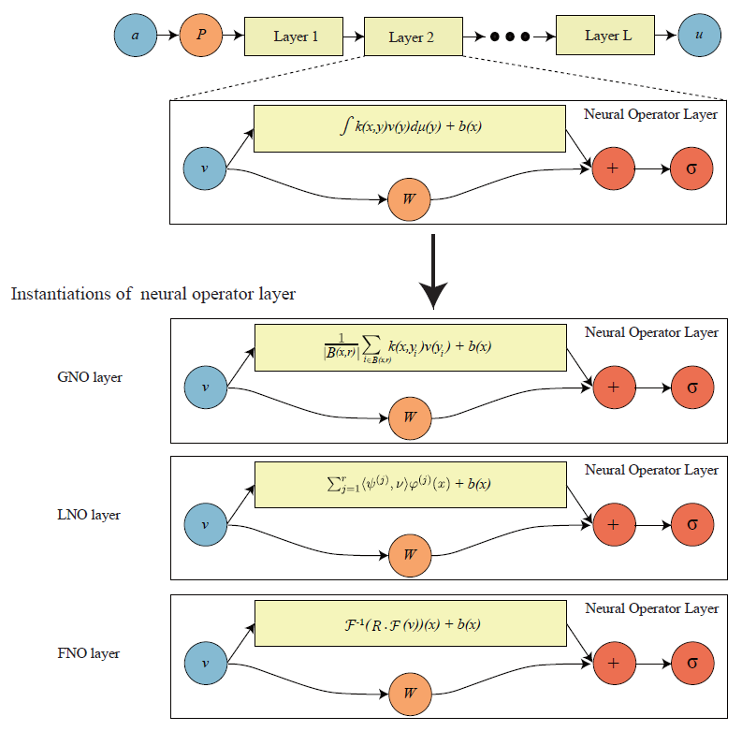
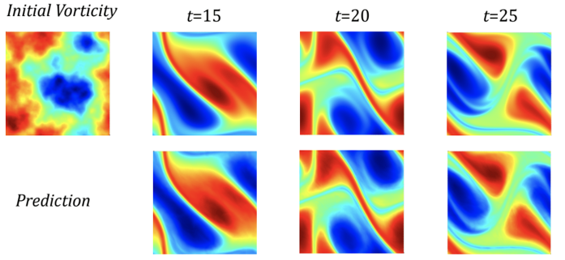
FNO Architecture
Input ‘a’ can be a raw input or an encoding of raw data.
Ex. Geometry image, encoded waveform.
First layer ‘P’ lifts ‘a’ into a high dimensional space.
Maps finite dimensional input information to something closer to an infinite (much higher) dimensional function space that is the domain of our operator in training.
Arbitrary number of spectral (Fourier) layers
2 branches before summation and non-linear activation function.
First branch deals with the spatial information of the input.
Second branch deals with the frequency information of the input.
Two weight matrices R, W, and bias b are trained.
Last layer usually a projection layer
returns outputs from a high dimensional latent space to input dimensionality.
(N. Kovachki, et. Al, JMLR 2023)
(Li, Zongyi, et. Al, ICLR 2021)

Slide 5
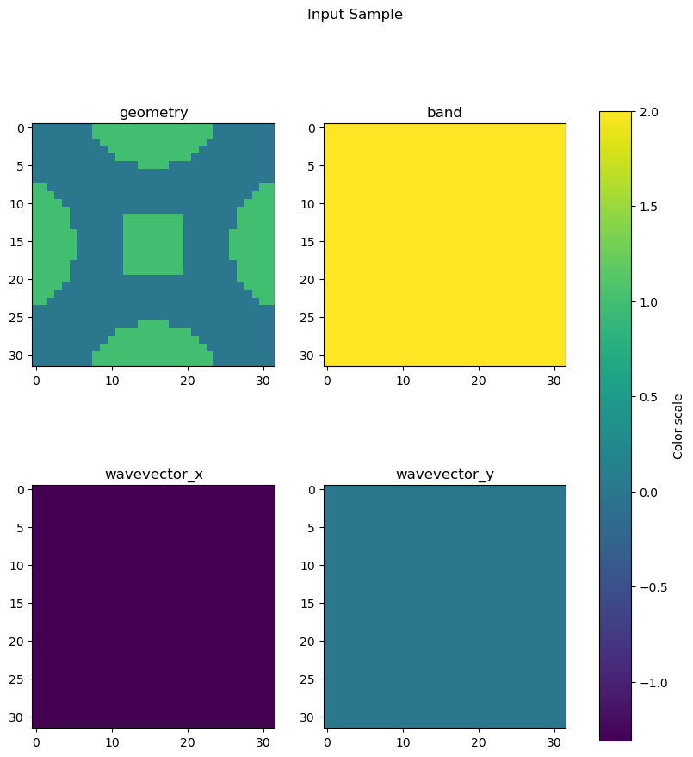
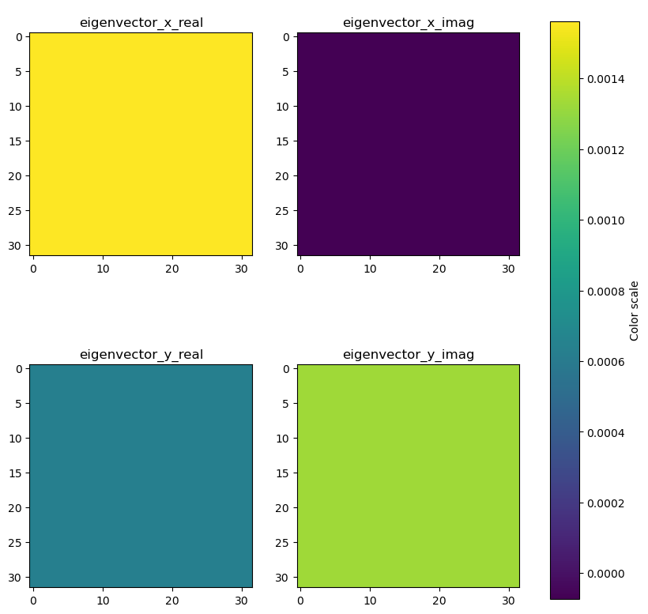
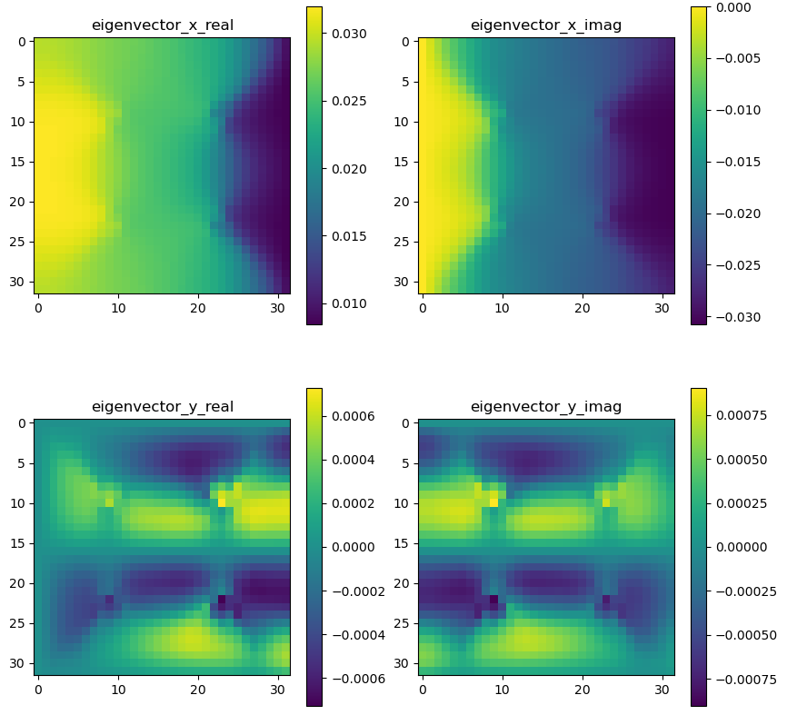
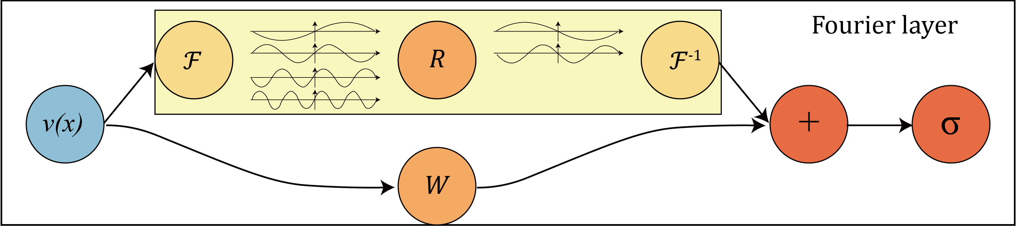
Constant Field Encoding Training
Inputs
FNO maps 4 inputs (geometry, band, kx, ky) to 4 displacement field outputs
Geometry given in spatial representation (32x32 pixels)
Band given as a field of constants ranging from [1/6,1], representing 6 bands.
Wavevector given as two separate fields of constants, kx and ky, ranging from [-1, 1], representing [-π, π]
Outputs (Mode Collapse!)
Targets
(Li, Zongyi, et. Al, ICLR 2021)
FFT
0

Slide 6
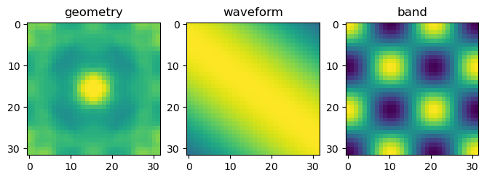
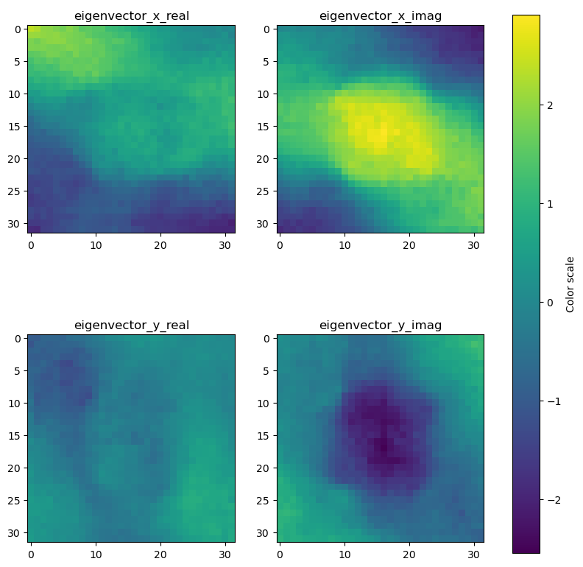
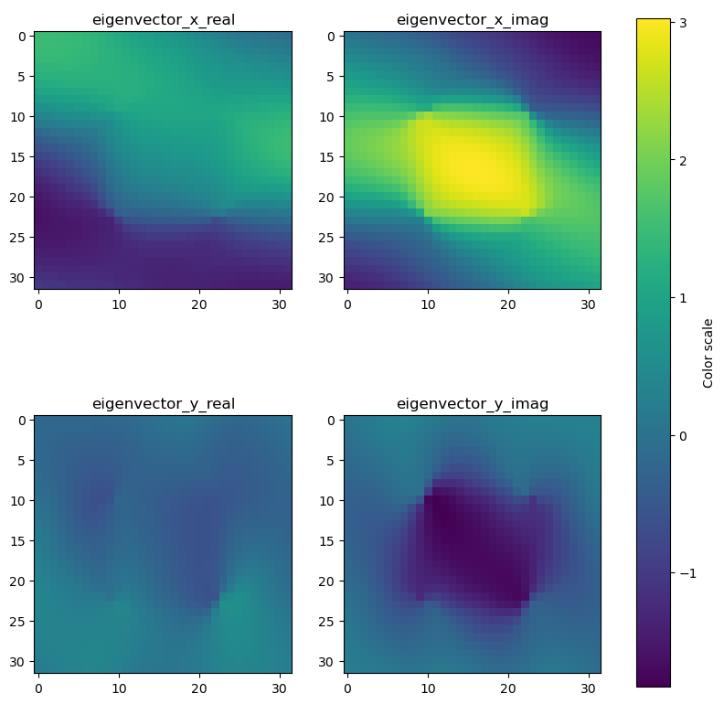
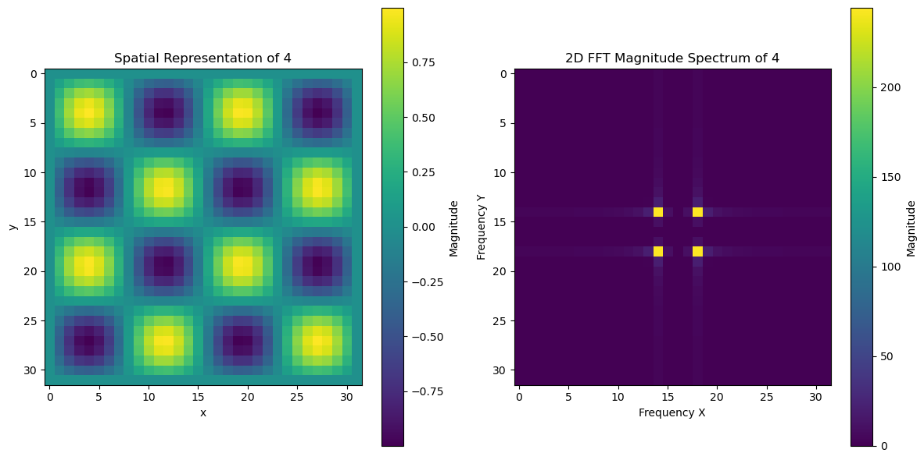
Sinusoidal Field Encoding Training
Inputs
FNO maps 3 inputs (geometry, wavevectors, & band) to 4 displacement field outputs
Geometry given in spatial representation (32x32 pixels) [0,1]
Band given as the frequency of a 2D sinusoidal function. [-1,1]
Wavevector given as two frequencies of a 2D sinusoidal function. [-1,1]
Outputs
Targets
(Li, Zongyi, et. Al, ICLR 2021)

Slide 7
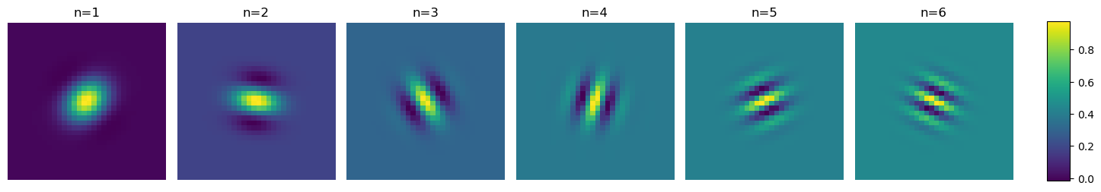
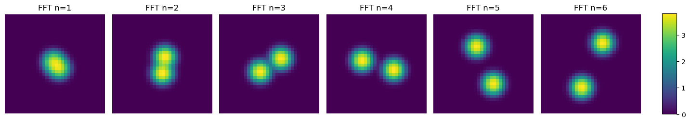
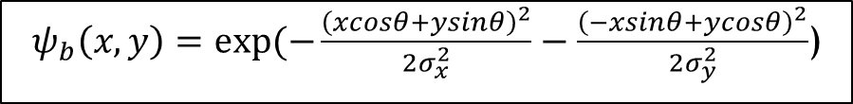
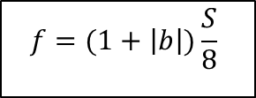
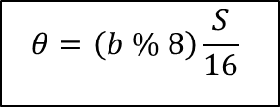
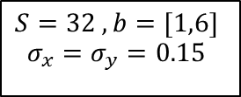
1D (Band) Wavelet Encoding
$$S=32 , b=[1,6]$$
$$σ_{x}=σ_{y}=0.15$$
$$f=(1+\left|b\right|)\frac{S}{8}$$
$$θ=\left(b \% 8\right)\frac{S}{16}$$
$ψ_{b}\left(x,y\right)=exp⁡(−\frac{{\left(xcosθ+ysinθ\right)}^{2}}{2σ_{x}^{2}}−\frac{{\left(−xsinθ+ycosθ\right)}^{2}}{2σ_{y}^{2}}$)

Slide 8
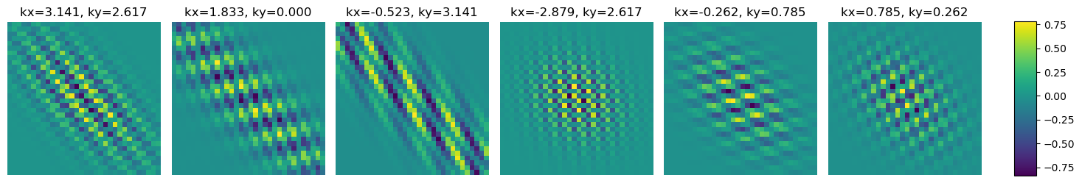
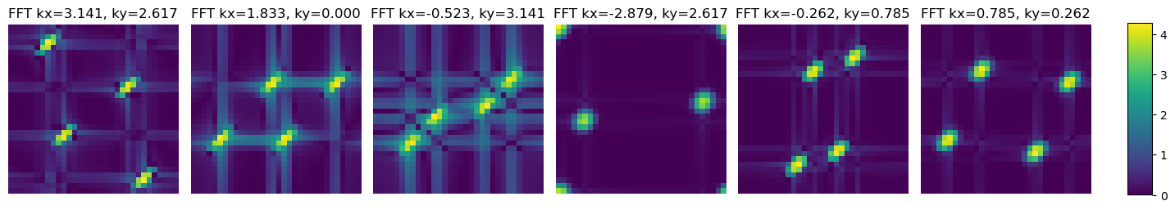
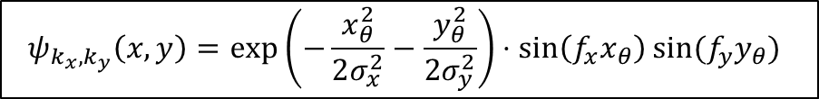
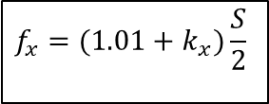
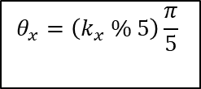
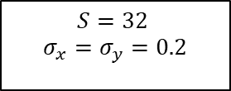
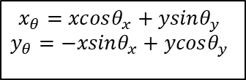
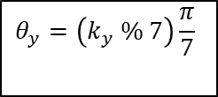
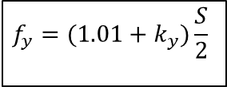
$$S=32$$
$$σ_{x}=σ_{y}=0.2$$
$$f_{x}=(1.01+k_{x})\frac{S}{2}$$
$$f_{y}=(1.01+k_{y})\frac{S}{2}$$
2D (Band) Wavelet Encoding Training
$$θ_{x}=\left(k_{x} \% 5\right)\frac{π}{5}$$
$$θ_{y}=\left(k_{y} \% 7\right)\frac{π}{7}$$
$$x_{θ}=xcosθ_{x}+ysinθ_{y}$$
$$y_{θ}=−xsinθ_{x}+ycosθ_{y}$$
$$ψ_{k_{x},k_{y}}\left(x,y\right)=\exp\left(−\frac{x_{θ}^{2}}{2σ_{x}^{2}}−\frac{y_{θ}^{2}}{2σ_{y}^{2}}\right)⋅\sin\left(f_{x}x_{θ}\right)sin⁡(f_{y}y_{θ})$$

Slide 9
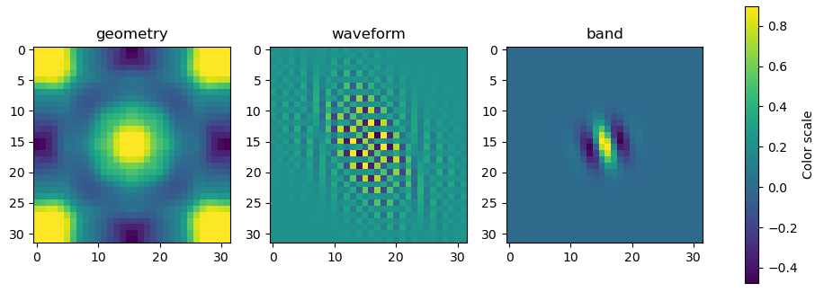
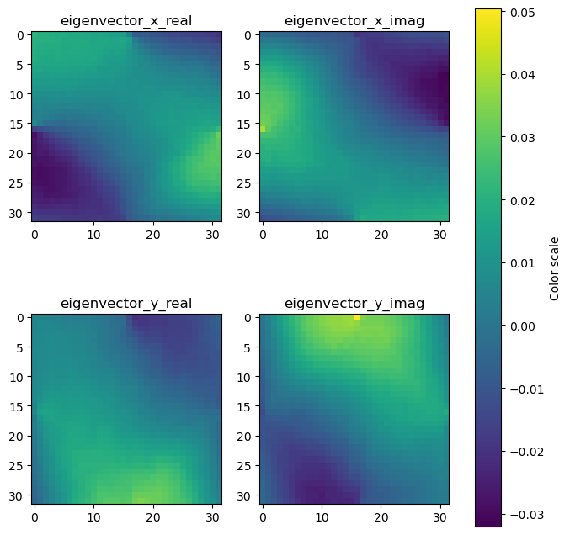
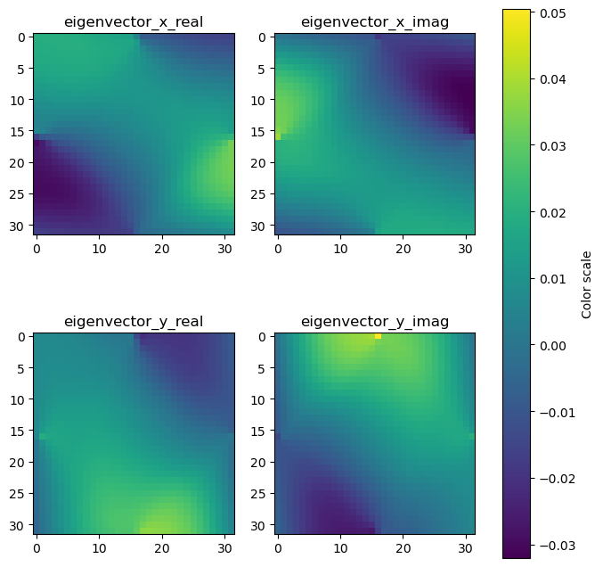
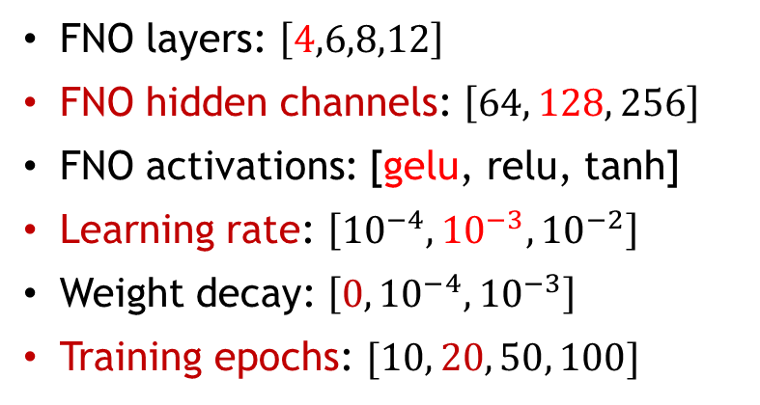
Wavelet Encoding
Inputs
FNO maps 3 inputs (geometry, wavevectors, and band) to 4 displacement field outputs
Geometry given in spatial representation (32x32 pixels) [0,1]
Band encoded in the frequency and rotation angle of a Gabor wavelet function. (-1,1)
Wavevectors similarly encoded in a Gabor wavelet function. (-1,1)
Outputs
Targets
Hyperparameter Tuning
FNO layers: $\left[4,6,8,12\right]$
FNO hidden channels: $\left[64, 128, 256\right]$
FNO activations: [gelu, relu, tanh]
Learning rate: $\left[{10}^{−4},{10}^{−3}, {10}^{−2}\right]$
Weight decay: $\left[0,{10}^{−4}, {10}^{−3}\right]$
Training epochs: $[10, 20, 50, 100]$

Slide 10
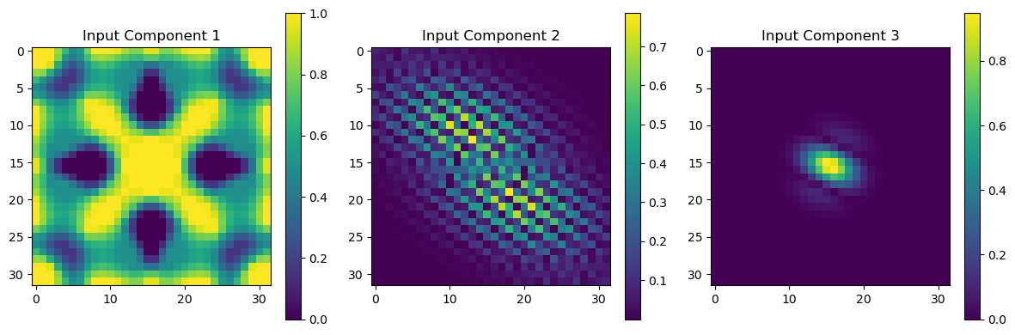
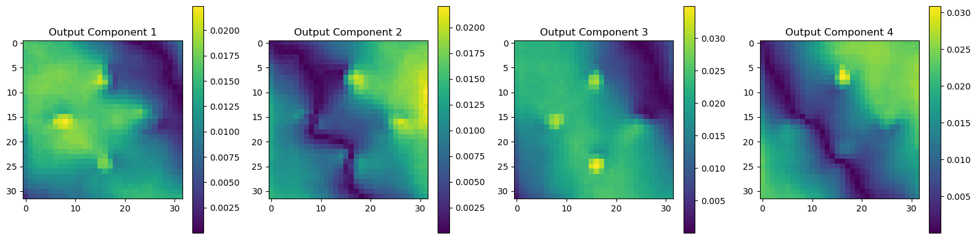
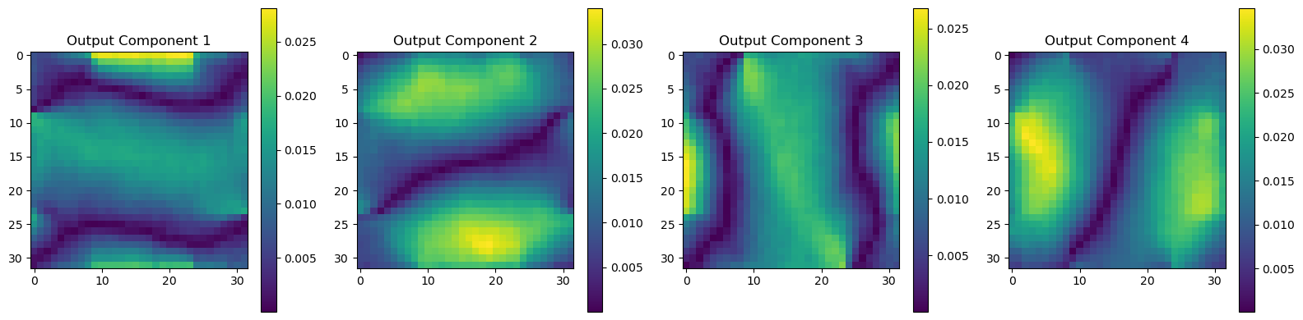
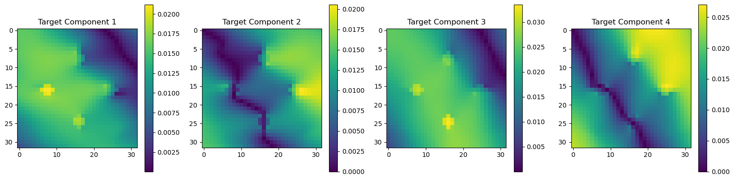
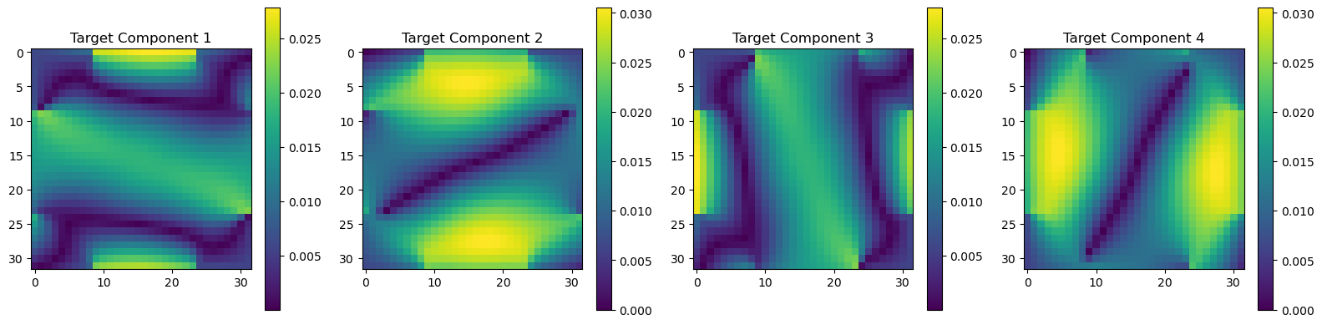
Performance On Novel Unseen Geometries
Random Sample 1
Inputs, Outputs, &Targets
Random Sample 2
Inputs, Outputs, &Targets

Slide 11
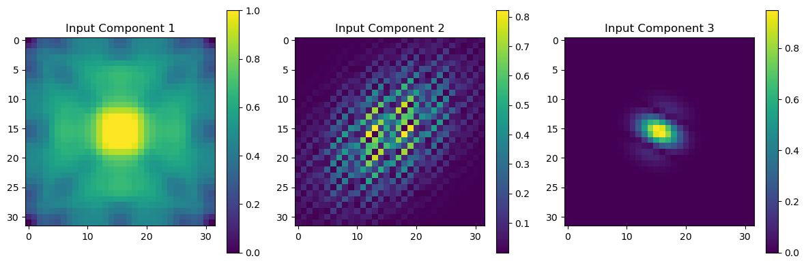
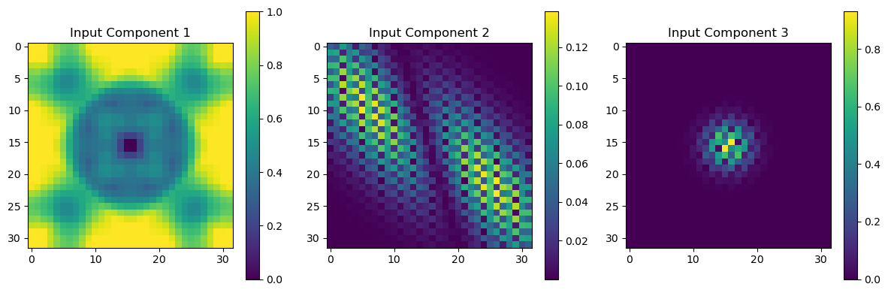
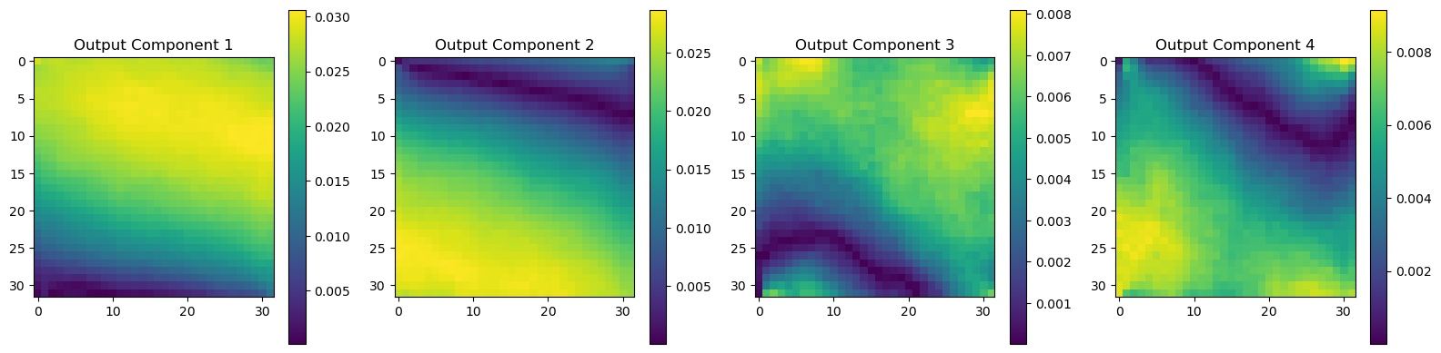
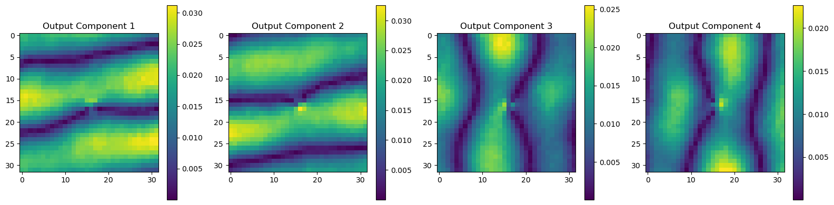
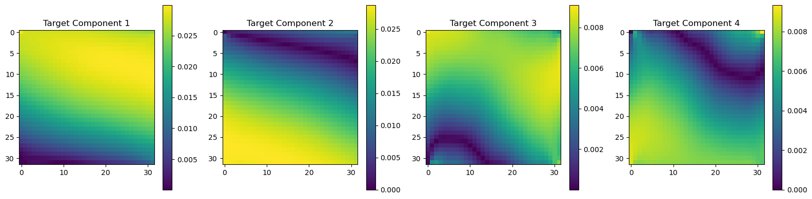
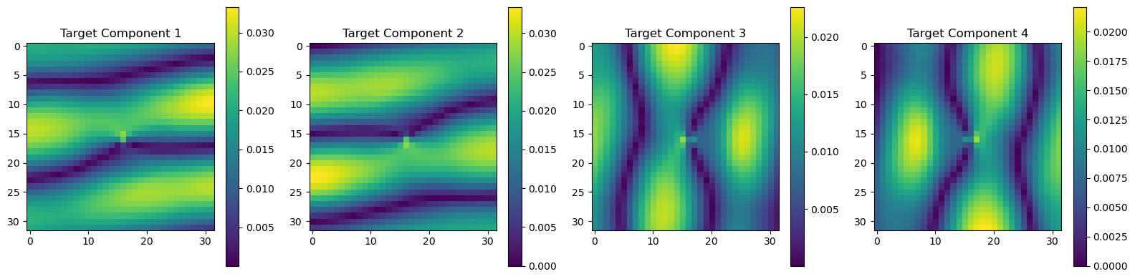
Performance On Novel Unseen Geometries
Random Sample 3
Inputs, Outputs, & Targets
Random Sample 4
Inputs, Outputs, & Targets

Slide 12
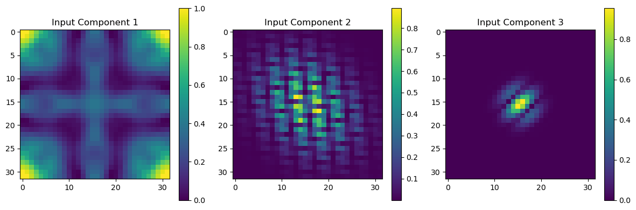
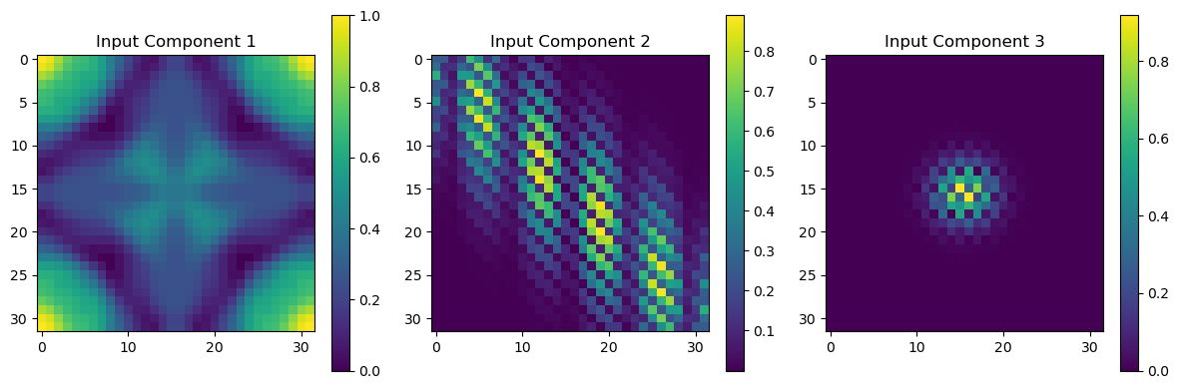
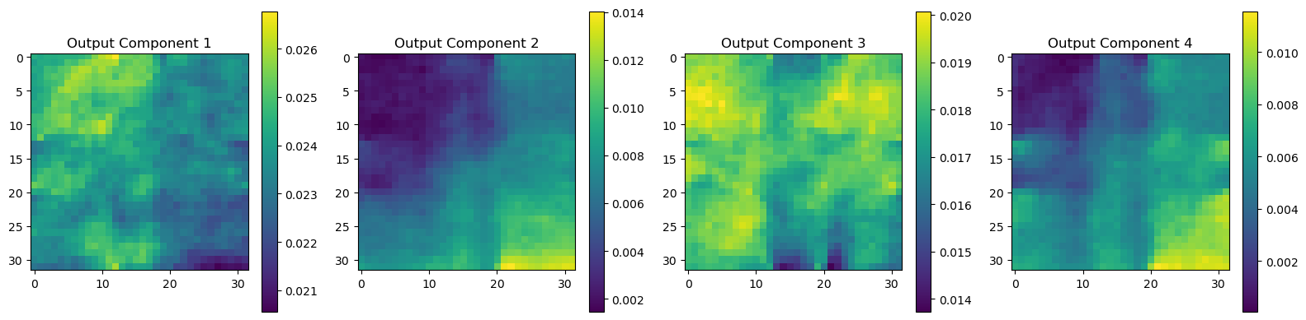



Performance On Novel Unseen Geometries
Picked Sample 1
Inputs, Outputs, & Targets
Picked Sample 2
Inputs, Outputs, & Targets

Slide 13

Conclusions & Future Work
FNOs are able to solve eigenvalue PDEs, and deterministically toggle between different solutions for the same structure.
FNOs are intrinsically wavelet operators, due to their spatial and spectral branches architecture.
To maximize FNO effectiveness, both spatial and frequency domain information of inputs should be passed in.
FNOs can extrapolate to not just to unseen combinations, but also unseen geometries, correctly predicting multiple deformation modes for given excitations.
Learning rate needs to be kept low for this sort of model, there are areas of the loss landscape which are very flat, which can optimizers to get stuck.
Train model with more geometry examples to increase performance on all possible geometries in the 8-fold symmetry group.
Expand to binary geometries (swap from continuous pixel values)
Expand to different symmetry groups and asymmetric geometries
Test model performance retention on half and double resolution scenarios.
Augment loss terms with physics informed terms. (More complicated for eigenvalue PDEs.)

Slide 14

FEA Process

Slide 15

Physics Informed Loss for an Eigenvalue PDE

Slide 16

Methodology Flowchart

