Slide 1
Fourier Neural Operators for 2D Acoustic Metamaterials
Han Zhang

Slide 2
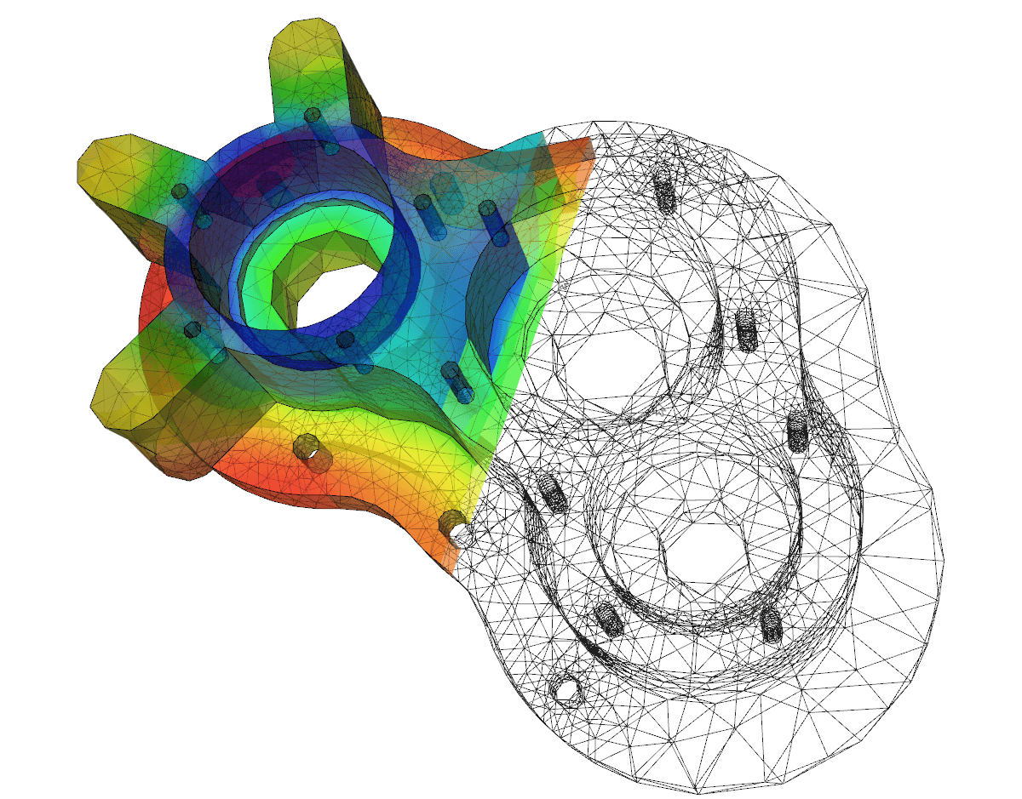
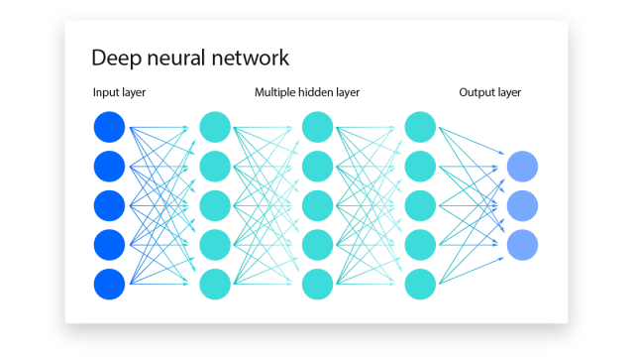
Motivation & Applications
The solving of PDEs is the fundamental problem
Analytical solutions are rare for real world problems
Numerical approaches (finite element methods)
Slow due to poor scaling laws.
Compute intensive so economically impractical
Traditional neural networks
Poor generalizability
Data intensive (upfront costs)
Neural operators
Generalizable across resolution
Relatively lightweight, because fundamentally, functions are more efficient representations than pointwise descriptions.
The applications are at minimum, anywhere where PDEs are used.
https://www.cambridge-dt.com/finite-element-analysis-predicting-the-real-world/
https://www.ibm.com/topics/neural-networks

Slide 3
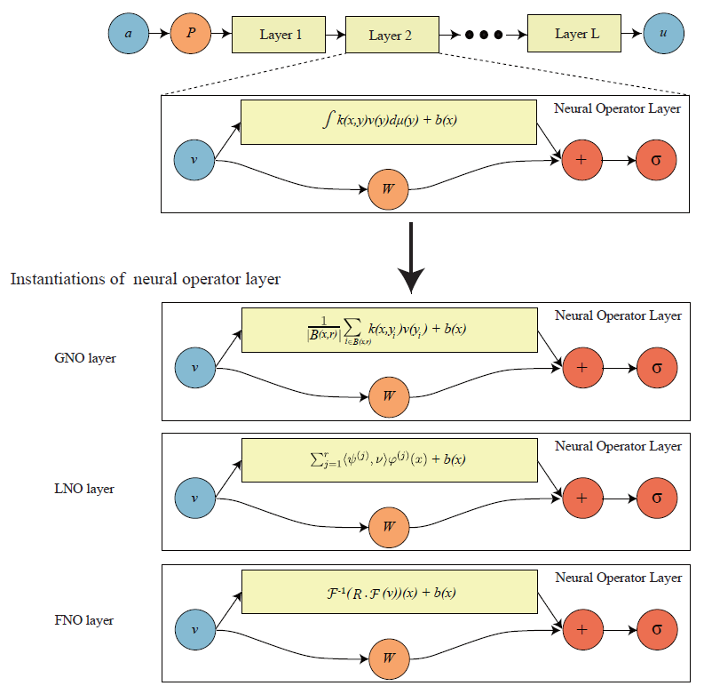
Methodology
Input ‘a’ is a function.
Ex. description of geometry
First layer ‘P’ lifts ‘a’ into a high dimensional space.
Maps finite dimensional function information to something closer to an infinite dimensional function space that is the domain of our operator in training.
Neural operator (Fourier) layers
Fourier transformations on continuous functions
Two bias terms, b(x) and W(v(x))
Linear transform R effectively discards some higher frequency modes (noise).
Last layer usually a projection layer that returns a function ‘u’ from high dimensional latent space to similar/same dimensionality as ‘a’
This is like the inverse of the first layer, mapping from (approximation) of infinite dimensional function space back to some finite dimension function space to give an approximation function.
Image from: N. Kovachki, et. al’s Neural Operator: Learning Maps Between Function Spaces With Applications to PDEs

Slide 4
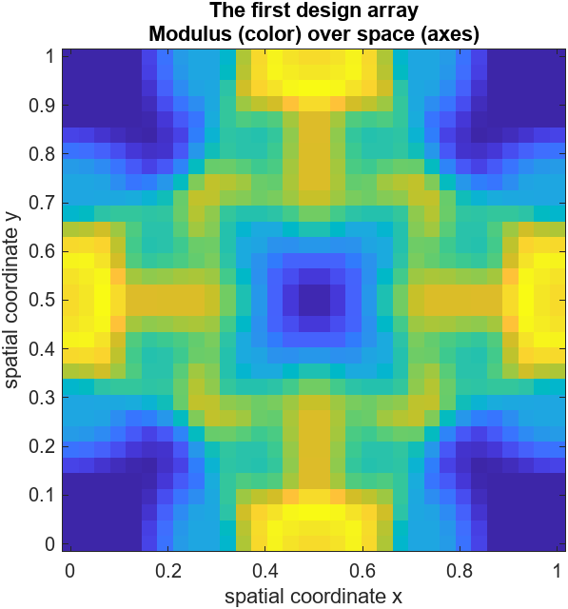
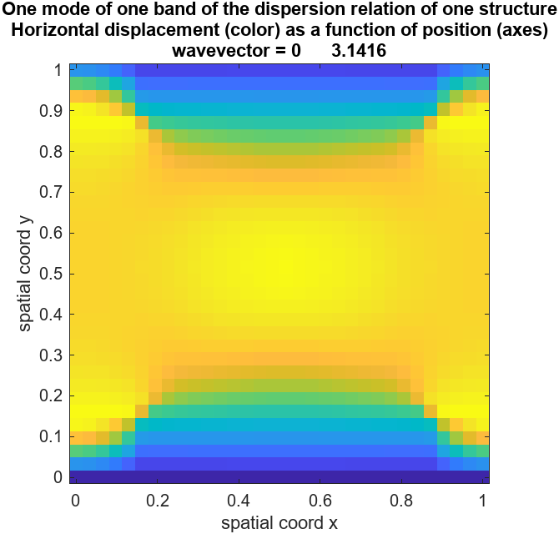
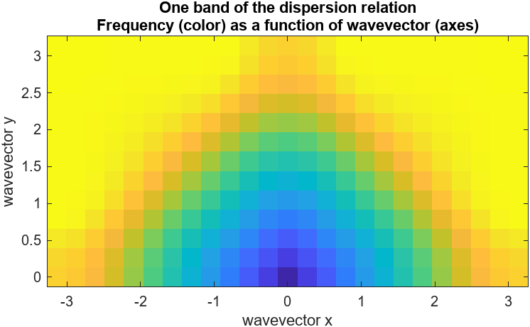
Data & Results
Encode as function
Neural Operator
Decode from function
Alternative Output

