Slide 1
Fourier Neural Operators for 2D Acoustic Metamaterials
Han Zhang

Slide 2
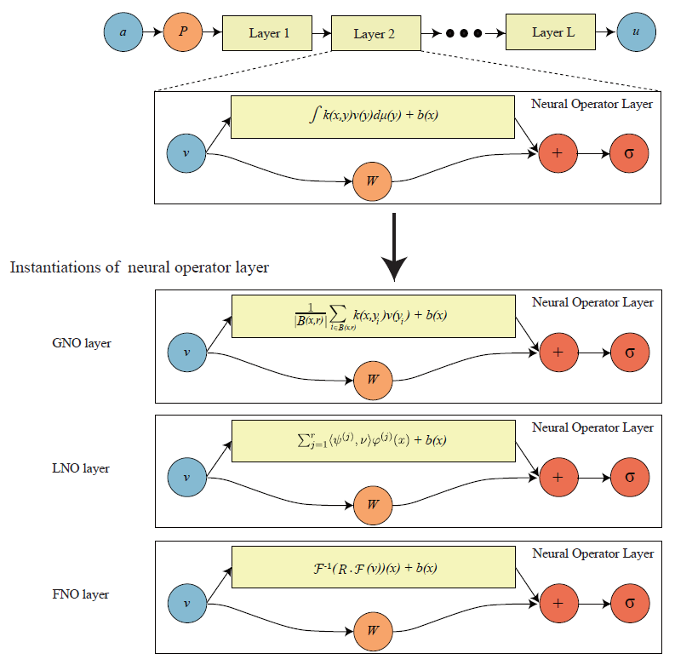
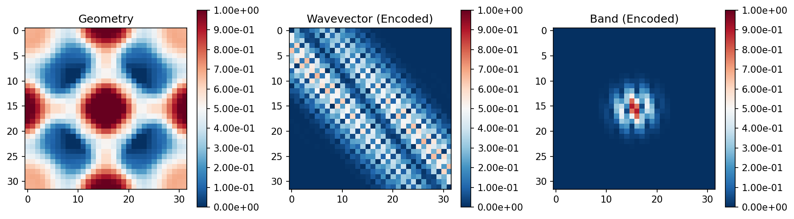
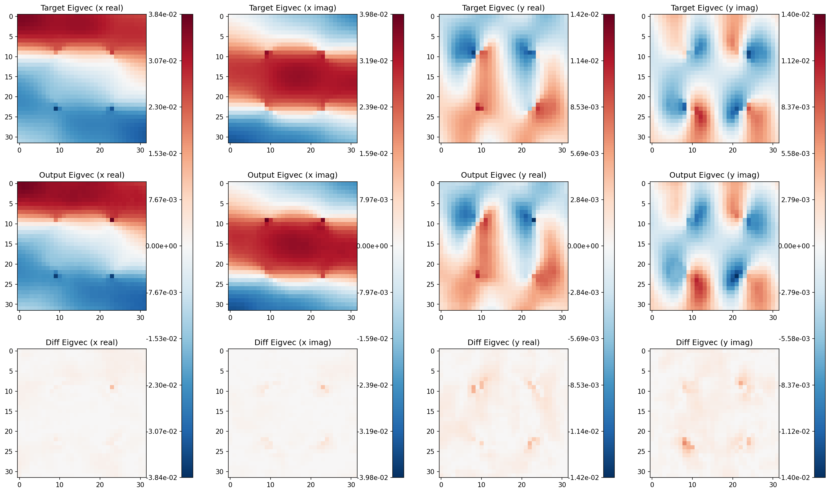
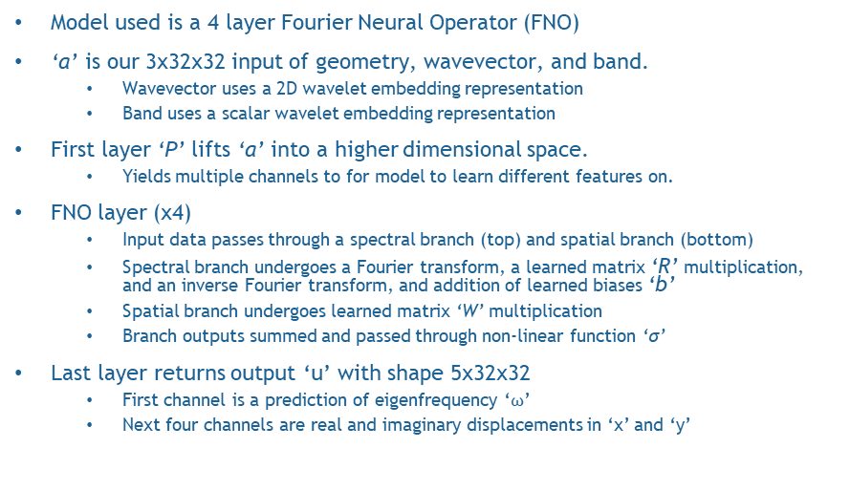
FNO Architecture & Sample Example
Inputs: Geometry, Wavevector, and Band with wavelet embeddings
Outputs, Predictions, & Differences at median (50th percentile) performance
Kovachki et. al: Neural Operator Learning Maps Between Function Spaces With Applications to PDEs
Model used is a 4 layer Fourier Neural Operator (FNO)
‘a’ is our 3x32x32 input of geometry, wavevector, and band.
Wavevector uses a 2D wavelet embedding representation
Band uses a scalar wavelet embedding representation
First layer ‘P’ lifts ‘a’ into a higher dimensional space.
Yields multiple channels to for model to learn different features on.
FNO layer (x4)
Input data passes through a spectral branch (top) and spatial branch (bottom)
Spectral branch undergoes a Fourier transform, a learned matrix ‘R’ multiplication, and an inverse Fourier transform, and addition of learned biases ‘b’
Spatial branch undergoes learned matrix ‘W’ multiplication
Branch outputs summed and passed through non-linear function ‘σ’
Last layer returns output ‘u’ with shape 5x32x32
First channel is a prediction of eigenfrequency ‘$ω$’
Next four channels are real and imaginary displacements in ‘x’ and ‘y’

Slide 3
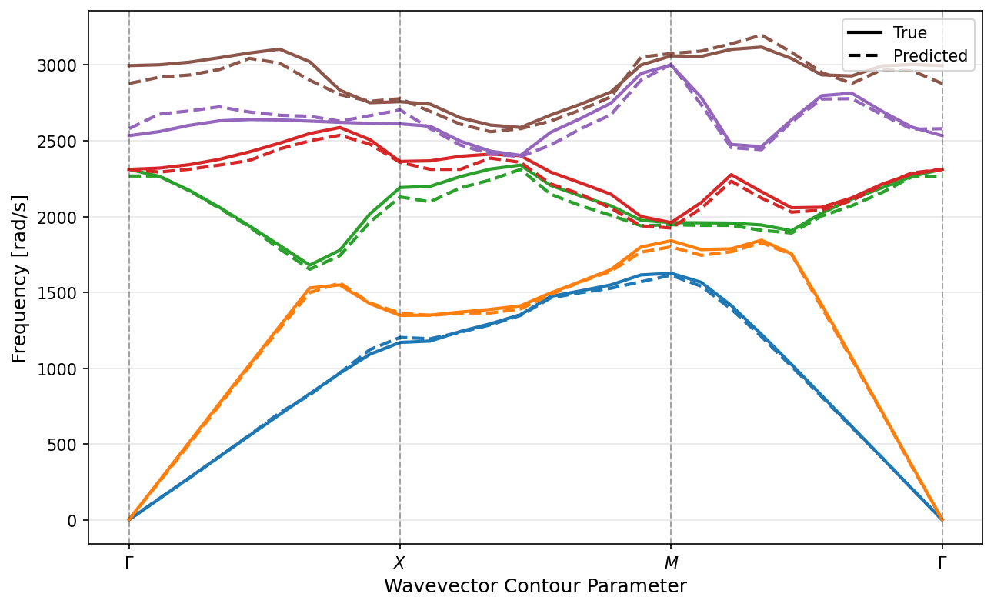
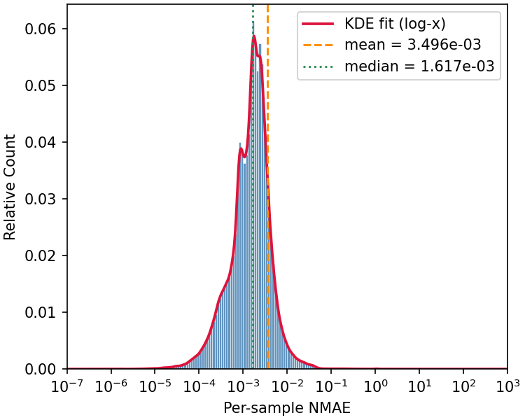
Results
Model size: 272 MB
Dataset:
24000 training & 1000 test geometries
Each geometry has 95 x and y wavevector combinations
Each geometry has 6 displacement modes (bands)
Training criterion: Huber loss (L2, followed by L1)
Training time: 1 day on 1 NVIDIA 4080 GPU
Inference time: <1ms per sample
Performance: Average normalized mean absolute error (NMAE) is 0.35%, median is 0.16% error
This model can be used to predict the shapes and temporal frequencies of multiple (6) deformation modes for each geometry, for any wavevector stimuli (within the IBZ)
Biggest contribution to performance is from wavelet embeddings for wavevector and band information which more richly interact with model weights in the spectral and spatial branches of each FNO layer.
Dispersion
Performance
Test set
Performance

Slide 4
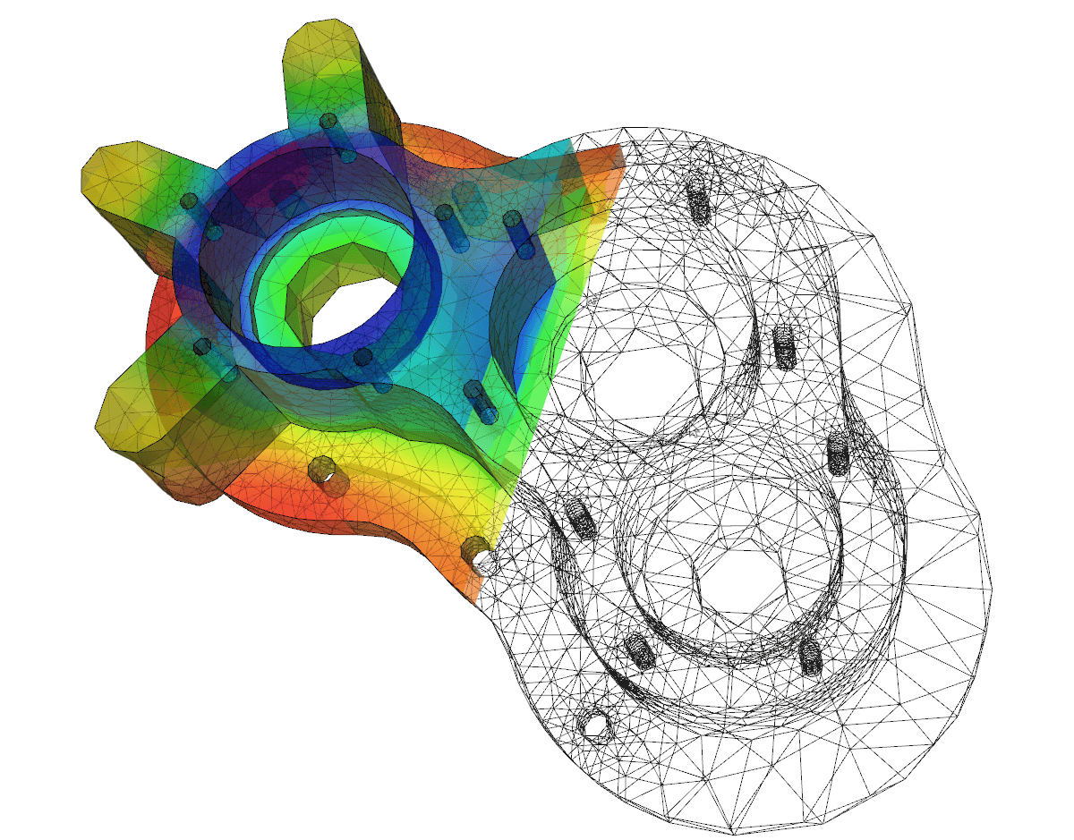
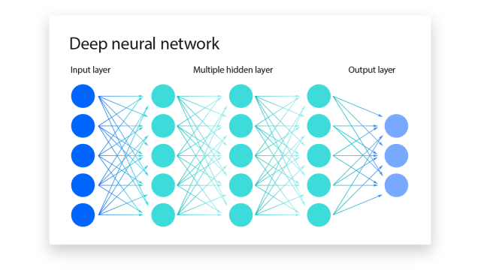
Motivation & Applications
The solving of PDEs is the fundamental problem
Analytical solutions are rare for real world problems
Numerical approaches (finite element methods)
Slow due to poor scaling laws.
Compute intensive so economically impractical
Traditional neural networks
Poor generalizability
Data intensive (upfront costs)
Neural operators
Generalizable across resolution
Relatively lightweight, because fundamentally, functions are more efficient representations than pointwise descriptions.
The applications are at minimum, anywhere where PDEs are used.
https://www.cambridge-dt.com/finite-element-analysis-predicting-the-real-world/
https://www.ibm.com/topics/neural-networks

Slide 5
Methodology
Input ‘a’ is a function.
Ex. description of geometry
First layer ‘P’ lifts ‘a’ into a high dimensional space.
Maps finite dimensional function information to something closer to an infinite dimensional function space that is the domain of our operator in training.
Neural operator (Fourier) layers
Fourier transformations on continuous functions
Two bias terms, b(x) and W(v(x))
Linear transform R effectively discards some higher frequency modes (noise).
Last layer usually a projection layer that returns a function ‘u’ from high dimensional latent space to similar/same dimensionality as ‘a’
This is like the inverse of the first layer, mapping from (approximation) of infinite dimensional function space back to some finite dimension function space to give an approximation function.
Image from: N. Kovachki, et. al’s Neural Operator: Learning Maps Between Function Spaces With Applications to PDEs

Slide 6
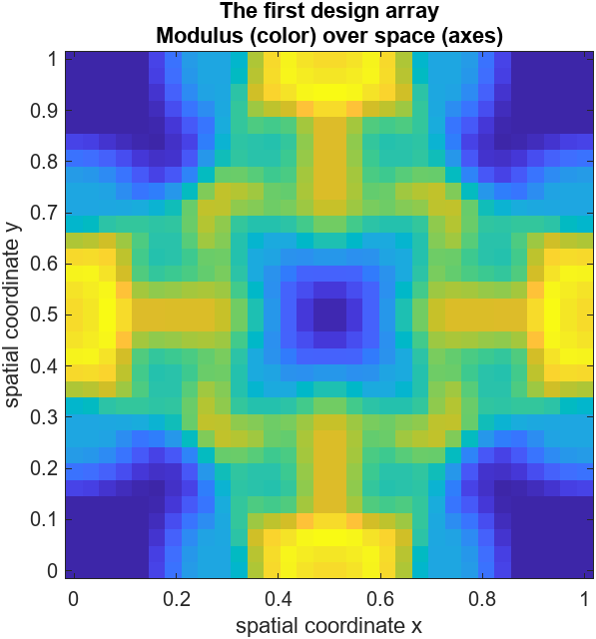
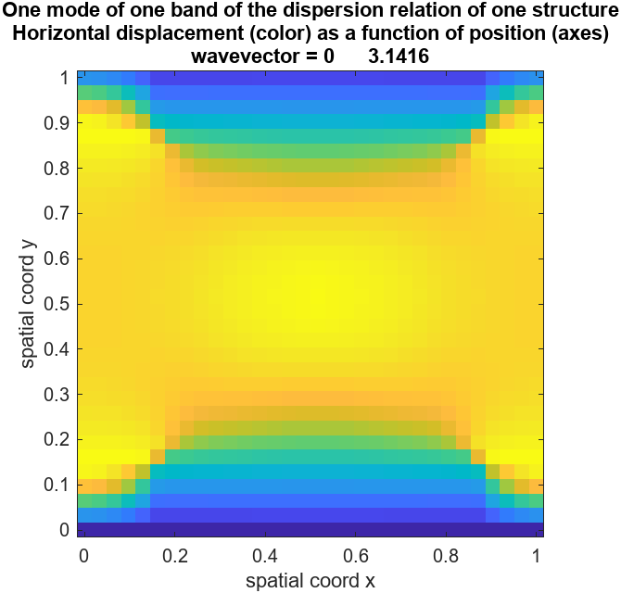
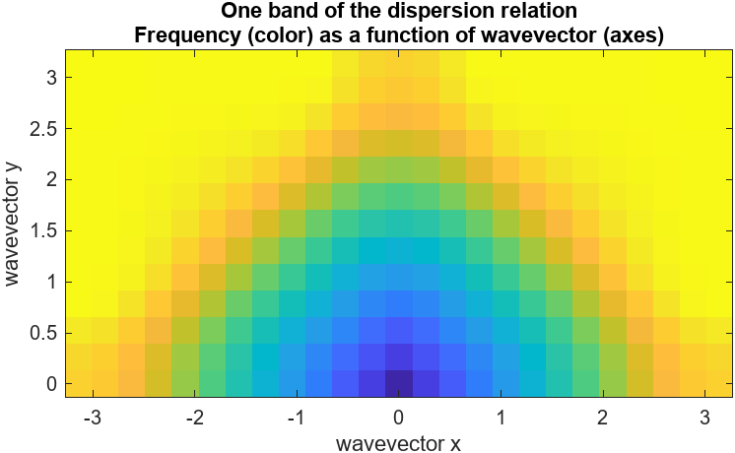
Data & Results
Encode as function
Neural Operator
Decode from function
Alternative Output

