Slide 1
Fourier Neural Operators as a Surrogate Eigenvalue PDE Solver for Acoustic Metamaterials
Han Zhang

Slide 2
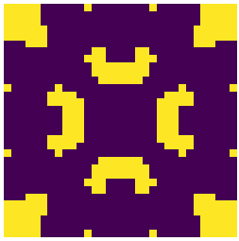
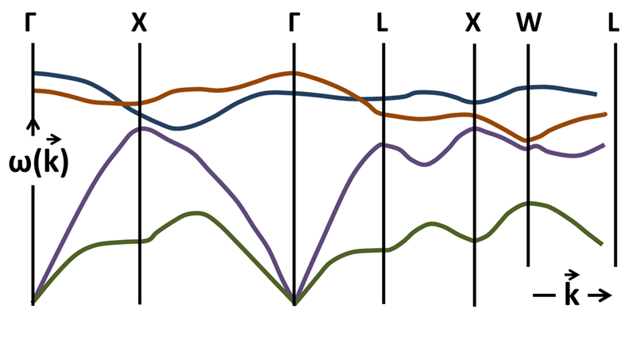
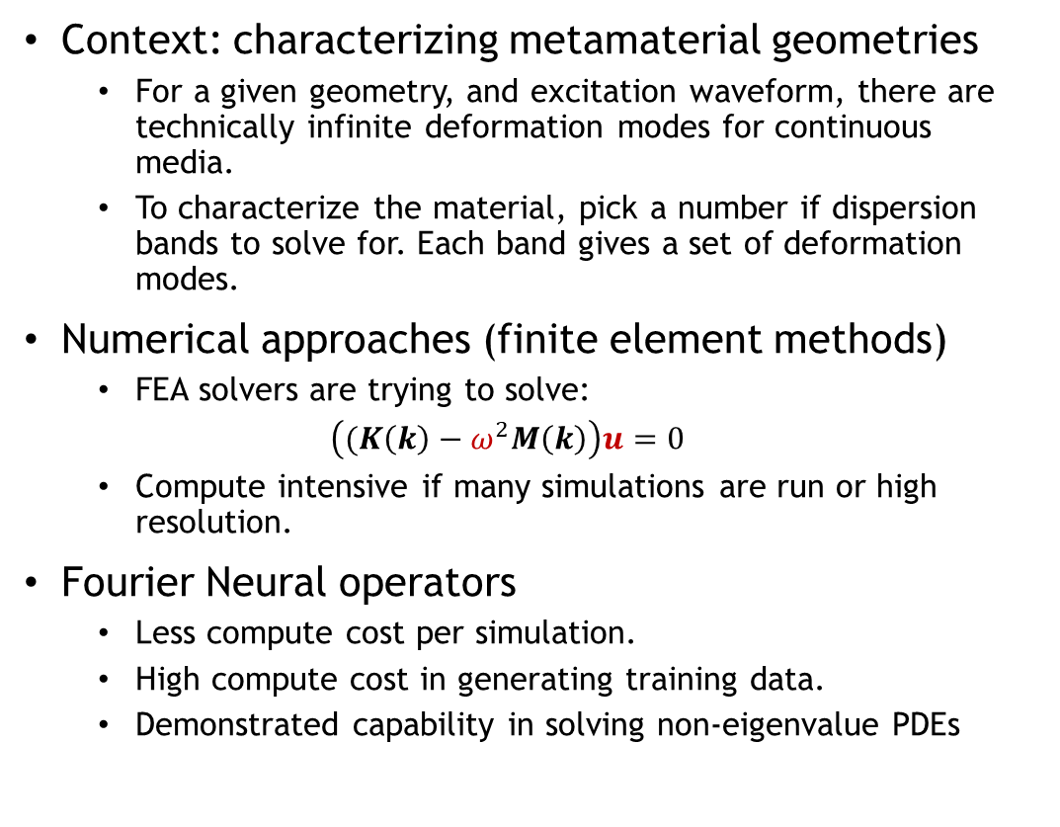
Introduction
Context: characterizing metamaterial geometries
For a given geometry, and excitation waveform, there are technically infinite deformation modes for continuous media.
To characterize the material, pick a number if dispersion bands to solve for. Each band gives a set of deformation modes.
Numerical approaches (finite element methods)
FEA solvers are trying to solve:
$\left((K\left(k\right)−ω^{2}M\left(k\right)\right)u=0$
Compute intensive if many simulations are run or high resolution.
Fourier Neural operators
Less compute cost per simulation.
High compute cost in generating training data.
Demonstrated capability in solving non-eigenvalue PDEs
Waveform (k)
Geometry
Dispersion Relation w(k)

Slide 3
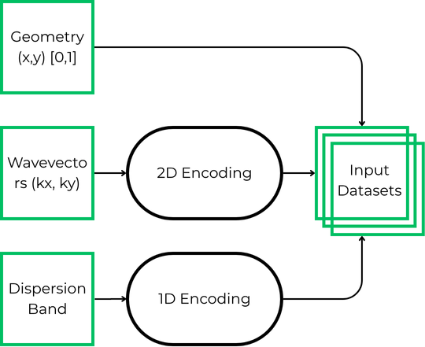
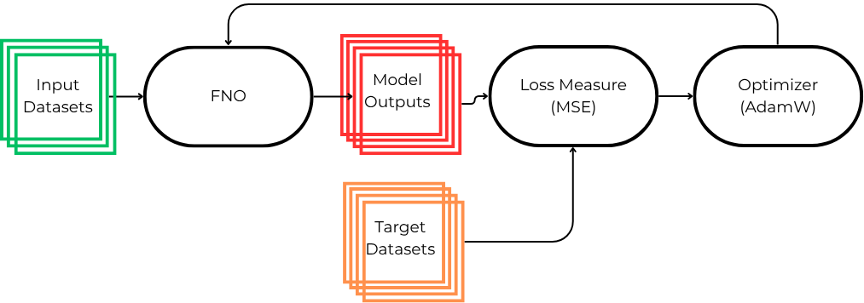
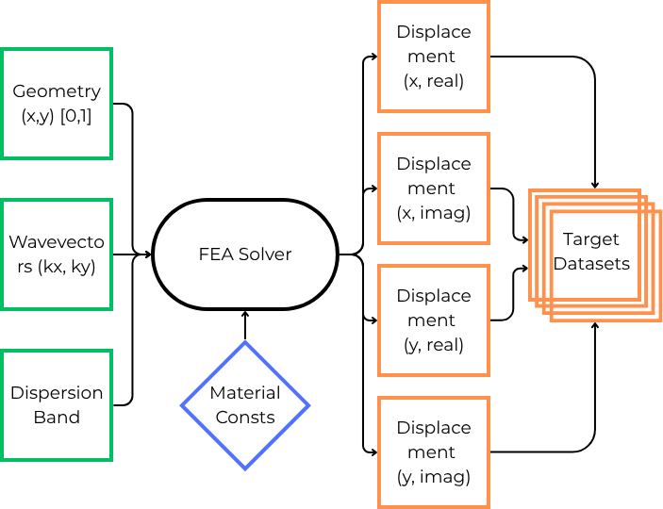
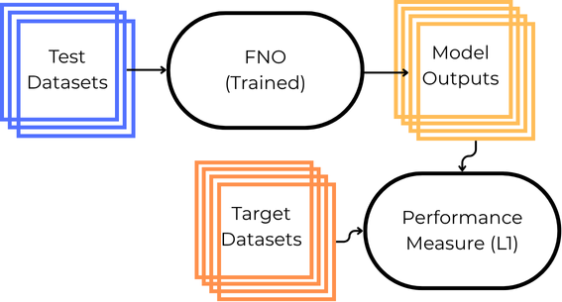
Methodology
Generate Input Data
Train Model
Generate
Output Data
Evaluate Model

Slide 4
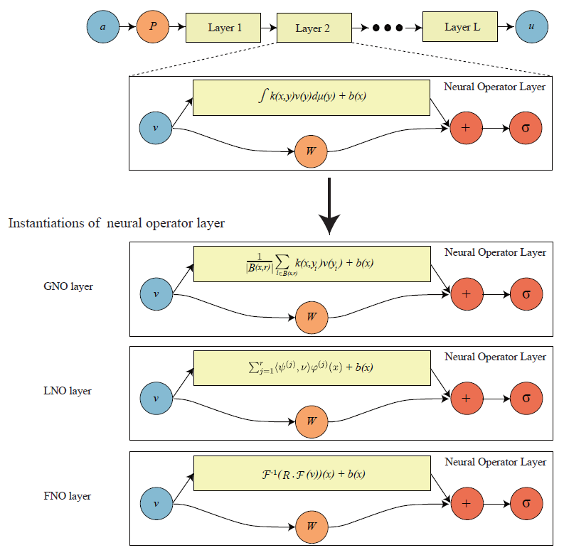
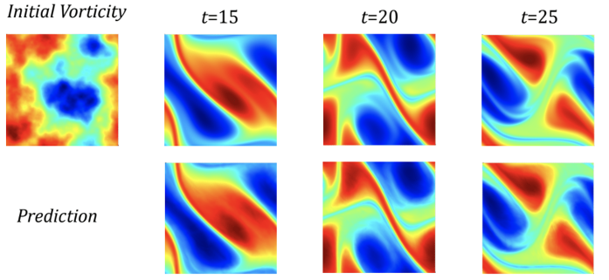
FNO Architecture
Input ‘a’ can be a raw input or an encoding of raw data.
Ex. Geometry image, encoded waveform.
First layer ‘P’ lifts ‘a’ into a high dimensional space.
Maps finite dimensional input information to something closer to an infinite (much higher) dimensional function space that is the domain of our operator in training.
Spectral (Fourier) layers
2 branches before summation and non-linear activation function.
First branch deals with the spatial information of the input.
Second branch deals with the frequency information of the input.
Two weight matrices R, W, and bias b are trained.
Last layer usually a projection layer that returns outputs from a high dimensional latent space to input dimensionality.
(N. Kovachki, et. Al, JMLR 2023)
(Li, Zongyi, et. Al, ICLR 2021)

Slide 5
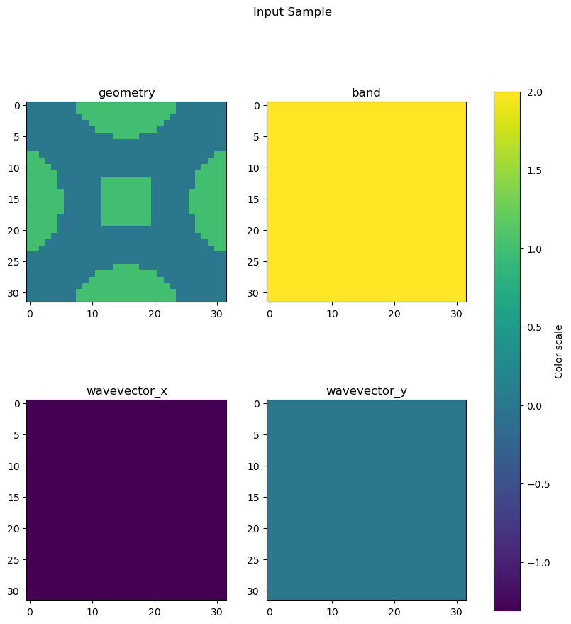
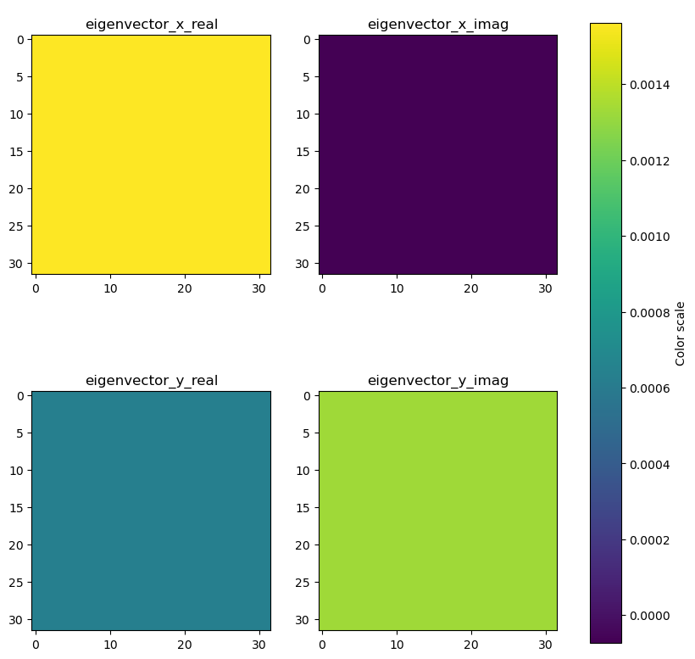
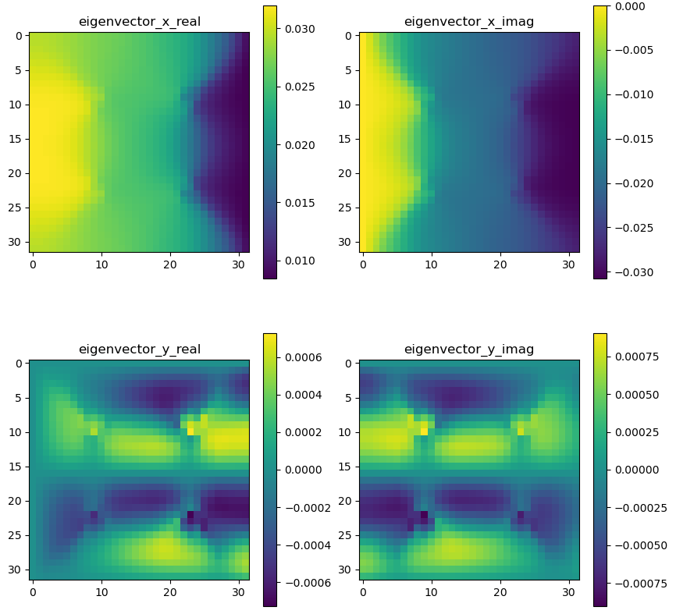
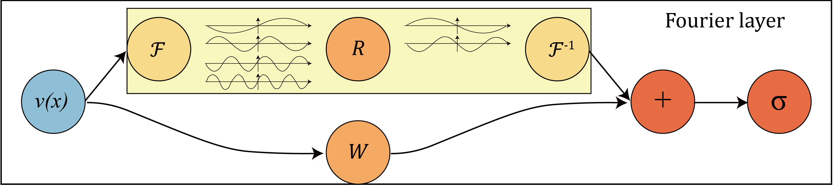
Constant Field Encoding
Inputs
Geometry given in spatial representation (32x32 pixels)
Band given as a field of constants ranging from [1/6,1], representing 6 bands.
Wavevector given as two separate fields of constants, kx and ky, ranging from [-1, 1], representing [-π, π]
Outputs
Targets
(Li, Zongyi, et. Al, ICLR 2021)
FFT
0

Slide 6
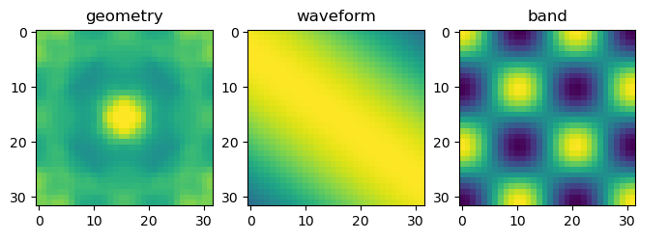
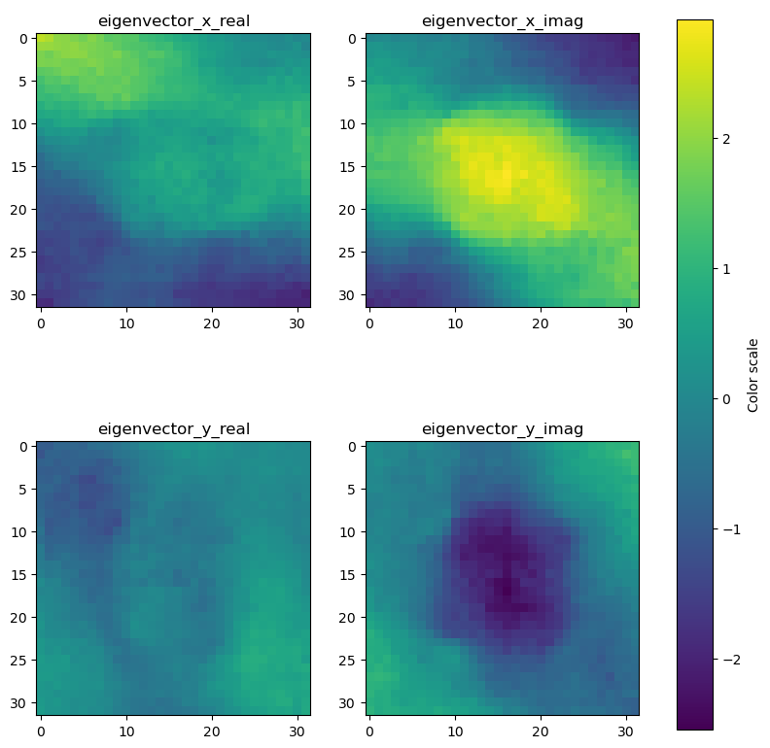
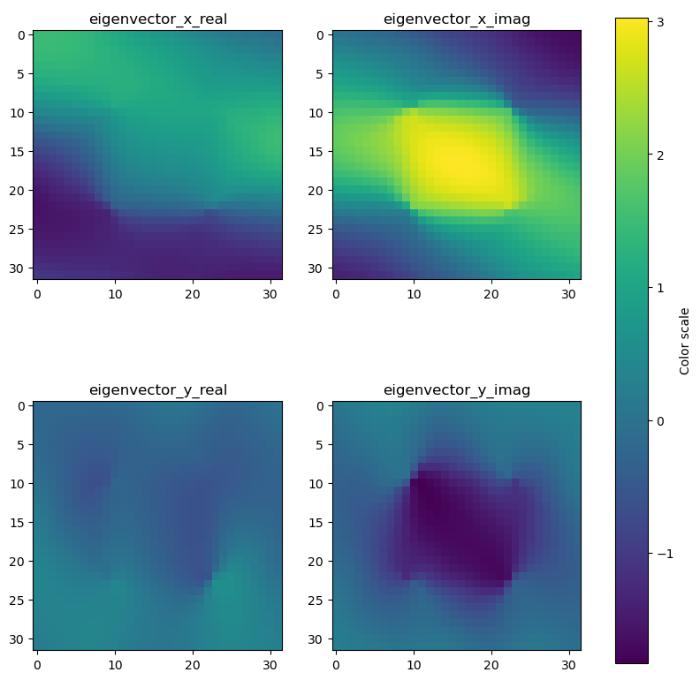
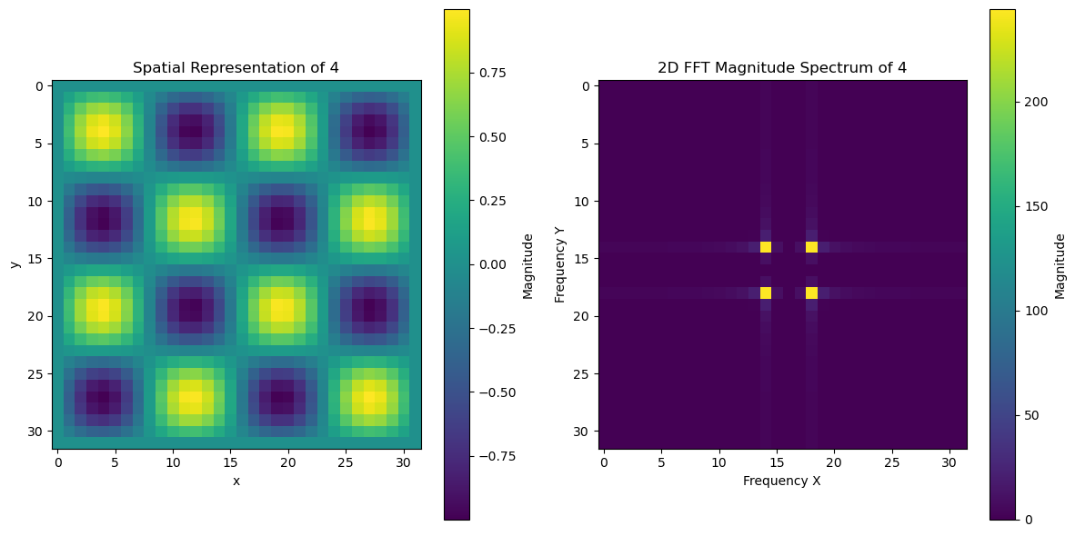
Sinusoidal Field Encoding
Inputs
Geometry given in spatial representation (32x32 pixels) [0,1]
Band given as the frequency of a 2D sinusoidal function. [-1,1]
Wavevector given as two frequencies of a 2D sinusoidal function. [-1,1]
Outputs
Targets
(Li, Zongyi, et. Al, ICLR 2021)

Slide 7
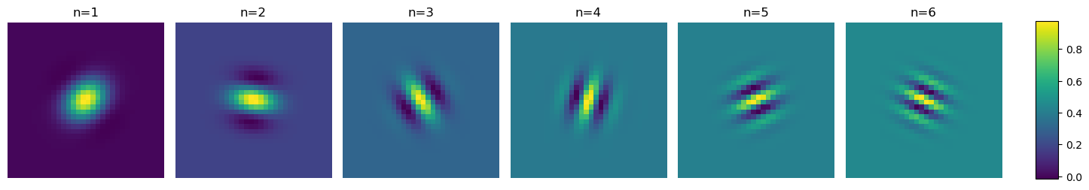
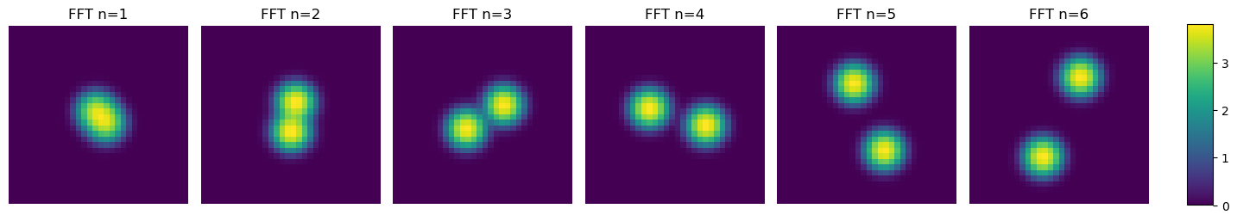
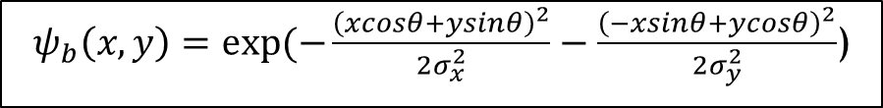
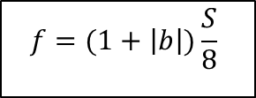
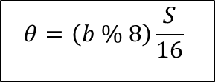
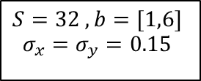
1D (Band) Wavelet Encoding
$$S=32 , b=[1,6]$$
$$σ_{x}=σ_{y}=0.15$$
$$f=(1+\left|b\right|)\frac{S}{8}$$
$$θ=\left(b \% 8\right)\frac{S}{16}$$
$ψ_{b}\left(x,y\right)=exp⁡(−\frac{{\left(xcosθ+ysinθ\right)}^{2}}{2σ_{x}^{2}}−\frac{{\left(−xsinθ+ycosθ\right)}^{2}}{2σ_{y}^{2}}$)

Slide 8
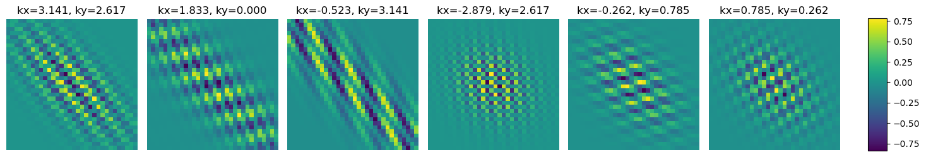
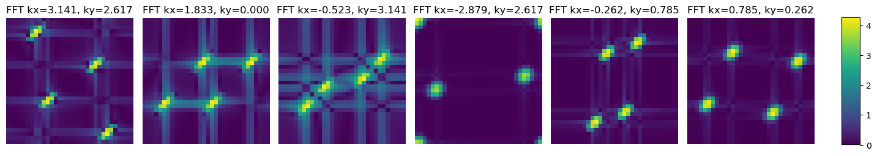
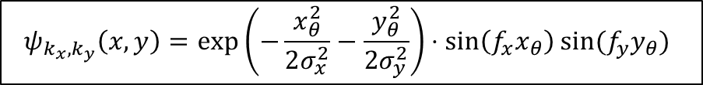
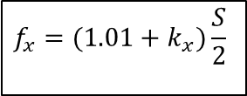
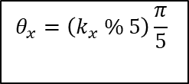
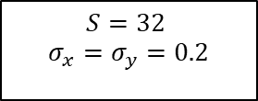
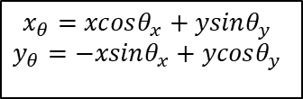
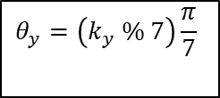
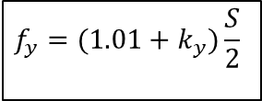
$$S=32$$
$$σ_{x}=σ_{y}=0.2$$
$$f_{x}=(1.01+k_{x})\frac{S}{2}$$
$$f_{y}=(1.01+k_{y})\frac{S}{2}$$
2D (Band) Wavelet Encoding
$$θ_{x}=\left(k_{x} \% 5\right)\frac{π}{5}$$
$$θ_{y}=\left(k_{y} \% 7\right)\frac{π}{7}$$
$$x_{θ}=xcosθ_{x}+ysinθ_{y}$$
$$y_{θ}=−xsinθ_{x}+ycosθ_{y}$$
$$ψ_{k_{x},k_{y}}\left(x,y\right)=\exp\left(−\frac{x_{θ}^{2}}{2σ_{x}^{2}}−\frac{y_{θ}^{2}}{2σ_{y}^{2}}\right)⋅\sin\left(f_{x}x_{θ}\right)sin⁡(f_{y}y_{θ})$$

Slide 9
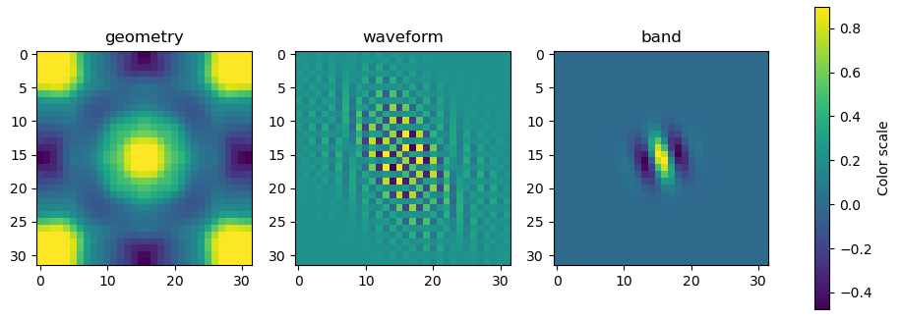
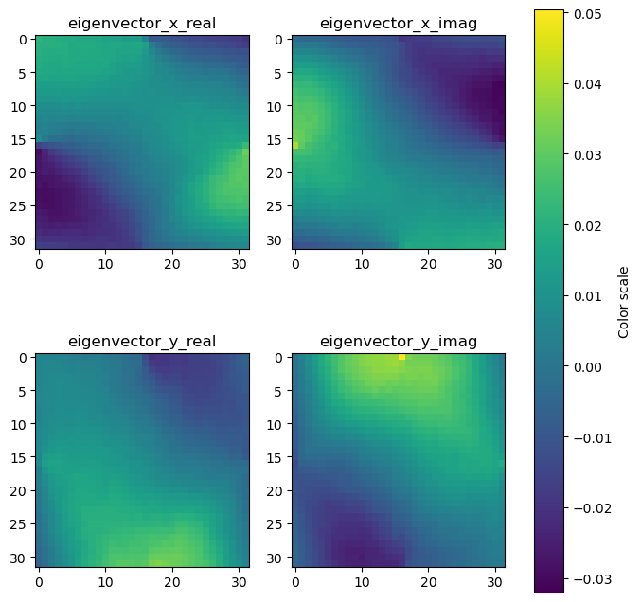
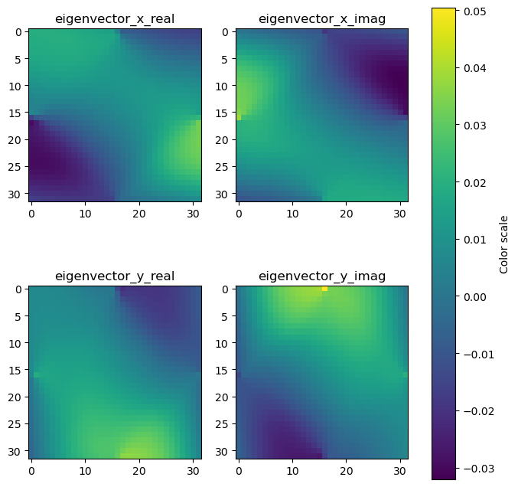
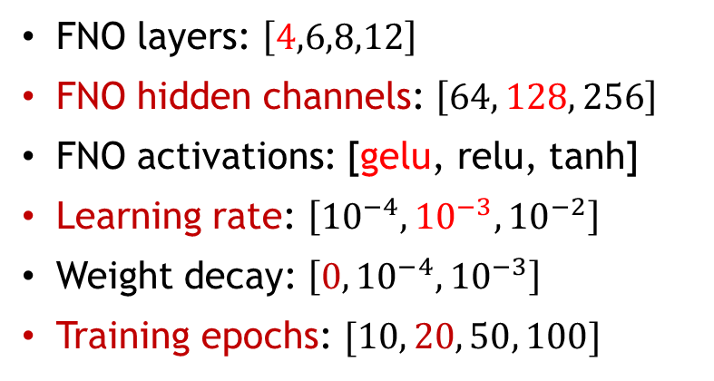
Wavelet Encoding
Inputs
Geometry given in spatial representation (32x32 pixels) [0,1]
Band encoded in the frequency and rotation angle of a Gabor wavelet function. (-1,1)
Wavevectors similarly encoded in a Gabor wavelet function. (-1,1)
Outputs
Targets
Hyperparameter Tuning
FNO layers: $\left[4,6,8,12\right]$
FNO hidden channels: $\left[64, 128, 256\right]$
FNO activations: [gelu, relu, tanh]
Learning rate: $\left[{10}^{−4},{10}^{−3}, {10}^{−2}\right]$
Weight decay: $\left[0,{10}^{−4}, {10}^{−3}\right]$
Training epochs: $[10, 20, 50, 100]$

