Slide 1
Fourier Neural Operators as a Surrogate Eigenvalue PDE Solver for Acoustic Metamaterials
Han Zhang

Slide 2
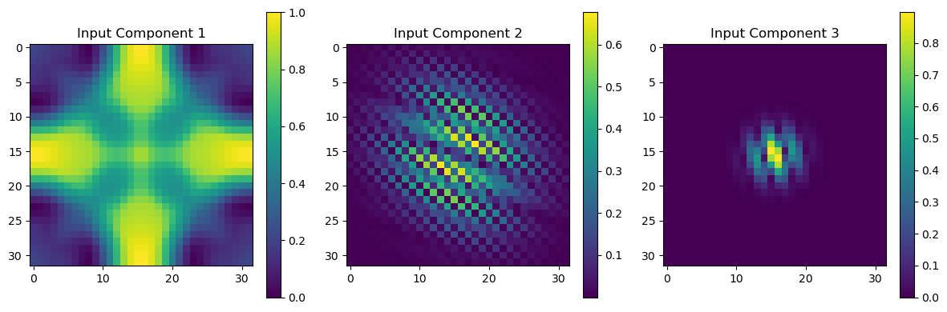
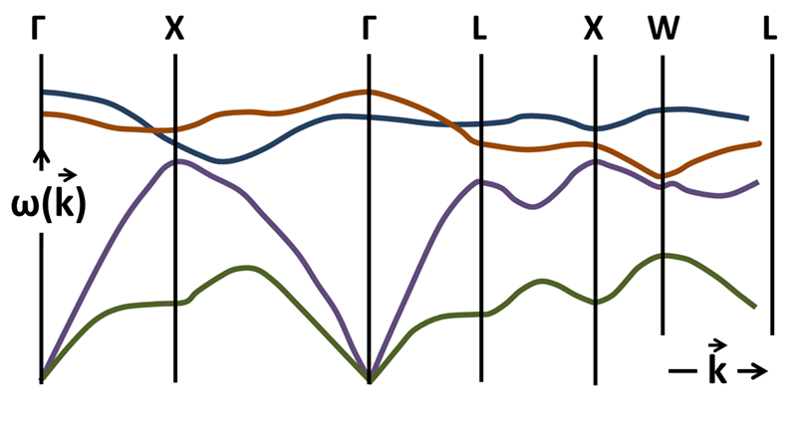
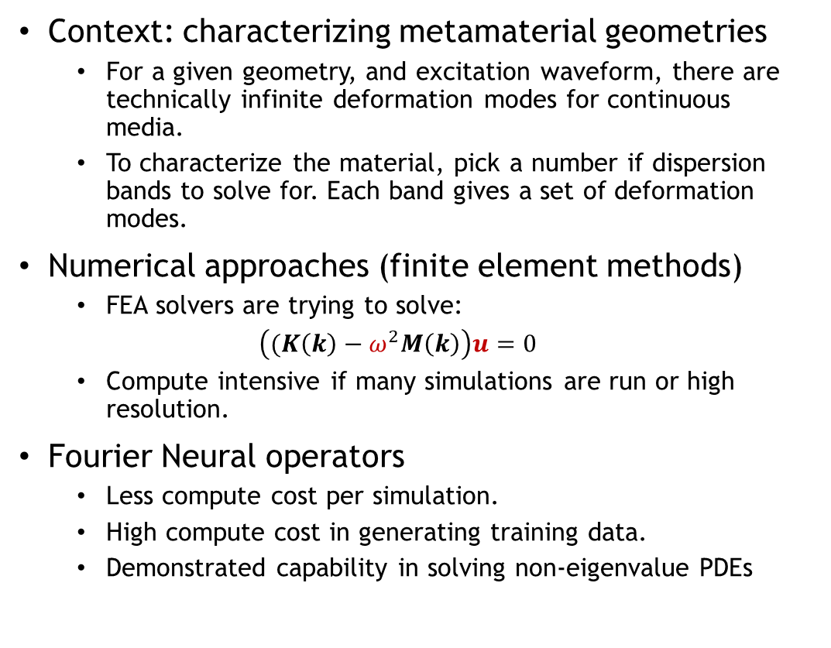
Introduction
Context: characterizing metamaterial geometries
For a given geometry, and excitation waveform, there are technically infinite deformation modes for continuous media.
To characterize the material, pick a number if dispersion bands to solve for. Each band gives a set of deformation modes.
Numerical approaches (finite element methods)
FEA solvers are trying to solve:
$\left((K\left(k\right)−ω^{2}M\left(k\right)\right)u=0$
Compute intensive if many simulations are run or high resolution.
Fourier Neural operators
Less compute cost per simulation.
High compute cost in generating training data.
Demonstrated capability in solving non-eigenvalue PDEs
Waveform (k)
Geometry
Dispersion Relation w(k)

Slide 3
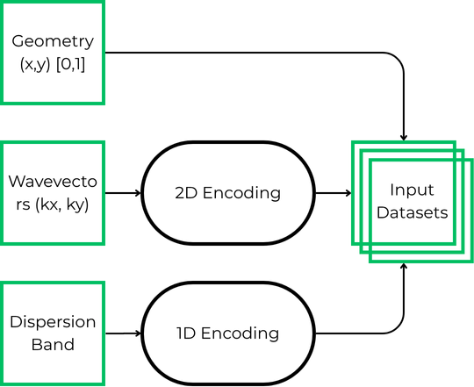
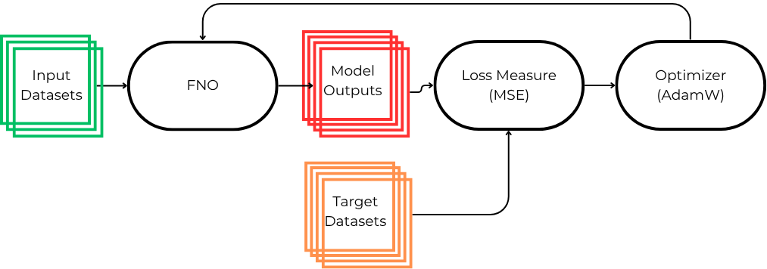
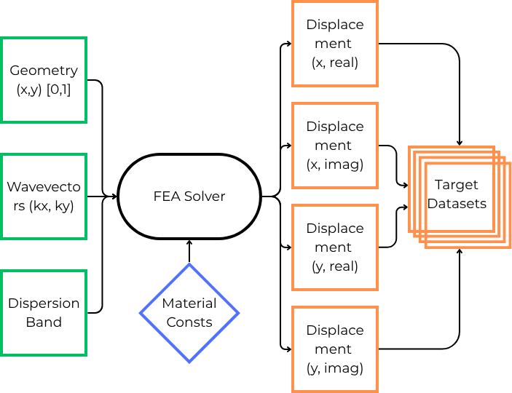
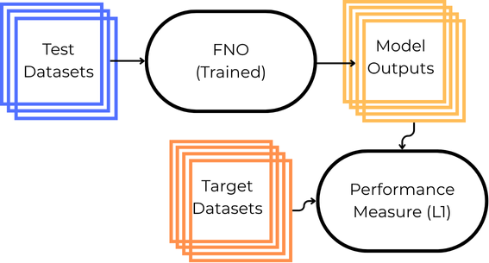
Methodology
Generate Input Data
Train Model
Generate
Output Data
Evaluate Model

Slide 4
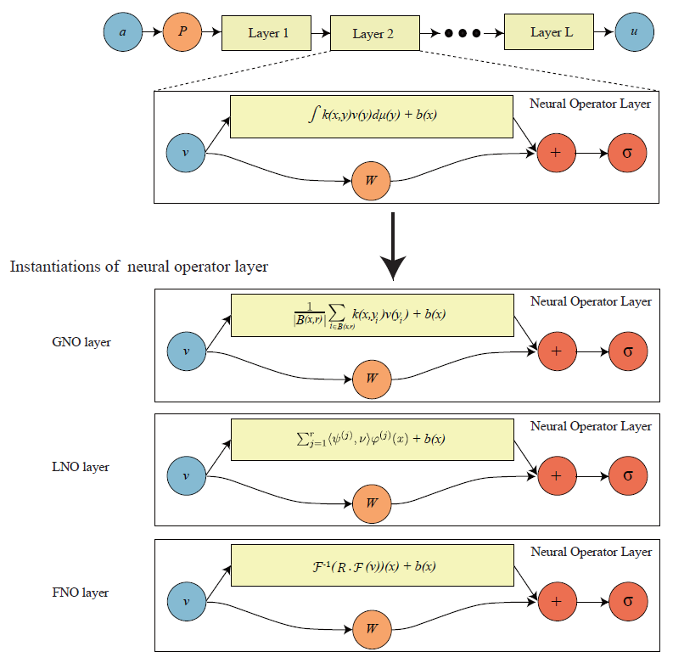
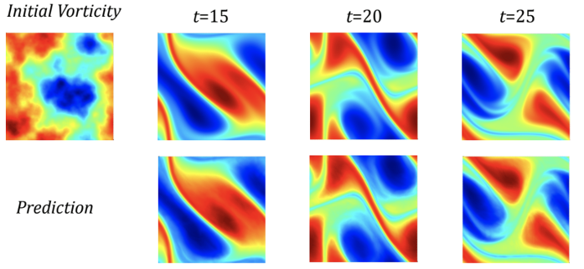
FNO Architecture
Input ‘a’ can be a raw input or an encoding of raw data.
Ex. Geometry image, encoded waveform.
First layer ‘P’ lifts ‘a’ into a high dimensional space.
Maps finite dimensional input information to something closer to an infinite (much higher) dimensional function space that is the domain of our operator in training.
Spectral (Fourier) layers
2 branches before summation and non-linear activation function.
First branch deals with the spatial information of the input.
Second branch deals with the frequency information of the input.
Two weight matrices R, W, and bias b are trained.
Last layer usually a projection layer that returns outputs from a high dimensional latent space to input dimensionality.
(N. Kovachki, et. Al, JMLR 2023)
(Li, Zongyi, et. Al, ICLR 2021)

Slide 5
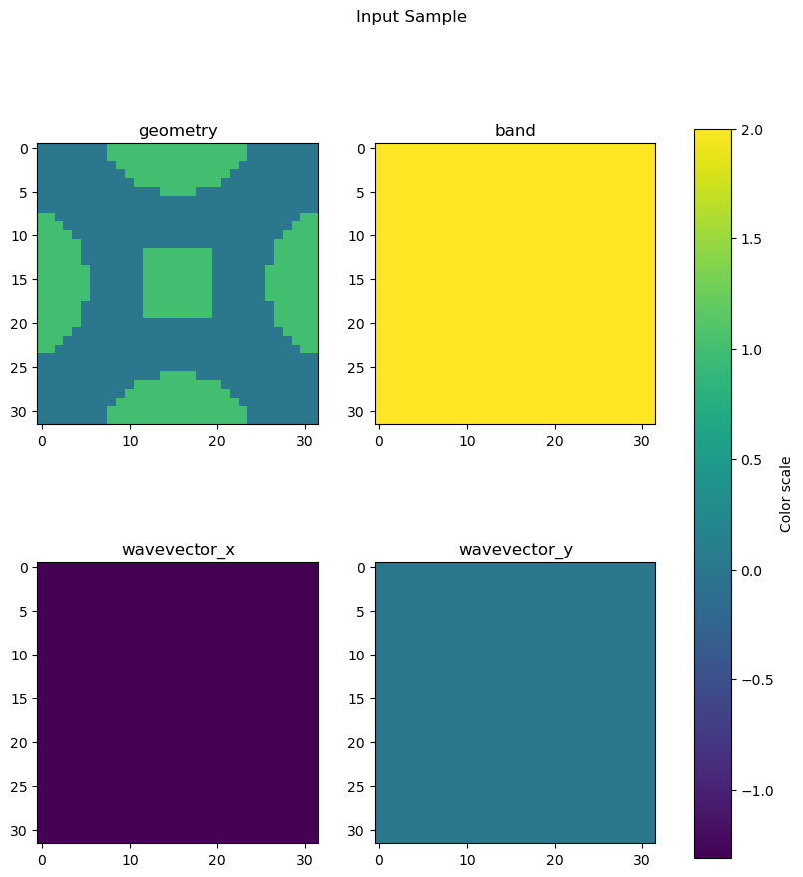
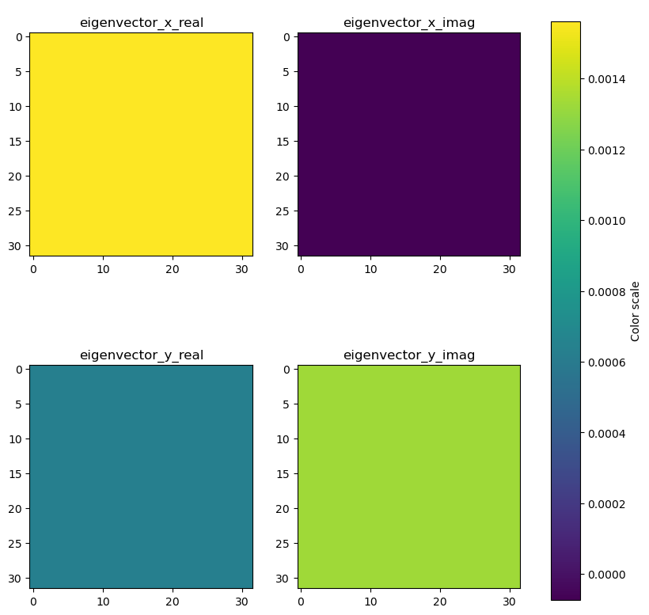
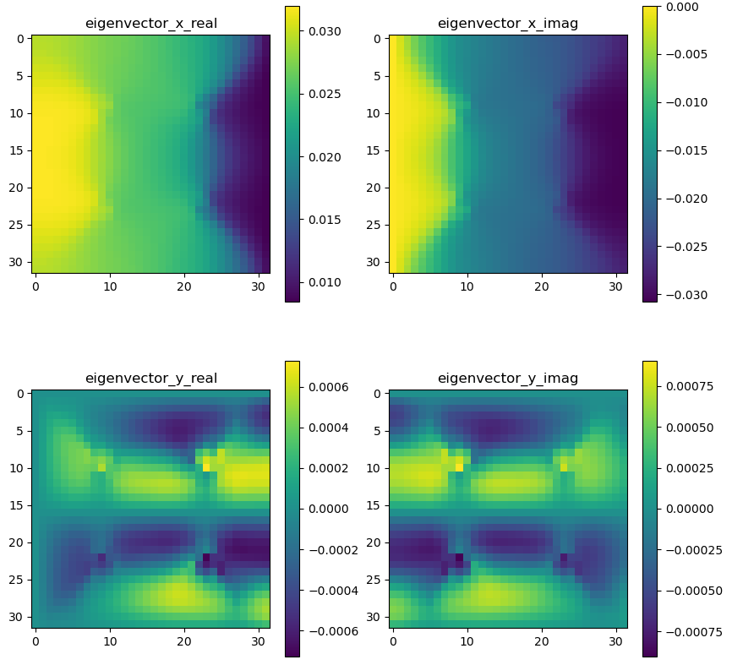
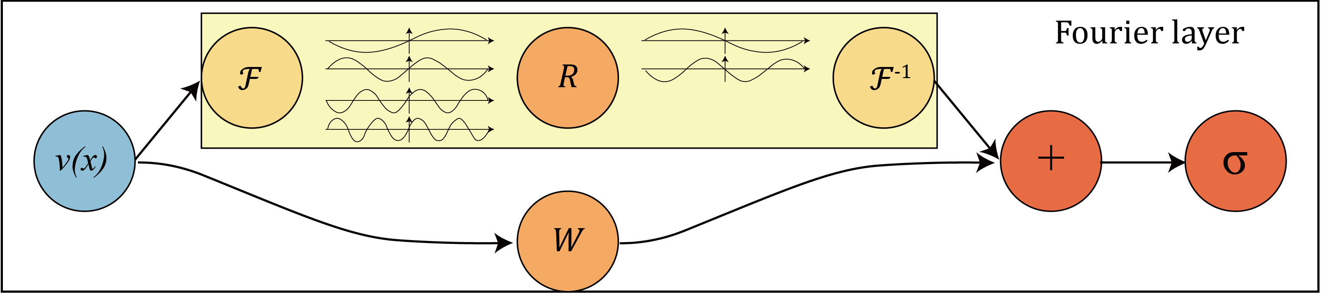
Constant Field Encoding
Inputs
Geometry given in spatial representation (32x32 pixels)
Band given as a field of constants ranging from [1/6,1], representing 6 bands.
Wavevector given as two separate fields of constants, kx and ky, ranging from [-1, 1], representing [-π, π]
Outputs
Targets
(Li, Zongyi, et. Al, ICLR 2021)
FFT
0

Slide 6
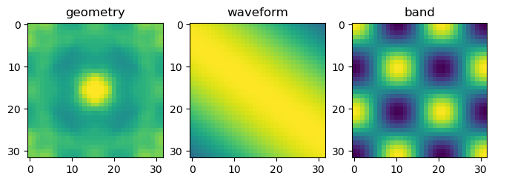
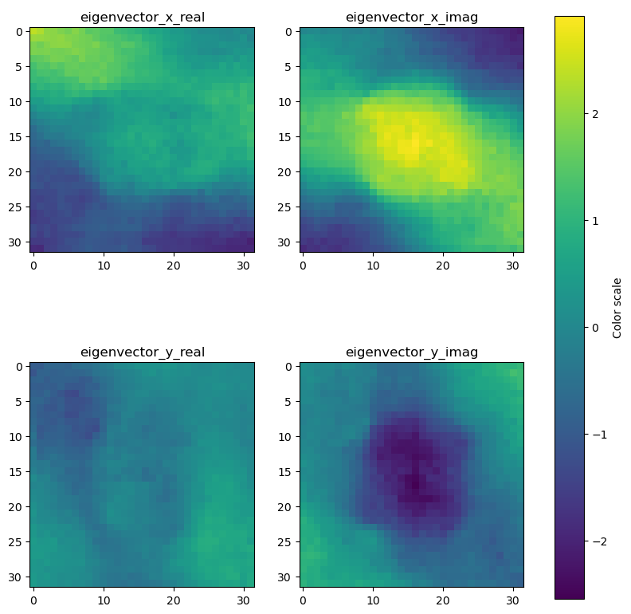
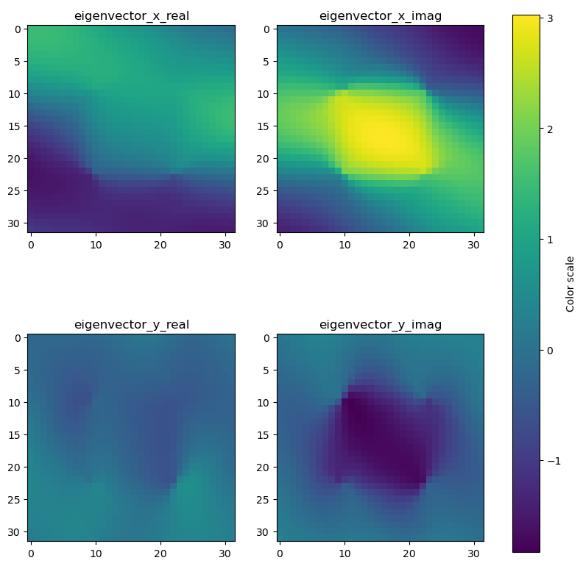
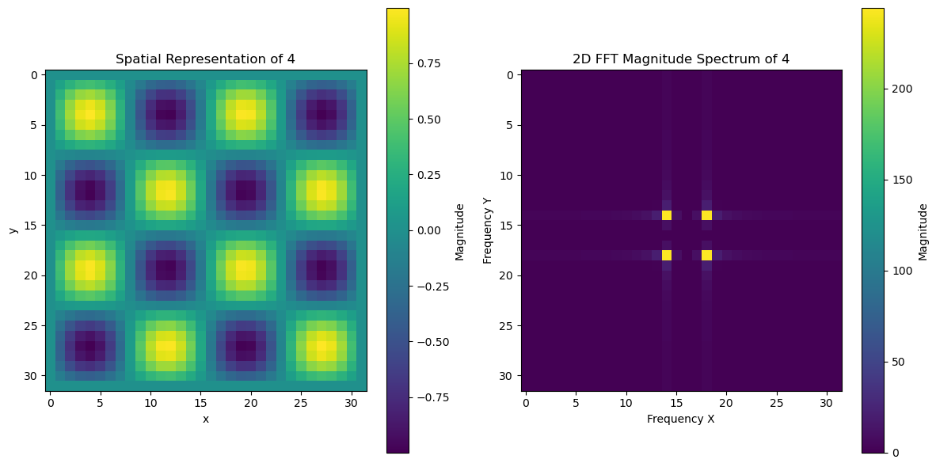
Sinusoidal Field Encoding
Inputs
Geometry given in spatial representation (32x32 pixels) [0,1]
Band given as the frequency of a 2D sinusoidal function. [-1,1]
Wavevector given as two frequencies of a 2D sinusoidal function. [-1,1]
Outputs
Targets
(Li, Zongyi, et. Al, ICLR 2021)

Slide 7
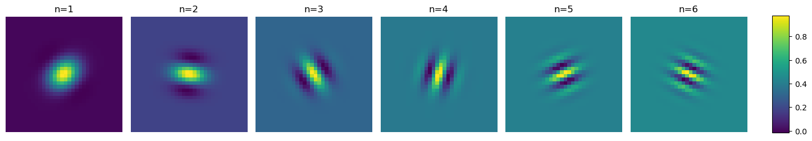
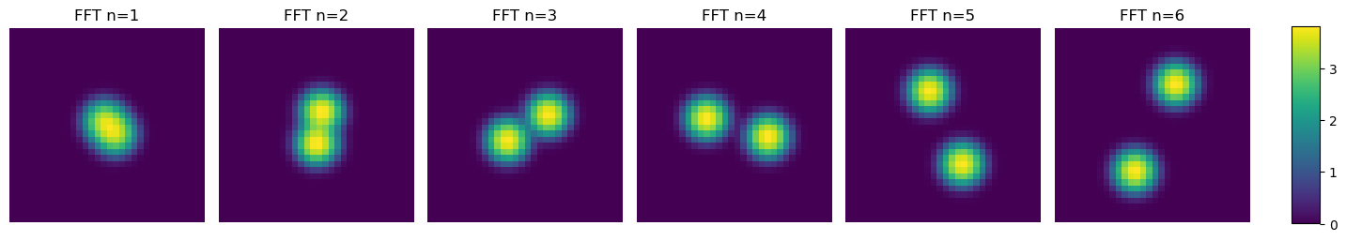
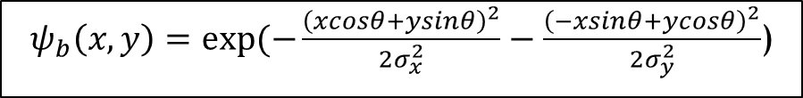
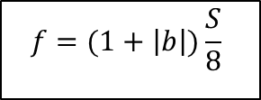
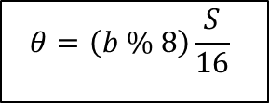
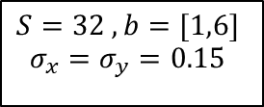
1D (Band) Wavelet Encoding
$$S=32 , b=[1,6]$$
$$σ_{x}=σ_{y}=0.15$$
$$f=(1+\left|b\right|)\frac{S}{8}$$
$$θ=\left(b \% 8\right)\frac{S}{16}$$
$ψ_{b}\left(x,y\right)=exp⁡(−\frac{{\left(xcosθ+ysinθ\right)}^{2}}{2σ_{x}^{2}}−\frac{{\left(−xsinθ+ycosθ\right)}^{2}}{2σ_{y}^{2}}$)

Slide 8
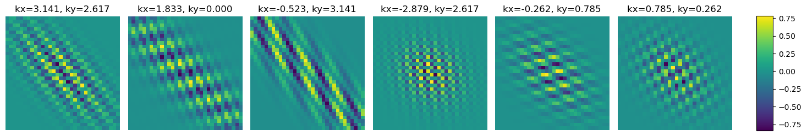
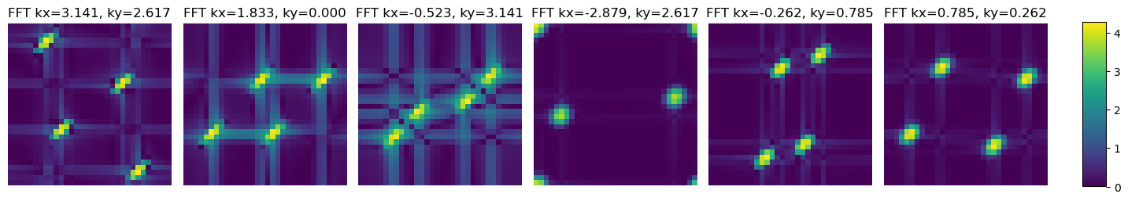
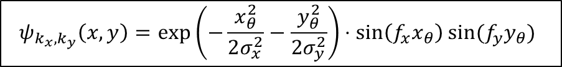
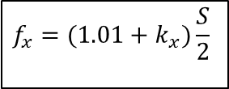
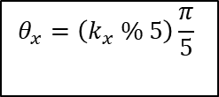
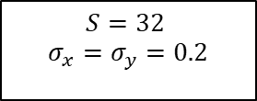
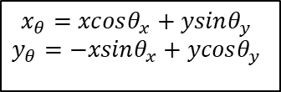
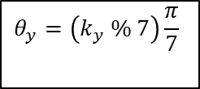
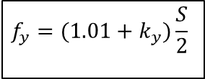
$$S=32$$
$$σ_{x}=σ_{y}=0.2$$
$$f_{x}=(1.01+k_{x})\frac{S}{2}$$
$$f_{y}=(1.01+k_{y})\frac{S}{2}$$
2D (Band) Wavelet Encoding
$$θ_{x}=\left(k_{x} \% 5\right)\frac{π}{5}$$
$$θ_{y}=\left(k_{y} \% 7\right)\frac{π}{7}$$
$$x_{θ}=xcosθ_{x}+ysinθ_{y}$$
$$y_{θ}=−xsinθ_{x}+ycosθ_{y}$$
$$ψ_{k_{x},k_{y}}\left(x,y\right)=\exp\left(−\frac{x_{θ}^{2}}{2σ_{x}^{2}}−\frac{y_{θ}^{2}}{2σ_{y}^{2}}\right)⋅\sin\left(f_{x}x_{θ}\right)sin⁡(f_{y}y_{θ})$$

Slide 9
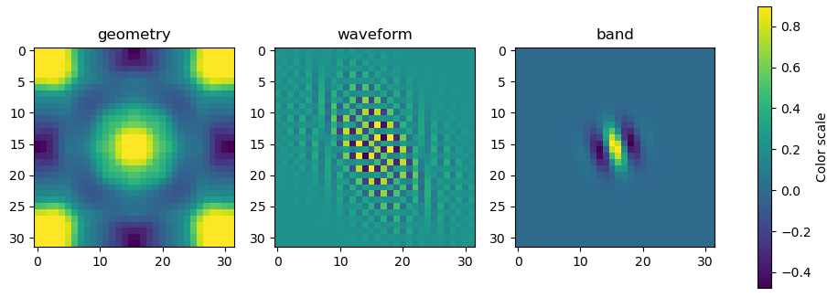
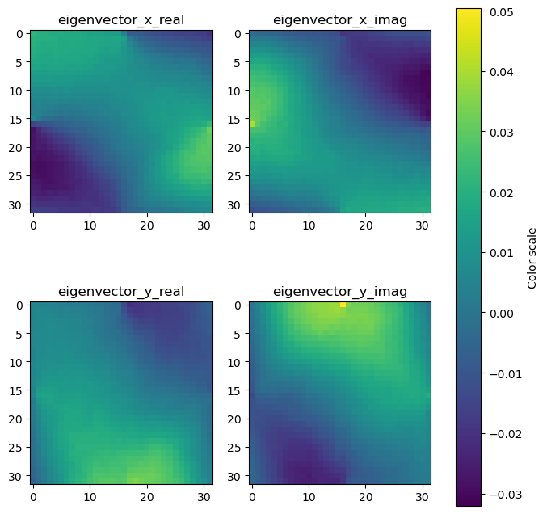
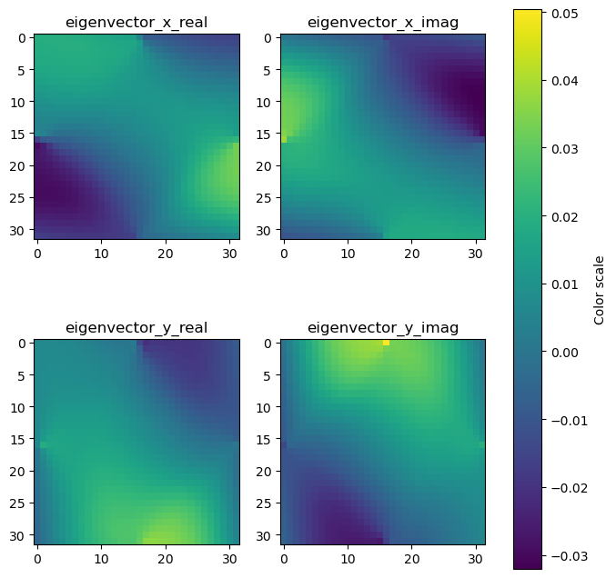
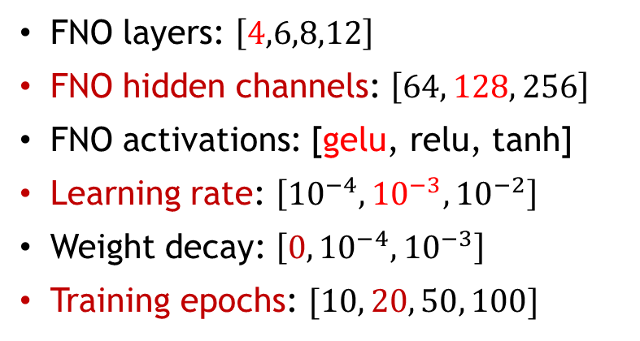
Wavelet Encoding
Inputs
Geometry given in spatial representation (32x32 pixels) [0,1]
Band encoded in the frequency and rotation angle of a Gabor wavelet function. (-1,1)
Wavevectors similarly encoded in a Gabor wavelet function. (-1,1)
Outputs
Targets
Hyperparameter Tuning
FNO layers: $\left[4,6,8,12\right]$
FNO hidden channels: $\left[64, 128, 256\right]$
FNO activations: [gelu, relu, tanh]
Learning rate: $\left[{10}^{−4},{10}^{−3}, {10}^{−2}\right]$
Weight decay: $\left[0,{10}^{−4}, {10}^{−3}\right]$
Training epochs: $[10, 20, 50, 100]$

Slide 10
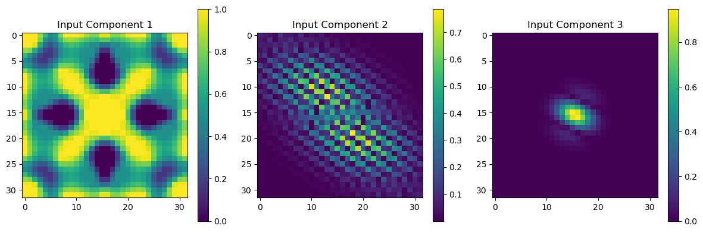
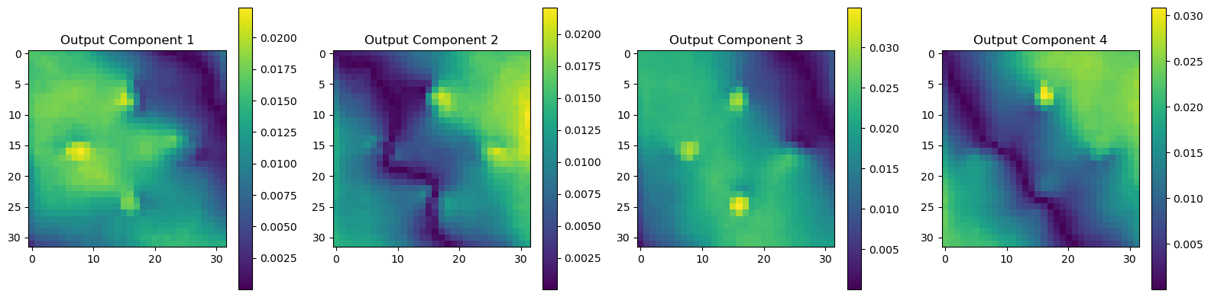
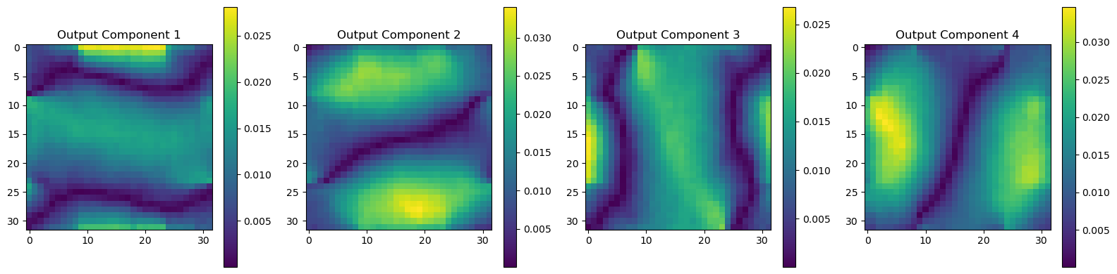
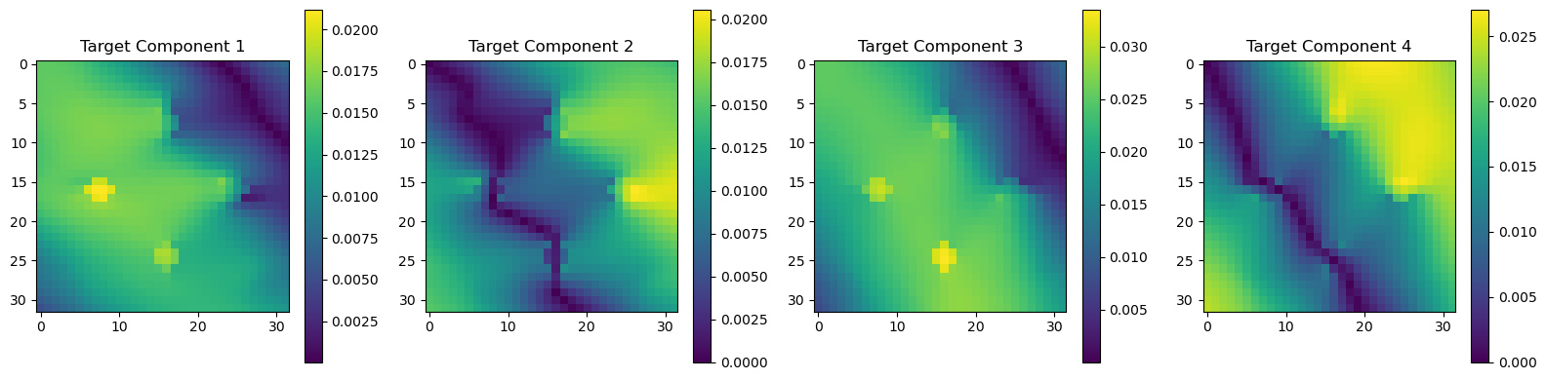
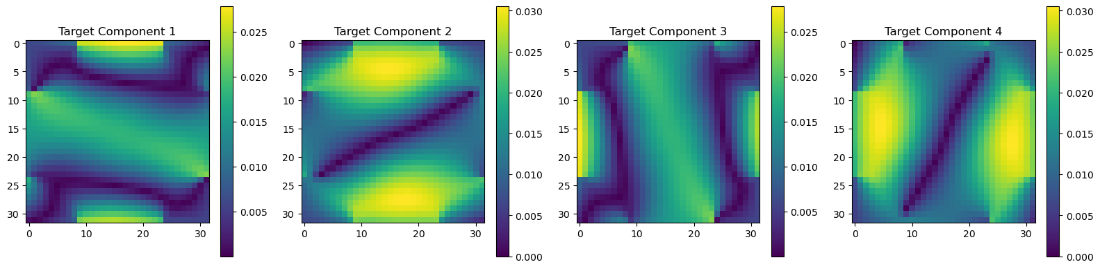
Performance On Novel Geometries
Random Sample 1
Inputs, Outputs, &Targets
Random Sample 2
Inputs, Outputs, &Targets

Slide 11
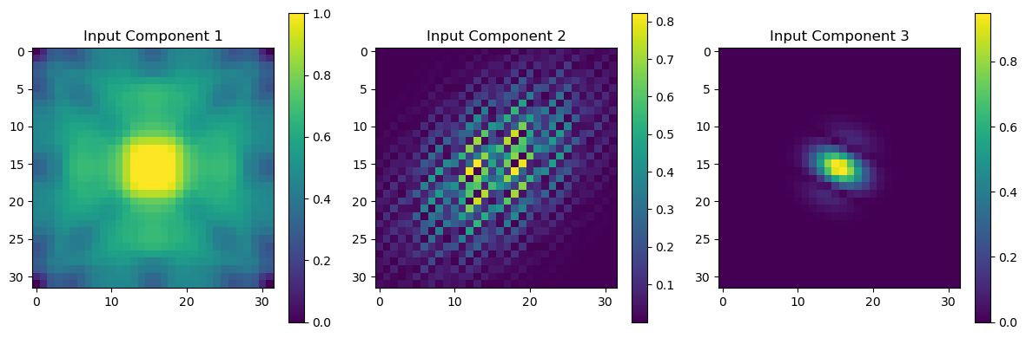
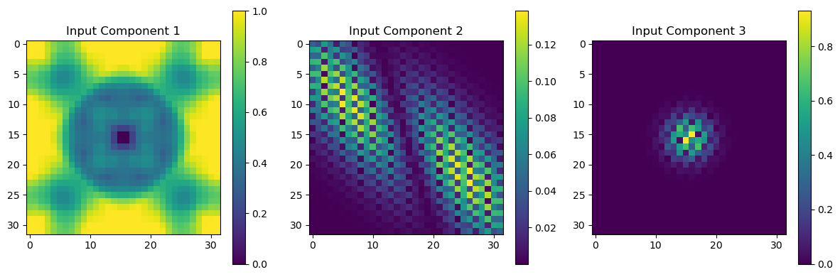
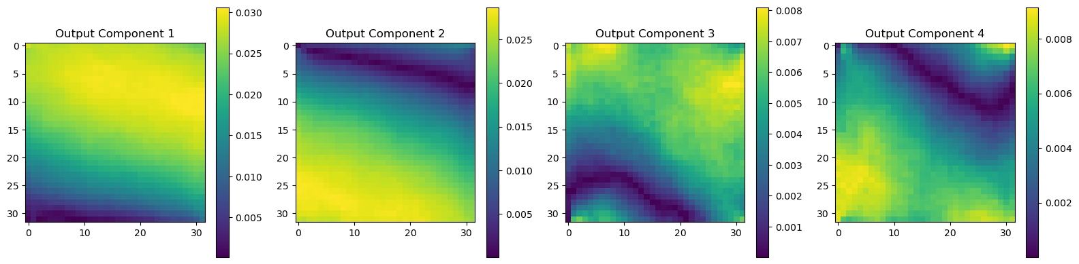
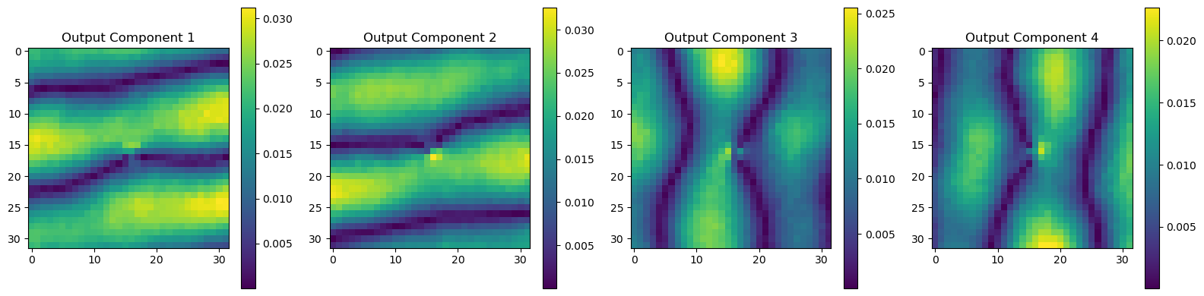
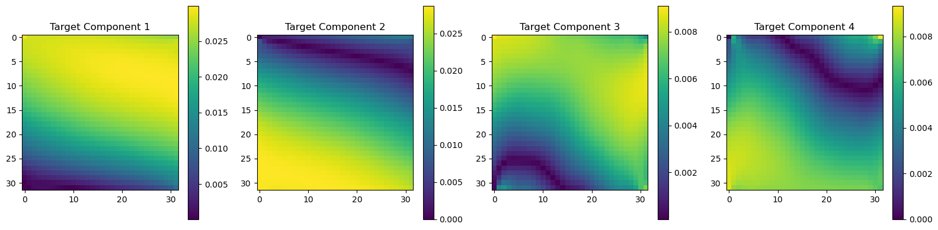
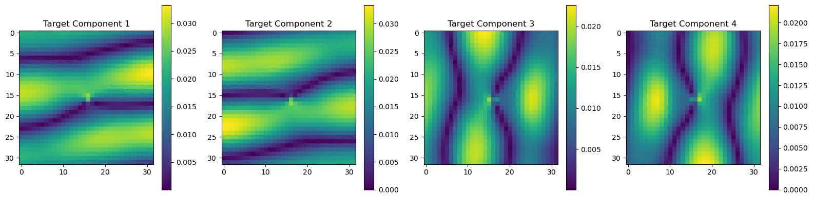
Performance On Novel Geometries
Random Sample 3
Inputs, Outputs, &Targets
Random Sample 4
Inputs, Outputs, &Targets

Slide 12
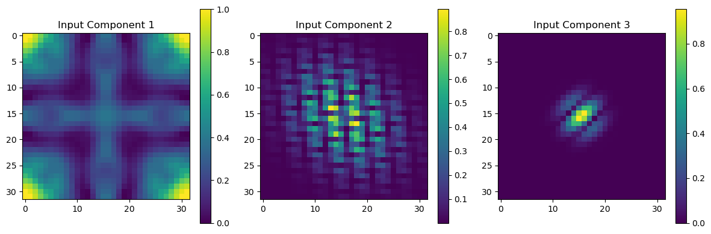
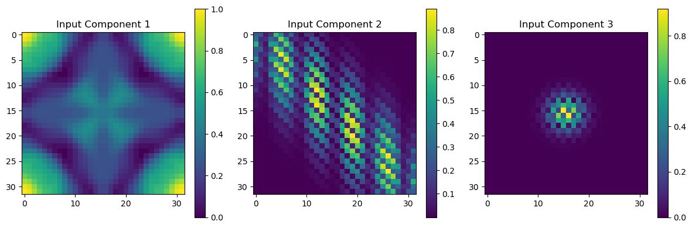
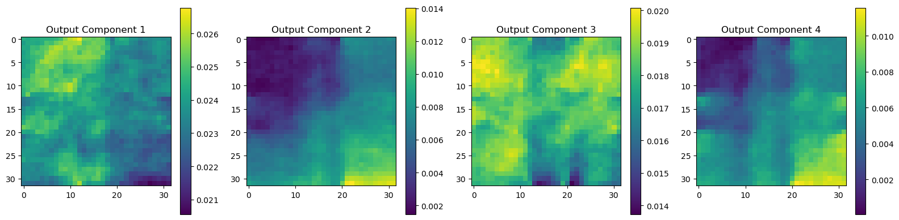



Performance On Novel Geometries
Picked Sample 1
Inputs, Outputs, &Targets
Picked Sample 2
Inputs, Outputs, &Targets

Slide 13

Conclusions & Future Work
FNOs are able to solve eigenvalue PDEs, and even deterministically toggle between different solutions for the same structure.
FNOs are intrinsically wavelet operators, due to their two branch nature
To maximize FNO effectiveness, both spatial and frequency domain information should be passed in.
FNOs can extrapolate to unseen geometries, correctly predicting multiple deformation modes (and their band order) for given excitations.
Learning rate needs to be kept low for this sort of model, there are areas of the loss landscape which are flat, which can optimizers to get stuck.
Train model with more geometry examples to increase performance on all possible geometries in the 8 fold symmetry group.
Expand to binary geometries (swap from continuous pixel values)
Expand to asymmetric geometries
Test model performance retention on half and double resolution scenarios.
Augment loss terms with physics informed terms. (More complicated for eigenvalue PDEs.)

Slide 14

FEA Process

Slide 15

Physics Informed Loss for an Eigenvalue PDE

Slide 16

Methodology Flowchart

