Slide 1
Uncertainty Quantification for 2D Metamaterials
Han Zhang

Slide 2
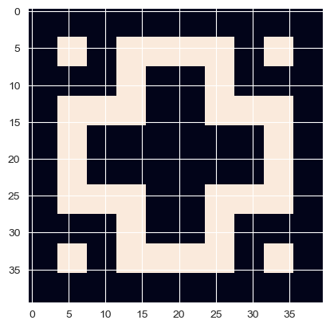
Input Parameters
Fixed Parameters:
Geometry Design, a 10x10 Boolean Array with 1 indicating hard material, 0 indicating soft material.
Random Parameters:
Soft material stiffness, E_soft, uniform distribution from 200e6±100e6
Hard material stiffness, E_hard, uniform distribution from 200e9±100e9
Soft material density, rho_soft, uniform distribution from 1e3±5e2
Hard material density, rho_hard, uniform distribution from 8e3±4e3
Soft material Poisson ratio, pr_soft, uniform distribution from 0.25±0.25
Hard material Poisson ratio, pr_hard, uniform distribution from 0.25±0.25
Outputs of interest:
Bandgap size
Bandgap location
Input dimensionality has important implications for UQ computation. More on this in following slides.

Slide 3
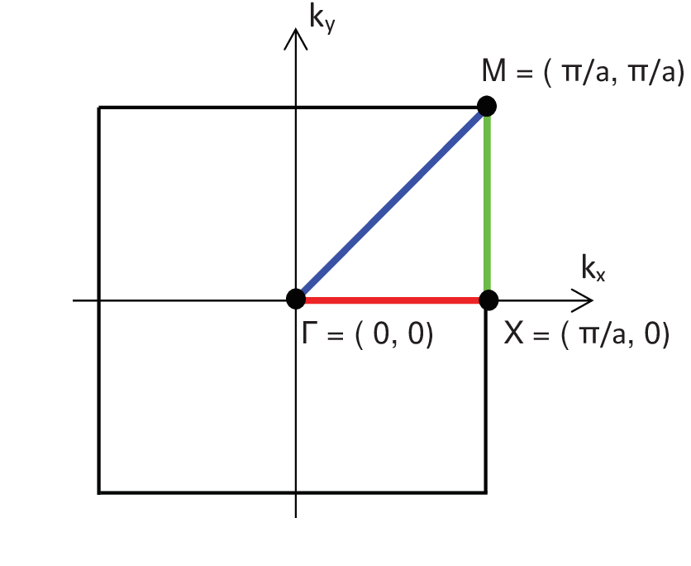
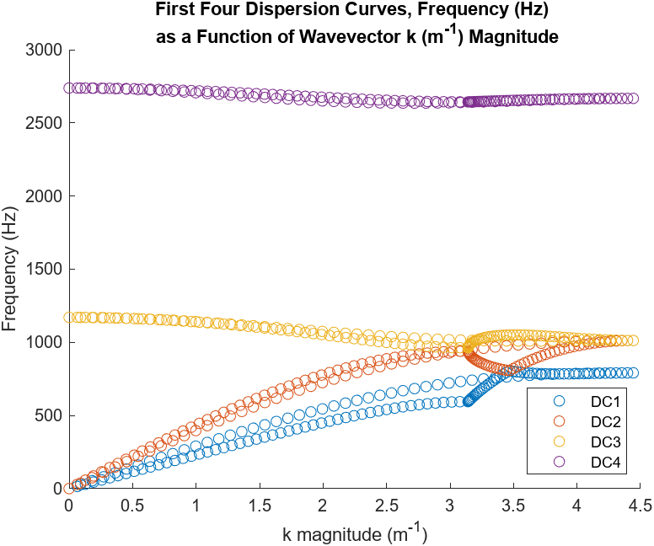
Dispersion Curve Calculations

Slide 4
7D Truncated Gaussian Distributions
E_soft: mean: 200e6 MPa, std: 8%
E_hard: mean: 200e9 MPa, std: 2%
Rho_soft: mean: 1e3 kg/m^3, std: 8%
Rho_hard: mean: 8e3 kg/m^3, std: 2%
Pr_soft: mean: 0.38, std: 2%
Pr_hard: mean: 0.28, std: 2%
Geo_fp: mean: 0.025, std: 8%

Slide 5
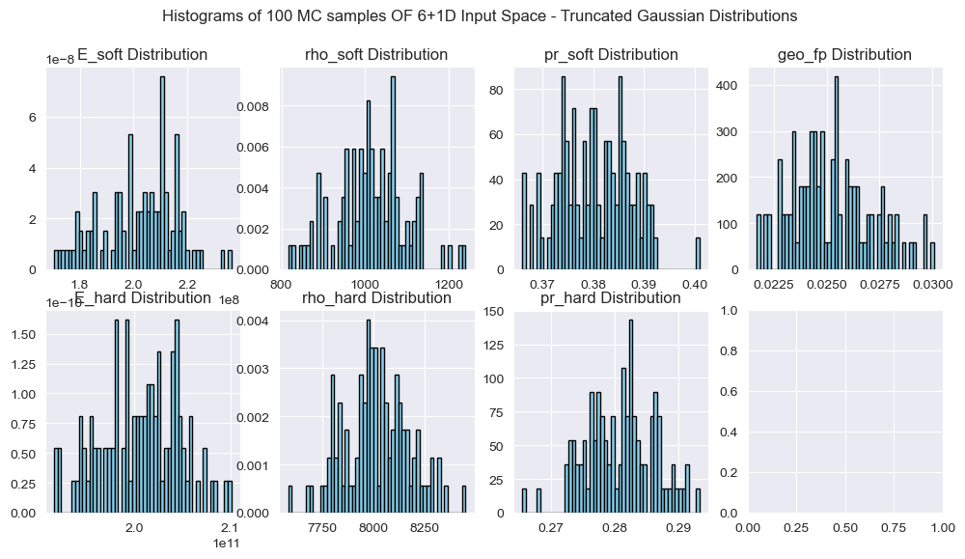
Histograms – 7D Truncated Gaussian 100 MC Inputs

Slide 6
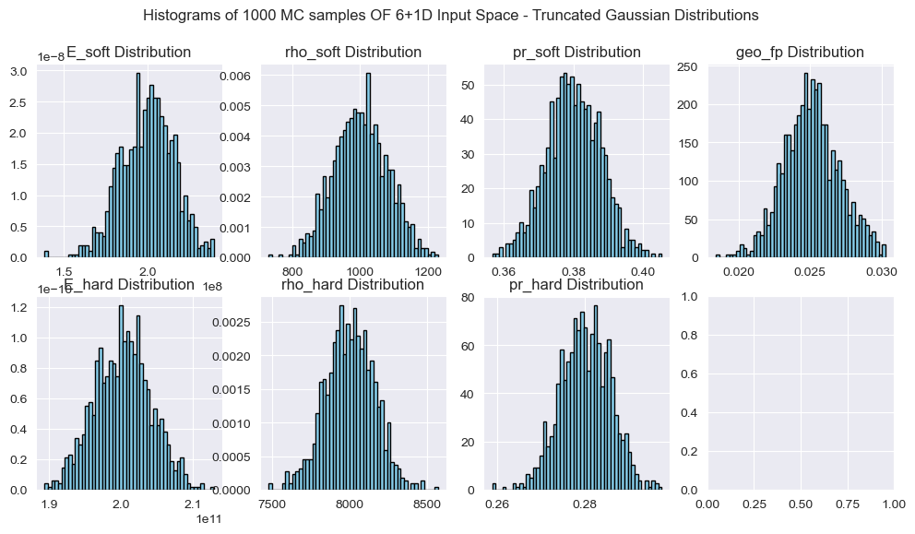
Histograms – 7D Truncated Gaussian 1000 MC Inputs

Slide 7
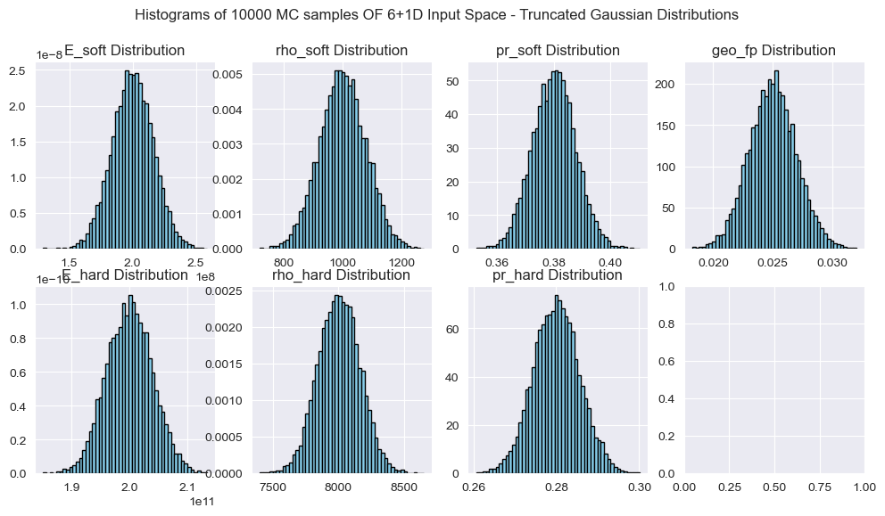
Histograms – 7D Truncated Gaussian 10000 MC Inputs

Slide 8
7D Gamma-Beta Distributions
Rho_soft: Gamma
Rho_hard: Gamma
K_soft: Gamma
K_hard: Gamma
G_soft: Gamma
G_hard: Gamma
Geo_fp: Beta

Slide 9
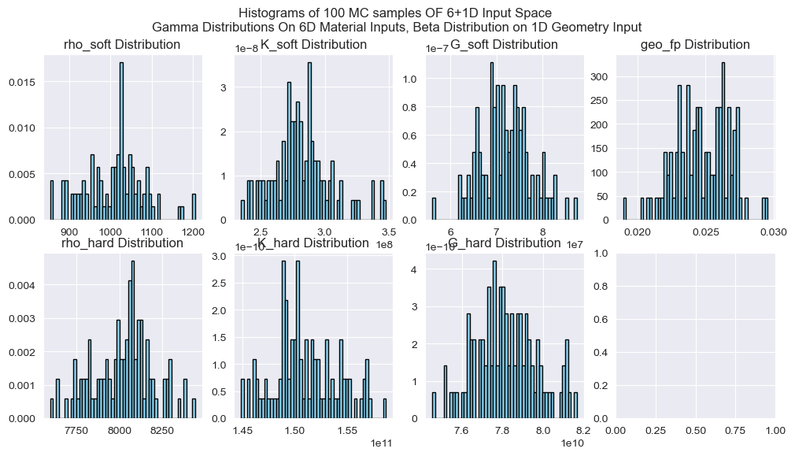
Histograms – 7D Truncated Gamma 100 MC Inputs

Slide 10
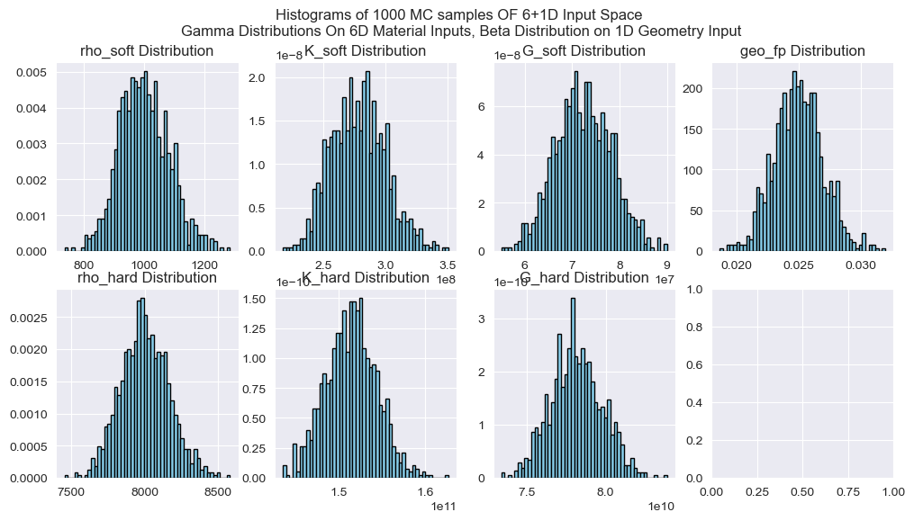
Histograms – 7D Truncated Gamma 1000 MC Inputs

Slide 11
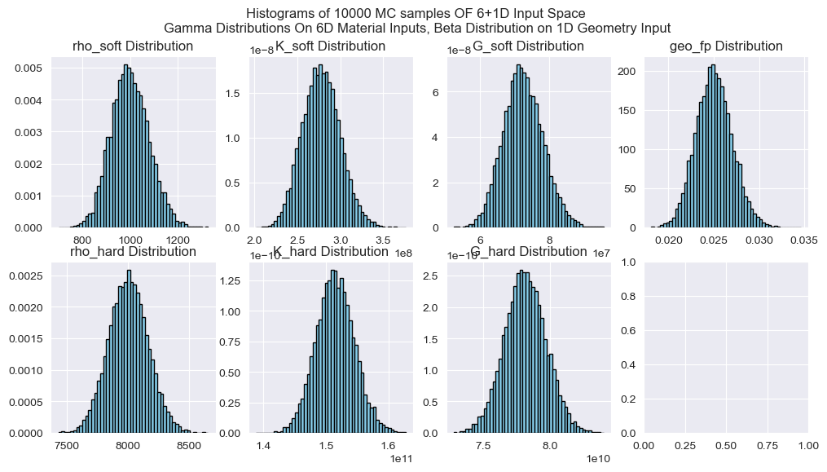
Histograms – 7D Truncated Gamma 10000 MC Inputs

Slide 12
The Geometry Uncertainty Problem
Curse of dimensionality limits possibilities with UQ on geometry.
Candidate approach: Individual Pixel Specification
Treat each pixel as a separate input with some value between 0-1 representing a ratio of how much hard and soft material is in that pixel.
Pros: Intuitive, simple, deterministic
Cons: Input dimensions scales with pixel count
Candidate approach: Latent parameters w/ ML algorithms (Wei’s group)
Use ML algorithms to generate realistic defects, forcing the neural architecture to be such that there are a small fixed number of “latent” parameters that specify the defect.
Pros: Can be deterministic?, NN tunable to give certain types of defects preferentially
Cons: Latent parameters are by definition not reflective of physical quantities, and thus difficult for any user to assign a distribution to given a real world problem.
Candidate approach: Edge pixel flip chance
For any given geometry, locate subset of pixels that are at the edge between hard and soft materials. One value, the flip chance, is applied to all these pixels to get random flipping of pixels to generate defective shapes.
Pros: 1D input regardless of geometry complexity, meaningful physical parameter
Cons: NOT deterministic, which means this is only a valid geometry UQ approach if the distribution from geometry defects alone is small for any given flip chance, relative to the distribution from variations in material properties. I.e. all defects of a certain flip chance are similar in their impact on outputs of interest.
Variations: Specify no. of flipped pixels instead of flip chance; include/exclude soft material from the edge pixel subset; count touching corners as edge pixels.

Slide 13
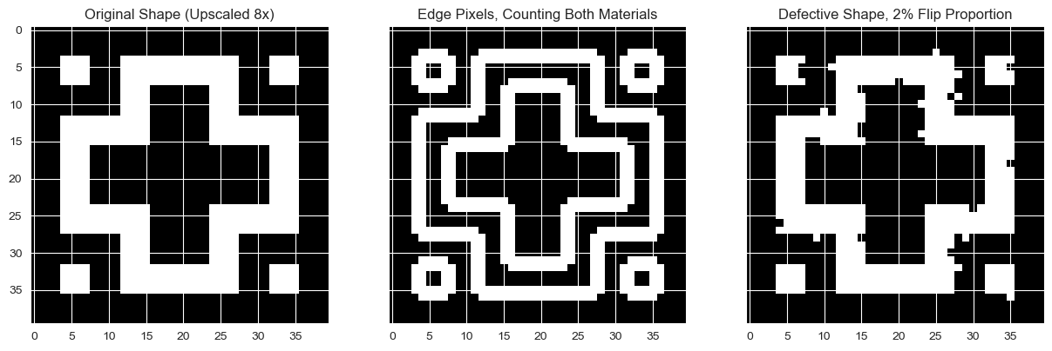
Edge Pixel Flip Proportion – Geometry Generation

Slide 14
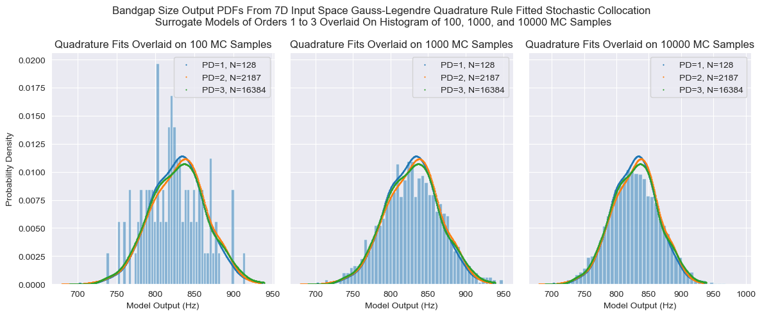
7D Stochastic Collocation – Quadrature Rule – Bandgap Size

Slide 15
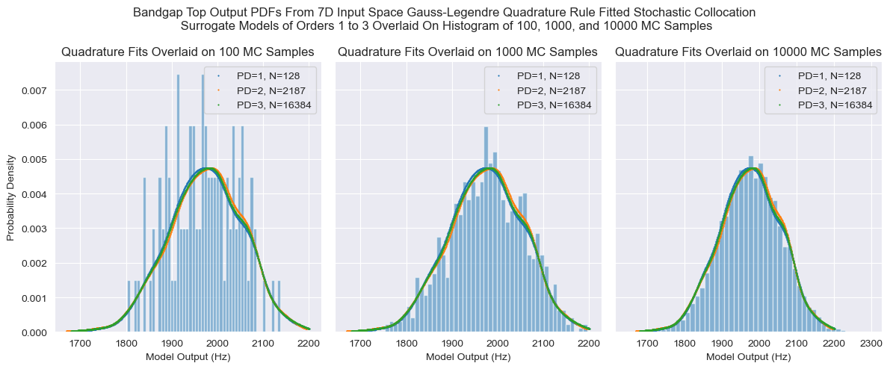
7D Stochastic Collocation – Quadrature Rule – Bandgap Top

Slide 16
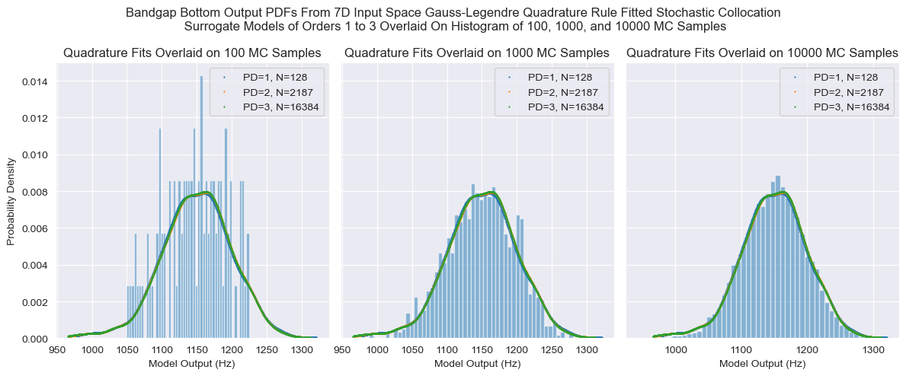
7D Stochastic Collocation – Quadrature Rule – Bandgap Bottom

Slide 17
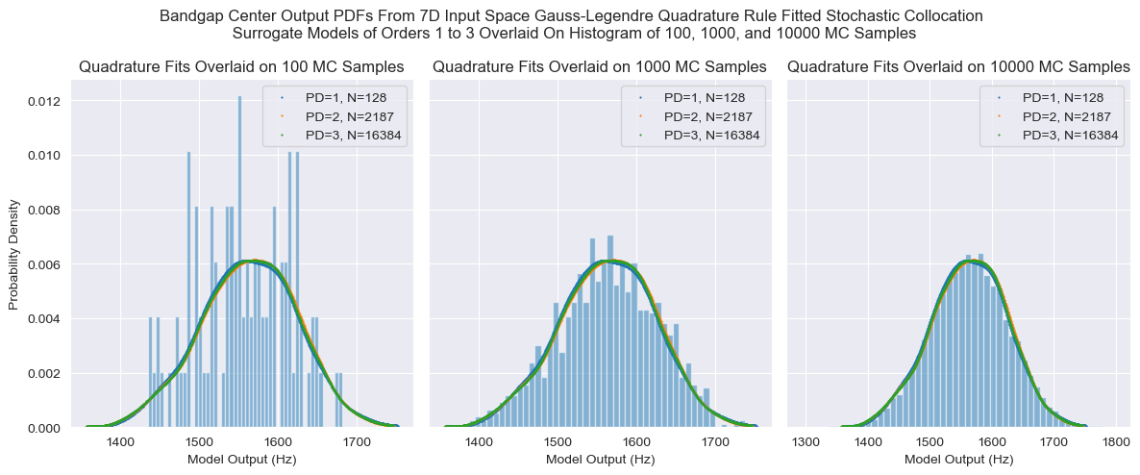
7D Stochastic Collocation – Quadrature Rule – Bandgap Center

Slide 18
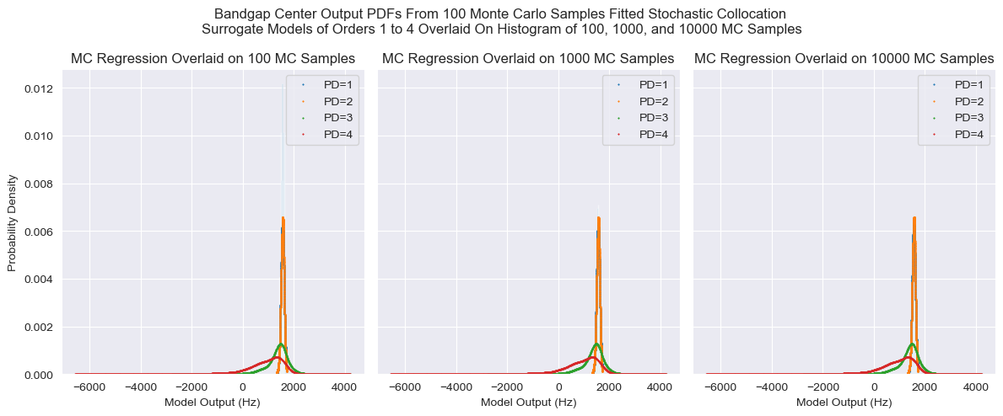
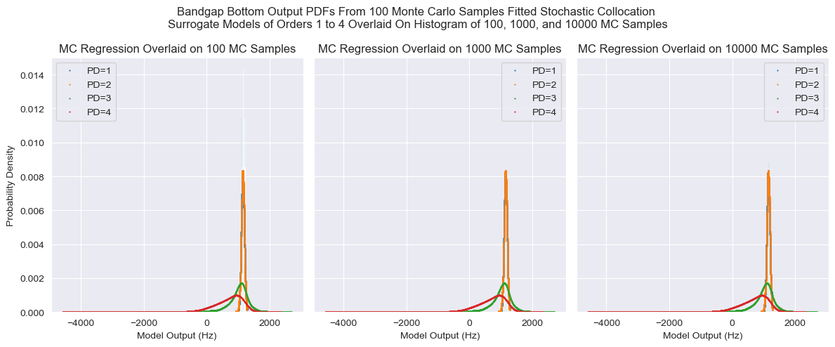
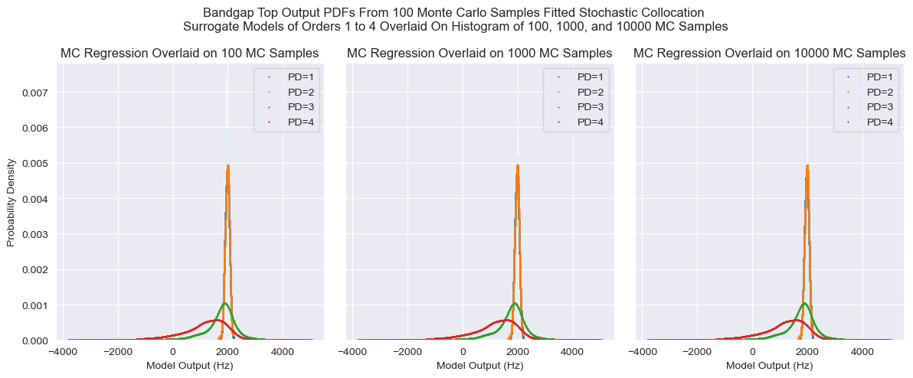
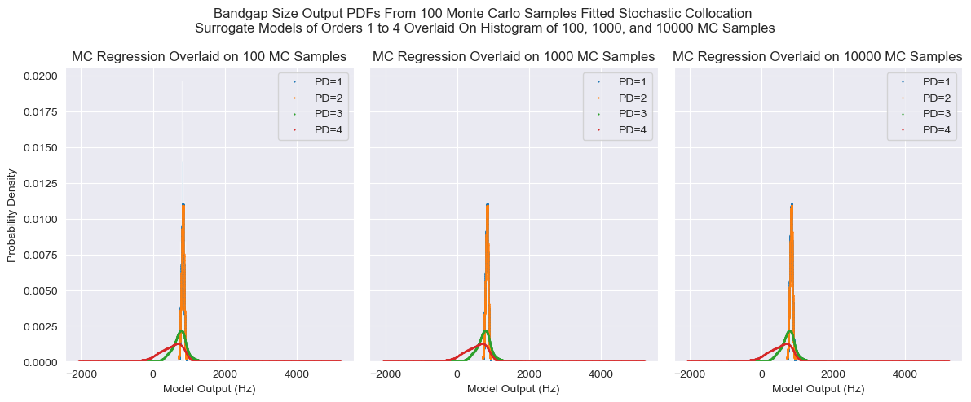
7D Stochastic Collocation – MC Regression – Insufficient Sample Size

Slide 19
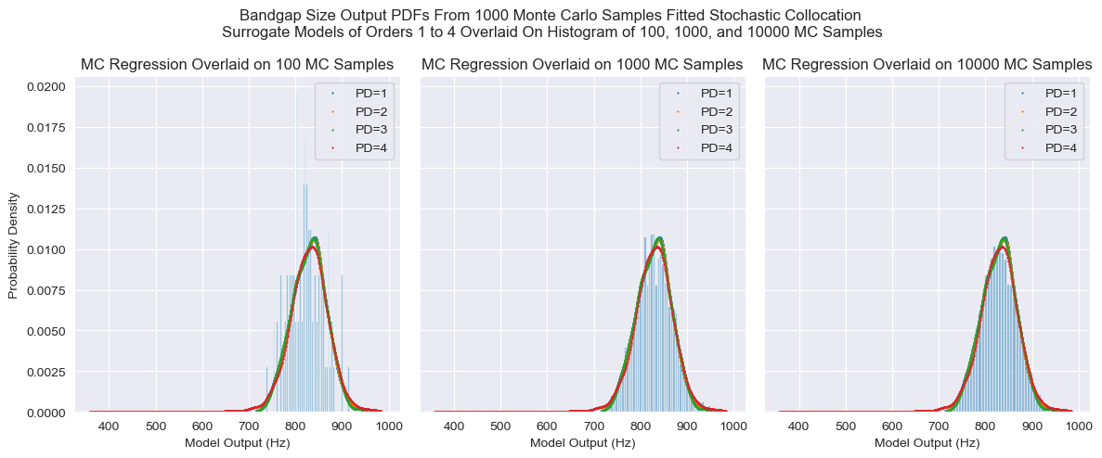
7D Stochastic Collocation – MC Regression (N = 1000) – Bandgap Size

Slide 20
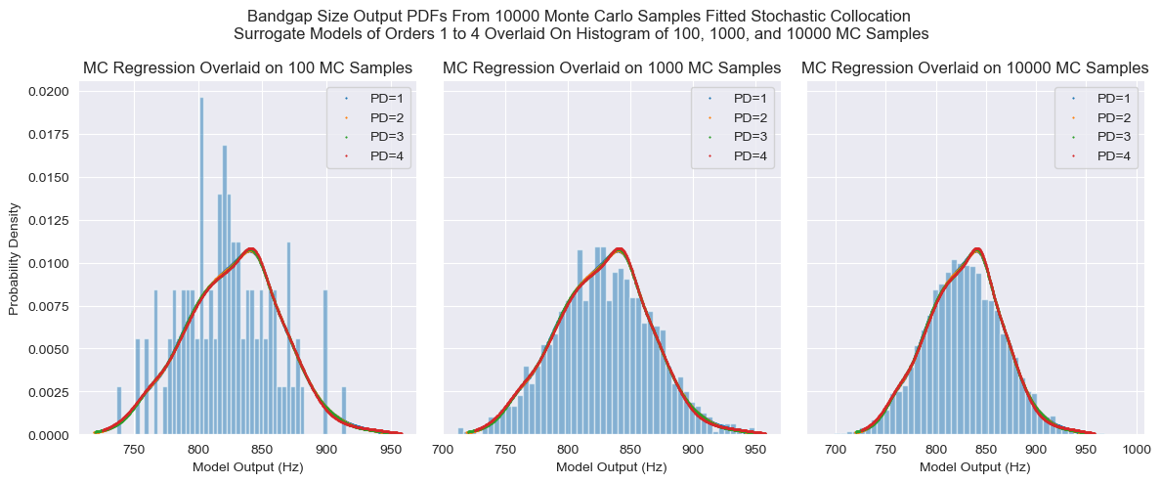
7D Stochastic Collocation – MC Regression (N = 10000) – Bandgap Size

Slide 21
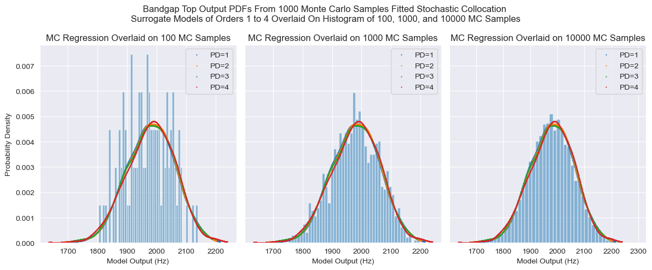
7D Stochastic Collocation – MC Regression (N = 1000) – Bandgap Top

Slide 22
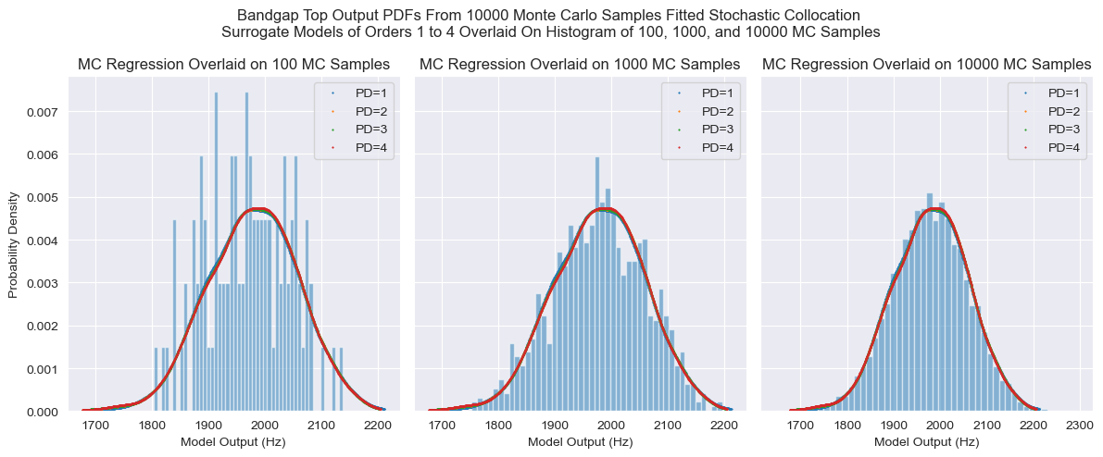
7D Stochastic Collocation – MC Regression (N = 10000) – Bandgap Top

Slide 23
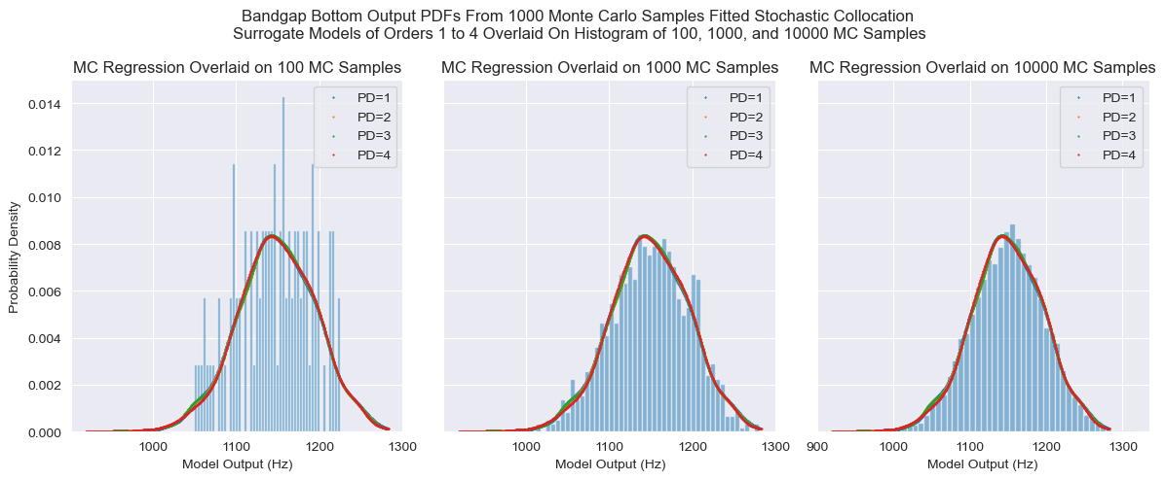
7D Stochastic Collocation – MC Regression (N = 1000) – Bandgap Bottom

Slide 24
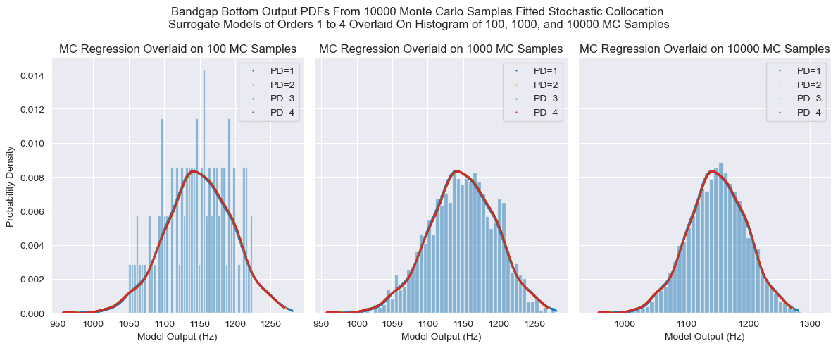
7D Stochastic Collocation – MC Regression (N = 10000) – Bandgap Bottom

Slide 25
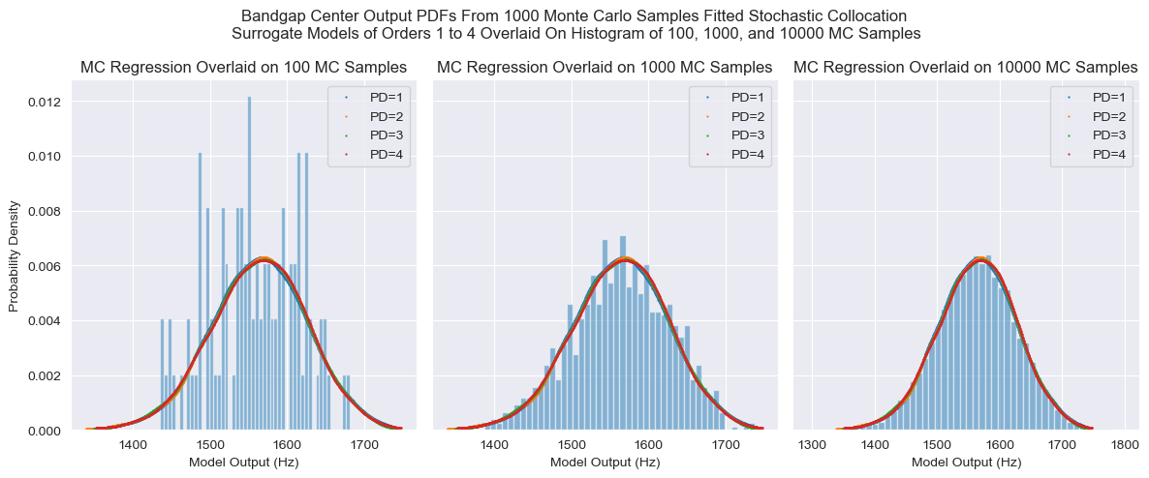
7D Stochastic Collocation – MC Regression (N = 1000) – Bandgap Center

Slide 26

7D Stochastic Collocation – MC Regression (N = 10000) – Bandgap Center

Slide 27
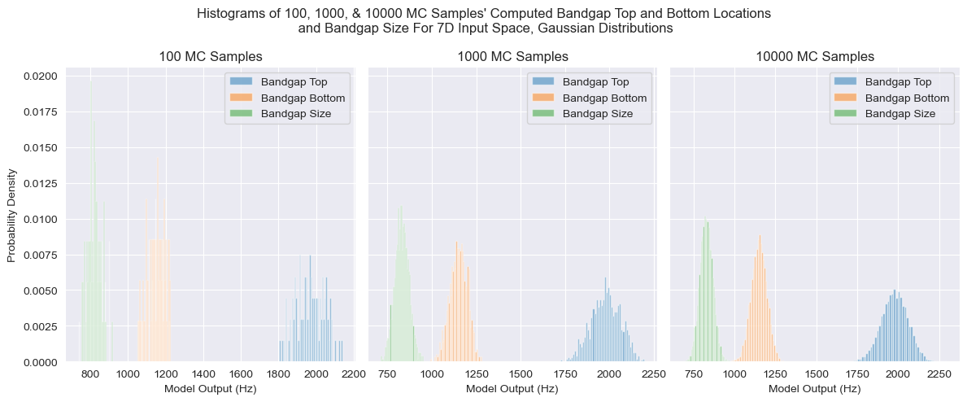
Histograms – Bandgap Top, Bottom, & Size

Slide 28
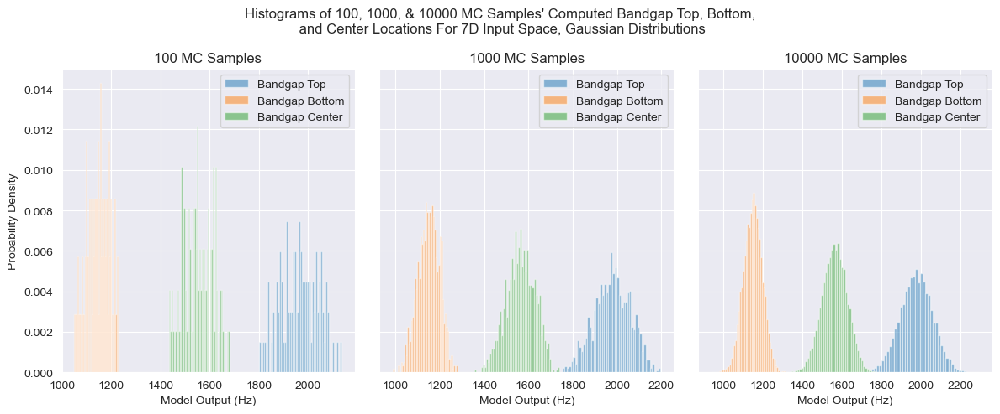
Histograms – Bandgap Top, Bottom, & Center

Slide 29
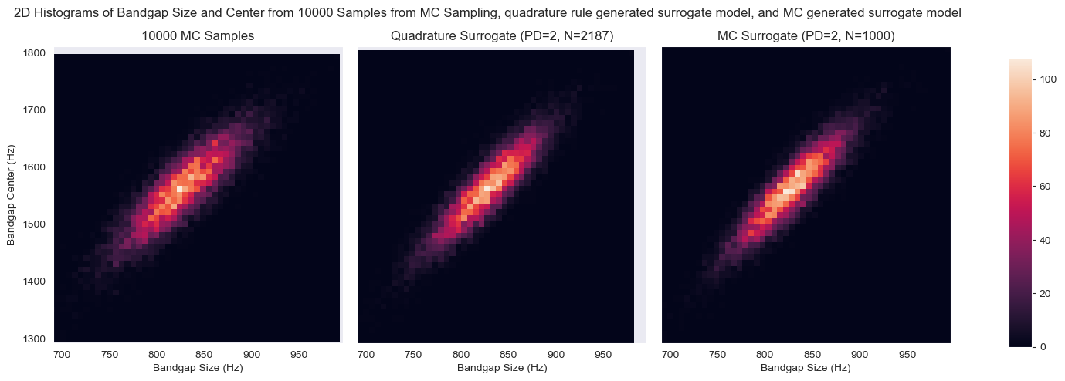
2D Histograms

Slide 30
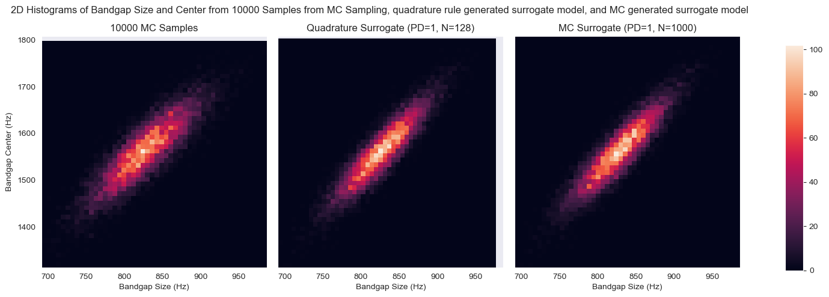
2D Histograms

Slide 31
E_soft
E_hard
Rho_soft
Rho_hard
Pr_soft
Pr_hard

