Slide 1
Uncertainty Quantification for 2D Metamaterials
Han Zhang

Slide 2
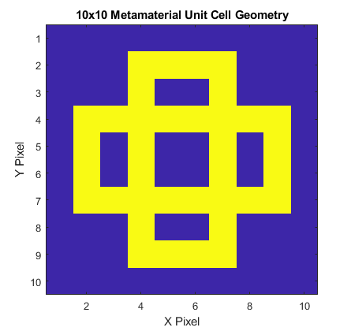
Input Parameters
Fixed Parameters:
Geometry Design, a 10x10 Boolean Array with 1 indicating hard material, 0 indicating soft material.
Random Parameters:
Soft material stiffness, E_soft, uniform distribution from 200e6±100e6
Hard material stiffness, E_hard, uniform distribution from 200e9±100e9
Soft material density, rho_soft, uniform distribution from 1e3±5e2
Hard material density, rho_hard, uniform distribution from 8e3±4e3
Soft material Poisson ratio, pr_soft, uniform distribution from 0.25±0.25
Hard material Poisson ratio, pr_hard, uniform distribution from 0.25±0.25
Outputs of interest:
Bandgap size
Bandgap location
Input dimensionality has important implications for UQ computation. More on this in following slides.

Slide 3
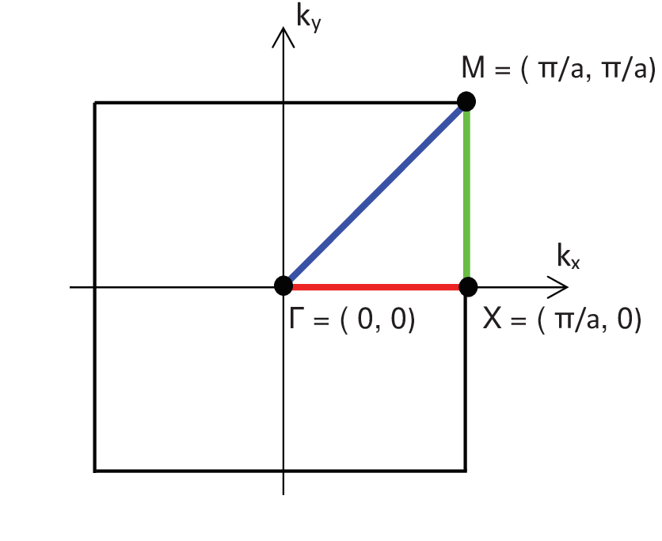
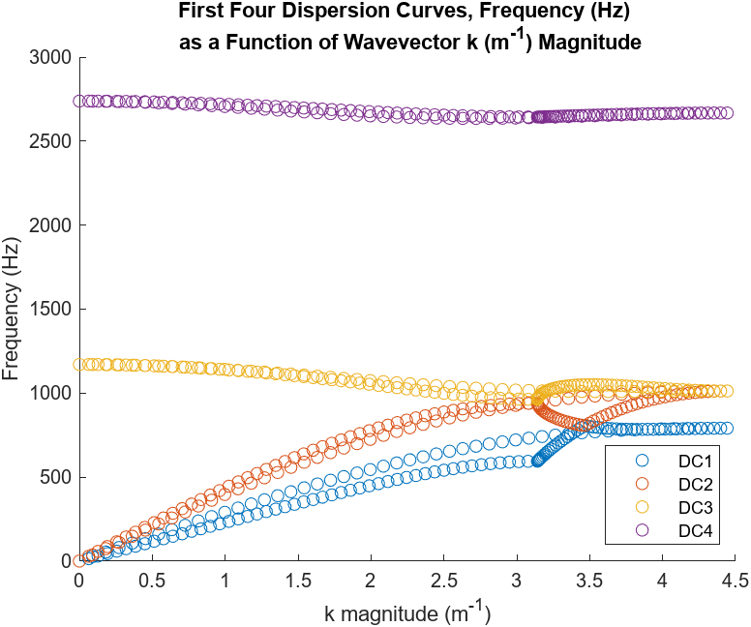
Dispersion Curve Calculations

Slide 4
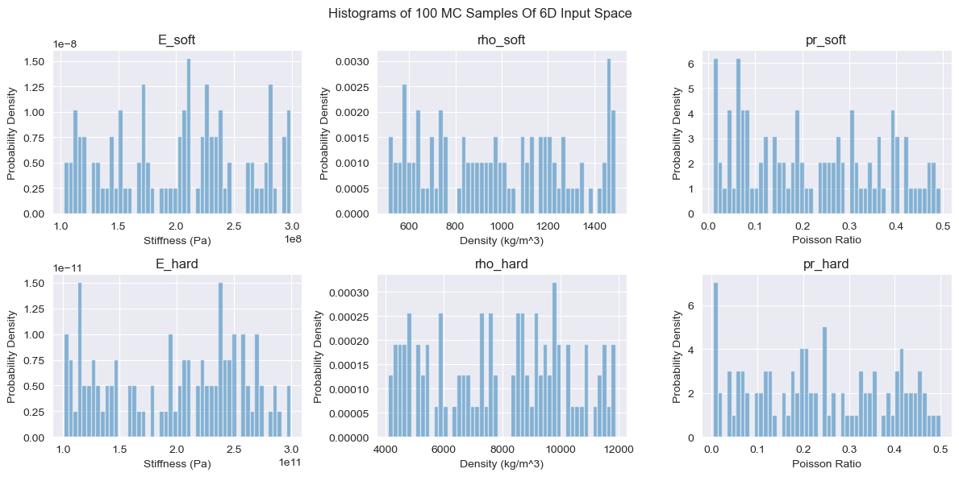
Histograms – 100 MC Inputs

Slide 5
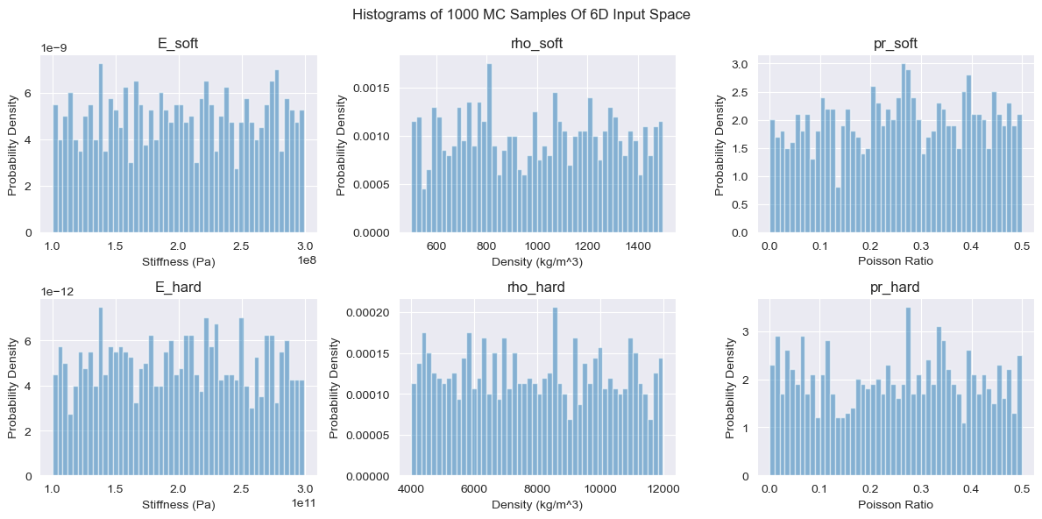
Histograms – 1000 MC Inputs

Slide 6
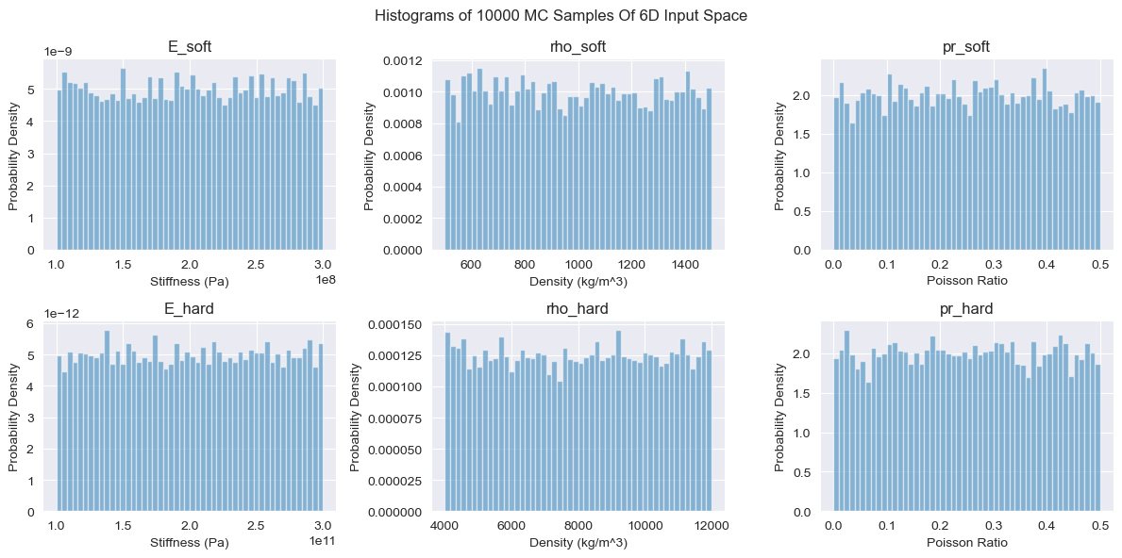
Histograms – 10000 MC Inputs

Slide 7
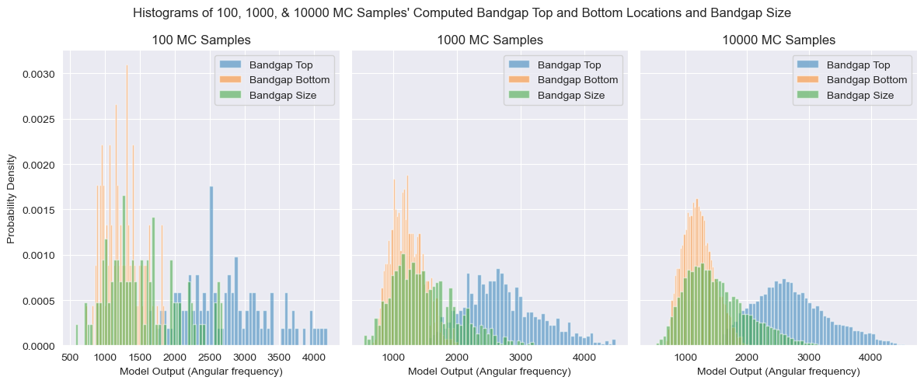
Histograms – Bandgap Top, Bottom, & Size

Slide 8
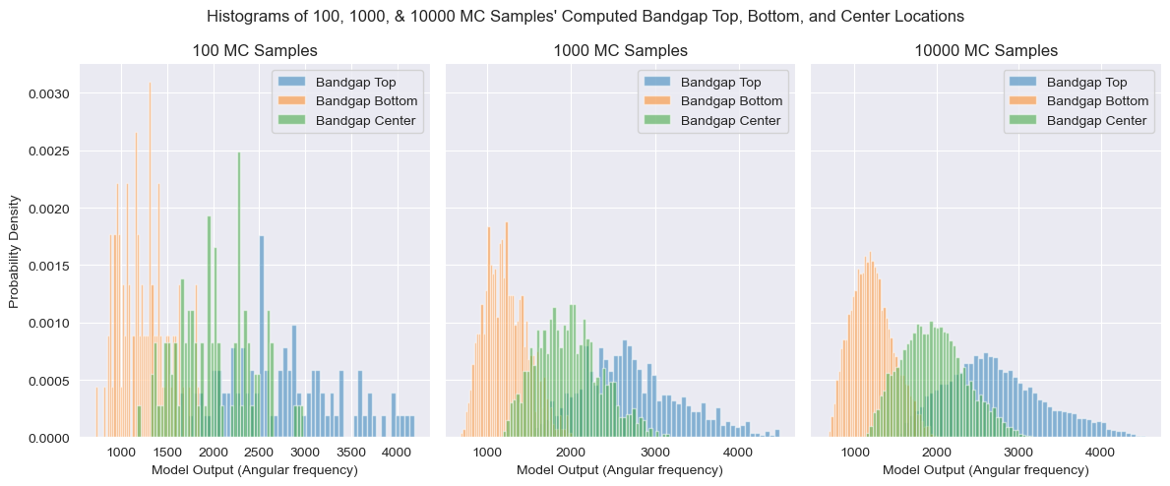
Histograms – Bandgap Top, Bottom, & Center

Slide 9
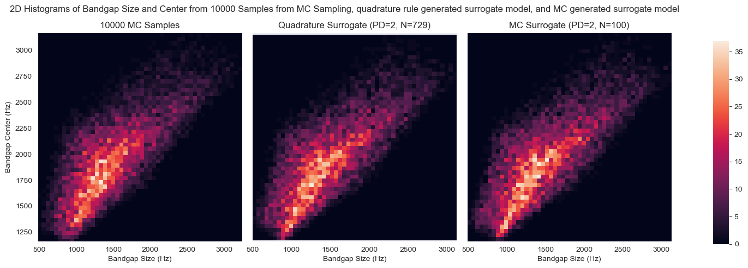
2D Histograms

Slide 10
The Geometry Uncertainty Problem
Curse of dimensionality limits possibilities with UQ on geometry.
Candidate approach: Individual Pixel Specification
Treat each pixel as a separate input with some value between 0-1 representing a ratio of how much hard and soft material is in that pixel.
Pros: Intuitive, simple, deterministic
Cons: Input dimensions scales with pixel count
Candidate approach: Latent parameters w/ ML algorithms (Wei’s group)
Use ML algorithms to generate realistic defects, forcing the neural architecture to be such that there are a small fixed number of “latent” parameters that specify the defect.
Pros: Can be deterministic?, NN tunable to give certain types of defects preferentially
Cons: Latent parameters are by definition not reflective of physical quantities, and thus difficult for any user to assign a distribution to given a real world problem.
Candidate approach: Edge pixel flip chance
For any given geometry, locate subset of pixels that are at the edge between hard and soft materials. One value, the flip chance, is applied to all these pixels to get random flipping of pixels to generate defective shapes.
Pros: 1D input regardless of geometry complexity, meaningful physical parameter
Cons: NOT deterministic, which means this is only a valid geometry UQ approach if the distribution from geometry defects alone is small for any given flip chance, relative to the distribution from variations in material properties. I.e. all defects of a certain flip chance are similar in their impact on outputs of interest.
Variations: Specify no. of flipped pixels instead of flip chance; include/exclude soft material from the edge pixel subset; count touching corners as edge pixels.

Slide 11
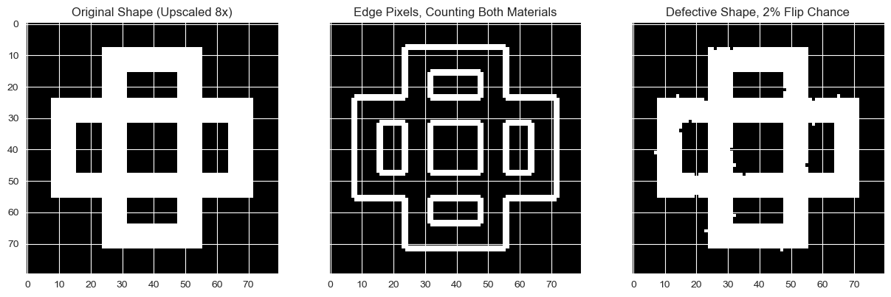
Edge Pixel Flip Chance – Geometry Generation

Slide 12
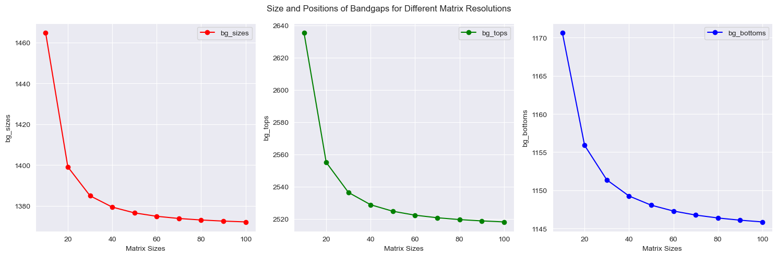
Finite Element Mesh Convergence

Slide 13
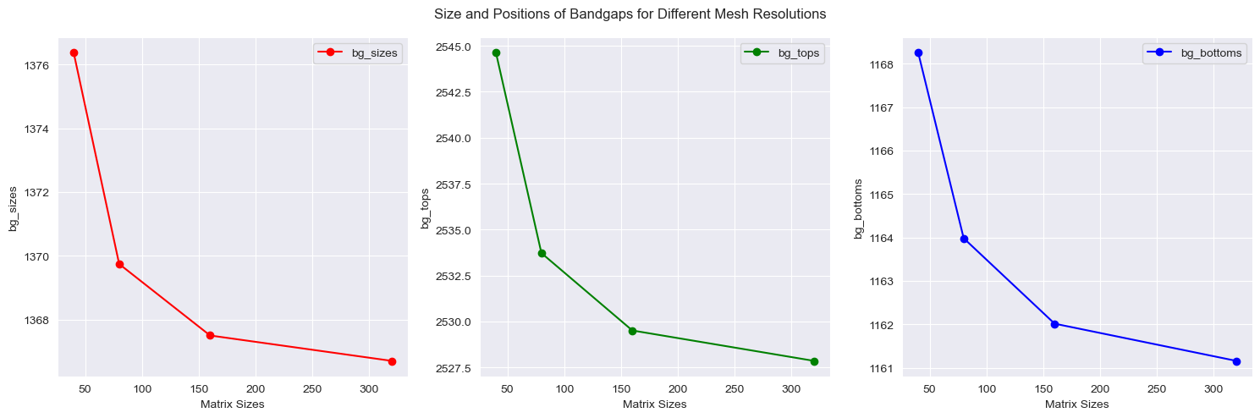
Finite Element Mesh Convergence

Slide 14
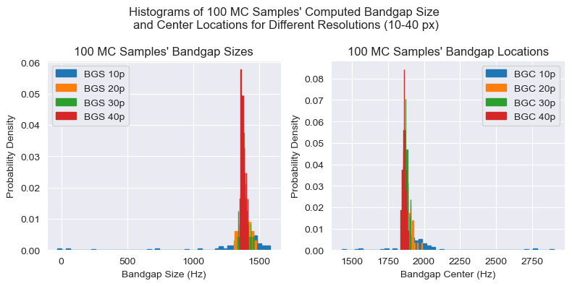
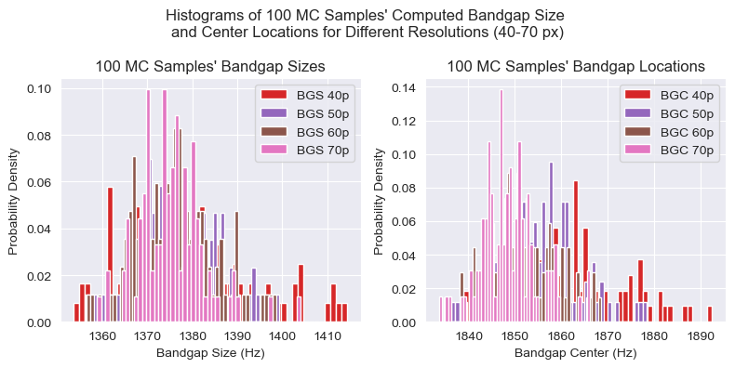
EPF (FC) – Defect Convergence
Typical bandgap size and center output distributions ranges 1000Hz for specified material property input distributions.
For 10p EPF, results are terrible, no way for any surrogate model to differentiate between effects of geometry defects and material properties.
However, around 40p, EPF becomes a reasonable strategy, with the distribution of computed bandgap results for fixed material properties and 100 randomly generated defective geometries being more than an order of magnitude tighter than ranges seen from UQ on material properties.
This suggests we may be able to either incorporate geometry defects as part of the original model (as a meta-parameter), or as one of the inputs to UQ.

Slide 15
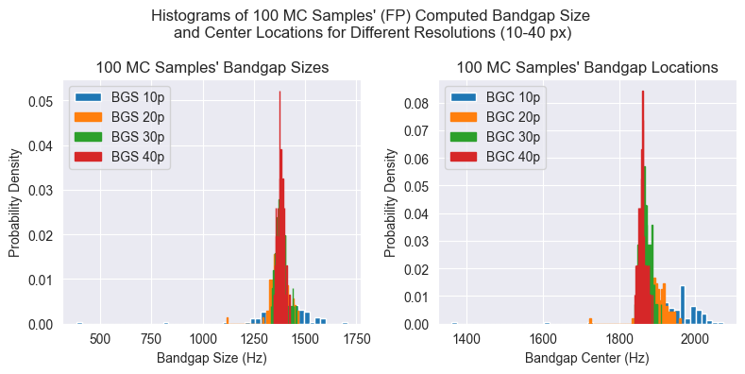
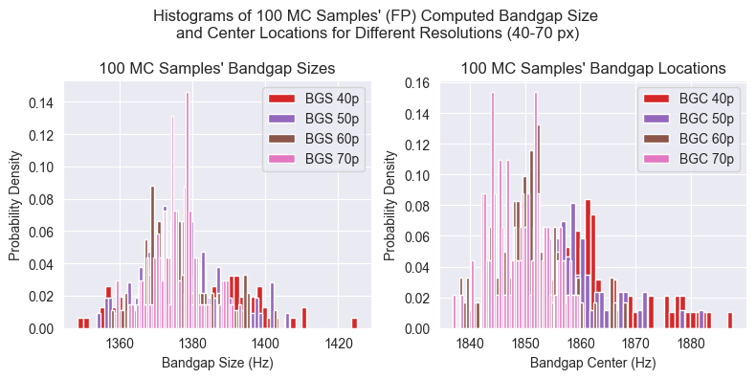
EPF (FP) – Defect Convergence
Typical bandgap size and center output distributions ranges 1000Hz for specified material property input distributions.
For 10p EPF, results are better with the FP approach than the FC approach. Still, we would probably consider this too wide of a distribution for any surrogate model to differentiate between effects of geometry defects and material properties.
However, around 40p, EPF-FP also converges and is a reasonable strategy, with the distribution of computed bandgap results for fixed material properties and 100 randomly generated defective geometries being more than an order of magnitude tighter than ranges seen from UQ on material properties.
This suggests we may be able to either incorporate geometry defects as part of the original model (as a meta-parameter), or as one of the inputs to UQ.

Slide 16
EPF FC VS FP – Defect Convergence

Slide 17
Stochastic Collocation – MC Regression
A variation of stochastic collocation where the orthogonal polynomials are fitted to MC generated samples
Usually more effective at higher dimensions and less efficient at lower dimensions compared to quadrature rule stochastic collocation

Slide 18
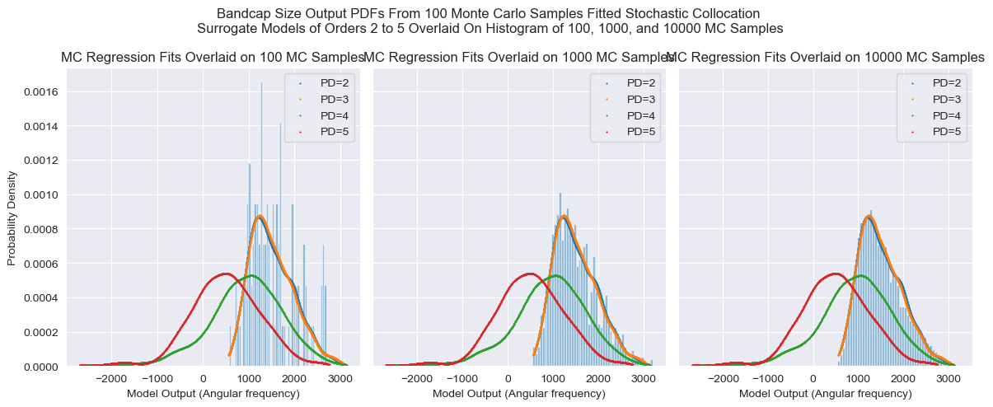
Stochastic Collocation – MC Regression (Underfit)

Slide 19
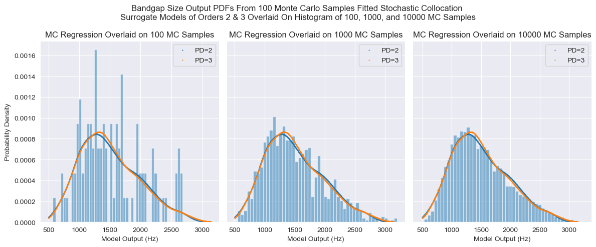
Stochastic Collocation – MC Regression – Bandgap Size

Slide 20
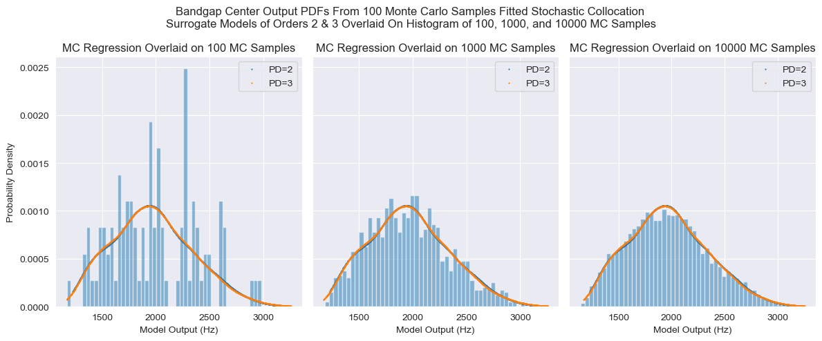
Stochastic Collocation – MC Regression – Bandgap Center

Slide 21
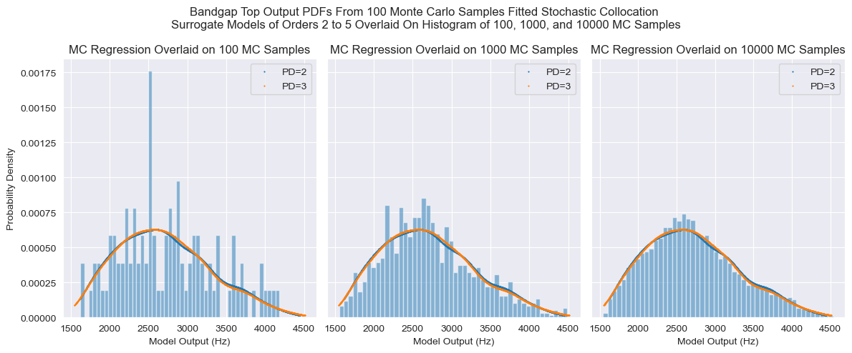
Stochastic Collocation – MC Regression – Bandgap Top

Slide 22
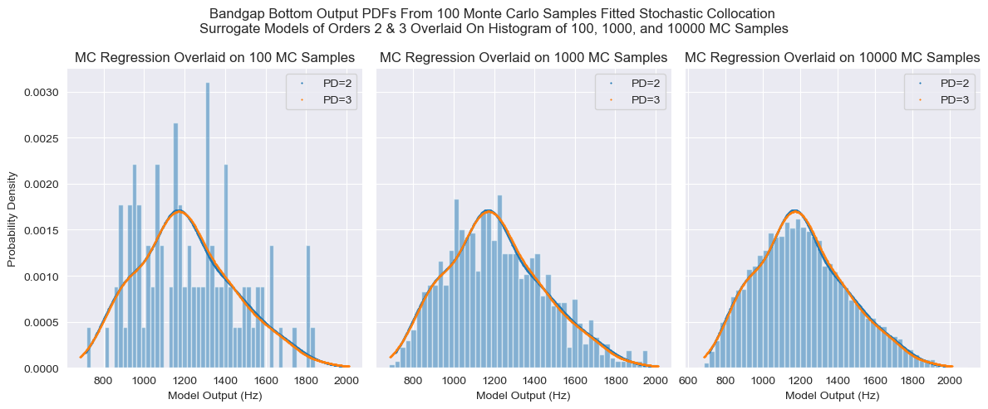
Stochastic Collocation – MC Regression – Bandgap Bottom

Slide 23
Stochastic Collocation – Quadrature Rule
A variation of stochastic collocation where the orthogonal polynomials are fitted to specific points with weights, generated by using a rule function on the input distribution.
Extremely efficient at low dimensions, however points needed scales as s = (p + 1)^d, where s is the number of samples needed, p is the order of polynomial fit, and d is the dimensionality of the input space. This method therefore becomes very expensive very quickly as d increases.

Slide 24
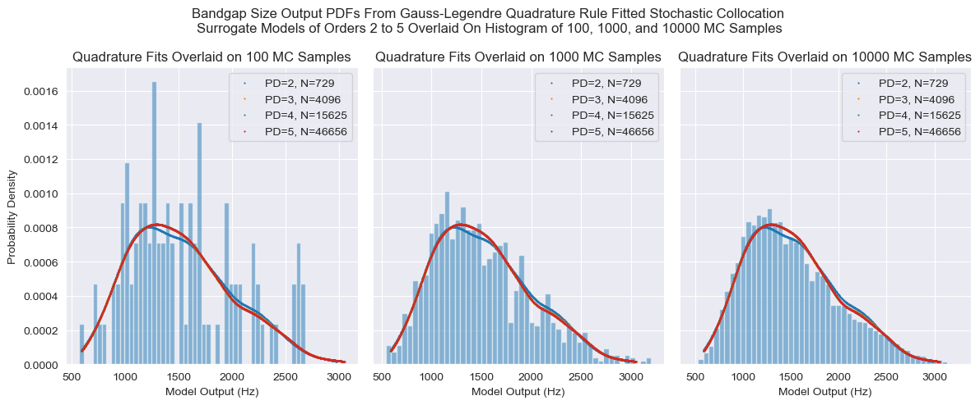
Stochastic Collocation – Quadrature Rule – Bandgap Size

Slide 25
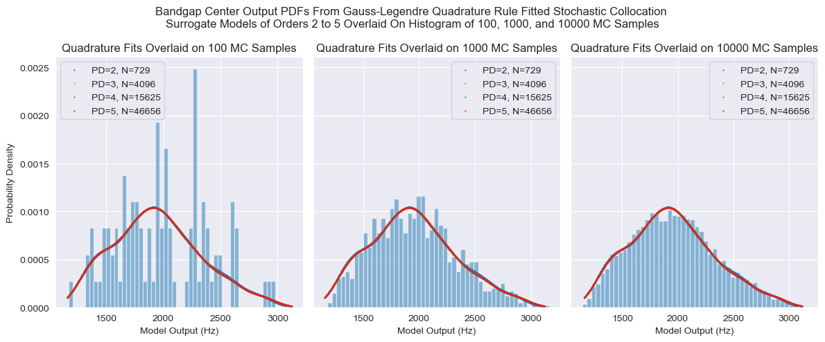
Stochastic Collocation – Quadrature Rule – Bandgap Center

Slide 26
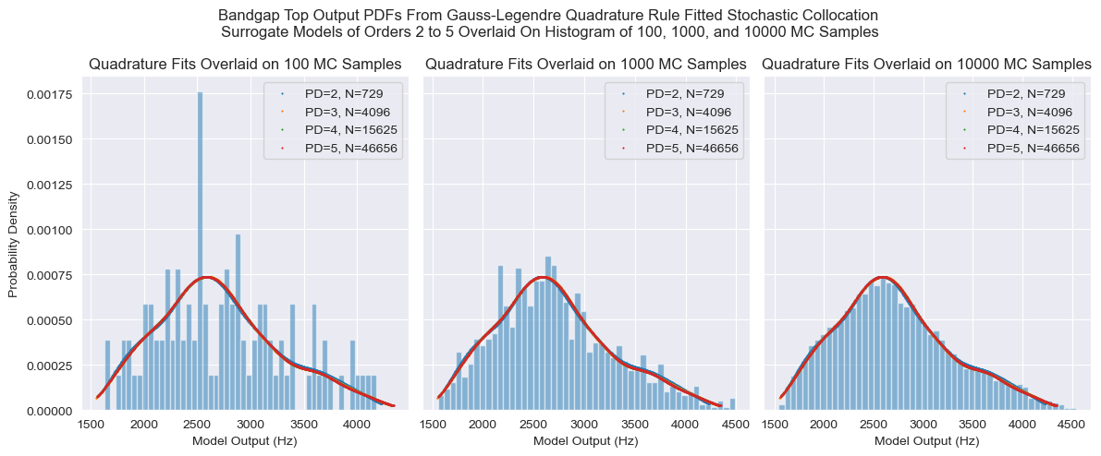
Stochastic Collocation – Quadrature Rule – Bandgap Top

Slide 27
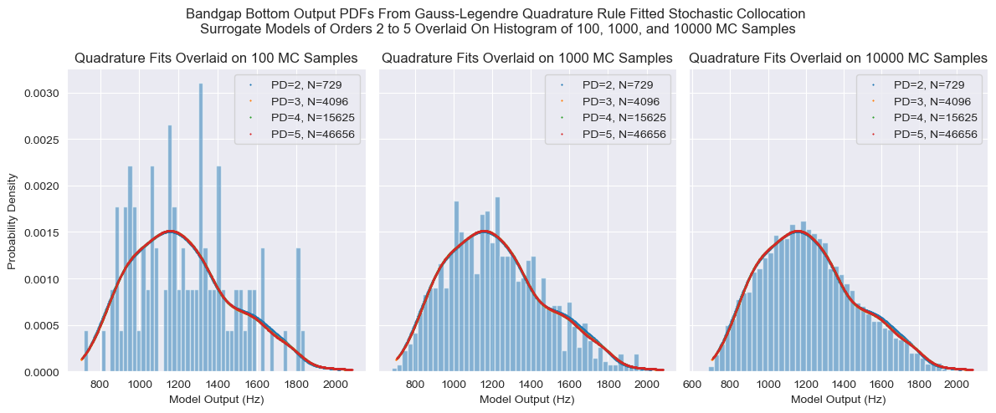
Stochastic Collocation – Quadrature Rule – Bandgap Bottom

Slide 28
1D PCE Fits
The following figures are for 1 input, 1 output scenarios, whereby the other 5 inputs are held at the following default values:
E_soft: 200 MPa
E_hard: 200 GPa
Rho_soft: 1000 kg/m^3
Rho_hard: 8000 kg/m^3
PR_soft: 0
PR_hard: 0.5

Slide 29
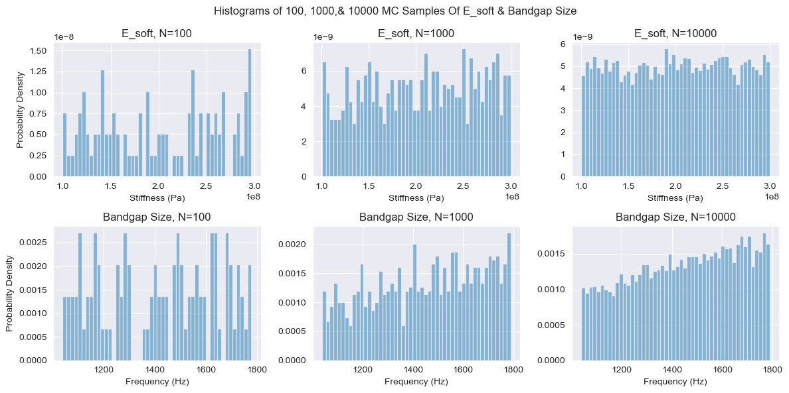
100, 1000, & 10000 MC E_soft & Bandgap Sizes

Slide 30
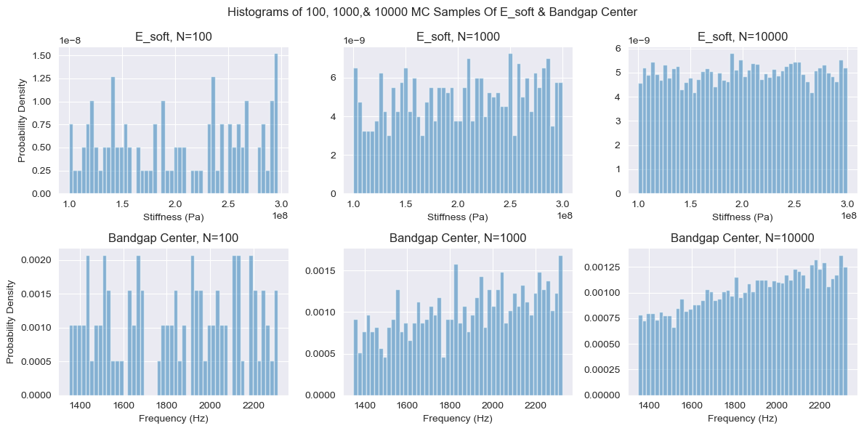
100, 1000, & 10000 MC E_soft & Bandgap Centers

Slide 31
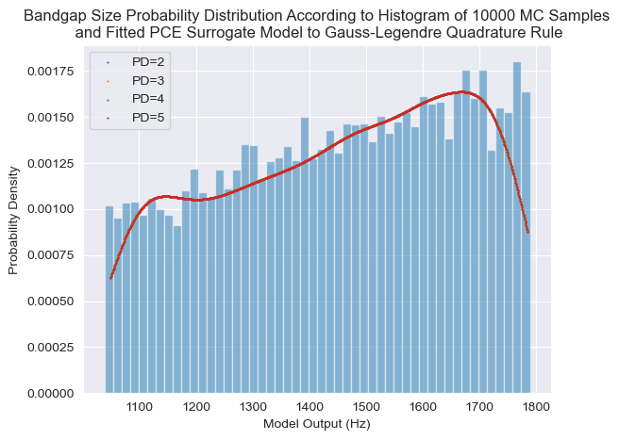
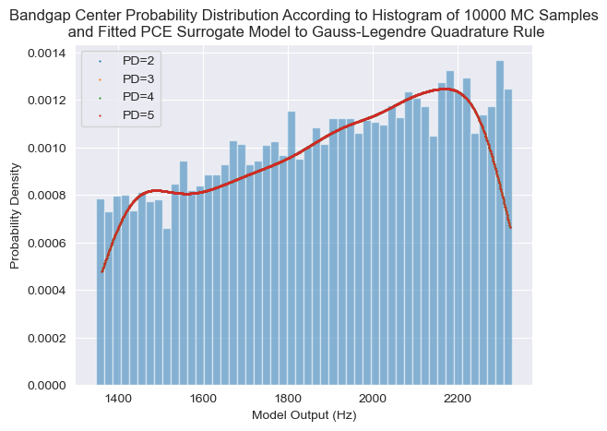
Stochastic Collocation 1D Quadrature – E_soft – Bandgap Size

Slide 32
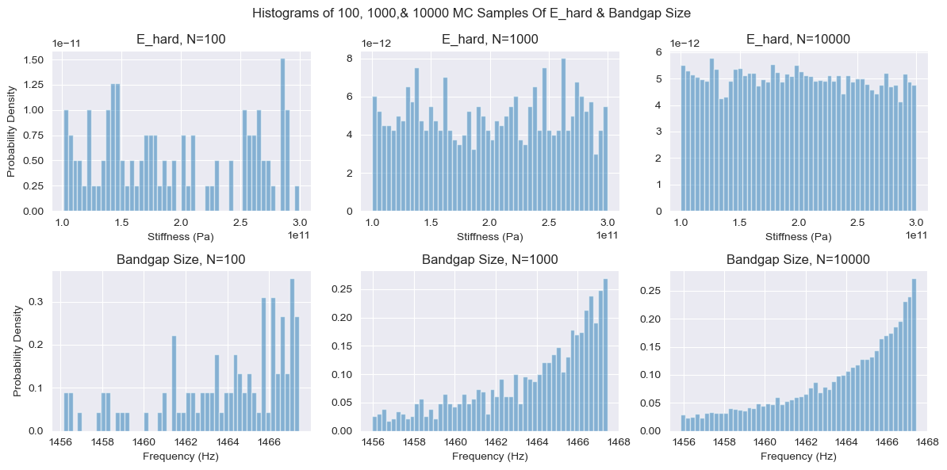
100, 1000, & 10000 MC E_hard & Bandgap Sizes

Slide 33
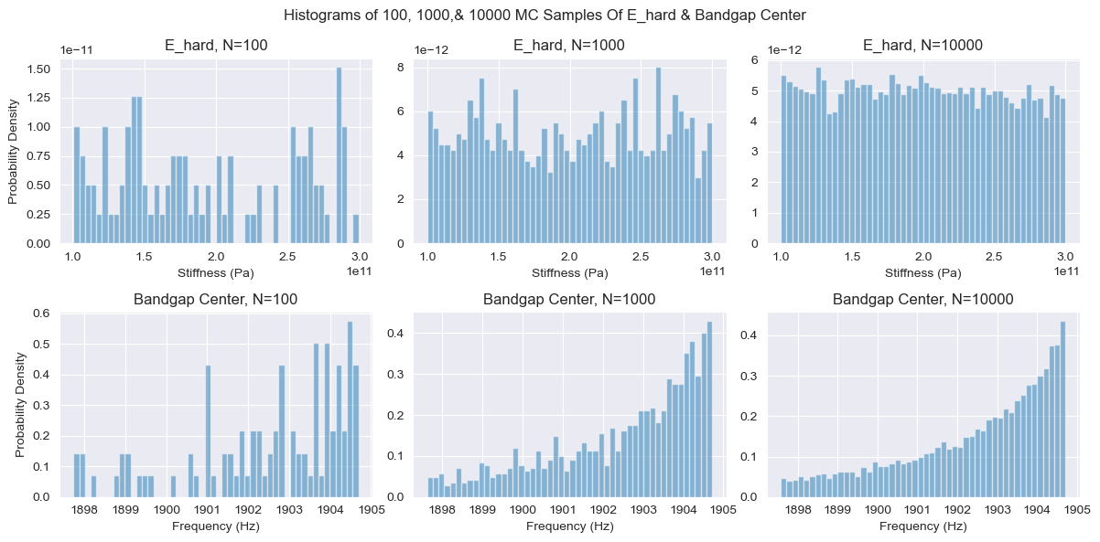
100, 1000, & 10000 MC E_hard & Bandgap Centers

Slide 34
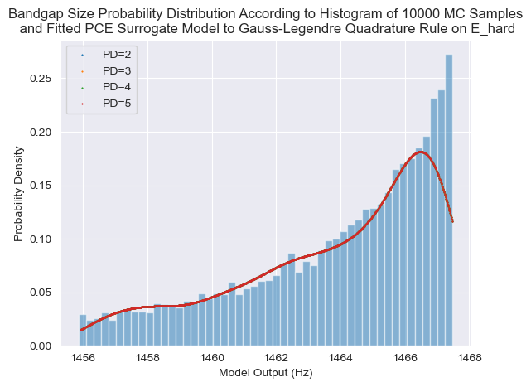
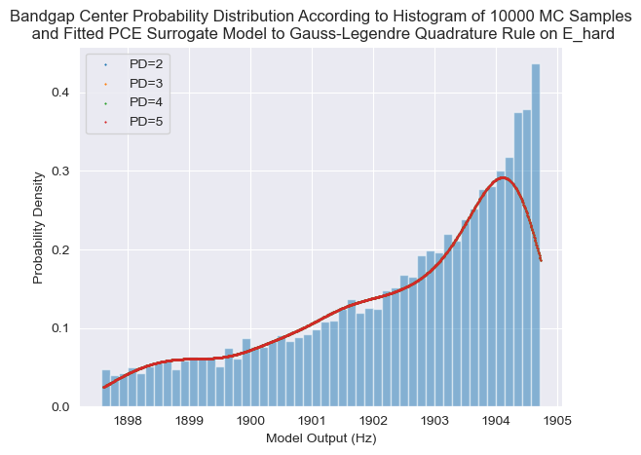
Stochastic Collocation 1D Quadrature – E_hard – Bandgap Size

Slide 35
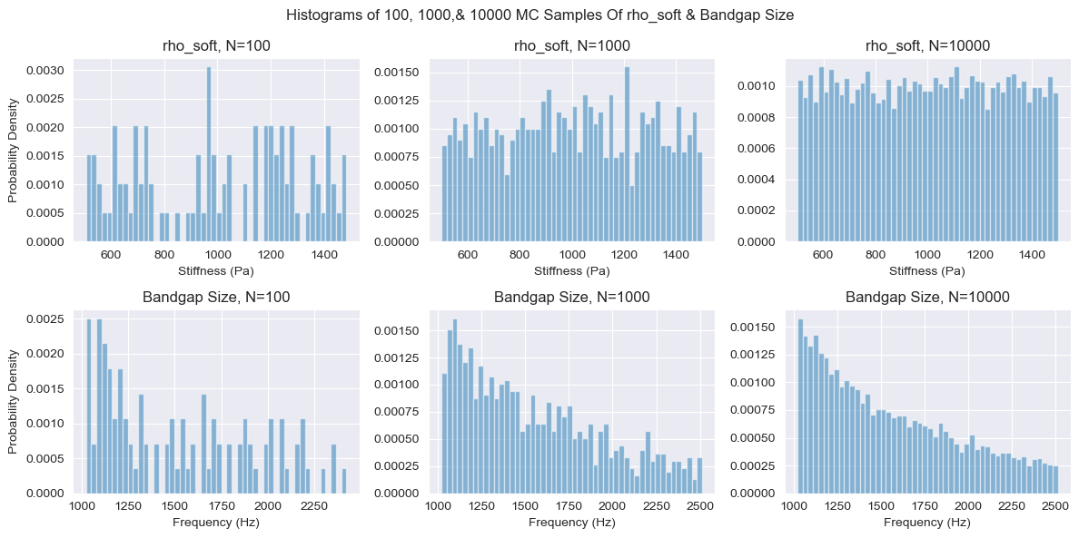
100, 1000, & 10000 MC Rho_soft & Bandgap Sizes

Slide 36
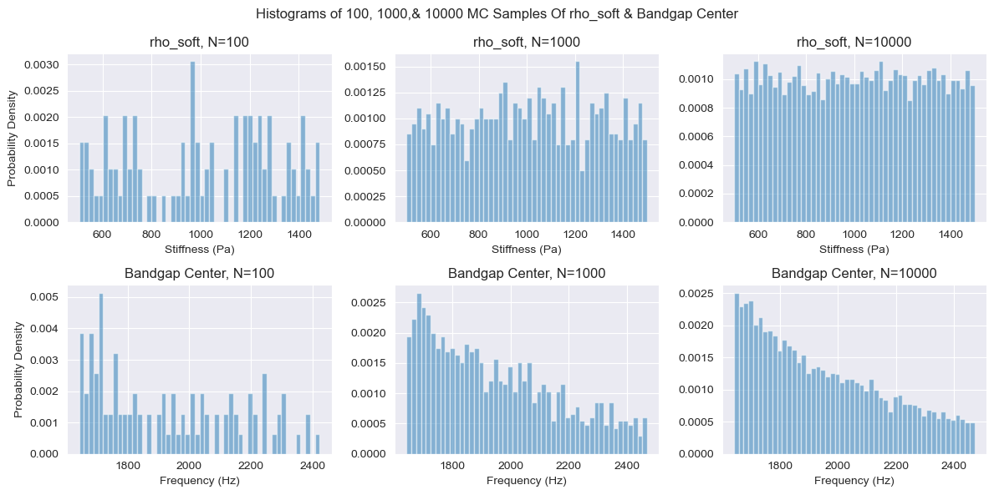
100, 1000, & 10000 MC rho_soft & Bandgap Centers

Slide 37
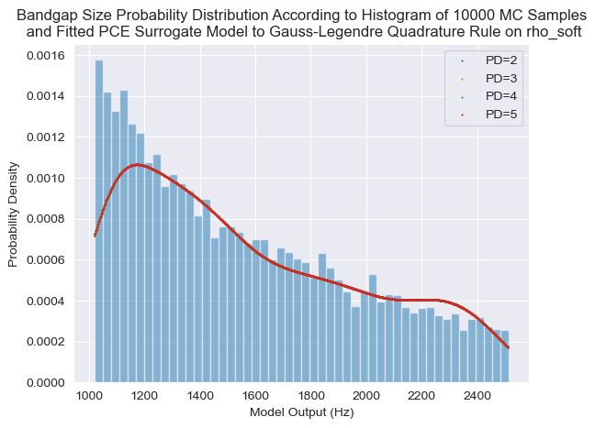
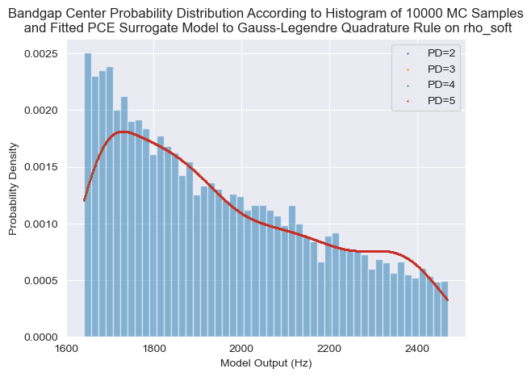
Stochastic Collocation 1D Quadrature – rho_soft – Bandgap Size

Slide 38
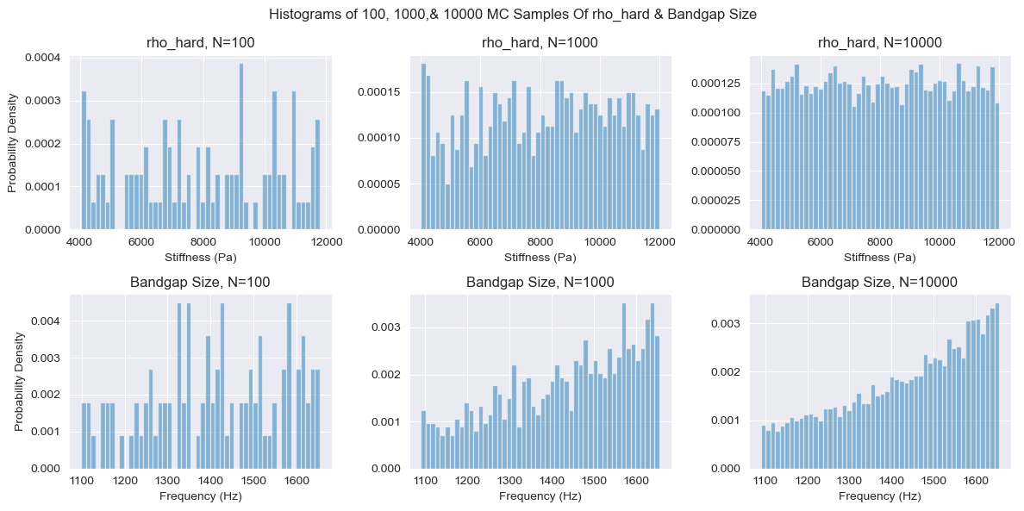
100, 1000, & 10000 MC rho_hard & Bandgap Sizes

Slide 39
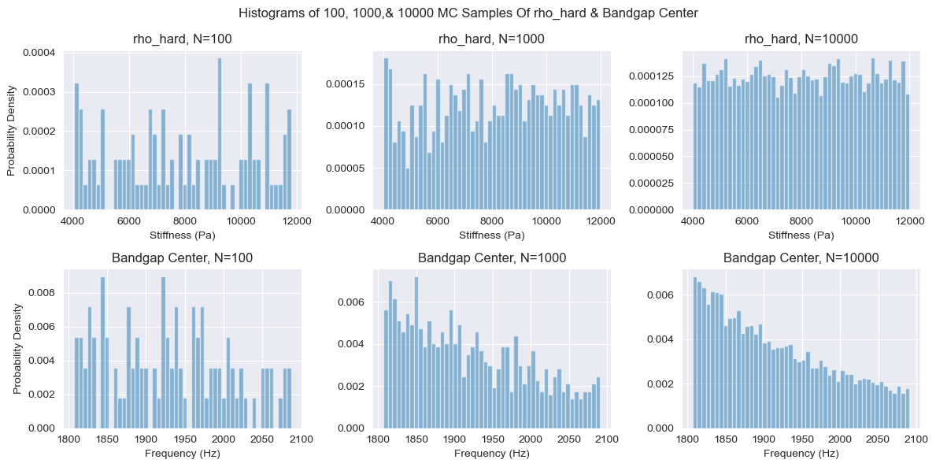
100, 1000, & 10000 MC rho_hard & Bandgap Centers

Slide 40
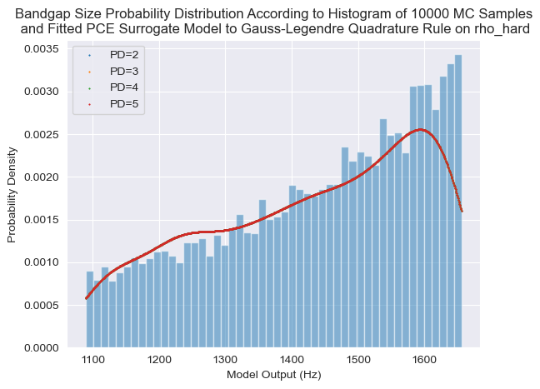
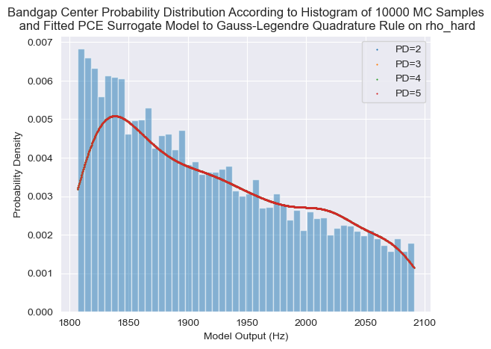
Stochastic Collocation 1D Quadrature – rho_hard – Bandgap Size

Slide 41
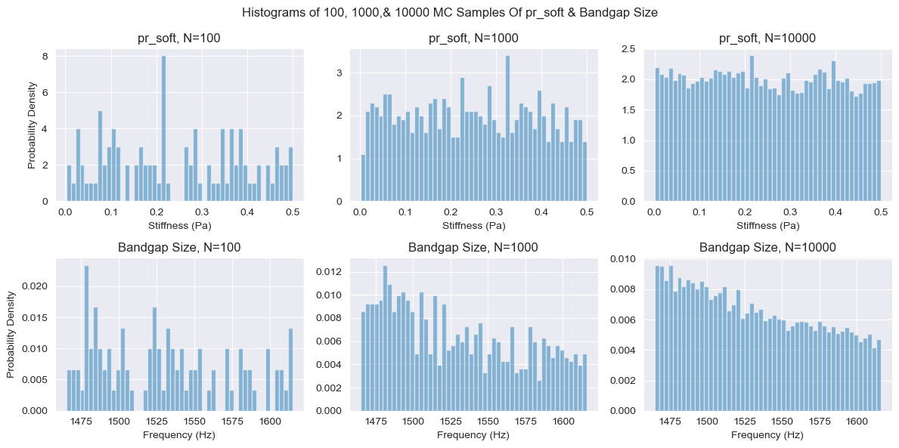
100, 1000, & 10000 MC $ν_{soft}$ & Bandgap Sizes

Slide 42
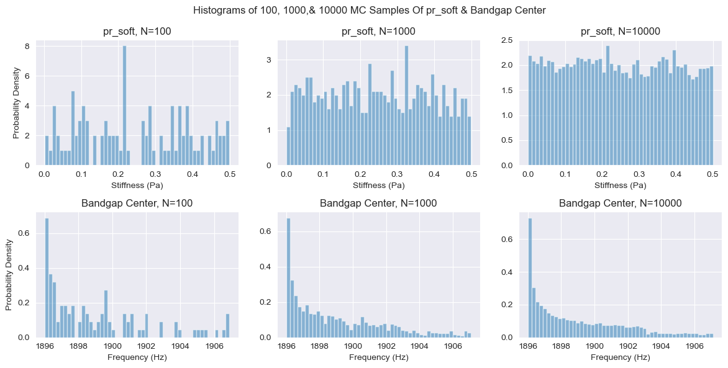
100, 1000, & 10000 MC $ν_{soft}$ & Bandgap Centers

Slide 43
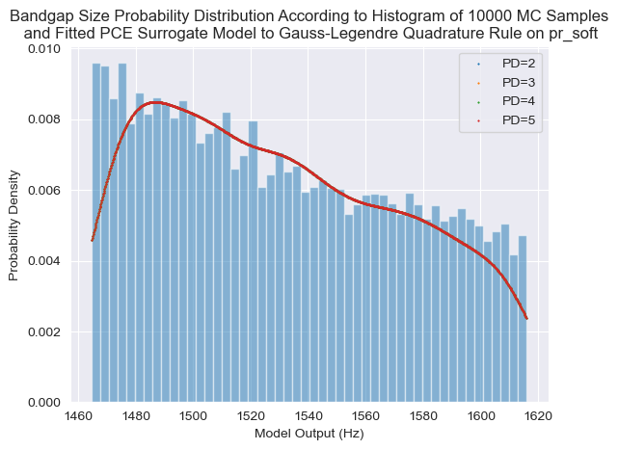
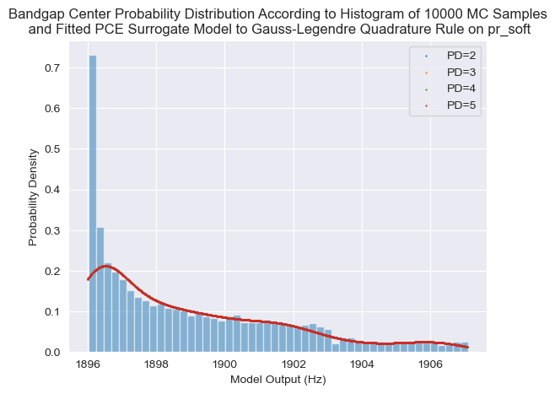
Stochastic Collocation 1D Quadrature – $ν_{soft}$– Bandgap Size

Slide 44
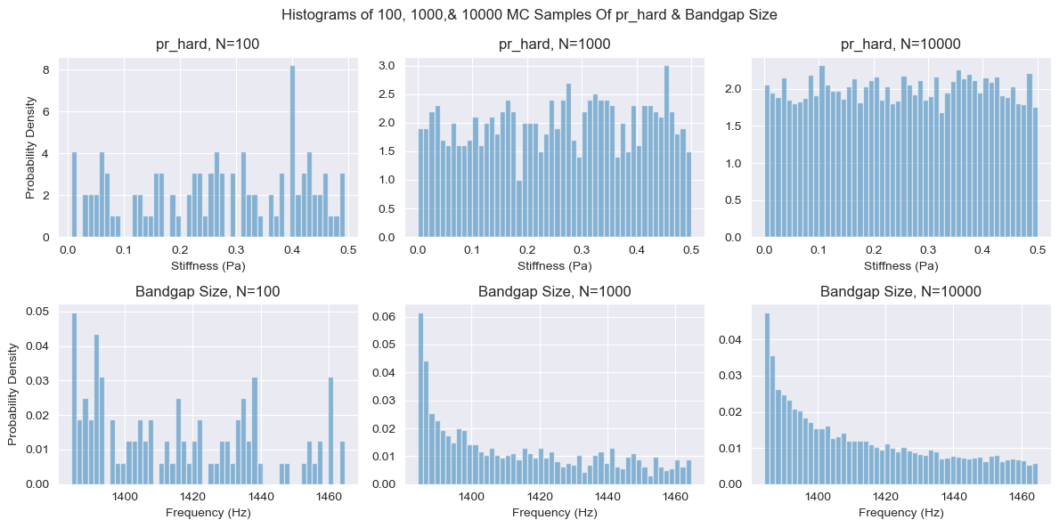
100, 1000, & 10000 MC $ν_{hard}$& Bandgap Sizes

Slide 45
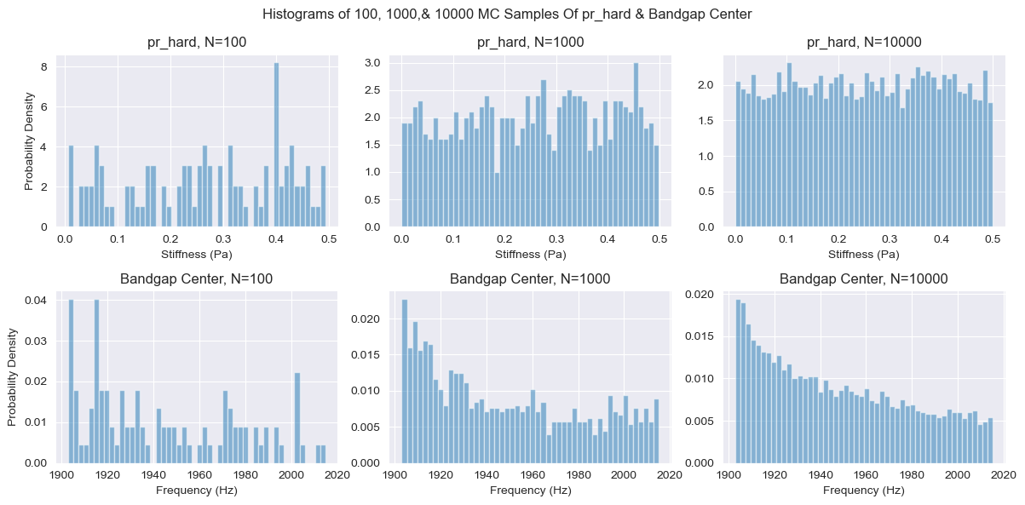
100, 1000, & 10000 MC $ν_{hard}$ & Bandgap Centers

Slide 46
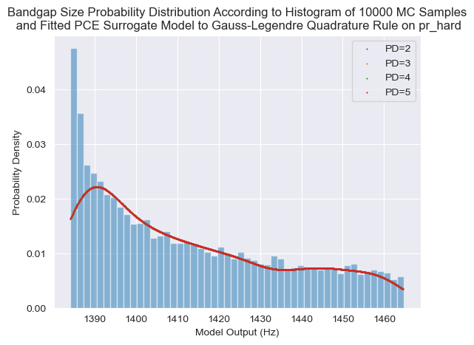
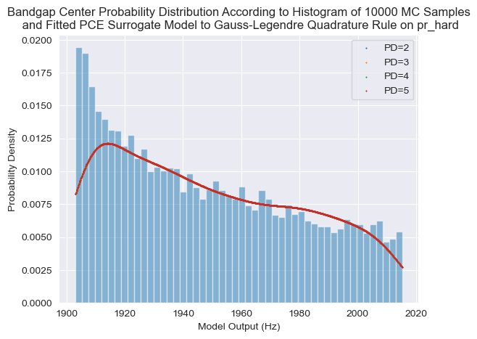
Stochastic Collocation 1D Quadrature – $ν_{hard}$ – Bandgap Size

Slide 47
E_soft
E_hard
Rho_soft
Rho_hard
Pr_soft
Pr_hard

