Slide 1
Uncertainty Quantification for 2D Metamaterials
Han Zhang

Slide 2
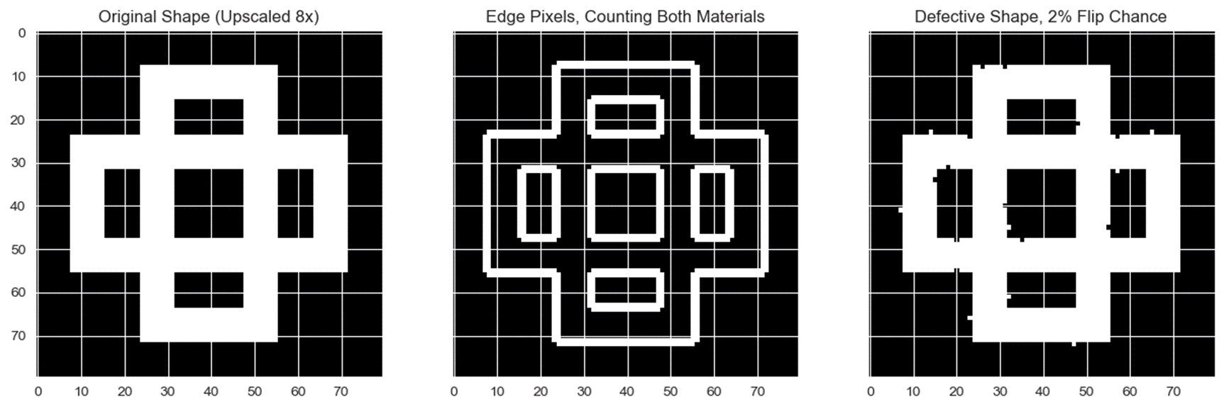
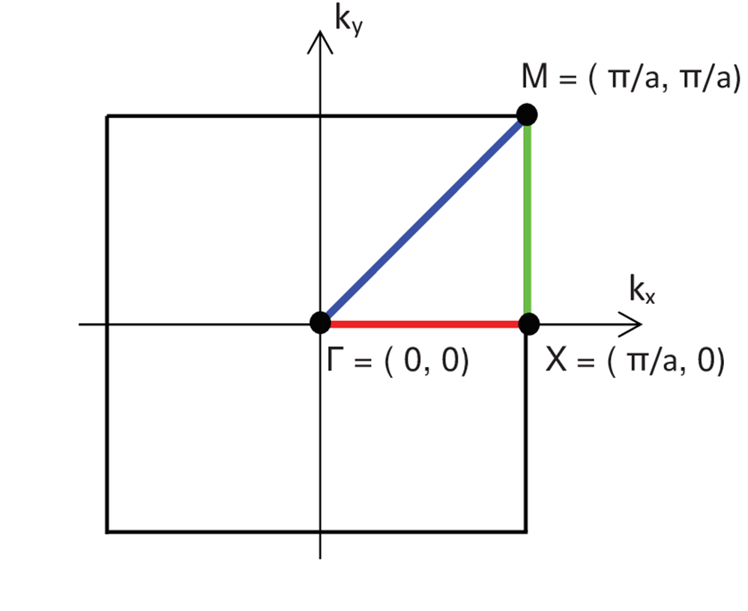
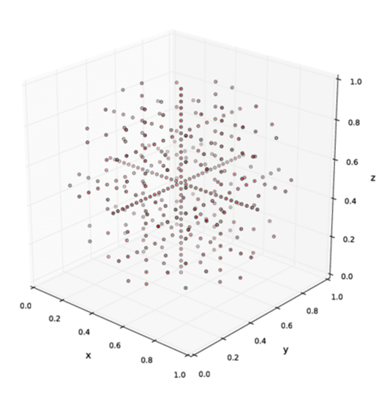
Motivation & Applications
In a wide range of material manufacturing processes, the effects of defects and material batch variations can be catastrophic to performance.
Significant capital, material and time must be devoted across myriad industrial sectors to testing and verification of manufacturing processes.
Using modern techniques in uncertainty quantification, we can efficiently sample and capture the effects of variations in material properties and geometries.
This project simulates an acoustic metamaterial manufacturing scenario, and demonstrates a general method which can reduce sampling needs to capture a high fidelity probability distribution of outputs of interest by orders of magnitude.

Slide 3
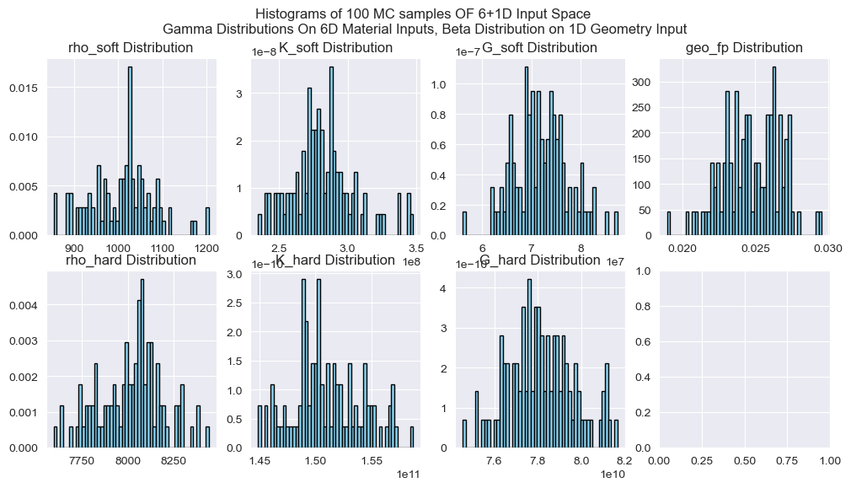
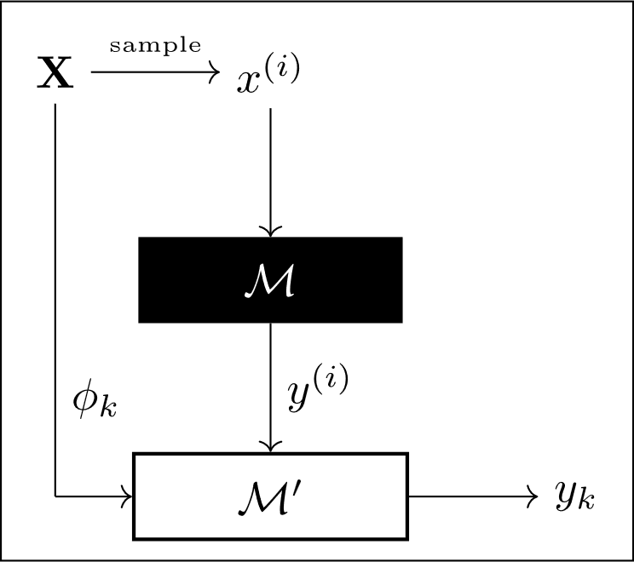
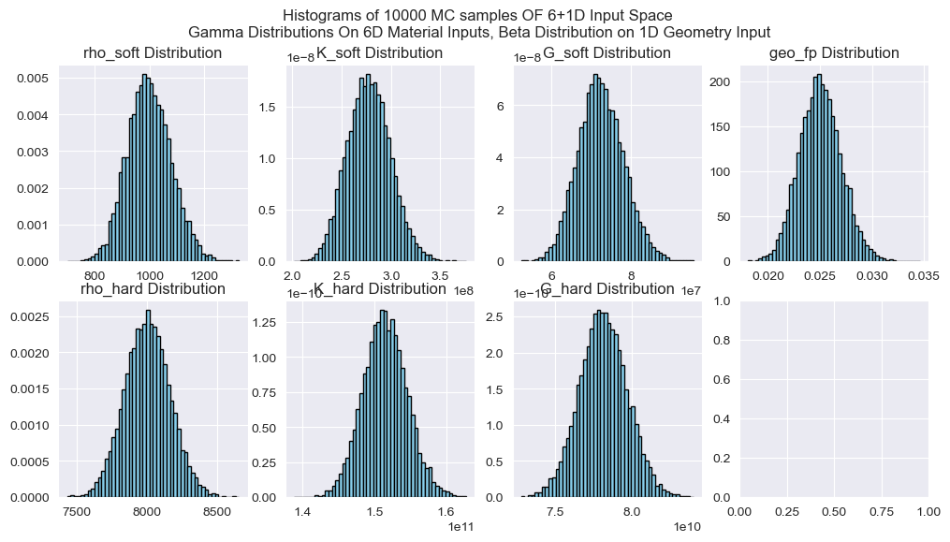
Methodology
Samples we use (~100)
Process
Specify Input distributions (X)
Sample Input distributions with Monte Carlo, Quadrature Rule, or Sparse Grid
Compute outputs (Y) with true model (M)
Form polynomial basis from X (P)
Build Surrogate Model (M’) from X, Y and P.
Generate surrogate outputs Y’
Evaluate surrogate accuracy
7D Input Space Distributions
Rho_soft: Gamma
Rho_hard: Gamma
K_soft: Gamma
K_hard: Gamma
G_soft: Gamma
G_hard: Gamma
Geo_FP: Beta
Sample size we compete against (~10000)
Sparse Grid Illustration in 3D Space
Left Image from: https://dictionary.helmholtz-uq.de/content/polynomial_chaos_expansion.html

Slide 4
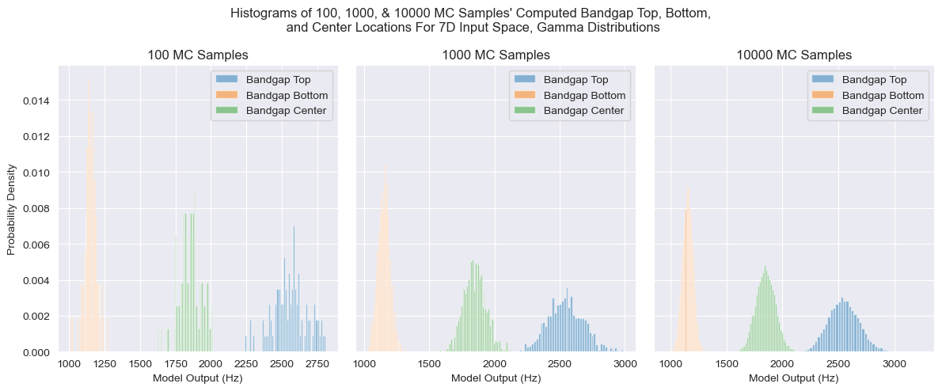
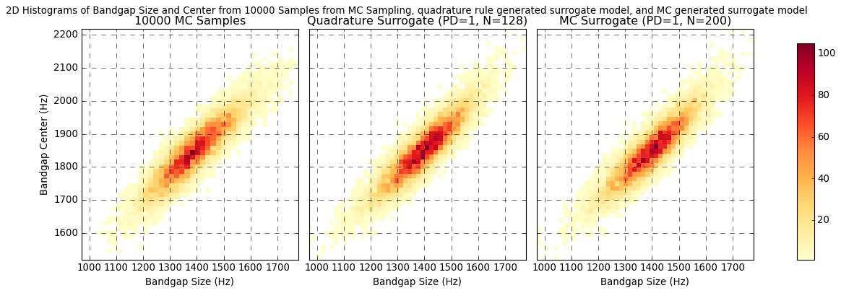
Results
Finite element solver generates bandgap size and location outputs from input samples. Representative output histogram in above figure.
Surrogate model is fitted to datasets (inputs, outputs) of size ~100.
~10000 surrogate model outputs generated to compare to ~10000 true samples for validation of method. Results from two method variations are shown in the middle and right of the bottom figure. True 2D histogram is on the left for comparison.
Note: surrogate model is trivially cheap to run compared to FEA, as it is a polynomial model (y=P(x))
Note: surrogate model does not guarantee pointwise convergence, only convergence in probability distribution of outputs. A fundamental tradeoff for sampling efficiency.

