Slide 1
Uncertainty Quantification for 2D Metamaterials
Han Zhang

Slide 2
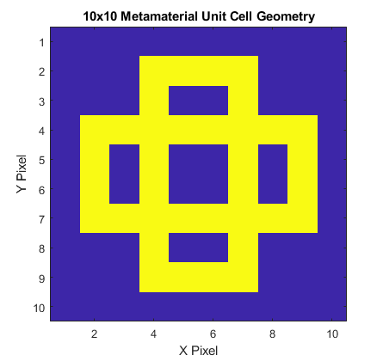
Input Parameters
Fixed Parameters:
Geometry Design, a 10x10 Boolean Array with 1 indicating hard material, 0 indicating soft material.
Random Parameters:
Soft material stiffness, E_soft, uniform distribution from 200e6±100e6
Hard material stiffness, E_hard, uniform distribution from 200e9±100e9
Soft material density, rho_soft, uniform distribution from 1e3±5e2
Hard material density, rho_hard, uniform distribution from 8e3±4e3
Soft material Poisson ratio, pr_soft, uniform distribution from 0.25±0.25
Hard material Poisson ratio, pr_hard, uniform distribution from 0.25±0.25
Outputs of interest:
Bandgap size
Bandgap location
Input dimensionality has important implications for UQ computation. More on this in following slides.

Slide 3
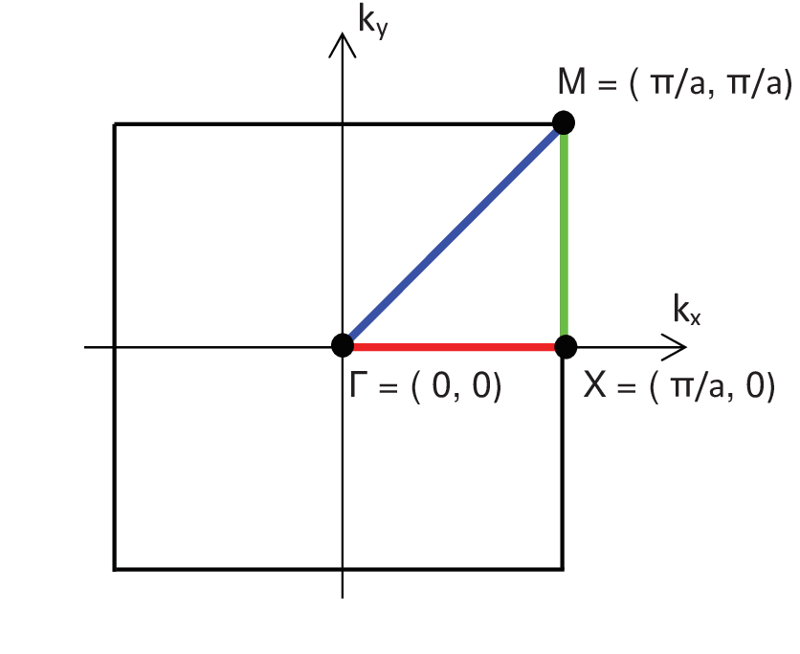
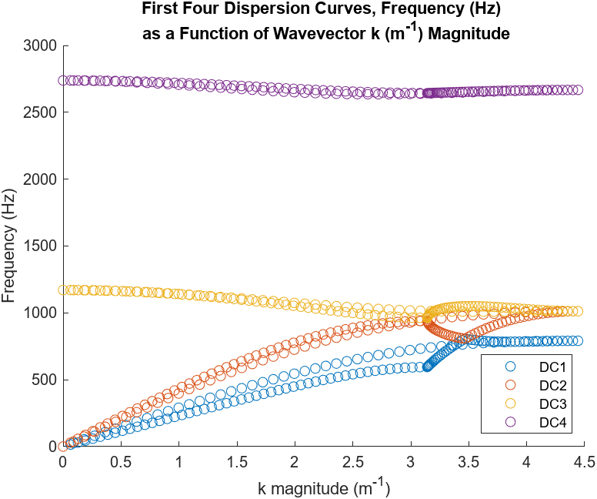
Dispersion Curve Calculations

Slide 4
Theory – Stochastic Collocation (MC)

Slide 5
Theory – Stochastic Collocation (Quadrature)

Slide 6
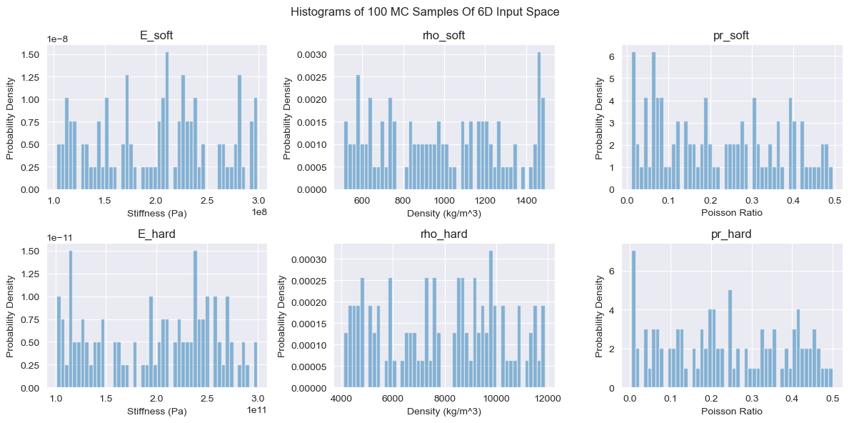
Histograms – 100 MC Inputs

Slide 7
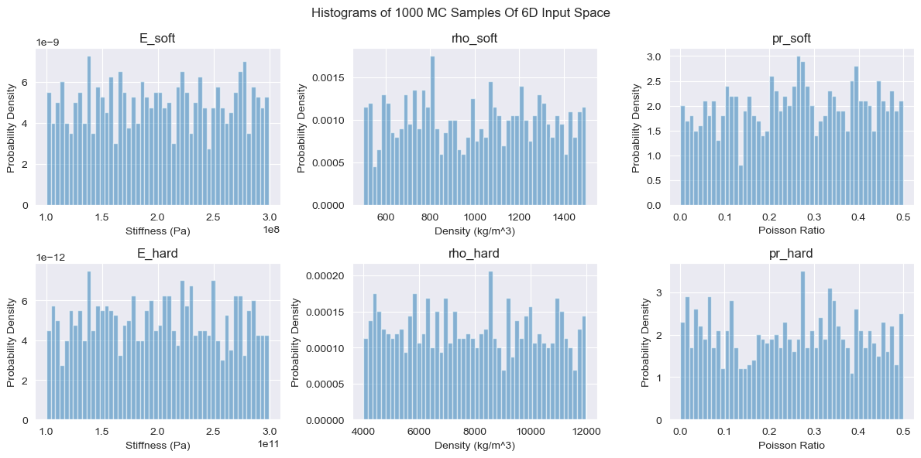
Histograms – 1000 MC Inputs

Slide 8
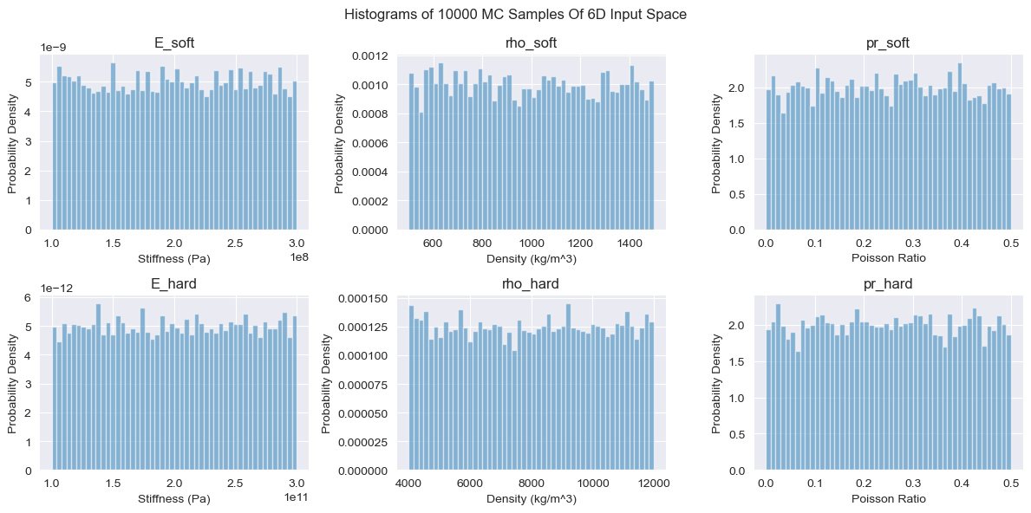
Histograms – 10000 MC Inputs

Slide 9
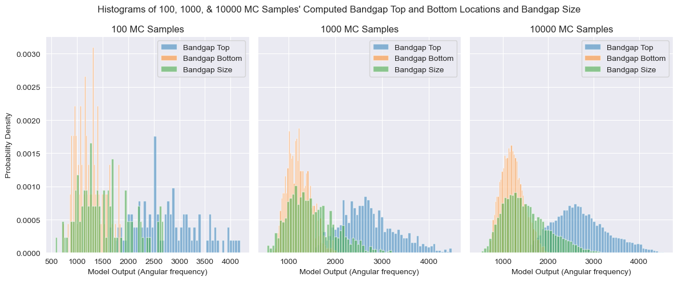
Histograms – Bandgap Top, Bottom, & Size

Slide 10
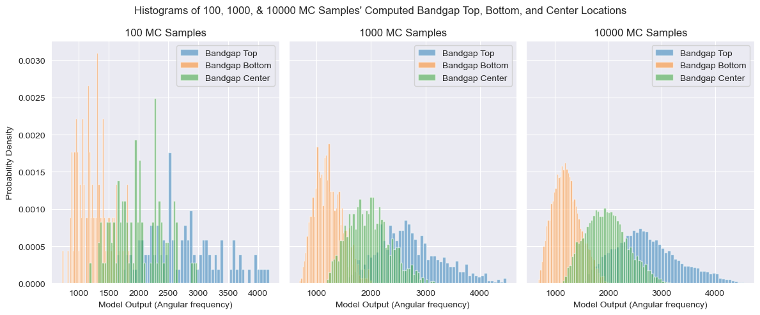
Histograms – Bandgap Top, Bottom, & Center

Slide 11
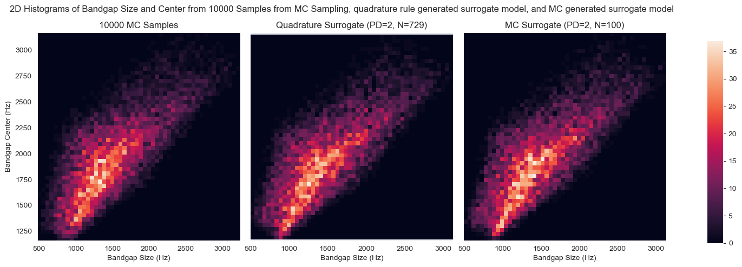
2D Histograms

Slide 12
Stochastic Collocation – MC Regression
A variation of stochastic collocation where the orthogonal polynomials are fitted to MC generated samples
Usually more effective at higher dimensions and less efficient at lower dimensions compared to quadrature rule stochastic collocation

Slide 13
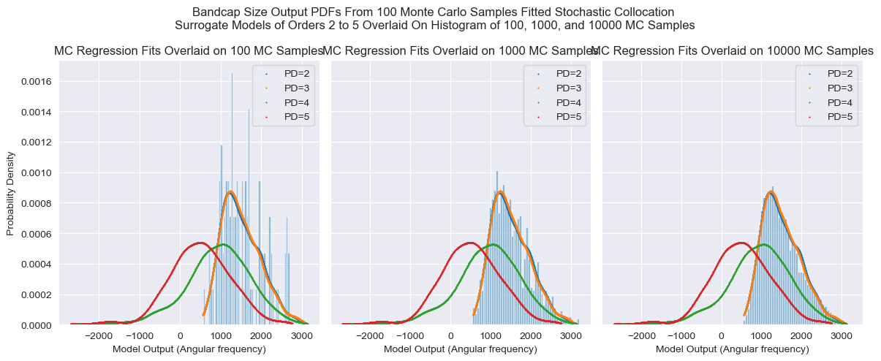
Stochastic Collocation – MC Regression (Underfit)

Slide 14
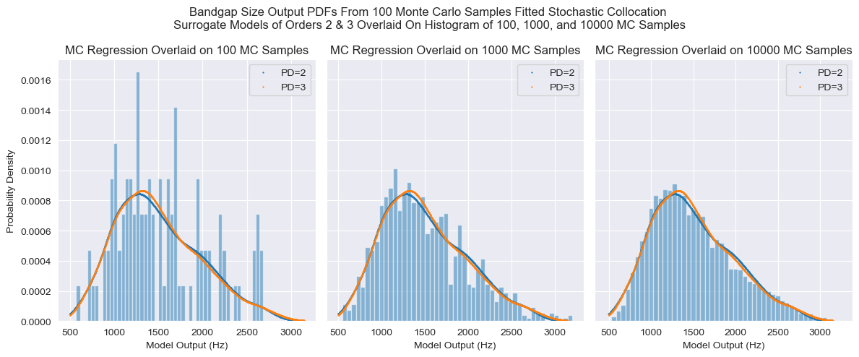
Stochastic Collocation – MC Regression – Bandgap Size

Slide 15
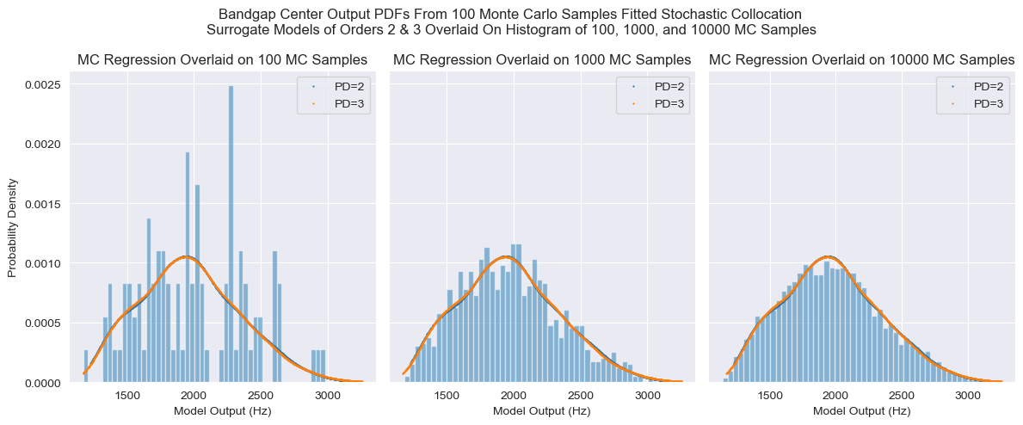
Stochastic Collocation – MC Regression – Bandgap Center

Slide 16
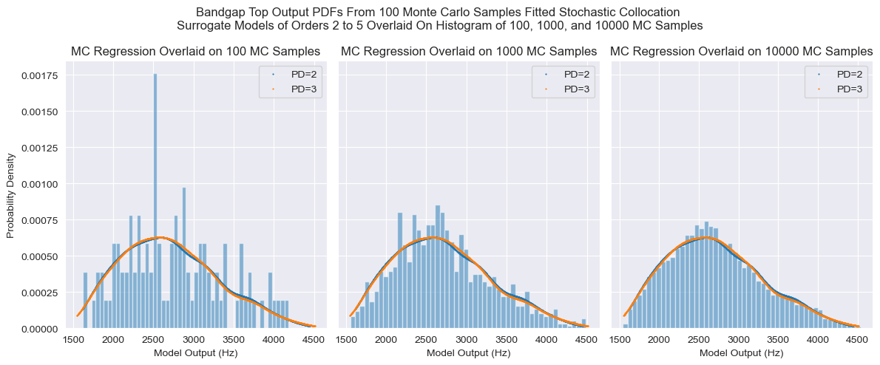
Stochastic Collocation – MC Regression – Bandgap Top

Slide 17
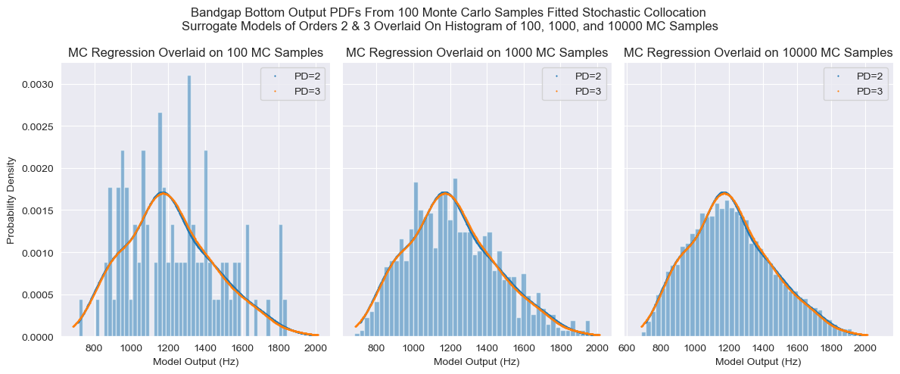
Stochastic Collocation – MC Regression – Bandgap Bottom

Slide 18
Stochastic Collocation – Quadrature Rule
A variation of stochastic collocation where the orthogonal polynomials are fitted to specific points with weights, generated by using a rule function on the input distribution.
Extremely efficient at low dimensions, however points needed scales as s = (p + 1)^d, where s is the number of samples needed, p is the order of polynomial fit, and d is the dimensionality of the input space. This method therefore becomes very expensive very quickly as d increases.

Slide 19
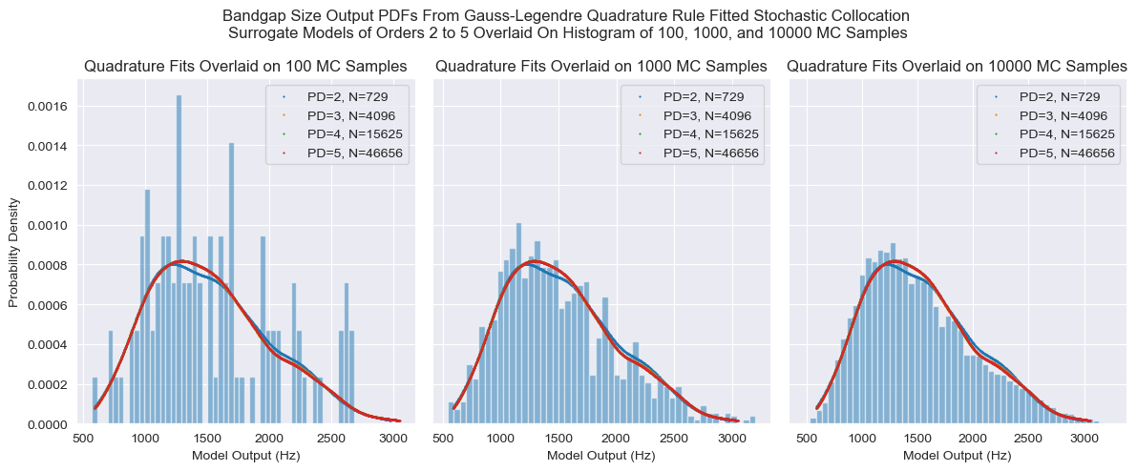
Stochastic Collocation – Quadrature Rule – Bandgap Size

Slide 20
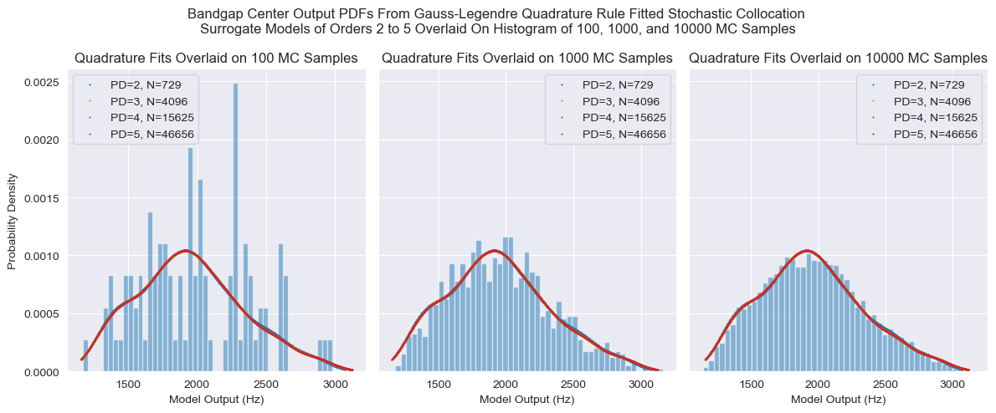
Stochastic Collocation – Quadrature Rule – Bandgap Center

Slide 21
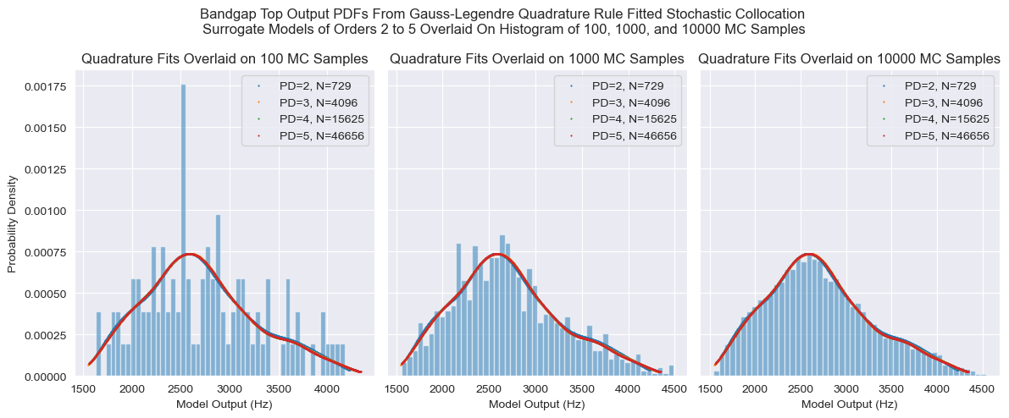
Stochastic Collocation – Quadrature Rule – Bandgap Top

Slide 22
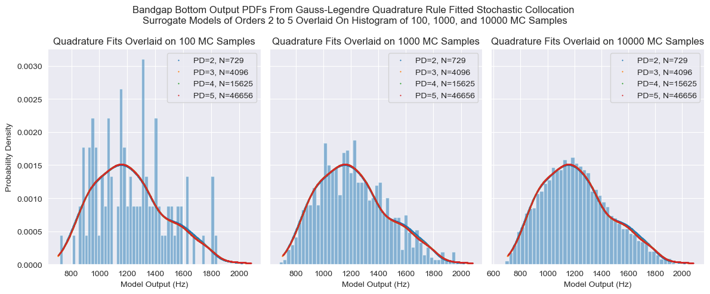
Stochastic Collocation – Quadrature Rule – Bandgap Bottom

Slide 23
1D PCE Fits
The following figures are for 1 input, 1 output scenarios, whereby the other 5 inputs are held at the following default values:
E_soft: 200 MPa
E_hard: 200 GPa
Rho_soft: 1000 kg/m^3
Rho_hard: 8000 kg/m^3
PR_soft: 0
PR_hard: 0.5

Slide 24
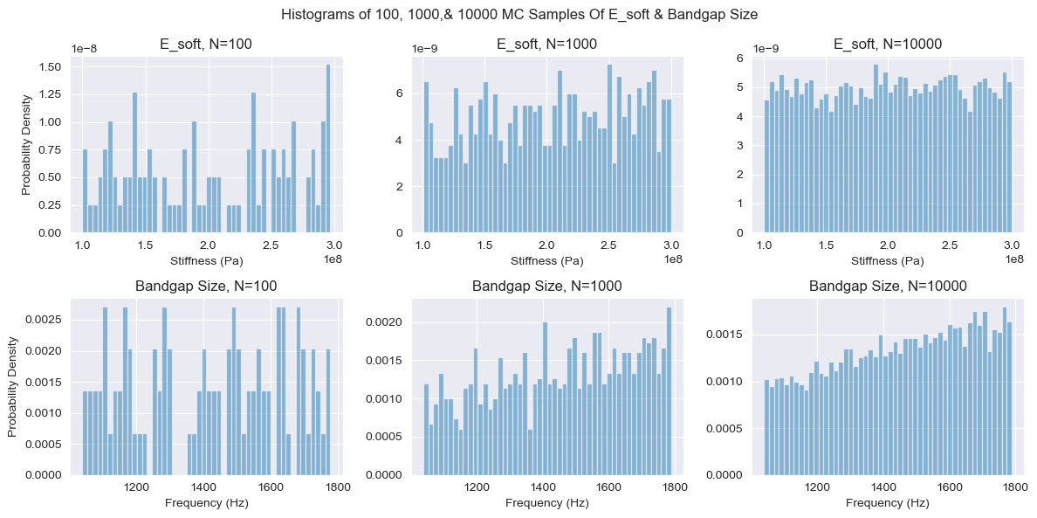
100, 1000, & 10000 MC E_soft & Bandgap Sizes

Slide 25
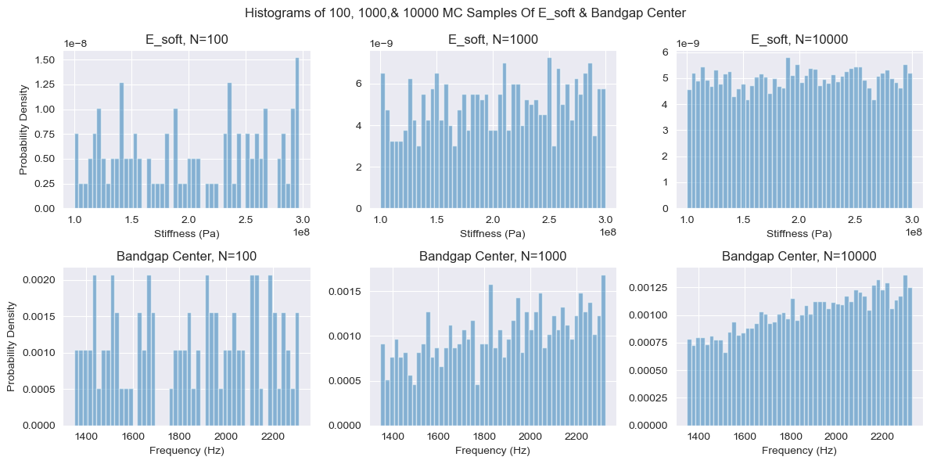
100, 1000, & 10000 MC E_soft & Bandgap Centers

Slide 26
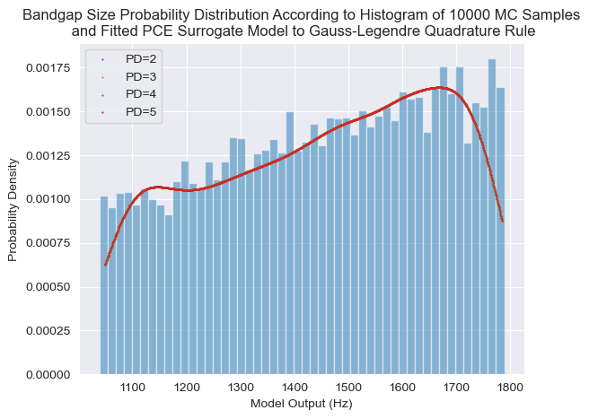
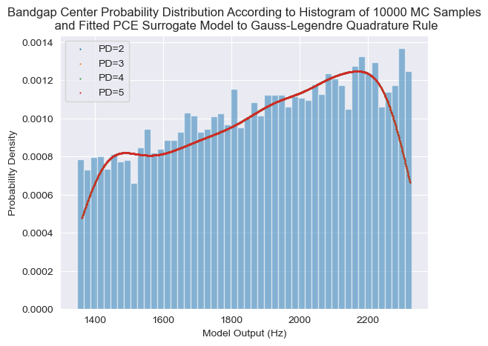
Stochastic Collocation 1D Quadrature – E_soft – Bandgap Size

Slide 27
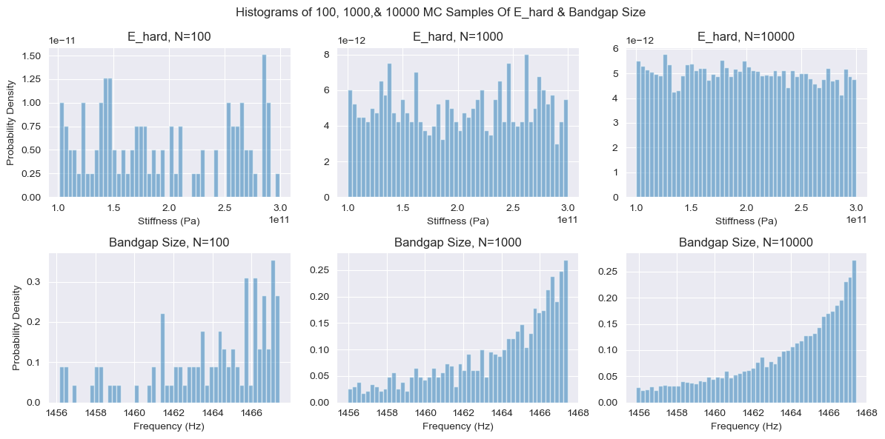
100, 1000, & 10000 MC E_hard & Bandgap Sizes

Slide 28
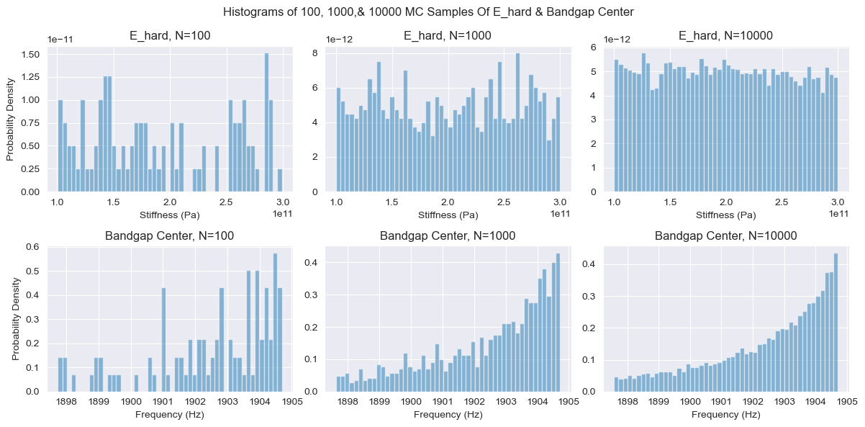
100, 1000, & 10000 MC E_hard & Bandgap Centers

Slide 29
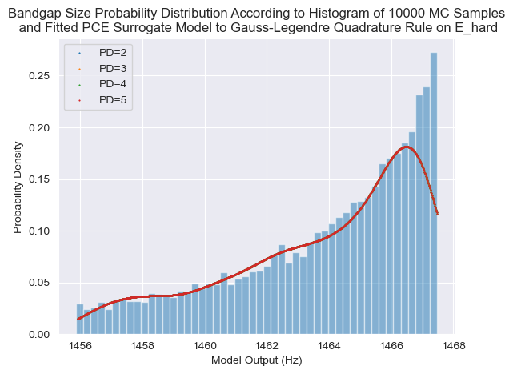
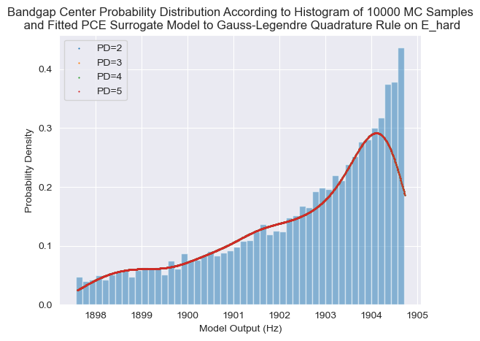
Stochastic Collocation 1D Quadrature – E_hard – Bandgap Size

Slide 30
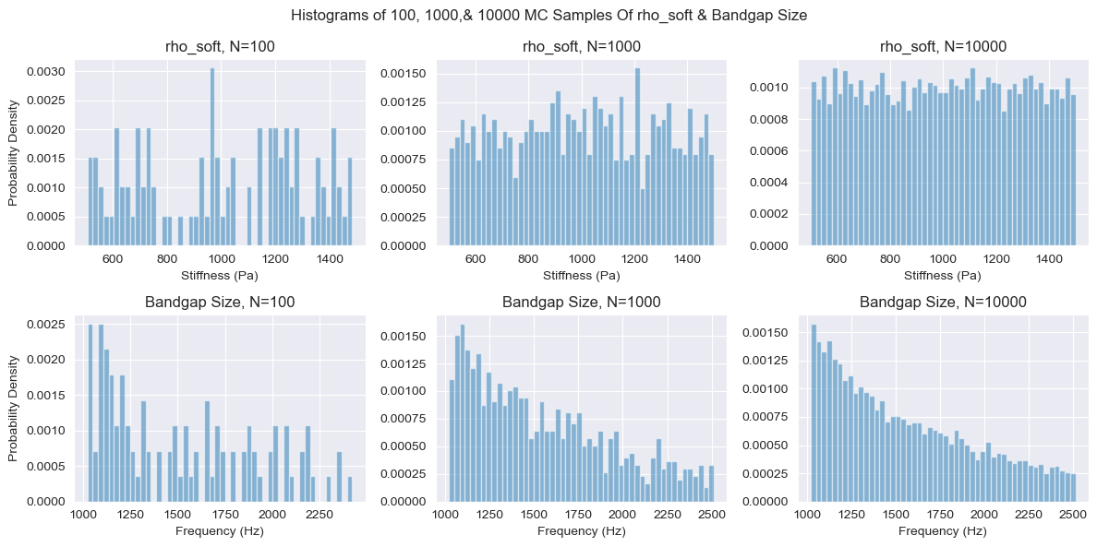
100, 1000, & 10000 MC Rho_soft & Bandgap Sizes

Slide 31
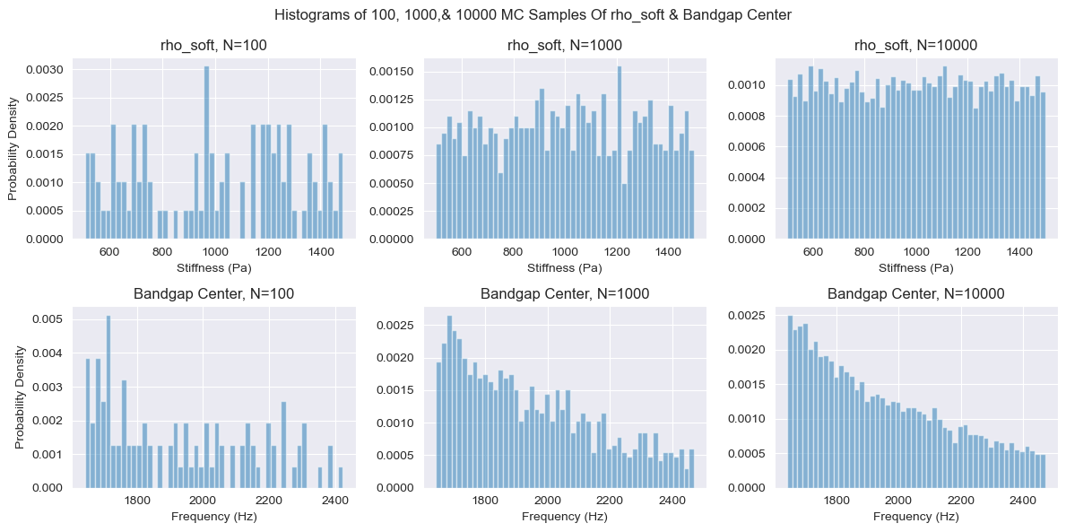
100, 1000, & 10000 MC rho_soft & Bandgap Centers

Slide 32
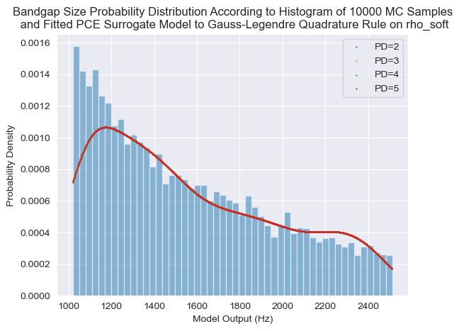
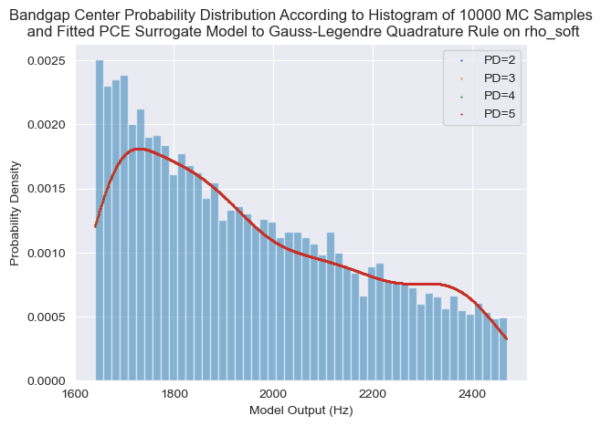
Stochastic Collocation 1D Quadrature – rho_soft – Bandgap Size

Slide 33
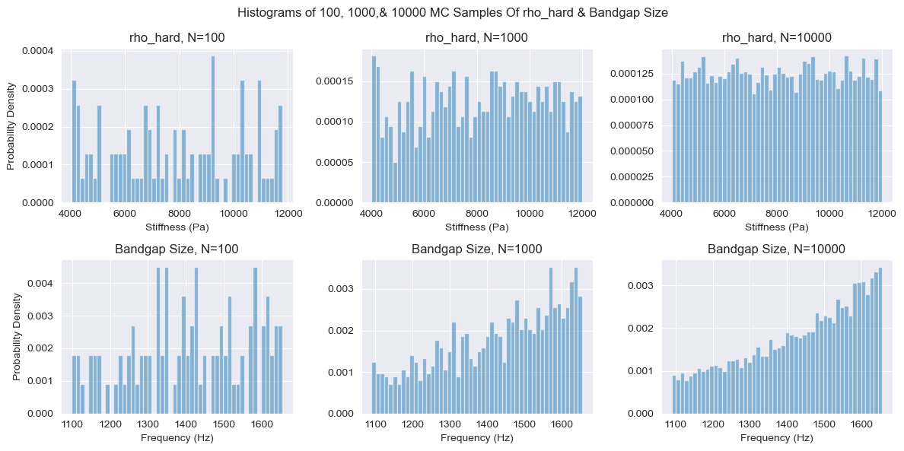
100, 1000, & 10000 MC rho_hard & Bandgap Sizes

Slide 34
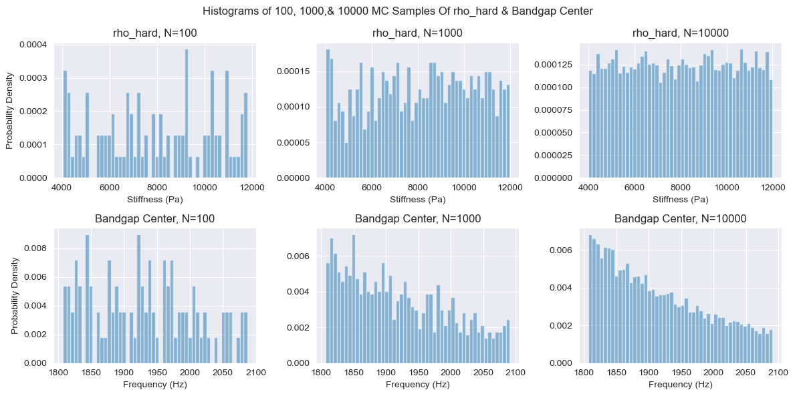
100, 1000, & 10000 MC rho_hard & Bandgap Centers

Slide 35
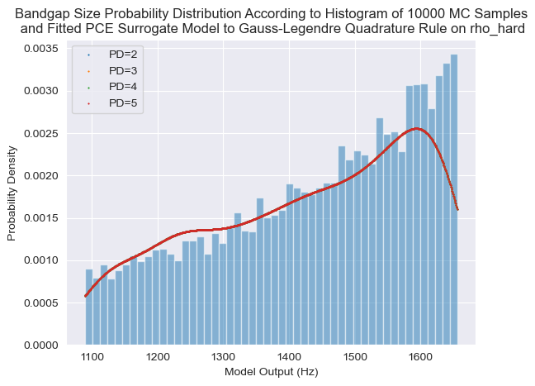
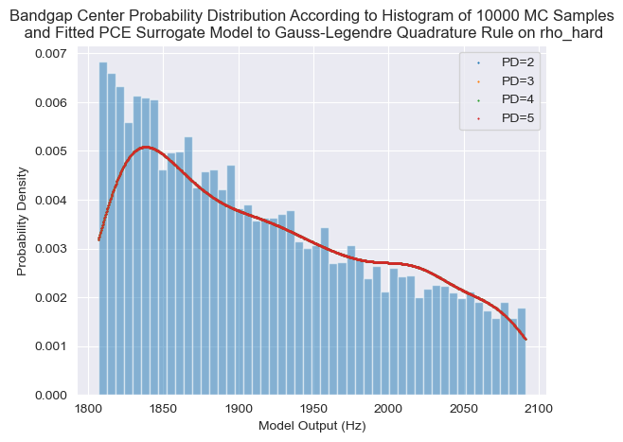
Stochastic Collocation 1D Quadrature – rho_hard – Bandgap Size

Slide 36
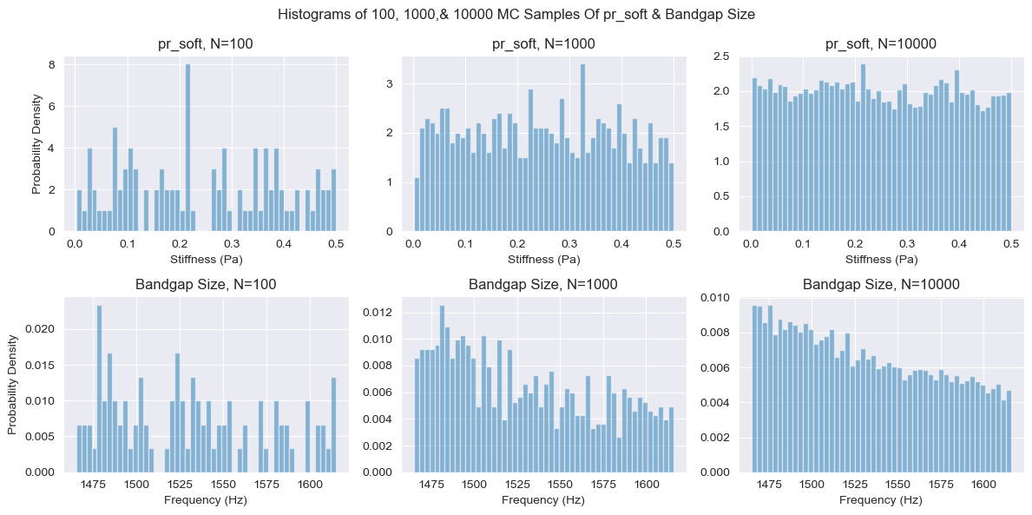
100, 1000, & 10000 MC $ν_{soft}$ & Bandgap Sizes

Slide 37
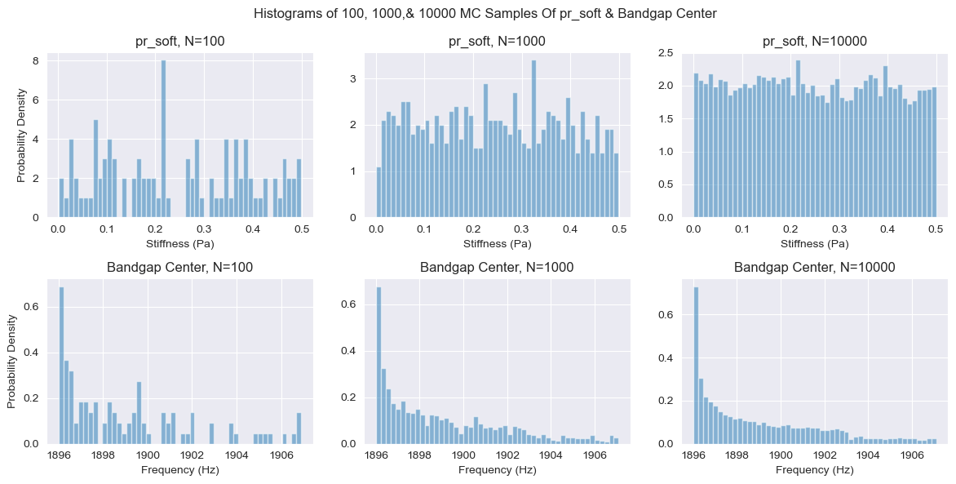
100, 1000, & 10000 MC $ν_{soft}$ & Bandgap Centers

Slide 38
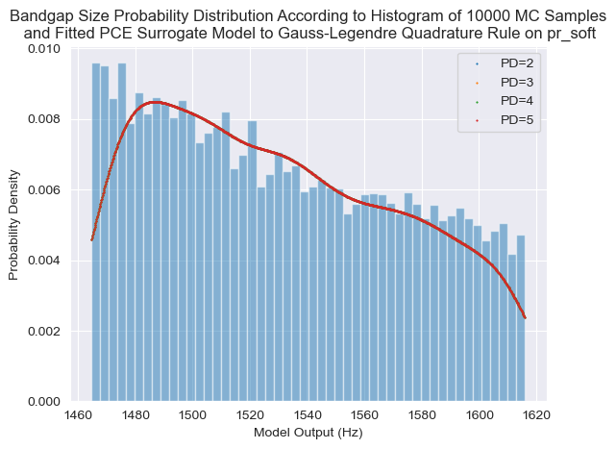
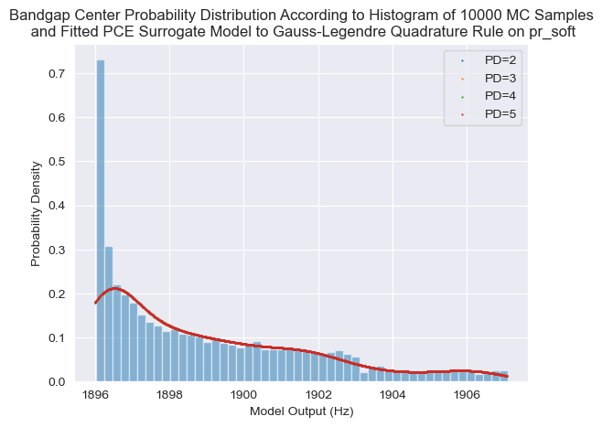
Stochastic Collocation 1D Quadrature – $ν_{soft}$– Bandgap Size

Slide 39
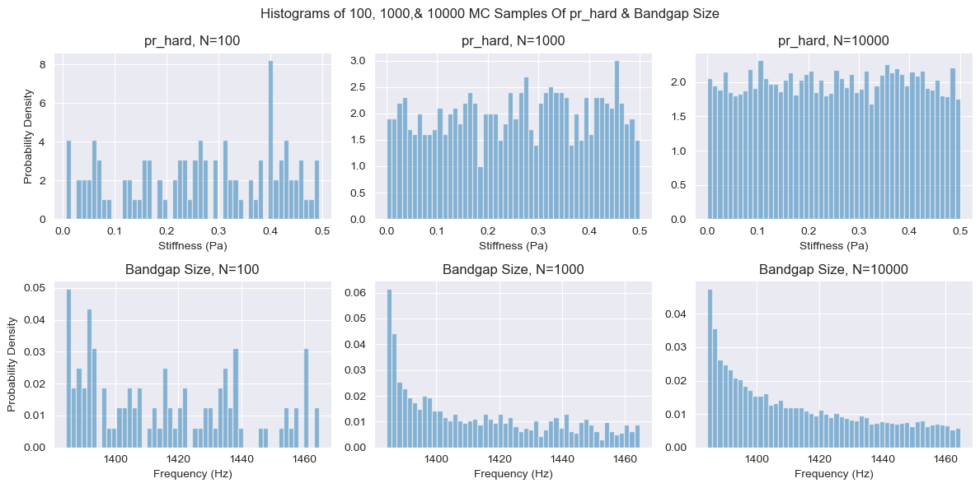
100, 1000, & 10000 MC $ν_{hard}$& Bandgap Sizes

Slide 40
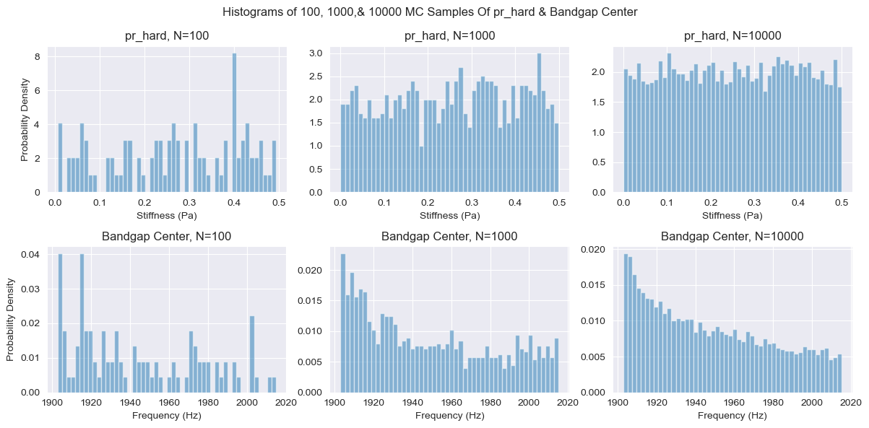
100, 1000, & 10000 MC $ν_{hard}$ & Bandgap Centers

Slide 41
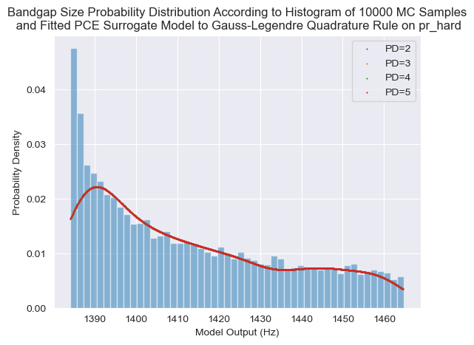
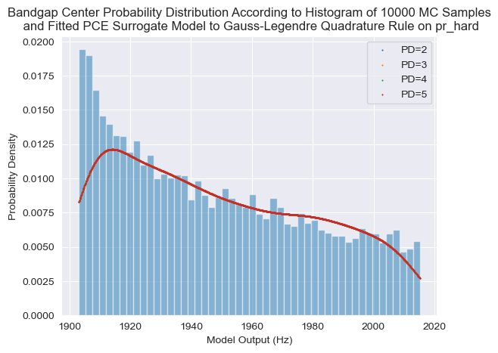
Stochastic Collocation 1D Quadrature – $ν_{hard}$ – Bandgap Size

Slide 42
E_soft
E_hard
Rho_soft
Rho_hard
Pr_soft
Pr_hard

