Slide 1
Uncertainty Quantification for 2D Metamaterials
Han Zhang

Slide 2
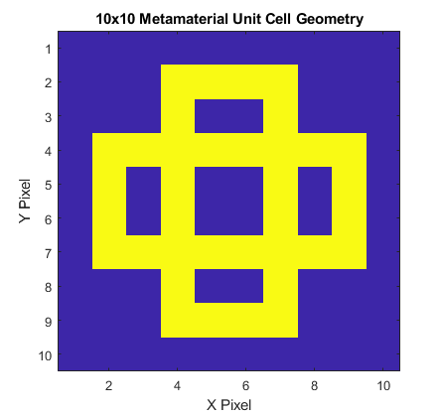
Input Geometry
Fixed Parameters:
Geometry Design, a 10x10 Boolean Array with 1 indicating hard material, 0 indicating soft material.
Random Parameters:
Soft material stiffness, E_soft, uniform distribution from 200e6±100e6
Hard material stiffness, E_hard, uniform distribution from 200e9±100e9
Soft material density, rho_soft, uniform distribution from 1e3±5e2
Hard material density, rho_hard, uniform distribution from 8e3±4e3
Soft material Poisson ratio, pr_soft, uniform distribution from 0.25±0.25
Hard material Poisson ratio, pr_hard, uniform distribution from 0.25±0.25
Outputs of interest:
Bandgap size
Bandgap location
Input dimensionality has important implications for UQ computation. More on this in following slides.

Slide 3
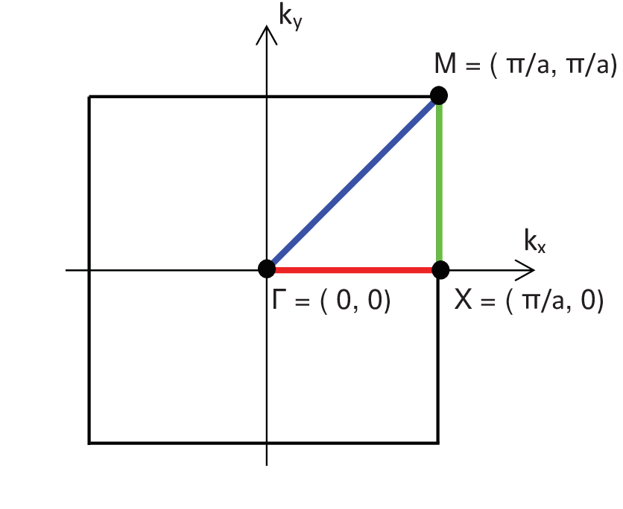
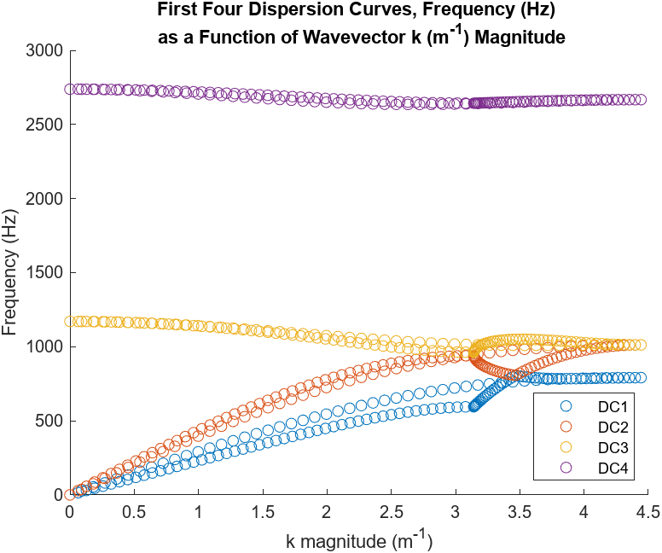
Dispersion Curve Calculations

Slide 4
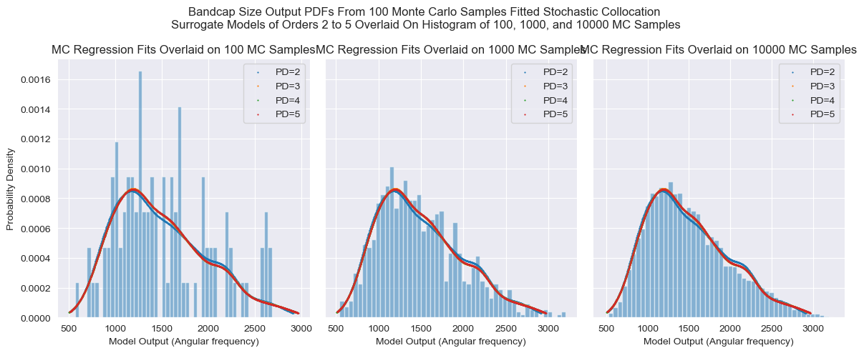
Stochastic Collocation – Regression on MC Samples

Slide 5
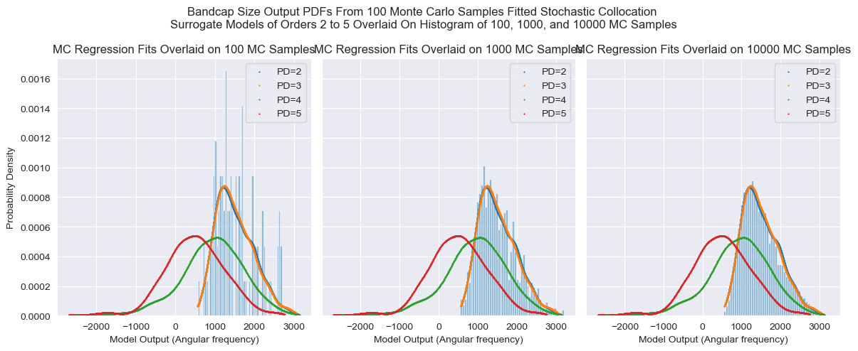
Stochastic Collocation – Regression on MC Samples

Slide 6
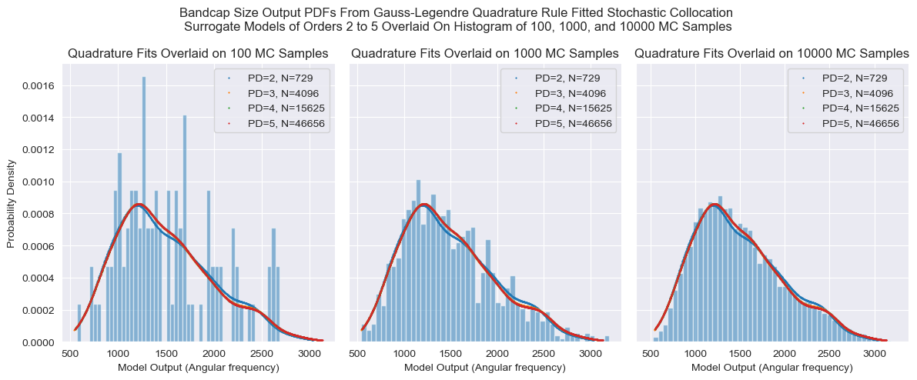
Stochastic Collocation – Quadrature Rule

