Slide 1
Uncertainty Quantification for 2D Metamaterials
Han Zhang

Slide 2
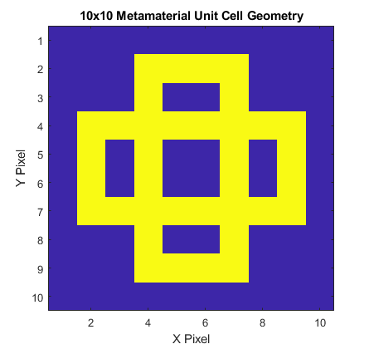
Input Parameters
Fixed Parameters:
Geometry Design, a 10x10 Boolean Array with 1 indicating hard material, 0 indicating soft material.
Random Parameters:
Soft material stiffness, E_soft, uniform distribution from 200e6±100e6
Hard material stiffness, E_hard, uniform distribution from 200e9±100e9
Soft material density, rho_soft, uniform distribution from 1e3±5e2
Hard material density, rho_hard, uniform distribution from 8e3±4e3
Soft material Poisson ratio, pr_soft, uniform distribution from 0.25±0.25
Hard material Poisson ratio, pr_hard, uniform distribution from 0.25±0.25
Outputs of interest:
Bandgap size
Bandgap location
Input dimensionality has important implications for UQ computation. More on this in following slides.

Slide 3
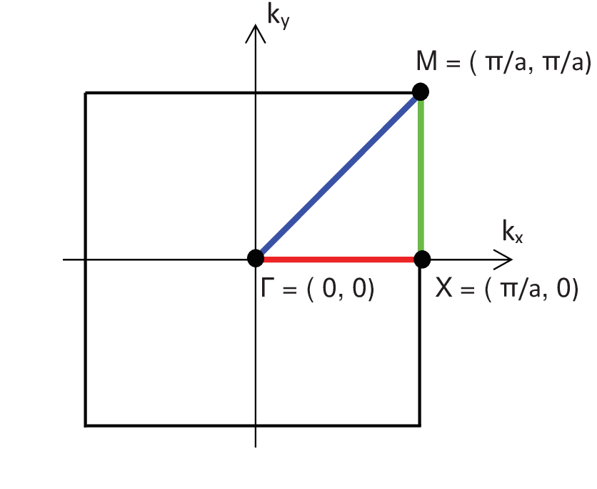
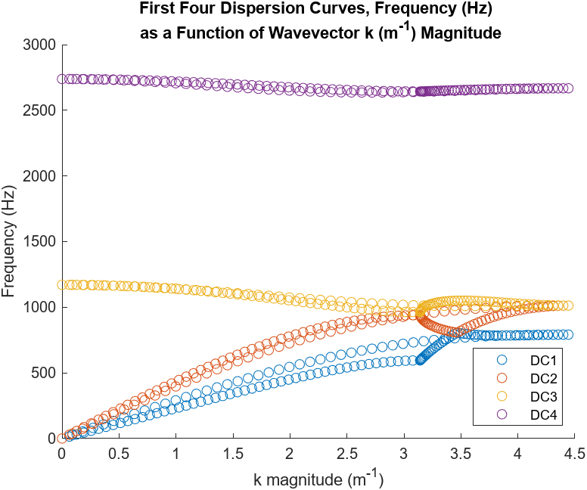
Dispersion Curve Calculations

Slide 4
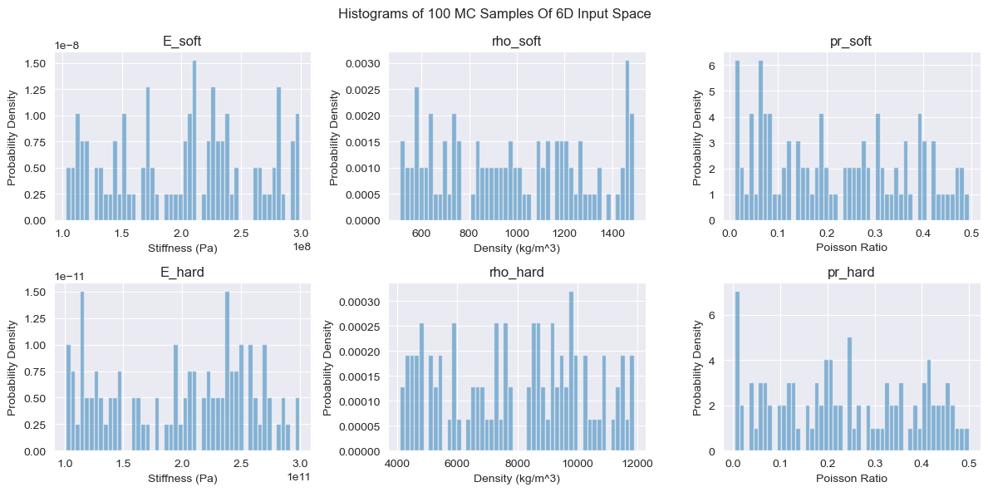
Histograms – 100 MC Inputs

Slide 5
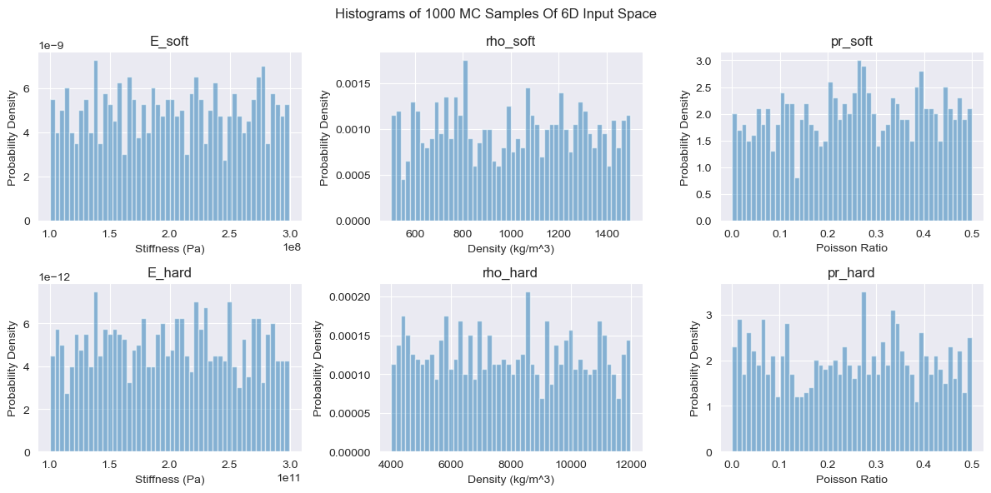
Histograms – 1000 MC Inputs

Slide 6
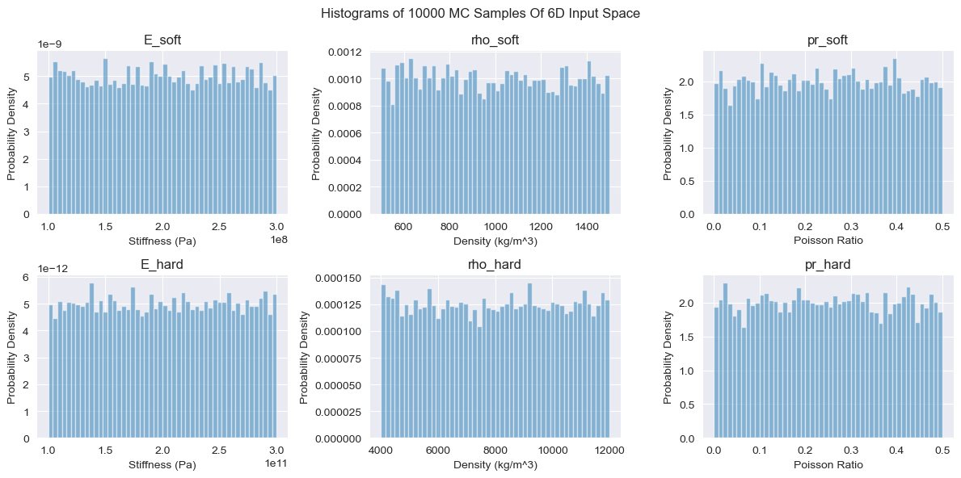
Histograms – 10000 MC Inputs

Slide 7
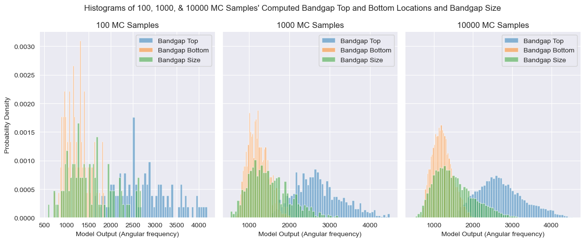
Histograms – Bandgap Top, Bottom, & Size

Slide 8
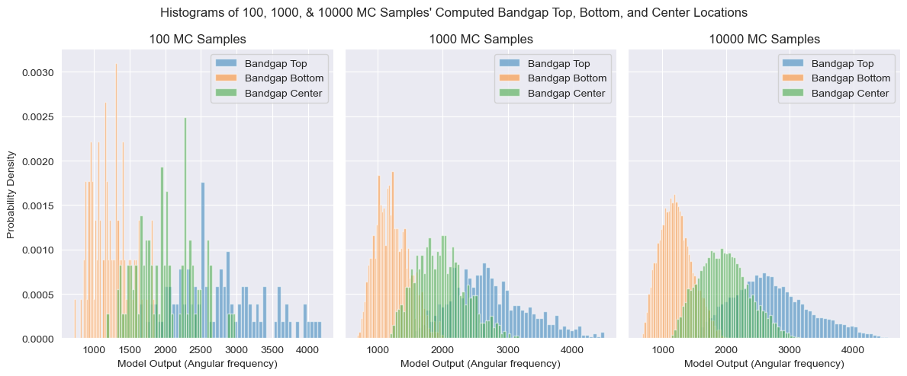
Histograms – Bandgap Top, Bottom, & Center

Slide 9
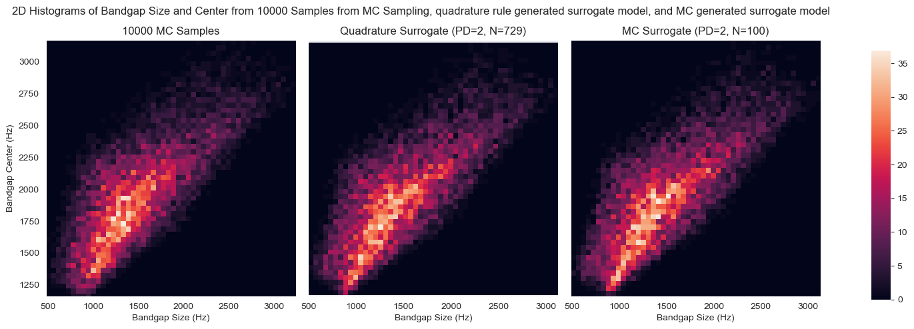
2D Histograms

Slide 10
Stochastic Collocation – MC Regression
A variation of stochastic collocation where the orthogonal polynomials are fitted to MC generated samples
Usually more effective at higher dimensions and less efficient at lower dimensions compared to quadrature rule stochastic collocation

Slide 11
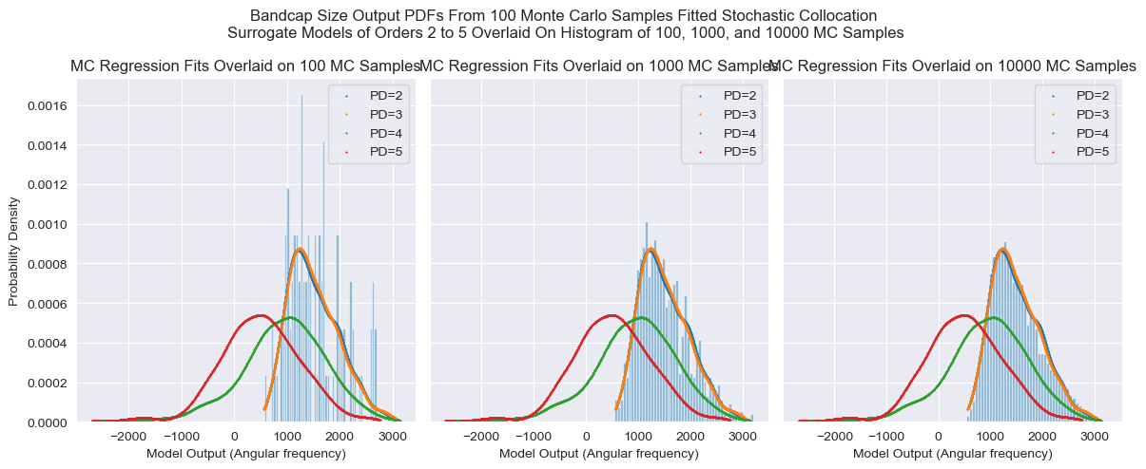
Stochastic Collocation – MC Regression (Underfit)

Slide 12
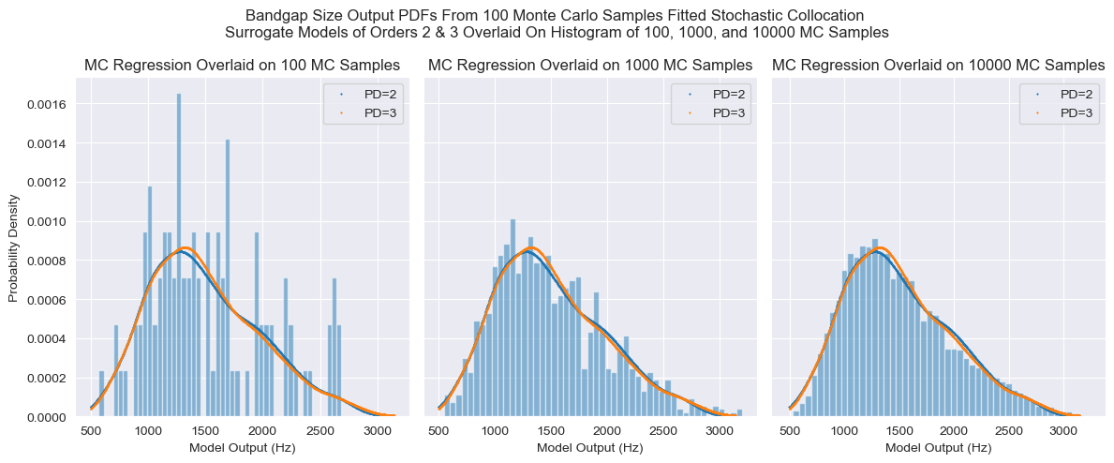
Stochastic Collocation – MC Regression – Bandgap Size

Slide 13
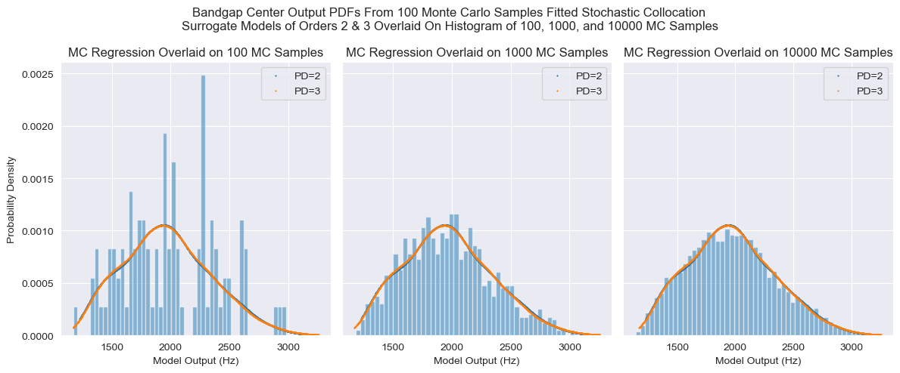
Stochastic Collocation – MC Regression – Bandgap Center

Slide 14
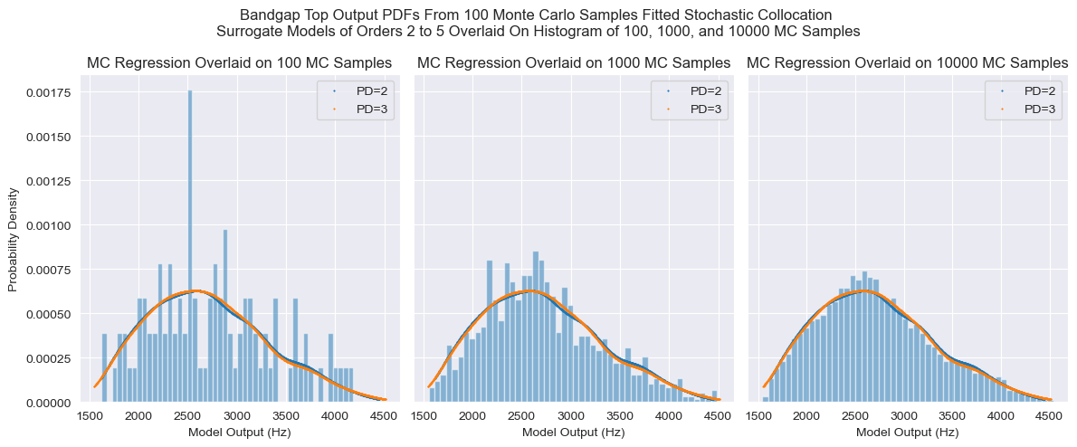
Stochastic Collocation – MC Regression – Bandgap Top

Slide 15
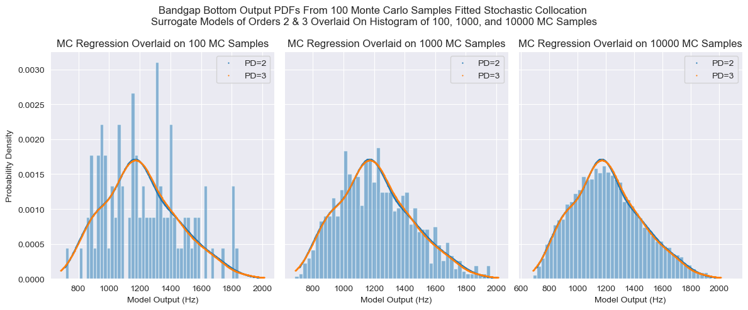
Stochastic Collocation – MC Regression – Bandgap Bottom

Slide 16
Stochastic Collocation – Quadrature Rule
A variation of stochastic collocation where the orthogonal polynomials are fitted to specific points with weights, generated by using a rule function on the input distribution.
Extremely efficient at low dimensions, however points needed scales as s = (p + 1)^d, where s is the number of samples needed, p is the order of polynomial fit, and d is the dimensionality of the input space. This method therefore becomes very expensive very quickly as d increases.

Slide 17
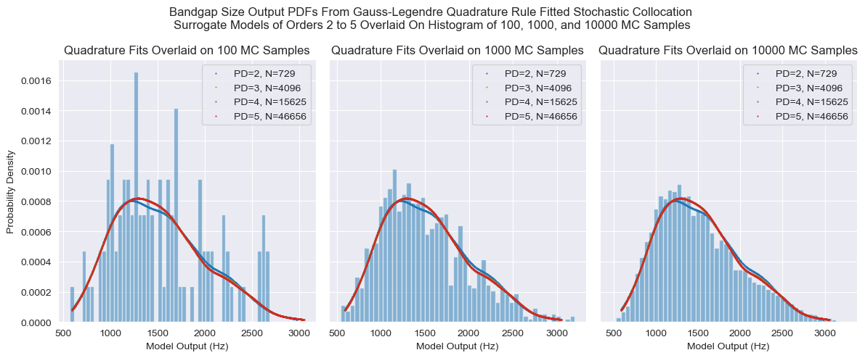
Stochastic Collocation – Quadrature Rule – Bandgap Size

Slide 18
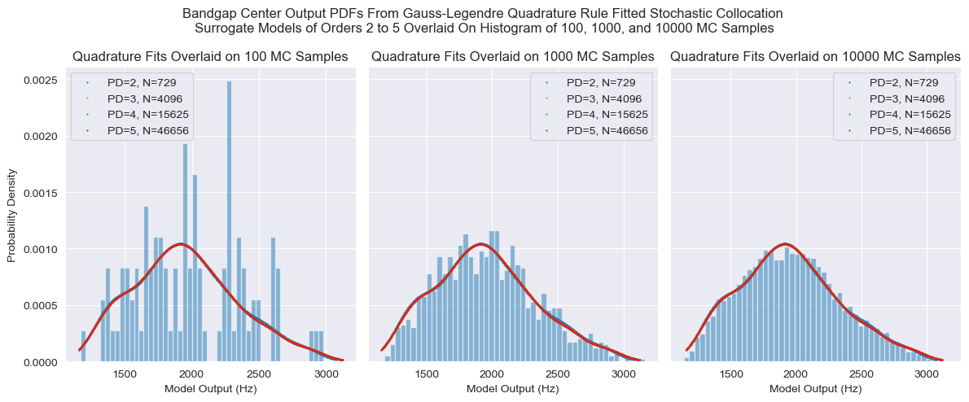
Stochastic Collocation – Quadrature Rule – Bandgap Center

Slide 19
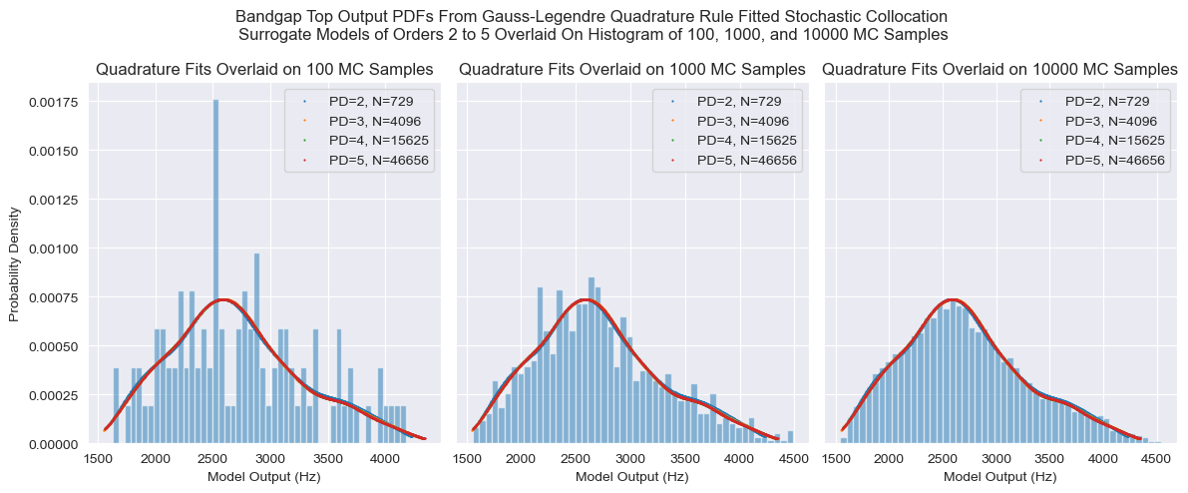
Stochastic Collocation – Quadrature Rule – Bandgap Top

Slide 20
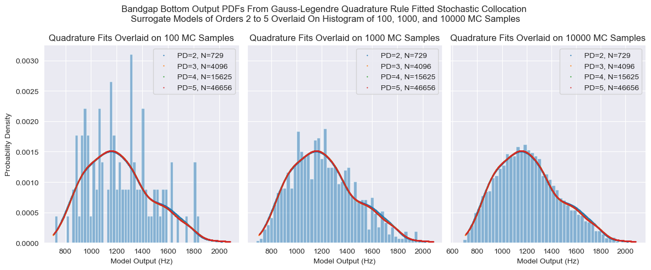
Stochastic Collocation – Quadrature Rule – Bandgap Bottom

Slide 21
1D PCE Fits
The following figures are for 1 input, 1 output scenarios, whereby the other 5 inputs are held at the following default values:
E_soft: 200 MPa
E_hard: 200 GPa
Rho_soft: 1000 kg/m^3
Rho_hard: 8000 kg/m^3
PR_soft: 0
PR_hard: 0.5

Slide 22
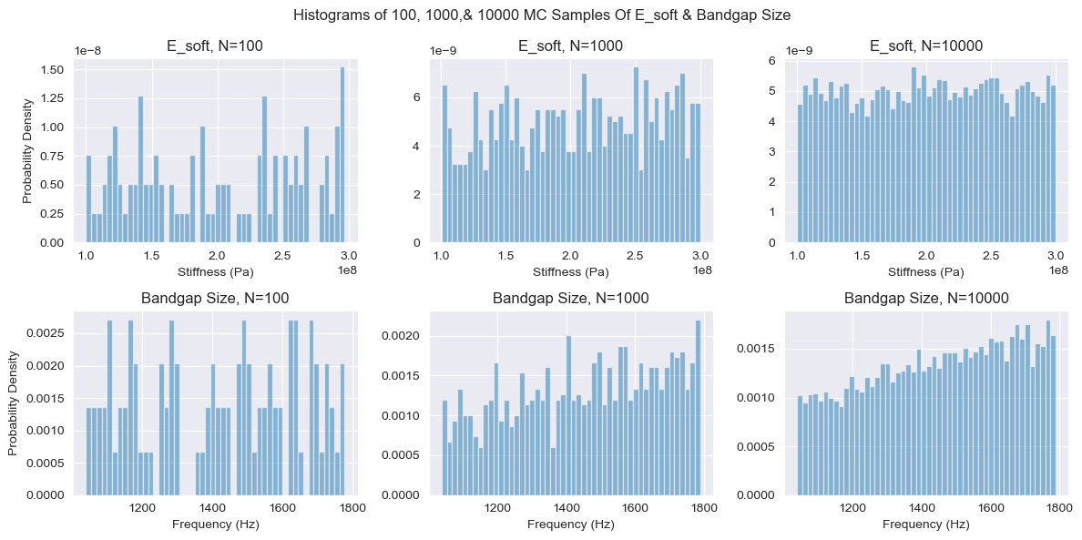
100, 1000, & 10000 MC E_soft & Bandgap Sizes

Slide 23
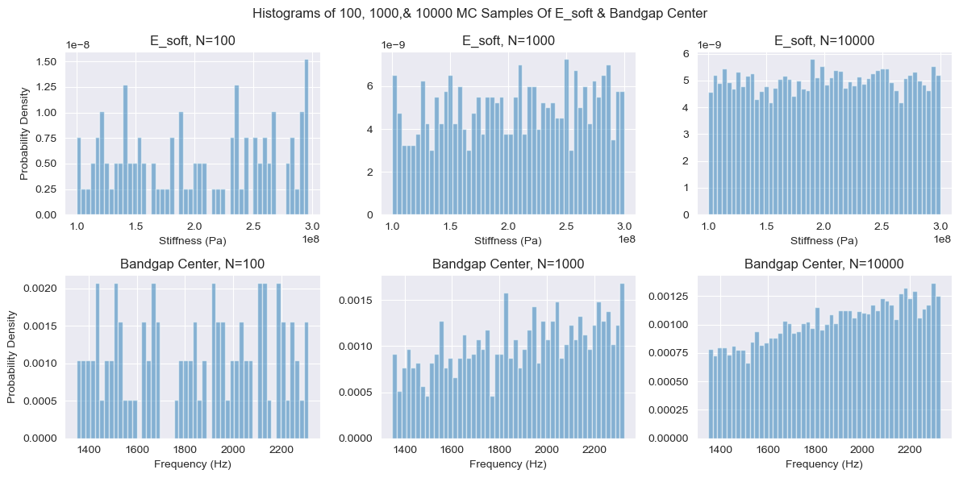
100, 1000, & 10000 MC E_soft & Bandgap Centers

Slide 24
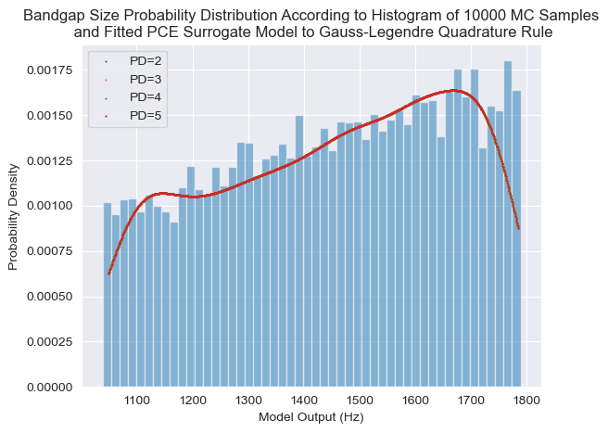
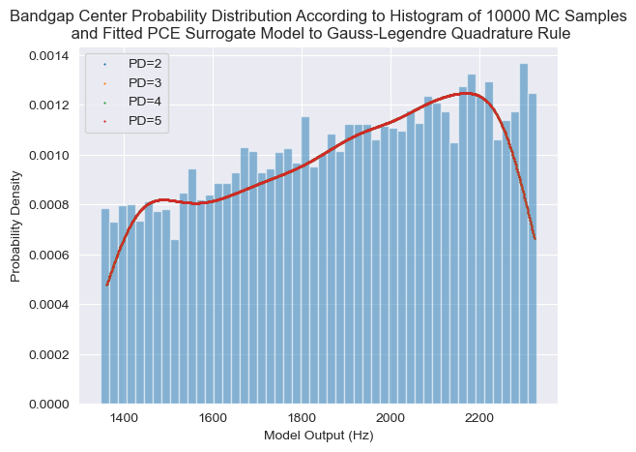
Stochastic Collocation 1D Quadrature – E_soft – Bandgap Size

Slide 25
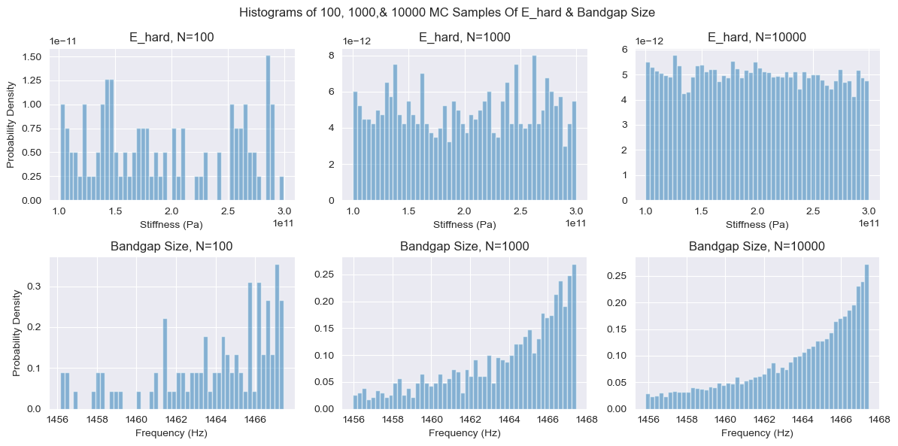
100, 1000, & 10000 MC E_hard & Bandgap Sizes

Slide 26
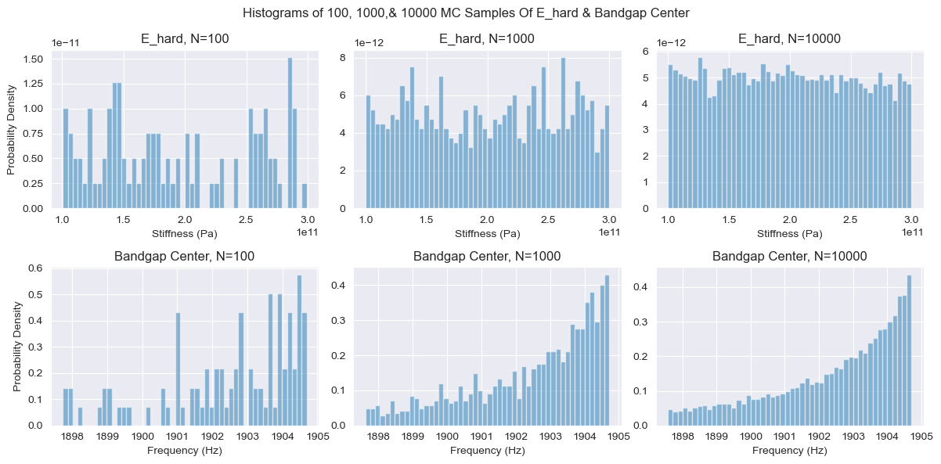
100, 1000, & 10000 MC E_hard & Bandgap Centers

Slide 27
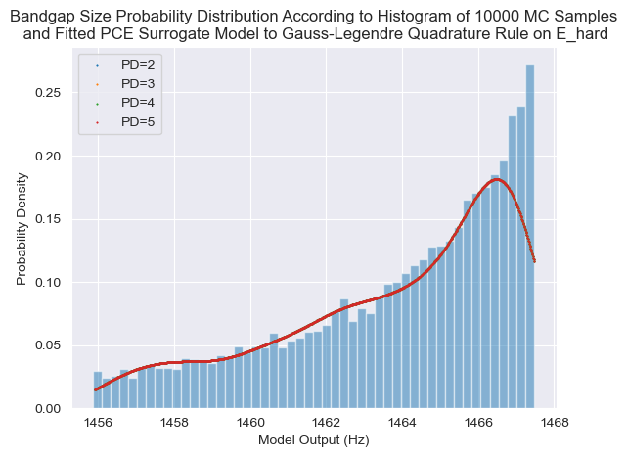
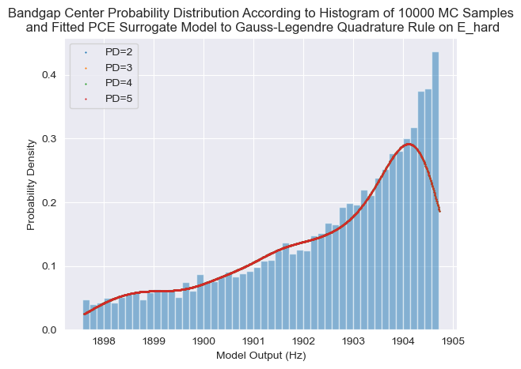
Stochastic Collocation 1D Quadrature – E_hard – Bandgap Size

Slide 28
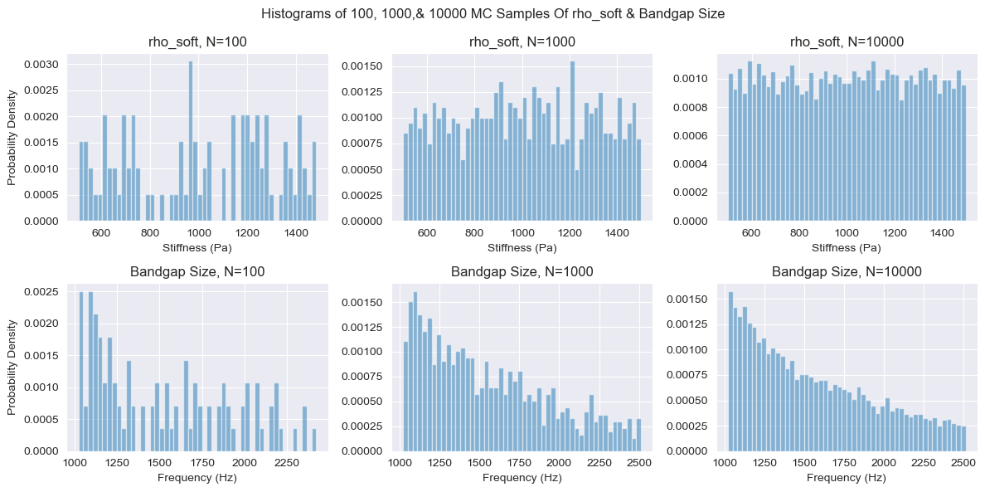
100, 1000, & 10000 MC Rho_soft & Bandgap Sizes

Slide 29
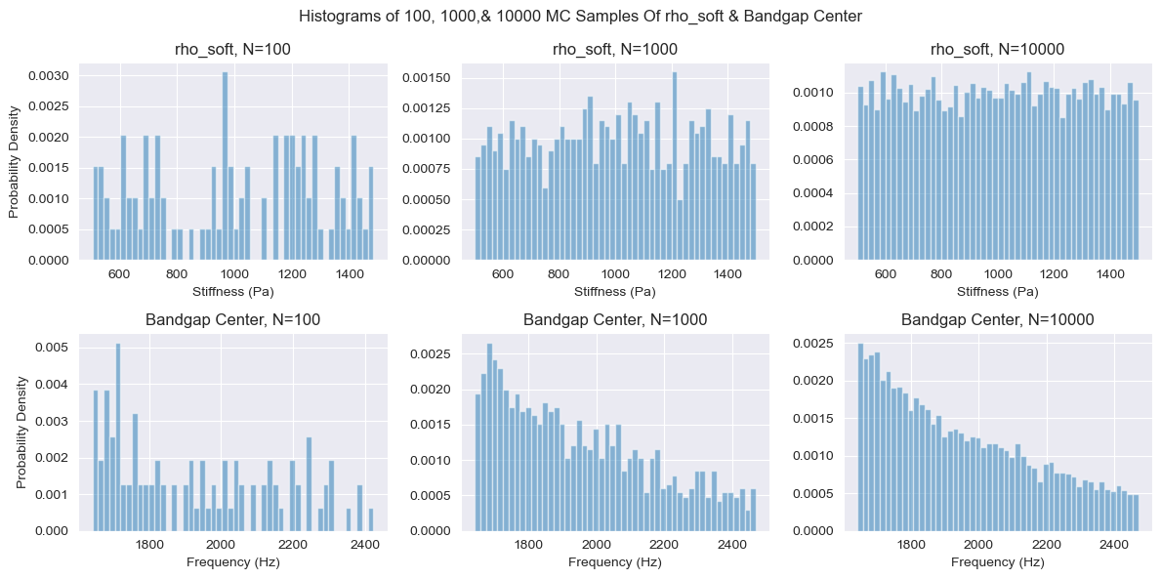
100, 1000, & 10000 MC rho_soft & Bandgap Centers

Slide 30
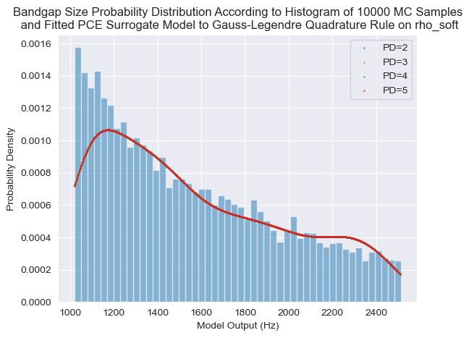
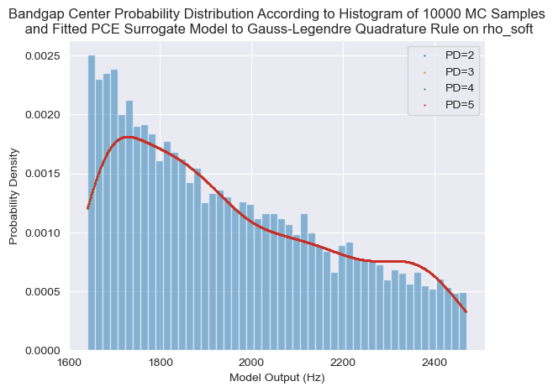
Stochastic Collocation 1D Quadrature – rho_soft – Bandgap Size

Slide 31
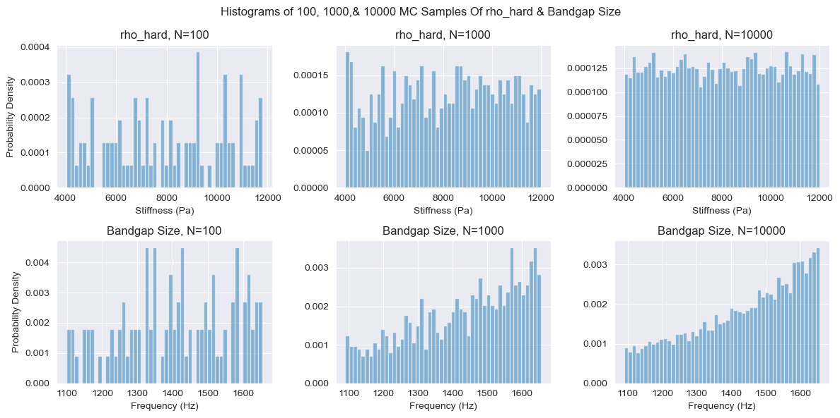
100, 1000, & 10000 MC rho_hard & Bandgap Sizes

Slide 32
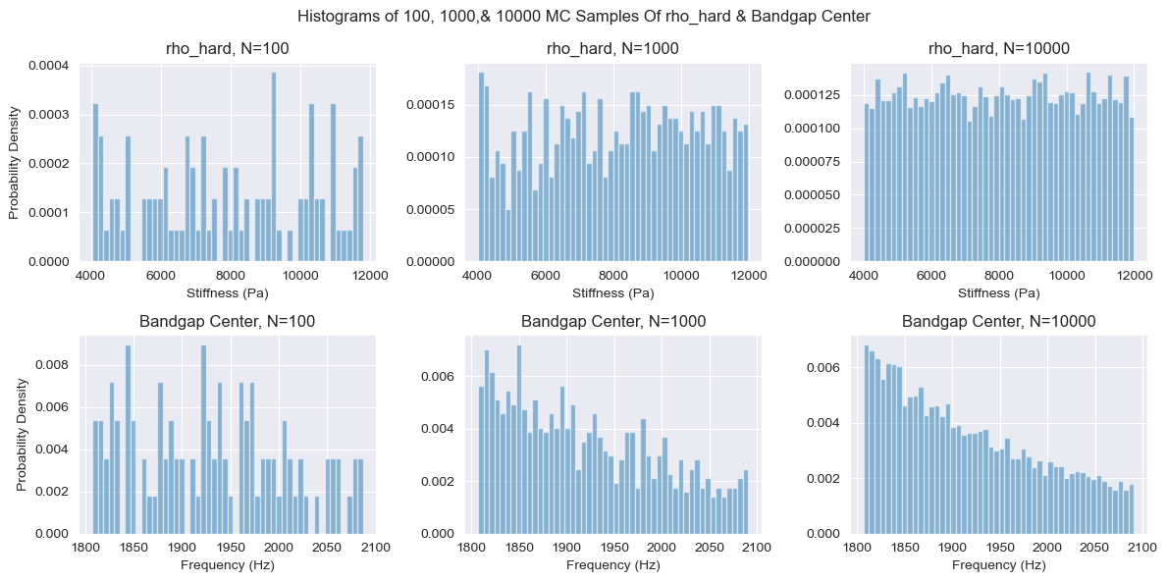
100, 1000, & 10000 MC rho_hard & Bandgap Centers

Slide 33
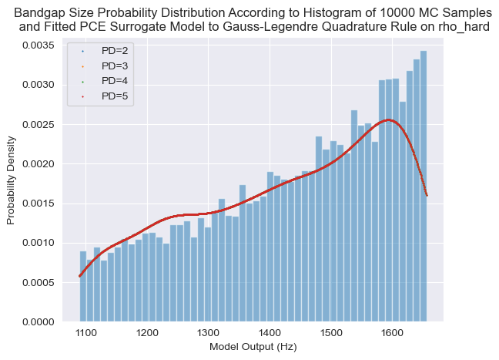
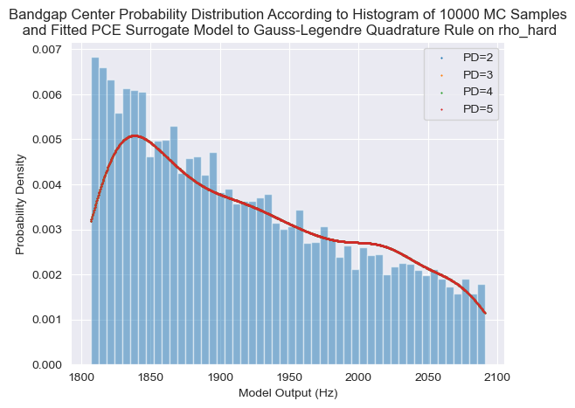
Stochastic Collocation 1D Quadrature – rho_hard – Bandgap Size

Slide 34
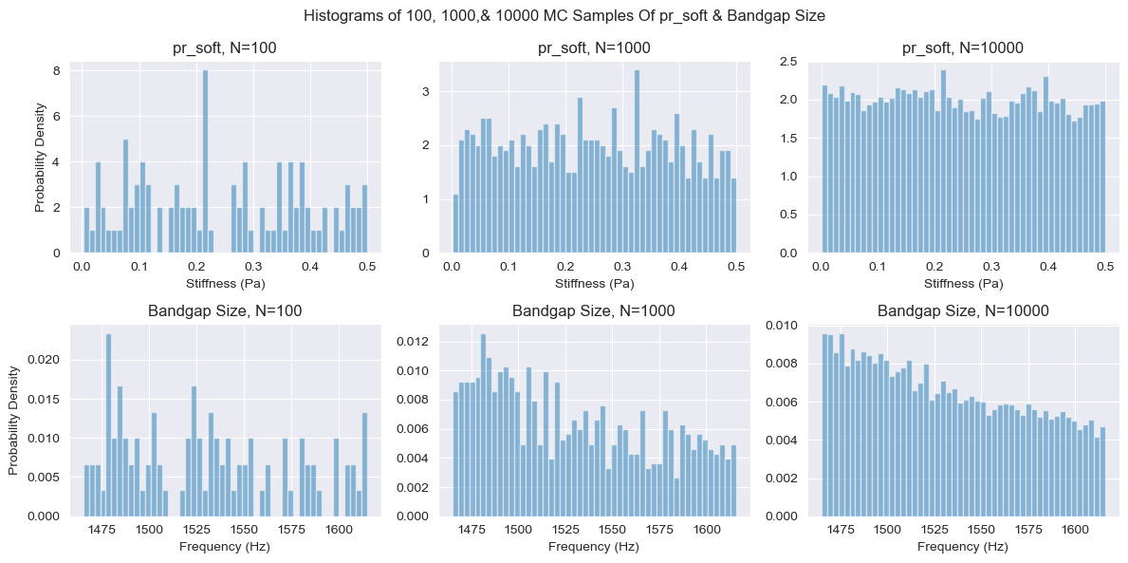
100, 1000, & 10000 MC $ν_{soft}$ & Bandgap Sizes

Slide 35
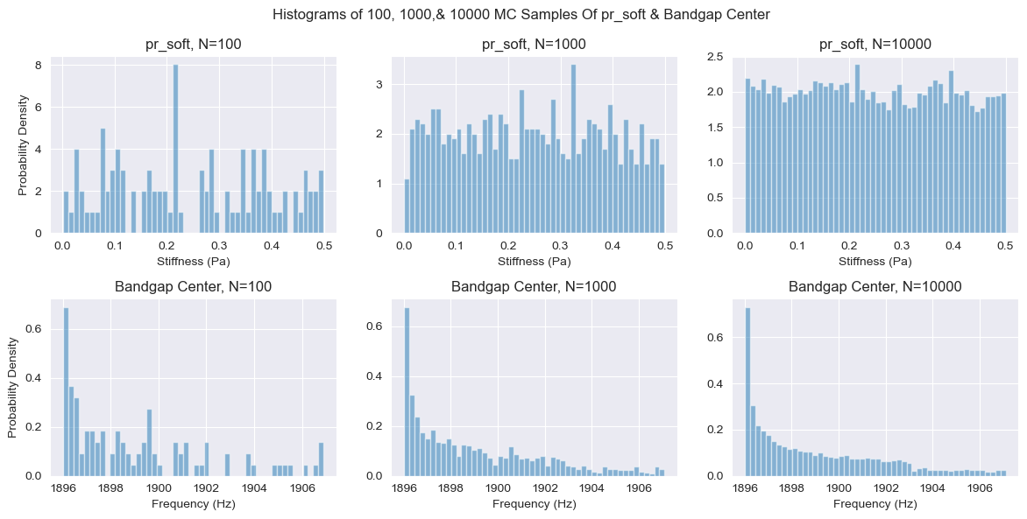
100, 1000, & 10000 MC $ν_{soft}$ & Bandgap Centers

Slide 36
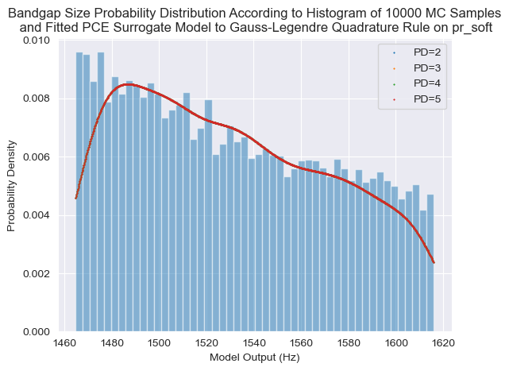
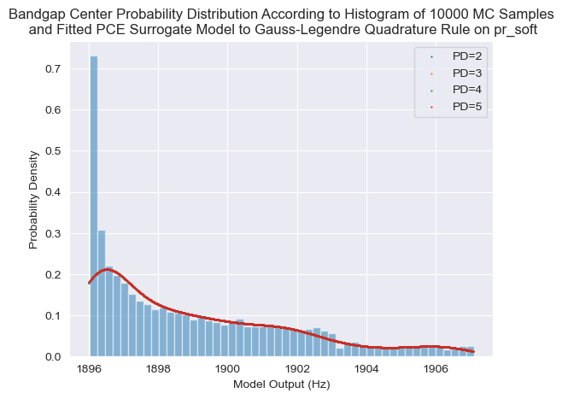
Stochastic Collocation 1D Quadrature – $ν_{soft}$– Bandgap Size

Slide 37
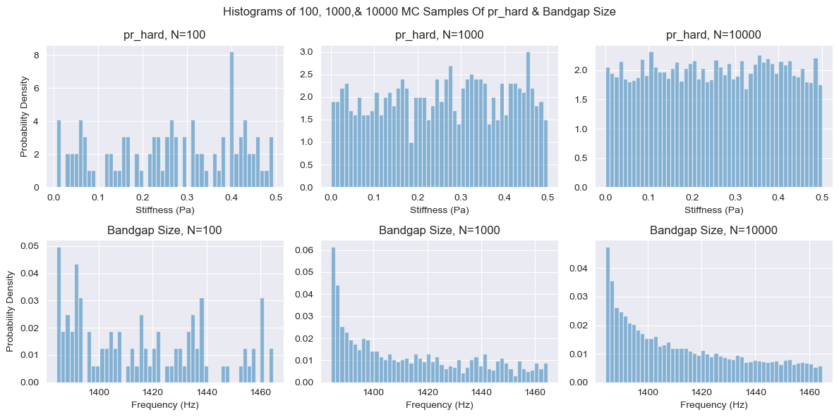
100, 1000, & 10000 MC $ν_{hard}$& Bandgap Sizes

Slide 38
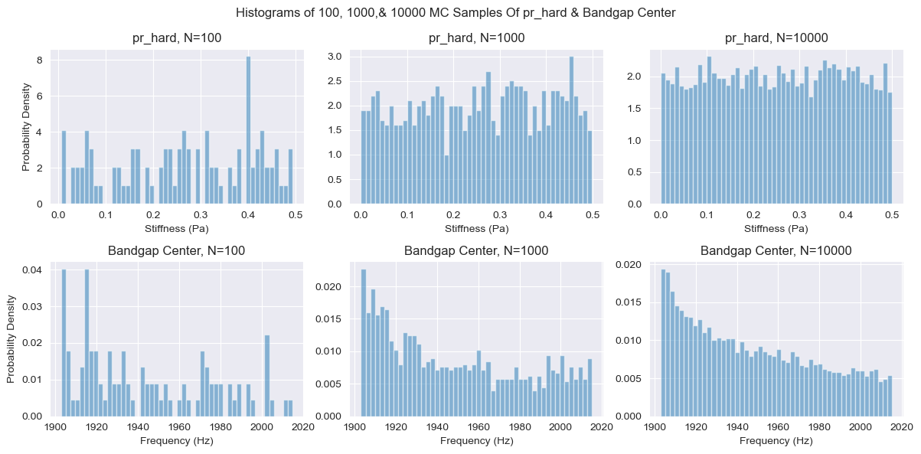
100, 1000, & 10000 MC $ν_{hard}$ & Bandgap Centers

Slide 39
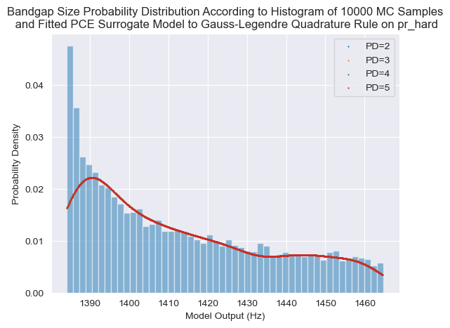
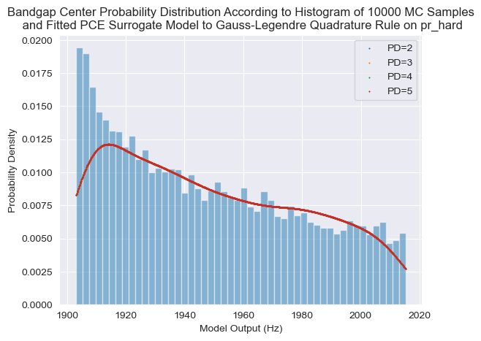
Stochastic Collocation 1D Quadrature – $ν_{hard}$ – Bandgap Size

Slide 40
E_soft
E_hard
Rho_soft
Rho_hard
Pr_soft
Pr_hard

