Slide 1
Sharing
Tuong Minh Service Private Enterprise
Automation Testing
SERENITY BDD - CUCUMBER
Team : Dynagility - QC
Presenter : Kieu Van Truyen

Slide 2
I. Testing funct
I.
II.
III.
IV.
Test function by MANUAL.
What is BDD?
Cucumber - Gherkin
Test function by AUTOMATION.
Demo & Report

Slide 3
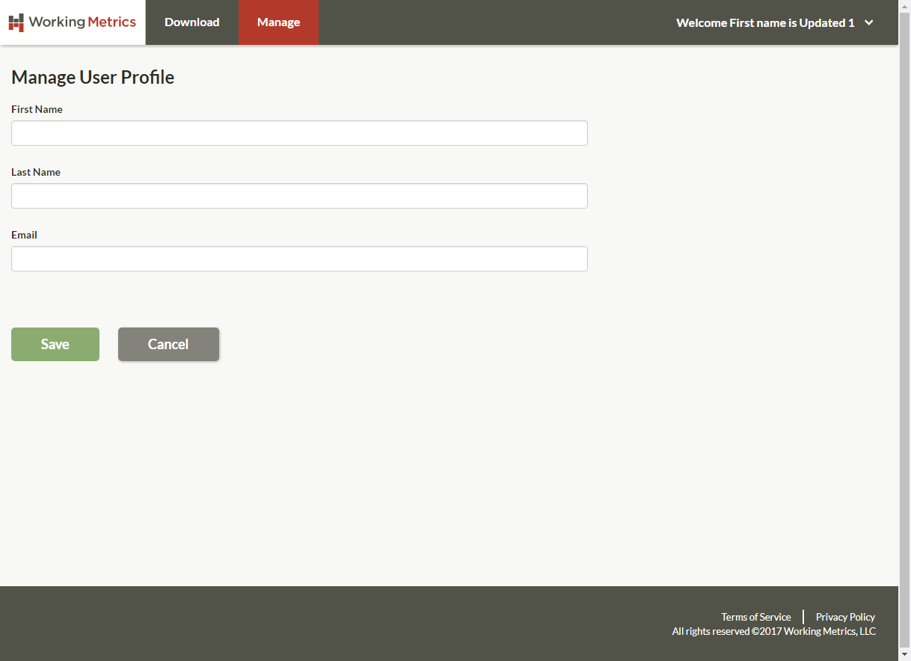
I. Test function by MANUAL
Example: Create new User

Slide 4
I. Test function by MANUAL
Precondition
Logged in successfully using admin@yopmail.com account
Steps
Click on Manage menu
Click on Manage Administrators menu
Click on Add User button
Input First Name, Last Name and Email.
Click on Save button
Expected
5.1 System navigates to Manage System Administrators screen.
5.2 User is displayed on screen.

Slide 5

II. Cucumber - Gherkin.
1. Cucumber.
A cucumber is a tool based on Behavior Driven Development (BDD) framework which is used to write acceptance tests for the web application.
It lets us define application behavior in plain meaningful English text using a simple grammar defined by a language called Gherkin.

Slide 6
II. Cucumber - Gherkin.
2. Gherkin - Definition
- Gherkin is plain-text language with a little extra structure.
- Gherkin is designed to be easy to learn by non-programmers
- Yet structured enough to allow concise description of examples to illustrate business rules in most real-world domains.

Slide 7
II. Cucumber - Gherkin.
2. Gherkin - Elements
Feature: Some terse yet descriptive text of what is desired starts the feature and gives it a title
Scenario: Some determinable business situation starts the scenario, and contains a description of the scenario
Given steps is to put the system in a known state before the user (or external system) starts interacting with the system
When

Slide 8
II. Cucumber - Gherkin.
2. Gherkin - Elements
When steps is to describe the key action the user performs
Then steps is to observe outcomes. The observations should be related to the business value/benefit in your feature description. The observations should inspect the output of the system (a report, user interface, message, command output)
And, But is writed if your scenario have several Given, When or Then steps, allowing your Scenario to read more fluently

Slide 9
II. Cucumber - Gherkin.
2. Gherkin - Elements
Background: ...
Scenario Outline:...
Tables:
Tabs:....

Slide 10
II. Cucumber - Gherkin.
3. Gherkin - Generating Steps
Precondition
Logged in successfully using
admin@yopmail.com account
Steps
Click on Manage menu
Click on Manage Administrators menu
Click on Add User button
Input First Name, Last Name and Email.
Click on Save button
Expected
5.1 System navigates to Manage
System Administrators screen.
5.2 User is displayed on screen.
Scenario: Create user normally
Given The user login site by "admin@yopmail.com"
and "Voyen!1412" successfully
When Click on Manage menu.
And Click on Manage Administrators menu.
And Click on Add User button.
And Input First Name is "Truyen", Last Name is "Kieu"
and Email is "truyen.kieu.02@yopmail.com".
And Click on Save button
Then System should navigate to
"Manage System Administrators" screen.
And "truyen.kieu.02@yopmail.com" should be
shown on screen.

Slide 11
II. Cucumber - Gherkin.
3. Gherkin - Generating Steps
Given The user login site by "admin@yopmail.com" and "Voyen!1412" successfully
@Given("^The user login site by \"([^\"]*)\" and \"([^\"]*)\" successfully$")
public void the_user_login_site_by_and_successfully(String email, String password) throws Exception {
loginStep.open_login_page();
loginStep.input_email(email);
loginStep.input_password(password);
loginStep.click_Login_button();
}

Slide 12
II. Cucumber - Gherkin.
3. Gherkin - Generating Steps
When Click on Manage menu.
@When("^Click on Manage menu\\.$")
public void click_on_Manage_menu() throws Exception {
homeStep.open_Manage_page();
}

Slide 13
II. Cucumber - Gherkin.
3. Gherkin - Generating Steps
And Click on Manage Administrators menu.
@When("^Click on Manage Administrators menu\\.$")
public void click_on_Manage_Administrators_menu() throws Exception {
manageStep.open_User_Manage_page();
}

Slide 14
II. Cucumber - Gherkin.
3. Gherkin - Generating Steps
And Click on Add User button.
@When("^Click on Add User button\\.$")
public void click_on_Add_User_button() throws Exception {
userManageStep.click_On_Add_Button();
}

Slide 15
II. Cucumber - Gherkin.
3. Gherkin - Generating Steps
And Input First Name is "Truyen", Last Name is "Kieu" and Email is "truyen.kieu.02@yopmail.com".
@When("^Input First Name is \"([^\"]*)\", Last Name is \"([^\"]*)\" and Email is \"([^\"]*)\"\\.$")
public void input_First_Name_is_Last_Name_is_and_Email_is(String firstName, String lastName,
String email) throws Exception {
manageUserProfileStep.input_FistName(firstName);
manageUserProfileStep.input_LastName(lastName);
manageUserProfileStep.input_Email(email);
}

Slide 16
II. Cucumber - Gherkin.
3. Gherkin - Generating Steps
And Click on Save button
@When("^Click on Save button$")
public void click_on_Save_button() throws Exception {
manageUserProfileStep.click_On_Save_Button();
}

Slide 17
II. Cucumber - Gherkin.
3. Gherkin - Generating Steps
Then System should navigate to "Manage System Administrators" screen.
@Then("^System should navigate to \"([^\"]*)\" screen\\.$")
public void system_should_navigate_to_screen(String systemAdminTitle) throws Exception {
Assert.assertEquals(userManageStep.get_sysAdminTitle(), systemAdminTitle);
}

Slide 18
II. Cucumber - Gherkin.
3. Gherkin - Generating Steps
And "truyen.kieu.02@yopmail.com" should be shown on screen.
@Then("^\"([^\"]*)\" should be shown on screen\\.$")
public void should_be_shown_on_screen(String email) throws Exception {
Assert.assertEquals(userManageStep.get_Email(), email);
}

Slide 19
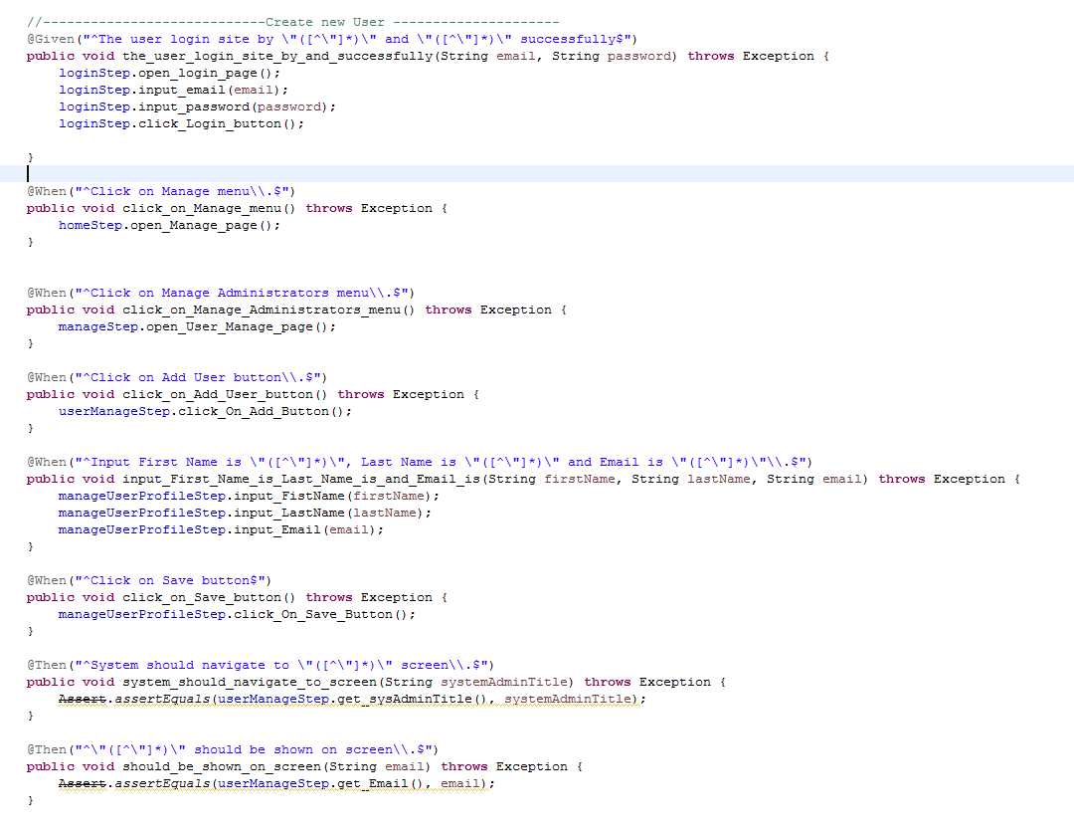
II. Test function by AUTOMATION.
Define step

Slide 20
II. Test function by AUTOMATION.
Feature File
STEP
PAGE
...locator 1....
~ Method 1 ~
Step 1
DEFINITION
...locator 2....
~ Method 2 ~
Action 1
Step 2
...locator 3....
~ Method 3~
Step 3

Slide 21
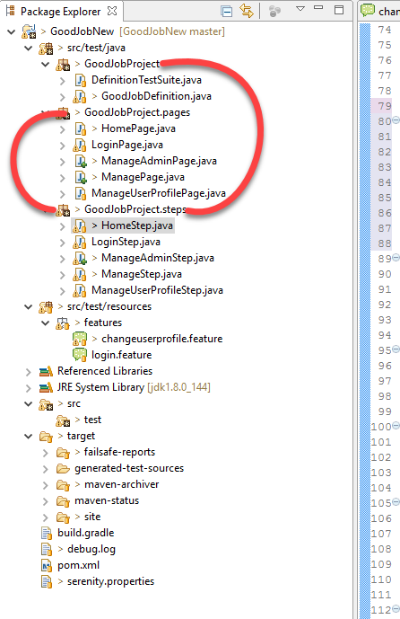
II. Test function by AUTOMATION.

Slide 22
III. Demo & Report
Scenario - Create new User

Slide 23
Thanks!

