Slide 1
Analysis of A/B Test Results
Data Scientist: Tavarus Wilcoxson
© 2024 Udacity.

Slide 2
Agenda
Findings of A/B test analysis
Experiment Setup
Conversion Rates
Experiment Results

Slide 3
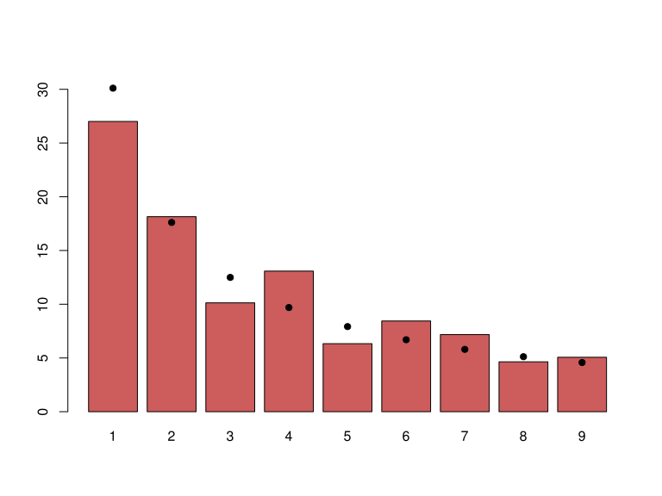
How Was the Experiment Implemented?
Total Variant Visitors: 35,211
Total Control Participants: 34,678
Visitors by Country: US: 48,850 | UK: 17,551 | CA: 3,488

Slide 4
Conversion Rates
 | U.S. | U.K. | CA
Control | 10.7% | 10.2% | 9.4%
Treatment | 15.8% | 14.9% | 15.4%
Executive Summary: The treatment group shows consistently higher conversion rates (~15%) vs. control (~10%) across all countries. Country alone has minimal impact on conversion. The ~5 pp lift from treatment is uniform across geographies, indicating no country-treatment interaction.

Slide 5
Experiment Results
Treatment Conversion Rate: 15.5%
Control Conversion Rate:​ 10.5%
Delta in Treatment vs. Control Conversion Rate:​ +5.0 percentage points
p-value:​ 0.000 (p < 0.001)
Conclusion:
  ​The p-value of 0.000 is far below our significance level of 0.05. We reject the null hypothesis and conclude that the treatment page produces a statistically significant increase in conversion rates. The ~5 percentage point lift (from 10.5% to 15.5%) represents a ~50% relative improvement. This effect is consistent across all three countries (US, UK, CA). Logistic regression confirms no confounding from country. Recommendation: Implement the new treatment page.

