Slide 1
Sleep Health and Lifestyle Analysis
Descriptive Statistics and Data Exploration
Data Scientist: Tim Wilcoxson
© 2024 Udacity.

Slide 2
Agenda
Results of sleep health and lifestyle analysis
Data Description
Typical Amount of Physical Activity
Number of Daily Steps
Distribution of Heart Rates

Slide 3
Data Description
Sleep Duration (hours) is an example of a continuous variable in the dataset.
Values such as 5.9, 6.1, and 7.8 can take any real number within a range.
Daily Steps is an example of an integer variable in the dataset.
Values such as 3,000, 5,600, and 10,000 are whole numbers.
Quality of Sleep (scale: 1–10) is an example of an ordinal categorical variable in the dataset.
The ratings have a meaningful order from low (1) to high (10).
Gender is an example of a nominal categorical variable in the dataset.
Categories (Male, Female) have no inherent order or ranking.

Slide 4
Typical Amount (Minutes) of Physical Activity
Measures of Center
• Mean: 59.17 minutes per day
• Median: 60.00 minutes per day
• Mode: 60 minutes per day
Distribution Shape (Mean vs. Median)
The mean (59.17) is very close to the median (60.00), indicating
the distribution is approximately symmetric. The mean is slightly
less than the median, which can suggest a minor left tail, but the
difference is negligible—the distribution of physical activity
levels is effectively symmetric.

Slide 5
Analysis of Daily Steps Taken
Measures of Spread
• Standard Deviation: 1,617.92 steps
• Maximum: 10,000 steps
• Minimum: 3,000 steps
• Range: 7,000 steps
Additional Measures of Spread
• Variance: 2,617,651.14 steps²
• Q1 (25th Percentile): 5,600 steps
• Q3 (75th Percentile): 8,000 steps
• Interquartile Range (IQR): 2,400 steps
The IQR of 2,400 steps shows that the middle 50% of participants
take between 5,600 and 8,000 steps daily.

Slide 6
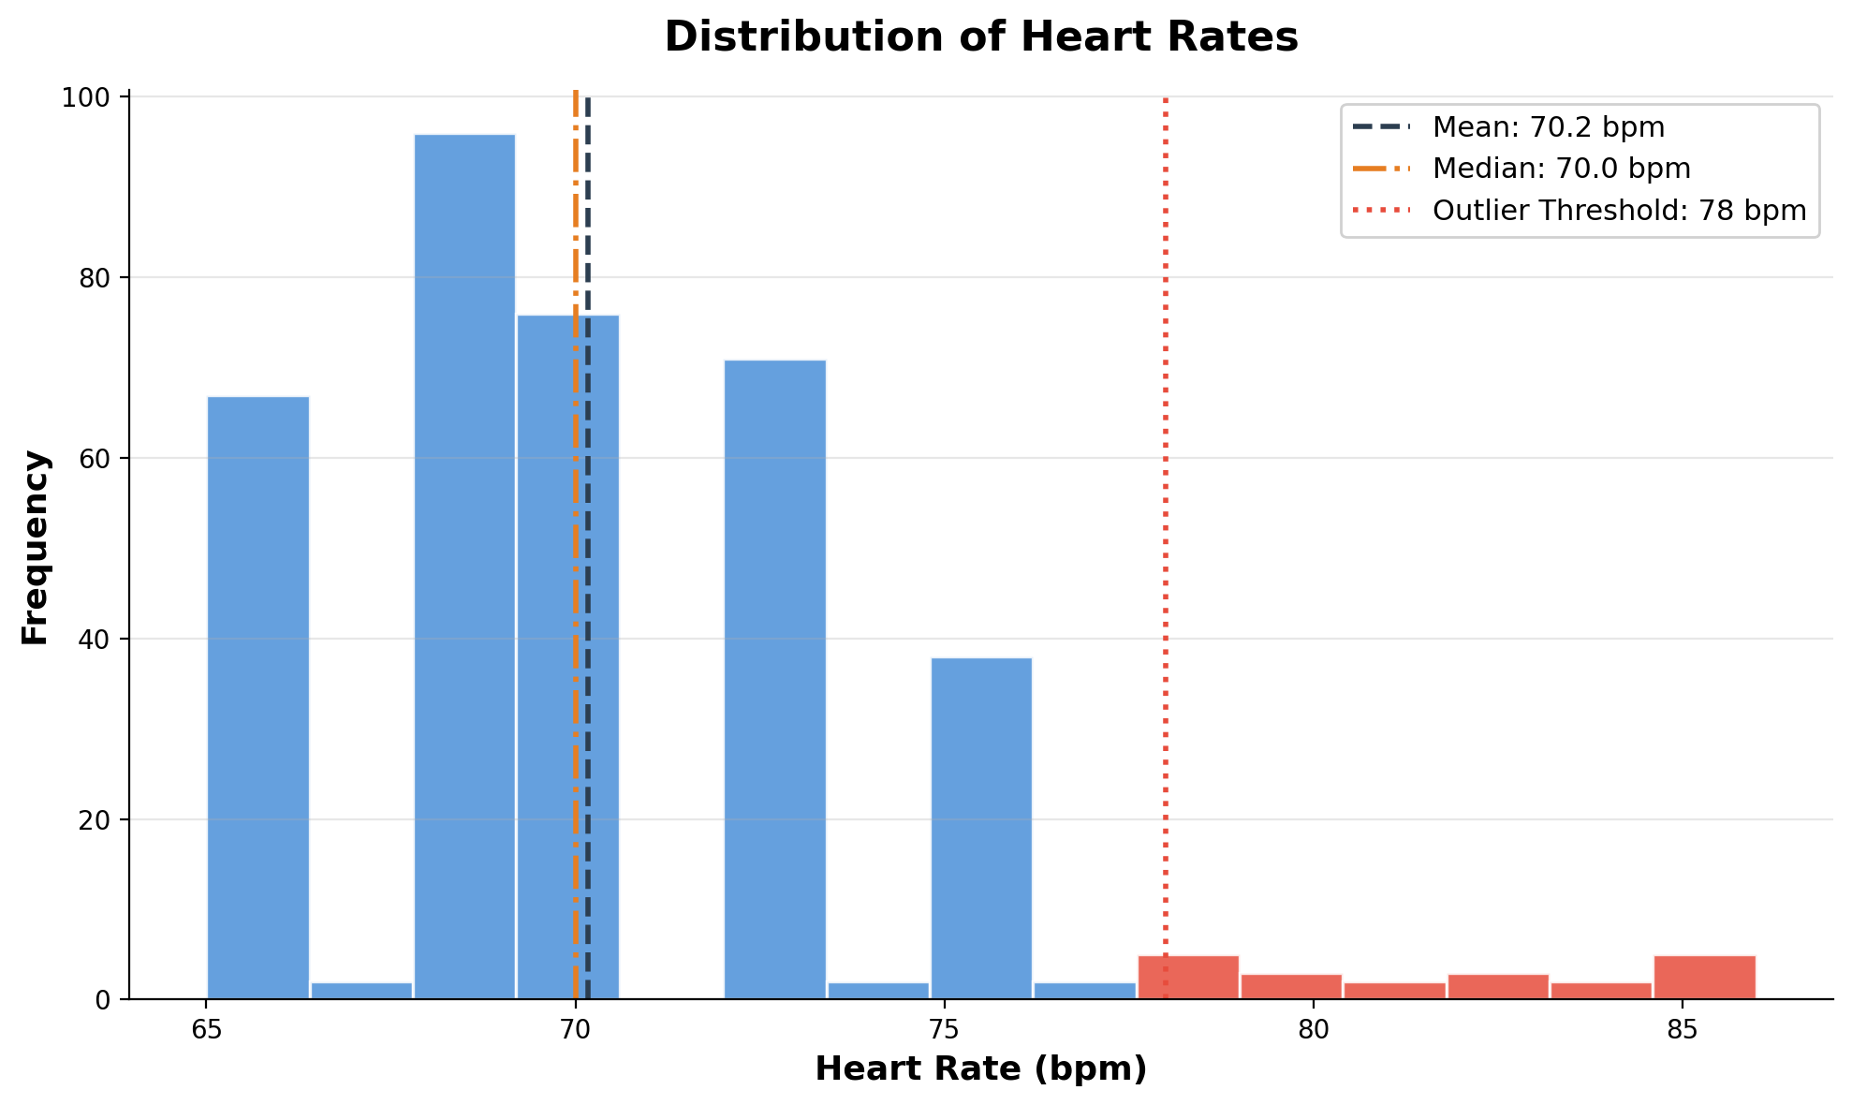
Distribution of Heart Rates
Measures of Center: Mean = 70.17,
Median = 70.00, Mode = 68 bpm
Distribution Shape: Right-skewed
Mean (70.17) > Median (70.00)
confirms a right-skewed distribution.
Outliers: 15 detected (IQR method)
Values above 78 bpm are outliers:
80, 81, 82, 83, 84, 85, 86 bpm
Q1=68, Q3=72, IQR=4
Upper fence = Q3+1.5×IQR = 78

