Slide 1
CONSOLIDATED SECURITY ASSESSMENT
Amazon ECS Fullstack App (Terraform Demo)
Date: 2026-02-18 | Classification: CONFIDENTIAL
Methodology: STRIDE-LM + PASTA + OWASP Risk Rating
Scope: 14 Terraform modules, Node.js backend, Vue.js frontend, AWS CI/CD

Slide 2
EXECUTIVE SUMMARY
CONCERNING
This AWS ECS demo/reference architecture contains significant security gaps that make it unsuitable for production use without substantial hardening.
26 unique findings across four specialist domains, with two CRITICAL-severity issues enabling full AWS account compromise via the CI/CD pipeline.
2
CRITICAL
10
HIGH
11
MEDIUM
3
LOW
26 Components Assessed | 25+ Data Flows Mapped | 8 Trust Boundaries | 5 Threat Actors Modeled
2

Slide 3
FINDING DISTRIBUTION & KEY METRICS
26
Total Findings
26
Components
25+
Data Flows
8
Trust Boundaries
5
Threat Actors
33
Remediation Items
3

Slide 4
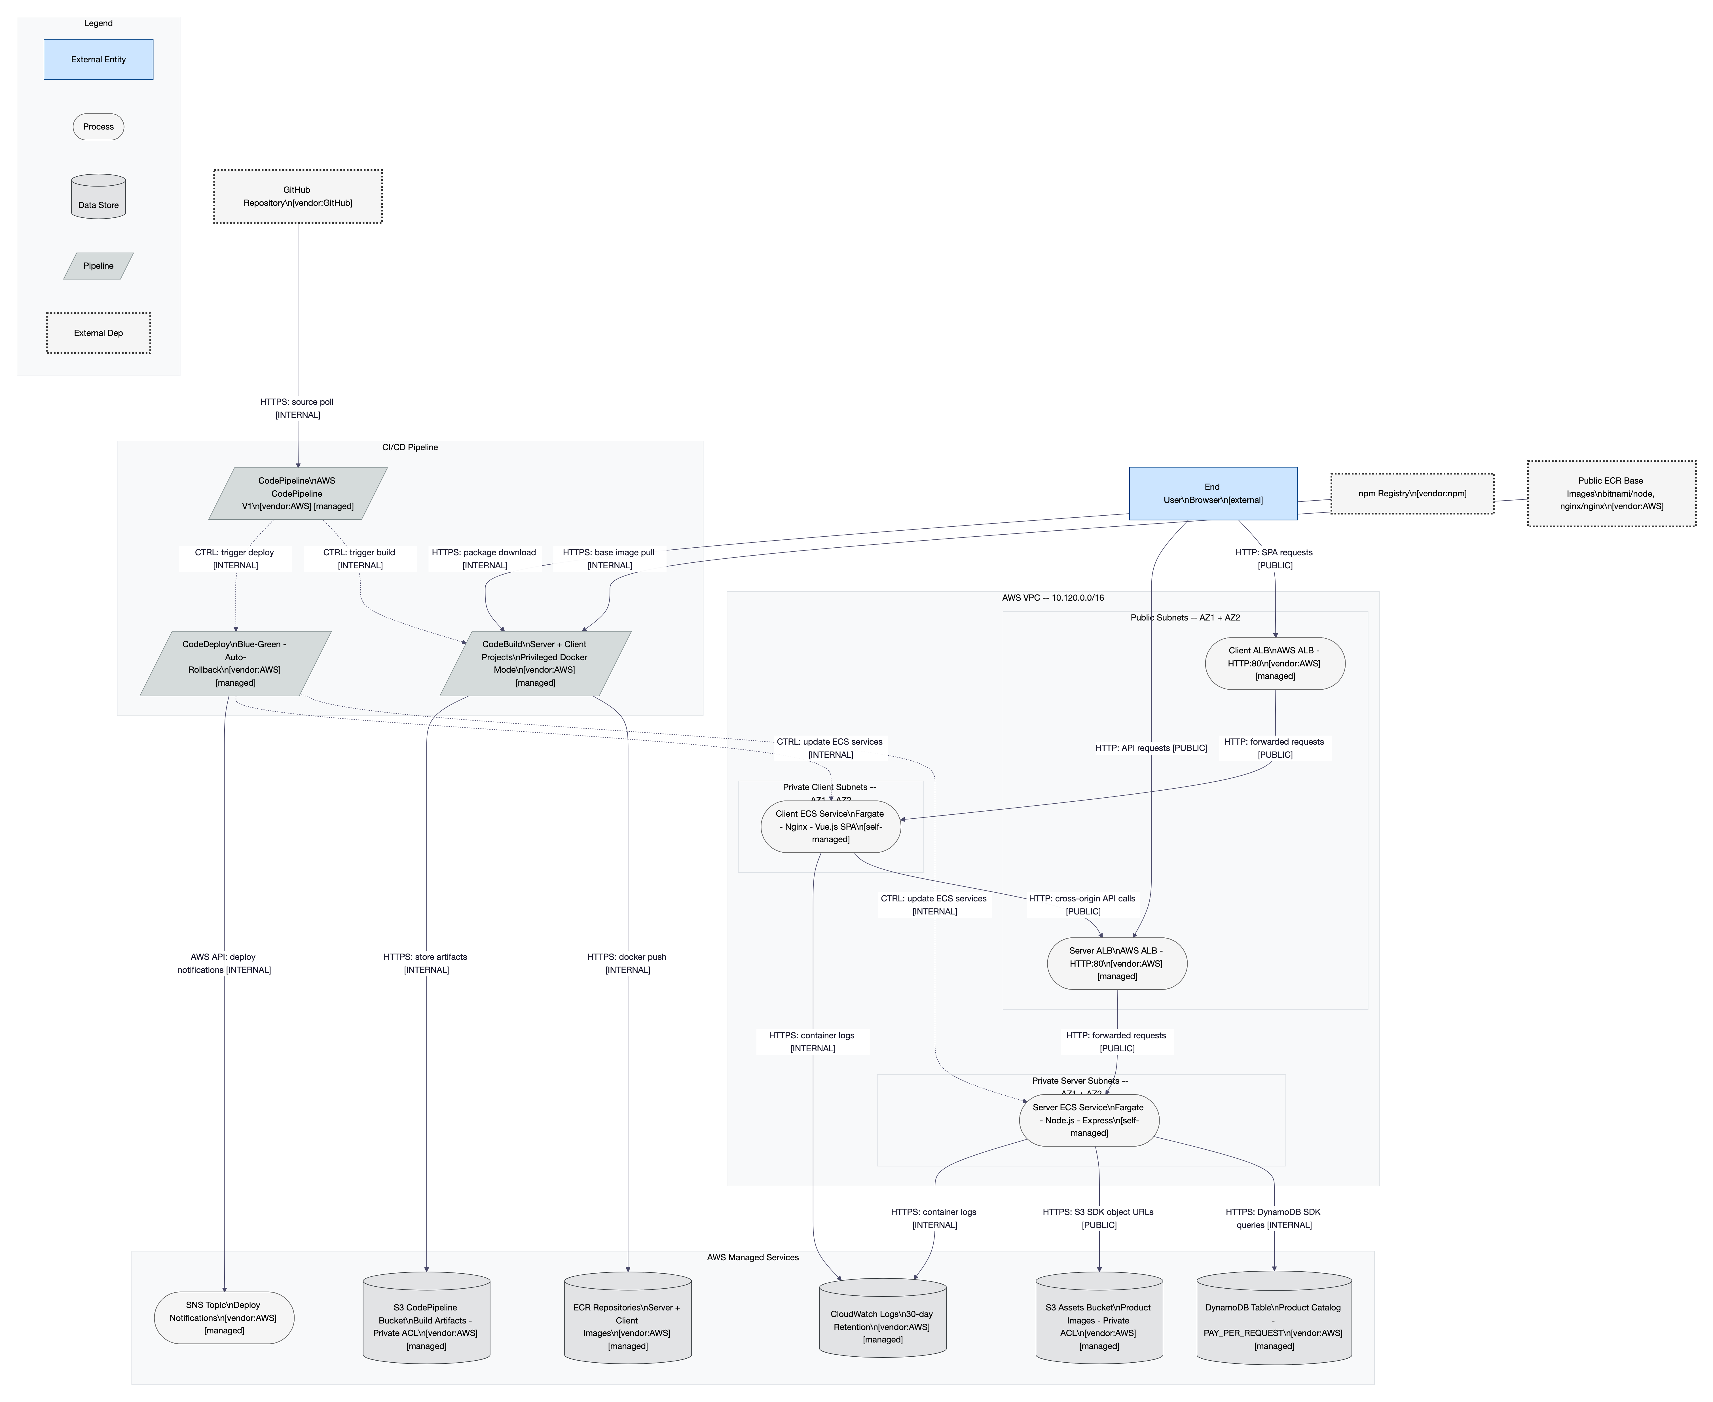
STRUCTURAL ARCHITECTURE DIAGRAM
Figure 1: L1 Architecture Diagram - 26 components across 8 trust boundaries (External, VPC, Public Subnets, Private Subnets, CI/CD Pipeline, Data Stores, IAM, Monitoring)
4

Slide 5
RISK OVERLAY DIAGRAM
Figure 2: L4 Risk Overlay - Highest risk: CodeBuild (CRITICAL), DevOpsRole (CRITICAL), ECSTaskRole (CRITICAL). 3 kill chains mapped: Developer Account Takeover, Supply Chain, Internet Attacker.
5

Slide 6
CRITICAL & HIGH FINDINGS
ID
Severity
Title
Component
Business Impact
Score
TM-004
CRITICAL
Repository-Sourced Buildspec + Broad IAM
CodeBuild, Pipeline
Full AWS account compromise via git push
25
TM-003
CRITICAL
IAM PassRole Wildcard (*)
DevOpsRole, ECSTaskRole
Privilege escalation to any IAM role
20
TM-023
HIGH
No Branch Protection
GitHub, Pipeline
Unreviewed code reaches production
16
TM-013
HIGH
CodeBuild Privileged Docker
CodeBuild
Container escape to host
16
TM-014
HIGH
No Pipeline Approval/Scanning
Pipeline, CodeDeploy
Malicious code deploys unchecked
16
TM-001
HIGH
No TLS/HTTPS on ALBs
ClientALB, ServerALB
All traffic in plaintext
15
TM-002
HIGH
No Authentication/Authorization
All ECS services
Any internet user has full access
15
TM-005
HIGH
GitHub Token in TF State
TFState, Pipeline
OAuth token exposure from S3
15
6

Slide 7
REMEDIATION ROADMAP
WAVE 1: Quick Wins
WAVE 2: Critical Fixes
WAVE 3: Hardening
WAVE 4: Production Ready
1-2 Days
1-2 Sprints
2-4 Sprints
Ongoing
ECR immutable tags
S3 public access block
DynamoDB PITR
npm ci
Billing alarm
Fix error handler
Configure CORS
Scope IAM PassRole
Secure buildspec (inline)
Branch protection
Pipeline approval gates
Enable HTTPS/TLS
VPC Flow Logs
Container hardening
Pipeline vulnerability scanning
Update dependencies
Restrict egress
Implement authentication
VPC endpoints
Git SHA image tags
Container Insights
CloudTrail data events
QUICK WINS: 10 items in Wave 1 can be completed in 1-2 days with immediate risk reduction
7

Slide 8
COMPLIANCE STATUS
SOC 2 Type II
9%
33 controls | 3 compliant, 6 partial, 22 non-compliant
ISO 27001:2022
10%
93 controls | 5 compliant, 8 partial, 41 non-compliant
NIST CSF 2.0
8%
106 controls | 4 compliant, 9 partial, 38 non-compliant
PCI-DSS v4.0
2%
64 controls | 1 compliant, 3 partial, 48 non-compliant
Overall Compliance Readiness: ~12/100 -- This system is a demo/reference architecture and was not designed for compliance. All frameworks require substantial investment.
8

Slide 9
POSITIVE OBSERVATIONS
Private Subnets with SG Segmentation
ECS tasks run in private subnets with security group segmentation providing good east-west network isolation.
Fargate Launch Type
AWS-managed infrastructure isolation eliminates OS patching and host-level attack surface.
Blue/Green Deployment
CodeDeploy with automatic rollback on CloudWatch alarm provides safe deployment with instant rollback capability.
Read-Only DynamoDB Access
Application IAM policy restricts DynamoDB operations to read-only -- proper least privilege for data operations.
awsvpc Network Mode
Per-task security group enforcement enables fine-grained network policy at the container level.
Infrastructure as Code
Terraform manages all infrastructure ensuring reproducibility, auditability, and consistent environments.
9

Slide 10
NEXT STEPS & RECOMMENDATIONS
IMMEDIATE (This Week)
SHORT-TERM (This Quarter)
STRATEGIC (Next Quarter)
Lock down IAM PassRole
Scope to specific role ARNs -- eliminates account takeover path
Impact: HIGH | Effort: LOW
Enable TLS on all ALBs
ACM certificate + HTTPS listener -- stops plaintext interception
Impact: HIGH | Effort: MED
Implement authentication
Add Cognito or external IdP -- currently zero access control
Impact: HIGH | Effort: HIGH
Move buildspec inline
Remove repository-sourced buildspec -- closes CI/CD compromise chain
Impact: HIGH | Effort: MED
Implement branch protection
Require PR reviews + status checks before merge
Impact: HIGH | Effort: LOW
Comprehensive monitoring
VPC Flow Logs, Container Insights, CloudTrail data events
Impact: MED | Effort: MED
Execute Wave 1 quick wins
10 configuration changes, 1-2 days, immediate risk reduction
Impact: HIGH | Effort: LOW
Add pipeline approval gates
Manual approval before production deployment
Impact: MED | Effort: LOW
Compliance program
Begin SOC 2 readiness if production planned
Impact: MED | Effort: HIGH
RECOMMENDATION: Do not deploy to production until Wave 1 and Wave 2 remediations are complete.
10

