Slide 1
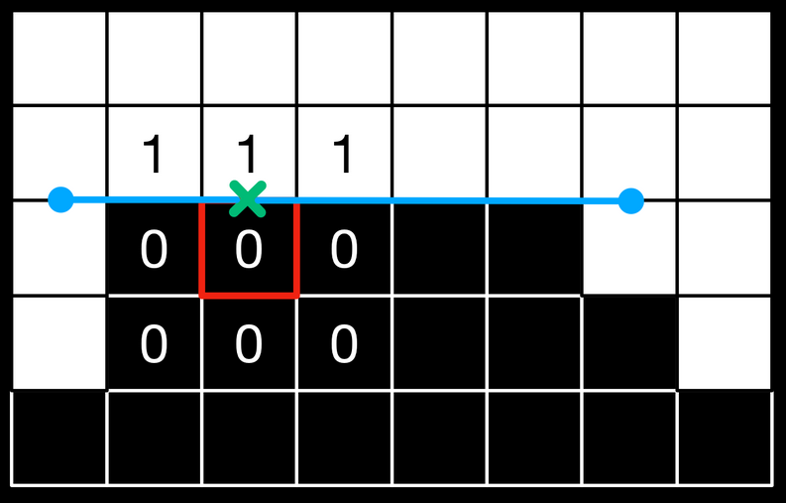
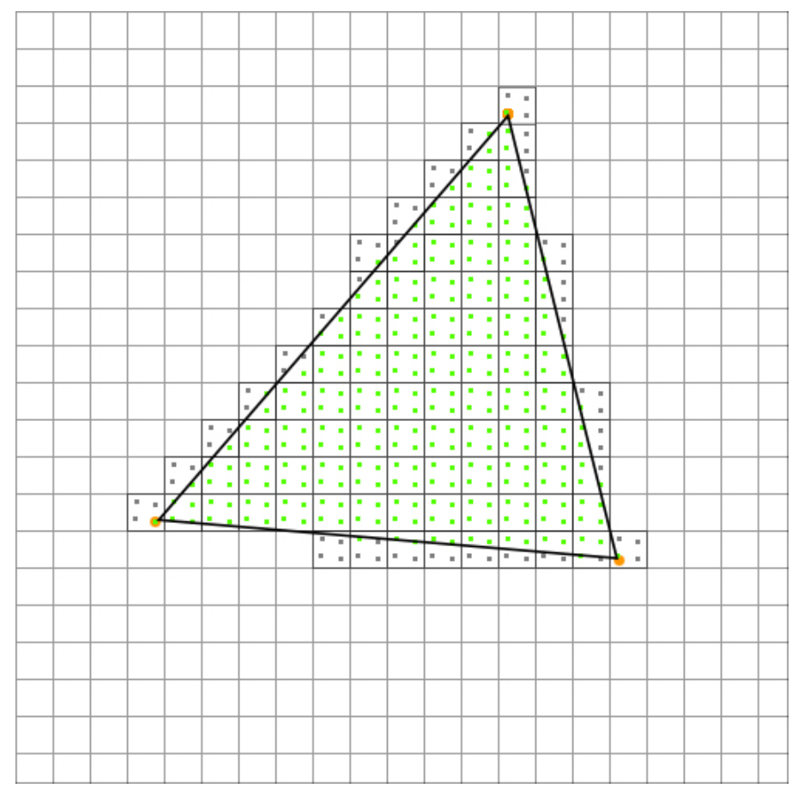
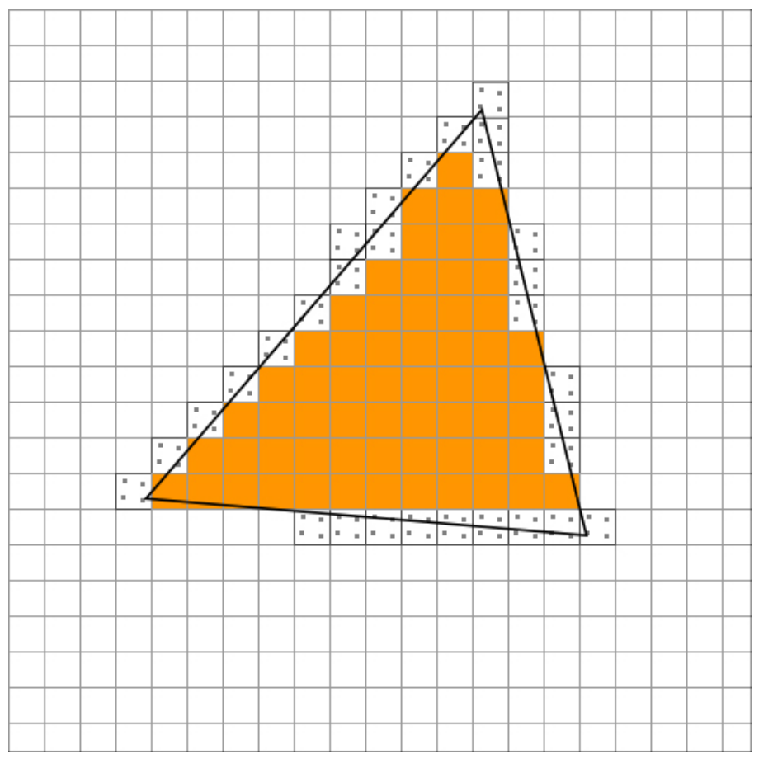
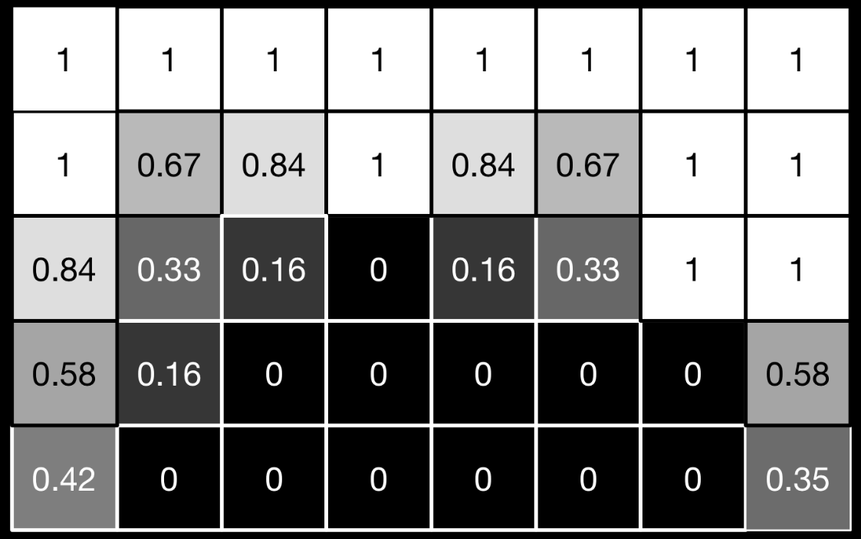
Uses a deterministic algorithm based on neighbouring fragment luma values
Uses point sampling of unrasterized polys
SSAA [x4]
MSAA [x4] = SSAA + Edge detection
FXAA = Fragment processing

Slide 2
. | . | . | . | .
Mipmap level k
. | . | . | . | .
Mipmap level k+1

Slide 3
Larger, higher resolution mipmap
Smaller, lower resolution mipmap
Suppose we have AA off. The only possible values that can be sampled per fragment are:
Suppose we have AA off. The only possible values that can be sampled per fragment are:

