Slide 1

ShellMS
What's ShellMS ?
ShellMS is the simplest and easiest ADB Shell SMS Messaging Application.
Powerful and useful tool for the Android Debug Bridge
Used to quickly send SMS with ADB from your computer.

Slide 2
ShellMS
Why should i use ShellMS ?
Because you're faster with your messaging.
Because it's easy
Because it's Free and OpenSource (GPLv3)

Slide 3
ShellMS
How to use ShellMS ?
adb shell am startservice --user 0 -n com.android.shellms/.sendSMS -e contact +123456789 -e msg "Message"
or
adb shell am startservice --user 0 -n com.android.shellms/.sendSMS -e contact "Contact's DISPLAY NAME" -e msg "MSG"

Slide 4
ShellMS
If you want it easier !!
Use a shell template:
#!/bin/sh
# ShellMS Script
ADB=adb
#or your path to adb
if [ $# != 2 ];then
echo "Usage: $0 \"Contact's DISPLAY NAME or Phone Number\" \"Your message\""
exit
else
$ADB shell am startservice --user 0 -n com.android.shellms/.sendSMS -e contact "$1" -e msg "$2" 1>/dev/null
sleep 1;
$ADB logcat -d -s -C ShellMS_Service_sendSMS:*
fi

Slide 5
ShellMS
Is that easy enough ?
sendSMS.sh „Telephone Number“ „your Message“
sendSMS.sh „Contact's DisplayName“ „Message“

Slide 6
ShellMS
OK. I want it. Where can i get ShellMS ?
ProjectHome (Source Code):
https://github.com/try2codesecure/ShellMS
Is availible on F-Droid Repository
For further information visit ProjectHome and read the README

Slide 7
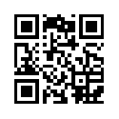
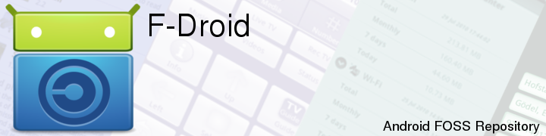
F-Droid ?!
F-Droid is an alternative app market like Google Play© but only for Free and Open Source Software (FOSS).
App's were searched and installed by F-Droid Client
  QR-Code download link
  or visit homepage http://f-droid.org)
All apps are signed by F-Droid but you have to allow the installation from „non-market sources“

