Slide 1
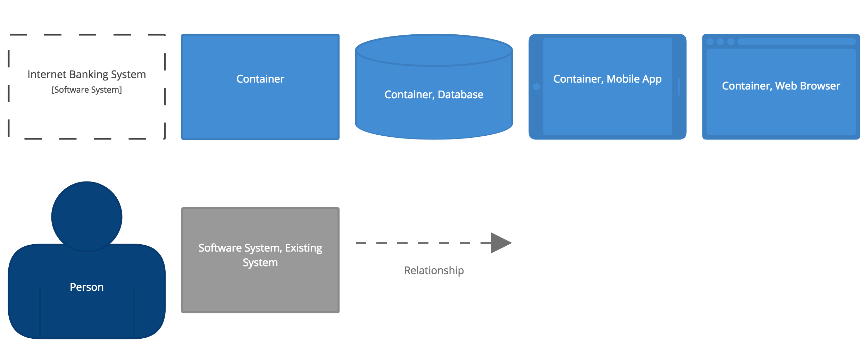
Context
User
Provides audio in
Uses
Audio Visualiser Application
Audio Input Device
Uses

Slide 2
Container
User
Uses
Uses
Uses
Audio Visualiser Application
(Windows)
Audio Visualiser Application
(macOS)
Audio Visualiser Application
(Linux)
Audio Input Device
Uses
Uses
JUCE Application
JUCE AudioApplication
Uses
Uses
Audio Visualiser Application

Slide 3
Component
Audio Visualiser Application
(macOS)
Uses
Home Page Container
Main
Settings Container
JUCE Application
Audio Input Device
Uses
Home Page Component
Main Component
Settings Component
Uses
JUCE Audio Application

Slide 4
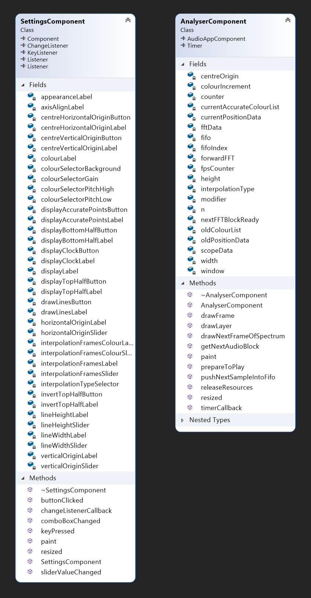
Code
This level of detail is sufficient because it shows the methods and the design pattern for the two most complex classes, along with their fields. At the moment the other classes are simple enough that a quick glance at the code would be just as informative as a diagram. This is based off of the recommendations on c4model.com in the ‘Core diagrams’ section (Brown, n.d.).

