Slide 1
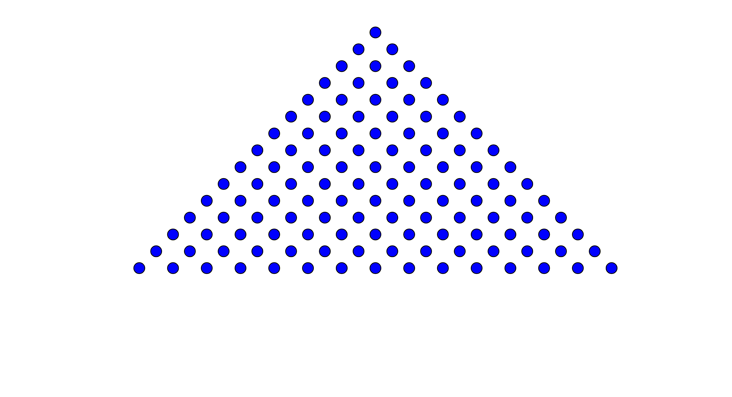
Inverting the Triangle

Slide 2
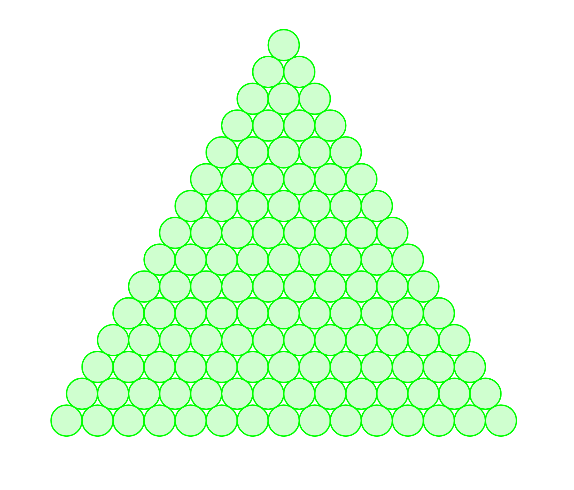
Inverting the Triangle

Slide 3
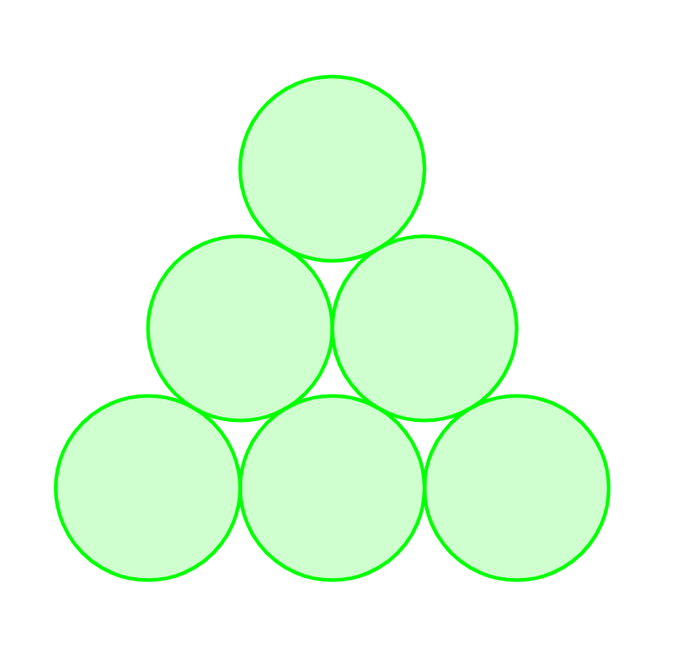
The Challenge!
How many disks do you need to move to turn this triangle upside-down?

Slide 4
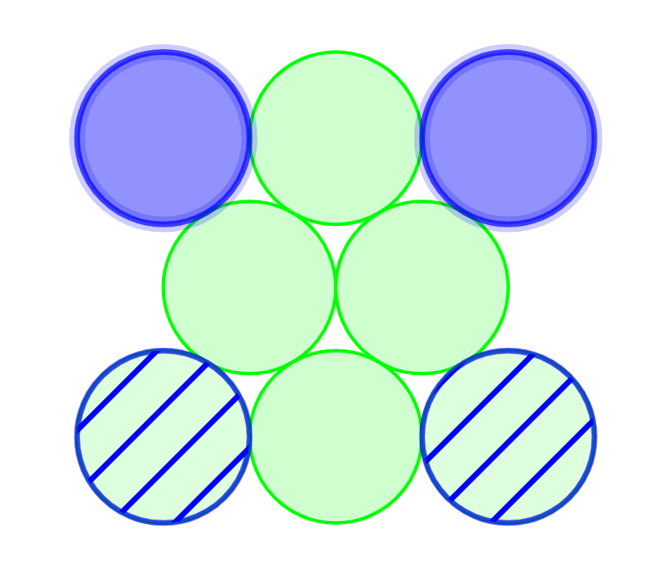
The Challenge!
How many disks do you need to move to turn this triangle upside-down?

Slide 5
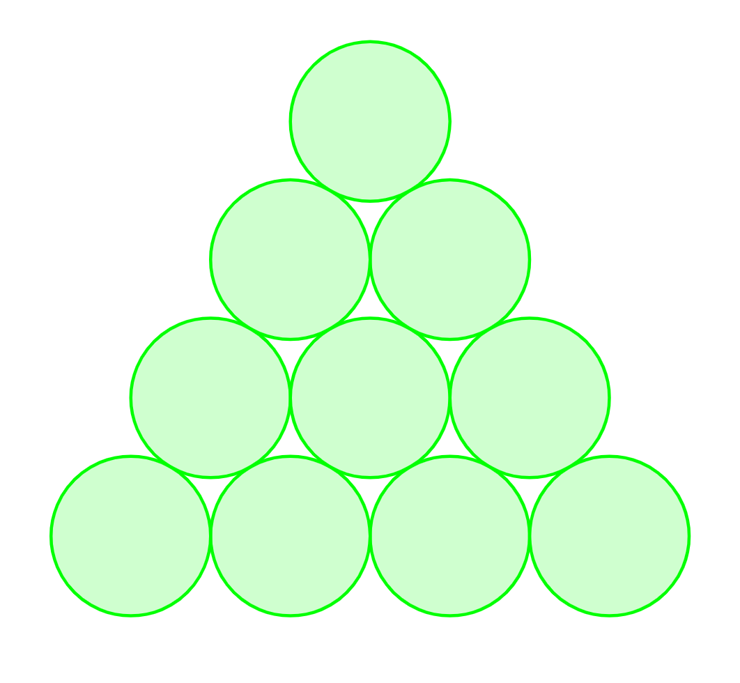
How about this triangle?

Slide 6
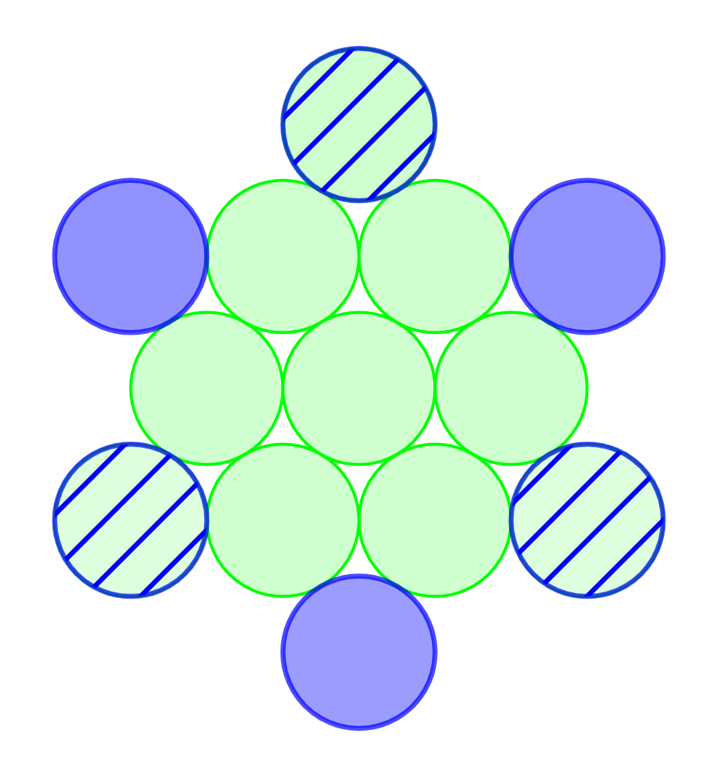
How about this triangle?

Slide 7
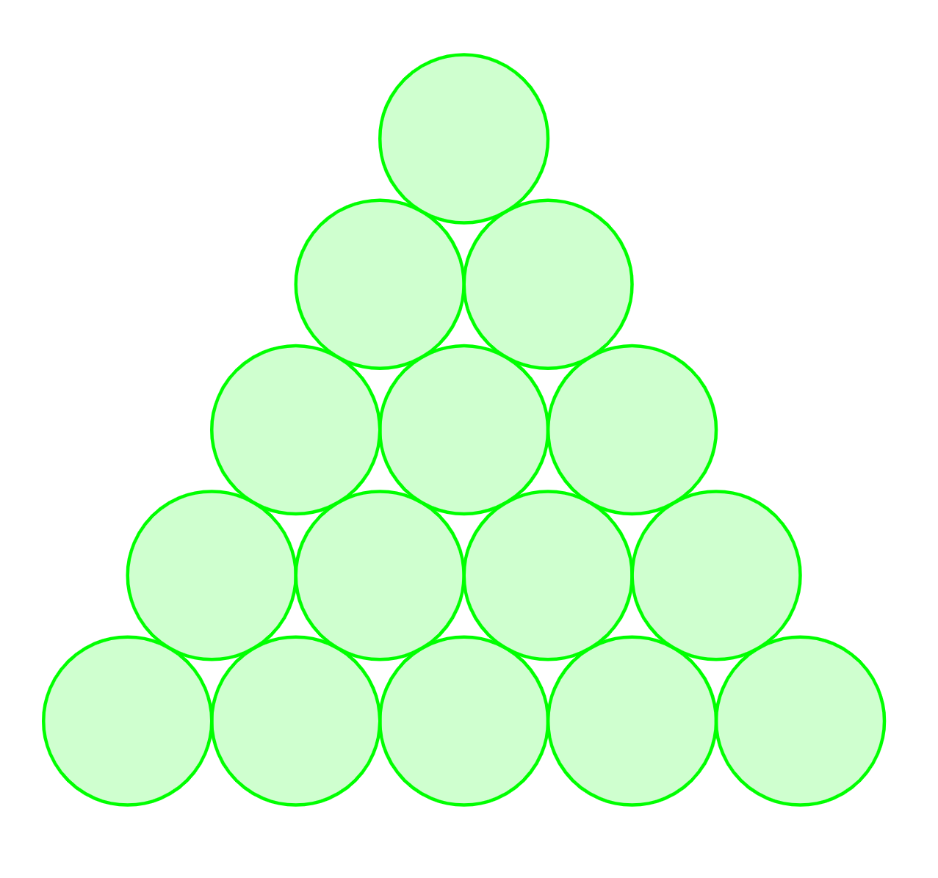
Or this one?

Slide 8
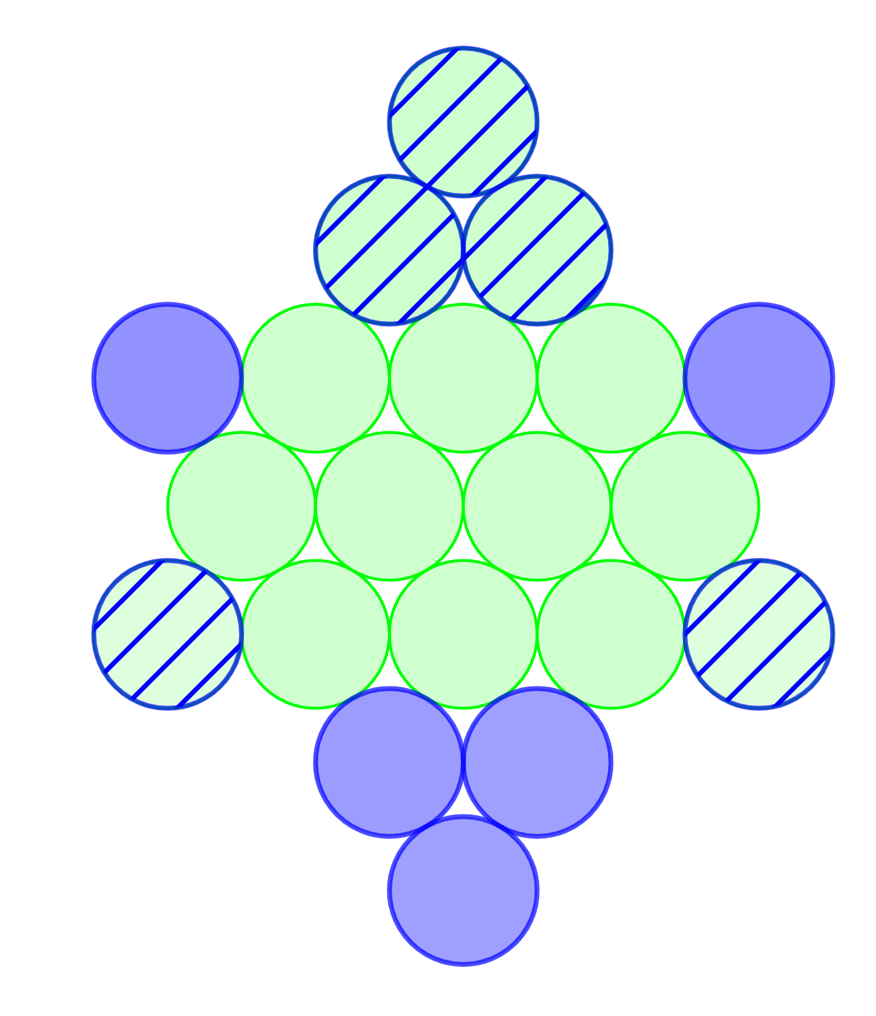
Or this one?

Slide 9
Charting the progress…
Base size | Disks to be moved
3 | 2
4 | 3
5 | 5
6 | 7
7 | 9
8 | 12

Slide 10
Is there a pattern??? Why?
Base size | Disks to be moved | First differences
1 | 0
2 | 1 | 1
3 | 2 | 1
4 | 3 | 1
5 | 5 | 2
6 | 7 | 2
7 | 9 | 2
8 | 12 | 3
9 | 15 | 3
10 | 18 | 3
11 | 22 | 4

Slide 11
“The other way ‘round”…
Which is easier…
If there are 25 people in a room, what is the probability that at least two of them have the same birthday?
If there are 25 people in a room, what is the probability that there are no matching birthdays?
Which is easier…
What’s the fewest number of disks that need to be moved?
What’s the greatest number of disks that can remain in place?

Slide 12
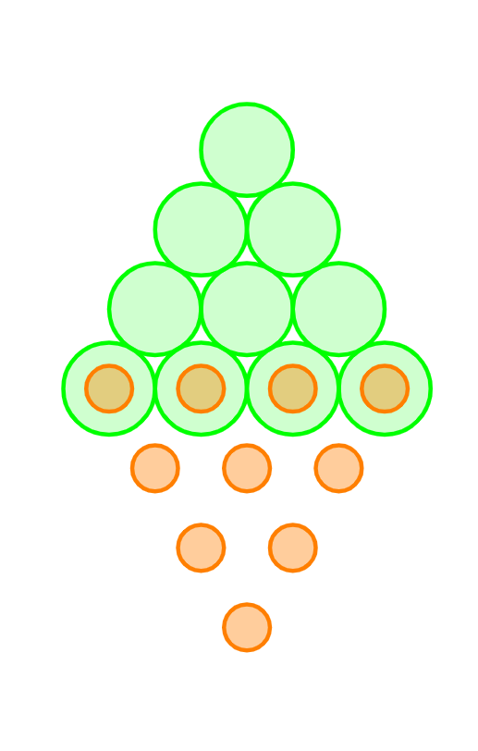
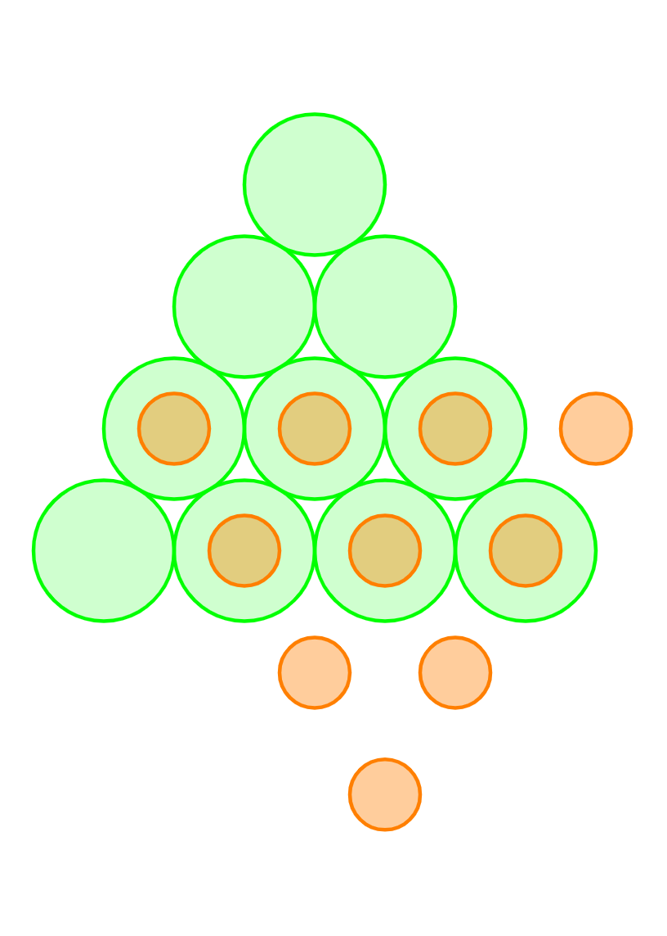
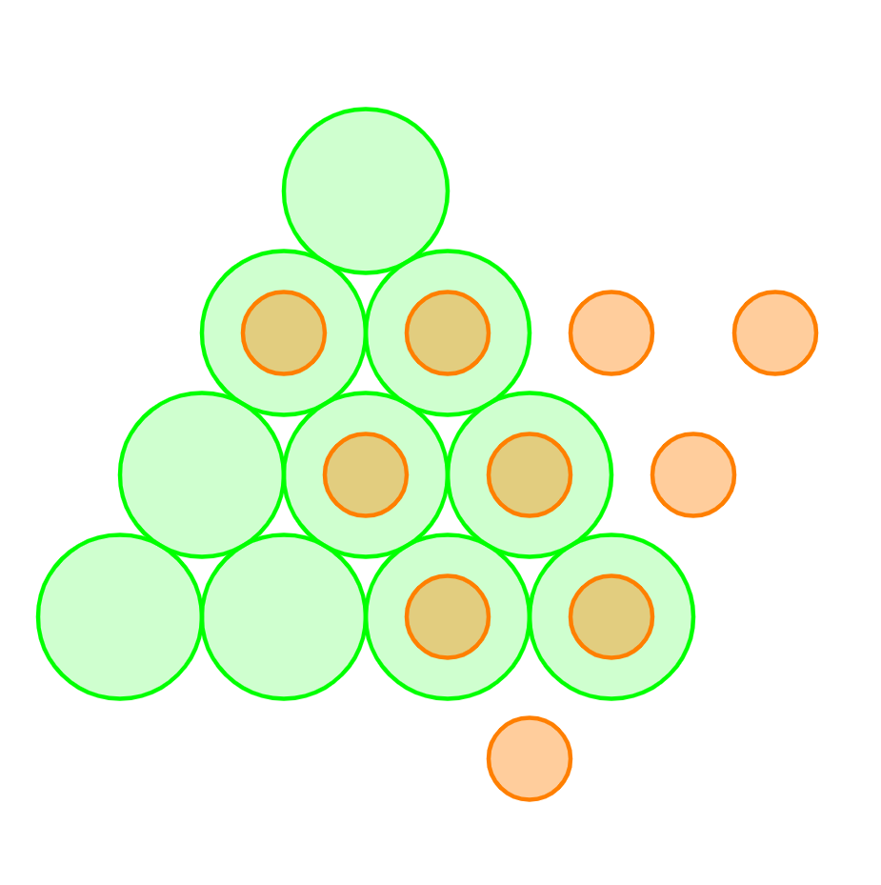
How many can we keep?
?

Slide 13
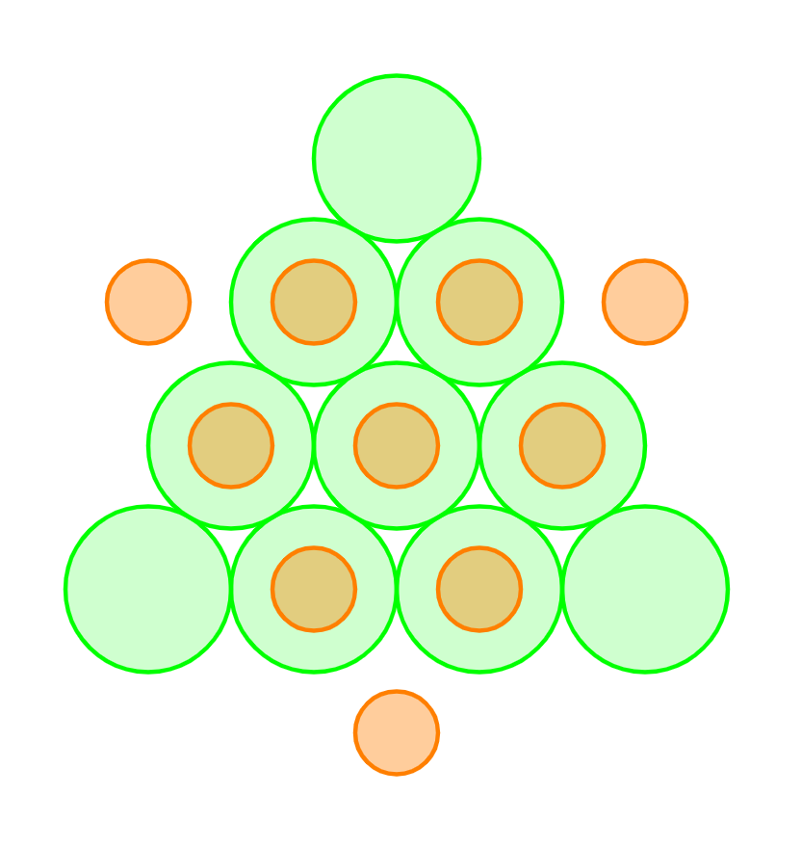
How many can we keep?

Slide 14
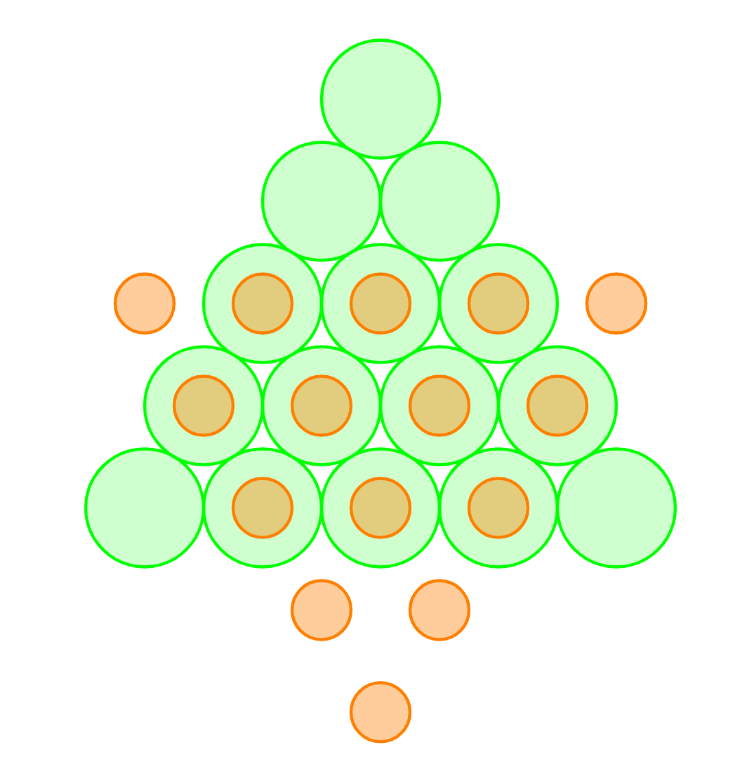
“The other way ‘round”…
Time for a little gratuitous GeoGebra!

Slide 15
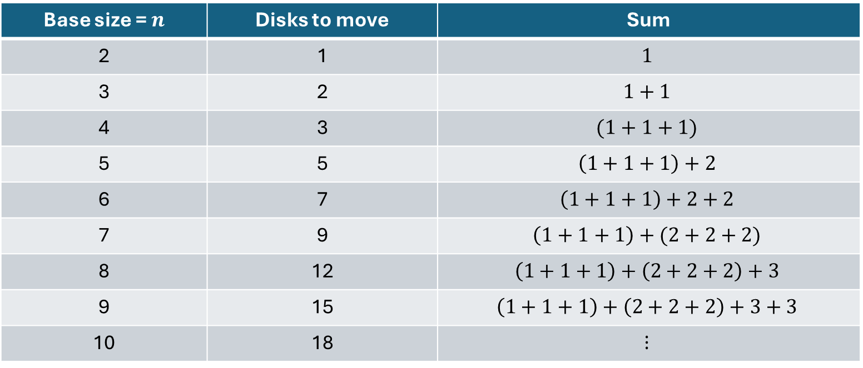

Closed formula? (Blech!)
How to sum $0+1+1+1+2+2+2+3+3+⋯?$
Kinda like $0+3+6+9+⋯$
Base size = $n$ | Disks to move | Sum
2 | 1 | $$1$$
3 | 2 | $$1+1$$
4 | 3 | $$(1+1+1)$$
5 | 5 | $$\left(1+1+1\right)+2$$
6 | 7 | $$\left(1+1+1\right)+2+2$$
7 | 9 | $$\left(1+1+1\right)+(2+2+2)$$
8 | 12 | $$\left(1+1+1\right)+\left(2+2+2\right)+3$$
9 | 15 | $$\left(1+1+1\right)+\left(2+2+2\right)+3+3$$
10 | 18 | $$⋮$$

Slide 16
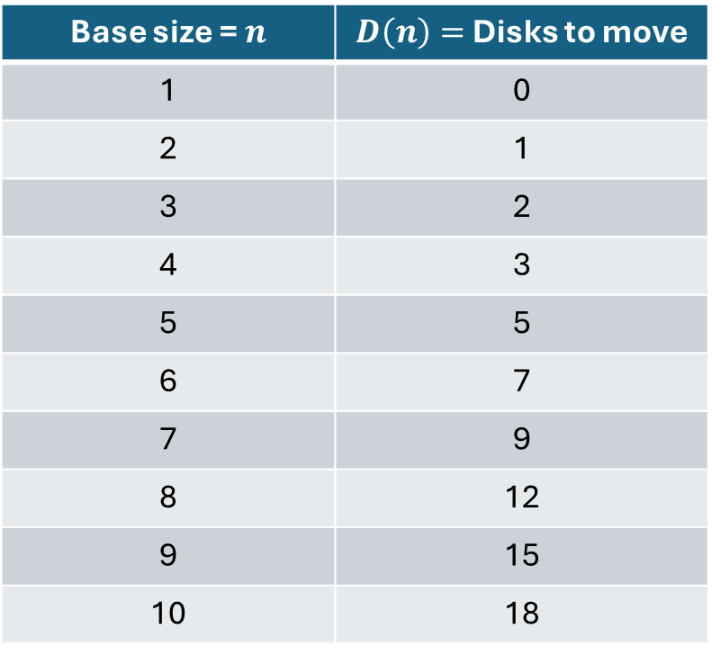
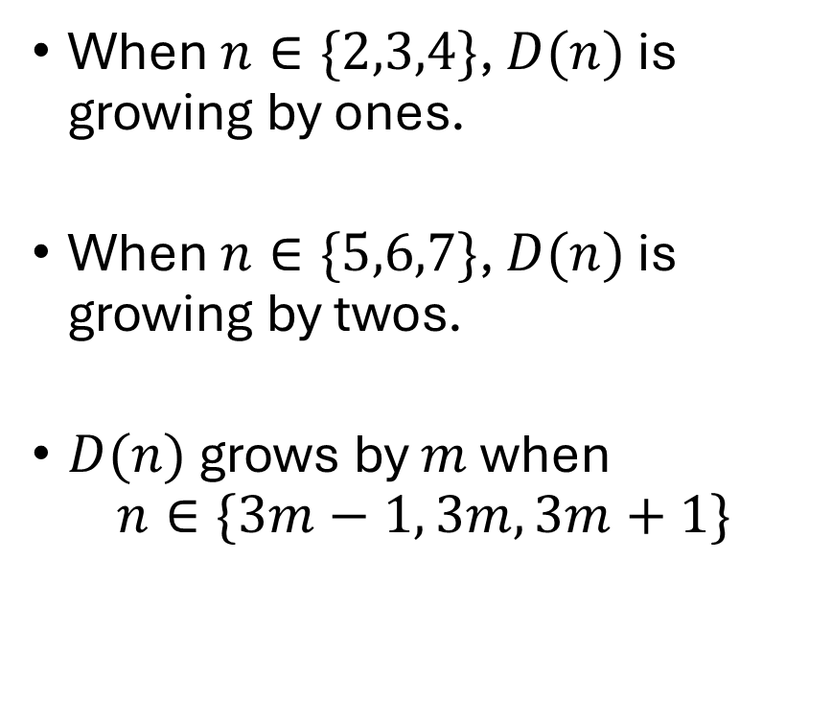
Growth rate…
When $n∈\{2,3,4\}$, $D(n)$ is growing by ones.
When $n∈\{5,6,7\}$, $D(n)$ is growing by twos.
$D(n)$ grows by $m$ when $n∈\{3m−1, 3m, 3m+1\}$
Base size = $n$ | $D\left(n\right)=$ Disks to move
1 | 0
2 | 1
3 | 2
4 | 3
5 | 5
6 | 7
7 | 9
8 | 12
9 | 15
10 | 18

Slide 17
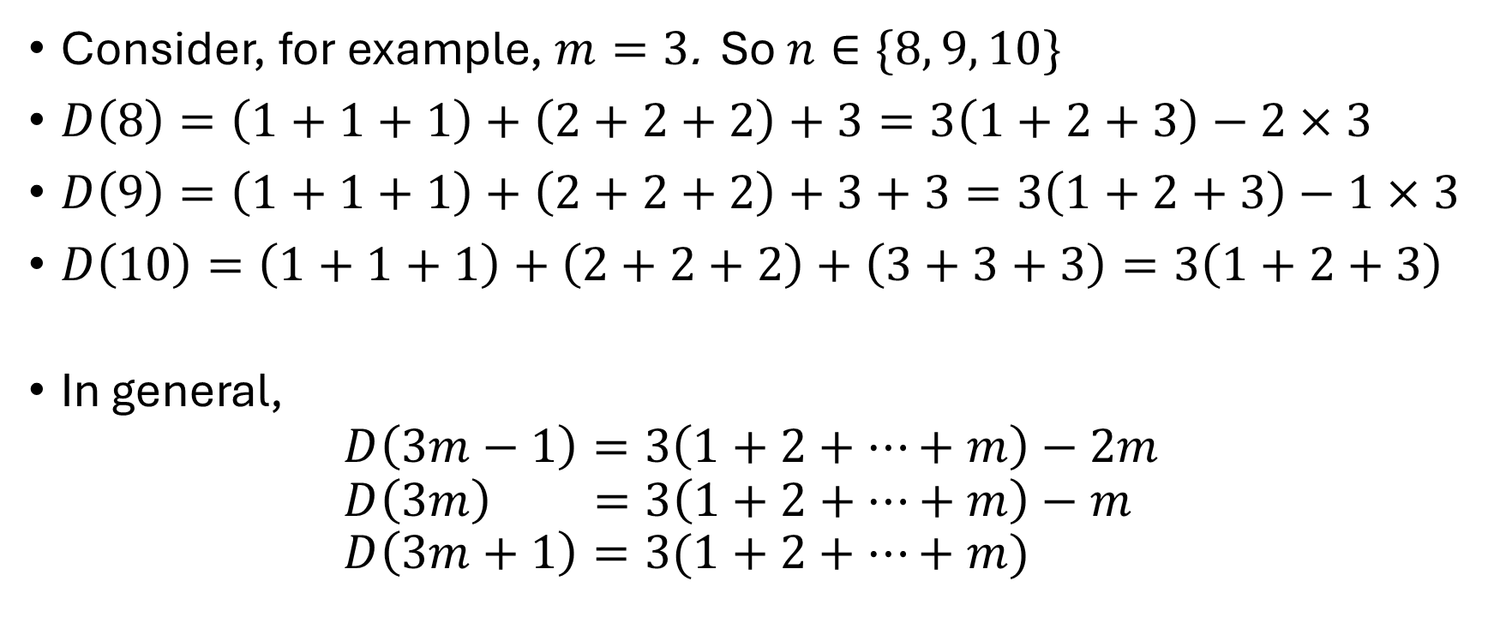

$$n∈\{3m−1, 3m, 3m+1\}$$
Consider, for example, $m=3$. So $n∈\{8, 9, 10\}$
$D\left(8\right)=\left(1+1+1\right)+\left(2+2+2\right)+3=3\left(1+2+3\right)−2×3$
$D\left(9\right)=\left(1+1+1\right)+\left(2+2+2\right)+3+3=3\left(1+2+3\right)−1×3$
$D\left(10\right)=\left(1+1+1\right)+\left(2+2+2\right)+\left(3+3+3\right)=3\left(1+2+3\right)$
In general, $D\left(3m−1\right)=3\left(1+2+⋯+m\right)−2m$ $D\left(3m\right) =3\left(1+2+⋯+m\right)−m$ $D\left(3m+1\right)=3(1+2+⋯+m)$

Slide 18
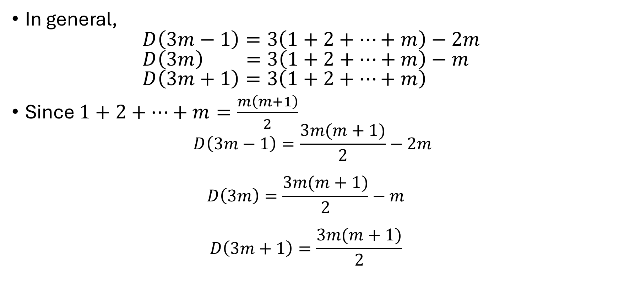
$$n∈\{3m−1, 3m, 3m+1\}$$
In general, $D\left(3m−1\right)=3\left(1+2+⋯+m\right)−2m$ $D\left(3m\right) =3\left(1+2+⋯+m\right)−m$ $D\left(3m+1\right)=3\left(1+2+⋯+m\right)$
Since $1+2+⋯+m=\frac{m\left(m+1\right)}{2}$ $D\left(3m−1\right)=\frac{3m(m+1)}{2}−2m$ $D\left(3m\right)=\frac{3m(m+1)}{2}−m$ $D\left(3m+1\right)=\frac{3m(m+1)}{2}$

Slide 19
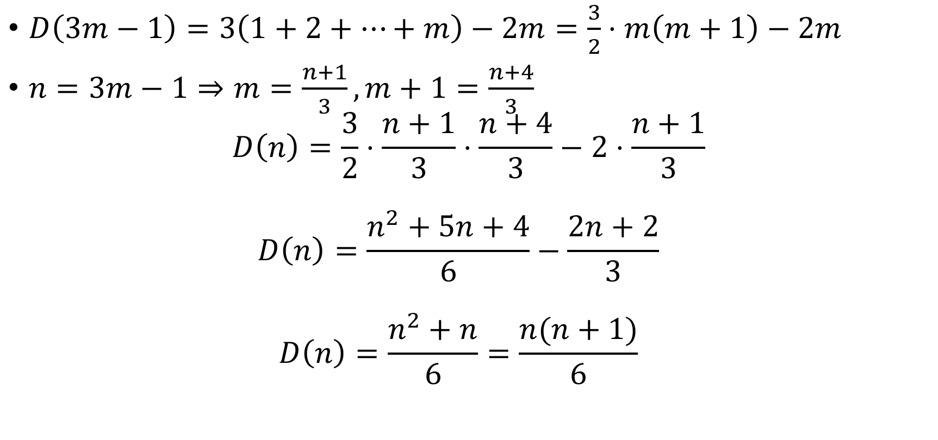
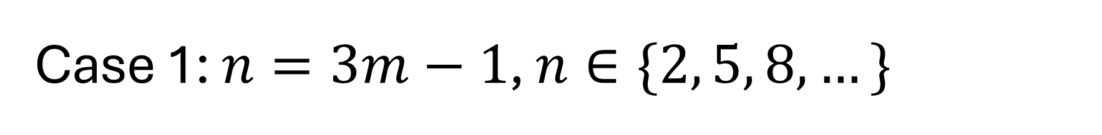
Case 1: $n=3m−1$, $n∈\{2, 5, 8,…\}$
$D\left(3m−1\right)=3\left(1+2+⋯+m\right)−2m=\frac{3}{2}⋅m\left(m+1\right)−2m$
$n=3m−1⇒m=\frac{n+1}{3}, m+1=\frac{n+4}{3}$ $D\left(n\right)=\frac{3}{2}⋅\frac{n+1}{3}⋅\frac{n+4}{3}−2⋅\frac{n+1}{3}$ $D\left(n\right)=\frac{n^{2}+5n+4}{6}−\frac{2n+2}{3}$ $D\left(n\right)=\frac{n^{2}+n}{6}=\frac{n(n+1)}{6}$

Slide 20

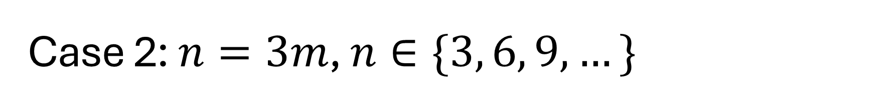
Case 2: $n=3m$, $n∈\{3, 6, 9,…\}$
$D\left(3m\right)=3\left(1+2+⋯+m\right)−m=\frac{3}{2}⋅m\left(m+1\right)−m$
$n=3m⇒m=\frac{n}{3}, m+1=\frac{n+3}{3}$ $D\left(n\right)=\frac{3}{2}⋅\frac{n}{3}⋅\frac{n+3}{3}−\frac{n}{3}$ $D\left(n\right)=\frac{n^{2}+3n}{6}−\frac{n}{3}$ $D\left(n\right)=\frac{n^{2}+n}{6}=\frac{n(n+1)}{6}$

Slide 21
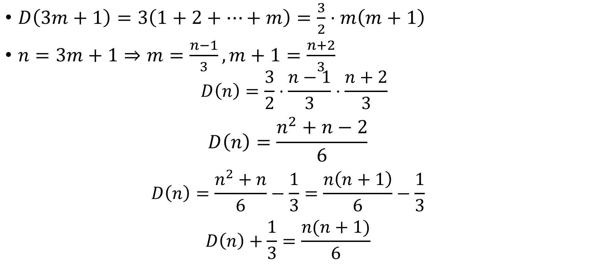
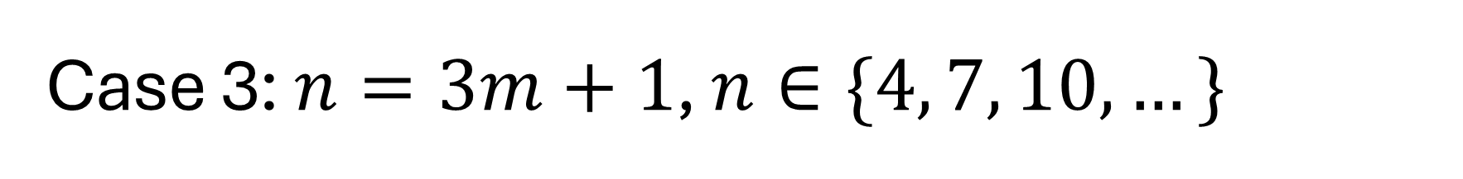
Case 3: $n=3m+1$, $n∈\{4, 7, 10,…\}$
$D\left(3m+1\right)=3\left(1+2+⋯+m\right)=\frac{3}{2}⋅m\left(m+1\right)$
$n=3m+1⇒m=\frac{n−1}{3}, m+1=\frac{n+2}{3}$ $D\left(n\right)=\frac{3}{2}⋅\frac{n−1}{3}⋅\frac{n+2}{3}$ $D\left(n\right)=\frac{n^{2}+n−2}{6}$ $D\left(n\right)=\frac{n^{2}+n}{6}−\frac{1}{3}=\frac{n\left(n+1\right)}{6}−\frac{1}{3}$ $D\left(n\right)+\frac{1}{3}=\frac{n(n+1)}{6}$

Slide 22
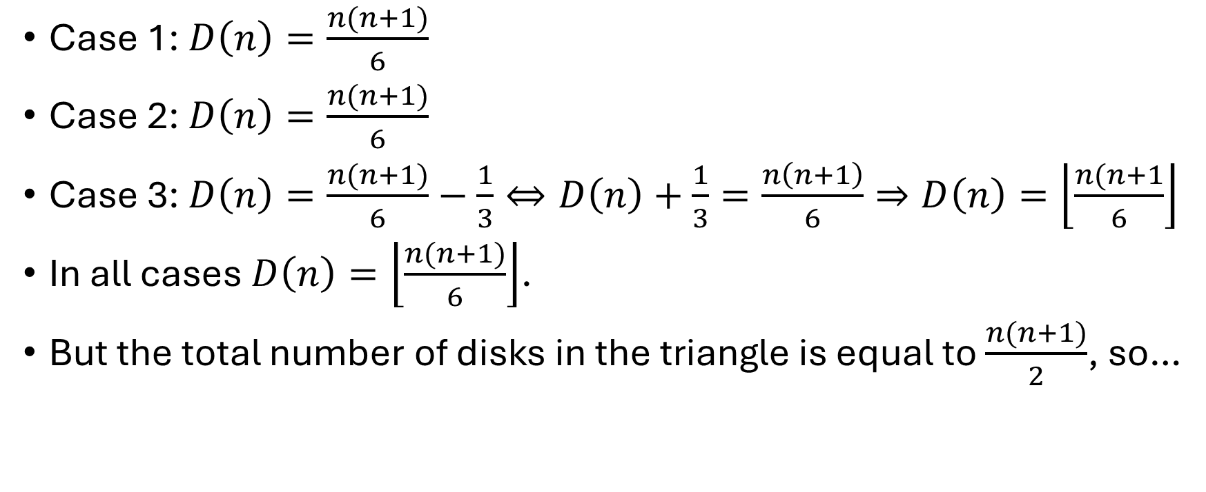
“Altogether now…”
Case 1: $D\left(n\right)=\frac{n(n+1)}{6}$
Case 2: $D\left(n\right)=\frac{n(n+1)}{6}$
Case 3: $D\left(n\right)=\frac{n(n+1)}{6}−\frac{1}{3}⇔D\left(n\right)+\frac{1}{3}=\frac{n\left(n+1\right)}{6}⇒D\left(n\right)=\left\lfloor \frac{n(n+1}{6}\right\rfloor$
In all cases $D\left(n\right)=\left\lfloor \frac{n(n+1)}{6}\right\rfloor$.
But the total number of disks in the triangle is equal to $\frac{n(n+1)}{2}$, so…

Slide 23
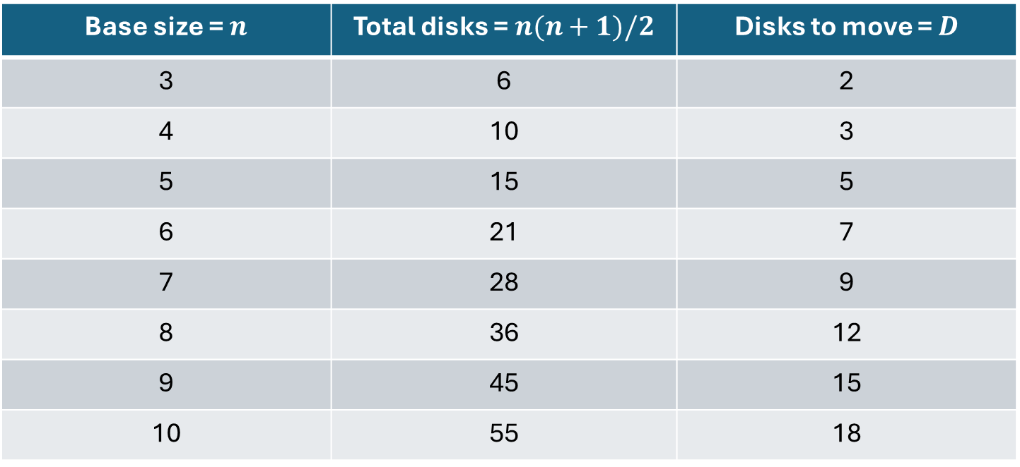
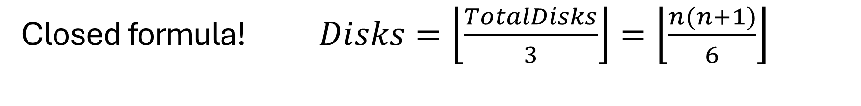
Closed formula! $Disks=\left\lfloor \frac{TotalDisks}{3}\right\rfloor =\left\lfloor \frac{n(n+1)}{6}\right\rfloor$
Base size = $n$ | Total disks = $n(n+1)/2$ | Disks to move = $D$
3 | 6 | 2
4 | 10 | 3
5 | 15 | 5
6 | 21 | 7
7 | 28 | 9
8 | 36 | 12
9 | 45 | 15
10 | 55 | 18

