Slide 1

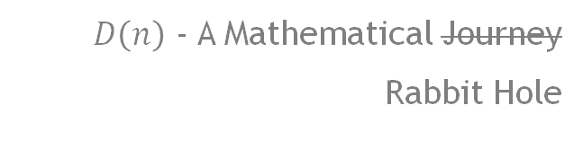
Daniel’s Average
$D\left(n\right)$ - A Mathematical Journey
Rabbit Hole

Slide 2
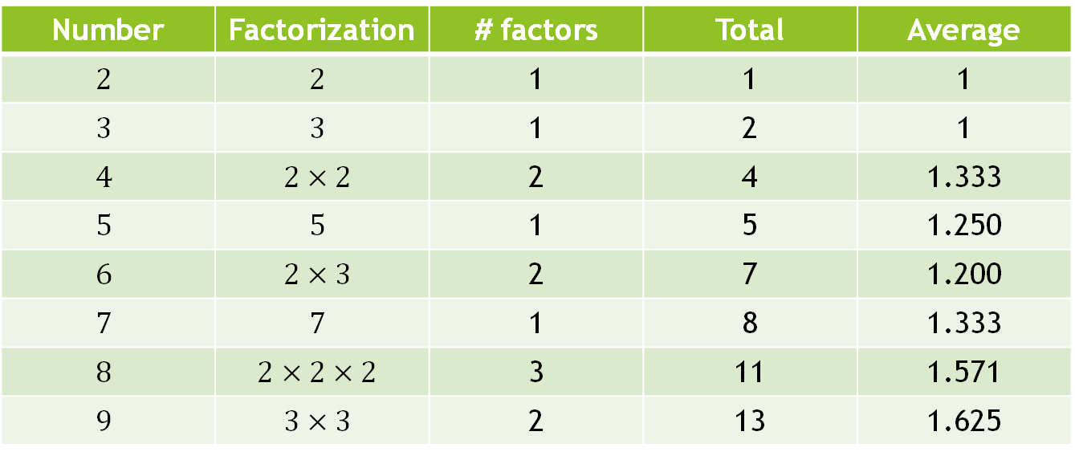

The Question
What’s the average number of prime factors for numbers up to $n$?
Is there a limit or does it grow without bound?
Number | Factorization | # factors | Total | Average
$$2$$ | $$2$$ | 1 | 1 | 1
$$3$$ | $$3$$ | 1 | 2 | 1
$$4$$ | $$2×2$$ | 2 | 4 | 1.333
$$5$$ | $$5$$ | 1 | 5 | 1.250
$$6$$ | $$2×3$$ | 2 | 7 | 1.200
$$7$$ | $$7$$ | 1 | 8 | 1.333
$$8$$ | $$2×2×2$$ | 3 | 11 | 1.571
$$9$$ | $$3×3$$ | 2 | 13 | 1.625

Slide 3
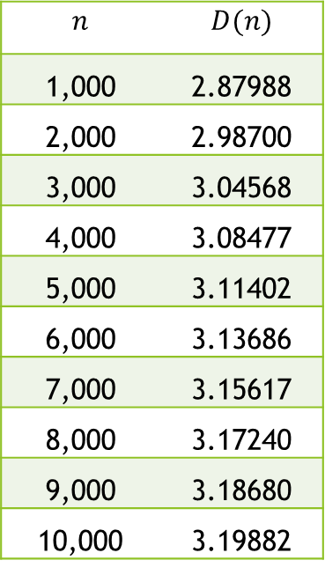
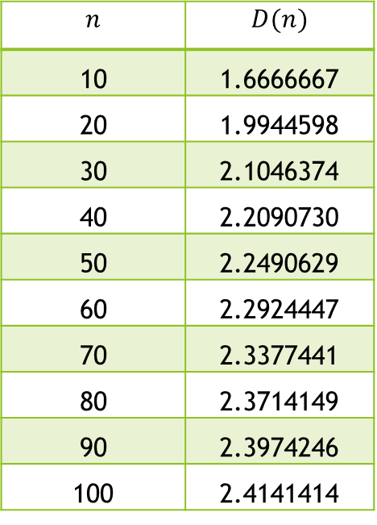
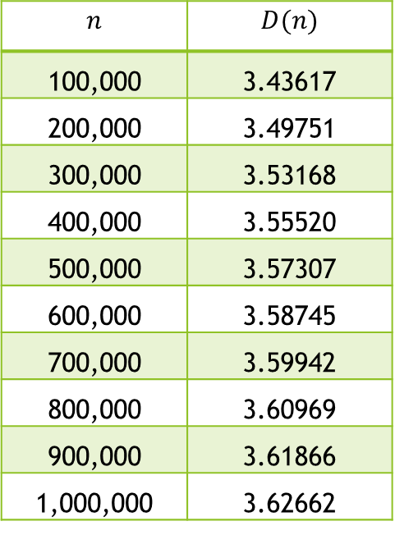
What does it look like?
Python results…
$$n$$ | $$D(n)$$
10 | 1.6666667
20 | 1.9944598
30 | 2.1046374
40 | 2.2090730
50 | 2.2490629
60 | 2.2924447
70 | 2.3377441
80 | 2.3714149
90 | 2.3974246
100 | 2.4141414
$$n$$ | $$D(n)$$
1,000 | 2.87988
2,000 | 2.98700
3,000 | 3.04568
4,000 | 3.08477
5,000 | 3.11402
6,000 | 3.13686
7,000 | 3.15617
8,000 | 3.17240
9,000 | 3.18680
10,000 | 3.19882
$$n$$ | $$D(n)$$
100,000 | 3.43617
200,000 | 3.49751
300,000 | 3.53168
400,000 | 3.55520
500,000 | 3.57307
600,000 | 3.58745
700,000 | 3.59942
800,000 | 3.60969
900,000 | 3.61866
1,000,000 | 3.62662

Slide 4
Growing & Slowing – so who wins?
n | Daniel's Average
10 | 1.667
100 | 2.414
1,000 | 2.880
10,000 | 3.199
100,000 | 3.436
1,000,000 | 3.627
10,000,000 | 3.786
100,000,000 | 3.924
1,000,000,000 | 4.044

Slide 5
What does it look like?

Slide 6
What does it look like? (On a log scale)

Slide 7
What does it look like?
Logarithmic??

Slide 8
Sidebar: What I could have done...

Slide 9
Sidebar: What I could have done...

Slide 10
A Distribution Hypothesis

Slide 11
A Distribution Hypothesis

Slide 12
A Distribution Hypothesis

Slide 13
A Distribution Hypothesis

Slide 14
A Distribution Hypothesis

Slide 15
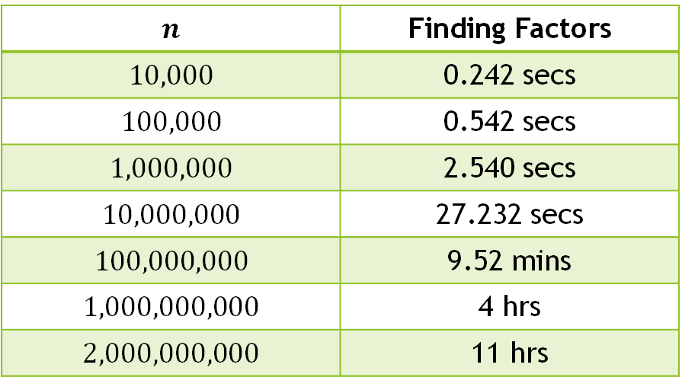
Where do we go from here??
Hypotheses are only educated guesses.
Factoring takes too long!
$$n$$ | Finding Factors
$$10,000$$ | 0.242 secs
$$100,000$$ | 0.542 secs
$$1,000,000$$ | 2.540 secs
$$10,000,000$$ | 27.232 secs
$$100,000,000$$ | 9.52 mins
$$1,000,000,000$$ | 4 hrs
$$2,000,000,000$$ | 11 hrs

Slide 16
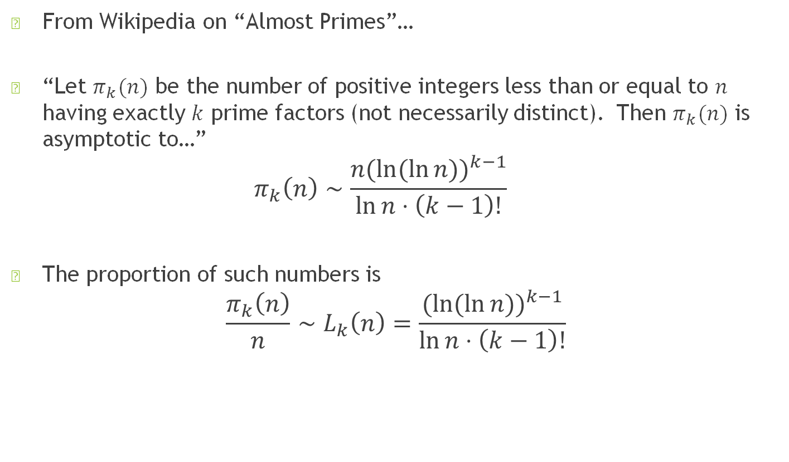
Distribution via Landau – thanks, Daniel!
From Wikipedia on “Almost Primes”…
“Let $π_{k}(n)$ be the number of positive integers less than or equal to $n$ having exactly $k$ prime factors (not necessarily distinct). Then $π_{k}(n)$ is asymptotic to…” $π_{k}\left(n\right)∼\frac{n(ln⁡(\ln{{n))}^{k−1}}}{\ln{n⋅\left(k−1\right)!}}$
The proportion of such numbers is $\frac{π_{k}\left(n\right)}{n}∼L_{k}\left(n\right)=\frac{(ln⁡(\ln{{n))}^{k−1}}}{\ln{n⋅\left(k−1\right)!}}$

Slide 17

Landau frequency - $L_{k}(n)$
Good news!
Asymptotic to reality! AKA, it’s “true at infinity”.
No more factoring needed!
Pretty results!

Slide 18
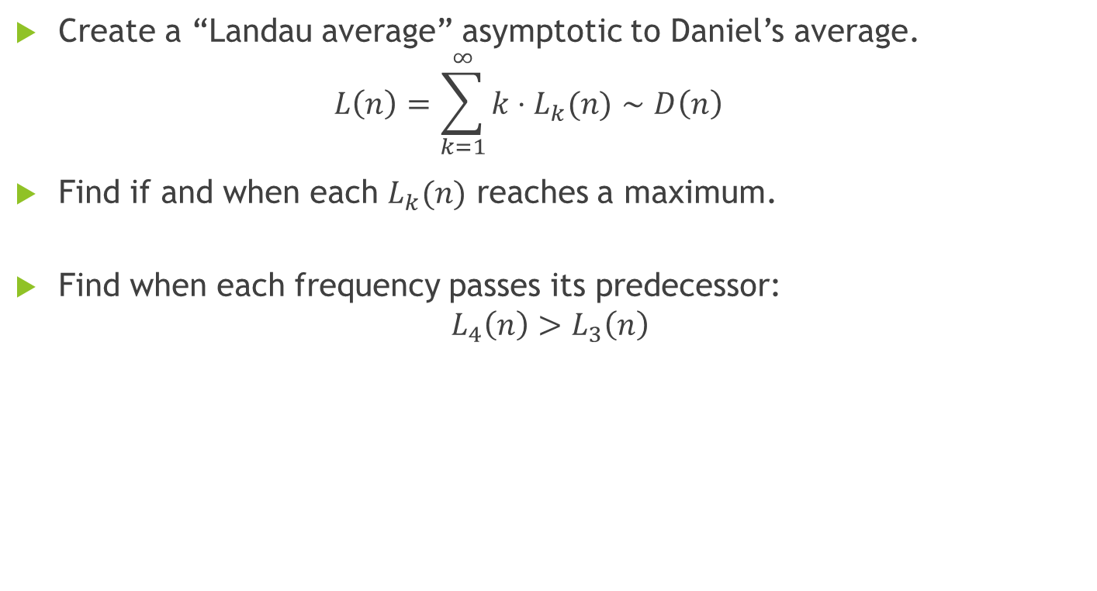

What can we do with $L_{k}(n)$?
Create a “Landau average” asymptotic to Daniel’s average. $L\left(n\right)=\sum_{k=1}^{∞}{k⋅L_{k}(n)}∼D\left(n\right)$
Find if and when each $L_{k}(n)$ reaches a maximum.
Find when each frequency passes its predecessor: $L_{4}\left(n\right)>L_{3}\left(n\right)$

Slide 19
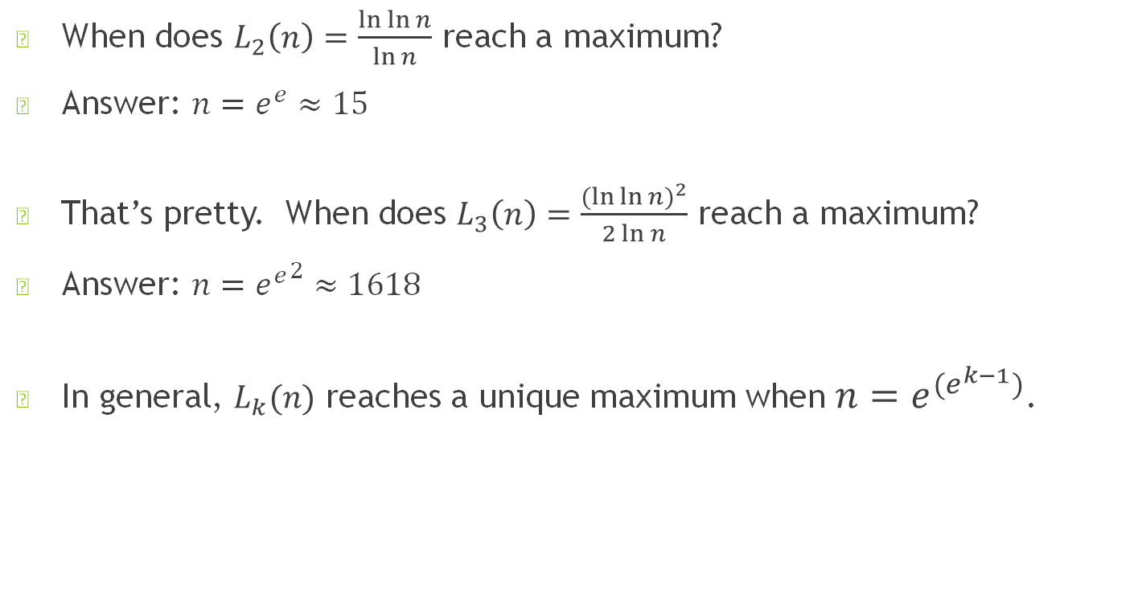
Finding maxima – thanks, Maplesoft!
When does $L_{2}\left(n\right)=\frac{\ln{\ln{n}}}{\ln{n}}$ reach a maximum?
Answer: $n=e^{e}≈15$
That’s pretty. When does $L_{3}\left(n\right)=\frac{({\ln{\ln{n)}}}^{2}}{2\ln{n}}$ reach a maximum?
Answer: $n={e^{e}}^{2}≈1618$
In general, $L_{k}(n)$ reaches a unique maximum when $n=e^{(e^{k−1})}$.

Slide 20

When k maxes, k+1 passes
When does $L_{k}(n)$ pass up $L_{k−1}(n)$?
Answer: $L_{k}\left(n\right)≥L_{k−1}(n)$ when $n={e^{e}}^{k−1}$
So $L_{3}(n)$ passes $L_{2}(n)$ when $L_{3}\left(n\right)$ peaks at $n={e^{e}}^{2}≈1618$.

Slide 21
What does it look like?

Slide 22
Landau frequency - $L_{k}(n)$
Bad news!
“Asymptotic” doesn’t mean “great” for small numbers.

Slide 23
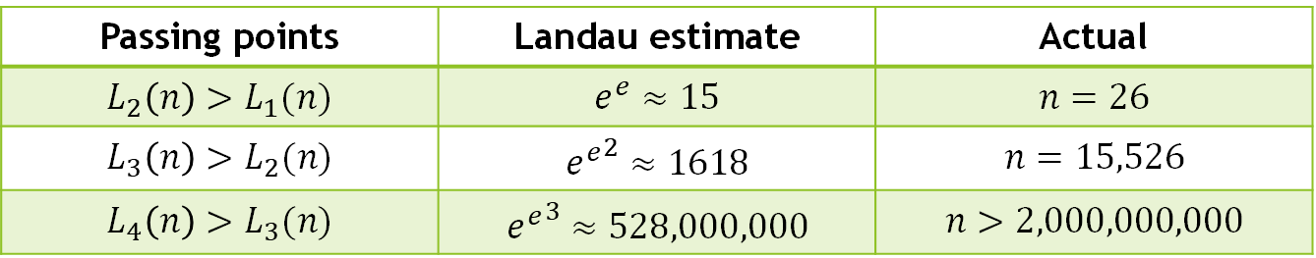
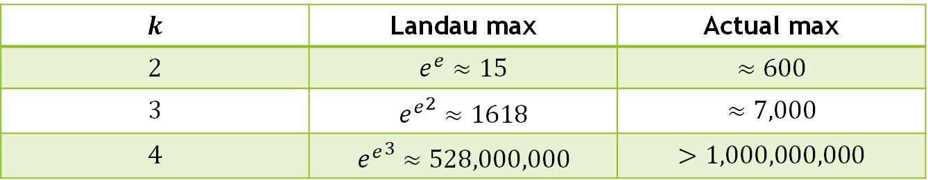
How close are we?
$$k$$ | Landau max | Actual max
$$2$$ | $$e^{e}≈15$$ | $$≈600$$
$$3$$ | $${e^{e}}^{2}≈1618$$ | $$≈7,000$$
$$4$$ | $${e^{e}}^{3}≈528,000,000$$ | $$>1,000,000,000$$
Passing points | Landau estimate | Actual
$$L_{2}\left(n\right)>L_{1}(n)$$ | $$e^{e}≈15$$ | $$n=26$$
$$L_{3}\left(n\right)>L_{2}(n)$$ | $${e^{e}}^{2}≈1618$$ | $$n=15,526$$
$$L_{4}\left(n\right)>L_{3}(n)$$ | $${e^{e}}^{3}≈528,000,000$$ | $$n>2,000,000,000$$

Slide 24
Landau – good news / bad news

Slide 25
The Landau estimate – over/under?

Slide 26
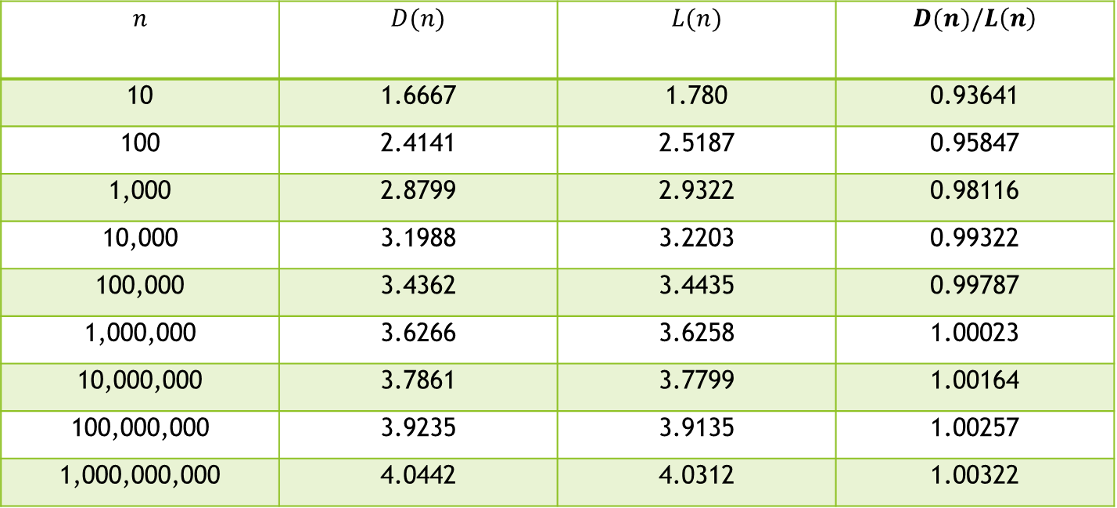
Landau averages, however…
Track very well!
Notice underestimate vs. overestimate!
$$n$$ | $$D(n)$$ | $$L(n)$$ | $$D(n)/L\left(n\right)$$
10 | 1.6667 | 1.780 | 0.93641
100 | 2.4141 | 2.5187 | 0.95847
1,000 | 2.8799 | 2.9322 | 0.98116
10,000 | 3.1988 | 3.2203 | 0.99322
100,000 | 3.4362 | 3.4435 | 0.99787
1,000,000 | 3.6266 | 3.6258 | 1.00023
10,000,000 | 3.7861 | 3.7799 | 1.00164
100,000,000 | 3.9235 | 3.9135 | 1.00257
1,000,000,000 | 4.0442 | 4.0312 | 1.00322

Slide 27
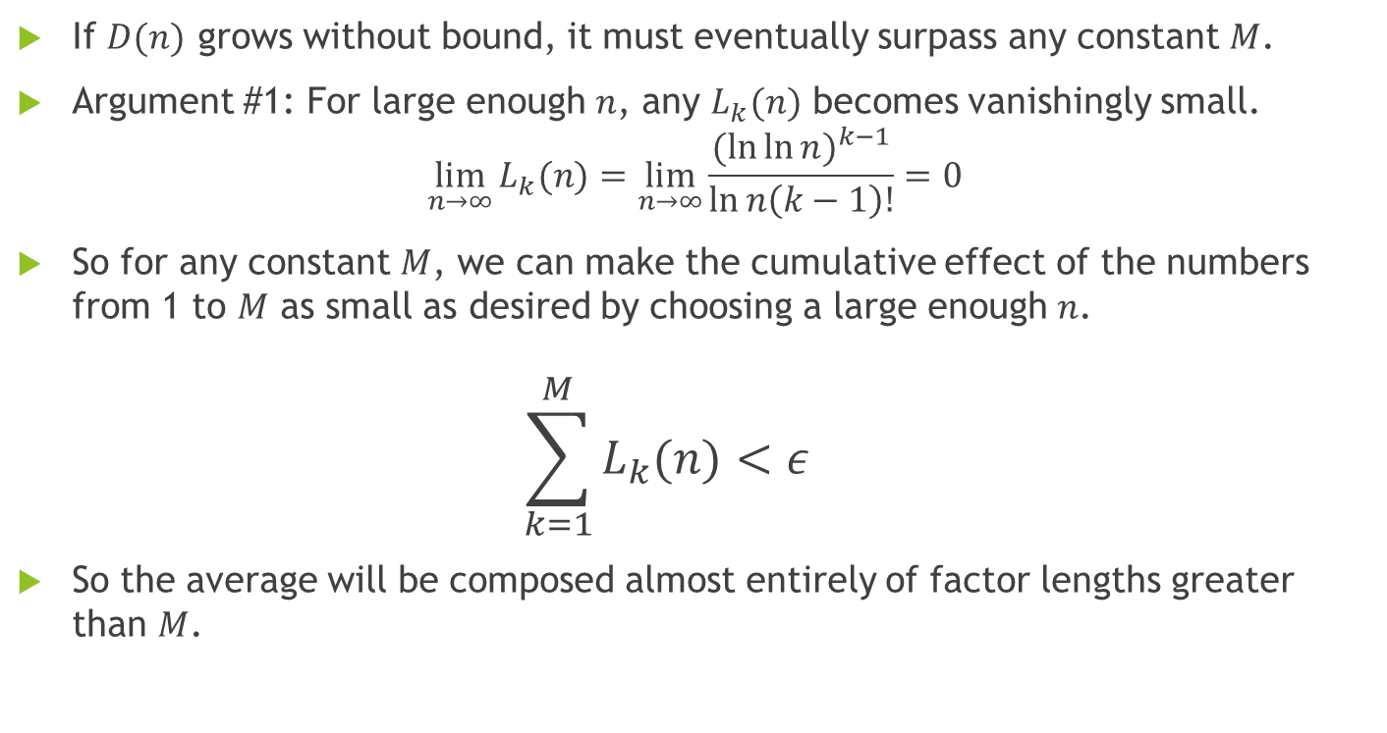
Growing without bounds?
If $D(n)$ grows without bound, it must eventually surpass any constant $M$.
Argument #1: For large enough $n$, any $L_{k}(n)$ becomes vanishingly small. $\lim_{n→∞}{L_{k}(n)}=\lim_{n→∞}{\frac{{(\ln{\ln{n}})}^{k−1}}{\ln{n\left(k−1\right)!}}}=0$
So for any constant $M$, we can make the cumulative effect of the numbers from 1 to $M$ as small as desired by choosing a large enough $n$. $\sum_{k=1}^{M}{L_{k}(n)}<ε$
So the average will be composed almost entirely of factor lengths greater than $M$.

Slide 28
Growth without bound - decreasing frequencies?

Slide 29
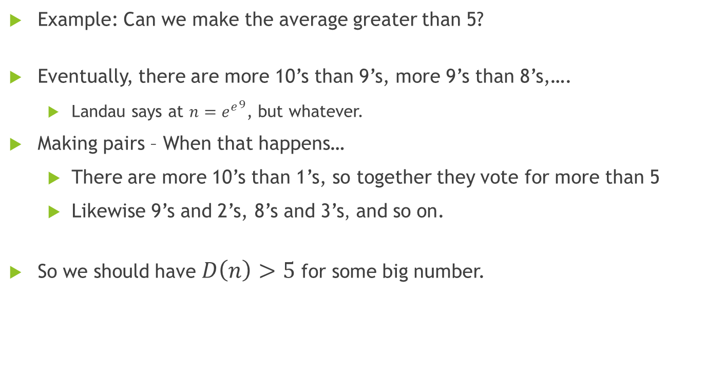
Growing without bounds - pairing
Example: Can we make the average greater than 5?
Eventually, there are more 10’s than 9’s, more 9’s than 8’s,….
Landau says at $n={e^{e}}^{9}$, but whatever.
Making pairs – When that happens…
There are more 10’s than 1’s, so together they vote for more than 5
Likewise 9’s and 2’s, 8’s and 3’s, and so on.
So we should have $D\left(n\right)>5$ for some big number.

Slide 30
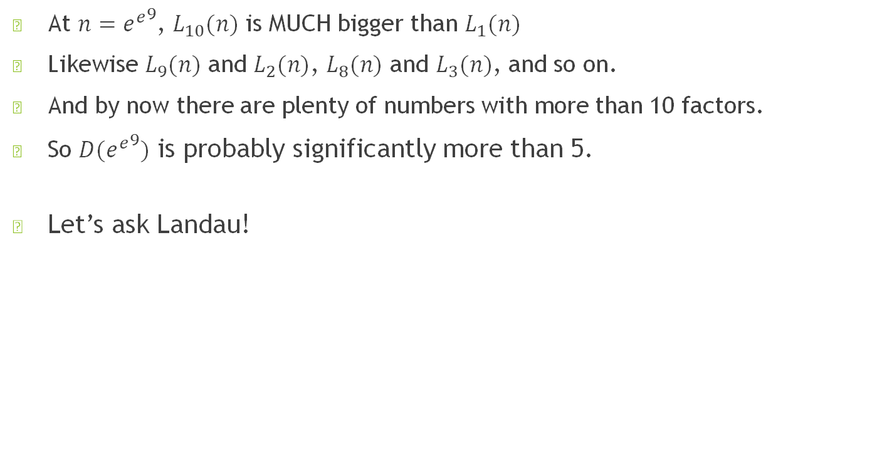

So is $L({e^{e}}^{9})$ pretty close to 5?
At $n={e^{e}}^{9}$, $L_{10}(n)$ is MUCH bigger than $L_{1}(n)$
Likewise $L_{9}(n)$ and $L_{2}(n)$, $L_{8}(n)$ and $L_{3}(n)$, and so on.
And by now there are plenty of numbers with more than 10 factors.
So $D({e^{e}}^{9})$ is probably significantly more than 5.
Let’s ask Landau!

Slide 31

Surprise!
$L\left({e^{e}}^{9}\right)=10$.
Wait a minute! What? So when $L_{10}(n)$ reaches a max, the average is 10???

Slide 32
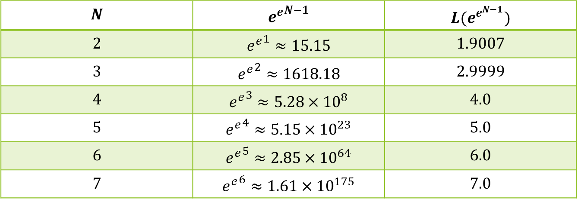
Surprise!
$L\left({e^{e}}^{9}\right)=10$.
Wait a minute! What? So when $L_{10}(n)$ reaches a max, the average is 10???
$$N$$ | $${e^{e}}^{N−1}$$ | $$L(e^{e^{N−1}})$$
$$2$$ | $${e^{e}}^{1}≈15.15$$ | $$1.9007$$
$$3$$ | $${e^{e}}^{2}≈1618.18$$ | $$2.9999$$
$$4$$ | $${e^{e}}^{3}≈5.28×{10}^{8}$$ | $$4.0$$
$$5$$ | $${e^{e}}^{4}≈5.15×{10}^{23}$$ | $$5.0$$
$$6$$ | $${e^{e}}^{5}≈2.85×{10}^{64}$$ | $$6.0$$
$$7$$ | $${e^{e}}^{6}≈1.61×{10}^{175}$$ | $$7.0$$

Slide 33

A little algebra…
It looks like $L\left({e^{e}}^{N−1}\right)=N$
If $L\left({e^{e}}^{N−1}\right)=N$, then $L\left({e^{e}}^{N}\right)=N+1$
But $n={e^{e}}^{ln⁡(\ln{n)}}$, so $L\left({e^{e}}^{ln⁡(\ln{n)}}\right)=L\left(n\right)=ln⁡(\ln{n)+1}$.
Looks like we have an asymptote! $D\left(n\right)∼L\left(n\right)=ln⁡(\ln{n)+1}$

Slide 34
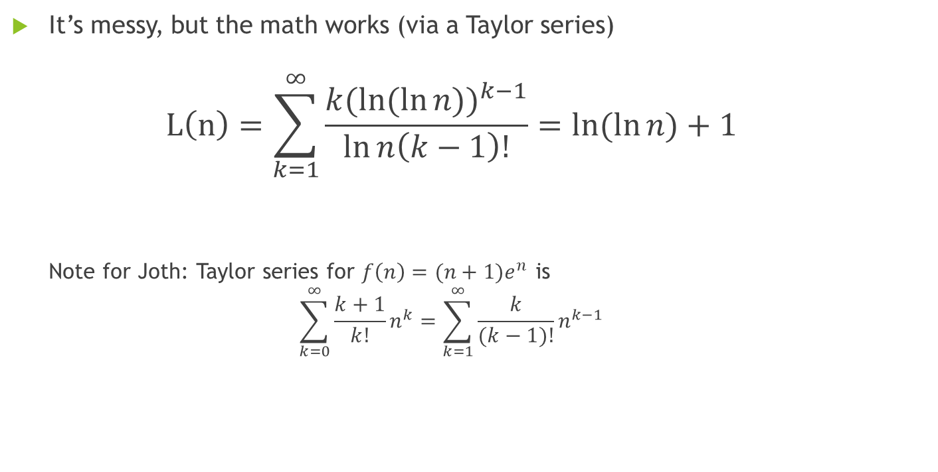
An asymptote for D(n)
It’s messy, but the math works (via a Taylor series) $L\left(n\right)=\sum_{k=1}^{∞}{\frac{k(ln⁡({\ln{n))}}^{k−1}}{\ln{n\left(k−1\right)!}}=ln⁡(\ln{n)+1}}$ Note for Joth: Taylor series for $f\left(n\right)={(n+1)e}^{n}$ is $\sum_{k=0}^{∞}{\frac{k+1}{k!}}n^{k}=\sum_{k=1}^{∞}{\frac{k}{(k−1)!}}n^{k−1}$

Slide 35
It was there all along…

Slide 36

$$D\left(n\right)∼ln⁡(\ln{n)+1}?$$

Slide 37
$$D\left(n\right)∼ln⁡(\ln{n)+1}?$$

Slide 38

$$D\left(n\right)∼ln⁡(\ln{n)+1}?$$

Slide 39

Imagining ln(ln(n)) growth
If $\ln{a}$ is one more than $\ln{b}$, then $a=e⋅b$.
So $2b<a<3b$.
But if $\ln{\ln{a}}$ is one more than $\ln{\ln{b}}$, then $a=b^{e}$.
So $b^{2}<a<b^{3}$.
That is, $a$ is between two and three times as long as $b$.

Slide 40
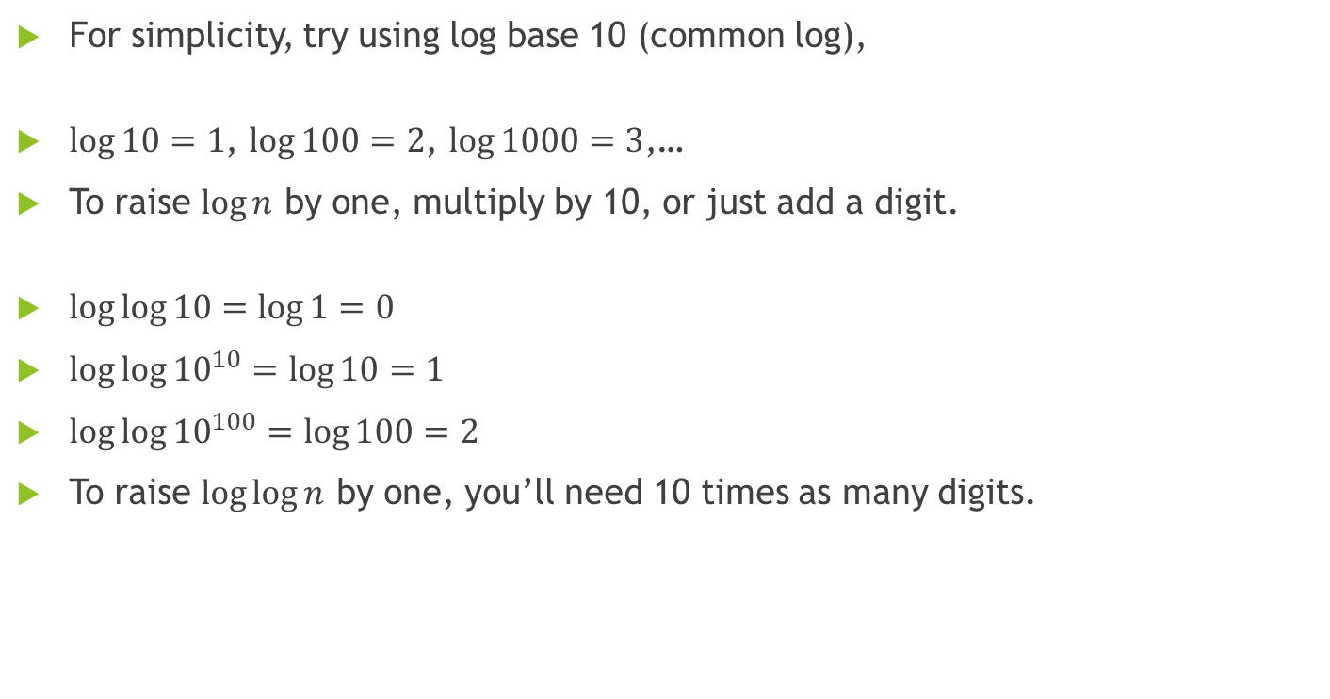
Imagining log(log(n)) growth
For simplicity, try using log base 10 (common log),
$\log{10=1}$, $\log{100=2}$, $\log{1000=3}$,…
To raise $\log{n}$ by one, multiply by 10, or just add a digit.
$\log{\log{10=\log{1=0}}}$
$\log{\log{{10}^{10}=\log{10=1}}}$
$\log{\log{{10}^{100}=\log{100=2}}}$
To raise $\log{\log{n}}$ by one, you’ll need 10 times as many digits.

Slide 41
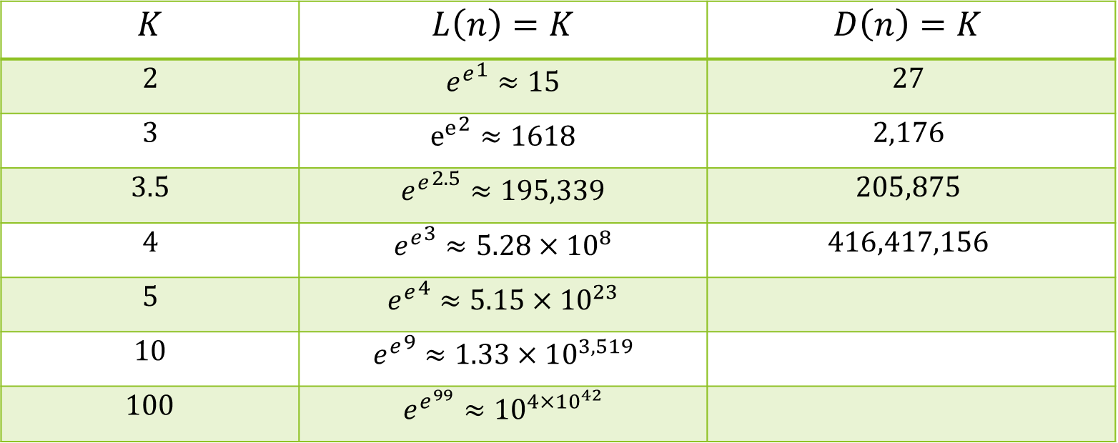
Are we there yet??
$$K$$ | $$L\left(n\right)=K$$ | $$D\left(n\right)=K$$
$$2$$ | $${e^{e}}^{1}≈15$$ | $$27$$
$$3$$ | $${e^{e}}^{2}≈1618$$ | $$2,176$$
$$3.5$$ | $${e^{e}}^{2.5}≈195,339$$ | $$205,875$$
$$4$$ | $${e^{e}}^{3}≈5.28×10^{8}$$ | $$416,417,156$$
$$5$$ | $${e^{e}}^{4}≈5.15×10^{23}$$
$$10$$ | $${e^{e}}^{9}≈1.33×10^{3,519}$$
$$100$$ | $$e^{e^{99}}≈{10}^{4×{10}^{42}}$$

Slide 42
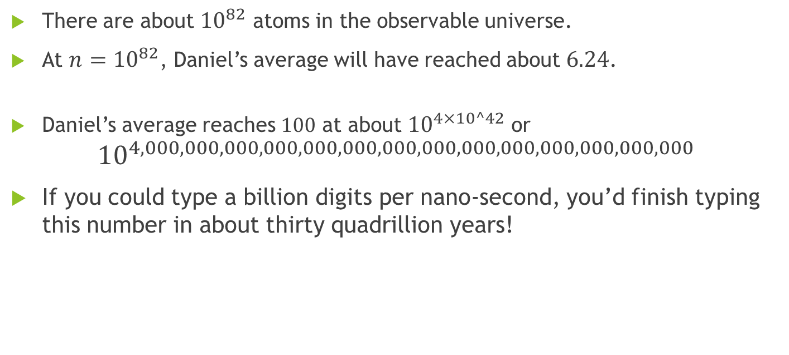
How big is that?
There are about ${10}^{82}$ atoms in the observable universe.
At $n={10}^{82}$, Daniel’s average will have reached about $6.24$.
Daniel’s average reaches $100$ at about ${10}^{4×10^42}$ or ${10}^{4,000,000,000,000,000,000,000,000,000,000,000,000,000,000}$
If you could type a billion digits per nano-second, you’d finish typing this number in about thirty quadrillion years!

Slide 43

This just in! (From perplexity.ai)
For distinct prime factors,…
Hardy-Ramanujan Theorem: “The average number of distinct prime factors for numbers up to $N$ is approximately $\log{\log{N}}$.” (Natural logs).
“On the order of…”, “tracks with…”?

Slide 44
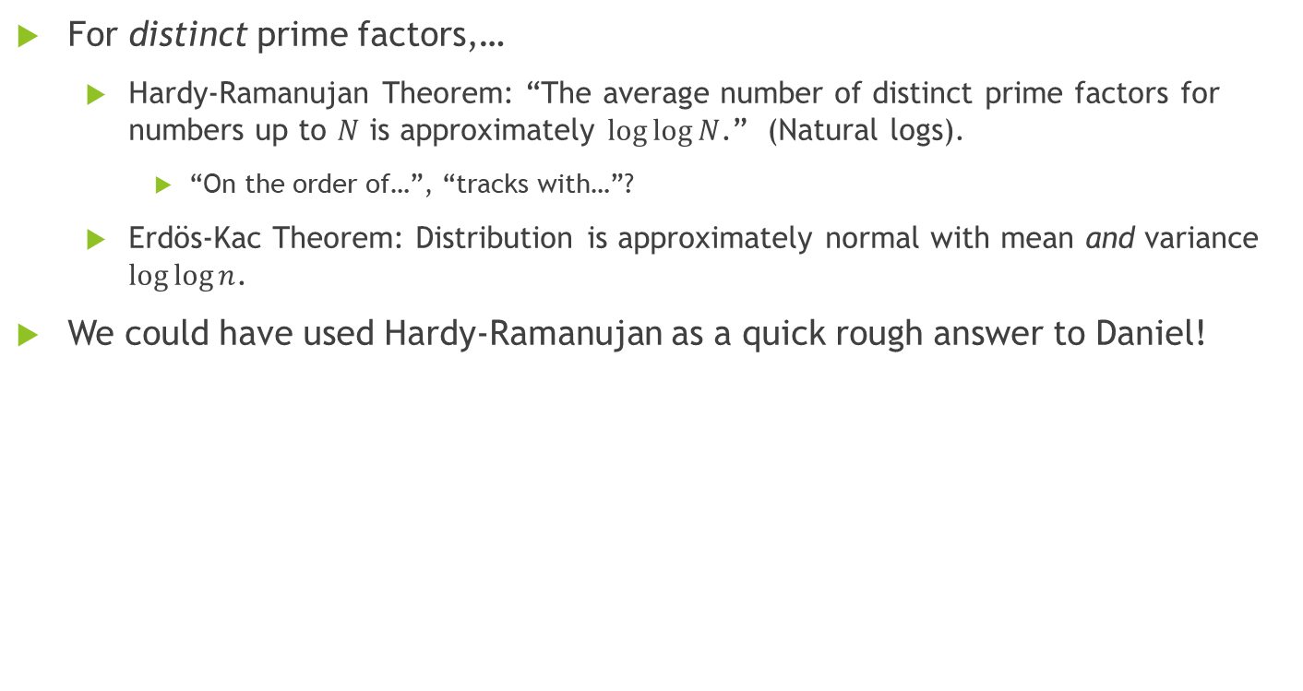
This just in! (From perplexity.ai)
For distinct prime factors,…
Hardy-Ramanujan Theorem: “The average number of distinct prime factors for numbers up to $N$ is approximately $\log{\log{N}}$.” (Natural logs).
“On the order of…”, “tracks with…”?
Erdös-Kac Theorem: Distribution is approximately normal with mean and variance $\log{\log{n}}$.
We could have used Hardy-Ramanujan as a quick rough answer to Daniel!

Slide 45
Hardy-Ramanujan – distinct primes

