Slide 1
Golden Mean
Problem 11651

Slide 2

Problem 11651 – American Mathematical Monthly, June/July 2012
Show that the equation $\left\lfloor \frac{n+1}{φ}\right\rfloor =n−\left\lfloor \frac{\left\lfloor \frac{n}{φ}\right\rfloor }{φ}\right\rfloor +\left\lfloor \frac{\left\lfloor \frac{\left\lfloor \frac{n}{φ}\right\rfloor }{φ}\right\rfloor }{φ}\right\rfloor −⋯$ holds for all natural numbers $n$ if and only if $φ=\frac{1+\sqrt{5}}{2}$, aka “The Golden Mean”.

Slide 3

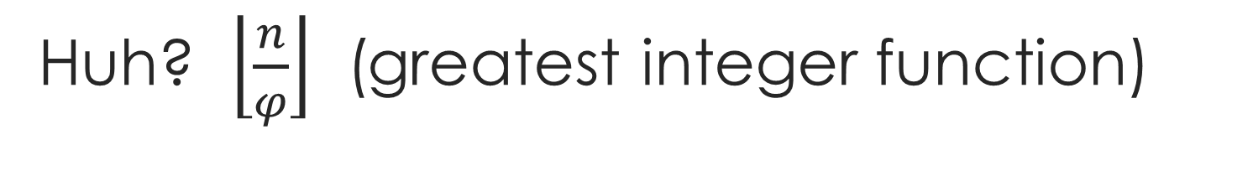
Huh? $\left\lfloor \frac{n}{φ}\right\rfloor$ (greatest integer function)
$\left\lfloor x\right\rfloor$ is the greatest integer less than or equal to $x$.
So $\left\lfloor 2\right\rfloor =2$, $\left\lfloor π\right\rfloor =3$, $\left\lfloor −2.2\right\rfloor =−3$, and so on.
$\left\lfloor \frac{5}{3}\right\rfloor =1$, $\left\lfloor \frac{23}{5}\right\rfloor =4$, and so on.
$\left\lfloor \frac{\left\lfloor \frac{23}{3}\right\rfloor }{3}\right\rfloor =\left\lfloor \frac{7}{3}\right\rfloor =2$.

Slide 4
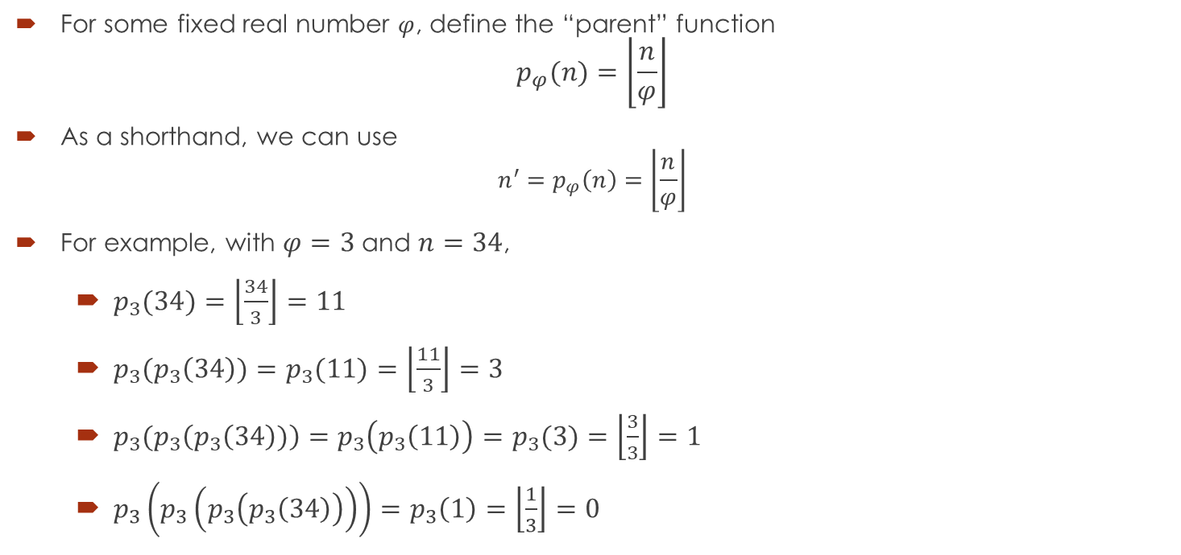

Notation for sanity: $n^{′}=p_{φ}(n)=\left\lfloor \frac{n}{φ}\right\rfloor$
For some fixed real number $φ$, define the “parent” function $p_{φ}(n)=\left\lfloor \frac{n}{φ}\right\rfloor$
As a shorthand, we can use $n^{′}=p_{φ}\left(n\right)=\left\lfloor \frac{n}{φ}\right\rfloor$
For example, with $φ=3$ and $n=34$,
$p_{3}(34)=\left\lfloor \frac{34}{3}\right\rfloor =11$
$p_{3}(p_{3}\left(34\right))=p_{3}(11)=\left\lfloor \frac{11}{3}\right\rfloor =3$
$p_{3}(p_{3}\left(p_{3}\left(34\right))\right)=p_{3}\left(p_{3}\left(11\right)\right)=p_{3}(3)=\left\lfloor \frac{3}{3}\right\rfloor =1$
$p_{3}\left(p_{3}\left(p_{3}\left(p_{3}\left(34\right)\right)\right)\right)=p_{3}\left(1\right)=\left\lfloor \frac{1}{3}\right\rfloor =0$

Slide 5
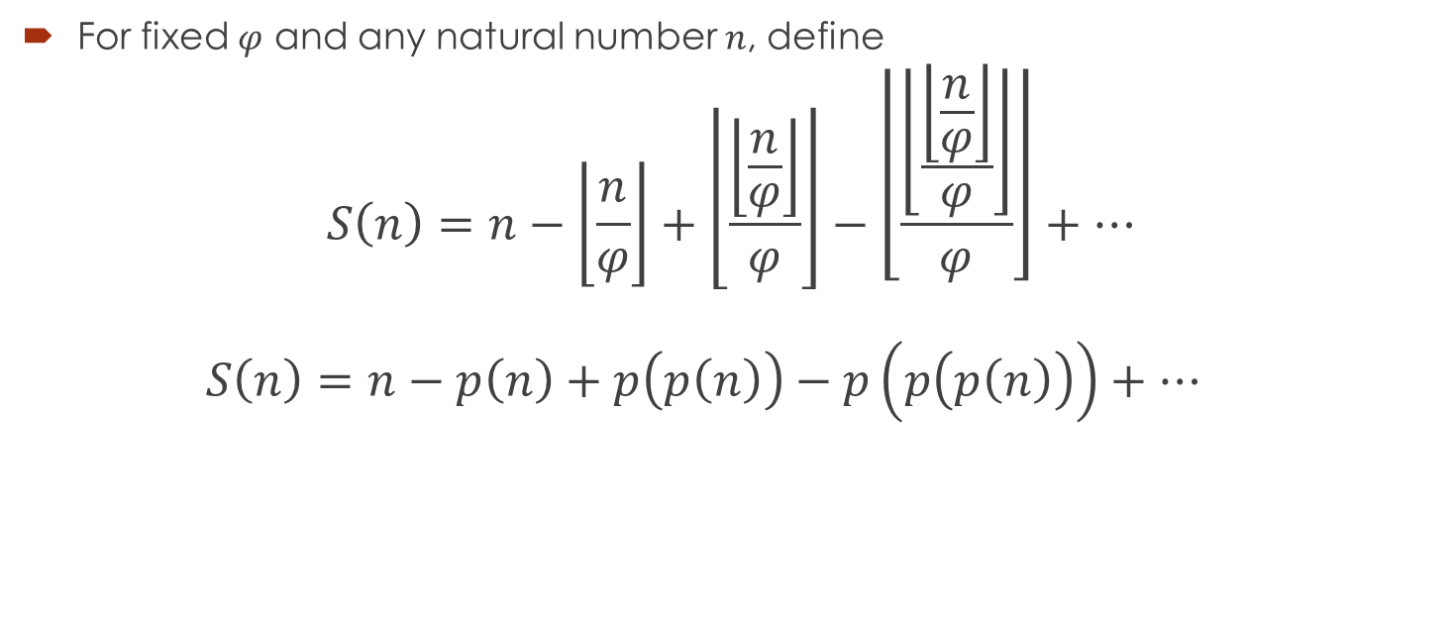
Basics – the sum
For fixed $φ$ and any natural number $n$, define $S\left(n\right)=n−\left\lfloor \frac{n}{φ}\right\rfloor +\left\lfloor \frac{\left\lfloor \frac{n}{φ}\right\rfloor }{φ}\right\rfloor −\left\lfloor \frac{\left\lfloor \frac{\left\lfloor \frac{n}{φ}\right\rfloor }{φ}\right\rfloor }{φ}\right\rfloor +⋯$ $S\left(n\right)=n−p\left(n\right)+p\left(p\left(n\right)\right)−p\left(p\left(p\left(n\right)\right)\right)+⋯$

Slide 6
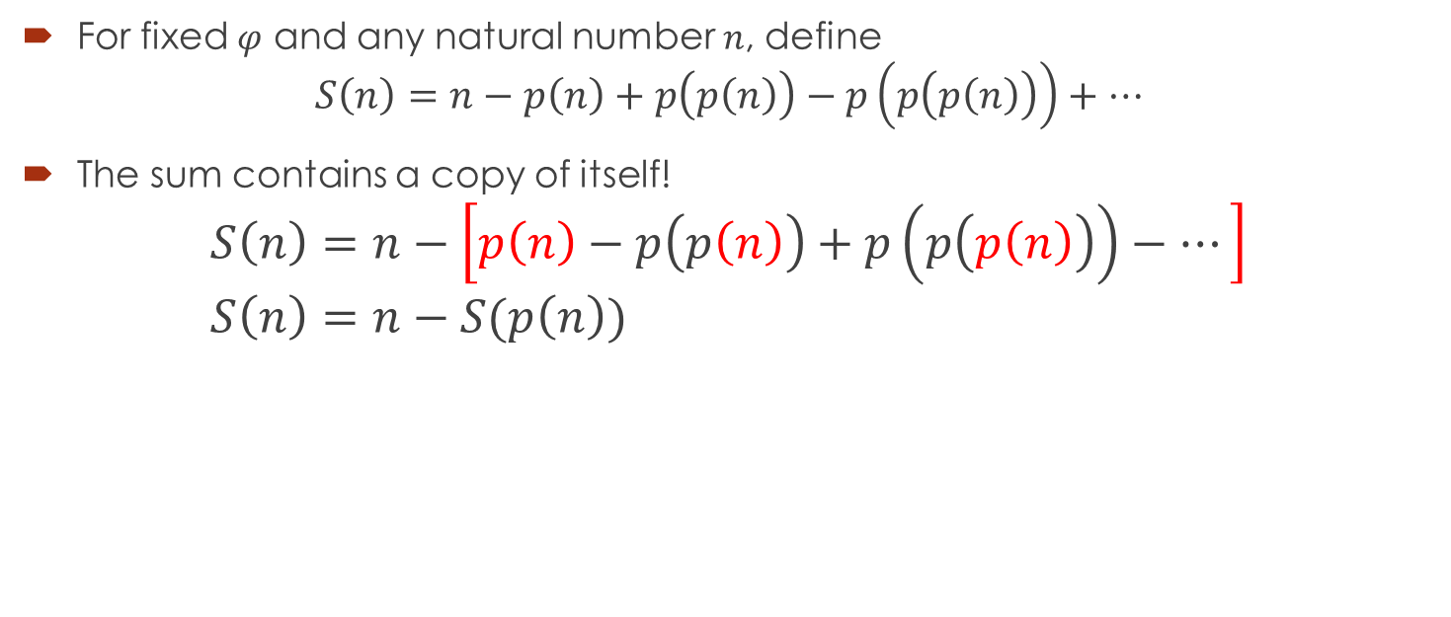
Profound observation #1
For fixed $φ$ and any natural number $n$, define $S\left(n\right)=n−p\left(n\right)+p\left(p\left(n\right)\right)−p\left(p\left(p\left(n\right)\right)\right)+⋯$
The sum contains a copy of itself! $S\left(n\right)=n−\left[p\left(n\right)−p\left(p\left(n\right)\right)+p\left(p\left(p\left(n\right)\right)\right)−⋯\right]$ $S\left(n\right)=n−S(p\left(n\right))$

Slide 7


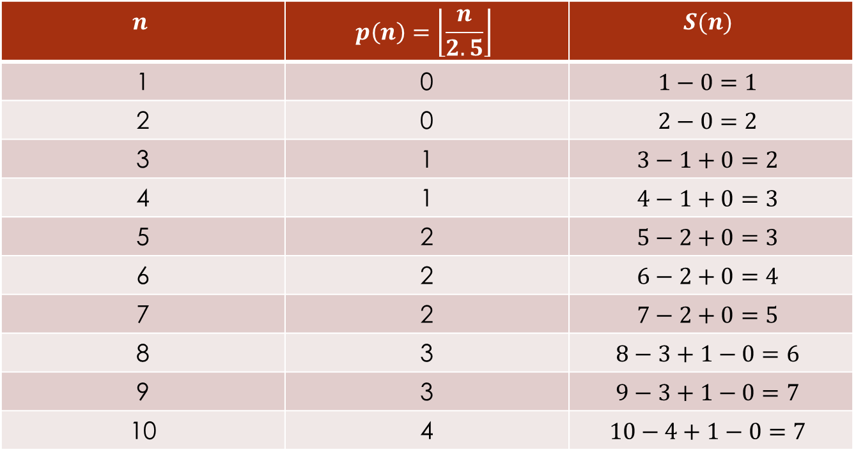
Comparing $p\left(n+1\right)$ and $S(n)$
Try $φ=2.5$. No particular relation between $p(n+1)$ and $S(n)$
$$n$$ | $$p\left(n\right)=\left\lfloor \frac{n}{2.5}\right\rfloor$$ | $$S(n)$$
1 | 0 | $$1−0=1$$
2 | 0 | $$2−0=2$$
3 | 1 | $$3−1+0=2$$
4 | 1 | $$4−1+0=3$$
5 | 2 | $$5−2+0=3$$
6 | 2 | $$6−2+0=4$$
7 | 2 | $$7−2+0=5$$
8 | 3 | $$8−3+1−0=6$$
9 | 3 | $$9−3+1−0=7$$
10 | 4 | $$10−4+1−0=7$$

Slide 8


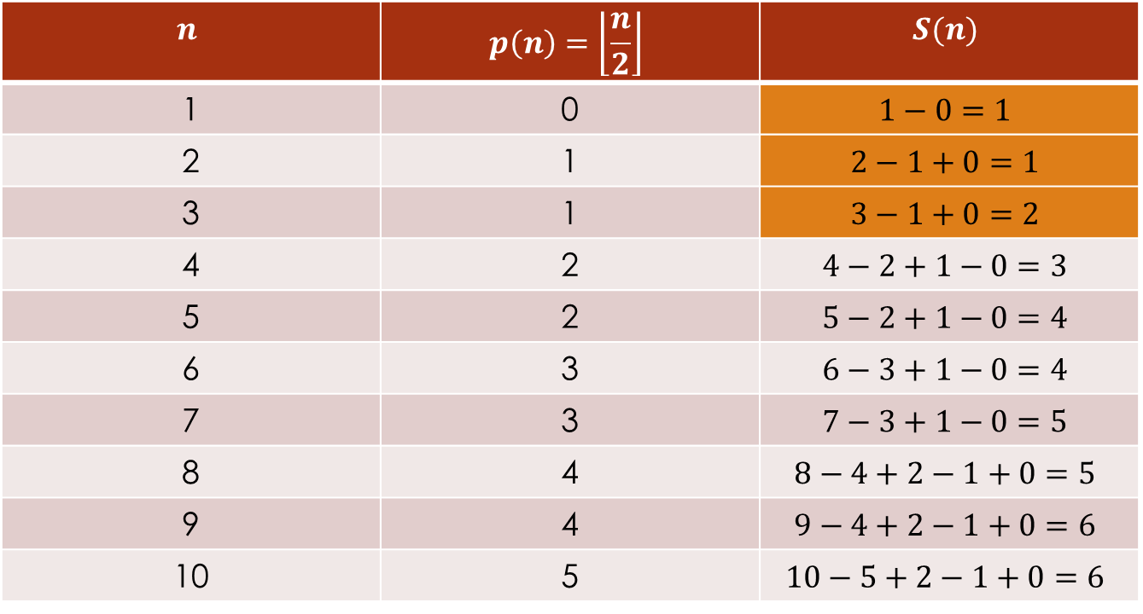
The goal: $p\left(n+1\right)=S(n)$
Try $φ=2$.
$$n$$ | $$p\left(n\right)=\left\lfloor \frac{n}{2}\right\rfloor$$ | $$S(n)$$
1 | 0 | $$1−0=1$$
2 | 1 | $$2−1+0=1$$
3 | 1 | $$3−1+0=2$$
4 | 2 | $$4−2+1−0=3$$
5 | 2 | $$5−2+1−0=4$$
6 | 3 | $$6−3+1−0=4$$
7 | 3 | $$7−3+1−0=5$$
8 | 4 | $$8−4+2−1+0=5$$
9 | 4 | $$9−4+2−1+0=6$$
10 | 5 | $$10−5+2−1+0=6$$

Slide 9

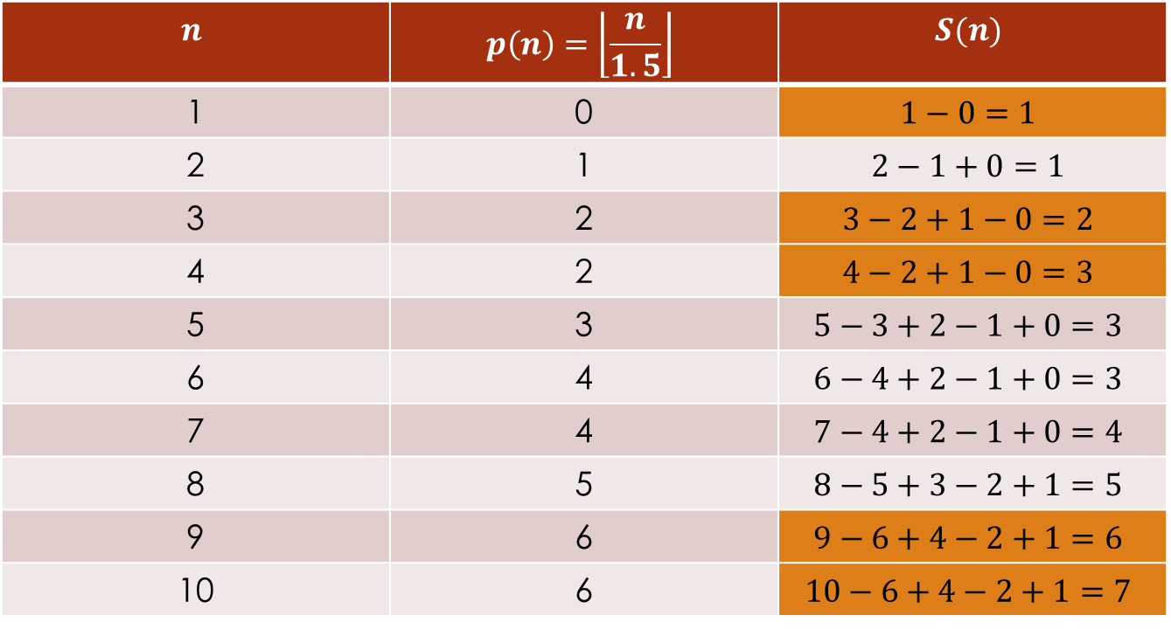
The goal: $p\left(n+1\right)=S(n)$
Try $φ=1.5$.
$$n$$ | $$p\left(n\right)=\left\lfloor \frac{n}{1.5}\right\rfloor$$ | $$S(n)$$
1 | 0 | $$1−0=1$$
2 | 1 | $$2−1+0=1$$
3 | 2 | $$3−2+1−0=2$$
4 | 2 | $$4−2+1−0=3$$
5 | 3 | $$5−3+2−1+0=3$$
6 | 4 | $$6−4+2−1+0=3$$
7 | 4 | $$7−4+2−1+0=4$$
8 | 5 | $$8−5+3−2+1=5$$
9 | 6 | $$9−6+4−2+1=6$$
10 | 6 | $$10−6+4−2+1=7$$

Slide 10

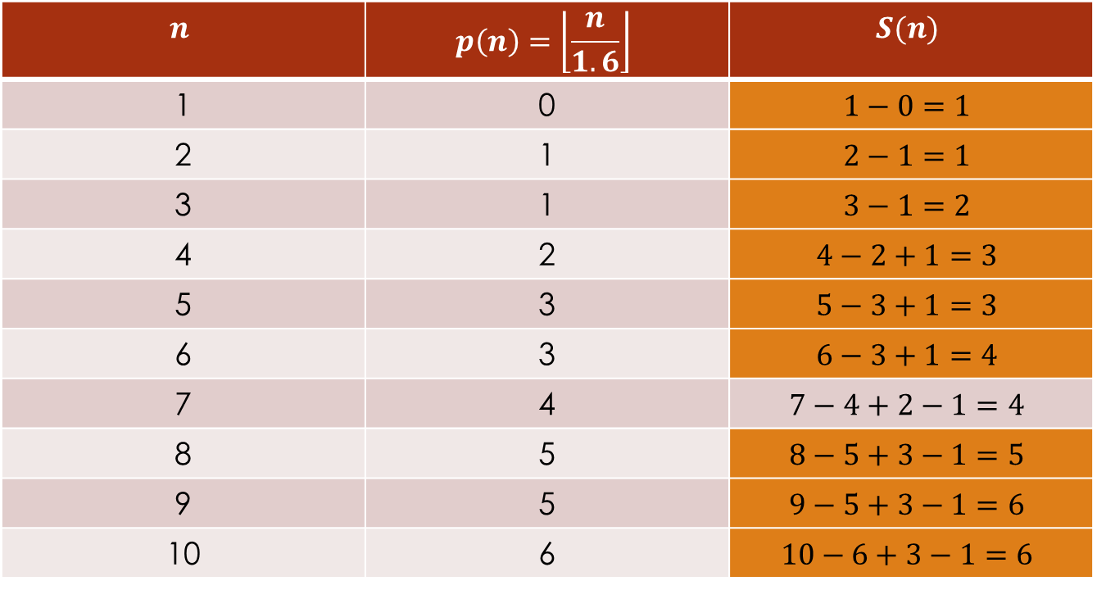
The goal: $p\left(n+1\right)=S(n)$
Finally, try $φ=1.6$.
$$n$$ | $$p\left(n\right)=\left\lfloor \frac{n}{1.6}\right\rfloor$$ | $$S(n)$$
1 | 0 | $$1−0=1$$
2 | 1 | $$2−1=1$$
3 | 1 | $$3−1=2$$
4 | 2 | $$4−2+1=3$$
5 | 3 | $$5−3+1=3$$
6 | 3 | $$6−3+1=4$$
7 | 4 | $$7−4+2−1=4$$
8 | 5 | $$8−5+3−1=5$$
9 | 5 | $$9−5+3−1=6$$
10 | 6 | $$10−6+3−1=6$$

Slide 11
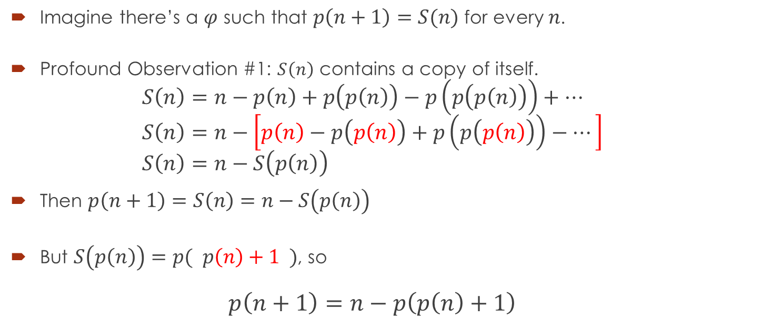
Suppose it worked all the time…
Imagine there’s a $φ$ such that $p\left(n+1\right)=S(n)$ for every $n$.
Profound Observation #1: $S\left(n\right)$ contains a copy of itself. $S\left(n\right)=n−p\left(n\right)+p\left(p\left(n\right)\right)−p\left(p\left(p\left(n\right)\right)\right)+⋯$ $S\left(n\right)=n−\left[p\left(n\right)−p\left(p\left(n\right)\right)+p\left(p\left(p\left(n\right)\right)\right)−⋯\right]$ $S\left(n\right)=n−S\left(p\left(n\right)\right)$
Then $p\left(n+1\right)=S\left(n\right)=n−S\left(p\left(n\right)\right)$
But $S\left(p\left(n\right)\right)=p( p\left(n\right)+1 )$, so $p\left(n+1\right)=n−p\left(p\left(n\right)+1\right)$

Slide 12

Profound observation #2
If we can find $p(1)$, we don’t need $φ$!!!!
Assume $φ>0$. (Should be provable.)
If $φ≤1$, then $S(n)$ won’t converge.
So it’s safe to assume $φ>1$.
In that case, $p\left(1\right)=\left\lfloor \frac{1}{φ}\right\rfloor =0$, and we’re off!!

Slide 13
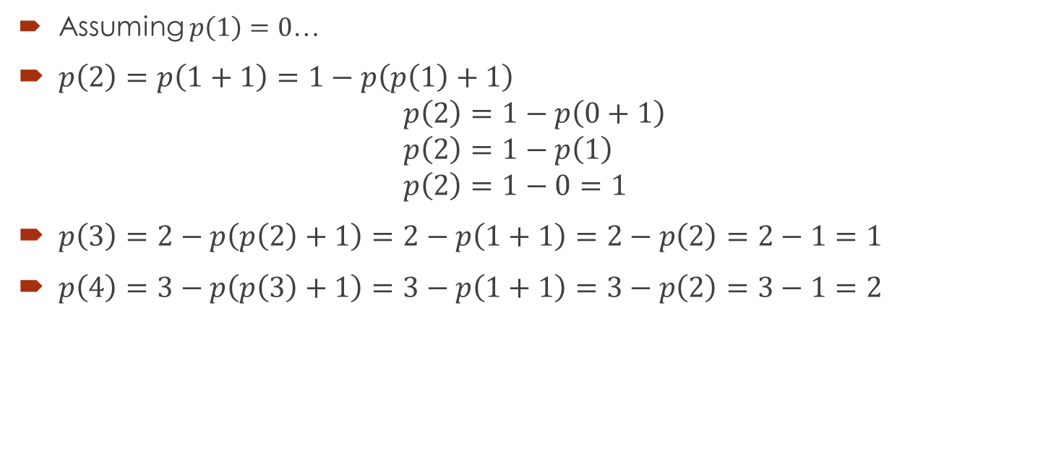

Building the rest… $$p\left(n+1\right)=n−p(p\left(n\right)+1)$$
Assuming $p\left(1\right)=0$…
$p\left(2\right)=p\left(1+1\right)=1−p\left(p\left(1\right)+1\right)$ $p\left(2\right)=1−p\left(0+1\right)$ $p\left(2\right)=1−p\left(1\right)$ $p\left(2\right)=1−0=1$
$p\left(3\right)=2−p\left(p\left(2\right)+1\right)=2−p\left(1+1\right)=2−p\left(2\right)=2−1=1$
$p\left(4\right)=3−p\left(p\left(3\right)+1\right)=3−p\left(1+1\right)=3−p\left(2\right)=3−1=2$

Slide 14
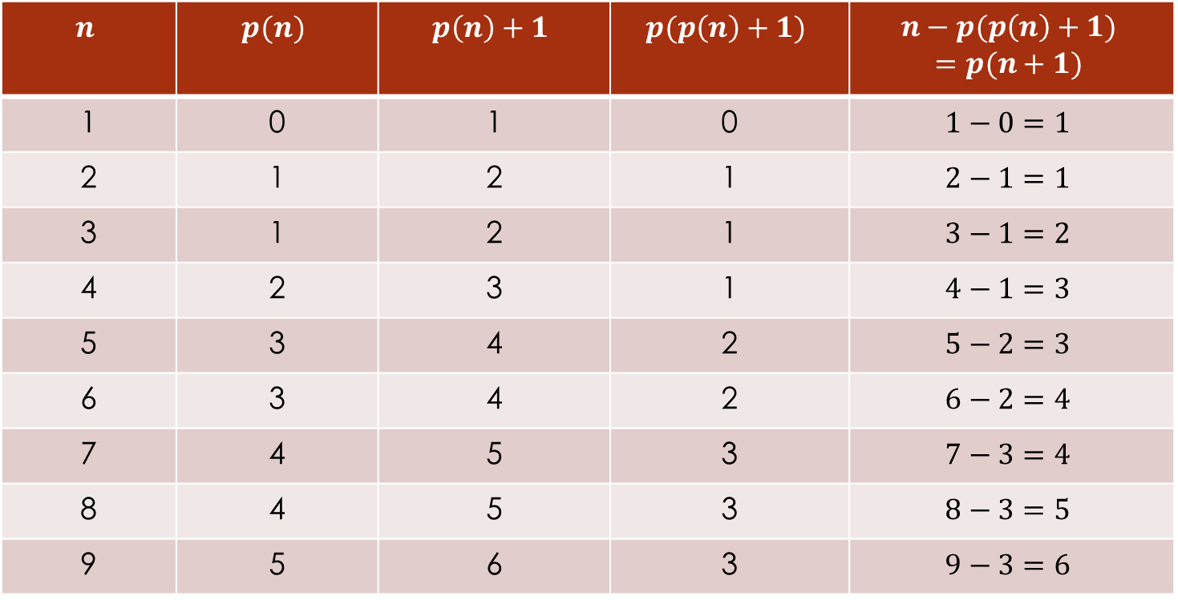

Table of values – assumes $φ>1$
$$n$$ | $$p(n)$$ | $$p\left(n\right)+1$$ | $$p(p\left(n\right)+1)$$ | $$n−p(p\left(n\right)+1)$$ $$=p(n+1)$$
1 | 0 | 1 | 0 | $$1−0=1$$
2 | 1 | 2 | 1 | $$2−1=1$$
3 | 1 | 2 | 1 | $$3−1=2$$
4 | 2 | 3 | 1 | $$4−1=3$$
5 | 3 | 4 | 2 | $$5−2=3$$
6 | 3 | 4 | 2 | $$6−2=4$$
7 | 4 | 5 | 3 | $$7−3=4$$
8 | 4 | 5 | 3 | $$8−3=5$$
9 | 5 | 6 | 3 | $$9−3=6$$

Slide 15
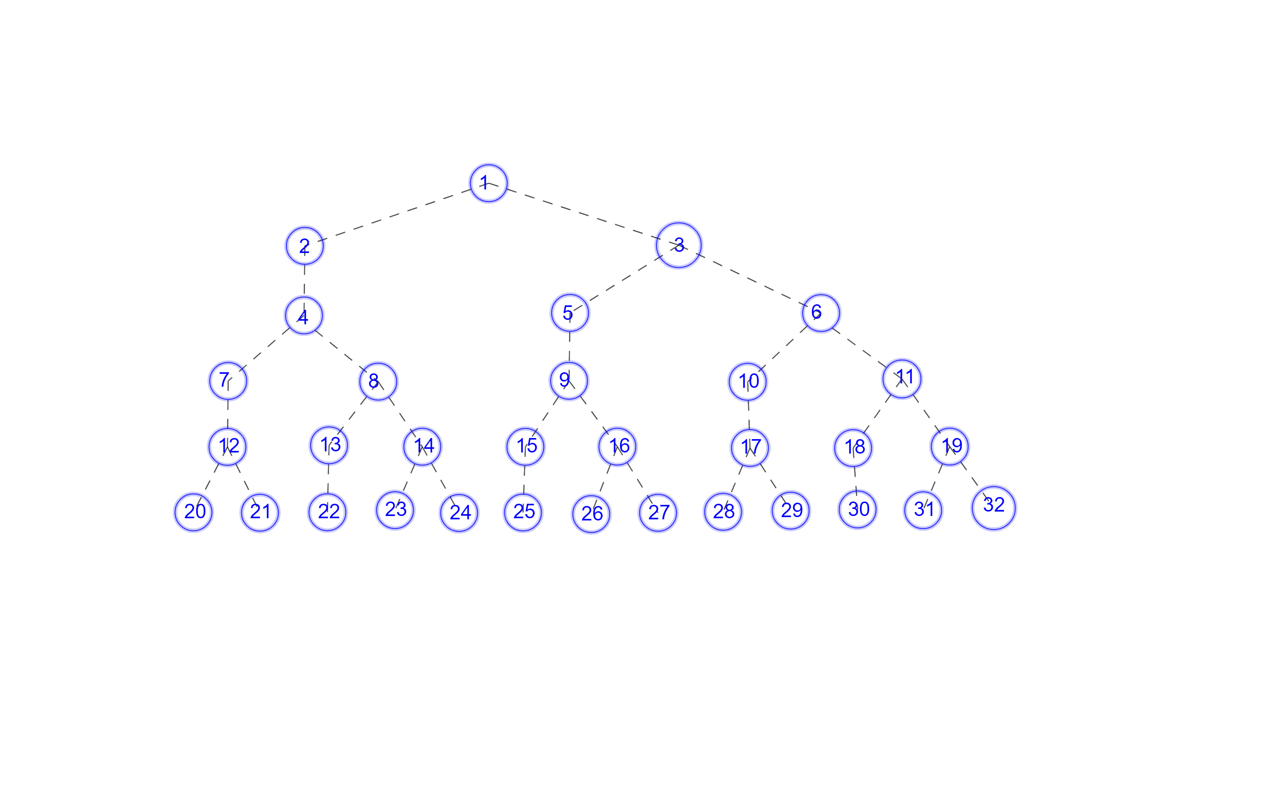
Painting a picture

Slide 16
Observations (Profound?!)
Every parent node has one or two children.
Left-hand children only have one child. Right-hand children and single children have two children.
Profound Observation #3: I don’t even need to do the calculations. I can build the table from the single-double children pattern!!

Slide 17
Fibonacci??
Profound observation (number whatever): The number of entries in each row follows the Fibonacci sequence!!
The left side of the tree produces a new copy of the tree.
The right side of the tree is a copy of the tree.
So row 3 is a copy of row 1 plus a copy of row 2, and so on.

Slide 18
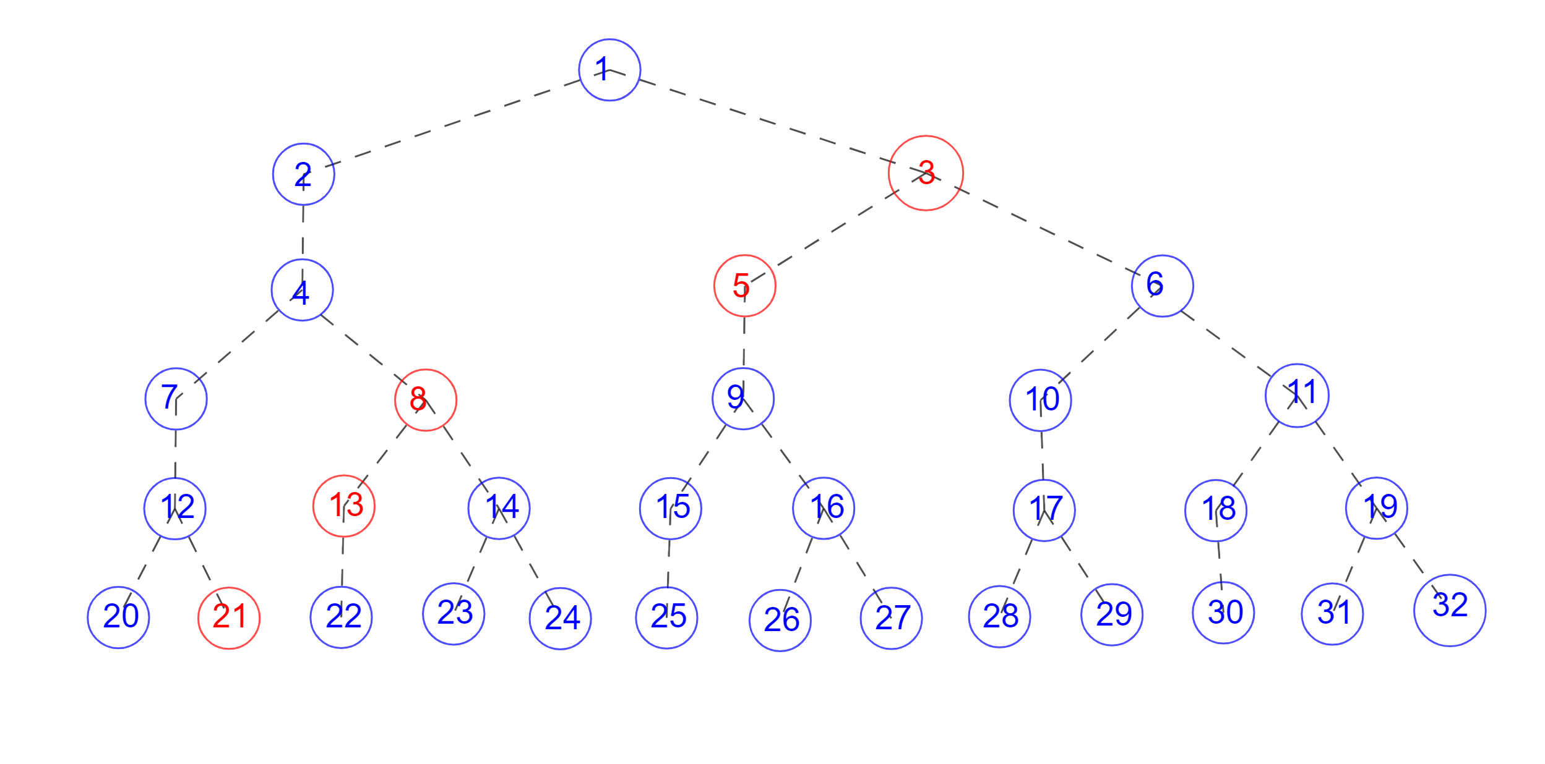
Fibonacci!!
Yet another profound observation: The second entries in the rows follow the Fibonacci sequence!!!!

Slide 19

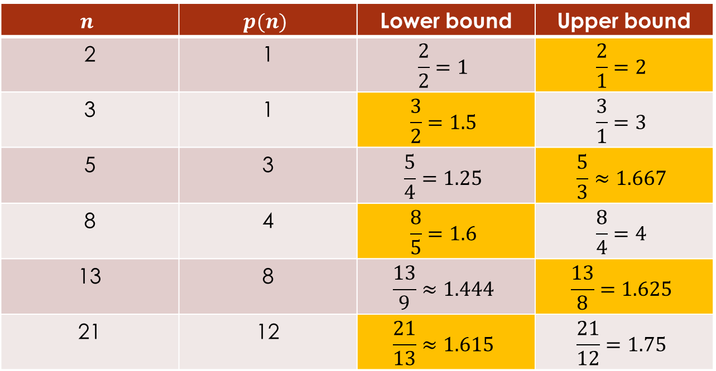
The Golden Mean
If $p\left(n\right)=\left\lfloor \frac{n}{φ}\right\rfloor$, then $p\left(n\right)≤\frac{n}{φ}<p\left(n\right)+1$.
Fiddling a bit, we get $\frac{n}{p\left(n\right)+1}<φ≤\frac{n}{p\left(n\right)}$.
$$n$$ | $$p(n)$$ | Lower bound | Upper bound
2 | 1 | $$\frac{2}{2}=1$$ | $$\frac{2}{1}=2$$
3 | 1 | $$\frac{3}{2}=1.5$$ | $$\frac{3}{1}=3$$
5 | 3 | $$\frac{5}{4}=1.25$$ | $$\frac{5}{3}≈1.667$$
8 | 4 | $$\frac{8}{5}=1.6$$ | $$\frac{8}{4}=4$$
13 | 8 | $$\frac{13}{9}≈1.444$$ | $$\frac{13}{8}=1.625$$
21 | 12 | $$\frac{21}{13}≈1.615$$ | $$\frac{21}{12}=1.75$$

Slide 20

The Golden Mean!
So far, we have $1.615<φ≤1.625$.
In fact, $\lim_{n→∞}{\frac{F_{n+1}}{F_{n}}}=\frac{1+\sqrt{5}}{2}≈1.618034$

