Slide 1
The Broken Stick Problem

Slide 2
Problem statement
Break a stick into three pieces at random.
That is, select two points on the stick at random, then break at those points.
What’s the probability that the three pieces can form a triangle?

Slide 3
Why???
Why not!
Oldie but a goodie! Dates back to an 1854 Cambridge University exam.
Daniel Scher, https://www.sineofthetimes.org/the-broken-stick-puzzle/
Well-known and easy to understand.
Works with standard probability methods…if you’re careful!
Some very pretty graphical / geometric solutions!

Slide 4
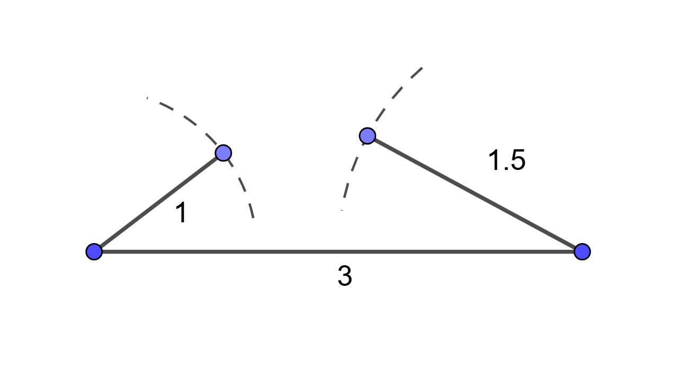

Why not 1?
Well, of course, three line segments make a triangle!
Oops, the Triangle Inequality: $a+b>c$.

Slide 5

Why not ½?
Well, then, we need the biggest piece shorter than one-half the stick length.
So why isn’t it 50-50? Either the biggest piece is less than a half or it isn’t.
The biggest piece varies between $\frac{1}{3}$ and $1$.

Slide 6
When in doubt, simulate!
“How many accountants does it take to change a light bulb?”
What kind of answer were you looking for?
“The Canonical List of Light Bulb Jokes”
Monte Carlo Python
250,159 / 1,000,000 = 0.250159

Slide 7
What’s the Frequency?

Slide 8
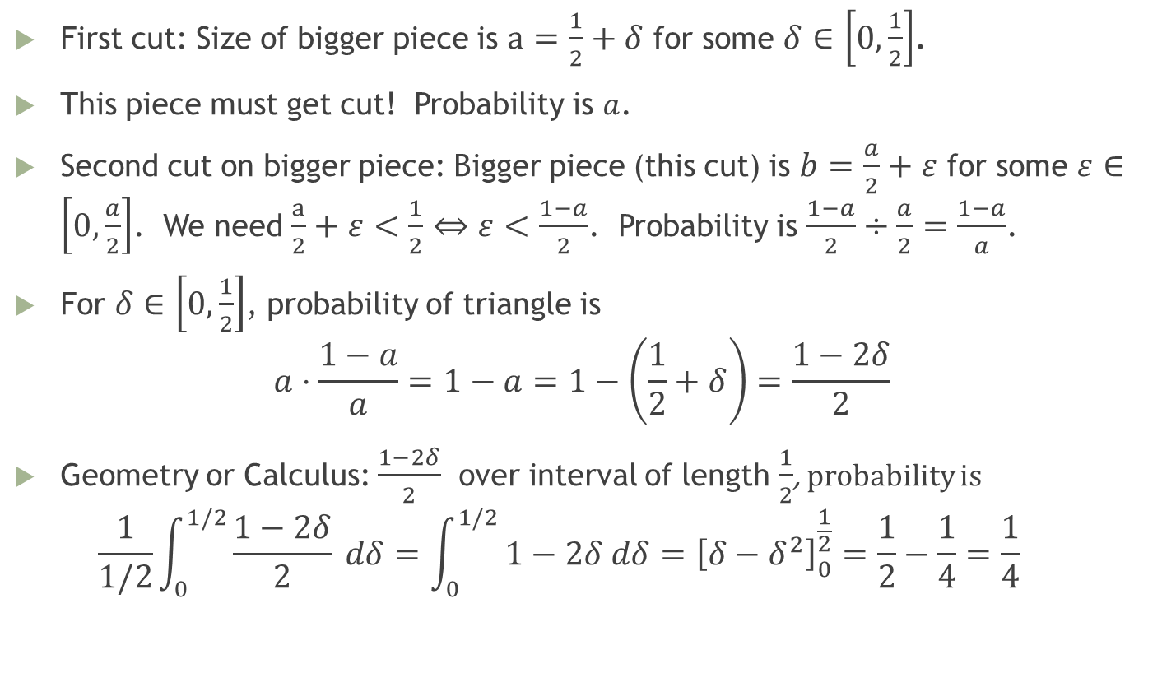
Calculus
First cut: Size of bigger piece is $a=\frac{1}{2}+δ$ for some $δ∈\left[0,\frac{1}{2}\right]$.
This piece must get cut! Probability is $a$.
Second cut on bigger piece: Bigger piece (this cut) is $b=\frac{a}{2}+ε$ for some $ε∈\left[0,\frac{a}{2}\right]$. We need $\frac{a}{2}+ε<\frac{1}{2}⇔ε<\frac{1−a}{2}$. Probability is $\frac{1−a}{2}÷\frac{a}{2}=\frac{1−a}{a}$.
For $δ∈\left[0,\frac{1}{2}\right]$, probability of triangle is $a⋅\frac{1−a}{a}=1−a=1−\left(\frac{1}{2}+δ\right)=\frac{1−2δ}{2}$
Geometry or Calculus: $\frac{1−2δ}{2}$ over interval of length $\frac{1}{2}$, probability is $\frac{1}{1/2}\int_{0}^{1/2}{\frac{1−2δ}{2} dδ}=\int_{0}^{1/2}{1−2δ dδ={\left[δ−δ^{2}\right]}_{0}^{\frac{1}{2}}=\frac{1}{2}−\frac{1}{4}=\frac{1}{4}}$

Slide 9
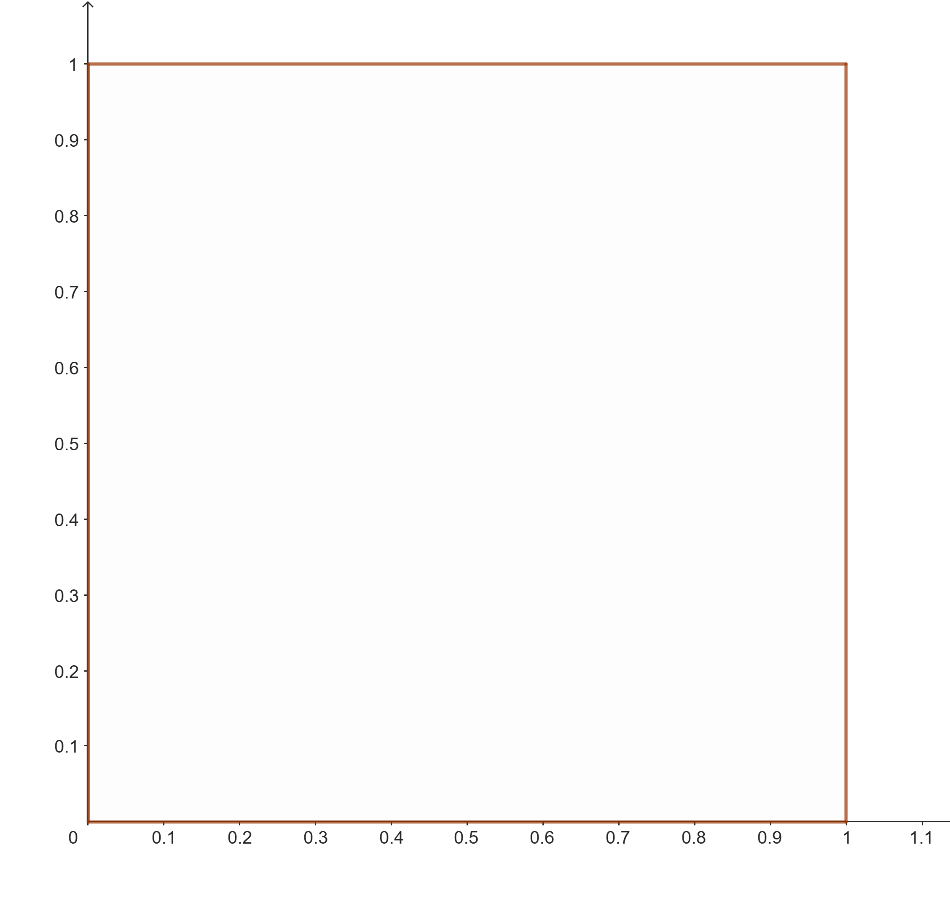
Square solution Daniel Scher, “Sine of the Times”

Slide 10
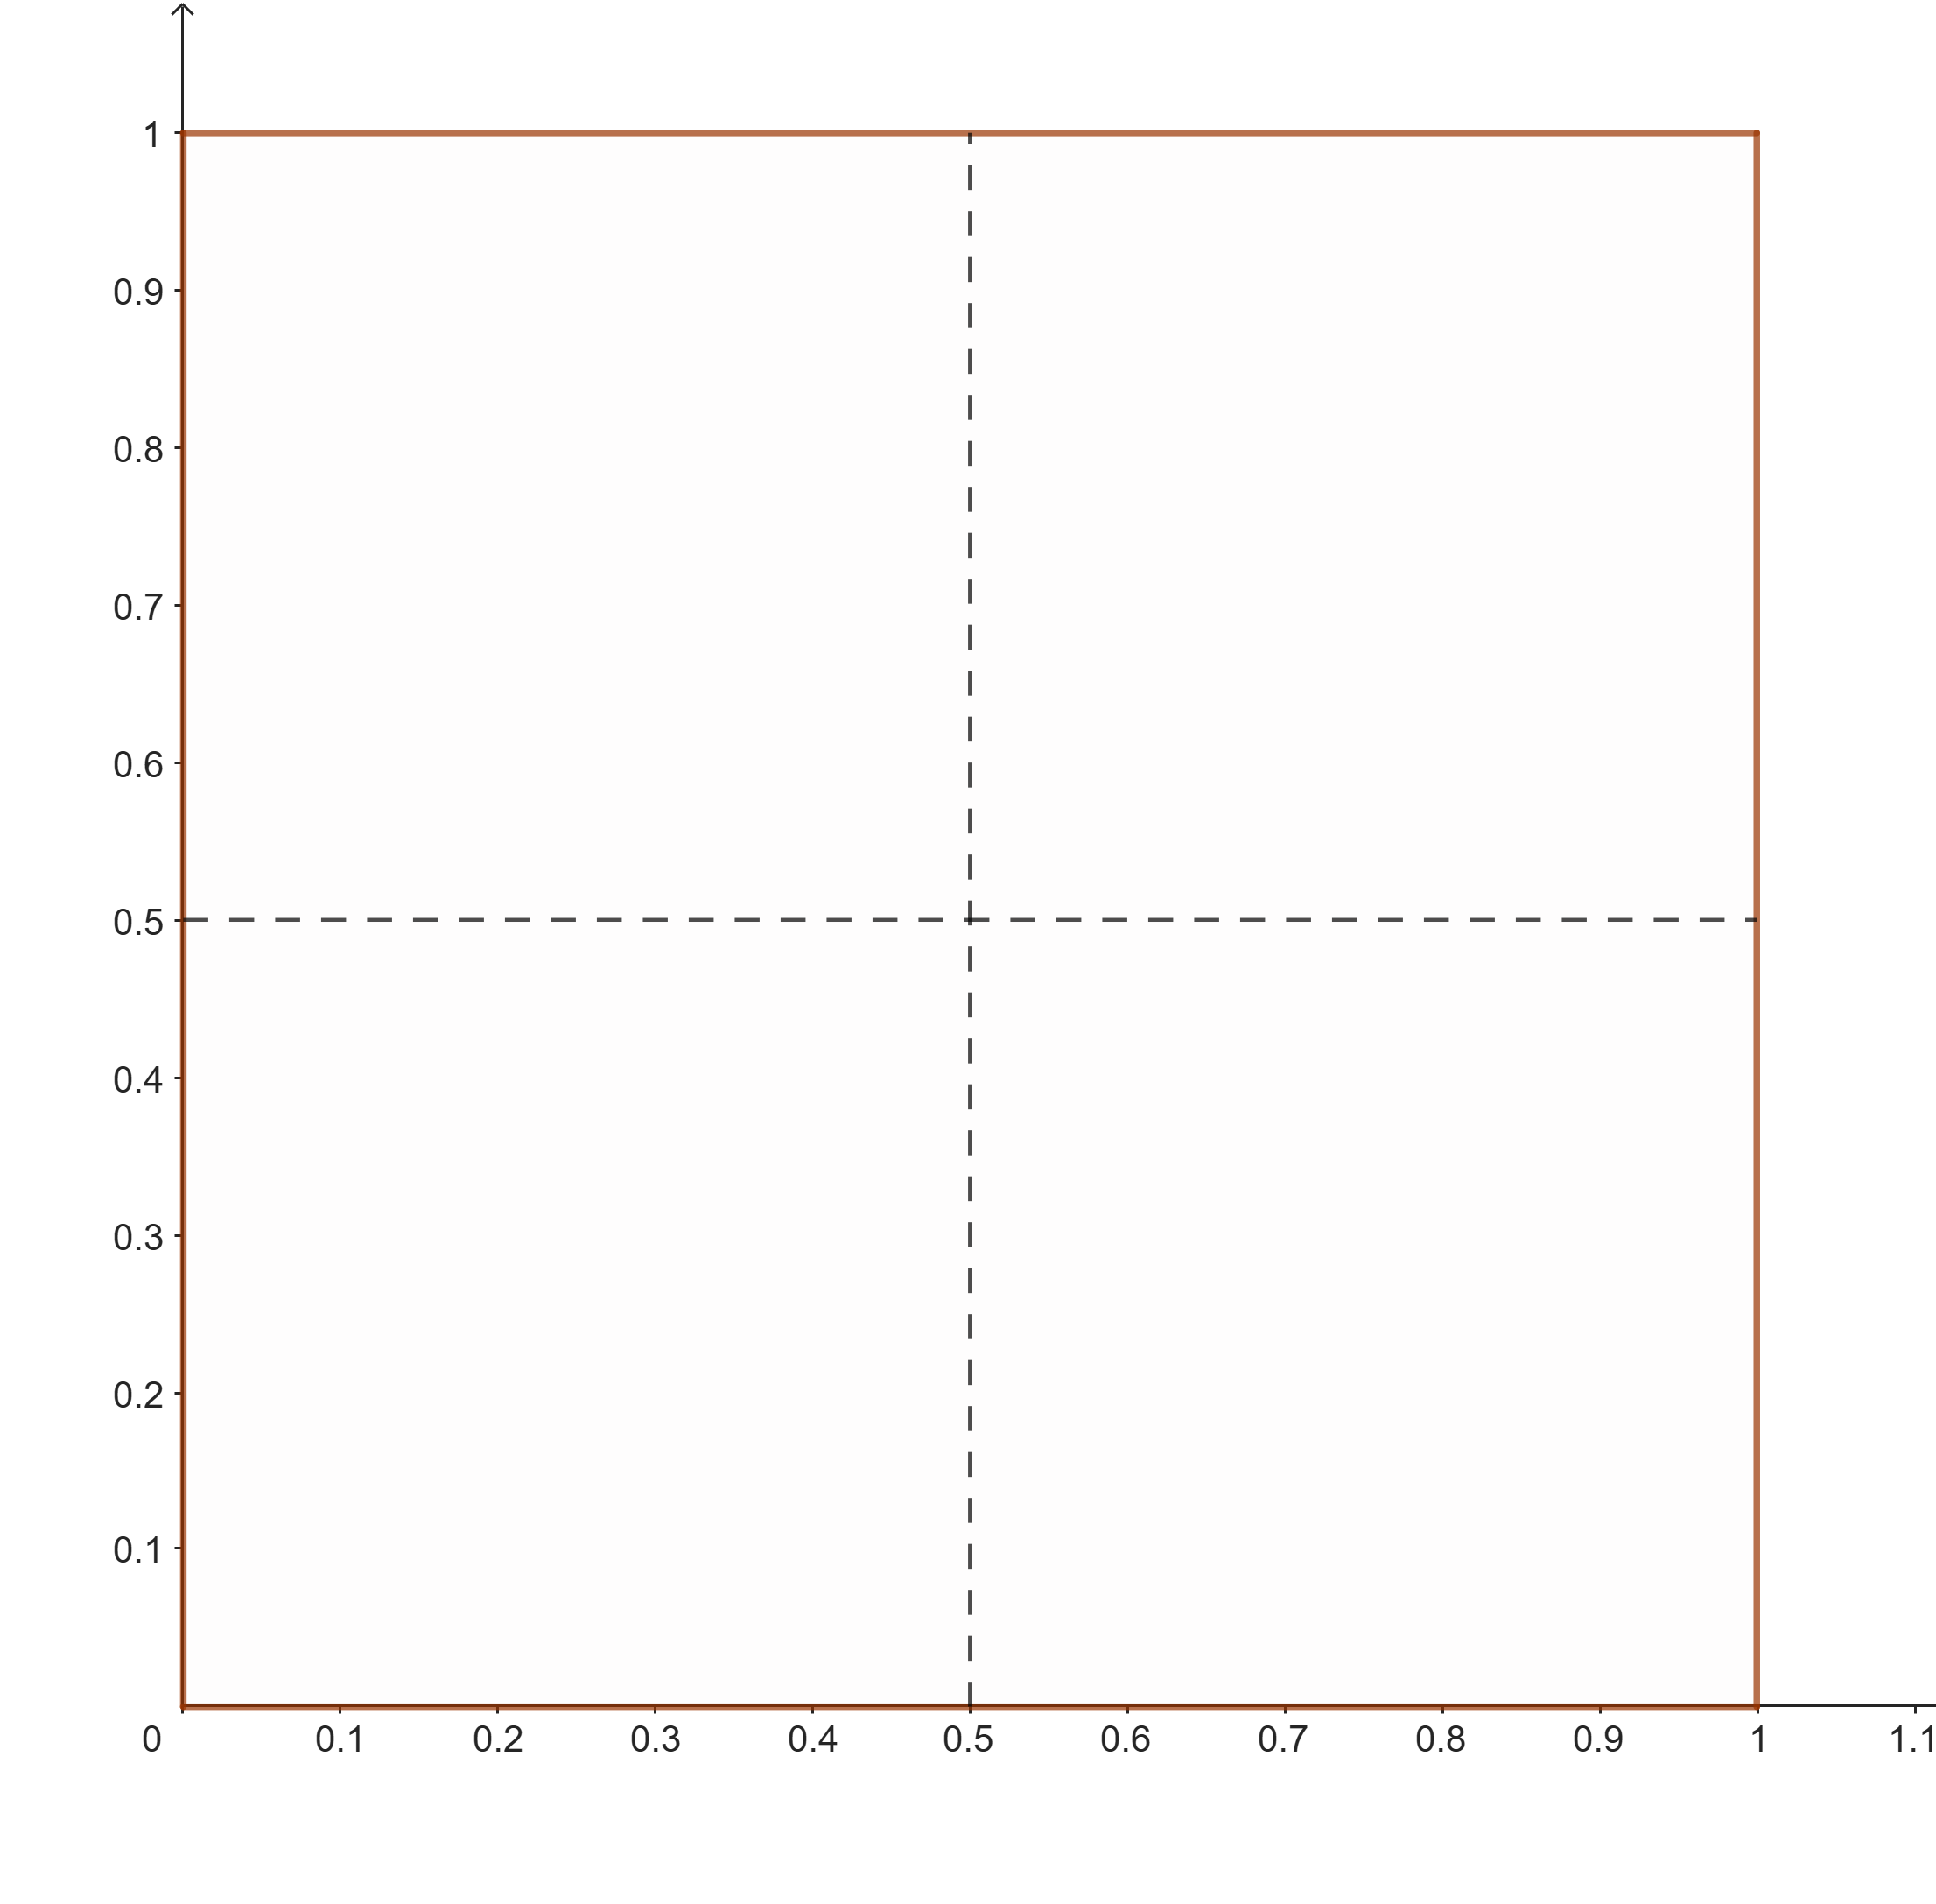
Square solution

Slide 11
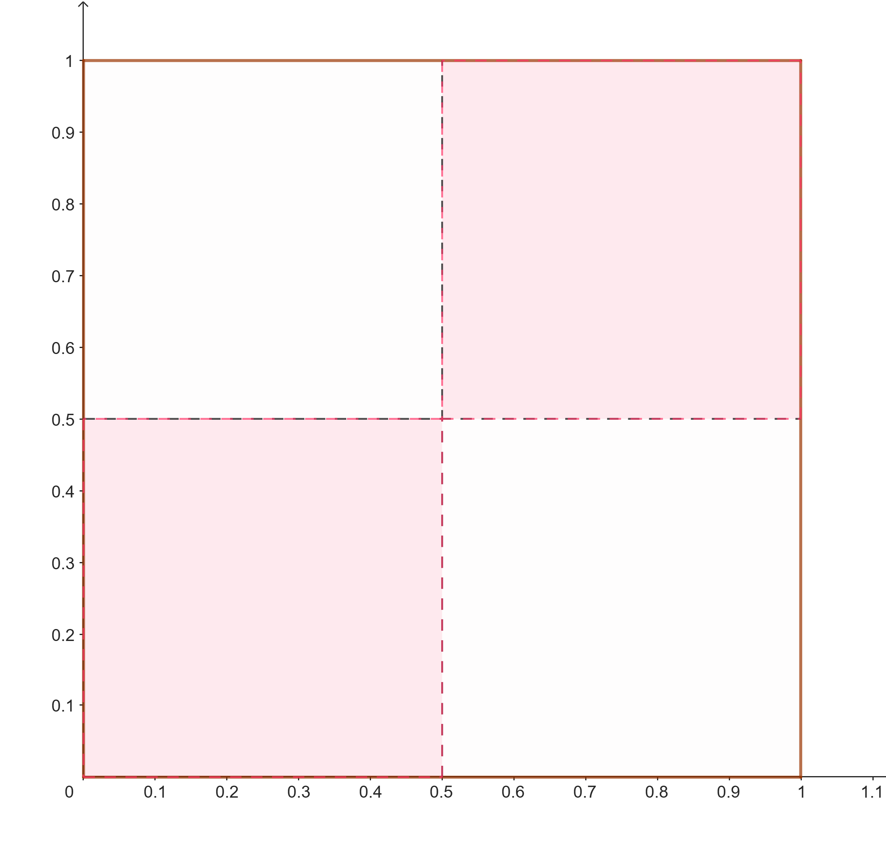
Square solution – dead corners

Slide 12
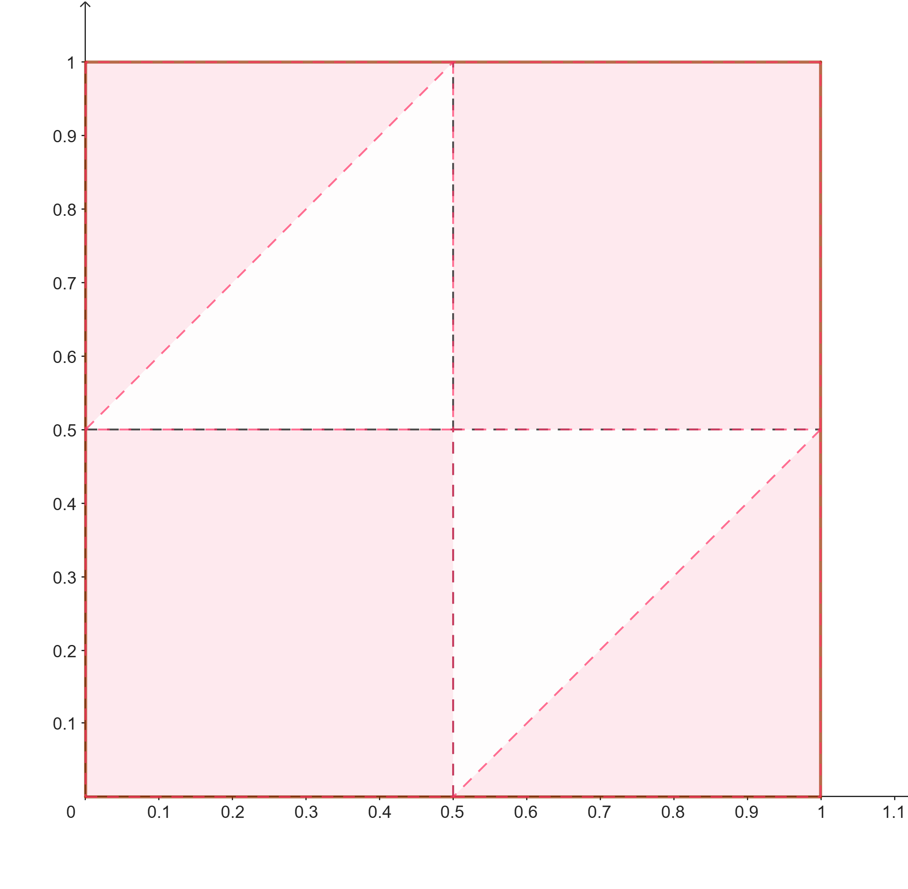
Square solution – big gaps

Slide 13
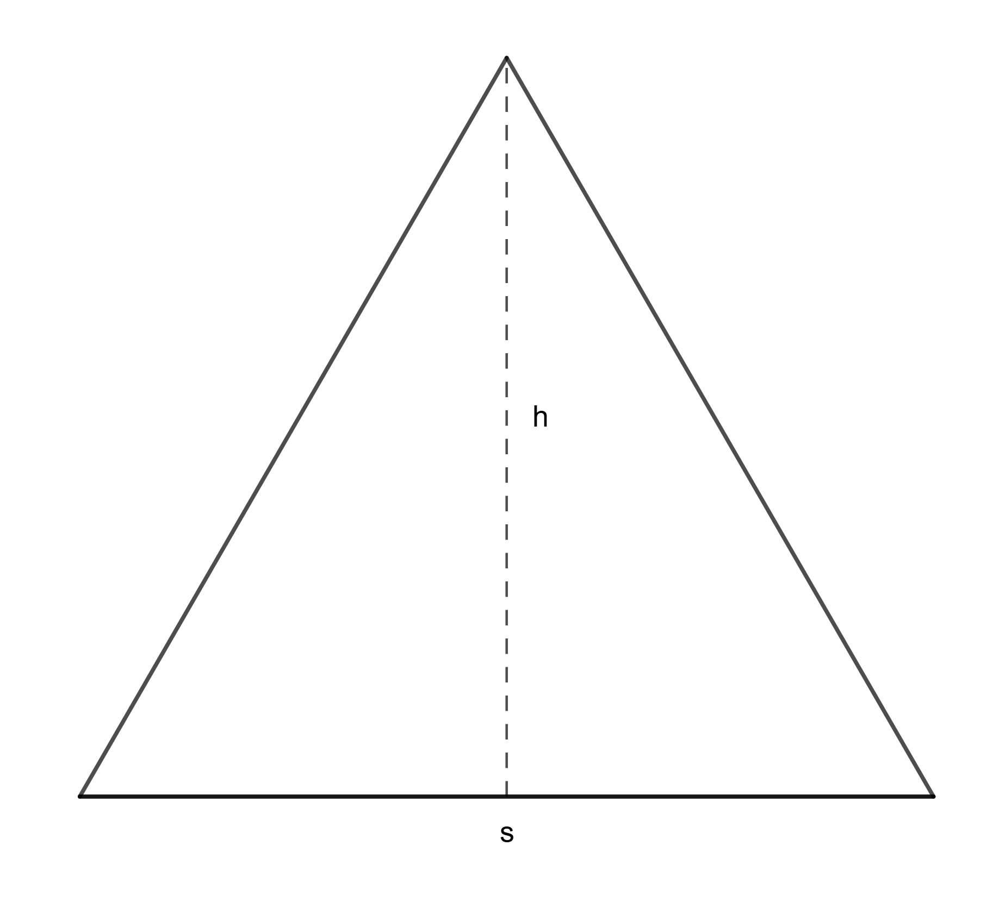

Triangle solution – Altitude Theorem
From Duke University…, part of a WebFeats II project.
Equilateral triangle with side $s$ and altitude $h$.
$Area=\frac{1}{2}sh$

Slide 14
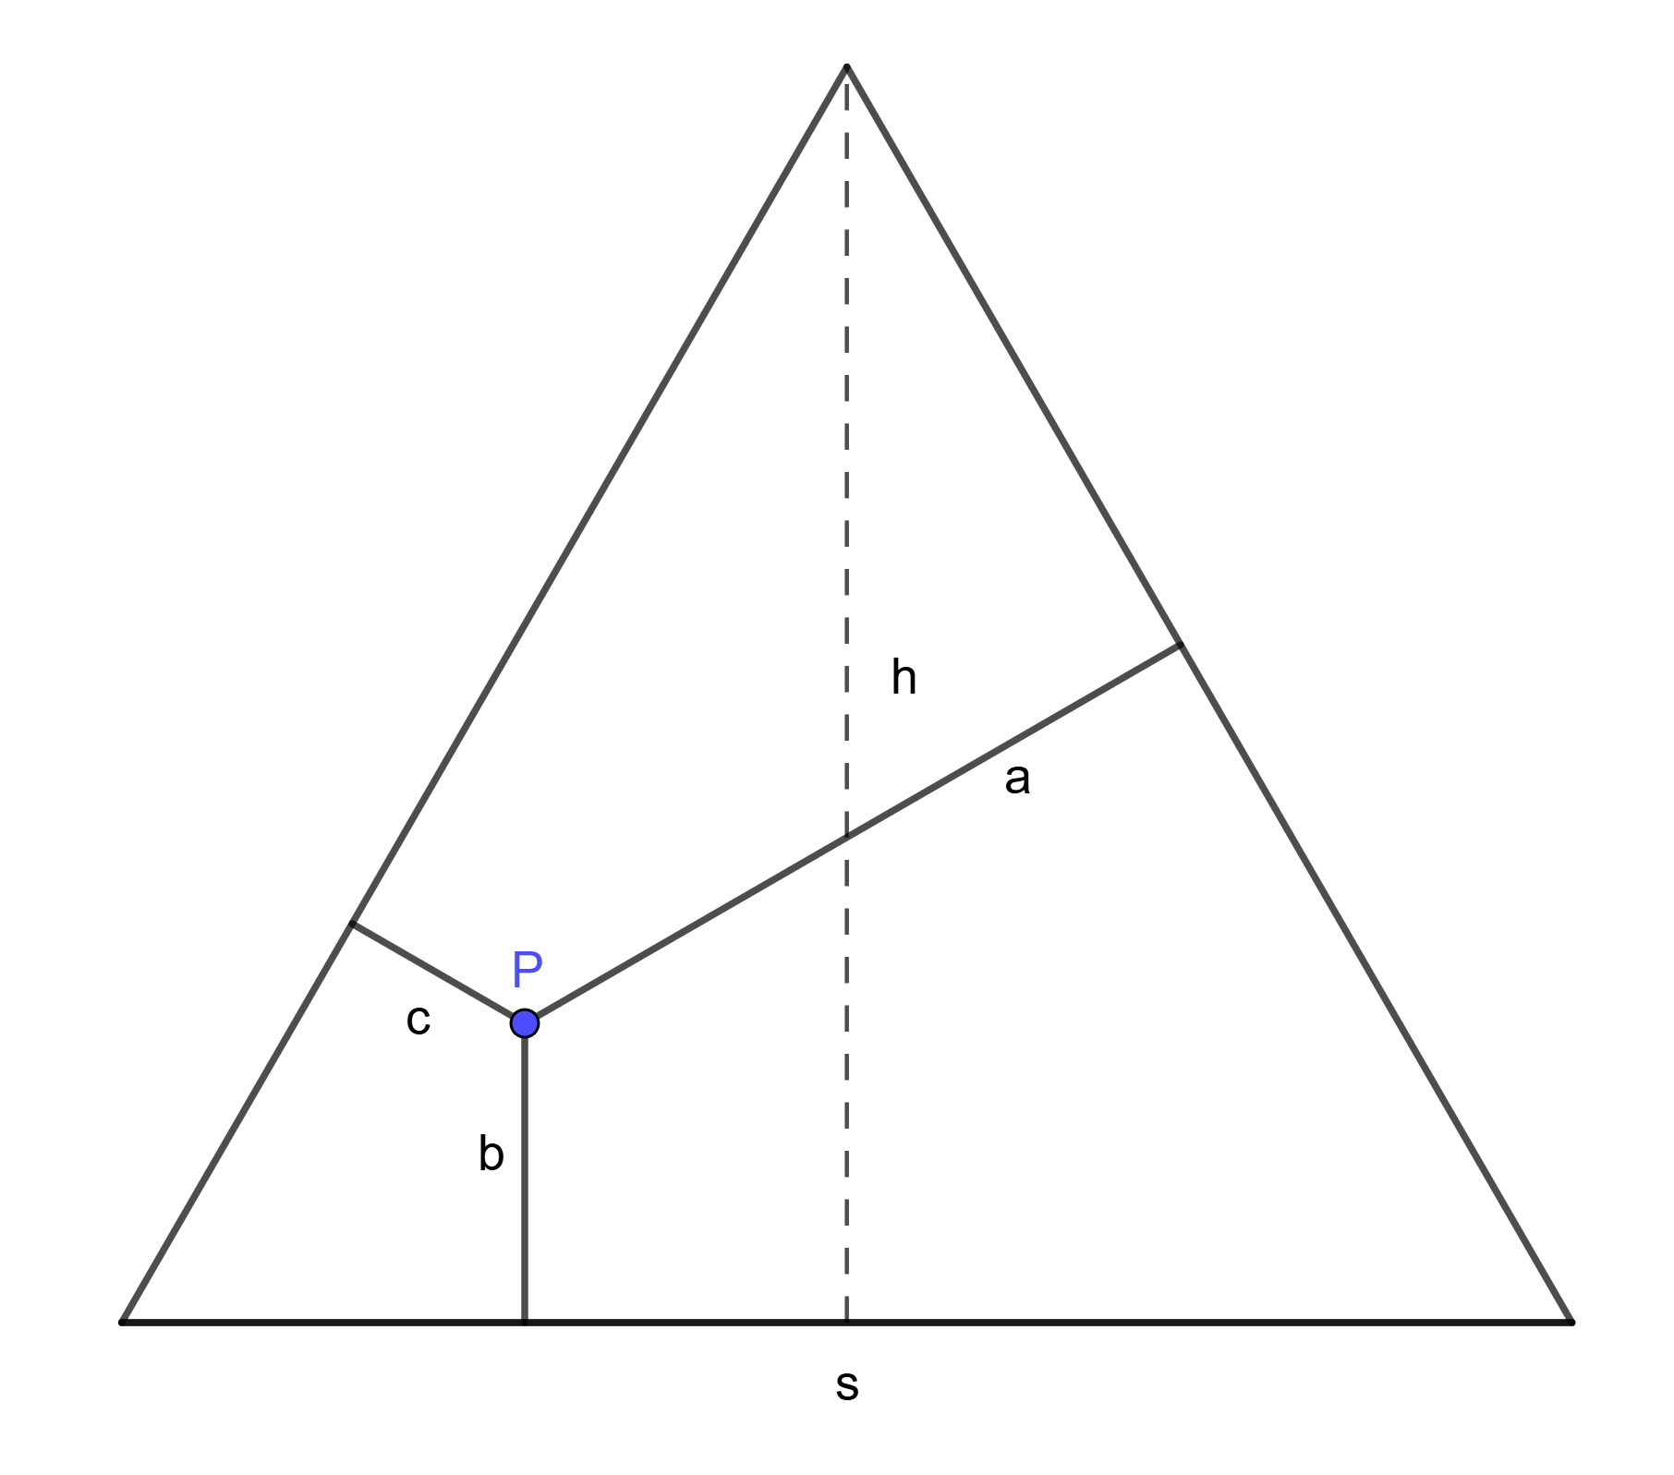

Triangle solution – Altitude Theorem
Equilateral triangle with side $s$ and altitude $h$.
$Area=\frac{1}{2}sh$
Altitudes $a,b,c$ from interior point $P$.

Slide 15
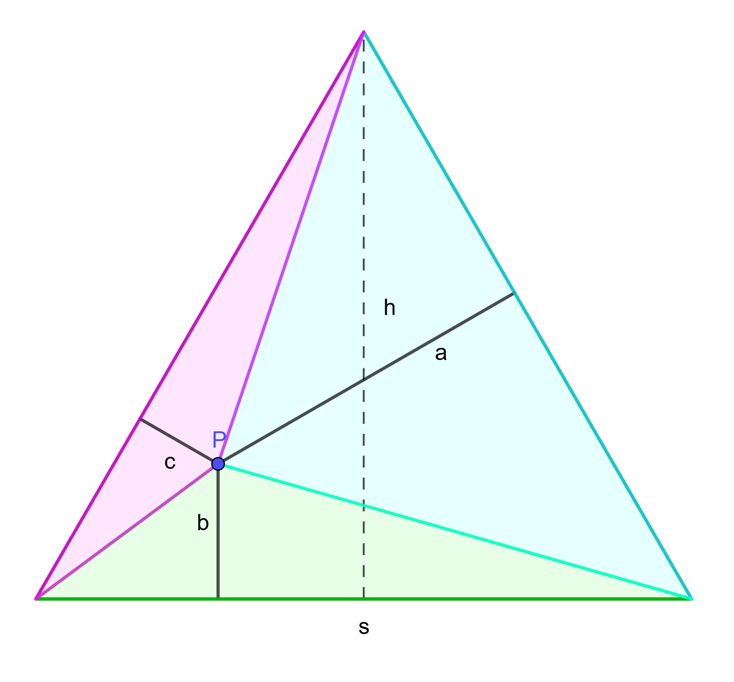
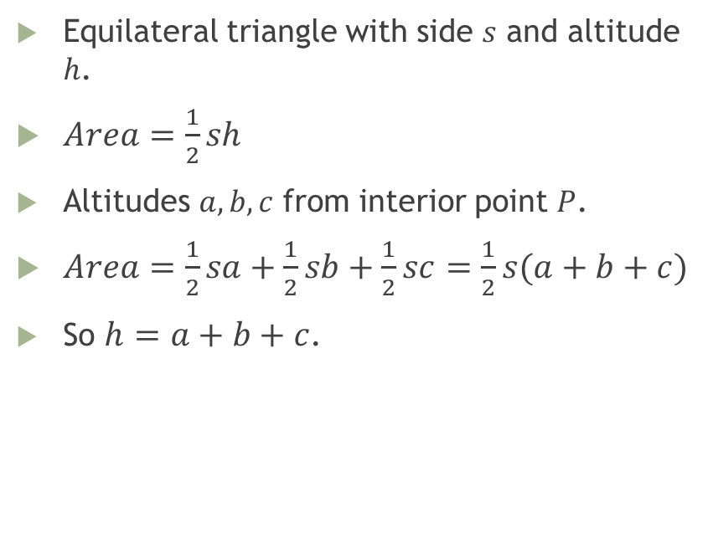
Triangle solution – Altitude Theorem
Equilateral triangle with side $s$ and altitude $h$.
$Area=\frac{1}{2}sh$
Altitudes $a,b,c$ from interior point $P$.
$Area=\frac{1}{2}sa+\frac{1}{2}sb+\frac{1}{2}sc=\frac{1}{2}s(a+b+c)$
So $h=a+b+c$.

Slide 16

Triangle solution
Each point breaks altitude $h$ into three pieces.

Slide 17
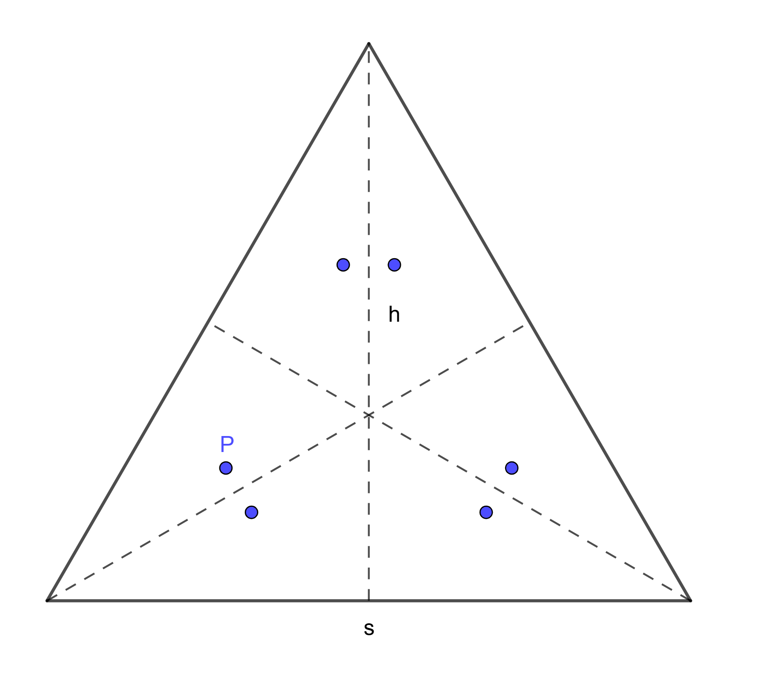

Triangle solution
Each point breaks altitude $h$ into three pieces.
In all six orderings.

Slide 18
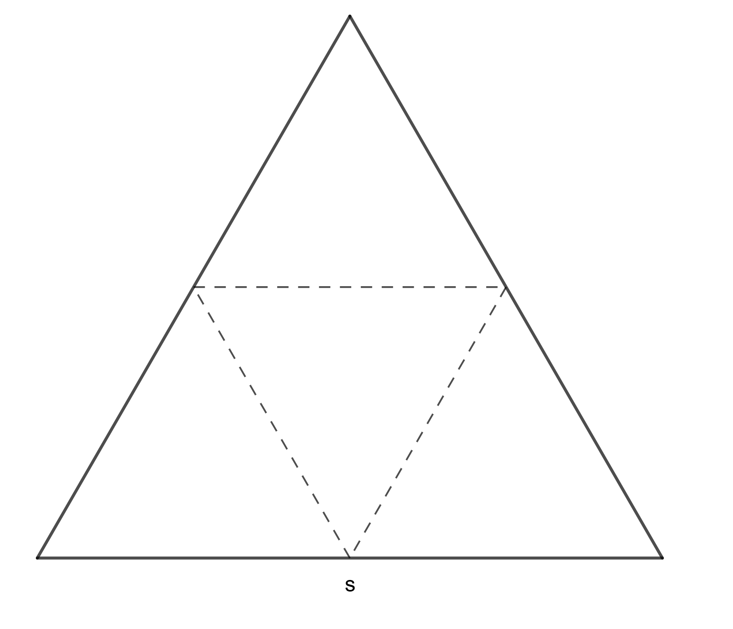
Triangle solution
Where are all pieces less than half the stick length?

Slide 19
Alternate breaking plans
Make a random first break, then a random break in the larger piece.
Make a random first break, the randomly pick one side to randomly break.

Slide 20
Extensions
More than three pieces…
Pieces = 3, 250159 / 1000000 = 0.250159
Pieces = 4, 571283 / 1000000 = 0.571283
Pieces = 5. 821464 / 1000000 = 0.821464
Pieces = 6, 946988 / 1000000 = 0.946988
Pieces = 7, 988634 / 1000000 = 0.988634
Pieces = 8, 998320 / 1000000 = 0.99832
Pieces = 9, 999832 / 1000000 = 0.999832

Slide 21
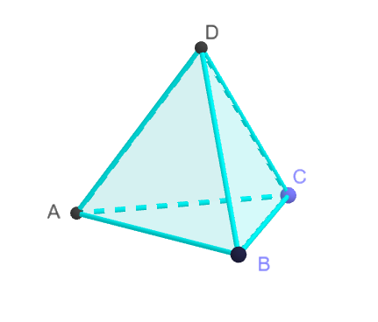
Extensions
If you break a stick into six pieces, what is the probability that the pieces can form a tetrahedron?
StackExchange re May 2015 at UIUC. Full article not found.
Answer: About 6.5%

Slide 22
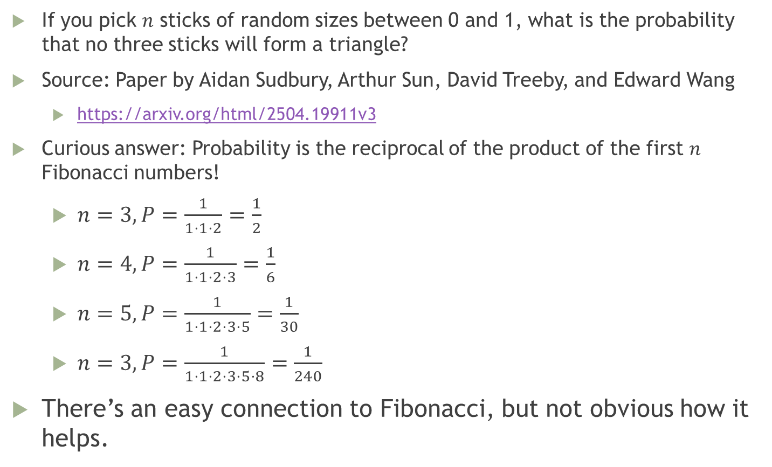
Extensions – The Fibonacci Connection
If you pick $n$ sticks of random sizes between 0 and 1, what is the probability that no three sticks will form a triangle?
Source: Paper by Aidan Sudbury, Arthur Sun, David Treeby, and Edward Wang
https://arxiv.org/html/2504.19911v3
Curious answer: Probability is the reciprocal of the product of the first $n$ Fibonacci numbers!
$n=3, P=\frac{1}{1⋅1⋅2}=\frac{1}{2}$
$n=4, P=\frac{1}{1⋅1⋅2⋅3}=\frac{1}{6}$
$n=5, P=\frac{1}{1⋅1⋅2⋅3⋅5}=\frac{1}{30}$
$n=3, P=\frac{1}{1⋅1⋅2⋅3⋅5⋅8}=\frac{1}{240}$
There’s an easy connection to Fibonacci, but not obvious how it helps.

Slide 23
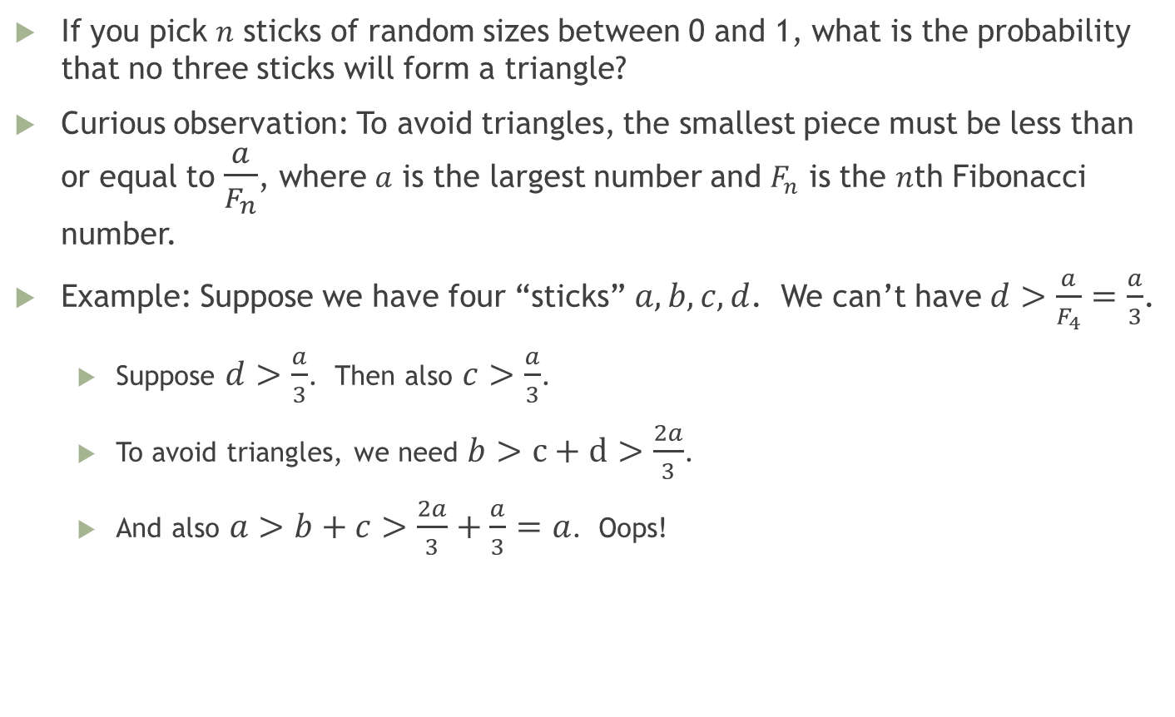
Extensions – The Fibonacci Connection
If you pick $n$ sticks of random sizes between 0 and 1, what is the probability that no three sticks will form a triangle?
Curious observation: To avoid triangles, the smallest piece must be less than or equal to $\frac{a}{F_{n}}$, where $a$ is the largest number and $F_{n}$ is the $n$th Fibonacci number.
Example: Suppose we have four “sticks” $a,b,c,d$. We can’t have $d>\frac{a}{F_{4}}=\frac{a}{3}$.
Suppose $d>\frac{a}{3}$. Then also $c>\frac{a}{3}$.
To avoid triangles, we need $b>c+d>\frac{2a}{3}$.
And also $a>b+c>\frac{2a}{3}+\frac{a}{3}=a$. Oops!

Slide 24

Extensions – The Fibonacci Connection
Unfortunately, this lovely observation doesn’t explain the complete result.
Example: Sticks $1,\frac{3}{4},\frac{1}{3},\frac{1}{10}$.
All the Fibonacci ratios work…
$\frac{1}{3}<\frac{1}{2}⋅1$
$\frac{1}{10}<\frac{1}{3}⋅1$
$\frac{1}{10}<\frac{1}{2}⋅\frac{3}{4}$
But $\frac{1}{3}+\frac{3}{4}>1$. Oh, well!

