Slide 1

The Tax Collector Problem
aka “The Tax Divisor”

Slide 2
History of the problem Original Puzzle
Puzzle by Daniel Finkel of Seattle-based “Math for Love”
New York Times, “Numberplay”, April 13, 2015

Slide 3
Problem statement
Paychecks $1 through $12.
You can take any number, but then the tax collector gets all (remaining) factors of your number.
The tax collector must always get at least one number.
Repeat until you can’t take any more numbers. Then the tax collector gets the rest.

Slide 4

Try it out, $n=12$

Slide 5
Observations…
How should I start?
How many numbers can I take?

Slide 6
Observations – the first choice

Slide 7
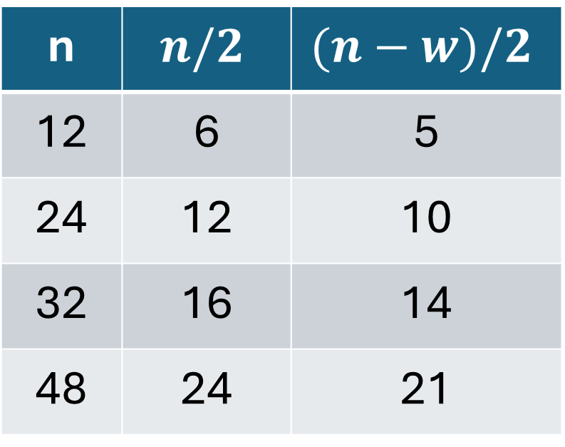

Observations – how many choices
n | $$n/2$$ | $$(n−w)/2$$
12 | 6 | 5
24 | 12 | 10
32 | 16 | 14
48 | 24 | 21
First guess: $n/2$
Second guess: $(n−waste)/2$

Slide 8
Observations – classes of numbers
Tax
Take
Take only
Tax only
Wasted
Take or Tax
1, 2, 3, 4
5, 6
7, 8, 9,
10, 11, 12

Slide 9
Classes of numbers – after taking 11
Tax
Take
Taken: 11
Taxed: 1
Wasted: 7
2, 3, 5
4, 6
8, 9,
10, 12
Waste: 7

Slide 10
Classes of numbers – after taking 11, 9
Tax
Take
Taken: 11, 9
Taxed: 1, 3
Wasted: 7
2, 5
4, 6
8,10, 12
Waste: 7

Slide 11
Observations – incompatibles
[8, 16]
[6, 10, 15]
[12, 16, 24]
[10, 14, 15, 21]

Slide 12
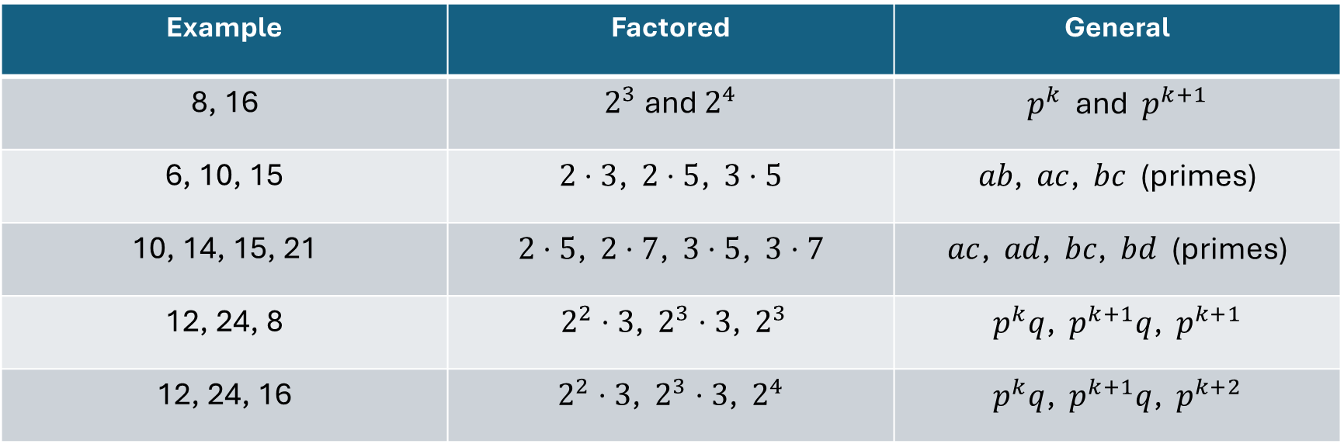
Incompatibles
Example | Factored | General
8, 16 | $2^{3}$ and $2^{4}$ | $p^{k}$ and $p^{k+1}$
6, 10, 15 | $2⋅3$, $2⋅5$, $3⋅5$ | $ab$, $ac$, $bc$ (primes)
10, 14, 15, 21 | $2⋅5$, $2⋅7$, $3⋅5$, $3⋅7$ | $ac$, $ad$, $bc$, $bd$ (primes)
12, 24, 8 | $2^{2}⋅3$, $2^{3}⋅3$, $2^{3}$ | $p^{k}q$, $p^{k+1}q$, $p^{k+1}$
12, 24, 16 | $2^{2}⋅3$, $2^{3}⋅3$, $2^{4}$ | $p^{k}q$, $p^{k+1}q$, $p^{k+2}$

Slide 13

Solving $n=24$
Getting started…
Top prime = 23
Wasted primes = 13, 17, 19
Available numbers = 21
Maximum choices = 10
Top choices = 24, 23, 22, 21, 20, 18, 16, 15, 14, 12

Slide 14
Solving $n=24$
Top choices = 24, 23, 22, 21, 20, 18, 16, 15, 14, 12
Incompatible: 12, 16, 24, so replace 12 with 10
Choices = 24, 23, 22, 21, 20, 18, 16, 15, 14, 10
Incompatible: 10, 14, 15, 21, so replace 10 with 9
Choices = 24, 23, 22, 21, 20, 18, 16, 15, 14, 9
Can it be done?

Slide 15

Solving $n=24$
Choices: 24, 23, 22, 21, 20, 18, 16, 15, 14, 9
Factors: 1, 2, 3, 4, 5, 6, 7, 8, 10, 12

Slide 16
Solving $n=24$
Choices: 24, 23, 22, 21, 20, 18, 16, 15, 14, 9
Factors: 1, 2, 3, 4, 5, 6, 7, 8, 10, 12
What we have to take:
23 (1)
9 (3) forces 15 (5) and 21 (7)
21 (7) forces 14 (2) forces 22 (11)
What’s left?
24 (12) and 20 (10)
So 18 (6) and 16 (8)
Just make sure 18 (6) comes before 24!

Slide 17
Statistics

Slide 18
Statistics
n | Best Score | % of all
12 | 50 | 64.1%
16 | 89 | 65.4%
24 | 182 | 60.7%
32 | 319 | 60.4%
36 | 442 | 66.4%
40 | 525 | 64.0%
48 | 734 | 62.4%
50 | 808 | 63.4%
54 | 935 | 63.0%
60 | 1,137 | 63.7%
70 | 1,566 | 63.0%
80 | 2,041 | 63.0%
90 | 2,552 | 62.3%
Mean (~12-90) |  | 63.2%
Std dev (~12-90) |  | 2.16%

Slide 19

Theoretically…
Let $h=\frac{n}{2}$ or $n=2h$.
Top half: $\frac{n(n+1)}{2}−\frac{h\left(h+1\right)}{2}=\frac{2h\left(2h+1\right)−h\left(h+1\right)}{2}=\frac{3h^{2}+h}{2}=\frac{3n^{2}+2n}{8}$
Theory: $\frac{3n^{2}+2n}{8}÷\frac{n(n+1)}{2}=\frac{2}{8}⋅\frac{3n^{2}+2n}{n^{2}+n}→\frac{3}{4}=75\%$ of the sum of all

Slide 20
% of possible

Slide 21
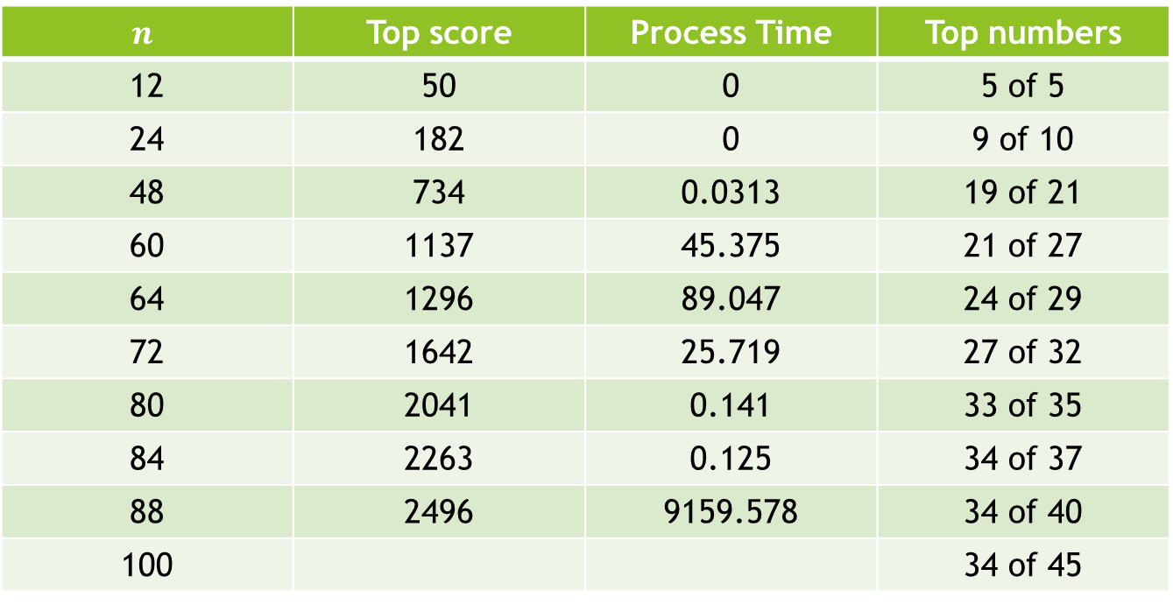
Programming challenges
$$n$$ | Top score | Process Time | Top numbers
12 | 50 | 0 | 5 of 5
24 | 182 | 0 | 9 of 10
48 | 734 | 0.0313 | 19 of 21
60 | 1137 | 45.375 | 21 of 27
64 | 1296 | 89.047 | 24 of 29
72 | 1642 | 25.719 | 27 of 32
80 | 2041 | 0.141 | 33 of 35
84 | 2263 | 0.125 | 34 of 37
88 | 2496 | 9159.578 | 34 of 40
100 |  |  | 34 of 45

