Slide 1
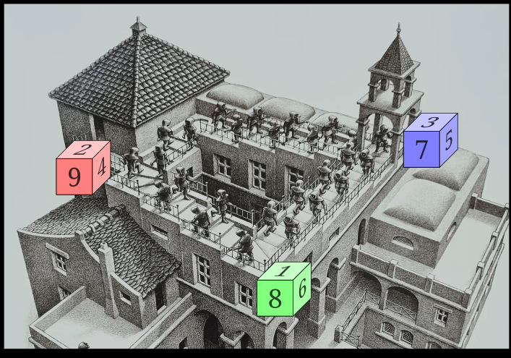
Notes:
Bar trick
Bar trick part 2
Etsy/Amazon - not as popular

Slide 2
Academic Papers
Search results for “intransitive dice”
AIM (American Institute of Mathematics) Martin Gardner 1970 article about Effron dice. https://aimath.org/~morrison/Research/IntransitiveDice.pdf
Wikipedia
Effron dice (4) described on the wikipedia page for intransitive dice
Oskar dice - 3 players, 7 dice
X-sided dice (etc)
General search
Notes:
https://en.wikipedia.org/wiki/G%C3%B6mb%C3%B6c

Slide 3
Academic Papers
Search results for “intransitive dice”
Emerging diversity in a population of evolving intransitive dice
Intransitive machines
The probability that a random triple of dice is transitive “Polymath” 2022
The probability of intransitivity in dice and close elections (2020)
Google Scholar
Notes:
Polymath (https://gowers.wordpress.com/2017/04/28/a-potential-new-polymath-project-intransitive-dice/)

Slide 4
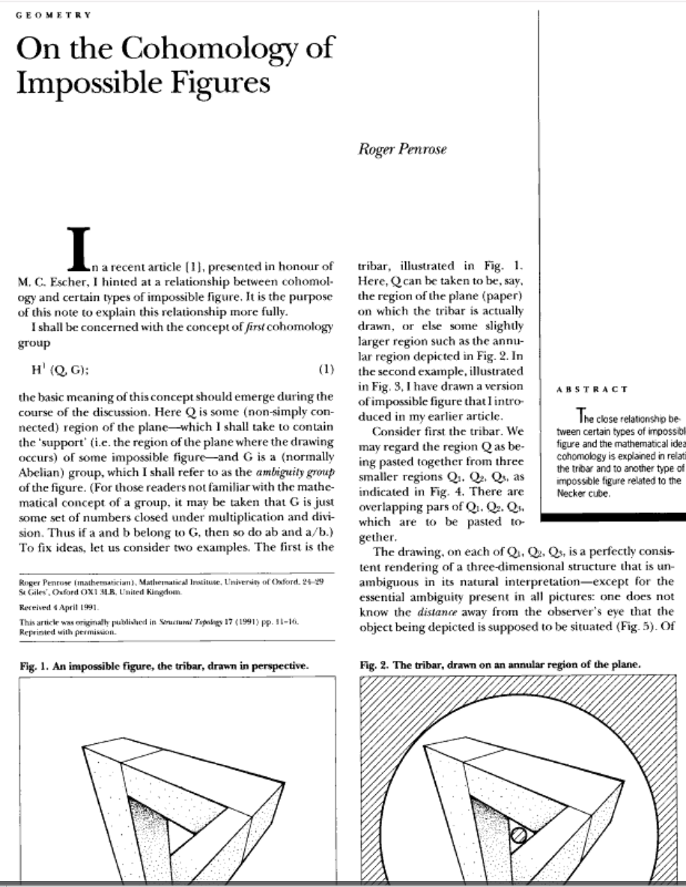
Cohomology
Notes:
https://www.youtube.com/watch?v=TCrCT-ZECDg&t=300s

Slide 5

What should we do next?
Notes:
General
Venue
I’ll set up a wiki
Talk topics list
Marketing
Happy to do whatever. Will you guys pitch in and share poster costs and maybe put up a few?

