Slide 1
PRODUCER – CONSUMBER problem

Slide 2
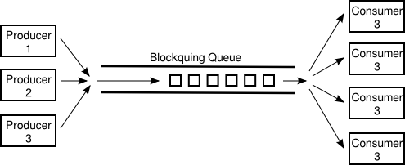
What is producer – consumer problem?

Slide 3
Problem: Copy file
How to copy a large file as fast as posible?
The problem:
File is too big: e.g 10GB …
Copy as fast as posible.

Slide 4


Solution for problem Copy file
Queue
Write Thread
Read Thread
10GB

Slide 5
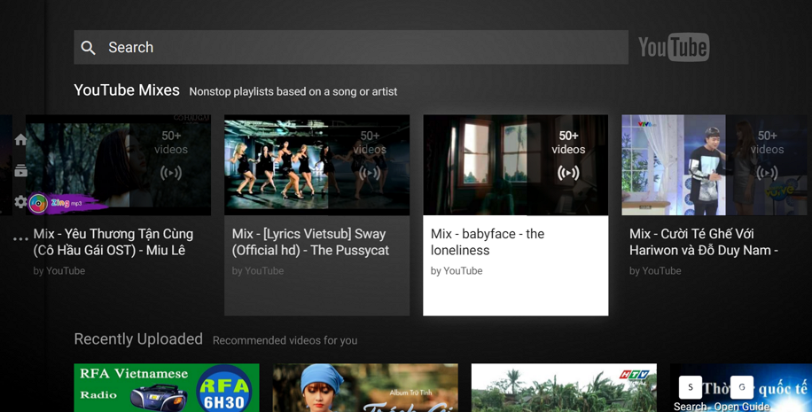
Problem: Download images and show to UI for Youtube App.

Slide 6
Solution for problem Download images and show to UI for Youtube App
Queue
Download thread 1
Download thread 2
Key thread
Create “Download Task” and Add to queue
Download thread 3
Download thread 4
Get “Download Task” from queue and Execute them

Slide 7
Demo
Source code: https://github.com/tryittogether52/ProducerComsumer

Slide 8

THANKS!
Any questions?
You can email me at ThanhVV8@FPT.COM.VN

Slide 9
Reference
http://vichargrave.com/multithreaded-work-queue-in-c/
http://www.cs.loyola.edu/~jglenn/702/S2008/Examples/ProducerConsumer/pc_cpp.html

