Slide 1

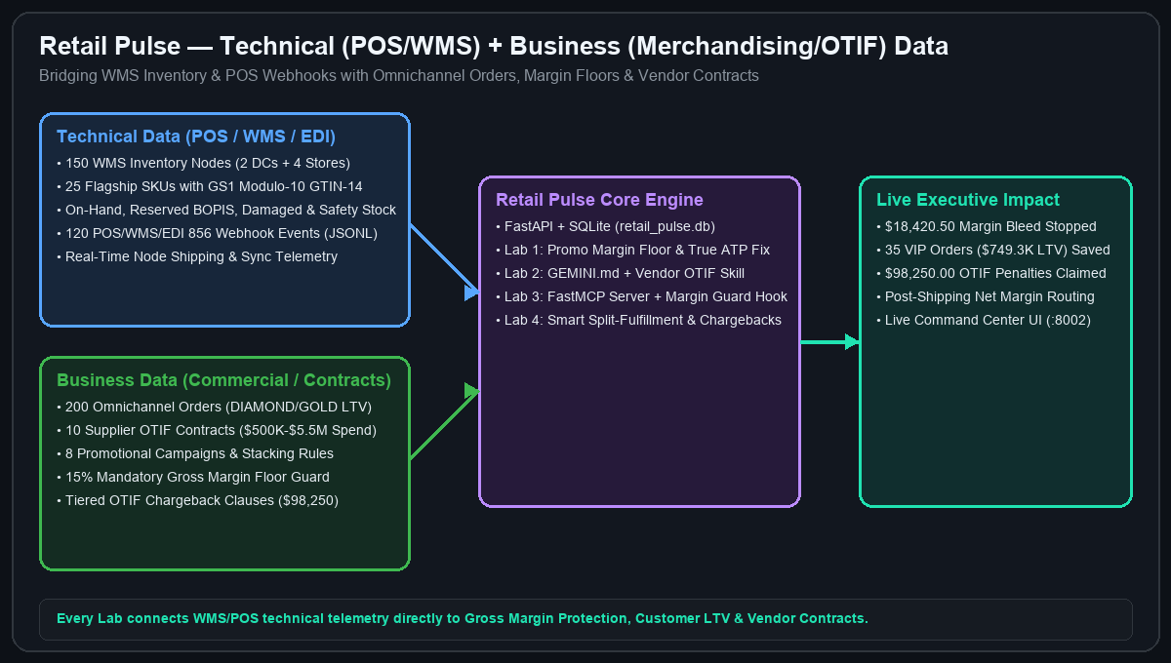
TRYOLABS EXECUTIVE WORKSHOP • 4 HOURS (10% THEORY / 90% HANDS-ON LABS)
Agentic Engineering with Google Antigravity — Retail Edition: Building 'Retail Pulse'
Omnichannel Order Routing, True ATP Inventory Sync & Vendor OTIF Margin Intelligence (Delivered by Tryolabs)
Workshop Mission & Industry Architecture
▸ Technical WMS/POS Data: 150 inventory nodes (2 DCs + 4 Stores), 25 GS1 Modulo-10 GTIN-14 SKUs
▸ Webhook & Scan Streams: 120 POS/WMS/EDI 856 JSONL events with BOPIS & damaged holds
▸ Commercial Business Data: 200 Omnichannel orders (DIAMOND/GOLD LTV, unit price vs cost)
▸ Supplier OTIF Contracts: 10 vendor agreements ($500K–$5.5M spend, OTIF targets & chargebacks)
▸ Tangible Impact: Stop $18,420.50 margin bleed, rescue 35 VIP orders ($749.3K LTV) & claim $98,250 OTIF
Delivered by Tryolabs • 100% Local Laptop Execution + Terraform Cloud Run & Gemini Enterprise Ready | Slide 1/15
Notes:
Welcome attendees on behalf of Tryolabs. Highlight the 10% theory / 90% hands-on format and how we combine technical telemetry with commercial business data (contracts, sales, revenue/margins).

Slide 2
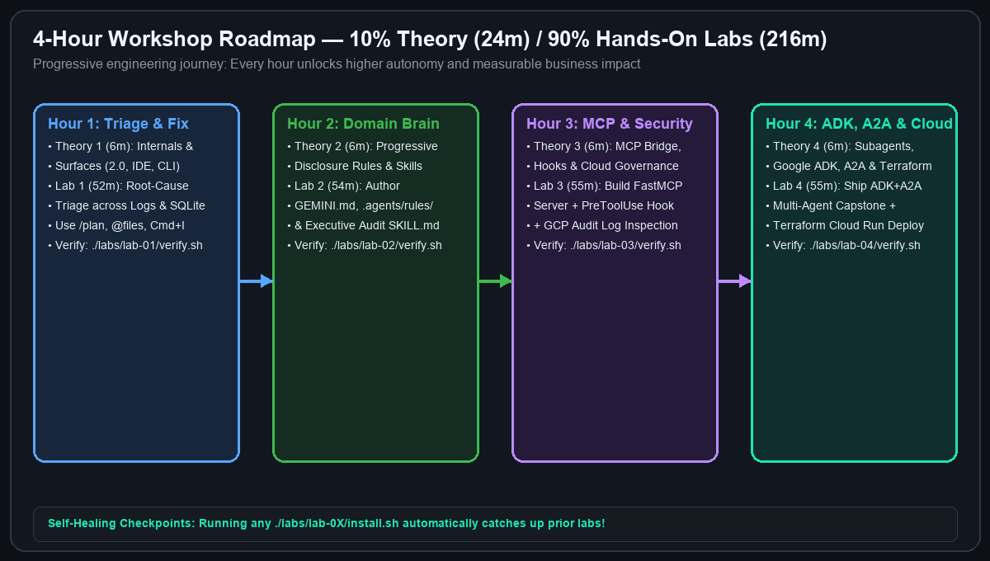
AGENDA & PROGRESSION • 24M THEORY / 216M HANDS-ON LABS
4-Hour Hands-On Roadmap: From Triage to Multi-Agent ADK & A2A
Four 6-minute micro-theory briefings paired with four progressive 52–55 minute hands-on labs
Minute-by-Minute Workshop Schedule
▸ Hour 1 (00:00–00:58): [6m Theory] Internal Architecture & Surfaces → [52m Lab 1] Triage & Revenue/Margin Recovery
▸ Hour 2 (00:58–01:58): [6m Theory] Rules & Progressive Skills → [54m Lab 2] Domain Standards & Executive Risk Skill
▸ Hour 3 (01:58–02:59): [6m Theory] MCP, Hooks & Cloud Governance → [55m Lab 3] Local FastMCP Server & Compliance Hooks
▸ Hour 4 (02:59–04:00): [6m Theory] Subagents, ADK, A2A & Terraform → [55m Lab 4] Multi-Agent Capstone, ADK Dev UI & Cloud Deploy
▸ Self-Healing Checkpoints: Running ./labs/lab-0X/install.sh automatically applies prior lab solutions!
Every lab includes LAB_0X_INSTRUCTIONS_EN.pdf, README.md, PROMPTS.md, install.sh, and verify.sh. | Slide 2/15
Notes:
Walk through the 4-hour progression. Emphasize that attendees use Antigravity itself to solve every lab using the curated prompts in PROMPTS.md and the printable PDF guides.

Slide 3
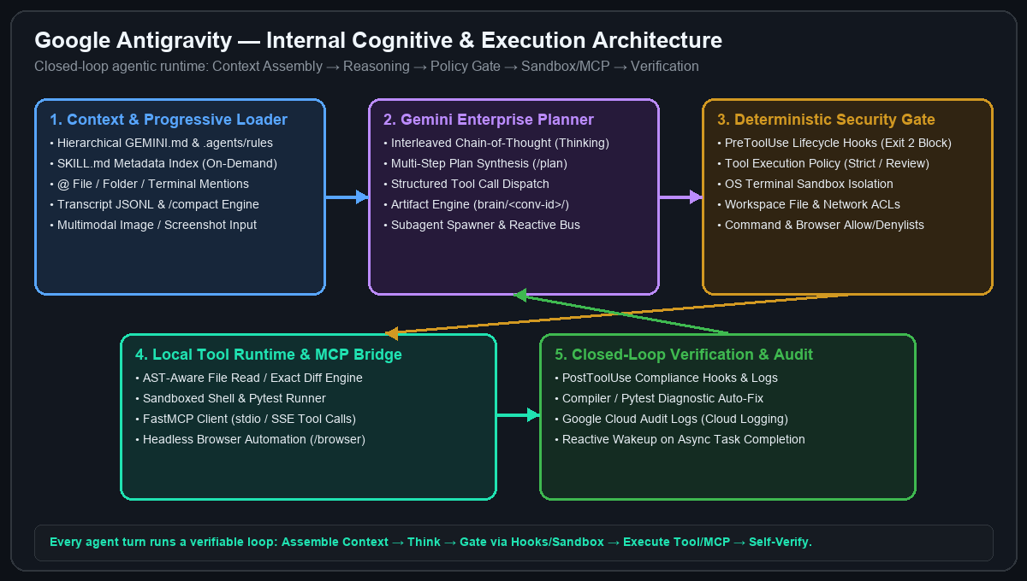
THEORY MODULE 1A (3 MINUTES) • UNDER THE HOOD
How Google Antigravity Works Internally
Inside the closed-loop cognitive planner, context assembler, policy gate, and sandboxed runtime
The 5-Stage Internal Execution Loop
▸ 1. Context & Progressive Loader: Walks directory tree for GEMINI.md & .agents/rules, indexes SKILL.md YAML frontmatter, resolves @mentions, and manages transcript.jsonl
▸ 2. Gemini Enterprise Planner: Generates interleaved chain-of-thought (thinking), synthesizes plans (/plan), and dispatches parallel tool or subagent calls
▸ 3. Deterministic Security Gate: Evaluates PreToolUse hooks (exit code 2 blocks execution), tool policies, file/network ACLs, and OS sandbox rules
▸ 4. Tool Runtime & MCP Bridge: Executes AST-aware file diffs, sandboxed pytest commands, and stdio/SSE FastMCP calls
▸ 5. Verification & Reactive Loop: Runs PostToolUse hooks, reads compiler/test outputs, and self-corrects until green
Key Insight: Antigravity is not just chat—it is a stateful, verifiable closed-loop engineering runtime. | Slide 3/15
Notes:
Explain how Antigravity works under the hood: Context Loader -> Interleaved Thinking Planner -> Deterministic Policy/Hook Gate -> Tool/MCP Runtime -> Closed-Loop Self-Verification.

Slide 4
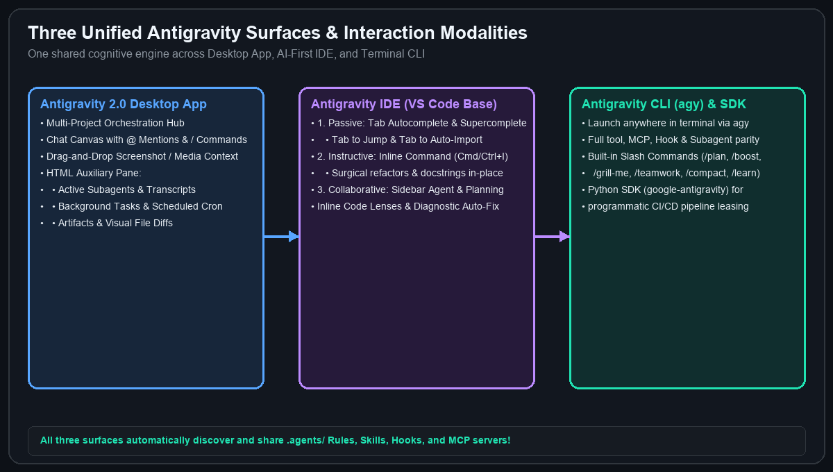
THEORY MODULE 1B (3 MINUTES) • UNIFIED SURFACES & MODALITIES
Antigravity 2.0, IDE & CLI (agy) — Core Modalities
Choosing the right modality and slash command for every engineering task
Features You Will Explore Today
▸ Passive Modality (IDE Tab): Context-aware Supercomplete, Tab-to-Jump across files, and Tab-to-Auto-Import
▸ Instructive Modality (Cmd/Ctrl+I & Code Lenses): Highlight a function for surgical inline refactoring or click 'Write Tests'
▸ Collaborative Modality (Chat Canvas & CLI agy): Multi-file reasoning with @file, @folder, @terminal, and screenshot drag-and-drop
▸ High-Leverage Slash Commands: /plan (step-by-step architecture), /grill-me (design interview), /boost, /teamwork, /learn & /compact
▸ HTML Auxiliary Pane: Real-time inspection of Subagents, Background Tasks, Artifacts, and File Diffs
Pro Tip: Start complex tasks with /plan and @file mentions; use Cmd+I for localized formula fixes. | Slide 4/15
Notes:
Demonstrate the three surfaces (Antigravity 2.0, IDE, CLI) and show how @ mentions, /plan, and Cmd+I work together.

Slide 5
HANDS-ON LAB 1 (PART 1/2) • OBJECTIVES & WHAT YOU WILL BUILD
Lab 1: Promo Margin Floor & True ATP Triage — Objectives & Build Spec
52 Minutes • Printable PDF Guide: labs/lab-01-margin-inventory-triage/LAB_01_INSTRUCTIONS_EN.pdf
Lab 1 Objectives & What You Will Build
▸ Objective 1 (Multi-File Agentic Triage): Master Antigravity @mentions, /plan, and inline Cmd/Ctrl+I to correlate POS/WMS webhook streams (pos_wms_webhooks.jsonl) with pricing and ATP inventory code.
▸ Objective 2 (Margin & VIP Stockout Recovery): Stop $18,420.50 in negative margin bleed across 28 MARGIN_HOLD orders and accurately flag 35 DIAMOND/GOLD VIP orders ($749,300.00 LTV) at phantom-stock nodes.
▸ What You Will Build #1 (GS1 & Margin-Floor Pricing Engine): Refactor src/services/promo_pricing.py to validate GS1 gtin_14 Modulo-10, use Decimal(ROUND_HALF_UP), compound stackable promos multiplicatively, and clamp net price to the margin_floor_pct.
▸ What You Will Build #2 (Real-Time True ATP Engine): Refactor src/services/inventory_atp.py (calculate_true_atp / evaluate_location_atp) to subtract reserved_qty + damaged_hold_qty + bopis_lock_qty + safety_stock_qty + unprocessed_pos_events.
▸ Deliverable & Verification: Pass all 6 unit/integration tests in tests/test_lab01_triage.py (./labs/lab-01-margin-inventory-triage/verify.sh) and inspect http://localhost:8002.
Delivered by Tryolabs • Full printable guide: LAB_01_INSTRUCTIONS_EN.pdf | Slide 5/15
Notes:
Review the Retail Lab 1 Objectives and What Attendees Will Build before starting Lab 1.

Slide 6
HANDS-ON LAB 1 (PART 2/2) • STEP-BY-STEP INSTRUCTIONS & PROMPTS
Lab 1 Instructions & Copy-Paste Antigravity Prompts
Follow Steps 1–5 on the left and copy-paste prompts from labs/lab-01-margin-inventory-triage/PROMPTS.md
Step-by-Step Lab 1 Instructions
▸ Step 1 (Initialize Lab 01): Run ./labs/lab-01-margin-inventory-triage/install.sh to seed data/retail_pulse.db and starter bugs.
▸ Step 2 (Reproduce Failing Tests): Run ./.venv/bin/pytest tests/test_lab01_triage.py to observe the margin bleed and phantom ATP failures.
▸ Step 3 (Fix src/services/promo_pricing.py): Validate GS1 gtin_14 Modulo-10, use Decimal(ROUND_HALF_UP), never stack EXCLUSIVE promos, apply stackable promos multiplicatively, and clamp price to margin_floor_pct.
▸ Step 4 (Fix src/services/inventory_atp.py): Subtract reserved_qty + damaged_hold_qty + bopis_lock_qty + safety_stock_qty + unprocessed_pos_events from on_hand_qty and clamp true_atp = max(0, raw_atp).
▸ Step 5 (Verify): Run ./labs/lab-01-margin-inventory-triage/verify.sh (6 passed: $18,420.50 bleed stopped across 28 orders; 35 VIP orders flagged).
Copy-Paste Prompts (PROMPTS.md) & Verification
▸ Prompt 1 — Discovery (@Mentions): '@src/services/promo_pricing.py @src/services/inventory_atp.py @data/logs/pos_wms_webhooks.jsonl @tests/test_lab01_triage.py Run pytest and explain why 28 orders are bleeding margin and 35 VIP orders have phantom ATP.'
▸ Prompt 2 — Planning (/plan): '/plan Create a remediation plan for promo_pricing.py (GS1 GTIN-14, Decimal, multiplicative stackable promos, margin floor clamping) and inventory_atp.py (subtract reserved, damaged_hold, bopis_lock, safety_stock, and unprocessed_pos_events).'
▸ Prompt 3 — Inline Edit (Cmd+I): Highlight calculate_true_atp in inventory_atp.py -> 'Subtract reserved_qty, damaged_hold_qty, bopis_lock_qty, safety_stock_qty, and unprocessed_pos_events from on_hand_qty.'
▸ Prompt 4 — Autonomous Verify: 'Apply fixes to @src/services/promo_pricing.py and @src/services/inventory_atp.py and run ./labs/lab-01-margin-inventory-triage/verify.sh.'
Delivered by Tryolabs • Self-Healing Checkpoint: ./labs/lab-01-margin-inventory-triage/apply_solution.sh | Slide 6/15
Notes:
Keep this slide projected during Retail Lab 1 so attendees have both the 5 steps and copy-paste prompts visible.

Slide 7
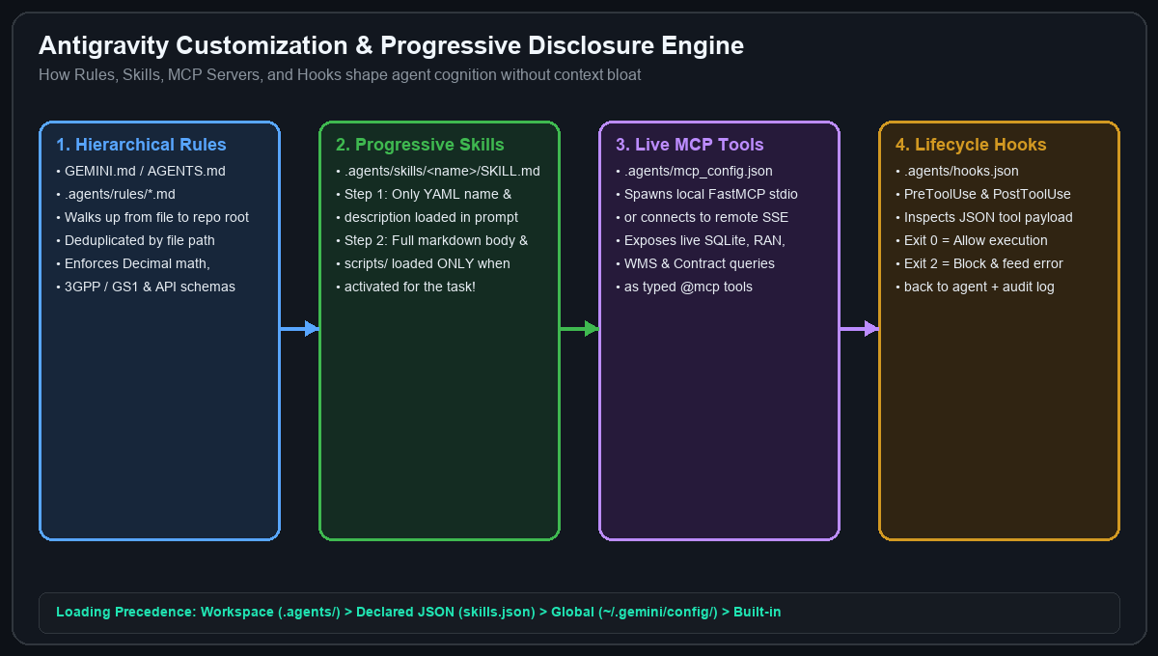
THEORY MODULE 2 (6 MINUTES) • CUSTOMIZATION ARCHITECTURE
How Rules & Progressive Disclosure Skills Work Internally
Specializing Antigravity for your industry without overflowing the context window
Rules vs. Skills vs. /learn
▸ Hierarchical Rules (GEMINI.md & .agents/rules/*.md): Always-on or model-decided domain invariants loaded from workspace root down to target directories (deduplicated automatically)
▸ Progressive Disclosure Skills (.agents/skills/<name>/SKILL.md): Only lightweight YAML frontmatter (name, description) sits in system prompt; full markdown runbook & scripts/ load ONLY when triggered!
▸ Self-Improving Memory (/learn): Ask Antigravity to codify a newly discovered debugging pattern or architectural standard into a reusable workspace customization
▸ Precedence Hierarchy: Workspace (.agents/) > Declared JSON (skills.json) > Global (~/.gemini/config/) > Built-in
Rule of Thumb: Put permanent guardrails in GEMINI.md/rules; put multi-step workflows & scripts in SKILL.md. | Slide 7/15
Notes:
Explain progressive disclosure: why 50 skills don't bloat the prompt because only YAML frontmatter is loaded until the agent activates a specific skill.

Slide 8
HANDS-ON LAB 2 (PART 1/2) • OBJECTIVES & WHAT YOU WILL BUILD
Lab 2: Workspace Rules & Progressive Skills — Objectives & Build Spec
54 Minutes • Printable PDF Guide: labs/lab-02-rules-and-skills/LAB_02_INSTRUCTIONS_EN.pdf
Lab 2 Objectives & What You Will Build
▸ Objective 1 (Hierarchical Domain Rules): Encode permanent GS1 GTIN-14, True ATP, multiplicative promo, and Supplier OTIF invariants into workspace rules.
▸ Objective 2 (Progressive Disclosure Skills): Build an on-demand executive merchandising & supply-chain audit skill in .agents/skills/ using lightweight YAML frontmatter.
▸ What You Will Build #1 (GEMINI.md & .agents/rules/retail-standards.md): Workspace context & rule files enforcing Decimal(ROUND_HALF_UP), GS1 Modulo-10 check digits, margin_floor_pct, and OTIF chargeback formulas.
▸ What You Will Build #2 (.agents/skills/retail-otif-margin-auditor/SKILL.md): Progressive skill (name: retail-otif-margin-auditor) orchestrating scripts/audit_vendor_otif.py.
▸ Deliverable & Verification: Generate data/exports/otif_chargeback_audit_report.json ($98,250.00 OTIF chargebacks across 6 suppliers) and pass all 4 Lab 02 tests (10 passed cumulative) in ./labs/lab-02-rules-and-skills/verify.sh.
Delivered by Tryolabs • Full printable guide: LAB_02_INSTRUCTIONS_EN.pdf | Slide 8/15
Notes:
Introduce the Retail Lab 2 Objectives and the Rules + Skill files attendees will build.

Slide 9
HANDS-ON LAB 2 (PART 2/2) • STEP-BY-STEP INSTRUCTIONS & PROMPTS
Lab 2 Instructions & Copy-Paste Antigravity Prompts
Follow Steps 1–5 on the left and copy-paste prompts from labs/lab-02-rules-and-skills/PROMPTS.md
Step-by-Step Lab 2 Instructions
▸ Step 1 (Initialize Lab 02): Run ./labs/lab-02-rules-and-skills/install.sh (auto-applies Lab 01 solution).
▸ Step 2 (Author Root GEMINI.md): Document sku_catalog, wms_inventory, vendor_contracts, promo_campaigns, omnichannel_orders, and mandatory Decimal(ROUND_HALF_UP) & gtin_14 rules.
▸ Step 3 (Author .agents/rules/retail-standards.md): Codify GS1 GTIN-14 Modulo-10, True ATP (on_hand - reserved - damaged_hold - bopis_lock - safety_stock - unprocessed_pos_events), multiplicative promos, margin floor, and Vendor OTIF rules.
▸ Step 4 (Author .agents/skills/retail-otif-margin-auditor/SKILL.md): Add YAML frontmatter (name: retail-otif-margin-auditor, description: ...) and instructions to run ./.venv/bin/python scripts/audit_vendor_otif.py.
▸ Step 5 (Verify): Run ./labs/lab-02-rules-and-skills/verify.sh (10 passed cumulative + data/exports/otif_chargeback_audit_report.json generated).
Copy-Paste Prompts (PROMPTS.md) & Verification
▸ Prompt 1 — Author Workspace Rules: '/plan Create @GEMINI.md and @.agents/rules/retail-standards.md enforcing Decimal ROUND_HALF_UP, GS1 GTIN-14 Modulo-10 validation, True ATP deductions, multiplicative promo stacking, and OTIF chargeback rules.'
▸ Prompt 2 — Build Progressive Skill: 'Create @.agents/skills/retail-otif-margin-auditor/SKILL.md with YAML frontmatter (name: retail-otif-margin-auditor) that executes ./.venv/bin/python scripts/audit_vendor_otif.py and writes data/exports/otif_chargeback_audit_report.json.'
▸ Prompt 3 — Trigger Skill On-Demand: 'Run a full executive margin, True ATP, and supplier OTIF chargeback audit using our workspace skill.'
▸ Verify Command: Run ./labs/lab-02-rules-and-skills/verify.sh and test /learn!
Delivered by Tryolabs • Self-Healing Checkpoint: ./labs/lab-02-rules-and-skills/apply_solution.sh | Slide 9/15
Notes:
Keep this slide displayed during Retail Lab 2.

Slide 10
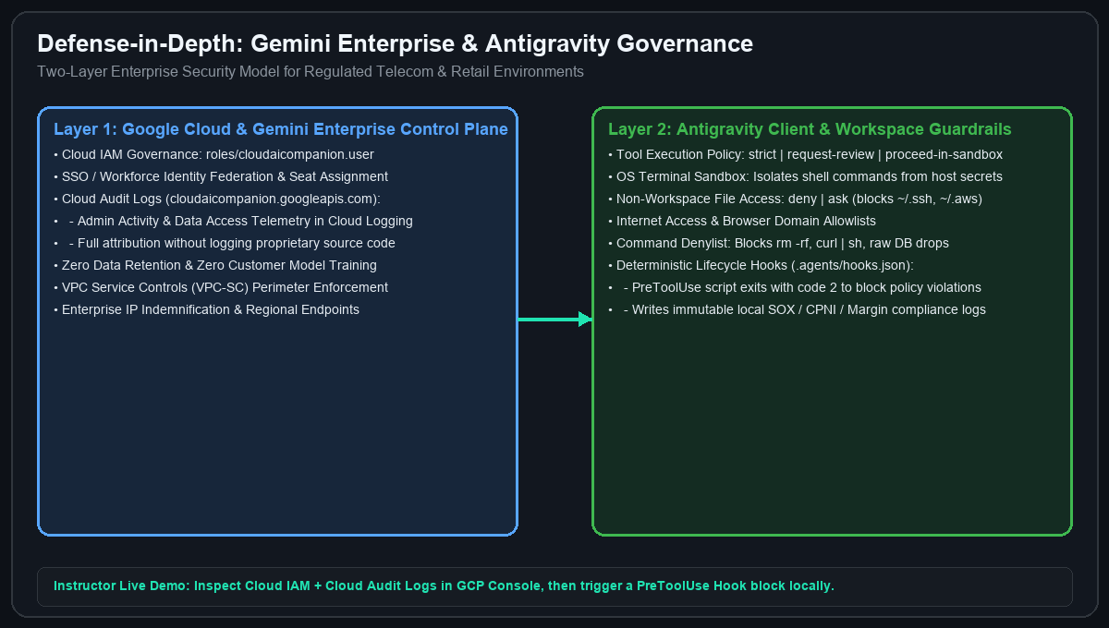
THEORY MODULE 3 (6 MINUTES) • MCP, HOOKS & ENTERPRISE GOVERNANCE
Live MCP Bridge, Deterministic Hooks & Gemini Enterprise Governance
Connecting live databases safely while proving end-to-end enterprise security in Google Cloud
2-Layer Enterprise Security & Governance
▸ Layer 1 — Google Cloud & Gemini Enterprise (Instructor Live Demo): Cloud IAM (roles/cloudaicompanion.user), Cloud Audit Logs (cloudaicompanion.googleapis.com), VPC-SC perimeters, Zero Data Retention / No Training on customer code
▸ Layer 2 — Antigravity Client Security: Tool Execution Policy (strict / request-review / proceed-in-sandbox), OS Terminal Sandbox, Non-Workspace File Access (deny), Command & Browser Allow/Denylists
▸ Live Context via FastMCP (.agents/mcp_config.json): Exposes strongly-typed Python tools querying live SQLite & telemetry over stdio/SSE
▸ Deterministic Lifecycle Hooks (.agents/hooks.json): PreToolUse script inspects tool JSON on stdin; exit code 2 hard-blocks policy violations and writes an immutable audit log!
Instructor Demo: Show Cloud Audit Logs in GCP Console + trigger a deterministic PreToolUse Hook block locally! | Slide 10/15
Notes:
This is a critical module for enterprise architects and CISOs. Show how Google Cloud governs Gemini Enterprise licenses & audit logs in Layer 1, while Antigravity enforces sandboxing and deterministic PreToolUse hooks in Layer 2.

Slide 11
HANDS-ON LAB 3 (PART 1/2) • OBJECTIVES & WHAT YOU WILL BUILD
Lab 3: Retail FastMCP Server & Margin Hooks — Objectives & Build Spec
55 Minutes • Printable PDF Guide: labs/lab-03-mcp-and-hooks/LAB_03_INSTRUCTIONS_EN.pdf
Lab 3 Objectives & What You Will Build
▸ Objective 1 (Live Omnichannel Grounding via MCP): Connect Antigravity to live SQLite WMS inventory, VIP orders, and vendor OTIF tables via a local FastMCP server.
▸ Objective 2 (Deterministic Margin Compliance Guardrails): Intercept every file-edit and shell tool call with PreToolUse & PostToolUse hooks that hard-block disabling margin_floor_pct or destructive SQL (exit code 2).
▸ What You Will Build #1 (mcp_server/retail_mcp.py & .agents/mcp_config.json): 4 @mcp.tool() functions (query_true_atp_inventory, audit_vendor_otif_contracts, simulate_promo_margin_guard, list_at_risk_vip_orders).
▸ What You Will Build #2 (.agents/hooks.json & scripts/margin_guard_hook.py): Deterministic PreToolUse & PostToolUse guardrail blocking margin_floor_pct = 0.0, DISABLE_MARGIN_FLOOR, or DROP/DELETE SQL and logging to data/logs/hook_compliance_audit.jsonl.
▸ Deliverable & Verification: Pass all 3 Lab 03 MCP & Hook tests (13 passed cumulative) in ./labs/lab-03-mcp-and-hooks/verify.sh.
Delivered by Tryolabs • Full printable guide: LAB_03_INSTRUCTIONS_EN.pdf | Slide 11/15
Notes:
Review the Retail Lab 3 Objectives and the FastMCP + Margin Hook components attendees will build.

Slide 12
HANDS-ON LAB 3 (PART 2/2) • STEP-BY-STEP INSTRUCTIONS & PROMPTS
Lab 3 Instructions & Copy-Paste Antigravity Prompts
Follow Steps 1–5 on the left and copy-paste prompts from labs/lab-03-mcp-and-hooks/PROMPTS.md
Step-by-Step Lab 3 Instructions
▸ Step 1 (Initialize Lab 03): Run ./labs/lab-03-mcp-and-hooks/install.sh (auto-applies Labs 01–02).
▸ Step 2 (Complete mcp_server/retail_mcp.py): Implement audit_vendor_otif_contracts(only_breaching=True), simulate_promo_margin_guard(sku, qty=1, promo_codes_csv=""), and list_at_risk_vip_orders(loyalty_tier="DIAMOND").
▸ Step 3 (Register .agents/mcp_config.json): Register retail-pulse-mcp invoking ./.venv/bin/python mcp_server/retail_mcp.py over stdio.
▸ Step 4 (Configure .agents/hooks.json): Wire PreToolUse and PostToolUse to ./.venv/bin/python scripts/margin_guard_hook.py --phase pre (and --phase post, blocking policy violations with exit code 2).
▸ Step 5 (Verify): Run ./labs/lab-03-mcp-and-hooks/verify.sh (13 passed cumulative across Labs 01–03 + compliance audit log verified).
Copy-Paste Prompts (PROMPTS.md) & Verification
▸ Prompt 1 — Complete FastMCP Server: '/plan Implement audit_vendor_otif_contracts, simulate_promo_margin_guard, and list_at_risk_vip_orders in @mcp_server/retail_mcp.py so all tool schemas match @tests/test_lab03_mcp_hooks.py.'
▸ Prompt 2 — Wire MCP & Hooks Config: 'Create @.agents/mcp_config.json for retail-pulse-mcp and @.agents/hooks.json wiring PreToolUse and PostToolUse to ./scripts/margin_guard_hook.py.'
▸ Prompt 3 — Test Hook Block (Exit Code 2): Run echo '{"tool_name":"edit_file","tool_input":{"content":"margin_floor_pct = 0.0"}}' | ./.venv/bin/python scripts/margin_guard_hook.py --phase pre
▸ Verify Command: Run ./labs/lab-03-mcp-and-hooks/verify.sh and inspect data/logs/hook_compliance_audit.jsonl.
Delivered by Tryolabs • Self-Healing Checkpoint: ./labs/lab-03-mcp-and-hooks/apply_solution.sh | Slide 12/15
Notes:
Keep this slide displayed during Retail Lab 3.

Slide 13
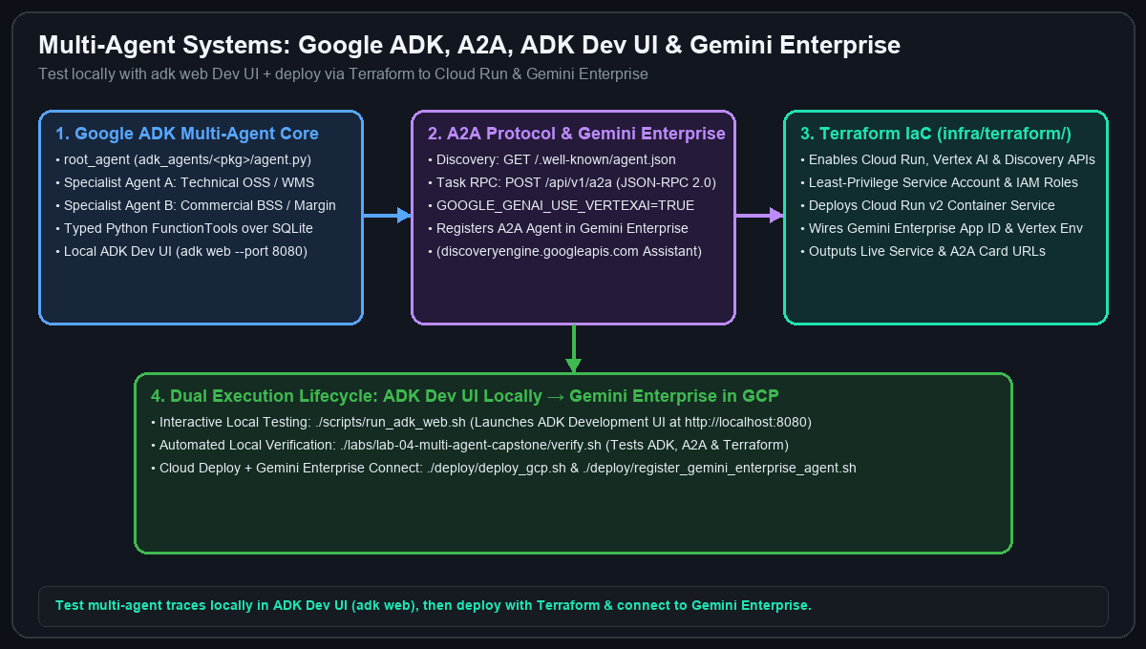
THEORY MODULE 4 (6 MINUTES) • SUBAGENTS, GOOGLE ADK, A2A & TERRAFORM
Multi-Agent Systems with Google ADK, A2A Protocol & Terraform
Designing multi-agent architectures locally with adk web and deploying to Cloud Run & Gemini Enterprise
End-to-End Multi-Agent Architecture
▸ Antigravity Subagents (/teamwork, /boost, /grill-me): Delegate parallel coding & research tasks inside Antigravity to build your application faster
▸ Google ADK (Agent Development Kit): Build domain multi-agent hierarchies (root_agent orchestrating Technical & Commercial specialist LlmAgents with typed Python tools)
▸ Local Testing via ADK Dev UI (adk web): Launch ./scripts/run_adk_web.sh (http://localhost:8080) to interactively inspect multi-agent event traces, tool calls, and session state!
▸ A2A (Agent2Agent) Protocol: Publish GET /.well-known/agent.json (Agent Card) and POST /api/v1/a2a (JSON-RPC 2.0 tasks/send) for cross-agent interoperability
▸ Terraform + Gemini Enterprise: Provision Cloud Run v2 & IAM via infra/terraform/ (deploy_gcp.sh) and register your A2A agent into Gemini Enterprise (register_gemini_enterprise_agent.sh)
Develop & test 100% locally with adk web + pytest, then deploy to Google Cloud & Gemini Enterprise with Terraform! | Slide 13/15
Notes:
Explain the synergy between Antigravity subagents (which help you write the code) and Google ADK + A2A (the runtime multi-agent system you build, test locally in adk web, deploy with Terraform, and register in Gemini Enterprise).

Slide 14
HANDS-ON LAB 4 CAPSTONE (PART 1/2) • OBJECTIVES & WHAT YOU WILL BUILD
Lab 4 Capstone: Multi-Agent ADK, A2A & Terraform — Objectives & Build Spec
55 Minutes • Printable PDF Guide: labs/lab-04-multi-agent-capstone/LAB_04_INSTRUCTIONS_EN.pdf
Lab 4 Objectives & What You Will Build
▸ Objective 1 (Multi-Agent System Design with Google ADK & A2A): Build a hierarchical multi-agent system with Google ADK (LlmAgent) and expose an A2A Agent Card + JSON-RPC 2.0 endpoint.
▸ Objective 2 (Local ADK Dev UI & Cloud Terraform Deployment): Test agent handoffs locally in adk web (http://localhost:8080) and validate Cloud Run + Gemini Enterprise provisioning with Terraform.
▸ What You Will Build #1 (src/services/fulfillment_router.py): Margin-preserving omnichannel split-shipment optimizer (optimize_at_risk_order_routing & claim_vendor_otif_chargebacks) rescuing all 35 VIP orders ($749,300.00 LTV) and claiming $98,250.00 OTIF.
▸ What You Will Build #2 (src/agents/adk_a2a_orchestrator.py & adk_agents/retail_pulse/): WMSInventoryATPAgent + MerchandisingMarginOTIFAgent coordinated by RetailPulseOrchestratorAgent, plus GET /.well-known/agent.json & POST /api/v1/a2a.
▸ What You Will Build #3 (Cloud Infrastructure): Validate infra/terraform/main.tf and Gemini Enterprise registration via ./labs/lab-04-multi-agent-capstone/deploy_gcp.sh --dry-run.
Delivered by Tryolabs • Full printable guide: LAB_04_INSTRUCTIONS_EN.pdf | Slide 14/15
Notes:
Introduce the Retail Lab 4 Capstone Objectives and the 3 major deliverables.

Slide 15
HANDS-ON LAB 4 CAPSTONE (PART 2/2) • STEP-BY-STEP INSTRUCTIONS & PROMPTS
Lab 4 Instructions, adk web Testing & Terraform Cloud Deploy
Follow Steps 1–5 on the left and copy-paste prompts from labs/lab-04-multi-agent-capstone/PROMPTS.md
Step-by-Step Lab 4 Instructions
▸ Step 1 (Initialize Lab 04): Run ./labs/lab-04-multi-agent-capstone/install.sh.
▸ Step 2 (Omnichannel Fulfillment Router): Implement optimize_at_risk_order_routing() and claim_vendor_otif_chargebacks() in src/services/fulfillment_router.py (rerouting all 35 VIP orders to REROUTED_SAVED and claiming $98,250.00).
▸ Step 3 (Google ADK & A2A Orchestrator): Complete src/agents/adk_a2a_orchestrator.py (WMSInventoryATPAgent, MerchandisingMarginOTIFAgent, RetailPulseOrchestratorAgent, get_a2a_agent_card, handle_a2a_jsonrpc).
▸ Step 4 (Local ADK Dev UI): Run ./scripts/run_adk_web.sh and test retail_pulse interactively at http://localhost:8080.
▸ Step 5 (Terraform & Full Verification): Run ./labs/lab-04-multi-agent-capstone/deploy_gcp.sh --dry-run and ./labs/lab-04-multi-agent-capstone/verify.sh (20/20 tests pass!).
Copy-Paste Prompts, adk web & Cloud Commands
▸ Prompt 1 — Fulfillment Router: '/plan Implement optimize_at_risk_order_routing and claim_vendor_otif_chargebacks in @src/services/fulfillment_router.py ranking candidate nodes by lowest shipping_cost_per_unit and highest true_atp.'
▸ Prompt 2 — ADK + A2A Orchestrator: '/teamwork Implement WMSInventoryATPAgent, MerchandisingMarginOTIFAgent, RetailPulseOrchestratorAgent, get_a2a_agent_card, and handle_a2a_jsonrpc in @src/agents/adk_a2a_orchestrator.py.'
▸ Prompt 3 — Interactive adk web (http://localhost:8080): 'Execute omnichannel remediation: enforce margin floor across 28 orders, reroute all 35 VIP orders, and claim OTIF vendor chargebacks.'
▸ Cloud Deploy & Verify: Run ./labs/lab-04-multi-agent-capstone/deploy_gcp.sh --dry-run and ./labs/lab-04-multi-agent-capstone/verify.sh.
Delivered by Tryolabs • Self-Healing Checkpoint: ./labs/lab-04-multi-agent-capstone/apply_solution.sh | Slide 15/15
Notes:
Keep this slide projected during the Retail Lab 4 Capstone.

