Slide 1

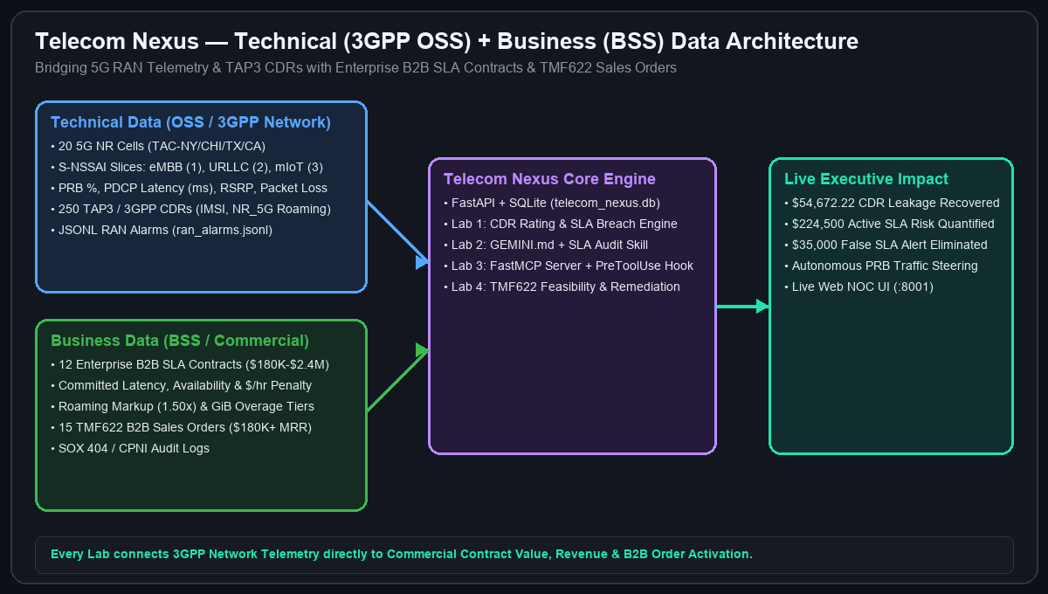
TRYOLABS EXECUTIVE WORKSHOP • 4 HOURS (10% THEORY / 90% HANDS-ON LABS)
Agentic Engineering with Google Antigravity — Telecom Edition: Building 'Telecom Nexus'
5G Network Slice SLA, CDR Revenue Assurance & B2B Contract Intelligence (Delivered by Tryolabs)
Workshop Mission & Industry Architecture
▸ OSS Technical Data: 20 5G NR cells (gNodeB, TAC, S-NSSAI SST 1/2/3, PRB%, PDCP latency)
▸ TAP3 / 3GPP CDRs: 250 call/data records (IMSI, MSISDN, NR_5G roaming PLMN, GiB volume)
▸ BSS Business Data: 12 Enterprise B2B SLA contracts ($180K–$2.4M ACV, $/hr SLA penalties)
▸ TMF622 Sales Pipeline: 15 pending B2B slice orders + JSONL RAN alarm telemetry
▸ Tangible Impact: Recover $54,672.22 in unbilled CDRs & protect $224,500 in active SLA exposure
Delivered by Tryolabs • 100% Local Laptop Execution + Terraform Cloud Run & Gemini Enterprise Ready | Slide 1/15
Notes:
Welcome attendees on behalf of Tryolabs. Highlight the 10% theory / 90% hands-on format and how we combine technical telemetry with commercial business data (contracts, sales, revenue/margins).

Slide 2
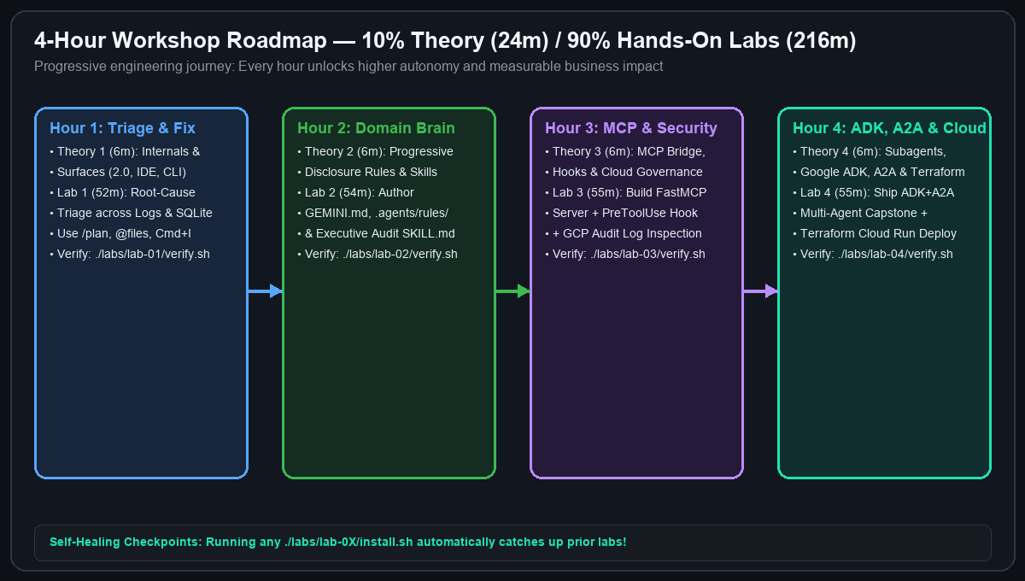
AGENDA & PROGRESSION • 24M THEORY / 216M HANDS-ON LABS
4-Hour Hands-On Roadmap: From Triage to Multi-Agent ADK & A2A
Four 6-minute micro-theory briefings paired with four progressive 52–55 minute hands-on labs
Minute-by-Minute Workshop Schedule
▸ Hour 1 (00:00–00:58): [6m Theory] Internal Architecture & Surfaces → [52m Lab 1] Triage & Revenue/Margin Recovery
▸ Hour 2 (00:58–01:58): [6m Theory] Rules & Progressive Skills → [54m Lab 2] Domain Standards & Executive Risk Skill
▸ Hour 3 (01:58–02:59): [6m Theory] MCP, Hooks & Cloud Governance → [55m Lab 3] Local FastMCP Server & Compliance Hooks
▸ Hour 4 (02:59–04:00): [6m Theory] Subagents, ADK, A2A & Terraform → [55m Lab 4] Multi-Agent Capstone, ADK Dev UI & Cloud Deploy
▸ Self-Healing Checkpoints: Running ./labs/lab-0X/install.sh automatically applies prior lab solutions!
Every lab includes LAB_0X_INSTRUCTIONS_EN.pdf, README.md, PROMPTS.md, install.sh, and verify.sh. | Slide 2/15
Notes:
Walk through the 4-hour progression. Emphasize that attendees use Antigravity itself to solve every lab using the curated prompts in PROMPTS.md and the printable PDF guides.

Slide 3
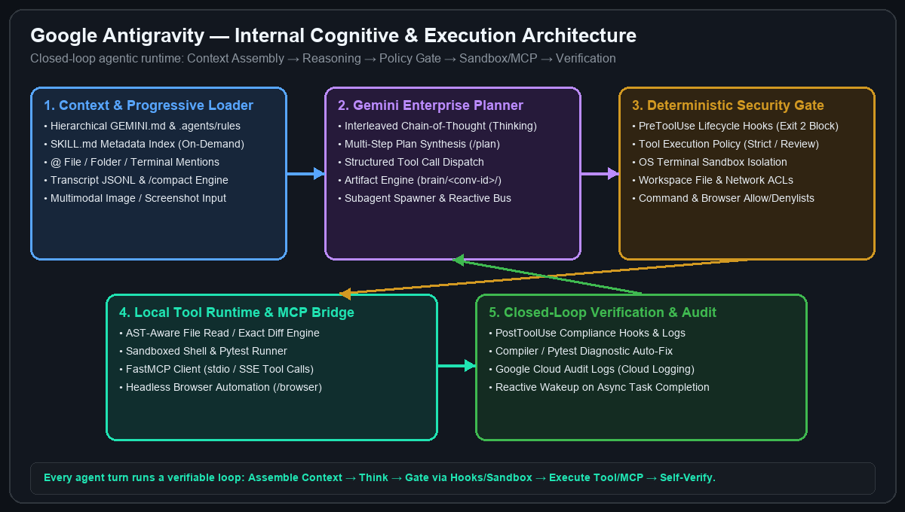
THEORY MODULE 1A (3 MINUTES) • UNDER THE HOOD
How Google Antigravity Works Internally
Inside the closed-loop cognitive planner, context assembler, policy gate, and sandboxed runtime
The 5-Stage Internal Execution Loop
▸ 1. Context & Progressive Loader: Walks directory tree for GEMINI.md & .agents/rules, indexes SKILL.md YAML frontmatter, resolves @mentions, and manages transcript.jsonl
▸ 2. Gemini Enterprise Planner: Generates interleaved chain-of-thought (thinking), synthesizes plans (/plan), and dispatches parallel tool or subagent calls
▸ 3. Deterministic Security Gate: Evaluates PreToolUse hooks (exit code 2 blocks execution), tool policies, file/network ACLs, and OS sandbox rules
▸ 4. Tool Runtime & MCP Bridge: Executes AST-aware file diffs, sandboxed pytest commands, and stdio/SSE FastMCP calls
▸ 5. Verification & Reactive Loop: Runs PostToolUse hooks, reads compiler/test outputs, and self-corrects until green
Key Insight: Antigravity is not just chat—it is a stateful, verifiable closed-loop engineering runtime. | Slide 3/15
Notes:
Explain how Antigravity works under the hood: Context Loader -> Interleaved Thinking Planner -> Deterministic Policy/Hook Gate -> Tool/MCP Runtime -> Closed-Loop Self-Verification.

Slide 4
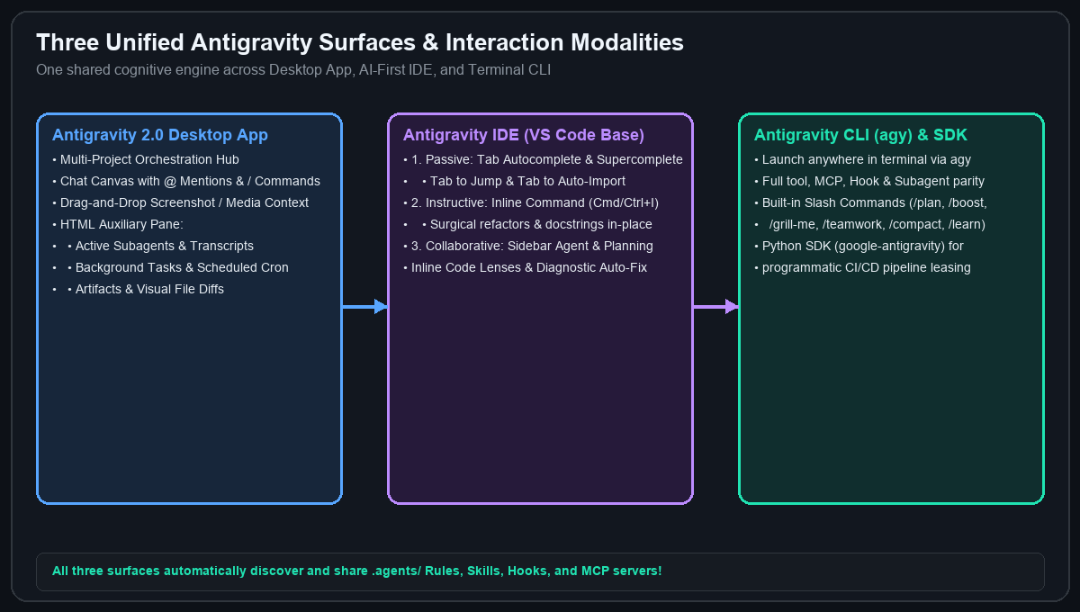
THEORY MODULE 1B (3 MINUTES) • UNIFIED SURFACES & MODALITIES
Antigravity 2.0, IDE & CLI (agy) — Core Modalities
Choosing the right modality and slash command for every engineering task
Features You Will Explore Today
▸ Passive Modality (IDE Tab): Context-aware Supercomplete, Tab-to-Jump across files, and Tab-to-Auto-Import
▸ Instructive Modality (Cmd/Ctrl+I & Code Lenses): Highlight a function for surgical inline refactoring or click 'Write Tests'
▸ Collaborative Modality (Chat Canvas & CLI agy): Multi-file reasoning with @file, @folder, @terminal, and screenshot drag-and-drop
▸ High-Leverage Slash Commands: /plan (step-by-step architecture), /grill-me (design interview), /boost, /teamwork, /learn & /compact
▸ HTML Auxiliary Pane: Real-time inspection of Subagents, Background Tasks, Artifacts, and File Diffs
Pro Tip: Start complex tasks with /plan and @file mentions; use Cmd+I for localized formula fixes. | Slide 4/15
Notes:
Demonstrate the three surfaces (Antigravity 2.0, IDE, CLI) and show how @ mentions, /plan, and Cmd+I work together.

Slide 5
HANDS-ON LAB 1 (PART 1/2) • OBJECTIVES & WHAT YOU WILL BUILD
Lab 1: 5G Slice SLA & CDR Revenue Triage — Objectives & Build Spec
52 Minutes • Printable PDF Guide: labs/lab-01-revenue-sla-triage/LAB_01_INSTRUCTIONS_EN.pdf
Lab 1 Objectives & What You Will Build
▸ Objective 1 (Multi-File Agentic Triage): Master Antigravity @mentions, /plan, and inline Cmd/Ctrl+I to correlate 3GPP RAN alarms (ran_alarms.jsonl) with BSS billing & SLA code.
▸ Objective 2 (Revenue & SLA Accuracy): Eliminate floating-point/unit bugs leaking $54,672.22 in 5G CDRs and stop $35,000 in false B2B SLA alerts on non-active contracts.
▸ What You Will Build #1 (3GPP TAP3 Rating Engine): Refactor src/services/cdr_rating.py to enforce binary GiB (Decimal(1024 ** 3)) and apply roaming_markup across all visiting PLMNs (NR_5G + EUTRAN_4G).
▸ What You Will Build #2 (B2B SLA Breach Monitor): Refactor src/services/sla_monitor.py to filter WHERE status = 'ACTIVE' and trigger breaches when worst_latency > committed_latency.
▸ Deliverable & Verification: Pass all 5 unit/integration tests in tests/test_lab01_triage.py (./labs/lab-01-revenue-sla-triage/verify.sh) and verify KPIs on http://localhost:8001.
Delivered by Tryolabs • Full printable guide: LAB_01_INSTRUCTIONS_EN.pdf | Slide 5/15
Notes:
Review the Lab 1 Objectives and What Attendees Will Build before they run install.sh.

Slide 6
HANDS-ON LAB 1 (PART 2/2) • STEP-BY-STEP INSTRUCTIONS & PROMPTS
Lab 1 Instructions & Copy-Paste Antigravity Prompts
Follow Steps 1–5 on the left and copy-paste prompts from labs/lab-01-revenue-sla-triage/PROMPTS.md
Step-by-Step Lab 1 Instructions
▸ Step 1 (Initialize Lab 01): Run ./labs/lab-01-revenue-sla-triage/install.sh to seed data/telecom_nexus.db and activate the starter bugs.
▸ Step 2 (Reproduce Failing Tests): Run ./.venv/bin/pytest tests/test_lab01_triage.py to observe the CDR underbilling and SLA latency failures.
▸ Step 3 (Fix src/services/cdr_rating.py): Set BYTES_DIVISOR = Decimal(1024 ** 3) (binary GiB per 3GPP TS 32.298) and apply roaming_markup whenever roaming_plmn != HOME_PLMN.
▸ Step 4 (Fix src/services/sla_monitor.py): Add WHERE status = 'ACTIVE' to the SQL query and fix latency_breach to worst_latency > committed_latency.
▸ Step 5 (Verify & Inspect): Run ./labs/lab-01-revenue-sla-triage/verify.sh (5 passed: $54,672.22 CDR leakage recovered; 5 ACTIVE SLA breaches = $224,500.00).
Copy-Paste Prompts (PROMPTS.md) & Verification
▸ Prompt 1 — Discovery (@Mentions): '@data/logs/ran_alarms.jsonl @src/services/cdr_rating.py @src/services/sla_monitor.py @tests/test_lab01_triage.py Run pytest to reproduce ALM-BSS-8006 and ALM-3GPP-8001..8005 and explain the exact root causes.'
▸ Prompt 2 — Planning (/plan): '/plan Create a step-by-step remediation plan to fix cdr_rating.py (10243 GiB & NR_5G roaming markup) and sla_monitor.py (ACTIVE contracts & worst_latency > committed_latency).'
▸ Prompt 3 — Inline Edit (Cmd+I): Select lines 19–48 in cdr_rating.py -> 'Fix BYTES_DIVISOR to Decimal(10243) and apply roaming markup to all visiting PLMNs including NR_5G.'
▸ Prompt 4 — Autonomous Verify: 'Apply fixes to @src/services/cdr_rating.py and @src/services/sla_monitor.py, then run ./labs/lab-01-revenue-sla-triage/verify.sh.'
Delivered by Tryolabs • Self-Healing Checkpoint: ./labs/lab-01-revenue-sla-triage/apply_solution.sh | Slide 6/15
Notes:
Keep this slide projected during Lab 1 so attendees have both the 5-step instructions and the copy-paste prompts visible at all times.

Slide 7
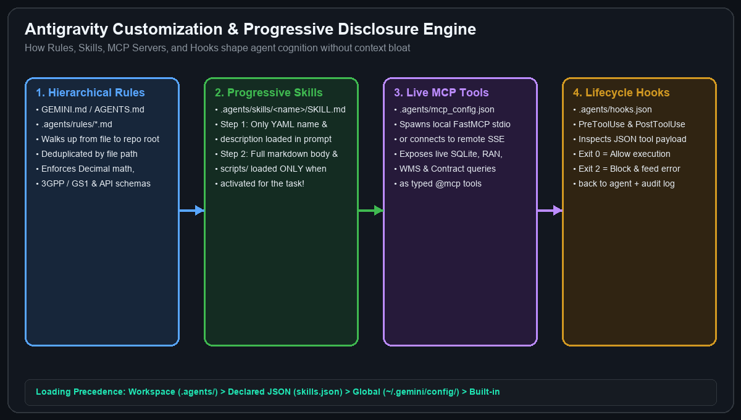
THEORY MODULE 2 (6 MINUTES) • CUSTOMIZATION ARCHITECTURE
How Rules & Progressive Disclosure Skills Work Internally
Specializing Antigravity for your industry without overflowing the context window
Rules vs. Skills vs. /learn
▸ Hierarchical Rules (GEMINI.md & .agents/rules/*.md): Always-on or model-decided domain invariants loaded from workspace root down to target directories (deduplicated automatically)
▸ Progressive Disclosure Skills (.agents/skills/<name>/SKILL.md): Only lightweight YAML frontmatter (name, description) sits in system prompt; full markdown runbook & scripts/ load ONLY when triggered!
▸ Self-Improving Memory (/learn): Ask Antigravity to codify a newly discovered debugging pattern or architectural standard into a reusable workspace customization
▸ Precedence Hierarchy: Workspace (.agents/) > Declared JSON (skills.json) > Global (~/.gemini/config/) > Built-in
Rule of Thumb: Put permanent guardrails in GEMINI.md/rules; put multi-step workflows & scripts in SKILL.md. | Slide 7/15
Notes:
Explain progressive disclosure: why 50 skills don't bloat the prompt because only YAML frontmatter is loaded until the agent activates a specific skill.

Slide 8
HANDS-ON LAB 2 (PART 1/2) • OBJECTIVES & WHAT YOU WILL BUILD
Lab 2: Workspace Rules & Progressive Skills — Objectives & Build Spec
54 Minutes • Printable PDF Guide: labs/lab-02-rules-and-skills/LAB_02_INSTRUCTIONS_EN.pdf
Lab 2 Objectives & What You Will Build
▸ Objective 1 (Hierarchical Domain Rules): Teach Antigravity permanent 3GPP, TAP3, TMF622, and CPNI invariants so every future prompt obeys telecom standards automatically.
▸ Objective 2 (Progressive Disclosure Skills): Package a repeatable executive audit workflow into .agents/skills/ where only YAML frontmatter loads until triggered on demand.
▸ What You Will Build #1 (GEMINI.md & .agents/rules/telecom-standards.md): Workspace memory & rule files enforcing Decimal(ROUND_HALF_UP), binary GiB (1024**3), PRB < 80%, and CPNI IMSI/MSISDN masking.
▸ What You Will Build #2 (.agents/skills/sla-revenue-audit/SKILL.md): Progressive disclosure skill with YAML frontmatter (name, description) that runs scripts/run_sla_audit.py.
▸ Deliverable & Verification: Generate data/exports/sla_revenue_audit_report.json & .md and pass all 4 tests in ./labs/lab-02-rules-and-skills/verify.sh.
Delivered by Tryolabs • Full printable guide: LAB_02_INSTRUCTIONS_EN.pdf | Slide 8/15
Notes:
Introduce the Lab 2 Objectives and explain the two customization artifacts attendees will build.

Slide 9
HANDS-ON LAB 2 (PART 2/2) • STEP-BY-STEP INSTRUCTIONS & PROMPTS
Lab 2 Instructions & Copy-Paste Antigravity Prompts
Follow Steps 1–5 on the left and copy-paste prompts from labs/lab-02-rules-and-skills/PROMPTS.md
Step-by-Step Lab 2 Instructions
▸ Step 1 (Initialize Lab 02): Run ./labs/lab-02-rules-and-skills/install.sh (automatically applies Lab 01 solution first).
▸ Step 2 (Author Root GEMINI.md): Define OSS/BSS tables (ran_telemetry, b2b_contracts, cdr_records), Decimal(ROUND_HALF_UP) billing math, and 1024 ** 3 GiB.
▸ Step 3 (Author .agents/rules/telecom-standards.md): Codify 3GPP TS 28.552 (PRB < 80%), TAP3 NR_5G roaming rules, TMF622 order states, and CPNI IMSI/MSISDN masking.
▸ Step 4 (Author .agents/skills/sla-revenue-audit/SKILL.md): Add YAML frontmatter (name: sla-revenue-audit, description: ...) and instructions to run ./.venv/bin/python scripts/run_sla_audit.py.
▸ Step 5 (Verify): Run ./labs/lab-02-rules-and-skills/verify.sh (4 passed + executive JSON/MD reports generated).
Copy-Paste Prompts (PROMPTS.md) & Verification
▸ Prompt 1 — Author Workspace Rules: '/plan Create @GEMINI.md and @.agents/rules/telecom-standards.md codifying 3GPP TS 28.552 PRB/PDCP thresholds, binary GiB (10243), Decimal ROUND_HALF_UP, TMF622 order states, and CPNI IMSI/MSISDN masking.'
▸ Prompt 2 — Build Progressive Skill: 'Create @.agents/skills/sla-revenue-audit/SKILL.md with YAML frontmatter (name: sla-revenue-audit) that runs ./scripts/run_sla_audit.py and outputs data/exports/sla_revenue_audit_report.json and .md.'
▸ Prompt 3 — Trigger Skill On-Demand: 'Run an executive 5G Slice SLA and CDR revenue assurance audit using our workspace skill and summarize the top breached contracts.'
▸ Verify Command: Run ./labs/lab-02-rules-and-skills/verify.sh and test /learn!
Delivered by Tryolabs • Self-Healing Checkpoint: ./labs/lab-02-rules-and-skills/apply_solution.sh | Slide 9/15
Notes:
Project this slide during Lab 2 so attendees can follow the 5 steps and copy-paste the prompts.

Slide 10
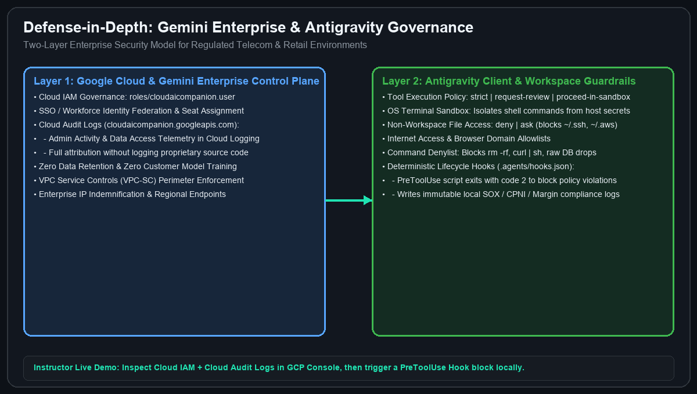
THEORY MODULE 3 (6 MINUTES) • MCP, HOOKS & ENTERPRISE GOVERNANCE
Live MCP Bridge, Deterministic Hooks & Gemini Enterprise Governance
Connecting live databases safely while proving end-to-end enterprise security in Google Cloud
2-Layer Enterprise Security & Governance
▸ Layer 1 — Google Cloud & Gemini Enterprise (Instructor Live Demo): Cloud IAM (roles/cloudaicompanion.user), Cloud Audit Logs (cloudaicompanion.googleapis.com), VPC-SC perimeters, Zero Data Retention / No Training on customer code
▸ Layer 2 — Antigravity Client Security: Tool Execution Policy (strict / request-review / proceed-in-sandbox), OS Terminal Sandbox, Non-Workspace File Access (deny), Command & Browser Allow/Denylists
▸ Live Context via FastMCP (.agents/mcp_config.json): Exposes strongly-typed Python tools querying live SQLite & telemetry over stdio/SSE
▸ Deterministic Lifecycle Hooks (.agents/hooks.json): PreToolUse script inspects tool JSON on stdin; exit code 2 hard-blocks policy violations and writes an immutable audit log!
Instructor Demo: Show Cloud Audit Logs in GCP Console + trigger a deterministic PreToolUse Hook block locally! | Slide 10/15
Notes:
This is a critical module for enterprise architects and CISOs. Show how Google Cloud governs Gemini Enterprise licenses & audit logs in Layer 1, while Antigravity enforces sandboxing and deterministic PreToolUse hooks in Layer 2.

Slide 11
HANDS-ON LAB 3 (PART 1/2) • OBJECTIVES & WHAT YOU WILL BUILD
Lab 3: FastMCP Server & Deterministic Hooks — Objectives & Build Spec
55 Minutes • Printable PDF Guide: labs/lab-03-mcp-and-hooks/LAB_03_INSTRUCTIONS_EN.pdf
Lab 3 Objectives & What You Will Build
▸ Objective 1 (Live Database Grounding via MCP): Expose read-only SQLite OSS/BSS telemetry and contract tools to Antigravity over Model Context Protocol (FastMCP).
▸ Objective 2 (Deterministic Security & CPNI Compliance): Enforce PII/CPNI masking (3104***0001) and hard-block destructive SQL (DROP/DELETE) before tool execution via PreToolUse hooks.
▸ What You Will Build #1 (mcp_server/telecom_mcp.py & .agents/mcp_config.json): 4 @mcp.tool() functions (query_ran_cell_health, calculate_contract_penalty_exposure, inspect_unbilled_cdrs, evaluate_slice_capacity).
▸ What You Will Build #2 (.agents/hooks.json & scripts/audit_hook.py): Deterministic PreToolUse & PostToolUse lifecycle gates returning exit code 2 on policy violations and writing data/logs/hook_audit.log.
▸ Deliverable & Verification: Pass all 6 MCP & Hook security tests in ./labs/lab-03-mcp-and-hooks/verify.sh.
Delivered by Tryolabs • Full printable guide: LAB_03_INSTRUCTIONS_EN.pdf | Slide 11/15
Notes:
Review the Lab 3 Objectives and the FastMCP + Hook components attendees will build.

Slide 12
HANDS-ON LAB 3 (PART 2/2) • STEP-BY-STEP INSTRUCTIONS & PROMPTS
Lab 3 Instructions & Copy-Paste Antigravity Prompts
Follow Steps 1–5 on the left and copy-paste prompts from labs/lab-03-mcp-and-hooks/PROMPTS.md
Step-by-Step Lab 3 Instructions
▸ Step 1 (Initialize Lab 03): Run ./labs/lab-03-mcp-and-hooks/install.sh (auto-applies Labs 01–02).
▸ Step 2 (Complete mcp_server/telecom_mcp.py): Implement calculate_contract_penalty_exposure, inspect_unbilled_cdrs (masking imsi/msisdn via _mask_cpni), and evaluate_slice_capacity.
▸ Step 3 (Register .agents/mcp_config.json): Configure telecom-nexus-mcp invoking ./.venv/bin/python mcp_server/telecom_mcp.py over stdio.
▸ Step 4 (Configure .agents/hooks.json): Wire PreToolUse and PostToolUse to scripts/audit_hook.py (blocks DROP/TRUNCATE/DELETE with exit code 2).
▸ Step 5 (Verify): Run ./labs/lab-03-mcp-and-hooks/verify.sh (6 passed + audit log verified).
Copy-Paste Prompts (PROMPTS.md) & Verification
▸ Prompt 1 — Complete FastMCP Server: '/plan Implement the 3 remaining @mcp.tool() functions in @mcp_server/telecom_mcp.py (calculate_contract_penalty_exposure, inspect_unbilled_cdrs with CPNI masking, evaluate_slice_capacity) to match @tests/test_lab03_mcp_hooks.py.'
▸ Prompt 2 — Wire MCP & Hooks Config: 'Create @.agents/mcp_config.json for telecom-nexus-mcp and @.agents/hooks.json wiring PreToolUse and PostToolUse to ./scripts/audit_hook.py.'
▸ Prompt 3 — Test Hook Block (Exit Code 2): Run echo '{"command":"sqlite3 data/telecom_nexus.db \"DROP TABLE b2b_contracts;\""}' | ./.venv/bin/python scripts/audit_hook.py --phase pre
▸ Verify Command: Run ./labs/lab-03-mcp-and-hooks/verify.sh and inspect data/logs/hook_audit.log.
Delivered by Tryolabs • Self-Healing Checkpoint: ./labs/lab-03-mcp-and-hooks/apply_solution.sh | Slide 12/15
Notes:
Keep this slide displayed during Lab 3 so attendees can follow Steps 1-5 and test the PreToolUse hook block.

Slide 13
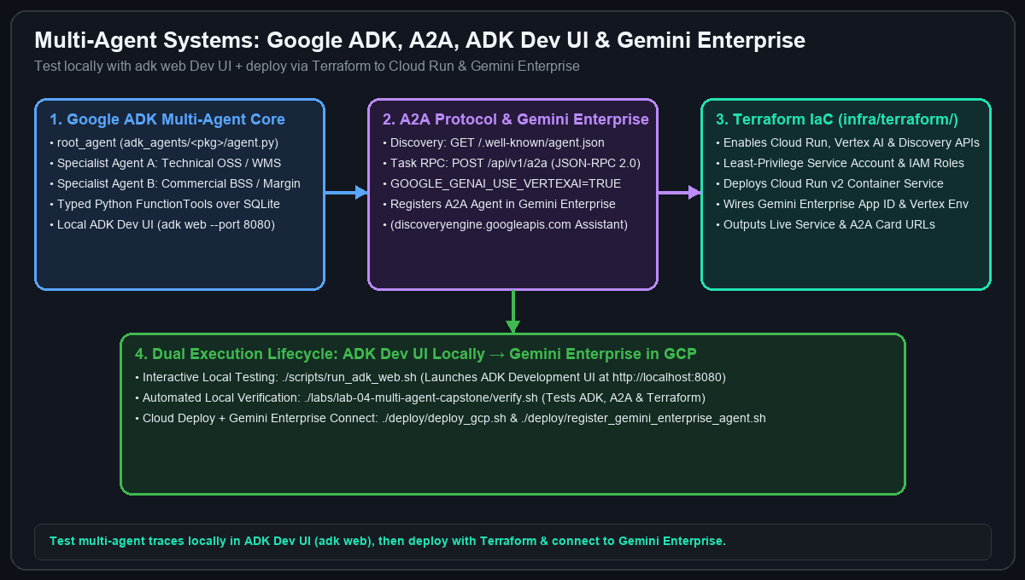
THEORY MODULE 4 (6 MINUTES) • SUBAGENTS, GOOGLE ADK, A2A & TERRAFORM
Multi-Agent Systems with Google ADK, A2A Protocol & Terraform
Designing multi-agent architectures locally with adk web and deploying to Cloud Run & Gemini Enterprise
End-to-End Multi-Agent Architecture
▸ Antigravity Subagents (/teamwork, /boost, /grill-me): Delegate parallel coding & research tasks inside Antigravity to build your application faster
▸ Google ADK (Agent Development Kit): Build domain multi-agent hierarchies (root_agent orchestrating Technical & Commercial specialist LlmAgents with typed Python tools)
▸ Local Testing via ADK Dev UI (adk web): Launch ./scripts/run_adk_web.sh (http://localhost:8080) to interactively inspect multi-agent event traces, tool calls, and session state!
▸ A2A (Agent2Agent) Protocol: Publish GET /.well-known/agent.json (Agent Card) and POST /api/v1/a2a (JSON-RPC 2.0 tasks/send) for cross-agent interoperability
▸ Terraform + Gemini Enterprise: Provision Cloud Run v2 & IAM via infra/terraform/ (deploy_gcp.sh) and register your A2A agent into Gemini Enterprise (register_gemini_enterprise_agent.sh)
Develop & test 100% locally with adk web + pytest, then deploy to Google Cloud & Gemini Enterprise with Terraform! | Slide 13/15
Notes:
Explain the synergy between Antigravity subagents (which help you write the code) and Google ADK + A2A (the runtime multi-agent system you build, test locally in adk web, deploy with Terraform, and register in Gemini Enterprise).

Slide 14
HANDS-ON LAB 4 CAPSTONE (PART 1/2) • OBJECTIVES & WHAT YOU WILL BUILD
Lab 4 Capstone: Multi-Agent ADK, A2A & Terraform — Objectives & Build Spec
55 Minutes • Printable PDF Guide: labs/lab-04-multi-agent-capstone/LAB_04_INSTRUCTIONS_EN.pdf
Lab 4 Objectives & What You Will Build
▸ Objective 1 (Multi-Agent System Design with Google ADK & A2A): Design a coordinator + specialist multi-agent hierarchy using Google ADK (LlmAgent) and expose it over the A2A JSON-RPC 2.0 protocol.
▸ Objective 2 (Local ADK Dev UI & Cloud Terraform Deployment): Test multi-agent trajectories locally in adk web (http://localhost:8080) and provision Cloud Run + Gemini Enterprise registration via Terraform.
▸ What You Will Build #1 (src/services/order_feasibility.py): TMF622 5G slice feasibility evaluator (PRB < 80%) and autonomous neighbor-cell load steering engine (remediate_slice_for_order).
▸ What You Will Build #2 (src/agents/adk_a2a_orchestrator.py & adk_agents/telecom_nexus/): RANSliceCapacityAgent + BSSCommercialSLAAgent coordinated by TelecomNexusOrchestratorAgent, plus GET /.well-known/agent.json & POST /api/v1/a2a.
▸ What You Will Build #3 (Cloud Infrastructure): Validate infra/terraform/main.tf and Gemini Enterprise registration via ./labs/lab-04-multi-agent-capstone/deploy_gcp.sh --dry-run.
Delivered by Tryolabs • Full printable guide: LAB_04_INSTRUCTIONS_EN.pdf | Slide 14/15
Notes:
Introduce the Capstone Objectives and the 3 major deliverables: TMF622 Feasibility Engine, Google ADK + A2A Multi-Agent Orchestrator, and Terraform + Gemini Enterprise deployment.

Slide 15
HANDS-ON LAB 4 CAPSTONE (PART 2/2) • STEP-BY-STEP INSTRUCTIONS & PROMPTS
Lab 4 Instructions, adk web Testing & Terraform Cloud Deploy
Follow Steps 1–5 on the left and copy-paste prompts from labs/lab-04-multi-agent-capstone/PROMPTS.md
Step-by-Step Lab 4 Instructions
▸ Step 1 (Initialize Lab 04): Run ./labs/lab-04-multi-agent-capstone/install.sh.
▸ Step 2 (TMF622 Order Engine): Implement evaluate_order_feasibility() & remediate_slice_for_order() in src/services/order_feasibility.py (neighbor cell PRB steering).
▸ Step 3 (Google ADK & A2A Orchestrator): Complete src/agents/adk_a2a_orchestrator.py (RANSliceCapacityAgent, BSSCommercialSLAAgent, TelecomNexusOrchestratorAgent, GET /.well-known/agent.json, POST /api/v1/a2a).
▸ Step 4 (Local ADK Dev UI): Run ./scripts/run_adk_web.sh and test telecom_nexus interactively at http://localhost:8080.
▸ Step 5 (Terraform & Full Verification): Run ./labs/lab-04-multi-agent-capstone/deploy_gcp.sh --dry-run and ./labs/lab-04-multi-agent-capstone/verify.sh (21/21 tests pass!).
Copy-Paste Prompts, adk web & Cloud Commands
▸ Prompt 1 — Feasibility Engine: '/plan Implement evaluate_order_feasibility and remediate_slice_for_order in @src/services/order_feasibility.py per 3GPP TS 28.552 PRB < 80% and neighbor cell steering.'
▸ Prompt 2 — ADK + A2A Orchestrator: '/teamwork Implement RANSliceCapacityAgent, BSSCommercialSLAAgent, TelecomNexusOrchestratorAgent, get_a2a_agent_card, and handle_a2a_jsonrpc_request in @src/agents/adk_a2a_orchestrator.py.'
▸ Prompt 3 — Interactive adk web (http://localhost:8080): 'Evaluate TMF622 order ORD-TMF622-9001, execute autonomous 5G slice remediation, and calculate protected ACV.'
▸ Cloud Deploy & Verify: Run ./labs/lab-04-multi-agent-capstone/deploy_gcp.sh --dry-run and ./labs/lab-04-multi-agent-capstone/verify.sh.
Delivered by Tryolabs • Self-Healing Checkpoint: ./labs/lab-04-multi-agent-capstone/apply_solution.sh | Slide 15/15
Notes:
Keep this slide projected during the Lab 4 Capstone as attendees test in adk web and validate Terraform.

