Slide 1


Slide 2

Debugging
December 2016

Slide 3
Index
1_ Debugging
1_1 Debugging (Static analysis)
1_2 Debugging (Dynamic analysis)
2_ PTRACE, STRACE, LTRACE
3_ GDB
4_ Radare
5_ Chrome
6_ Debbugging countermeasures

Slide 4


Debugging

Slide 5
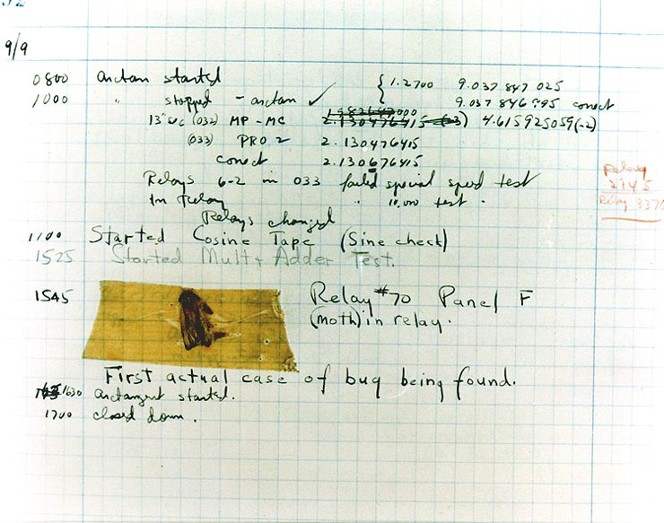
Debbuging
The use of the word bug as a synonym for error (unwanted result) originated in engineering. The term's application to computing and the inspiration for using the word debugging as a synonym for troubleshooting has been attributed to Admiral Grace Hopper in the 1940s.

Slide 6
1.1_ Debbuging
In computer programming and engineering:
Is a multistep process that involves identifying a problem or action.
Isolating the source of the problem or action.
Correcting the problem or determining a way to work around it.
When debugging we can do:
Can changing the value of variables at run-time, pause the program temporarily, list source code, print the datatype of a variable or struct, jump to an arbitrary line of code…
On a running process; you don't even have to kill the process.
On a process that has already crashed and died without having to re-run the program. You'll see the state the program was in at the time of death and can inspect all the variables.

Slide 7
1.1_ Debbuging
To effectively learn how to use a debbuger, we must understand registers and stack frames.
To learn about the stack frames, we need to learn about the memory layout of an executing program.
To understand memory layout, we must learn the structure of executable file.

Slide 8
1.1_ Debbuging
Static vs Dynamic:
In static analysis:
We can obtain some information about binary: File structure, code, initialized variables, no initialized variables, immutable strings, dead code...
Avoid most anti-analysis techniques.
In dynamic analysis:
Memory mapping analysis, CPU registers, status program analysis…
Faster than static analysis.

Slide 9
Debugging (Static analysis)
1.1

Slide 10
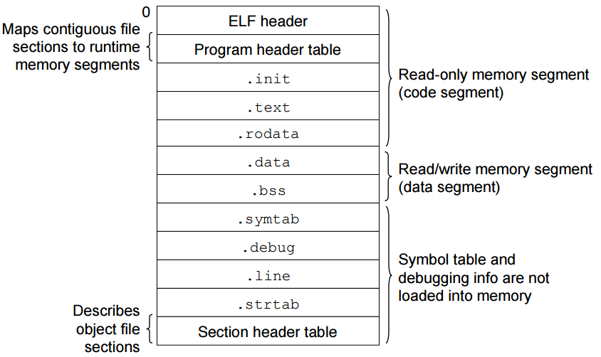
1.1.1_ Debbuging
Structure of binary file format (Executable and Linkable format (ELF):

Slide 11
1.1.1_ Debbuging
ELF binary files consist of an ELF header followed by a few segments.
Each segment, in turn, includes one or more sections. The length of each segment and of each section is specified in the ELF header.
Most segments, and thus most sections, have an initial address which is also specified in the ELF header. In addition, each segment has its own access rights.
The linker merges together all sections of the same type included in the input object files into a single section and assigns an initial address to it.
For instance, the .text sections of all object files are merged together into a single .text section, which by default contains all of the code in the program.
Executable files include four canonical sections called, by convention, .text, .data, .rodata, and .bss:
The .text section contains executable code and is packed into a segment which has the read and execute access rights.
The .data and .bss sections contain initialized and uninitialized data respectively, and are packed into a segment which has the read and write access rights.

Slide 12
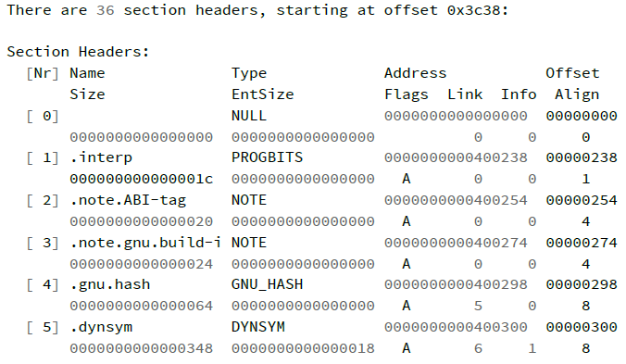
1.1.2_ Debbuging
Executable and Linkable Format (ELF):
Is the standard format for Linux executables, shared libraries, and core dumps.
$ readelf –S [executable]

Slide 13
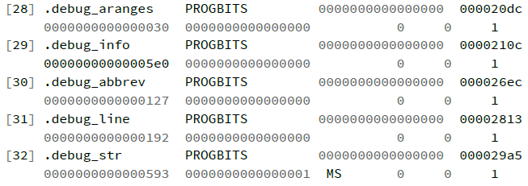
1.1.2_ Debbuging
These sections contains the debugging information in DWARF.
DWARF: Debbuging With Attributed Record Format is the default format uses to store debugging information.
The segments contain information that is necessary for runtime execution of the file, while sections contain important data for linking and relocation.

Slide 14
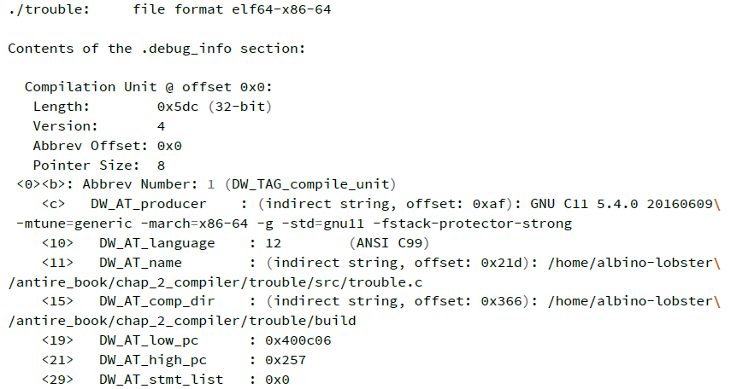
1.1.2_ Debbuging
Objdump displays information about one or more object files.
$ objdump --dwarf=info [executable]
Full path of source file.
Full path compilation directory.
Version of C used.
Variable was declared.
(NOTE) All this information is never available in our analysis.

Slide 15
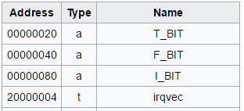
1.1.3_ Debbuging
Symbol table:
Can be associated to an object, archive library or executable file. (.obj, .lib, .exe, .map).
This table stores the location of functions and variables by name.
Holds information needed to locate and relocate a program's symbolic definitions and references.
Symbol tables may be embedded into the program, or stored as a separate file.
A program without the symbol table is called a “retail” build, and is more difficult to reverse-engineer.

Slide 16
1.1.3_ Debbuging
Symbol types:
A: Absolute symbol, global.
a: Absolute symbol, local.
D: Initialized data, global.
d: Initialized data, local.
T: Text symbol, global.
t: Text symbol, local
U: Undefined symbol. (should be resolved by linking against another object file)
?: Unknown symbol.

Slide 17
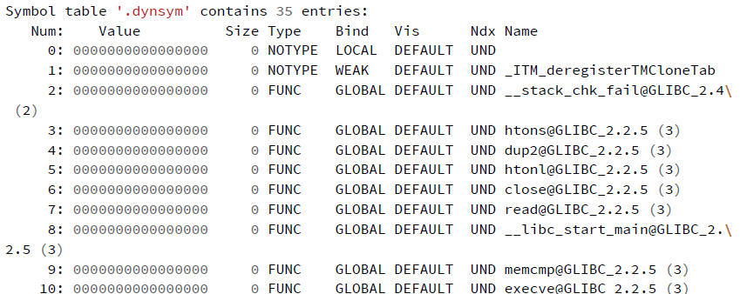
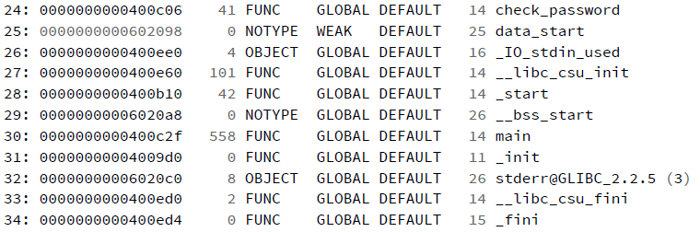
1.1.3_ Debbuging
$ readelf –-syms [executable]

Slide 18
Debugging (Dynamic analysis)
1.2

Slide 19
1.2.1_ Debbuging
Virtual Memory:
When a process is created, the kernel provides a chunk of physical memory which can be located anywhere at all called virtual memory space.
A process is unaware of the details of its physical memory (i.e. where it physically resides). All the process knows is how big the chunk is and that its chunk begins at address 0.
Unaware of any other chunks of VM belonging to other processes.
Even if the process did know about other chunks of VM, it's physically prevented from accessing that memory.
Each time a process wants to read or write to memory, its request must be translated from a VM address to a physical memory address (MMU).

Slide 20
1.2.1_ Debbuging
Memory Layout:
Kernel VM
High Address (0xC00000000)
Args and environment var
Text Seg.: ELF and code to be executed.
Stack: Stores local variables and function parameters in most programming languages.
Calling a method or function pushes a new stack frame onto the stack.
The stack frame is destroyed when the function returns.
MMS: It is used for loading dynamic libraries. Ex: /lib/libc.so
Heap: Provides runtime memory allocation.
Stack
Memory mapping segment
Heap
Data Segment
(static variables)
Text Segment
Low Address (0x00000000)

Slide 21
1.2.1_ Debbuging
Memory Layout:
Linux randomizes the stack, memory mapping segment, and heap by adding offsets to their starting addresses.
Unfortunately the 32-bit address space is pretty tight, leaving little room for randomization and hampering its effectiveness.

Slide 22
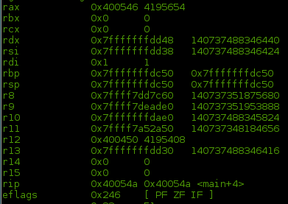
1.2.2_ Debbuging
General purpose registers for Linux x86 and x86-64:
AX, EAX, RAX: Acumulator for 16, 32 and 64 bits.
CX, ECX, RCX: Count.
SP, ESP, RSP: Stack pointer.
BP, EBP, RBP: Stack base pointer.
EIP, RIP: Instruction pointer.
EFLAGS

Slide 23
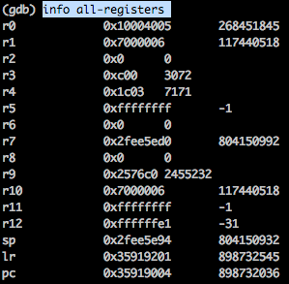
1.2.2_ Debbuging
ARM registers:
R0..R12: 13 general purpose registers.
SP (R13): Stack pointer.
LR (R14): Link register to store the return address when a subroutine call is made.
PC (R15): Program counter.
APSR: The Application Program
Status Register holds copies of the
Arithmetic Logic Unit (ALU) status
flags.

Slide 24
1.2.3_ Debbuging
The /proc/ filesystem:
The /proc file system contains an imaginary or virtual file system. This does not exist physically on disk, but the core creates it in memory. It is used to provide information related to the system (originally about processes, hence its name).
/proc/[pid]/maps The file contains the currently mapped memory regions and their access permissions, also memory maps to executables and library files.
/proc/[pid]/environ Values of environment variables.
/proc/[pid]/mem Memory held by this process.
/proc/[pid]/statm Process memory status information.
/proc/[pid]/status Process status in human readable form.

Slide 25
PTRACE
2

Slide 26
2.1_ PTRACE
System call provides a means by which one process (the "tracer") may observe and control the execution of another process (the "tracee"), and examine and change the tracee's memory and registers.
It is primarily used to implement breakpoint debugging and system call tracing.
Most debugging tools are based on ptrace (e.g: gdb). ptrace is extremely useful but almost unknown syscall.
Only one tracer can control a tracee at a time. Useful from an anti debugging point of view we are able to determine if a debugger is attached to an object simply by calling ptrace().

Slide 27
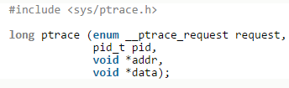
2.2_ PTRACE
_ptrace_request request: A code provided to ptrace telling it which operation to perform.
pid_t pid: The task ID to perform the operation on.
void *addr: The address in memory for which to read or write for certain ptrace operations; other operations ignore this parameter.
void *data: Address for various data structures to be read/written to/from the process.

Slide 28
2.2_ PTRACE
Ptrace_request:
_ptrace_attach: Used by a task when it wishes to trace the execution of another task.
_ptrace_detach: If the parent attached to the child, “re-parents” the child back to its original parent process.
_ptrace_cont: When wait() indicates that the child has stopped after receiving a signal to get it running again.
_ptrace_peektext / _ptrace_peekdata: Read words from the child task’s data address space and inspect the values.
_ptrace_getregs / _ptrace_setregs: Reading and writing the general-purpose register values for the child process.

Slide 29
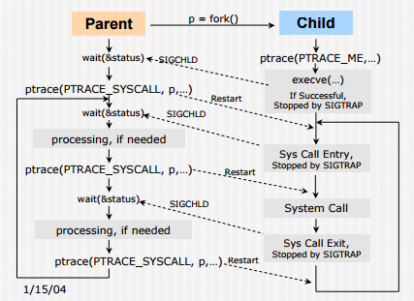
2.2_ PTRACE
Sample code:

Slide 30
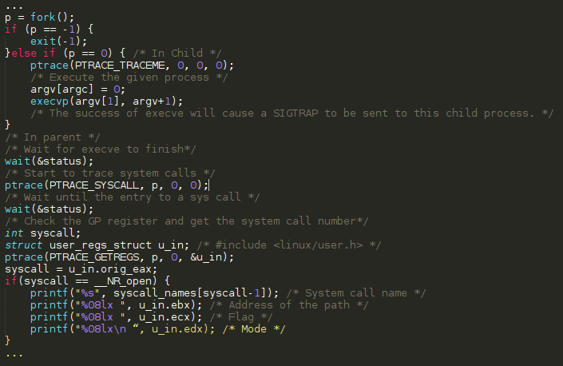
2.2_ PTRACE
Sample code:

Slide 31
2.3_ STRACE
It intercepts and records the system calls which are called by a process and the signals which are received by a process. The name of each system call, its arguments and its return value are printed
It can filter based on the specific system call or groups of system calls
It can profile the use of system calls by tallying up the number of times a specific system call is used, and the time taken, and the number of successes and errors.
It traces signals sent to the process.
It can attach to any running process by pid

Slide 32
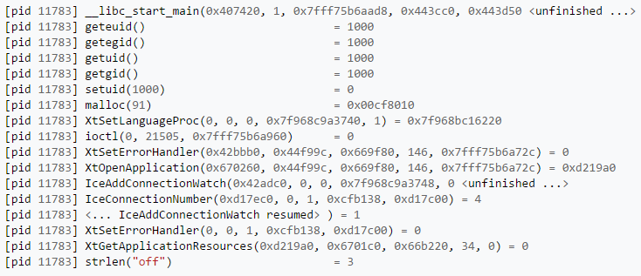
2.4_ LTRACE
It intercepts and records the dynamic library calls which are called by the executed process and the signals which are received by that process. It can also intercept and print the system calls executed by the program.
Is able to record these calls by using ptrace to insert breakpoints at the beginning of the loaded functions.

Slide 33
GDB
3

Slide 34

3.1_ GDB
Symbolic Command line debugger by GNU project.
GDB can step through the source code line-by-line or even instruction by instruction.
Watch the value of any variable at run-time.
It allows you to inspect what the program is doing at a certain point during execution.
Graphical tools: Data Display Debugger (DDD).

Slide 35
3.2_ GDB
Basic operations:
run: Executes the program.
start: Executes the program but stop in main function.
break: Put a breakpoint in specified point (name fuction, line…).
list: Display source code.
info: Generic command for showing things about the program being debugged.
print: Display expression value.
next: Executes next instruction, (no enter in function calls).
step: Executes next instruction, (enter in function calls).
set: Change a value of registers or variable.
finish: Upon return, the value returned is printed and put in the value history.

Slide 36
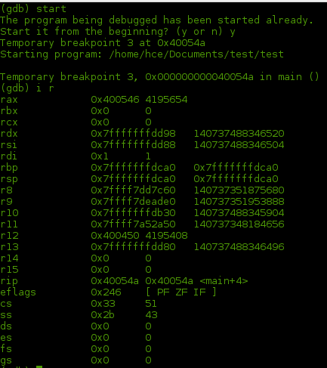
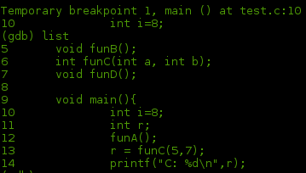
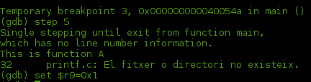
3.3_ GDB
Example commands:
Img.2 – list command (source code)
Img.1 - Info registers command
Img.3 – step & set command

Slide 37
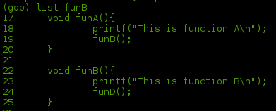
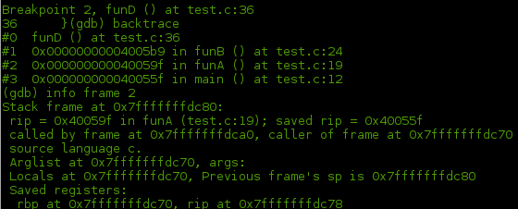
3.3_ GDB
Example commands:
Img.4 – list command (fun source code)
Img.5 – backtrace and info frame commands

Slide 38
3.4_ GDB
Remote GDB:
We need the following two utilities to perform a remote debugging:
gdbserver – Run this on your target system
GDB – Execute this on your host system to connect to your target system.
Run gdbserver [:port] - -attach [pid] & : With pid of process to debug.
In client device ($ adb forward tcp:[port] tcp:[port])
Run ./gdb : Launch a native debugging session for your NDK-generated machine code. (/android/ndk/android-ndk-r12b/prebuilt/linux-x86_64/bin/)
gdb$ set sysroot : Specifies the local directory that contains copies of target libraries in the corresponding subdirectories.
gdb$ set solib-search-path ./ : Specifies directories where GDB will search for shared libraries with symbols.
gdb$ target remote [host][:port] : If your remote target is actually running on the same machine as your debugger session, you can omit the hostname.

Slide 39
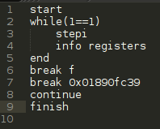
3.5_ GDB
Automate debbuging in GDB:
You can automate debugging with gdb using source files with gdb commands.
- source [filename]: Execute the gdb instructions sequentially in file.
Img.1 – example body of source file

Slide 40

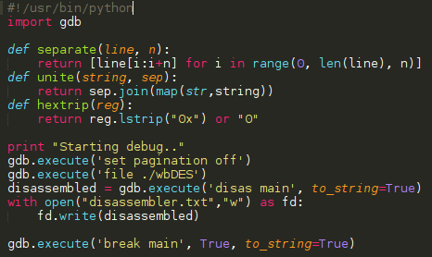
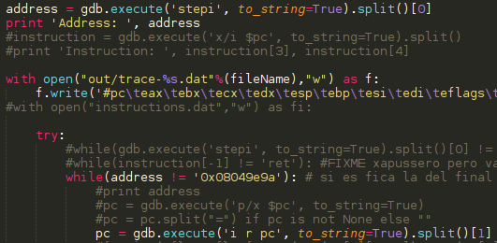
3.6_ GDB
Python scripts to extends GDB:
You can extend gdb using the Python programming language. The python feature is available only if gdb was configured using --with-python.
gdb –x [python file]
Img.2 – example body of python file
Img.1 – example body of python file

Slide 41
Radare
4

Slide 42
4.1_ Radare
A rewrite from scratch of radare in order to provide a set of libraries and tools to work with binary files.
Started as a forensics tool, a scriptable command line hexadecimal editor able to open disk files, but later support for analyzing binaries, disassembling code, debugging programs, attaching to remote gdb servers.
Architectures: arm, avr, bf, blackfin, xap, dalvik, dcpu16, gameboy, i386, i4004, i8080, m68k, malbolge, mips, msil, msp430, nios II, powerpc, rar, sh, snes, sparc, tms320 (c54x c55x c55+), V810, x86-64, zimg, risc-v.
File formats: bios, CGC, dex, elf, elf64, filesystem, java, fatmach0, mach0, mach0-64, MZ, PE, PE+, TE, COFF, plan9, dyldcache, Commodore VICE emulator, Game Boy (Advance), Nintendo DS ROMs and Nintendo 3DS FIRMs.
OS: Android, GNU/Linux, iOs, Windows..

Slide 43
4.2_ Radare
Is composed by a set of small utilities that can be used together or independently.
Radare:
The core of the hexadecimal editor and debugger. Allows to open any kind of file from different IO access like disk, network, kernel plugins, remote devices, debugged processes, ... and handle any of them as if they were a simple plain file.
Implements an advanced command line interface for moving around the file, analyzing data, disassembling, binary patching, data comparision, searching, replacing, scripting with ruby, python, lua and perl, ...
Rabin:
Extracts information from executable binaries like ELF, PE, Java CLASS, MACH-O. It's used from the core to get exported symbols, imports, file information, xrefs, library dependencies, sections, ...
Rasm:
Commandline assembler and disassembler for multiple architectures.

Slide 44
4.2_ Radare
Rasc:
Small utility to prepare buffers or shellcodes for exploiting vulnerabilities. It has an internal hardcoded database of shellcodes and a syscall-proxy interface with some nice helpers like fillwith nops, breakpoints, series of values to find the landing point, etc...
Rahash:
Implementation of a block-based rahash for small text strings or large disks, supporting multiple algorithms like md4, md5, crc16, crc32, sha1, sha256, sha384, sha512, par, xor.
Radiff:
Binary diffing utility with multiple algorithms implemented inside. Supports byte-level.
Rsc:
Entrypoint for calling multiple small scripts and utilities that can be used from the shell.

Slide 45
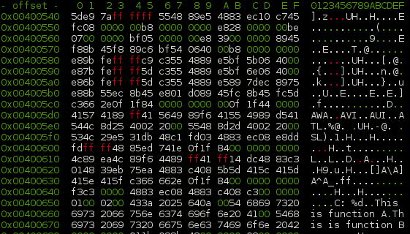
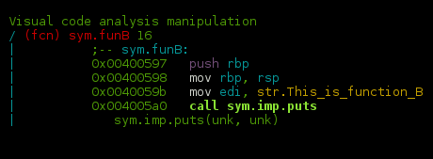
4.3_ Radare
$ r2 ./hello_world
$ run ‘aa’ or ‘aaa’ to analyze all code.
$ ‘V’ to enter Visual Mode.
$ ‘v’ to view the graph of a function.
$ ‘p’ show the disassembly at the current location. ‘p’ again show registers state.

Slide 46
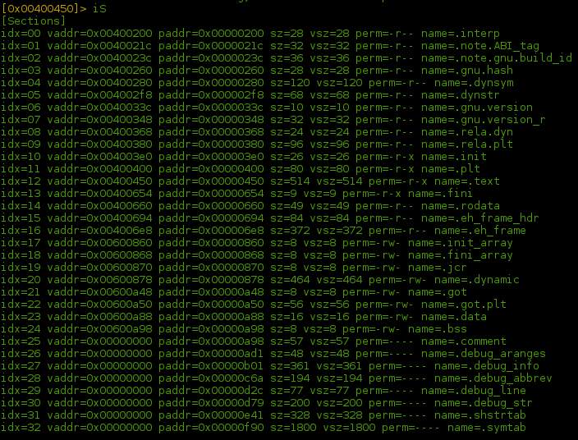
4.3_ Radare
$ iS -> View Sections and their permissions.

Slide 47
Chrome
5

Slide 48
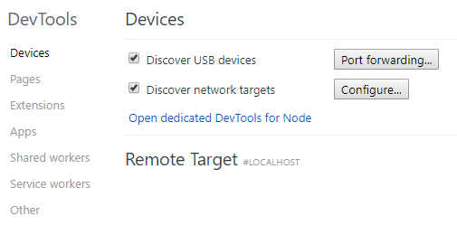
5.1_ Chrome
Chrome includes a functionality to debug WebView applications.
The debugging functionallity is only available if the debug is enabled in the WebView “WebView.setWebContentsDebuggingEnabled(true);”
The functionality is available in chrome://inspect

Slide 49
5.2_ Chrome
Is composed by a set utilities that are available together. The most relevant ones are:
Console:
The console allows to execute JavaScript code.
Network:
Networking analysis of the different petitions sent by the WebView.
Filesystem:
Utility to view the data stored by the WebView (cookies, etc.).
Breakpoint/Call stack:
Utility to set, remove breakpoints and also analyze the call stack.

Slide 50
Debugging Countermeasures
6

Slide 51
6.1_ Debugging Countermeasures
Only one debugger may be connected to a debugged process.
This fact can be used to prevent applications from being debugged by a 3rd party.
Other anti-debugging tricks include:
messing with debugger memory structures
Treating signals such as SIGTRAP
Checking available info about a process status

Slide 52
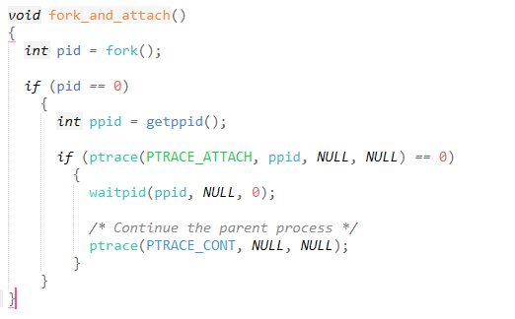
6.2_ Ptrace
We can use ptrace to attach a forked child to our process:
Beware that ptrace “tricks” based on PTRACE_TRACEME instead of PTRACE_ATTACH won’t work on Android 4.4 or newer due to permission restrictions .

Slide 53
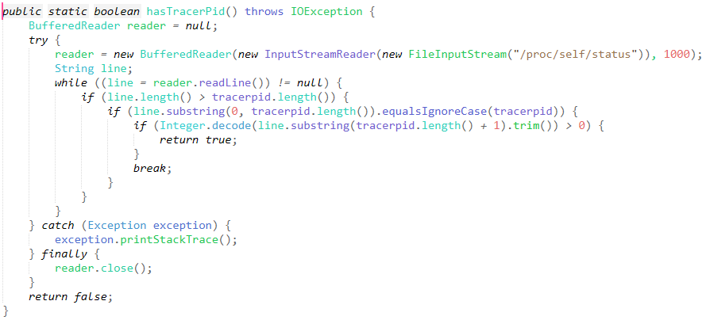
6.3_ /proc/self/status
This code checks /proc/self/status for the existence of a tracer

Slide 54
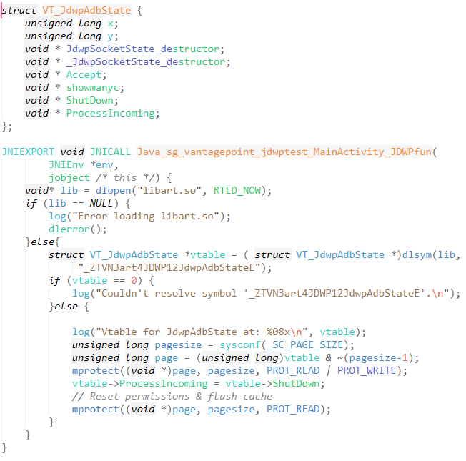
6.4_ JDWP
This code changes the pointer of jdwpAdbState::ProcessIncoming with the address of JdwpAdbState::Shutdown. This makes the debugger to disconnect immediately.

Slide 55
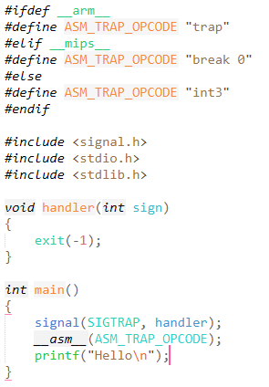
6.5_ SIGTRAP
We can intercept inside our code the trap signal, which is the one used to create breakpoints when debugging. This code shows that we can redirect our flow whenever a SIGTRAP is launched.

