Slide 1

Clearline
Get paid in digital dollars without the detective work.
Digital dollars: stablecoins such as USDC and USDT.
Working demo · seeking feedback
Aashmiin Kaur · Singapore Management University · October 2026
Notes:
SAY: Thank you for making time. This is Clearline, a working demo I built on my own. It helps a business that gets paid in digital dollars (stablecoins) by doing the detective work that today falls on a finance person. I'm here for honest feedback, not to sell anything.
LABELS: no factual claims on this slide.

Slide 2
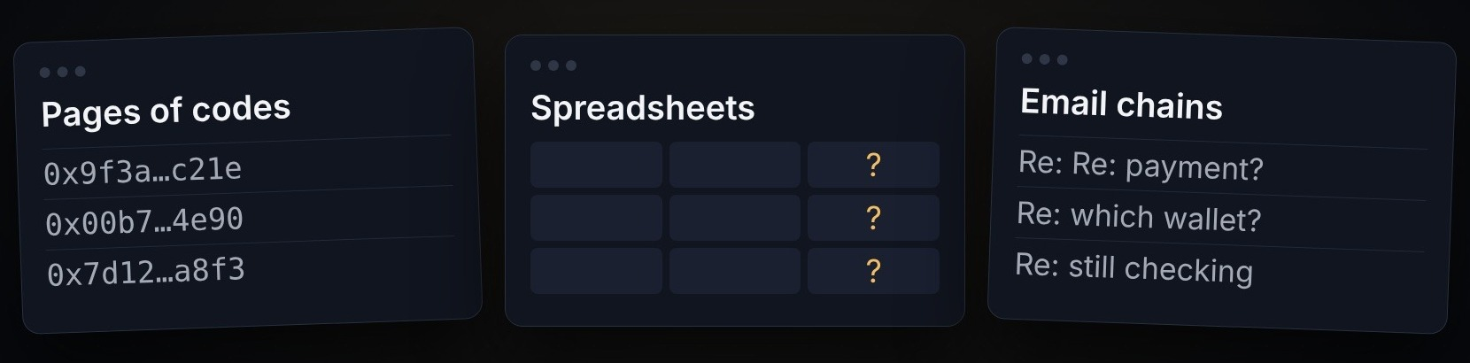
Paid in seconds. Checked for hours.
“We paid INV-1043 in full yesterday. Please confirm and close the invoice.”
What a finance manager like Maya (illustrative) opens to find one payment [ASSUMPTION]
Illustrative message · fictional demo company
Seconds to pay.
Hours to check. [ASSUMPTION]
Ethereum adds a block about every 12 s (ethereum.org); receivers may wait minutes for confirmations. “Hours” is our assumption, to be tested in interviews.
Notes:
SAY: Imagine Maya, a finance manager (an illustrative persona) whose customers pay in digital dollars. The money arrives in seconds, but every time something is off, she ends up in pages of codes, spreadsheets and email chains to work out what happened. The message on the right is the kind she gets every day. "Hours" is our assumption: it is the first thing the interviews must confirm.
LABELS: "arrives in seconds" — [VERIFIED as general knowledge: stablecoin transfers settle on-chain within seconds to minutes; e.g. Ethereum blocks are ~12 s (ethereum.org/developers/docs/blocks)]. "Takes hours" — [ASSUMPTION], untested. The quote is illustrative, taken from the product's fictional demo data (Orbit Retail, INV-1043), not from a real customer.

Slide 3
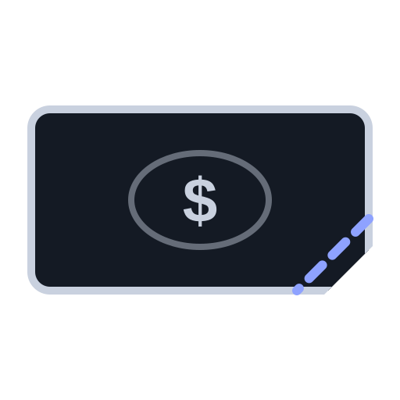



Four things go wrong with these payments
A token transfer records sender, receiver and amount: no invoice reference.¹
Paid a little
too little
Sent on the
wrong network
Counterfeit
digital dollars
No invoice
number
Today a person sorts out each one. How often each happens is what the interviews will measure. [ASSUMPTION]
¹ ERC-20 standard (eips.ethereum.org/EIPS/eip-20). Real cases in our tests include 13 fake-USDT and 6 wrong-network transfers (demo/REPORT.md).
Notes:
SAY: Four things go wrong. Customers pay a little too little, for example because an exchange took a fee (how often is an assumption the interviews will measure). They send on the wrong network, like using the wrong road. Some are tricked into paying with counterfeit digital dollars: anyone can create a token with the same name. And many forget to say which invoice they're paying, because a blockchain transfer has no reference field.
LABELS: "A transfer carries an amount and an address, not an invoice number" — [VERIFIED] ERC-20 standard: a Transfer has only from, to and value (eips.ethereum.org/EIPS/eip-20). Fake tokens with real names — [VERIFIED] any contract can set its own name/symbol (same standard). Which of the four is most common and how often — [ASSUMPTION], untested.

Slide 4



A smart cashier for digital-dollar payments
It does the checking a finance person does today, and shows its work.
Customers know exactly how to pay
Correct payments tick themselves off
Problems explain themselves
Amount, network and address on one page
Checked and marked paid automatically
The cause in plain English, and the reply drafted
All three run in the working demo today, on fictional data. Clearline reads payments; it never holds or moves money.
Notes:
SAY: Clearline is a smart cashier for digital-dollar payments. Before anyone pays, it tells the customer exactly what to send, on which network and to which address. When a payment arrives correctly, it ticks the invoice off by itself. When something is wrong, it explains why in plain English and drafts the reply to the customer. It never moves money; a person makes every decision that isn't routine.
LABELS: these are product capabilities, [VERIFIED] in the working demo (demo/REQUESTS_DEMO.md, "Working now" column). Real-world accuracy of the payment-matching side — not yet tested on real data (demo/REPORT.md).

Slide 5
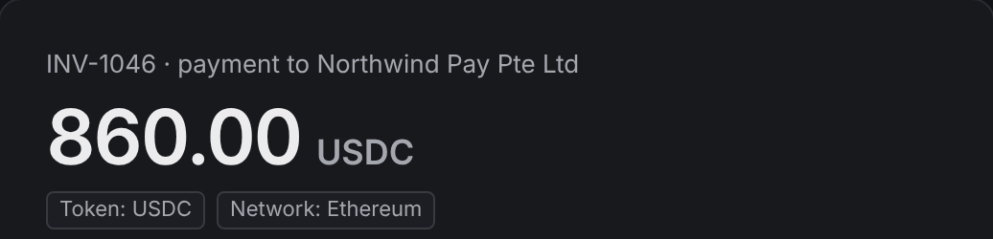
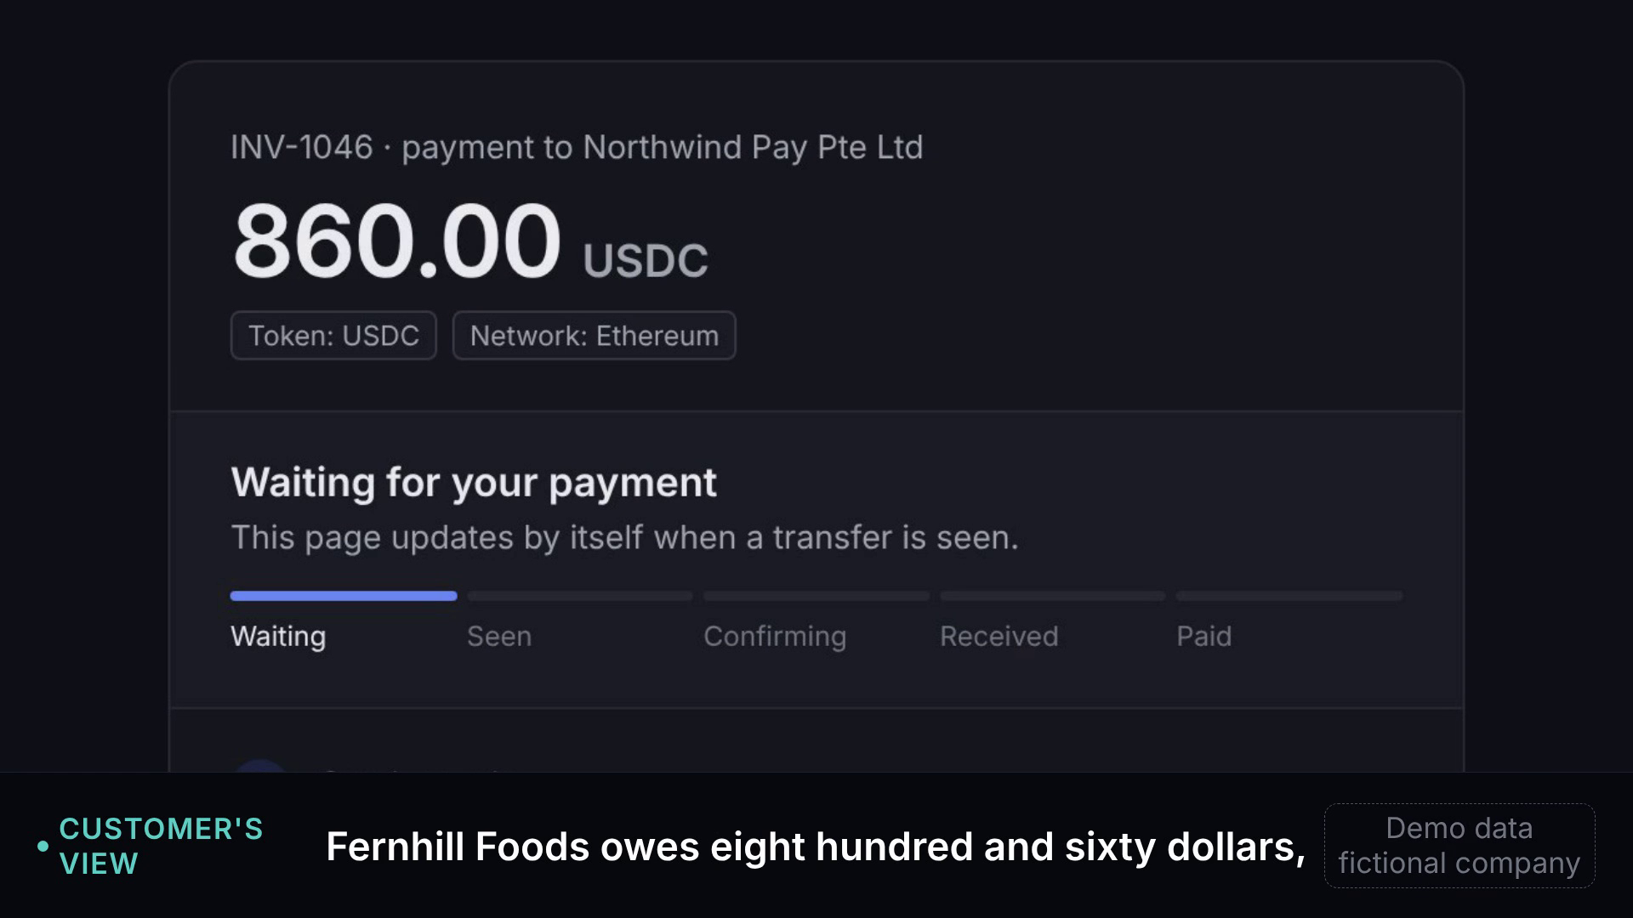
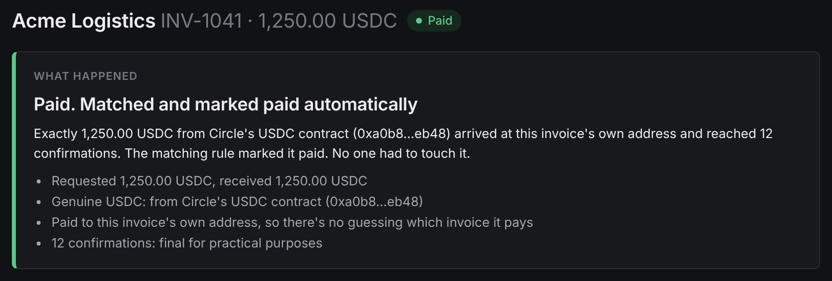
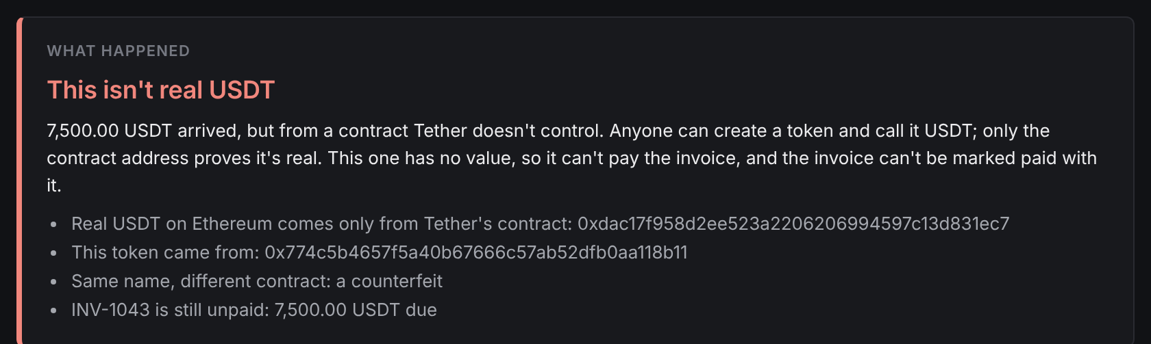
The working demo
1
The customer sees exactly what to send, and where
2
A correct payment marks itself paid
▶ Live demo · 60 s · click to play
Full 2-minute walkthrough: demo_live_full.mp4
3
Fake digital dollars, explained in plain English
Real screenshots and a real recording of the app in demo mode. All companies, people and amounts are fictional.
Notes:
SAY: Here is the real product, running on a fictional company. One: the customer's payment page says exactly what to send and on which network. Two: a correct payment is checked and marked paid with no one touching it. Three: fake digital dollars are caught, explained in plain English, and can't be marked paid by mistake. [Click the video to play the 60-second demo; for the full 2-minute walkthrough, play demo_live_full.mp4.]
LABELS: screenshots captured from the app in demo mode (pitch/assets/shots); all data fictional. [VERIFIED]

Slide 6
Why now: rules, money and rails are arriving
Rules
Business use
Gateways
US GENIUS Act signed, 18 Jul 2025 1
MAS consulted on stablecoin law changes, Sep–Oct 2026 2
~US$226B a year of business stablecoin payments: an estimate, ~0.01% of B2B payments 3
Singapore: a top-5 sender of stablecoin payments 4
Stripe: US, EU/HK in preview; not Singapore; USDC, max US$10k 5
HitPay + Triple-A: offered to 20,000+ Singapore merchants 6
1 eco.com GENIUS tracker · 2 mas.gov.sg, Gibson Dunn · 3 McKinsey, 2026 (with Artemis) · 4 Artemis, Oct 2025 · 5 docs.stripe.com, Oct 2026 · 6 fintechnews.sg
Notes:
SAY: Three things changed. Rules: the US signed its stablecoin law in July 2025, and Singapore's central bank published draft legislation for its stablecoin framework on 1 September 2026. Use: McKinsey and Artemis counted about 226 billion US dollars of business-to-business stablecoin payments in 2025, and Singapore is one of the top five sending countries. Gateways are arriving: Stripe accepts stablecoins and HitPay offers them to Singapore merchants. I expect more businesses will get paid this way, and the checking work to grow with them [ASSUMPTION].
SOURCES:
[1] GENIUS Act signed 18 July 2025 — eco.com GENIUS Act implementation tracker (Aug 2026); Morgan Lewis, July 2025 (House passed 17 July 2025). Final implementing rules still pending as of mid-2026.
[2] MAS consultation and draft amendments to the Payment Services Act for the stablecoin framework, published 1 Sep 2026, comments closed 16 Oct 2026 — mas.gov.sg media release; Gibson Dunn client alert, Sep 2026.
[3] "About $226 billion a year" of B2B stablecoin payments — McKinsey, "Stablecoins in payments: What the raw transaction numbers miss" (2026, with Artemis Analytics), mckinsey.com; an estimate assuming ~20% of tagged activity is B2B, annualised from Dec 2025; B2B penetration ~0.01%. Also reported by CoinDesk, 23 Jan 2026. NOTE: Artemis's own Oct 2025 report gives a lower B2B run-rate (US$76B annualised, Aug 2025; its conclusion says US$36B) — the definitions differ, so quote 226B only with "McKinsey & Artemis" attached.
[4] Singapore among the top five stablecoin-sending countries — Artemis, "Stablecoin Payments from the Ground Up", Oct 2025.
[5] Stripe stablecoin payments: available to US businesses; private preview in the EU, Hong Kong, Mexico, Switzerland; not Singapore; USDC (USDP/USDG US-only); customer limit US$10,000 per transaction — docs.stripe.com/crypto/stablecoins (checked Oct 2026).
[6] HitPay × Triple-A, 14 Oct 2025: "will enable more than 20,000 Singapore merchants" to accept stablecoins, with instant fiat settlement — fintechnews.sg. Eligible merchants, not active users.
[4] note: checked via PaymentExpert's 29 Oct 2025 write-up of the Artemis report (US, Singapore, Hong Kong, Japan, UK); open the Artemis PDF once to see the exact chart.

Slide 7
First customer: teams paid directly
Not through a checkout page, which already handles its own payments
Through a checkout page
Customer clicks a payment link
Gateway matches it
Handled within their limits: Stripe, HitPay [ASSUMPTION]
Direct transfer
From an exchange account or company wallet
To a fixed address, any network
Exceptions land on a person → Clearline [ASSUMPTION]
Start: Singapore crypto and Web3 firms that invoice other businesses in USDC/USDT [ASSUMPTION]
EDB counts 300+ Web3 companies¹; MAS licenses 37 token providers². How many are paid in stablecoins: unknown.
¹ Singapore EDB, “Singapore: the onchain state” (undated; counting method not stated) · ² fintechnews.sg, 6 Aug 2026 (parliamentary reply)
Notes:
SAY: Checkout pages already handle payments that go through them. Our first customer is the other lane: finance teams whose business customers send digital dollars directly, from an exchange account or a company wallet, to a fixed address. That's where short payments, wrong networks, fakes and missing references land on a person. In Singapore I'd start with crypto and Web3 companies that invoice other businesses in USDC or USDT.
LABELS: that direct payments are common for this group — [ASSUMPTION], it is exactly what the key interview question tests. 300+ Web3 companies in Singapore — [VERIFIED] Singapore EDB, "Singapore: the onchain state" (edb.gov.sg). 37 MAS-licensed digital payment token service providers — [VERIFIED] fintechnews.sg, 6 Aug 2026, citing a parliamentary reply.

Slide 8
The gap I believe exists: direct payments
Every piece exists somewhere. What each does well, and what it leaves to a person.
Who | Does well | Leaves to a person [ASSUMPTION]
Checkout pages Stripe, Coinbase Commerce, Request Finance, HitPay | Match payments made through their page | Payments sent straight to an address
Wallet warnings MetaMask, Trust Wallet, Safe + Blockaid | Warn the sender about look-alike addresses | The invoice, and the receiving side
Risk and compliance Blockaid, Elliptic, Chainalysis | Flag scam tokens and risky addresses | “Which invoice is this, and what do I reply?”
Crypto accounting Bitwave, Request Finance | Books, ERP sync, payouts | Investigating each exception
Clearline working demo, fictional data | Explains 7 payment situations, with the reply drafted | No customers; matching untested on real data
Not yet compared: TRES Finance, Cryptio. Elliptic and Chainalysis described from general knowledge. Sources: docs.stripe.com · eco.com · fintechnews.sg · KuCoin News · trustwallet.com · blockaid.io · bitwave.io
Notes:
SAY: Every piece of this exists somewhere, and these companies do it well. Checkout tools match payments made through their own pages. Wallets warn the sender about look-alike addresses. Risk tools flag scam tokens. Accounting tools keep the books. What I haven't found is a tool built for the finance person facing a direct payment that went wrong, with the explanation and the reply ready. That's a gap I believe exists, not one I've proven.
SOURCES:
Stripe — docs.stripe.com/crypto/stablecoins (invoices, payment links, checkout; settles in local currency). Coinbase Commerce, Request Finance (hosted invoice pages; Request Finance marks invoices paid and syncs QuickBooks/Xero) — eco.com "Best B2B stablecoin invoicing tools 2026". HitPay × Triple-A — fintechnews.sg, Oct 2025.
MetaMask address-poisoning alert (2026) — KuCoin News; Trust Wallet Address Poisoning Protection (Mar 2026) — trustwallet.com; Safe{Wallet} + Blockaid (Sep 2024) — blockaid.io.
Blockaid token security (scam tokens, address poisoning) — blockaid.io/token-security. Elliptic, Chainalysis — blockchain analytics and compliance (general knowledge; not checked feature by feature).
Bitwave — matches payouts to vendors and invoices, ERP sync (bitwave.io reconciliation guide).
"Leaves to a person" column — [ASSUMPTION] from public product pages; not tested with these products.

Slide 9
What I believe that others may not
1
Business customers often pay from exchange accounts and company wallets, not checkout pages. [ASSUMPTION]
2
The cost is in the exceptions: each one is a 15–30 minute investigation. [GUESS]
3
Gateways would rather plug in exception handling than build it. [ASSUMPTION]
None of these is tested yet. Three early calls with vendor teams, on an earlier idea, found reconciliation “not really an issue” for them; buyer teams are untested.
Notes:
SAY: Here's what I believe, and I want to be clear these are beliefs, not findings. First, many business customers pay from exchange accounts or company wallets rather than checkout pages. Second, the cost isn't the payments, it's the exceptions: each one is a small investigation. Third, gateways and custodians would rather plug in exception handling than build it. If the first belief is wrong, the plan changes, and slide 12 says how.
LABELS: all three [ASSUMPTION]/[GUESS]. The "15–30 minutes per exception" is a [GUESS]: the demo's own "time saved" figure (20 min per explained exception) is a demo estimate, not a measurement. The three earlier calls (custodian and compliance-software teams) said reconciliation was "not really an issue" for them — that cuts against belief 2 for vendors; buyers (finance teams receiving payments) are untested.

Slide 10
Business model: two hypotheses, both untested
Direct
Embedded
Monthly subscription per finance team, priced by payment volume
A gateway or custodian pays per exception handled for its merchants
S$300–800 / month [ASSUMPTION]
S$1–3 / exception [GUESS]
Test: ask 10 teams what one exception costs them today, in staff time.
Prices are placeholders for interviews, not quotes.
Notes:
SAY: I haven't tested pricing, so these are two hypotheses. Direct: a monthly subscription per finance team, priced by payment volume. Embedded: a gateway or custodian pays per exception Clearline handles for its merchants. The interviews will tell me which one people would actually pay for: I'll ask what an exception costs them today in staff time.
LABELS: both models and all prices [ASSUMPTION]/[GUESS], untested.

Slide 11
Market: start small and countable
300+
× ~50%
× S$6k
S$0.9M
Web3 companies in Singapore¹ [VERIFIED]
invoice businesses that pay them directly in stablecoins [GUESS]
a year per finance team [ASSUMPTION]
a year if every one bought: a ceiling for a test market [ASSUMPTION]
Next, sized only after interviews: Southeast Asia and India, and gateways' merchants through the embedded model.
¹ Singapore EDB, “Singapore: the onchain state”, edb.gov.sg. The other three figures are estimates; no top-down market size is claimed.
Notes:
SAY: Bottom-up, and deliberately small. Singapore has over 300 Web3 companies. If about half are paid directly in stablecoins, and a team pays about 6,000 Singapore dollars a year, that's under a million dollars a year. That's a test market, not the business. The bigger prize is the region and India, and the embedded route through gateways, and I'll size those once the interviews tell me how many exceptions a team really has.
LABELS / SOURCES: 300+ Web3 companies in Singapore — [VERIFIED] Singapore EDB, "Singapore: the onchain state" (edb.gov.sg). "About half paid directly" — [GUESS]. S$6,000/year — [ASSUMPTION] (S$500/month, the middle of the untested range on slide 10). 300 × 50% × S$6,000 = S$900,000 / year. No top-down TAM is claimed.

Slide 12
Traction: a working product, no customers yet
7
52 / 52
3
0
payment situations
run end to end in the demo
new real transactions given
the correct verdict¹
early calls, all with
vendor teams²
customers or
paid pilots
Next: 10 finance teams that receive stablecoins, one question
“Do customers pay through a checkout page, or send directly?”
Mostly directly → sell to finance teams. Mostly checkout → become a plug-in for gateways.
¹ demo/REPORT.md: held-out cases (59/59 on tuning cases). Explanations and matching not yet tested on real data; company records were sample data. ² Custodian and compliance-software teams, 16 Oct 2026, earlier idea.
Notes:
SAY: Honestly: a working product, no customers yet. The demo runs seven real-world payment situations end to end. On the investigation side, it gave the correct verdict on 52 of 52 new real transactions, after being tuned on 59 others; but the explanations and the payment matching haven't been tested on real data, and the company records were sample data. My three early calls were with custodian and compliance-software teams about an earlier idea, and they said reconciliation wasn't really an issue for them. So the next step is ten conversations with the actual buyers, and one question decides the direction.
SOURCES / LABELS: 7 payment cases — [VERIFIED] demo/REQUESTS_DEMO.md. Correct verdicts: 43/59 before fixes, 59/59 after, 52/52 on held-out cases collected afterwards (deposit-investigation part; 6 networks + Bitcoin IDs) — [VERIFIED] demo/REPORT.md, 24–25 Oct 2026; matching side and AI explanations NOT tested on real data. 3 early calls (custodian and compliance-software teams, 16 Oct 2026) — [VERIFIED from the founder's notes; names withheld]. 0 customers, 0 paid pilots — [VERIFIED].

Slide 13
Team
AK
Aashmiin Kaur
Founder · builds the product and talks to customers
Year 2, Bachelor of Accountancy, Singapore Management University
Self-taught coder (Harvard CS50); built Clearline's working product myself, with AI coding tools
Business development: student analyst, Protégé Ventures; partner outreach, Hatch
SMU BIG incubator
Missing: payments operations experience. That's what I'm asking mentors for.
Founder's own background.
Notes:
SAY: It's just me for now. I'm a second-year accountancy student at SMU, which is why the finance person's side of this matters to me. I taught myself to code through Harvard's CS50 and built this product myself, using AI coding tools. I've done business development as a student analyst at Protégé Ventures and in partner outreach at Hatch, and I'm in SMU's BIG incubator. What I lack is payments operations experience, which is part of why I'm asking for your help.
LABELS: background as stated by the founder — please check each line before presenting.

Slide 14
What I'd value from you
1
Honest feedback on the wedge
Are direct payments and their exceptions really underserved?
2
3–5 introductions
Finance teams that receive stablecoin payments, for a 20-minute conversation
3
Advice on gateways
Whether and how to partner with gateways or custodians
Aashmiin Kaur aashmiin@gmail.com · linkedin.com/in/aashmiin-kaur-479665391
Notes:
SAY: Three things would help most. Your honest view of the wedge: am I right that direct payments and their exceptions are underserved, or am I missing something? Introductions to three to five finance teams that receive stablecoin payments, for a 20-minute conversation, not a sales pitch. And your advice on whether and how to approach gateways or custodians as partners. Thank you.
LABELS: no factual claims.

Slide 15
Appendix · Risks and open questions
Checkout tools absorb the problem
Interview test on slide 12; if so, become a plug-in for gateways [ASSUMPTION]
Licensing
Read-only: never holds or moves money. Confirm with a Singapore lawyer [ASSUMPTION]
Data access
Start with public blockchain data plus an invoice export; integrations later [ASSUMPTION]
A wrong match
Never matches on a guess; a person confirms with a note [VERIFIED in the demo; untested on real data]
Solo founder
Find a co-founder with payments operations experience [ASSUMPTION]
Notes:
SAY (only if asked): These are the risks I see, and what I'd do about each.
LABELS: mitigations are plans, [ASSUMPTION]. Licensing note is not legal advice: Clearline reads payment data and drafts messages; it never holds, moves or exchanges money, which is why I believe it sits outside a payment-services licence, but that needs confirming with a Singapore lawyer.

Slide 16
Appendix · Hard questions: a YC partner
You haven't spoken to an actual buyer. How do you know anyone has this problem?
I don't yet. Vendors said it isn't an issue for them; my next ten calls are finance teams that receive stablecoins.
Your own market estimate is S$0.9M. Why is this venture-scale?
It isn't proven. Singapore is a test market; the region and the gateway route get sized once interviews give exception counts.
Why won't Stripe, HitPay or Circle just build this?
They might. If buyers mostly pay through checkout pages, I'll build the plug-in for gateways instead of competing.
Why you: a solo second-year student with no payments experience?
I built a working product and I'm trained on the finance side. I lack payments operations experience, and I'm looking for it.
What does your real-data test actually prove?
Investigation verdicts were right on 52 of 52 new real transactions. Matching and explanations aren't tested on real data yet.
Notes:
These are the hardest questions from the honesty check, with the short answer to give. Full answers:
Q: You haven't spoken to an actual buyer. How do you know anyone has this problem?
A: Honestly, I don't know. My only three calls were with custodian and compliance-software teams, about an earlier idea, and they said reconciliation wasn't really an issue for them. Next I'll talk to ten finance teams that receive stablecoins, asking whether customers pay through a checkout or send directly, and how many exceptions they handle. If none of them feel the pain, I'll change direction.
Q: Your own market estimate is S$0.9M. Why is this venture-scale?
A: S$0.9M is deliberately a ceiling for a test market, built on a guess and an assumption. The bet is that business stablecoin payments keep growing (McKinsey and Artemis estimate about US$226B a year) and that gateways would pay per exception for their merchants. I can't size either honestly until I know how many exceptions a real finance team has, which is what the interviews ask.
Q: Why won't Stripe, HitPay or Circle just build this?
A: They could, and for payments made through their own pages they already handle matching. My untested belief is that business customers often pay directly from exchange accounts and company wallets, outside any checkout; Stripe also caps a payment at US$10,000 and takes USDC only. If interviews show most payments go through checkouts, Clearline becomes an exception-handling plug-in that gateways pay for per exception.
Q: Why you: a solo second-year student with no payments experience?
A: I'm a second-year accountancy student, so the finance person's side is what I'm trained in. I built the working demo myself, with AI coding tools, and tested its investigation side on real transactions. What I'm missing is payments-operations experience, and the deck says so; I'm looking for a co-founder or advisor with that background.
Q: What does your real-data test actually prove?
A: The investigation engine reached the right verdict on real on-chain cases across six networks, checked against independent sources such as Tronscan and the issuers' own contracts. It scored 43 of 59 before fixes and 59 of 59 after, then 52 of 52 on new cases collected afterwards. Company records were sample data, and the matching side and the plain-English explanations haven't been tested on real data. It shows the technology can work, not that anyone wants it.

Slide 17
Appendix · Hard questions: a payments expert
A unique deposit address per invoice fixes missing references, and your demo uses one. What's left?
Payments that ignore the instructions: short, wrong network, fake tokens, old addresses. How common they are, I don't know yet.
Crypto accounting tools already reconcile on-chain payments to invoices. How are you different?
They match and book; I focus on investigating exceptions and drafting the reply. I haven't tested whether that difference matters.
Singapore's likely buyers are licensed crypto firms with compliance tools. Why buy another?
Maybe they won't. My three vendor calls said much the same. The buyer I need to test is the finance team receiving invoices.
Who is liable if it marks a fake or frozen payment as paid, and do you need a licence?
A person confirms anything non-routine, and fakes can't be marked paid. It never holds money; a lawyer must confirm licensing.
How many exceptions does a team see a month, and what does one cost?
I don't know. My 15–30 minutes is a guess; I'll ask ten teams for monthly counts and the staff time each takes.
Notes:
These are the hardest questions from the honesty check, with the short answer to give. Full answers:
Q: A unique deposit address per invoice fixes missing references, and your demo uses one. What's left?
A: Agreed: per-invoice addresses solve most of the reference problem, and Clearline's payment page uses them. What's left are exceptions that still happen: short payments, the wrong network, counterfeit tokens, and payments to a retired or another customer's address. All of these appear in my real-data test cases. Whether they happen often enough to pay for, I'll learn by asking ten finance teams for their monthly exception count.
Q: Crypto accounting tools already reconcile on-chain payments to invoices. How are you different?
A: From their public pages, Bitwave matches payments to invoices and syncs the ERP, and Request Finance marks invoices paid. My 'leaves to a person' column is an assumption from those public pages, not from using the products, and I haven't yet compared TRES Finance or Cryptio. Before claiming a gap I'll try the main tools, including any you'd name, and ask finance teams what they do when a payment doesn't match.
Q: Singapore's likely buyers are licensed crypto firms with compliance tools. Why buy another?
A: It's a real risk: my three early calls were with that kind of vendor team, and they said reconciliation wasn't really an issue for them. My target is the finance team receiving invoice payments, not the compliance team, and that buyer is untested. If these firms already handle it in-house, the fallback is selling through gateways per exception, which is also untested.
Q: Who is liable if it marks a fake or frozen payment as paid, and do you need a licence?
A: In the demo, only routine payments are marked paid by a rule; anything else goes to a person who confirms with a note, and fake tokens can't be marked paid by mistake. On real data the investigation side caught 13 of 13 fake-USDT and 11 of 11 issuer-freeze cases, but matching hasn't been tested on real data. Clearline only reads payment data and drafts messages, so I believe it sits outside a payment-services licence; a Singapore lawyer must confirm that before any live customer.
Q: How many exceptions does a team see a month, and what does one cost?
A: I don't have a number. The 15–30 minutes per exception is a guess, and the demo's 20-minute figure is an estimate, not a measurement. Pricing depends on this, so the interviews ask how many exceptions happen a month and what one costs in staff time. If it's only a handful, the subscription model doesn't work.

