Slide 1
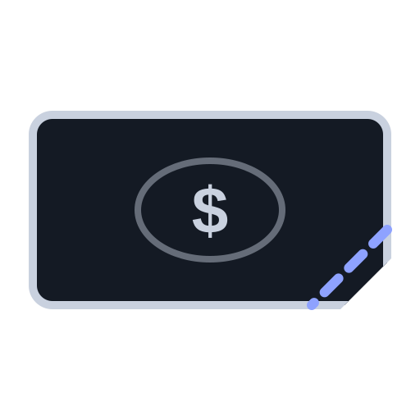
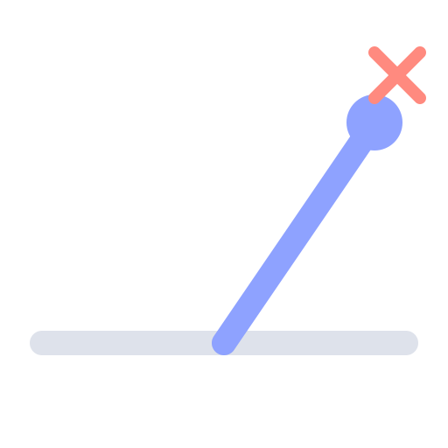


The wrong payments are the hard part
Most arrive fine. The work is in the ones that don't◦
Paid short
Wrong network
Counterfeit token
No reference
52 of 52
15–30 min†
real public transfers checked right. Our own test, not a customer result
per problem payment. Our guess, not measured
52 of 52: own test of real public USDC/USDT transfers not used to build the rules (clearline website, Trust section). 15–30 min: untested guess (Clearline spec §1).
◦ estimate or assumption † untested unmarked = sourced
Notes:
SAY: Most stablecoin payments arrive fine. The work is in the few that don't: paid short, sent on the wrong network, a counterfeit token, or no invoice reference. That's where I've focused. In my own test, the checks gave the right answer on 52 of 52 real public transfers I hadn't used while building the rules. I don't yet know how long these take a finance team; my guess is 15 to 30 minutes each, and that's one of the first things I want to check with you and with finance teams.
LABELS:
- "Most arrive fine. The work is in the ones that don't" [ASSUMPTION]: our own view, not measured. Marked ◦ on the subtitle.
- Four problem types (short, wrong network, counterfeit token, no reference) [VERIFIED: docs/SPEC.md and the demo cases; ERC-20 transfers carry no invoice reference, eips.ethereum.org/EIPS/eip-20].
- "52 of 52" [VERIFIED]: website/src/components/Sections.tsx lines 66-71 on pitch-deck: real public USDC/USDT transfers not used while building the rules; right answers confirmed on block explorers. Our own small test, not a customer result. Covers the checks (real token, right network, right address), not automatic matching, which hasn't been tested on real data.
- "15-30 minutes per problem payment" [GUESS]: docs/SPEC.md section 1, not measured. Marked † on the slide.

