Slide 1

Clearline
Get paid in digital dollars without the detective work.
Digital dollars: stablecoins such as USDC and USDT.
Working demo · seeking feedback
Aashmiin Kaur · Singapore Management University · October 2026
Notes:
SAY: Thank you for making time. This is Clearline, a working demo I built myself. It helps a business that gets paid in digital dollars (stablecoins such as USDC and USDT) by doing the detective work that today falls on a finance person. I'm here for honest feedback, not to sell anything.
LABELS: no factual claims on this slide.
FROM OLD SLIDE 1: everything kept.

Slide 2
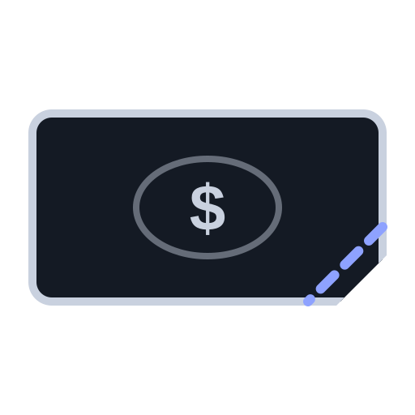



Paid in seconds. Checked for hours.◦
“We paid INV-1043 in full yesterday. Please confirm and close the invoice.”
Illustrative · fictional demo company
Paid too little
Wrong network
Counterfeit
No invoice number¹
¹ A token transfer records sender, receiver and amount: no invoice reference (ERC-20 standard, eips.ethereum.org/EIPS/eip-20).
◦ estimate or assumption † untested guess unmarked = sourced
Notes:
SAY: Imagine Maya, a finance manager (an illustrative persona) whose customers pay in digital dollars. The money arrives in seconds, but when something is off she ends up in pages of codes, spreadsheets and email chains to work out what happened. It's one of four things: paid a little too little, sent on the wrong network, counterfeit digital dollars, or no invoice number, because a token transfer has no reference field. "Hours" is an assumption, the first thing the interviews must confirm.
SOURCES / LABELS:
- "Arrives in seconds" [VERIFIED, general knowledge]: Ethereum adds a block about every 12 s (ethereum.org/developers/docs/blocks); receivers may wait minutes for confirmations.
- "Checked for hours" [ASSUMPTION], untested.
- The quote is illustrative, from the product's fictional demo data (Orbit Retail, INV-1043), not a real customer.
- ¹ A token transfer records sender, receiver and amount only, no invoice reference [VERIFIED]: ERC-20 standard, eips.ethereum.org/EIPS/eip-20. Any contract can set its own name and symbol, which is why counterfeits exist.
- Real cases in our tests include 13 fake-USDT and 6 wrong-network transfers [VERIFIED]: demo/REPORT.md.
- Short payments, for example because an exchange took a fee; how often each problem happens [ASSUMPTION], which the interviews measure.
FROM OLD SLIDES 2-3 (moved here): the "pages of codes, spreadsheets, email chains" picture; "Today a person sorts out each one".

Slide 3



Clearline is a smart cashier for digital dollars
Customers know exactly how to pay
Correct ones: ready to mark paid on approval
Problems explain themselves, reply drafted
Runs today in the working demo, on fictional data. Clearline reads payments; it never holds or moves money.
Notes:
SAY: Clearline is a smart cashier for digital-dollar payments. Before anyone pays, it tells the customer exactly what to send, on which network and to which address. When a payment arrives correctly, it checks it and has the invoice ready to mark paid once you approve; when something is wrong, it explains why in plain English and drafts the reply. It never holds or moves money, and a person makes every decision that isn't routine.
SOURCES / LABELS: the three outcomes are product capabilities [VERIFIED in the working demo], demo/REQUESTS_DEMO.md, "Working now" column. Real-world accuracy of the payment-matching side is not yet tested on real data (demo/REPORT.md).
FROM OLD SLIDE 4 (moved here): the third outcome's full wording "Problems explain themselves" + "the reply drafted"; subtitle "It does the checking a finance person does today, and shows its work"; card details "amount, network and address on one page" / "checked, then marked paid once you approve" / "the cause in plain English, and the reply drafted"; footer "runs on fictional data; reads payments, never holds or moves money".

Slide 4
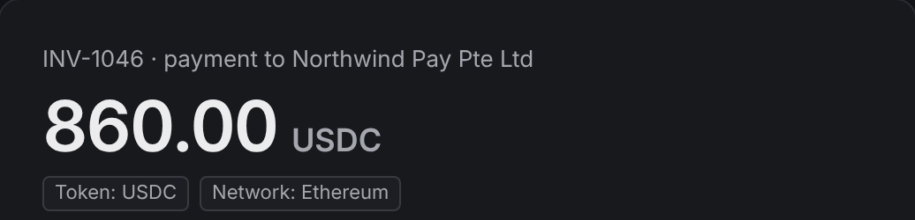
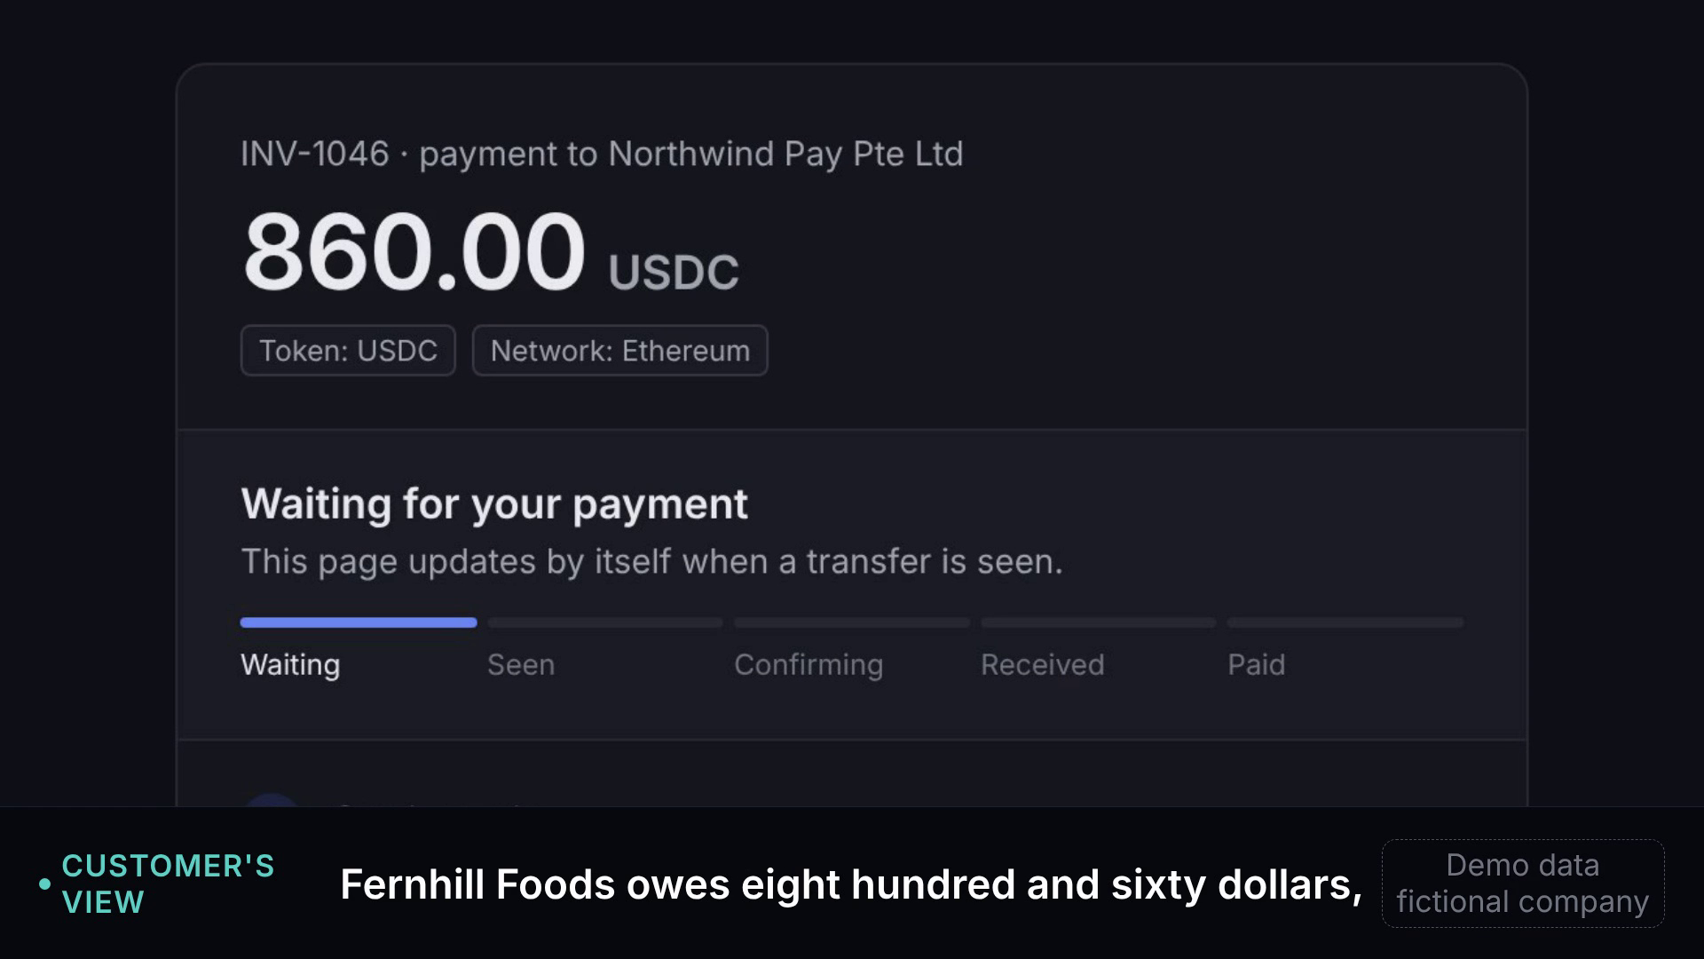
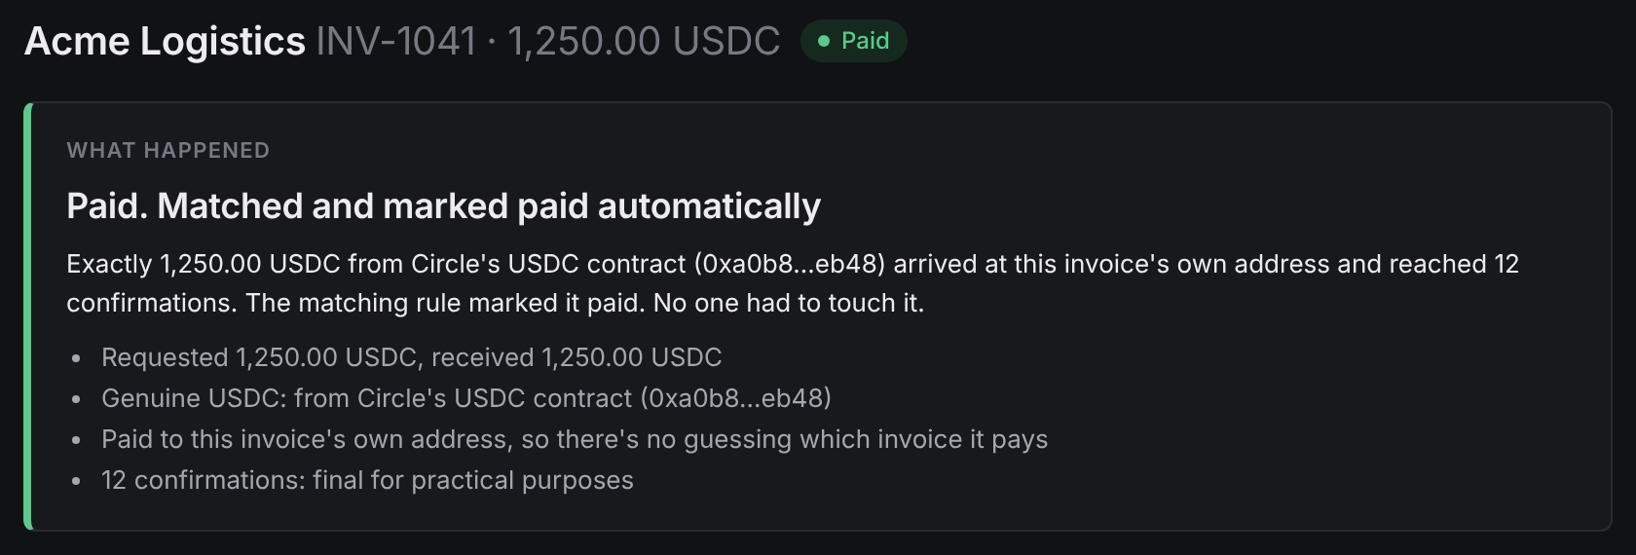
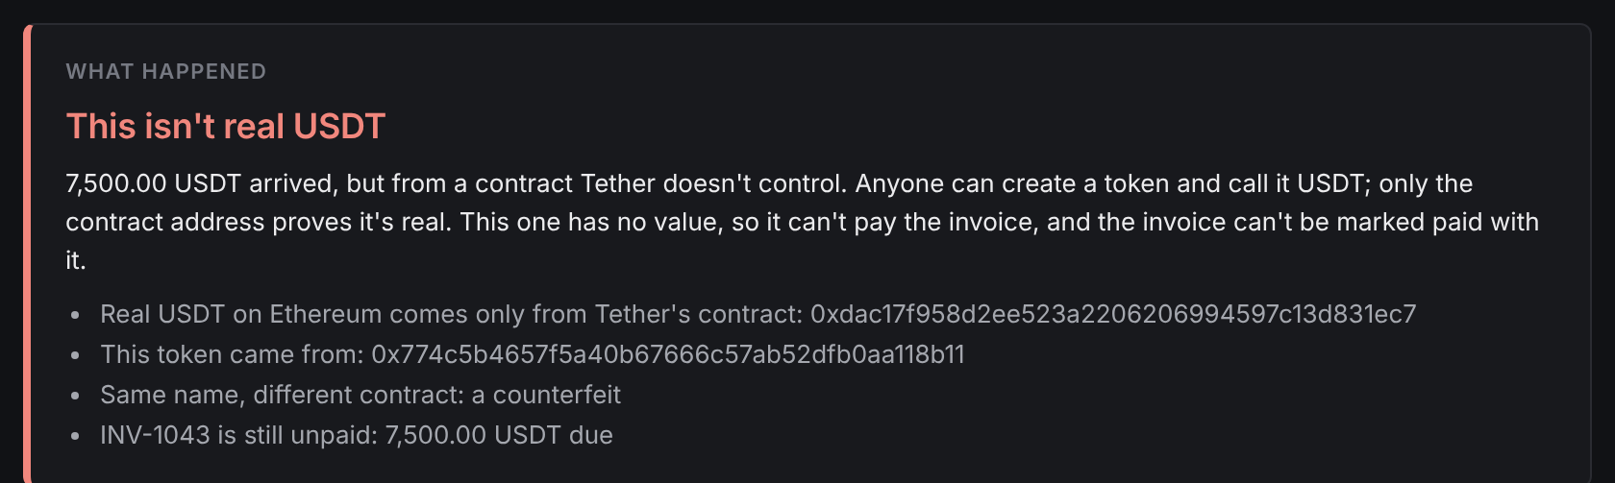
It works today: a real demo on fictional data
1
The customer sees what to send
2
A correct payment marks itself paid
▶ Live demo · 60 s
3
Fake dollars, explained
Real screenshots and a real recording of the app in demo mode. All companies, people and amounts are fictional.
Notes:
SAY: Here is the real product, running on a fictional company. One: the customer's page says exactly what to send and on which network. Two: a correct payment is checked and marked paid with no one touching it. Three: fake digital dollars are caught, explained in plain English, and can't be marked paid by mistake. [Click the video for the 60-second demo; for the full 2-minute walkthrough, play demo_live_full.mp4.]
SOURCES / LABELS: screenshots captured from the app in demo mode (pitch/assets/shots); the video is a real recording of the app (demo/live). All companies, people and amounts are fictional [VERIFIED].
FROM OLD SLIDE 5: everything kept; the "Full 2-minute walkthrough" line is now only in these notes.

Slide 5
The rules and the money are arriving now
Rules
Business use
Singapore
Singapore consulted on its stablecoin law, Sep–Oct 2026¹
~US$226B a year of business stablecoin payments◦²
A top-5 sender of stablecoin payments³
¹ MAS consultation, 1 Sep 2026 (mas.gov.sg; Gibson Dunn) ² McKinsey with Artemis, 2026: an estimate, ~0.01% of B2B payments ³ Artemis, Oct 2025
◦ estimate or assumption † untested guess unmarked = sourced
Notes:
SAY: Three things are arriving together. Rules: Singapore's central bank consulted on the law changes for its stablecoin framework in September and October 2026, after the US signed its stablecoin law in July 2025. Use: McKinsey and Artemis estimate about 226 billion US dollars a year of business stablecoin payments, still only about 0.01% of business payments. And Singapore is one of the top five countries sending stablecoin payments. I expect more businesses to get paid this way, and the checking work to grow with them [ASSUMPTION].
SOURCES:
[1] MAS consultation and draft amendments to the Payment Services Act for the stablecoin framework, published 1 Sep 2026, comments closed 16 Oct 2026 — mas.gov.sg media release; Gibson Dunn client alert, Sep 2026.
[2] "About $226 billion a year" of B2B stablecoin payments — McKinsey, "Stablecoins in payments: What the raw transaction numbers miss" (2026, with Artemis Analytics). An estimate assuming ~20% of tagged activity is B2B, annualised from Dec 2025; B2B penetration ~0.01%. Also reported by CoinDesk, 23 Jan 2026. Artemis's own Oct 2025 report gives a lower B2B run-rate (US$76B annualised, Aug 2025; its conclusion says US$36B): the definitions differ, so always quote 226B with "McKinsey & Artemis" and "estimate".
[3] Singapore among the top five stablecoin-sending countries — Artemis, "Stablecoin Payments from the Ground Up", Oct 2025; checked via PaymentExpert's 29 Oct 2025 write-up (US, Singapore, Hong Kong, Japan, UK). Open the Artemis PDF once to see the exact chart.
FROM OLD SLIDE 6 (moved here, not on the slide):
- US GENIUS Act signed 18 Jul 2025 — eco.com GENIUS Act tracker (Aug 2026); Morgan Lewis, Jul 2025 (House passed 17 Jul 2025). Final rules still pending as of mid-2026.
- Stripe stablecoin payments: US businesses; private preview in the EU, Hong Kong, Mexico and Switzerland; not Singapore; USDC (USDP/USDG US-only); US$10,000 limit per transaction — docs.stripe.com/crypto/stablecoins (Oct 2026).
- HitPay × Triple-A, 14 Oct 2025: "will enable more than 20,000 Singapore merchants" to accept stablecoins with instant fiat settlement — fintechnews.sg. These are eligible merchants, not active users.

Slide 6
Direct payments are the gap others leave◦
Tool | Does well | Leaves ◦
Checkout | Own payments | Direct transfers
Wallets | Warn senders | The invoice
Risk tools | Scam tokens | The reply
Accounting | The books | Exceptions
Checkout page
Gateway matches it
our wedge
Direct transfer
A person sorts it out◦
Belief: business customers often pay directly, not via checkout pages◦
Examples and sources for each row in the speaker notes (docs.stripe.com · eco.com · fintechnews.sg · KuCoin News · trustwallet.com · blockaid.io · bitwave.io). Not yet compared: TRES Finance, Cryptio.
◦ estimate or assumption † untested guess unmarked = sourced
Notes:
SAY: Checkout pages already handle the payments made through them. Our first customer is the other lane: finance teams whose business customers send digital dollars directly, from an exchange account or a company wallet, to a fixed address, where exceptions land on a person. Every piece of this exists somewhere: checkout tools, wallet warnings, risk tools and accounting tools each do their part well, but none, as far as I can tell, is built for the finance person facing a direct payment that went wrong. That gap is my belief, not a finding, and the interviews test it.
THE THREE BELIEFS (old slide 9; only the first is on the slide):
1. Business customers often pay from exchange accounts and company wallets, not checkout pages [ASSUMPTION].
2. The cost is in the exceptions: each one is a 15–30 minute investigation [GUESS]. The demo's "time saved" figure (20 min per explained exception) is a demo estimate, not a measurement.
3. Gateways would rather plug in exception handling than build it [ASSUMPTION].
None is tested. Three early calls with vendor teams, on an earlier idea, found reconciliation "not really an issue" for them; buyer teams are untested.
FIRST CUSTOMER (old slide 7): Singapore crypto and Web3 firms that invoice other businesses in USDC/USDT [ASSUMPTION]. EDB counts 300+ Web3 companies (undated; counting method not stated); MAS has licensed 37 digital payment token service providers (fintechnews.sg, 6 Aug 2026, parliamentary reply). How many are paid in stablecoins: unknown.
COMPETITORS (old slide 8; table abbreviated on the slide). "Left to a person" is [ASSUMPTION], from public product pages, not from using the products.
- Checkout pages: Stripe, Coinbase Commerce, Request Finance, HitPay. Match payments made through their own page; payments sent straight to an address skip them. Sources: docs.stripe.com/crypto/stablecoins; eco.com "Best B2B stablecoin invoicing tools 2026" (Request Finance marks invoices paid, syncs QuickBooks/Xero); fintechnews.sg.
- Wallet warnings: MetaMask (2026, KuCoin News), Trust Wallet (Mar 2026, trustwallet.com), Safe + Blockaid (Sep 2024, blockaid.io). Warn the sender about look-alike addresses; nothing about the invoice or the receiving side.
- Risk and compliance: Blockaid (blockaid.io/token-security), Elliptic, Chainalysis (general knowledge, not checked feature by feature). Flag scam tokens and risky addresses; not "which invoice is this, and what do I reply?".
- Crypto accounting: Bitwave (bitwave.io reconciliation guide), Request Finance. Books, ERP sync, payouts; investigating each exception is still left to a person.
- Clearline: working demo on fictional data; explains 7 payment situations with the reply drafted; no customers; matching untested on real data.
- Not yet compared: TRES Finance, Cryptio.

Slide 7
Two pricing bets, and a small test market first
Direct per team
Embedded per exception
S$300–800/mo◦
S$1–3†
300+
× ~50%†
× S$6k◦
S$0.9M◦
Web3 firms in Singapore¹
paid directly
a year each
test-market ceiling
Then: Southeast Asia, India, gateways◦
¹ Singapore EDB, “Singapore: the onchain state” (edb.gov.sg). Prices are placeholders for interviews, not quotes; no top-down market size is claimed.
◦ estimate or assumption † untested guess unmarked = sourced
Notes:
SAY: The founding pilot price is set: US$300 for 30 days, then US$200 a month, for the first 10 businesses. Beyond the pilot I haven't tested pricing, so these are two hypotheses. Direct: a monthly subscription per finance team, priced by payment volume; embedded: a gateway or custodian pays per exception handled for its merchants. Bottom-up, the Singapore test market is deliberately small: 300-plus Web3 companies, about half paid directly in stablecoins, about 6,000 Singapore dollars a year each, is a ceiling of about 0.9 million a year. It grows beyond Singapore through Southeast Asia and India and through gateways, and I'll size that only after the interviews.
SOURCES / LABELS:
- Both models and both prices [ASSUMPTION]/[GUESS], untested; they're placeholders for the interviews, not quotes. Direct S$300–800/month [ASSUMPTION]; embedded S$1–3 per exception [GUESS].
- 300+ Web3 companies in Singapore [VERIFIED]: Singapore EDB, "Singapore: the onchain state" (edb.gov.sg; undated, counting method not stated).
- ~50% that invoice businesses which pay them directly in stablecoins [GUESS].
- S$6,000/year [ASSUMPTION]: S$500/month, the middle of the untested direct range.
- 300 × 50% × S$6,000 = S$900,000 a year, if every one bought: a ceiling for a test market, not the business. No top-down market size is claimed.
- Growth beyond Singapore (Southeast Asia, India, gateways' merchants through the embedded model) [ASSUMPTION], sized only after interviews.
- Test: ask 10 teams what one exception costs them today, in staff time.

Slide 8
A working product, no customers yet
7
52 / 52
3
0
situations in
the demo
real transactions
correct¹
vendor calls²
customers
Next: 10 finance-team interviews
“Do customers pay through a checkout page, or send directly?”
¹ demo/REPORT.md: held-out cases (59/59 on tuning cases); explanations and matching not yet tested on real data. ² Custodian and compliance-software teams, 16 Oct 2026, on an earlier idea.
Notes:
SAY: Honestly: a working product, no customers yet. The demo runs seven payment situations end to end, and the investigation side gave the correct verdict on 52 of 52 new real transactions. My three early calls were with custodian and compliance-software teams about an earlier idea, and they said reconciliation wasn't really an issue for them. So the next step is ten conversations with actual buyers, and one question decides the direction: mostly direct means selling to finance teams; mostly checkout means becoming a plug-in for gateways.
SOURCES / LABELS:
- 7 payment situations [VERIFIED]: demo/REQUESTS_DEMO.md.
- Correct verdicts [VERIFIED]: 43/59 before fixes, 59/59 after, 52/52 on held-out cases collected afterwards (deposit-investigation part; 6 networks + Bitcoin IDs). Source: demo/REPORT.md, 24–25 Oct 2026. Explanations and payment matching NOT tested on real data; company records were sample data.
- 3 early calls [VERIFIED from the founder's notes; names withheld]: custodian and compliance-software teams, 16 Oct 2026, about an earlier idea.
- 0 customers, 0 paid pilots [VERIFIED].
FROM OLD SLIDE 12 (moved here): full labels "payment situations run end to end in the demo", "new real transactions given the correct verdict", "early calls, all with vendor teams", "customers or paid pilots"; "Next: 10 finance teams that receive stablecoins, one question"; the decision rule "Mostly directly → sell to finance teams. Mostly checkout → become a plug-in for gateways."

Slide 9
A solo founder who builds and sells
AK
Aashmiin Kaur
Year 2 Accountancy, Singapore Management University
Self-taught coder (CS50); built Clearline with AI coding tools
Business development: Protégé Ventures, Hatch
SMU BIG incubator
Looking for: payments operations experience
Founder's own background.
Notes:
SAY: It's just me for now. I'm a second-year accountancy student at SMU, which is why the finance person's side matters to me. I taught myself to code through Harvard's CS50 and built this product myself, using AI coding tools, and I've done business development at Protégé Ventures and Hatch. What I lack is payments operations experience, which is part of why I'm asking for your help.
LABELS: background as stated by the founder; please check each line before presenting.
FROM OLD SLIDE 13 (moved here): "Founder · builds the product and talks to customers"; the BD roles in full: student analyst at Protégé Ventures, partner outreach at Hatch.

Slide 10
Three things would help me most
1
Honest feedback on the wedge
Is direct payment really the gap?
2
3–5 introductions
Finance teams receiving stablecoins
3
Advice on gateways
How to partner, if at all
Aashmiin Kaur aashmiin@gmail.com · linkedin.com/in/aashmiin-kaur-479665391
Notes:
SAY: Three things would help most. Your honest view of the wedge: are direct payments and their exceptions really underserved, or am I missing something? Introductions to three to five finance teams that receive stablecoin payments, for a 20-minute conversation, not a sales pitch. And your advice on whether and how to partner with gateways or custodians. Thank you.
LABELS: no factual claims.
FROM OLD SLIDE 14 (full wording, shortened on the slide): "Are direct payments and their exceptions really underserved?"; "Finance teams that receive stablecoin payments, for a 20-minute conversation"; "Whether and how to partner with gateways or custodians".

Slide 11
Backup · Five risks, and what I'd do about each
Checkout tools absorb it
Interview test; if so, a gateway plug-in◦
Licensing
Read-only, never moves money; a lawyer confirms◦
Data access
Public chain data + invoice export first◦
A wrong match
No guessing: a person confirms
Solo founder
Find a payments-ops co-founder◦
“No guessing” is how the demo works today; matching is untested on real data.
◦ estimate or assumption † untested guess unmarked = sourced
Notes:
SAY (only if asked): These are the risks I see, and what I'd do about each.
LABELS:
- Mitigations are plans [ASSUMPTION].
- "Never matches on a guess; a person confirms with a note" is [VERIFIED in the demo; untested on real data].
- The licensing line is not legal advice. Clearline reads payment data and drafts messages; it never holds, moves or exchanges money. That's why I believe it sits outside a payment-services licence, but a Singapore lawyer must confirm that before any live customer.
FROM OLD SLIDE 15: all five risks kept, wording shortened.

Slide 12
Backup · Hard questions, honest answers
A YC partner
A payments expert
No buyer interviews yet: how do you know?
I don't yet. Vendors said it isn't an issue for them; my next ten calls are finance teams that receive stablecoins.
Per-invoice addresses fix references. What's left?
Payments that ignore the instructions: short, wrong network, fake tokens, old addresses. How common they are, I don't know yet.
S$0.9M market: why venture-scale?
It isn't proven. Singapore is a test market; the region and the gateway route get sized once interviews give exception counts.
Crypto accounting tools reconcile already. Why you?
They match and book; I focus on investigating exceptions and drafting the reply. I haven't tested whether that difference matters.
Why won't Stripe or HitPay just build this?
They might. If buyers mostly pay through checkout pages, I'll build the plug-in for gateways instead of competing.
Who's liable for a wrong match? A licence?
A person confirms anything non-routine, and fakes can't be marked paid. It never holds money; a lawyer must confirm licensing.
Notes:
SAY: only if asked; give the short answer, then stop.
FULL ANSWERS:
[YC] Q: You haven't spoken to an actual buyer. How do you know anyone has this problem?
A: Honestly, I don't know. My only three calls were with custodian and compliance-software teams, about an earlier idea, and they said reconciliation wasn't really an issue for them. Next I'll talk to ten finance teams that receive stablecoins, asking whether customers pay through a checkout or send directly, and how many exceptions they handle. If none of them feel the pain, I'll change direction.
[YC] Q: Your own market estimate is S$0.9M. Why is this venture-scale?
A: S$0.9M is deliberately a ceiling for a test market, built on a guess and an assumption. The bet is that business stablecoin payments keep growing (McKinsey and Artemis estimate about US$226B a year) and that gateways would pay per exception for their merchants. I can't size either honestly until I know how many exceptions a real finance team has, which is what the interviews ask.
[YC] Q: Why won't Stripe, HitPay or Circle just build this?
A: They could, and for payments made through their own pages they already handle matching. My untested belief is that business customers often pay directly from exchange accounts and company wallets, outside any checkout; Stripe also caps a payment at US$10,000 and takes USDC only. If interviews show most payments go through checkouts, Clearline becomes an exception-handling plug-in that gateways pay for per exception.
[Expert] Q: A unique deposit address per invoice fixes missing references, and your demo uses one. What's left?
A: Agreed: per-invoice addresses solve most of the reference problem, and Clearline's payment page uses them. What's left are exceptions that still happen: short payments, the wrong network, counterfeit tokens, and payments to a retired or another customer's address. All of these appear in my real-data test cases. Whether they happen often enough to pay for, I'll learn by asking ten finance teams for their monthly exception count.
[Expert] Q: Crypto accounting tools already reconcile on-chain payments to invoices. How are you different?
A: From their public pages, Bitwave matches payments to invoices and syncs the ERP, and Request Finance marks invoices paid. My 'leaves to a person' column is an assumption from those public pages, not from using the products, and I haven't yet compared TRES Finance or Cryptio. Before claiming a gap I'll try the main tools, including any you'd name, and ask finance teams what they do when a payment doesn't match.
[Expert] Q: Who is liable if it marks a fake or frozen payment as paid, and do you need a licence?
A: In the demo, only routine payments are marked paid by a rule; anything else goes to a person who confirms with a note, and fake tokens can't be marked paid by mistake. On real data the investigation side caught 13 of 13 fake-USDT and 11 of 11 issuer-freeze cases, but matching hasn't been tested on real data. Clearline only reads payment data and drafts messages, so I believe it sits outside a payment-services licence; a Singapore lawyer must confirm that before any live customer.
FROM OLD SLIDES 16-17 (not on the slide; same honesty):
Q: Why you: a solo second-year student with no payments experience?
Short: I built a working product and I'm trained on the finance side. I lack payments operations experience, and I'm looking for it.
A: I'm a second-year accountancy student, so the finance person's side is what I'm trained in. I built the working demo myself, with AI coding tools, and tested its investigation side on real transactions. What I'm missing is payments-operations experience, and the deck says so; I'm looking for a co-founder or advisor with that background.
Q: What does your real-data test actually prove?
Short: Investigation verdicts were right on 52 of 52 new real transactions. Matching and explanations aren't tested on real data yet.
A: The investigation engine reached the right verdict on real on-chain cases across six networks, checked against independent sources such as Tronscan and the issuers' own contracts. It scored 43 of 59 before fixes and 59 of 59 after, then 52 of 52 on new cases collected afterwards. Company records were sample data, and the matching side and the plain-English explanations haven't been tested on real data. It shows the technology can work, not that anyone wants it.
Q: Singapore's likely buyers are licensed crypto firms with compliance tools. Why buy another?
Short: Maybe they won't. My three vendor calls said much the same. The buyer I need to test is the finance team receiving invoices.
A: It's a real risk: my three early calls were with that kind of vendor team, and they said reconciliation wasn't really an issue for them. My target is the finance team receiving invoice payments, not the compliance team, and that buyer is untested. If these firms already handle it in-house, the fallback is selling through gateways per exception, which is also untested.
Q: How many exceptions does a team see a month, and what does one cost?
Short: I don't know. My 15–30 minutes is a guess; I'll ask ten teams for monthly counts and the staff time each takes.
A: I don't have a number. The 15–30 minutes per exception is a guess, and the demo's 20-minute figure is an estimate, not a measurement. Pricing depends on this, so the interviews ask how many exceptions happen a month and what one costs in staff time. If it's only a handful, the subscription model doesn't work.

