Slide 1
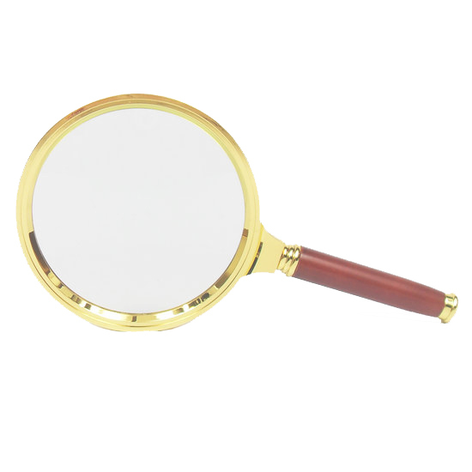
READ AGAIN
ACCESSIBILITY APP

Slide 2
Read Again
Read Again is an accessible
web design-in-progress.
The goal is to support
people who love to read but
do not find the written word
accessible or enjoyable on
the world wide web.

Slide 3
Iteration 0: Accessible Times
This slide show introduces
Accessible Times,
an experience that enables
readers who face barriers
because of both hearing and
vision loss to enjoy
The New York Times content
While addressing cognitive
challenges people face as
they age.

Slide 4
Accessible Times Team Story
Grandmother used to like to read but stopped because of vision problems.
Mother did programming in punchcard era and is having a hard time reading the technology content she enjoys.
Candida Haynes
Experience Designer
Twitter: @dihaynes
Github: thelady
Mark Nyon
Developer
Twitter @scorintha
Github:trystant

Slide 5
Accessible Times Team Story
Accessible Times is a social support,
Keeping folks up-to-speed on current
events, which gives them confidence to
participate in conversations when they
Socialize.
The people behind this app want to
restore, or perhaps reinvent something
that used to be part of their loved ones'
daily routines.

Slide 6
Accessible Times Inspiration
My grandmother can enjoy a distraction
from her back pain or her worries about
what's happening to her granddaughter
in streets full of protests or behind
closed doors at HACK-athons.

Slide 7
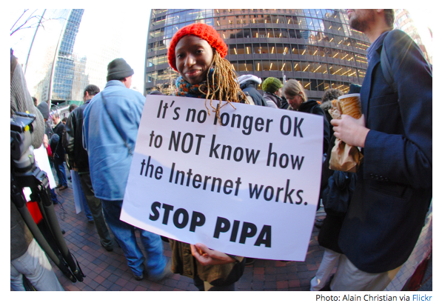
https://advocacy.mozilla.org/open-web-fellows/

Slide 8
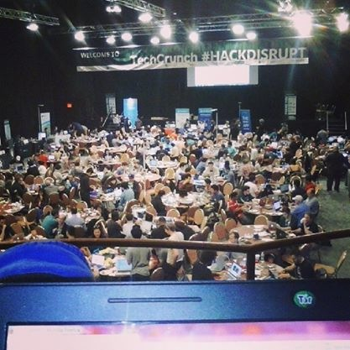
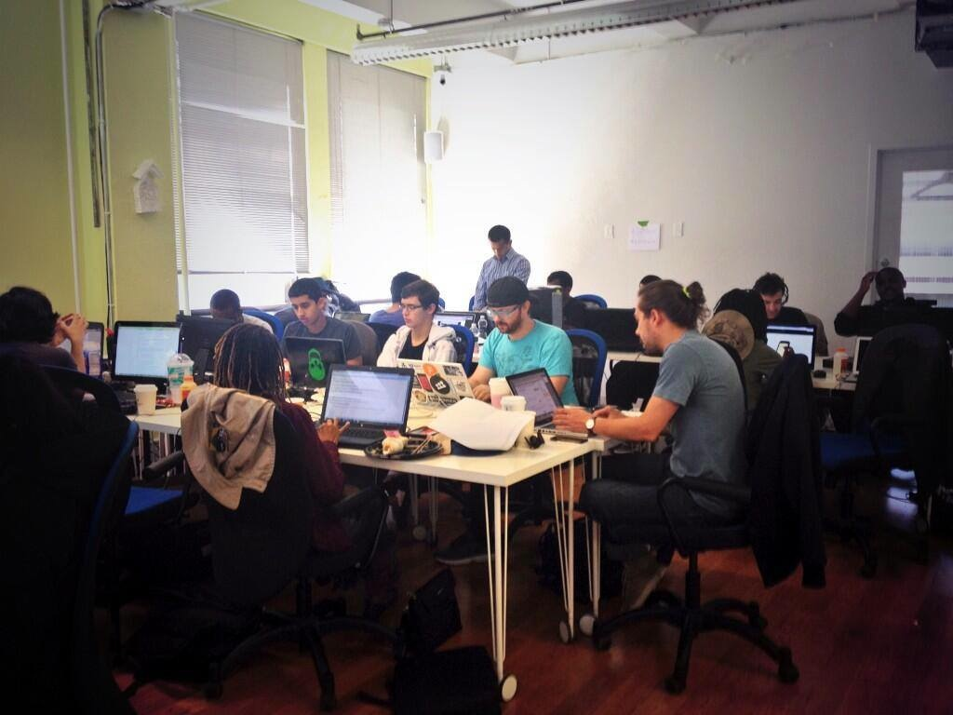
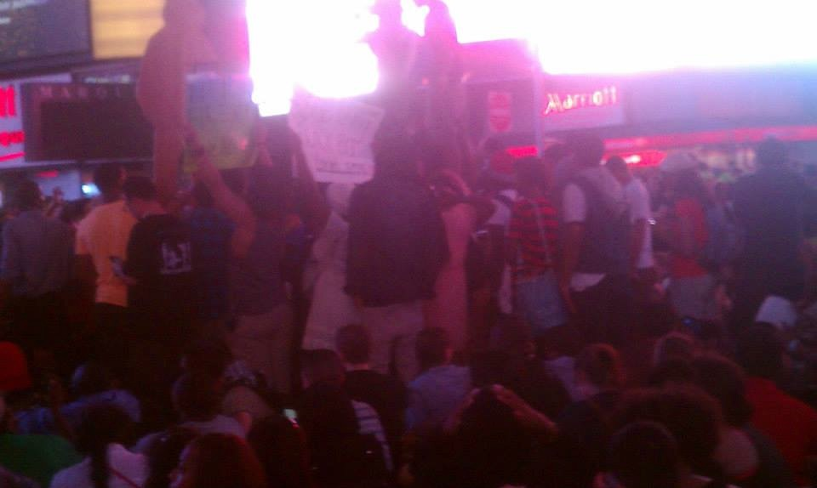
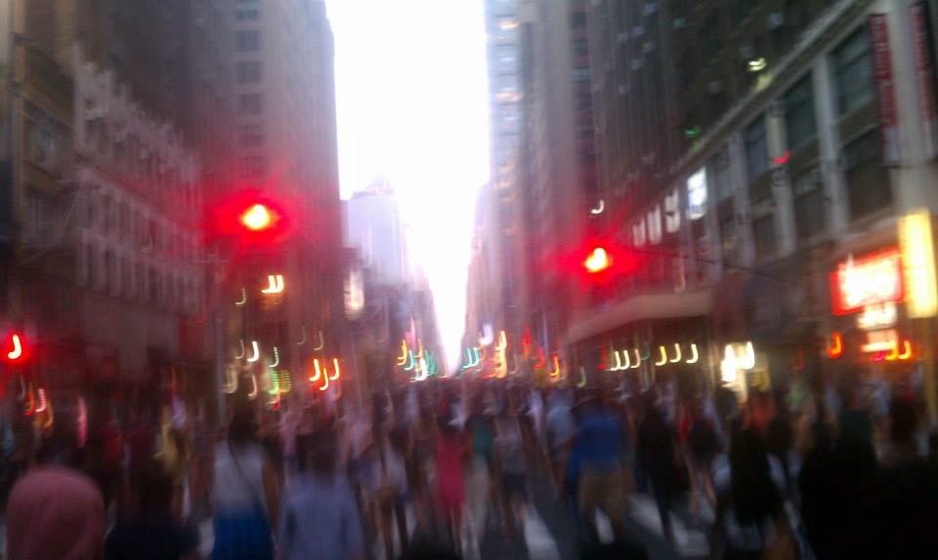
Accessible Times Inspiration

Slide 9
Accessible Times Inspiration
Or… she can put her fears to rest
because she understands them
better after reading The New York
Times.

Slide 10
Accessible Times Inspiration
On a previous slide, you saw that
both team members had a loved one
with failing vision.
But I also mentioned hearing loss
because as my grandmother's
hearing deteriorated, she started
losing the ability to process what
she heard.
For me, this all meant that if I wanted
to enable her to pick up her old
reading habit, I would have to do
more than add sound and raise the
volume.

Slide 11
Auditory Processing
Auditory processing is the ability to listen, comprehend, and respond to information that we hear through our auditory channels.
This includes the detection of sound by the external ear and the transmission of sound through the auditory pathways to the brain.

Slide 12
Auditory Processing Disorder
Here is an example of what someone
with an auditory processing disorder
might experience.
You say, “Tell me how a chair and a couch are alike.”
My grandmother might hear, “Tell me how a couch and a chair are alike.”
Or she might hear, “Tell me how a cow and a chair are alike.”
http://athome.readinghorizons.com/research/auditory-processing-disorder

Slide 13

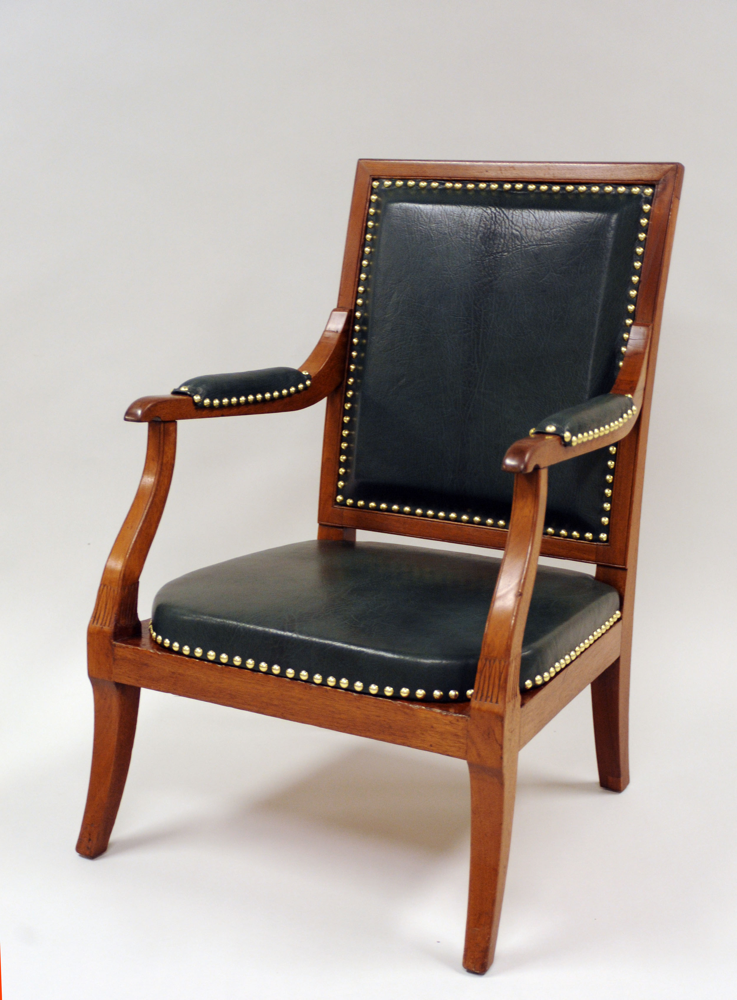
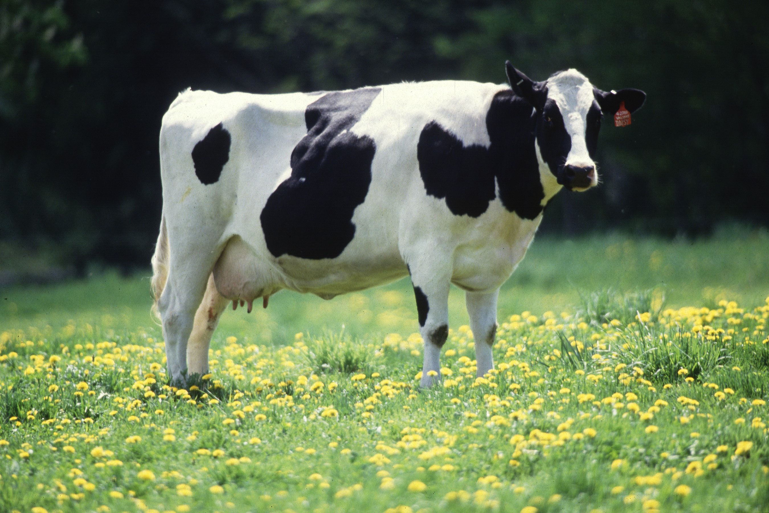
Auditory Processing Disorder
Tell me how a and a are alike.
Keith Weller/USDA
http://www.ars.usda.gov/is/graphics/photos/k5176-3.htm

Slide 14
You can imagine how hard it might be to stay focused if this is what’s happening in your mind.

Slide 15
And if you are using this to read…

Slide 16
… it’s just another barrier
that makes comprehension
more difficult
and reading
a boring
chore.

Slide 17
Accessible Times: A Solution
It turns out that you can increase comprehension by combining non-auditory communication with sound.

Slide 18
Accessible Times: A Solution
We combine:
written text
spoken words
warm
fuzzies
pictures

Slide 19
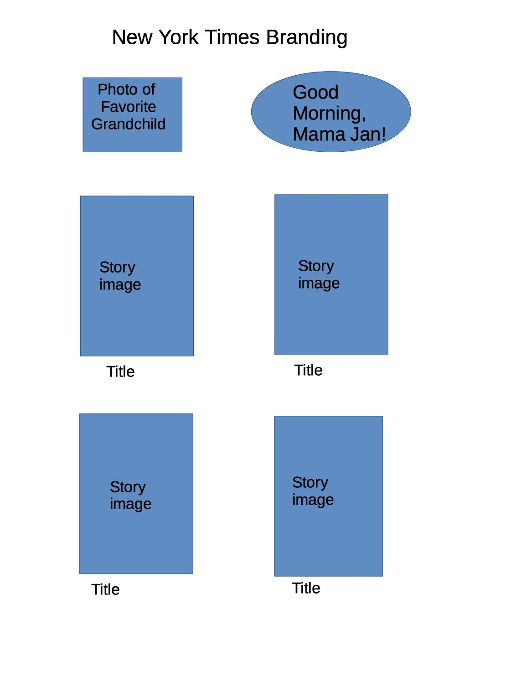
Accessible Times: An Enhanced Experience
Notes:
Warm Fuzzies: Shows a comforting image, perhaps a photo of a favorite family member or a photo of my grandmother. She sees and maybe hears a greeting with her name.
Engaging Content: Top stories from NYT API or personalized suggestions based on my selections, which I would base on a conversation with her.
Accessibility Enhancements: Tap title text to hear the title. Tap image to enlarge, and…

Slide 20
Accessible Times: An Enhanced Experience
Warm Fuzzies: Shows a comforting image, perhaps a photo of a favorite family member or a photo of my grandmother. She sees and maybe hears a greeting with her name.

Slide 21
Accessible Times: An Enhanced Experience
Engaging Content: Top stories from NYT
API or personalized suggestions based
on my selections, which I would base on
a conversation with her.
Accessibility Enhancements: Tap title
text to hear the title. Tap image to
enlarge.
Notes:
Warm Fuzzies: Shows a comforting image, perhaps a photo of a favorite family member or a photo of my grandmother. She sees and maybe hears a greeting with her name.
Engaging Content: Top stories from NYT API or personalized suggestions based on my selections, which I would base on a conversation with her.
Accessibility Enhancements: Tap title text to hear the title. Tap image to enlarge, and…

Slide 22
Accessible Times: An Enhanced Experience
Title
Image
Read
Go
Back

Slide 23
Accessible Times: An Enhanced Experience
Title
Image
Read
Go
Back
You still have the option to tap the title to hear it.
If you tap the image or the green “Read” button, it will take you to the story.

Slide 24
Accessible Times: An Enhanced Experience
Anchors
The story page plays the text in the
article. If my grandmother falls
behind, there are a few reader’s
anchors - a reminder image, the
title, and control buttons that allow
the reader to pause, return to the
previous page or advance.

Slide 25
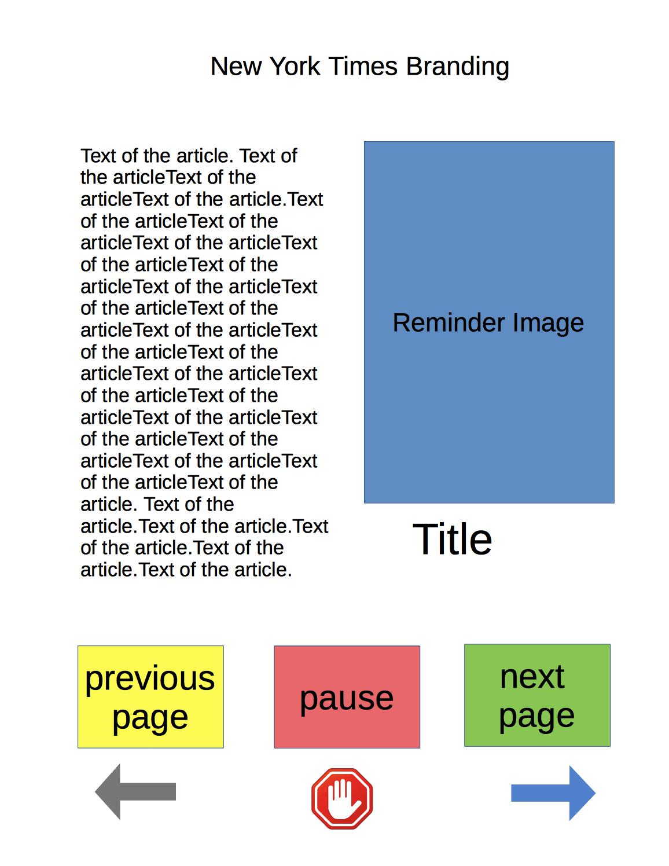
Anchors
The story page plays
the text in the article.
If the reader falls
behind the voice, there
are a few reader’s
anchors:
reminder image
title
control buttons
to allow the reader to
pause, return to the
previous page, or
advance.

Slide 26
Accessible Times and Publishing
Retain readers as they age (think
“Baby-Boomers” by making
The New York Times more
accessible and enjoyable.
Lead the industry in appealing to a new readership that needs a more accessible web.
Stay ahead of in-progress public
Initiatives and new rules to make
Information on the world wide web
More accessible to people with
disabilities.

Slide 27
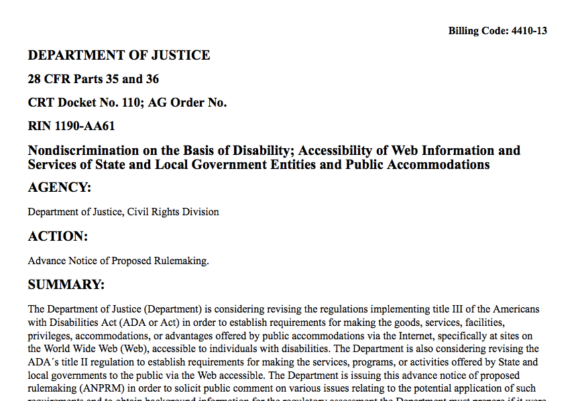
Accessible Times and Publishing
http://www.ada.gov/anprm2010/web%20anprm_2010.htm

Slide 28
Accessible Times
We just want our loved ones to enjoy
reading again by going from this…

Slide 29
Notes:
To…

Slide 30
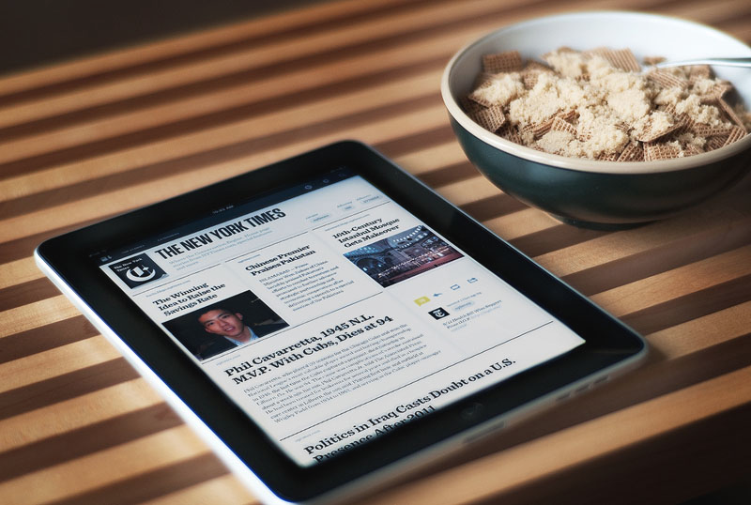
To
ACCESSIBLE TIMES
Candida Haynes
Experience Designer
Twitter: @dihaynes
Github: thelady
Mark Nyon
Developer
Twitter @scorintha
Github:trystant
Notes:
This.This is a basic sketch of what Accessible Times could be. It does not include details about tablet-based experiences, platforms, or other interfaces that can make reading more engaging, accessible, and/or rehabilitative. Feel free to use this contact information if you would like to expand on this project or incorporate accessible experiences for your readers.

Slide 31
Links
Information about auditory processing disorders came from the following links:
http://www.bbbautism.com/auditory_processing_disorder.htm from a mom’s page in 2002
Center for Speech, Language, and Occupational Therapy
http://cslot.com/recognizing-and-treating-auditory-processing-disorders-in-adults/
http://www.audiologyonline.com/articles/auditory-processing-in-adults-beyond-898 Audiology Online
American Speech and Language Association
http://www.asha.org/public/hearing/Auditory-Processing-Disorder/
Reading Horizons At-Home Solutions
http://athome.readinghorizons.com/research/auditory-processing-disorder (geared towards children but gives a clearer explanation of what happens with APD.

Slide 32
Call to Collaborate
This is a basic sketch of an Accessible Times Read Again app. It does not include ideas about platforms, details about tablet-based experiences, or extensions to other interfaces that can make reading more engaging, accessible, and/or rehabilitative.
Feel free to use this contact information if you would like to add to this project or incorporate accessible experiences for your readers.

