Slide 1
Better Spotify Jam
Trysten Giorgione
Advisor: Dr. Fred Annexstein

Slide 2
Project Goals
Enhance Spotify’s 'Jam' feature to make group listening fair and memorable.
Rotate songs between users instead of chronological order.
Allow hosts full control (pause, skip, fallback playlist, etc.).
Enable playlist saving at the end of sessions.

Slide 3

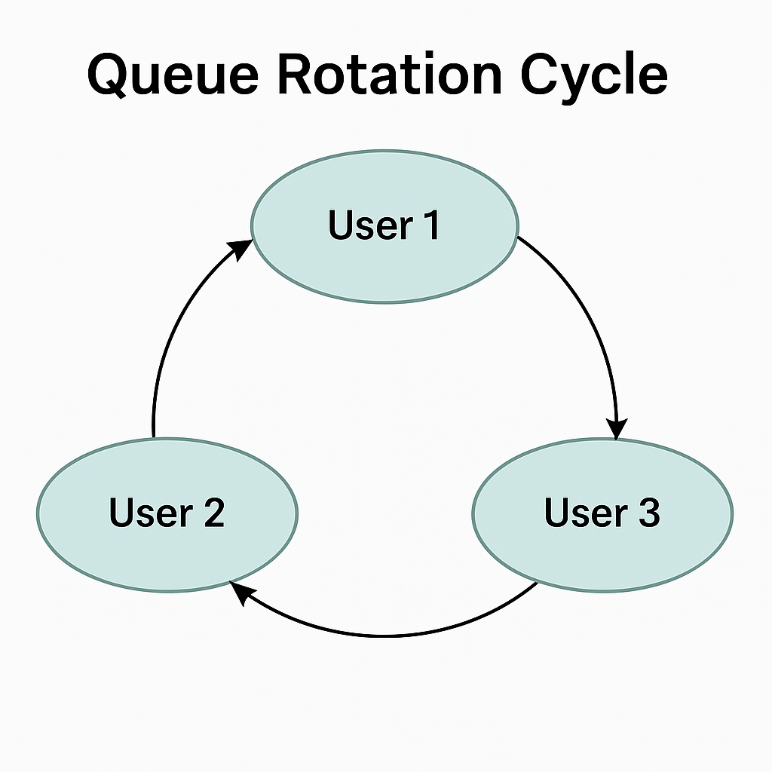
Intellectual Merits
Fair queueing algorithm for round-robin song playback.
Integrated Spotify OAuth and Playback API.
Guest participation without needing a token.
Optional guest dashboard and semi-real-time views.
Note: Every user gets a single shot at a song being played per rotation. If nobody has a song in queue, a fallback playlist can be played if set

Slide 4
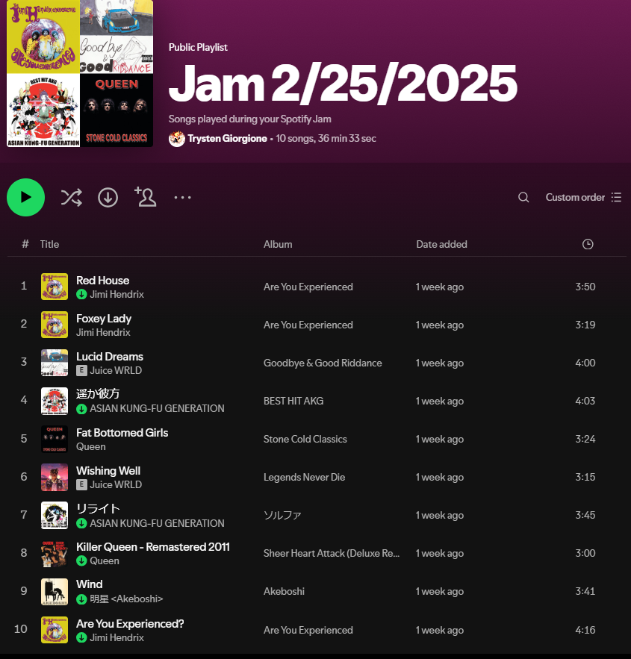
Broader Impacts
Encourages inclusive and fun music experiences.
Creates a 'time capsule' by saving playlists.
Prevents users from dominating the queue.
Potential for gamification and badges in future.

Slide 5
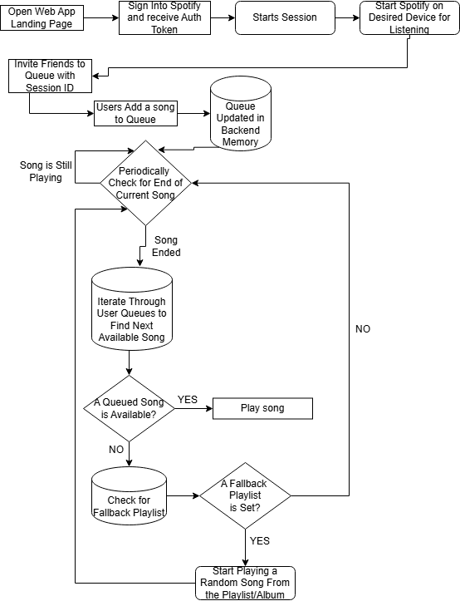
Design Specifications
Host login, session creation, and queue logic managed by backend.
Sessions store tokens, guest list, rotated queue, and fallback playlist info.
Guest access via simple UI without needing Spotify login.
Guest dashboard shows rotation and history (optional).

Slide 6



Technologies Used
Backend: Node.js, Express, Spotify Web API.
Frontend: React.js, Axios, React Router.
Spotify features: OAuth, search, playback, playlists.
Optional WebSocket support for real-time updates.

Slide 7
Project Milestones
Fall 2024: Brainstorming, and Ideation of design.
Winter 2025: Queue algo implementation ideation, UI layout drafting, reasonable achievements goals (fallback playlist, session mgmt., fair queue, usable UI)
Spring 2025: Frontend/Backend dev, Spotify API integration, Testing.
Final Week: UI polish, Presentation / Expo prep and testing.

Slide 8
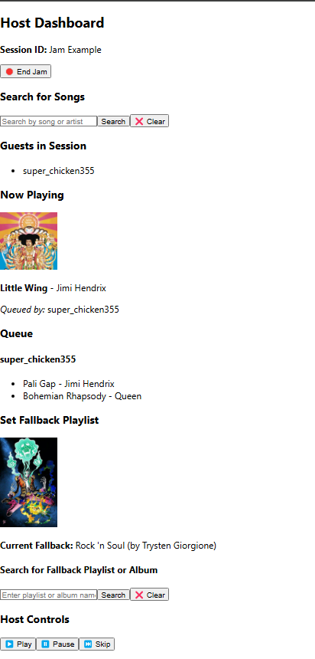
Results and Progress
Rotating queue system completed.
Host authentication and session handling work.
End Jam saves session playlist.
Fallback playlists work for albums and playlists.
Guest dashboard implemented.
Remaining: polish UI, optional real-time updates.

Slide 9
Challenges and Solutions
Spotify Authentication: managed persistent tokens.
Fair Queueing: custom logic ensured round-robin fairness.
Guest Access: allowed without login via backend logic.
Real-time Updates: optional stretch feature handled gracefully.
Learned full-stack tools and overcame tech unfamiliarity.

