Slide 1
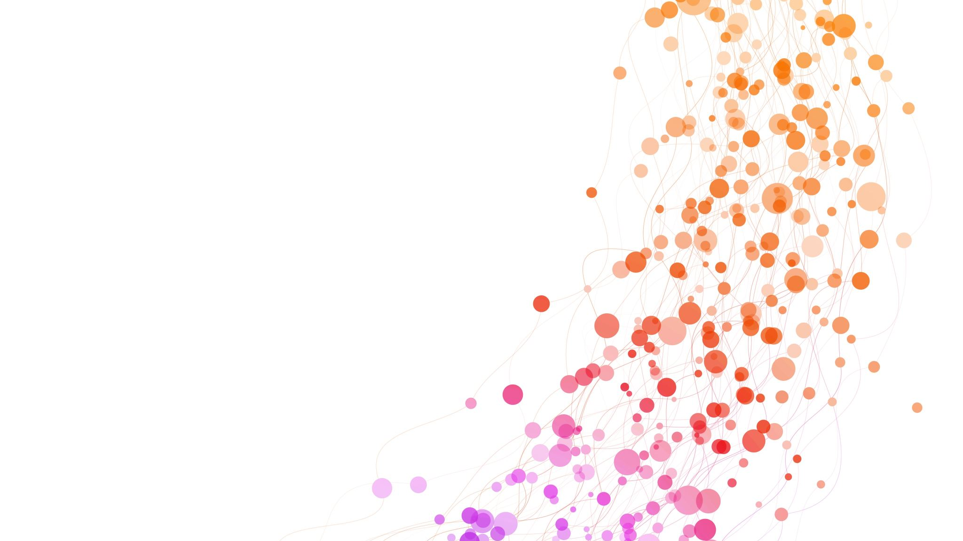
Spotify Web App: Friendly Jam
Purpose:
To enhance the joint listening experience amongst peers and users by changing the shared queue feature to be more equitable.
GOAL:
Develop a web application that can rotate songs for shared listeners using the Spotify API.
Project by: Trysten Giorgione
Email: giorgite@mail.uc.edu
Advisor: TBD

Slide 2
Project Abstract
This project aims to create a web application that improves Spotify’s group listening functionality by implementing fair queue management. Using the Spotify API, our solution will ensure all users in a shared session are equally represented in the song rotation. This approach will enhance user satisfaction and encourage a more enjoyable, balanced experience for group listening. Key aspects include API integration, queue logic design, and a user-friendly interface for selecting queue preferences. This project addresses technical, ethical, and legal constraints associated with fair queue management.

Slide 3
User Stories
1. “As a user, when I am listening to music with my friends I want everyone to be fairly represented in the songs that play”
2. “When using Spotify, I think it would be cool if there were different ways of sorting/randomizing queued songs”

Slide 4
DIAGRAMS

Slide 5
Project Constraints
Economic: This project relies on free and/or open-source tools due to budget limits for developers and consumers
Professional: As a portfolio project, this project should be developed with high-quality code.
Ethical/Legal: Ensure fair use of Spotify’s API and protection of user data

Slide 6
Current Progress
Completed: Project required tasks development, Research on API integration, Design UI for host and friends
In Progress: Queuing/sorting backend logic, ensuring reliable API calls with multiple users

Slide 7
Expected Accomplishments By Term’s End
Logic for important backend is developed
Everyone adding songs, queue being sorted properly, songs playing in proper order
UI for queue host and other members is drawn up and partially coded

Slide 8
Division of Labor
I will be working on all parts by myself as this is a solo project

Slide 9
Expected Demo at Expo
I expect to showcase the system in full use.
I want to:
Start a queue
Let observers join and add songs
Have a big screen showing the host’s view of the app as I let some songs play and let the system do it’s work

