Slide 1
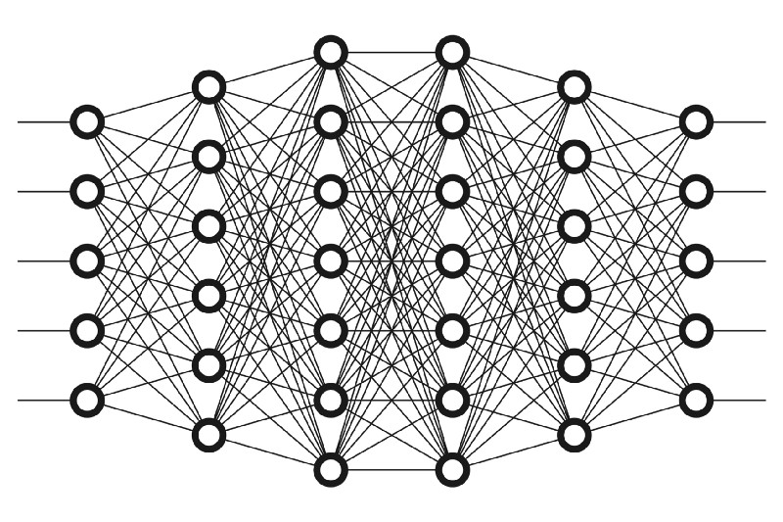
Neural networks
by Maurycy Borkowski

Slide 2
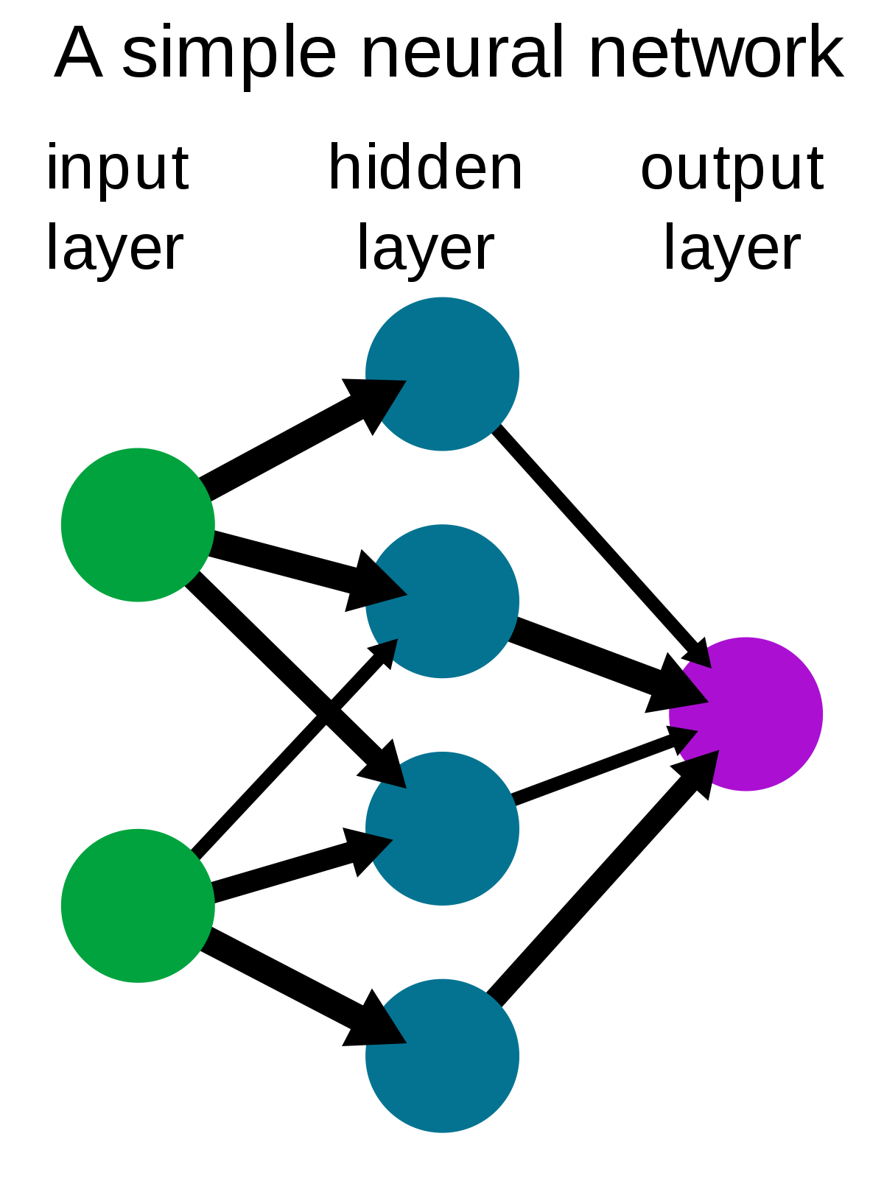
What is inside?
Neural network is build of layers of neurons connected with weighted edges. Each neuron and weight of edge is just a number (usually between 0 and 1) .
We can group layers into: input, hidden, output.

Slide 3
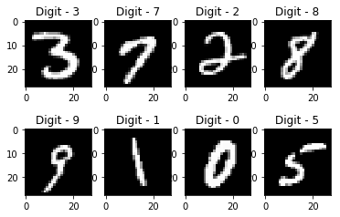
What is inside? example
To understand a little bit what is going on here let's go by example. As an ilustration we will take handwritten numbers recognition network (it’s like Hello World! In machine learning):
Our input data is black and white picture (i.e 28x28 = 784 pixels) so we can just set input layer neurons values to grayscale number of pixel.
For now let's leave the hidden layers discussion.
The output layer size is 10, each neuron corresponds to a number from 0 to 9.
The goal product is only one highlighted neuron.

Slide 4
Network rewarding
We need to be able to check whether our network is working correctly or not. That’s why why need cost function.
Cost function is just sum of (squares of) differences between output and goal output. So the smaller difference, the better network.
We can think about our structure also as a function, here is nice comparison:
 | Network | Cost function
input | 784 pixels | edges weights
output | 1 number (guess) | 1 number (cost)
parameters | edges weights | 784 pixels

Slide 5
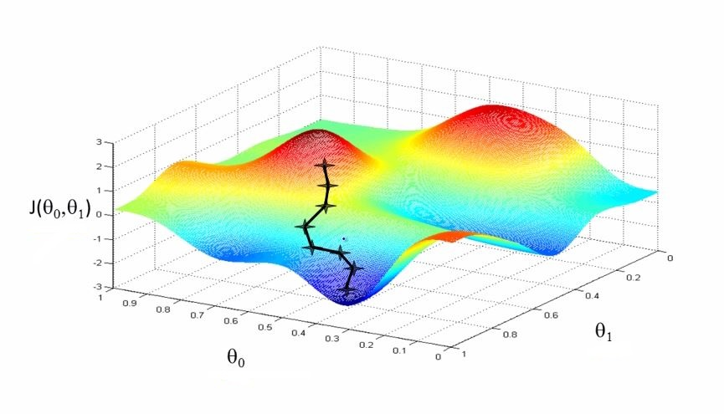
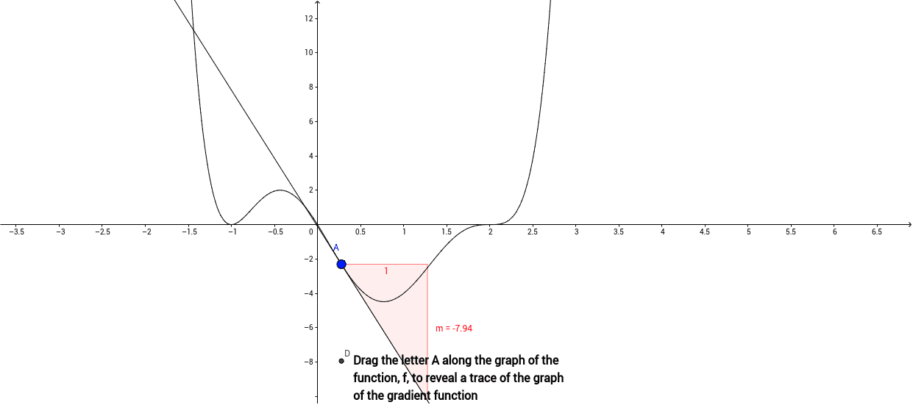
Learning network
Now our goal is of course to minimize cost function.
We can interpret this problem as problem of minimizing a function in <number of all weights> dimension space…
So what we do need to do is:
Algorithm:
  compete gradient of cost function:
  do small step in
  repeat
2 dimensions
3 dimensions

Slide 6
Updating. Backtracking.
Now we know what to do but how do we should do algorithm from previous slide?
When we are processing neuron N we know should we increase or decrease value of it.
How to modify it?
  Adapt bias (value on each neuron to operate of linear combination of edges*neurons)
  Fit weight of edge in proportion neuron neighbor value
  Revise neighbor amount in proportion of edge weight
Going like that from the output layer ending in input layer.
It turns out that vector average of changes (balance) for each weight (bias, neuron) for some training data is
Naturally more data = detailed value of gradient.

Slide 7
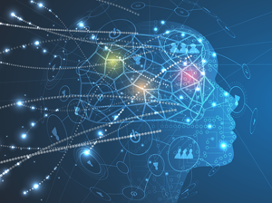
Summary
That is how neural network works in a nutshell :) I know that I skipped implementation / math details but what I wanted is give you some intuition of machine learning. I hope that know you don't think of it as a black magic.

Slide 8
Applications
Automatic speech recognition
Image recognition
Natural language processing
Financial fraud detection
Military

Slide 9
Successes of machine learning
Playing games Chess (1996), Go (2016),Poker (2017)
Automatic speech recognition (Microsoft/IBM, Switchboard Corpora, about 2016)
Knowledge competitions (Watson, Jeopardy)
Image recognition (ImageNet, 1mln pictures):
  2010: about 28% mistakes
  2015 (4.94% , human: 5.1%)
  Current record: 1.3% (Top5 accuracy, 2020)

